Slide 1
Faithful

Slide 2
Pr. 20:6 “Most men will proclaim their own goodness,
but a faithful Man (ʾēmûn: trustworthy)
who can find?"
⁷ The just man walketh in his integrity:
his children are blessed after him.”

Slide 3
Over the past century our society has transitioned away from being Patriarchal (Father led) to Matriarchal (Mother led) and finally to “Anarchal” (Child centered).
This transition has been steadily fueled by the “god of this world” (2 Cor 4:4) for his own perverse purposes. (Mk 3:27)
Speaking of Satan’s intention/nature to
“steal, kill, and destroy” (Jn 10:10)
Jesus warned in Mk 3:27:
“No one can enter into a strong man's house, and spoil his goods, except he will first bind the strong man;
and then he will spoil (diarpazo: Plunder) his house.”

Slide 4
In spite of the shifting sands of cultural corruption, God still calls us to build our lives on His truths. (Mt 7:24-27)
His words through Jeremiah some 2700 years ago still echo from His heart:
“Thus saith the LORD, Stand ye in the ways,
and see, and ask for the old paths,
where is the good way, and walk therein,
and ye shall find rest for your souls.
But they said, We will not walk therein."
(Jer 6:16)

Slide 5
God’s testimony about Abraham reveals that in spite of some personal problems and failures,
God trusted him! (Is. 51:1,2; Gen. 18:19)
"For I know him, that he will command his children and his household after him, …."
God has commissioned Fathers to be the “Commanders” of the little “armies”
He’s entrusted to their care.
In light of this truth, it shouldn’t surprise us that Satan is targeting men!

Slide 6
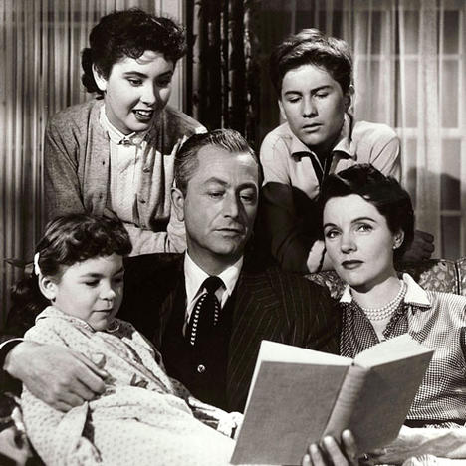
He seeks to turn Strong men into “struggling men!”
Ps 12:1 “Help, LORD; for the godly man ceaseth;
for the faithful fail from among the children of men. “
“Daddy is Confused” 2024

Slide 7
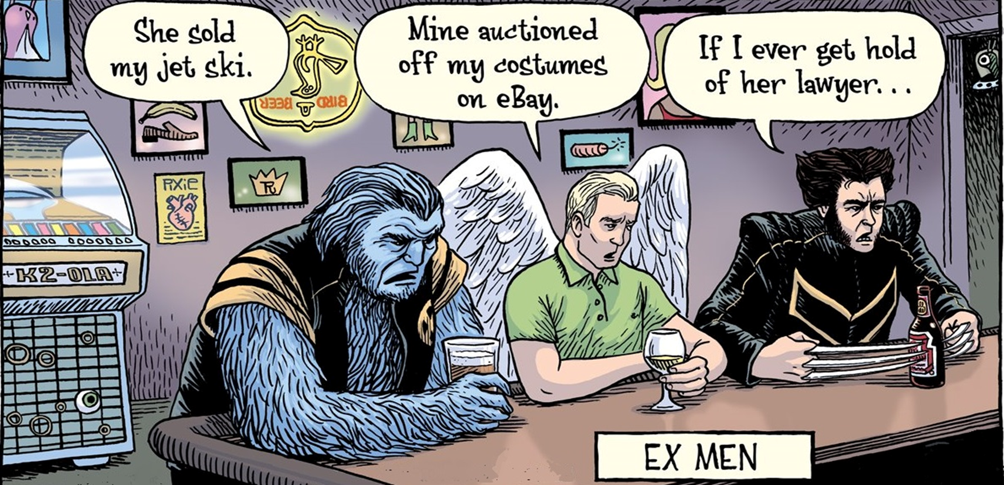
Strong Men are in danger of becoming:

Slide 8
“Father” is used 352 times in the New Testament.
266 times it is used to describe God!
“The Heavenly Father”
has called men (earthly Fathers) to be:
“The Goodman of the house”
Pr 7:19, Mt 20:11; 24:43; Mk 14:14; Lk 12:39; 22:11
OT (ʾîsh) Man, Champion NT (oikodespotēs) Leader
“The Strongman of the house” Mt 12:29; Mk 3:27
ischyros’: forceful, mighty, able (OT: Gibbor)

Slide 9
What a Sacred Honor and Awesome Responsibility to share such a description
with our “Heavenly Father”!
Let’s take a new look at an old word that might help us stay in shape as
“good soldiers of Jesus Christ”. (2 Tim 2:1-5)
1 Thess. 5:24 “Faithful is He that calleth you,
who also will do it!”

Slide 10
F: FAITHFUL Deut. 6:1-9
1. Faithful to our heavenly Father
Mal.1:6 “A son honors his father, and a servant his master:
if then I be a father,
(kaw-bade' : to make weighty, valuable)
A. Notice the Order of Deut 6: Faithful Fathers:
1) Listen vs 3 “Hear (shama: understand {2 Tim. 2:15})
…and observe (shamar: guard, protect)
to do it “ (āśâ” to accomplish)
and His purposes.
where is mine honor?”

Slide 11
A. Notice the Order of Dt 6: Faithful Fathers:
1) Listen: vs 3 “Hear therefore and observe to do it
2) Love: 5 Thou shalt Love the Lord thy God…
3) Learn: 6 these words, …shall be in thine heart:
4) Lead: 7 thou (Fathers) shalt teach them diligently
Unto thy children…”
The Church is to be a support to the parents,
(to Reinforce God’s Plan/Purpose/Priorities)
not a substitute!
(to Relieve Parents from their responsibility)

Slide 12
Can God Trust you to Listen, Love, and Learn,
so you can Lead (shepherd) your family?
B. Examples of Faithful Fathers: 1 Cor 10:11-13
1) Abraham: Gen 18:19 “I know him, that he will command
his children and his household after him, and they shall keep
the way of the LORD that the LORD…”
2) Moses; Nu 12:7 "My servant Moses …is faithful
in all mine house." (1st mention)
OT: ʾāman: to build up or support; to foster; to render
(or be) firm / faithful, permanent, to turn to the right.

Slide 13
B. Examples of Faithful Fathers: 1 Cor 10:11-13
3) Samuel: 1Sam. 2:35
"I will raise me up a faithful priest,
that shall do according to that which is in mine heart and in my mind:
and I will build him a sure house"
Are we focused on what’s in God’s heart/mind
or what’s in our own?

Slide 14
4) Jesus is our primary model: John 8:29
“The Father hath not left me alone;
for I do always those things that please him.”
Lk 22:42 “Father, if thou be willing, remove this cup from me:
Oswald Chambers “The one dominant note in Jesus’ life
was to do his Father's will.
His is not the way of wisdom or of success,
but the way of faithfulness.”
nevertheless not my will, but thine, be done.”

Slide 15
1. Faithfulness to God should motivate us to be:
2. Faithful to our family:
Heb 3:2 “(Jesus) was faithful to him that appointed him,
as also Moses was faithful in all his house.
Vs 5 And Moses verily was faithful in all his house,
as a servant, for a testimony…"
1 Cor 4:2 "Moreover it is required in stewards,
(oikonom’os: manager, overseer)
that a man be found faithful.“ (pistos: trustworthy)

Slide 16
Our Heavenly bridegroom commands us
to faithfully love and lead our wives. Eph 5:25-33
25 “Husbands, love your wives,
even as Christ also loved the church,
and gave himself for it!
32 This is a great mystery:
but I speak concerning Christ and the church.
34 Nevertheless let every one of you in particular so love his wife even as himself;
and the wife see that she reverence her husband.”

Slide 17
Our Heavenly Father has charged Fathers to accurately represent Him to their children.
Ps. 126:1 “Children are the heritage of the LORD”
Pr 22:6 “Train up a child in the way he should go…”
Eph 6:4 “fathers, provoke not your children to wrath: but bring them up (ektreph’ō: cherish/train)
in the nurture (paidei’a: educate/discipline)
and admonition (nouthesia: rebuke/warning)
of the Lord.”

Slide 18
How do we demonstrate Faithfulness as Fathers: Dt. 6:3-7
“Hear therefore (God’s Word) and observe to do it…
thou shalt love the LORD thy God
with all thine heart…soul…might.
And these words, which I command thee this day, shall be in thine heart:
And thou shalt teach them diligently
to thy children…”

Slide 19
Dt 6:7 “And thou shalt teach them diligently …”
(Shānan: to sharpen, whet)
Eccl 10:1 “Dead flies cause the ointment …
to send forth a stinking savour:
so doth a little folly him that is in reputation for wisdom and honor….
10 If the iron be blunt, and he do not whet the edge,
then must he put to more strength:
but wisdom is profitable to direct.”
Pr 2:6; 9:10

Slide 20
In what area of your responsibilities do you need to “sharpen the sword?”
Listening to God: vs 3 “Hear and observe to do it
Loving God: 5 Thou shalt Love the Lord thy God
Learning God: 6 “these words which I command
thee shall be in thine heart: (See Joshua 1:8)
Leading your Family for God! Vs 7
“thou (Fathers) shalt teach them diligently
Unto thy children…”

Slide 21
"To get his goodnight Kiss he stood,
beside my chair one night.
And raised an eager face to me,
a face with love alight.
And as I gathered in my arms,
the son God gave to me;
I thanked the lad for being good,
and hoped he'd always be.

Slide 22
His little arms crept 'round my neck,
and then I heard him say;
Five simple words I can't forget,
five words that made me pray.
They turned a mirror on my soul,
on secrets no one knew.
They startled me, I hear them yet;
He said,
"I'll be just like you!"

Slide 23
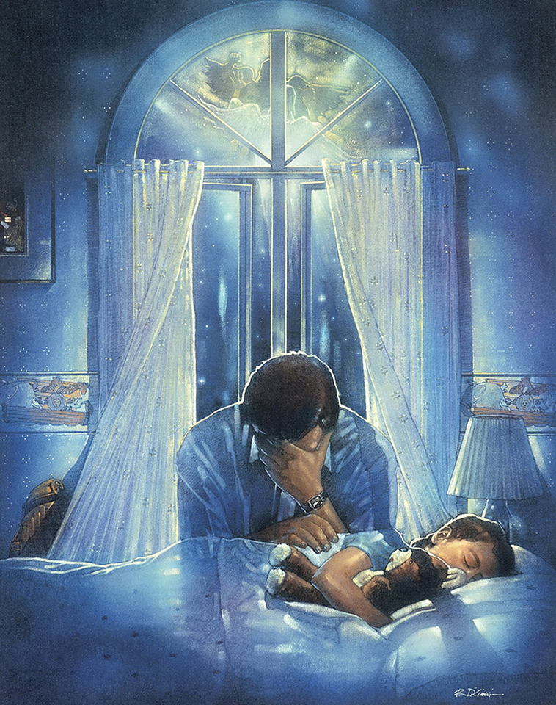
Ph 1:6 “he which hath begun a good work in you will perform it until the day of Jesus Christ:”
Ph 2:13 “It is God which worketh in you
both to will and to do of his
good pleasure.”
1 Th 5:24 “Faithful is he that calleth you,
who also will do it.”
Will you let Him? 1 Cor 3:9

