Slide 1
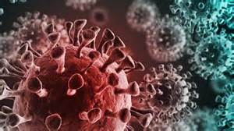
The Covid-19 Virus provides a powerful illustration of a deep spiritual reality!
This highly contagious disease has left millions in our country (and world) “infected”,
and “affected” billions with the anxiety, uncertainty and perplexity that surrounds it.

Slide 2
In much the same way, Sin has infected and affected our entire world, …
Leaving us sick and in desperate need of the Great Physician!
John 3:15-18

Slide 3
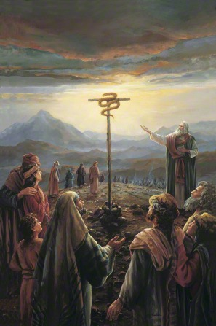
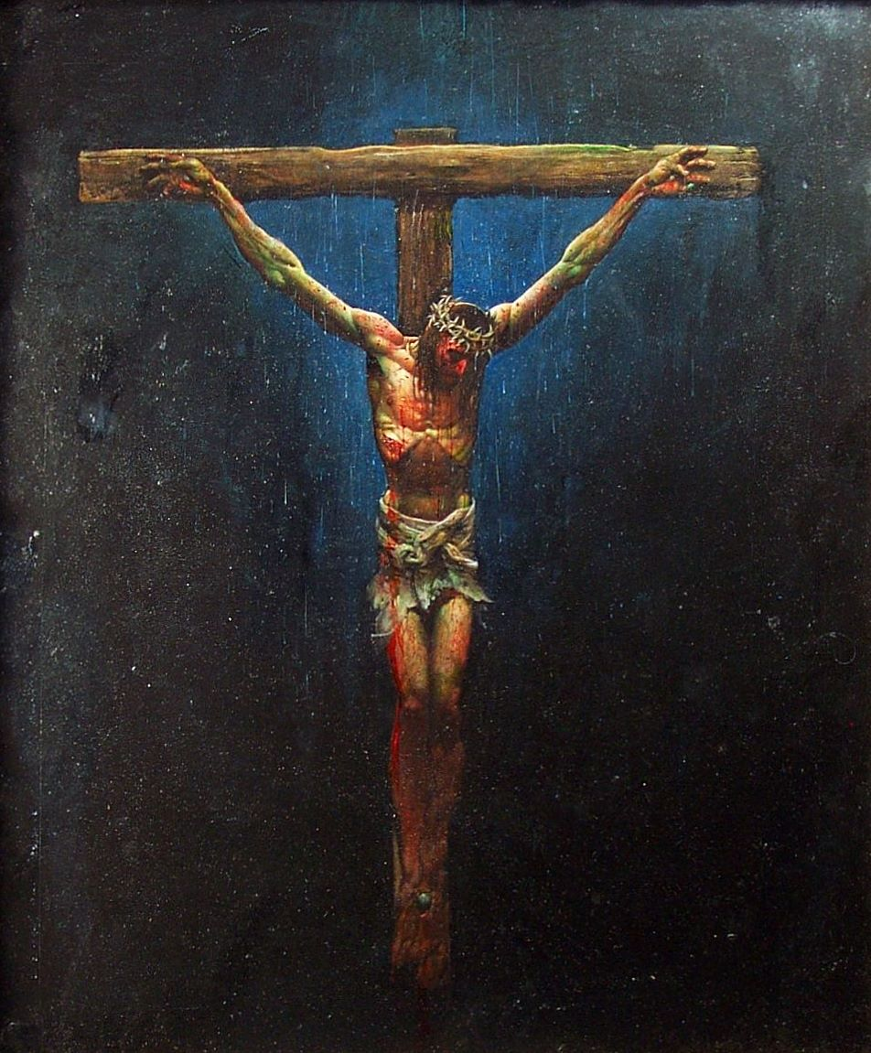
John 3:14-15 “as Moses lifted up the serpent in the wilderness,
even so must the Son of man be lifted up…
18 He that believeth in Him is not condemned…”

Slide 4
Jesus warned us about the “thief” (serpent) that comes to “steal, kill, destroy” Jn 10:10a
God wants us Healthy and Strong so that we can:
Enjoy the promised Abundant life (Jn 10:10)
Become “more than conquerors…” Ro 8:37
Enabling us to become His “ambassadors” 2 Cor. 5:20
and “salt and light” (Mt 5:13-16; Phil. 2:13-16)
to minister to this broken, diseased world.

Slide 5
But sadly, like the ancient Jews, we often become re-infected with other worldly viruses. Jms 4
Due to the virility of sin’s viruses,
God challenges us to “Examine ourselves”
(Dokimazō: to test, discern, prove)
Revealing that “for this cause
many are weak and sickly among you,
and many sleep”
(1 Cor. 11:28-30)
(Lack of “testing”)
(koi’maō: deceased)

Slide 6
The Great Physician offers His “Great Prescriptions” to help restore our health / strength so we can better represent Him and help a sick society.
These include The Great Commission (Mt 28:18-20)
And the Great Commandment (Mt 22:37)
(megas entole) Powerful, Authoritative
Prescription.

Slide 7
We’ve discussed that the first two aspects of The Great Commission involve:
Sharing God’s message of Salvation:
Mt 28:18 “Go ye …Teach all nations.”
Mark 16:15 “Preach the gospel…”
Encouraging a clear & obedient Association: “Baptizing them…”
from bapto: “to dip or stain (as with dye)”
aka: identify/associate with!
(Jn 3:15,16)
baptizo: “make fully wet”

Slide 8
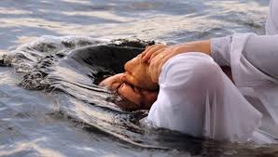
Last time we focused on how baptism is an external act of obedience that:
Reflects an internal change of allegiance.
Col 1:13 “God delivered us from the power of darkness
and translated us into the kingdom of His dear Son.”
Identifies (associates) us with Jesus’ death,
burial and resurrection (Ro. 6:3-5)
Faith should be personal,
But not PRIVATE! Ps. 107:2

Slide 9
Why we need a church family
Biblical Baptism not only “associates” us with God,
but also with His Church!
A Bible word for this association is Fellowship!
koinonia: “Partnership and Participation”!
We’re “partners” with God and each other
in the accomplishing of God’s Purposes!
(1 Cor 3:9; Phil. 1:5; Rev. 4:11)

Slide 10
Why we need a church family
“Fellowship” involves a process whereby God grows us in the fulfilment of the Great Commandment so that we can effectively…
fulfil the “Great Commission”.
In Acts 2:41-47 (1st mention of Fellowship)
God gives us a picture of this process revealing God’s original design for His Church!

Slide 11
The Process of this Partnership
1. MEMBERSHIP. Choosing to belong. (identify with) Acts 2:41
“Then they that gladly received his word were baptized: and the same day there were
added unto them about three thousand souls.”
God wants you to identify with His family. Eph. 2:19
“Now ye are no more strangers and foreigners, but fellow-citizens with the saints,
1) The Christian life is not just about believing,
it’s also about belonging!
and of the household of God.”

Slide 12
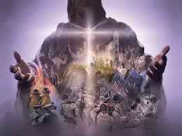
B. Notice some of the “pictures” God uses to describe His Church.
1) Members of a common (HIS) Body.
1 Cor 12:27 “ye are the body of Christ,
and members in particular.”
Ro 12:5 “we, being many, are one body in Christ,
and every one members one of another.”
a) Every “member” must work together in
order to be healthy and effective. Eph 4:15-16

Slide 13
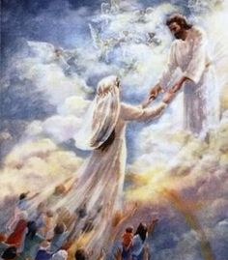
B. Notice the Pictures God uses
2) Marriage to a common groom.
(Eph. 5:22-31; Rev. 19:9; 2 Cor 11:2)
Eph 5:32 “This is a great mystery: but I speak
concerning Christ and the church.”
Many “believers” are perpetually “dating” God,
but never seem to act “married!”
See James 4:4

Slide 14
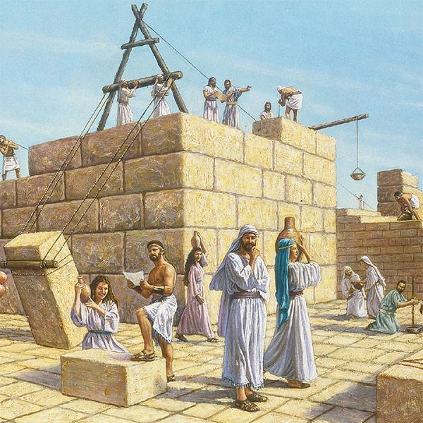
B. Notice the Pictures God uses
3) Materials in a common Building (Temple).
1 Cor 3:9-11 “we are laborers together with God:
ye are God’s …building.
According to the grace of God which is given unto me, as a wise master-builder, I have laid the foundation, and another buildeth thereon.
But let every man take heed how he buildeth”
Bricks that aren’t “mortared” together are
Fragile and Dangerous.

Slide 15
B. Notice the Pictures God uses:
4) Plants (trees) in a common garden.
1 Cor 3:9 “we are laborers together with God,
Ye are God’s husbandry” (Ge-ōr’gion: garden)
Jn 15:1-6 “I am the vine…ye are the branches”
Is. 61:3 “they might be called trees of righteousness, the planting of the Lord,
That He might be glorified”

Slide 16
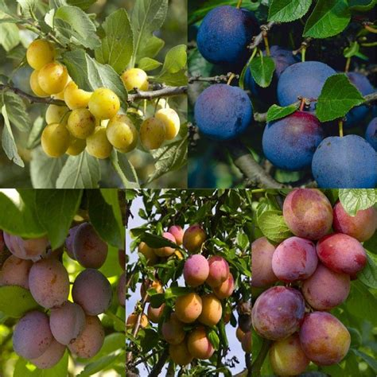
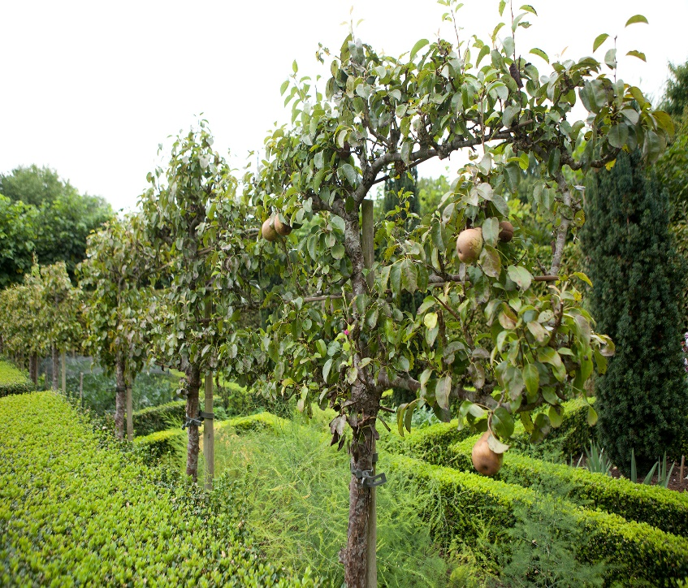
B. Notice the Pictures God uses:
4) Plants (trees) in a common garden
a) Few vines or fruit trees can produce alone!
They need to cross pollinate
in order to produce!

Slide 17
5) Members of a Common Family Eph. 3:14-18
“For this cause I bow my knees unto the Father of our Lord Jesus Christ, Of whom the whole family in heaven and earth is named, that he would grant you,
according to the riches of his glory, to be strengthened with might by his Spirit in the inner man;
That Christ may dwell in your hearts by faith; that ye, being rooted and grounded in love, may be able to comprehend with all the saints
what is the breadth, and length, and depth, and height;

Slide 18
5) Members of a Common Family Eph. 3:19-21
“& to know the love of Christ, which passeth knowledge, that ye might be filled with all the fulness of God.
Now unto him that is able to do exceeding abundantly above all that we ask or think,
according to the power that worketh in us,
Unto him be glory in the church by Christ Jesus throughout all ages, world without end. Amen.”
The Only time the word “Family” is found in the NT!

Slide 19
What do all of these have in common?
Members of a common Body. (1 Cor. 12; Ro. 12)
Married to a common Groom.(Eph.5; Rev. 19)
Materials in a common Building. (Eph. 2)
Plants in a common Garden (1 Cor 3:9; Is. 61)
People in a common Family. (Eph. 3:14-21)
They all involve Diversity
and require Commitment!

Slide 20
Of the 27 books of the New Testament, 13 were written to the pastors / people of a local church!
Out of 114 times that the “church” is mentioned in the New Testament,
90 of them refer to specific local gatherings of believers who have banded together for fellowship and mission.

Slide 21
“Let us hold fast the profession of our faith without wavering;
(for he is faithful that promised;)
²⁴ And let us consider one another
to provoke unto love and to good works:
²⁵ Not forsaking the assembling of ourselves together, as the manner of some is;
but exhorting (parakaleo: call near) one another:
Hebrews 10:23-25
katanoeō: observe, understand fully
and so much the more, as ye see the day approaching.”

Slide 22
It’s impossible to obey the more than 48
“one another” commands of Christ,
Without being a committed part of a local church!
Are you a Connected and Committed part of God’s Plan accomplished through His Church??

