Slide 1
The Final Countdown. 2 Peter

Slide 2
“Heaven and earth shall pass away”
Mt. 24:35
God operates by a specific “time table”.

Slide 3
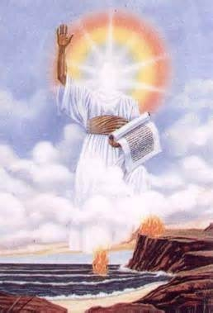
Rev 10:5-6 “the angel which I saw stand upon the sea and upon the earth lifted up his hand to heaven,
And sware by him that liveth for ever and ever, who created heaven, and the things that therein are, …
that there should be time no longer”

Slide 4
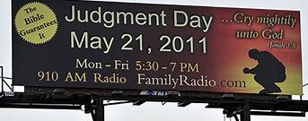
Many have tried to “predict” when this would happen.
In 1992, Harold Camping wrote a book explaining why Jesus must come in 1994.
He spent almost 200 million (of donated money) to advertise on over 5000 billboards that the Rapture would come in May, 2011.

Slide 5
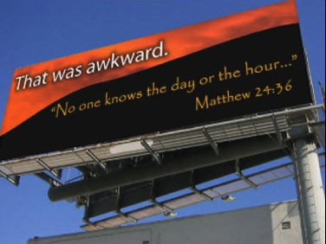
He was sincere, but sincerely wrong!
Undaunted, he simply revised his apocalyptic prophecy, saying he was off by five months because the Earth actually will be obliterated on Oct. 21, 2011.

Slide 6
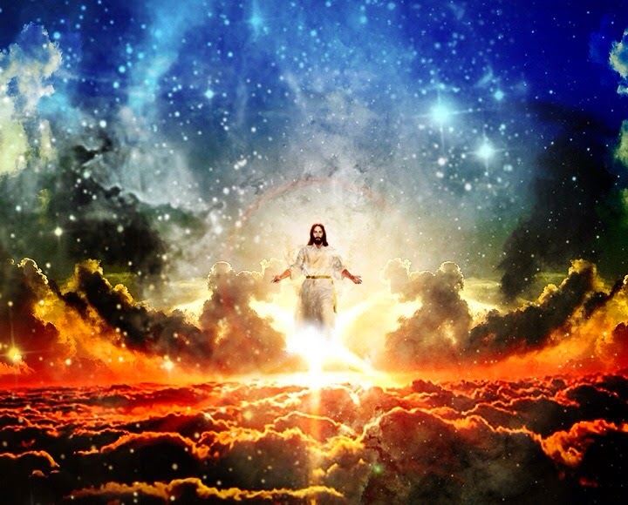
While we don’t know the “day or the hour” we are given “signs” of end times events.
“what shall be the sign of thy coming,
and of the end of the world?”
Mt 24:3 (also Luke 21:7)
“when these things begin to come to pass, then look up, and lift up your heads;
for your redemption draweth nigh.”
Luke 21:28

Slide 7
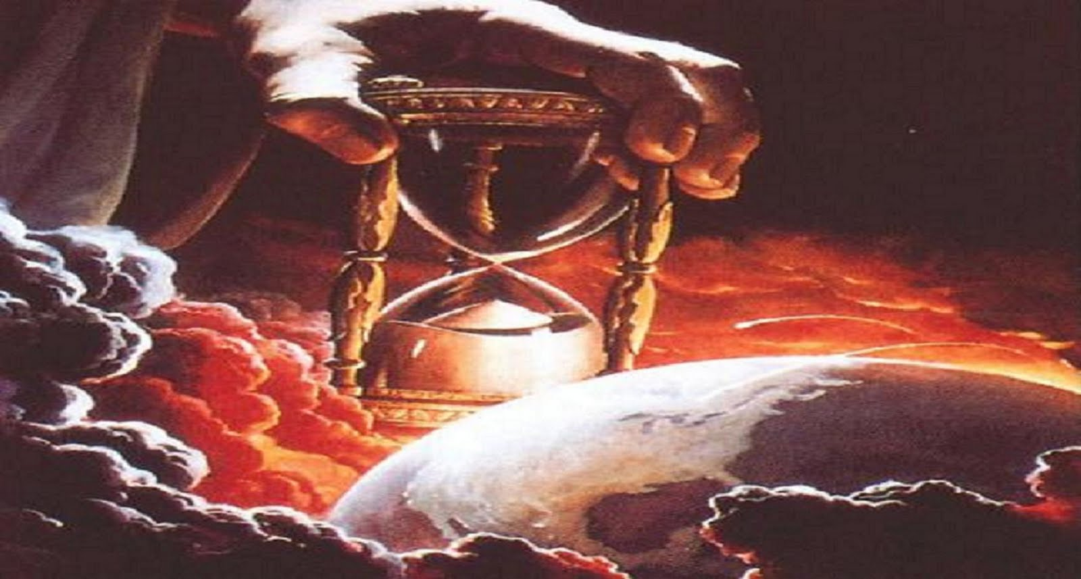
“ye can discern the face of the sky;
but can ye not discern
the signs of the times?”
Mt 16:2-3

Slide 8
The Final Countdown. 2 Peter

Slide 9
2 Peter deals with the last days, opening with a:
Prayer: “Grace and peace be multiplied unto you”
A. Grace: char’is: divine influence on heart and life.
B. Peace: Eirēnē: to join, to set at one again.
“through the knowledge of God, and Jesus our Lord”
Epig’nōsis: recognition, discernment, awareness
God’s Grace & Peace are related to our recognition and awareness of Him and His ways!

Slide 10
2 Peter opens with a
2. Provision: v 3 “his divine power hath given us all
things that pertain unto life and godliness,
through the knowledge (awareness) of him
A. A Calling: “that called us”
1) to glory (doxa: dignity, honor)
It comes from dokeō: meaning to think!)
2) and virtue: (aret’ē: manliness, valor!)
1 Pt. 2:9 “Ye are a chosen generation…”

Slide 11
2 Peter opens with a
2. Provision:
B. Precious Promises: vs 4
“Whereby are given unto us exceeding great
and precious promises: that by these ye might
1) “be partakers of the divine nature,” (see Gal. 4:6)
2) “having escaped the corruption that is in the world
through lust.” (See Phil. 2:15,16)

Slide 12
2 Peter opens with a
3. Plea: “giving all diligence, (spoude’: urgency!)
A. Grow Up! (Get equipped)
“add to your faith virtue; knowledge; temperance;
patience; godliness; brotherly kindness; charity.” 5-7
B. Settle Up! “make your calling and election sure”
vs 10 beb’aios: steadfast, strong, sure
11 “For so an entrance shall be ministered unto you abundantly into the everlasting kingdom of our Lord”

Slide 13
4. A Problem 2 Peter 2:1,2 “But there were false
prophets also among the people,
even as there shall be false teachers among you,
A. Division: “who privily shall bring in damnable
heresies,”
Apōleia hai’resis (ruinous choices & division)
B. Denial: “even denying the Lord that bought them,
C. Destruction: “and bring …swift destruction” (ruin)
D. Disciples “many shall follow their pernicious ways”

Slide 14
2 Timothy 3:13
“evil men and seducers shall wax worse and worse, deceiving,
and being deceived.”

Slide 15
5. A Promise “I will come again…” Jn 14:3
2 Peter 3:2-4 “be mindful of the words which were spoken
before by the prophets, and apostles of the Lord:
Knowing, that there shall come in the last days scoffers,
(empaiktēs’: deriders, false teachers)
And saying, Where is the promise of his coming?
for since the fathers fell asleep, all things continue as they were from the beginning of the creation.”

Slide 16
5. A Promise! “where’s the promise of his coming?”
Vs 5-7 “For this they willingly are ignorant of,
that by the word of God the heavens were of old…
Whereby the world that then was, being overflowed with water, perished:
But the heavens and the earth, which are now, by the same word are kept in store,
reserved unto fire against the day of judgment and perdition of ungodly men. ”

Slide 17
Vs 5-7 “For this they willingly are ignorant of”
Evolutionist George Wald (a Harvard University biochemist and Nobel Laureate), wrote,
"When it comes to the Origin of Life there are only two possibilities:
creation or spontaneous generation.
There is no third way.
Spontaneous generation was disproved one hundred years ago!”

Slide 18
Vs 5-7 “For this they willingly are ignorant of”
Evolutionist George Wald wrote,
“that leads us to only one other conclusion,
that of supernatural creation.
We cannot accept that on philosophical grounds;
therefore, we choose to believe the impossible:
that life arose spontaneously by chance!"
("The Origin of Life," Scientific American, 191:48, May 1954).

Slide 19
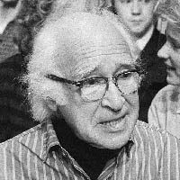
“I don’t want to believe in God.
Therefore I choose to believe in that which I know is scientifically impossible,
Spontaneous generation
leading to evolution.”
“Frontiers of Modern Biology to Theories of Origin of Life” (Ney York: Houghton Mifflin, 1972 P. 187)

Slide 20
“There is none so blind, as they that will not see!”
“having eyes they see not…” Jer. 5:21
Ro 1:28 “even as they did not like to retain God in their knowledge,
God gave them over to a reprobate mind…”
Literally “worthless understanding!”
Ps. 14;1; 53:1 “The fool hath said in his heart, there is no God! They are corrupt …”
Shāḥat’: ruined, destroyed!

Slide 21
Conclusion:
1) Every day Jesus delays gives people opportunity to repent!
“But, beloved, be not ignorant of this one thing,
that one day is with the Lord as a thousand years…
The Lord is not slack concerning his promise…
but is longsuffering, not willing that any should perish,
but that all should come to repentance.”
2 Peter 3:8-9

Slide 22
Conclusion:
2) Someday will be the last day!
“But the day of the Lord will come
as a thief in the night!”
He’ll come without warning!

Slide 23
3) This world will End!
“in the which the heavens shall pass away with a great noise,
and the elements shall melt with fervent heat, the earth also and the works that are therein
shall be burned up.” 2 Peter 3:10
(See also 1 John 2:17)

Slide 24
This truth should MOTIVATE US!
“Seeing then that all these things shall be dissolved,
what manner of persons ought ye to be
To personal godliness: in all holy
conversation and godliness, 3:11-12
To Partnership with God! “in peace”

Slide 25
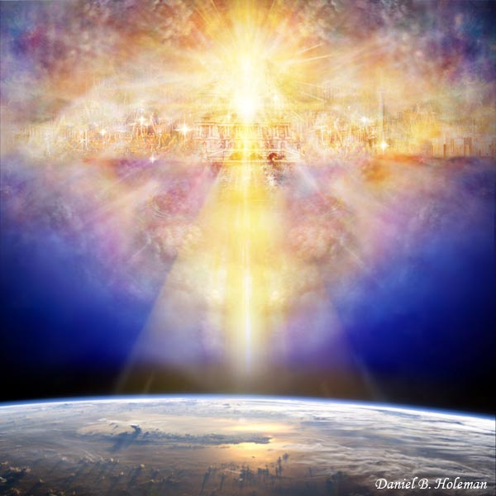
2 Peter 3:13-15
“Nevertheless we, according to his promise,
look for new heavens and a new earth,
wherein dwelleth righteousness.
…seeing that ye look for such things, be diligent
that ye may be found of him in peace…and
Account that the longsuffering of our Lord is salvation”

Slide 26
This truth should MOTIVATE US!
To cautious vigilance. 2 Peter 3:17
“Ye therefore, beloved, seeing ye know these things,
beware lest ye also, being led away with the error of the wicked,
fall from your own steadfastness.”

Slide 27
This truth should MOTIVATE US!
To Personal Growth. 2 Peter 3:18
“But grow in grace, and in the knowledge
of our Lord and Savior Jesus Christ.
To him be glory both now and for ever.
Amen.”

Slide 28
The Final Countdown. 2 Peter

