Slide 1
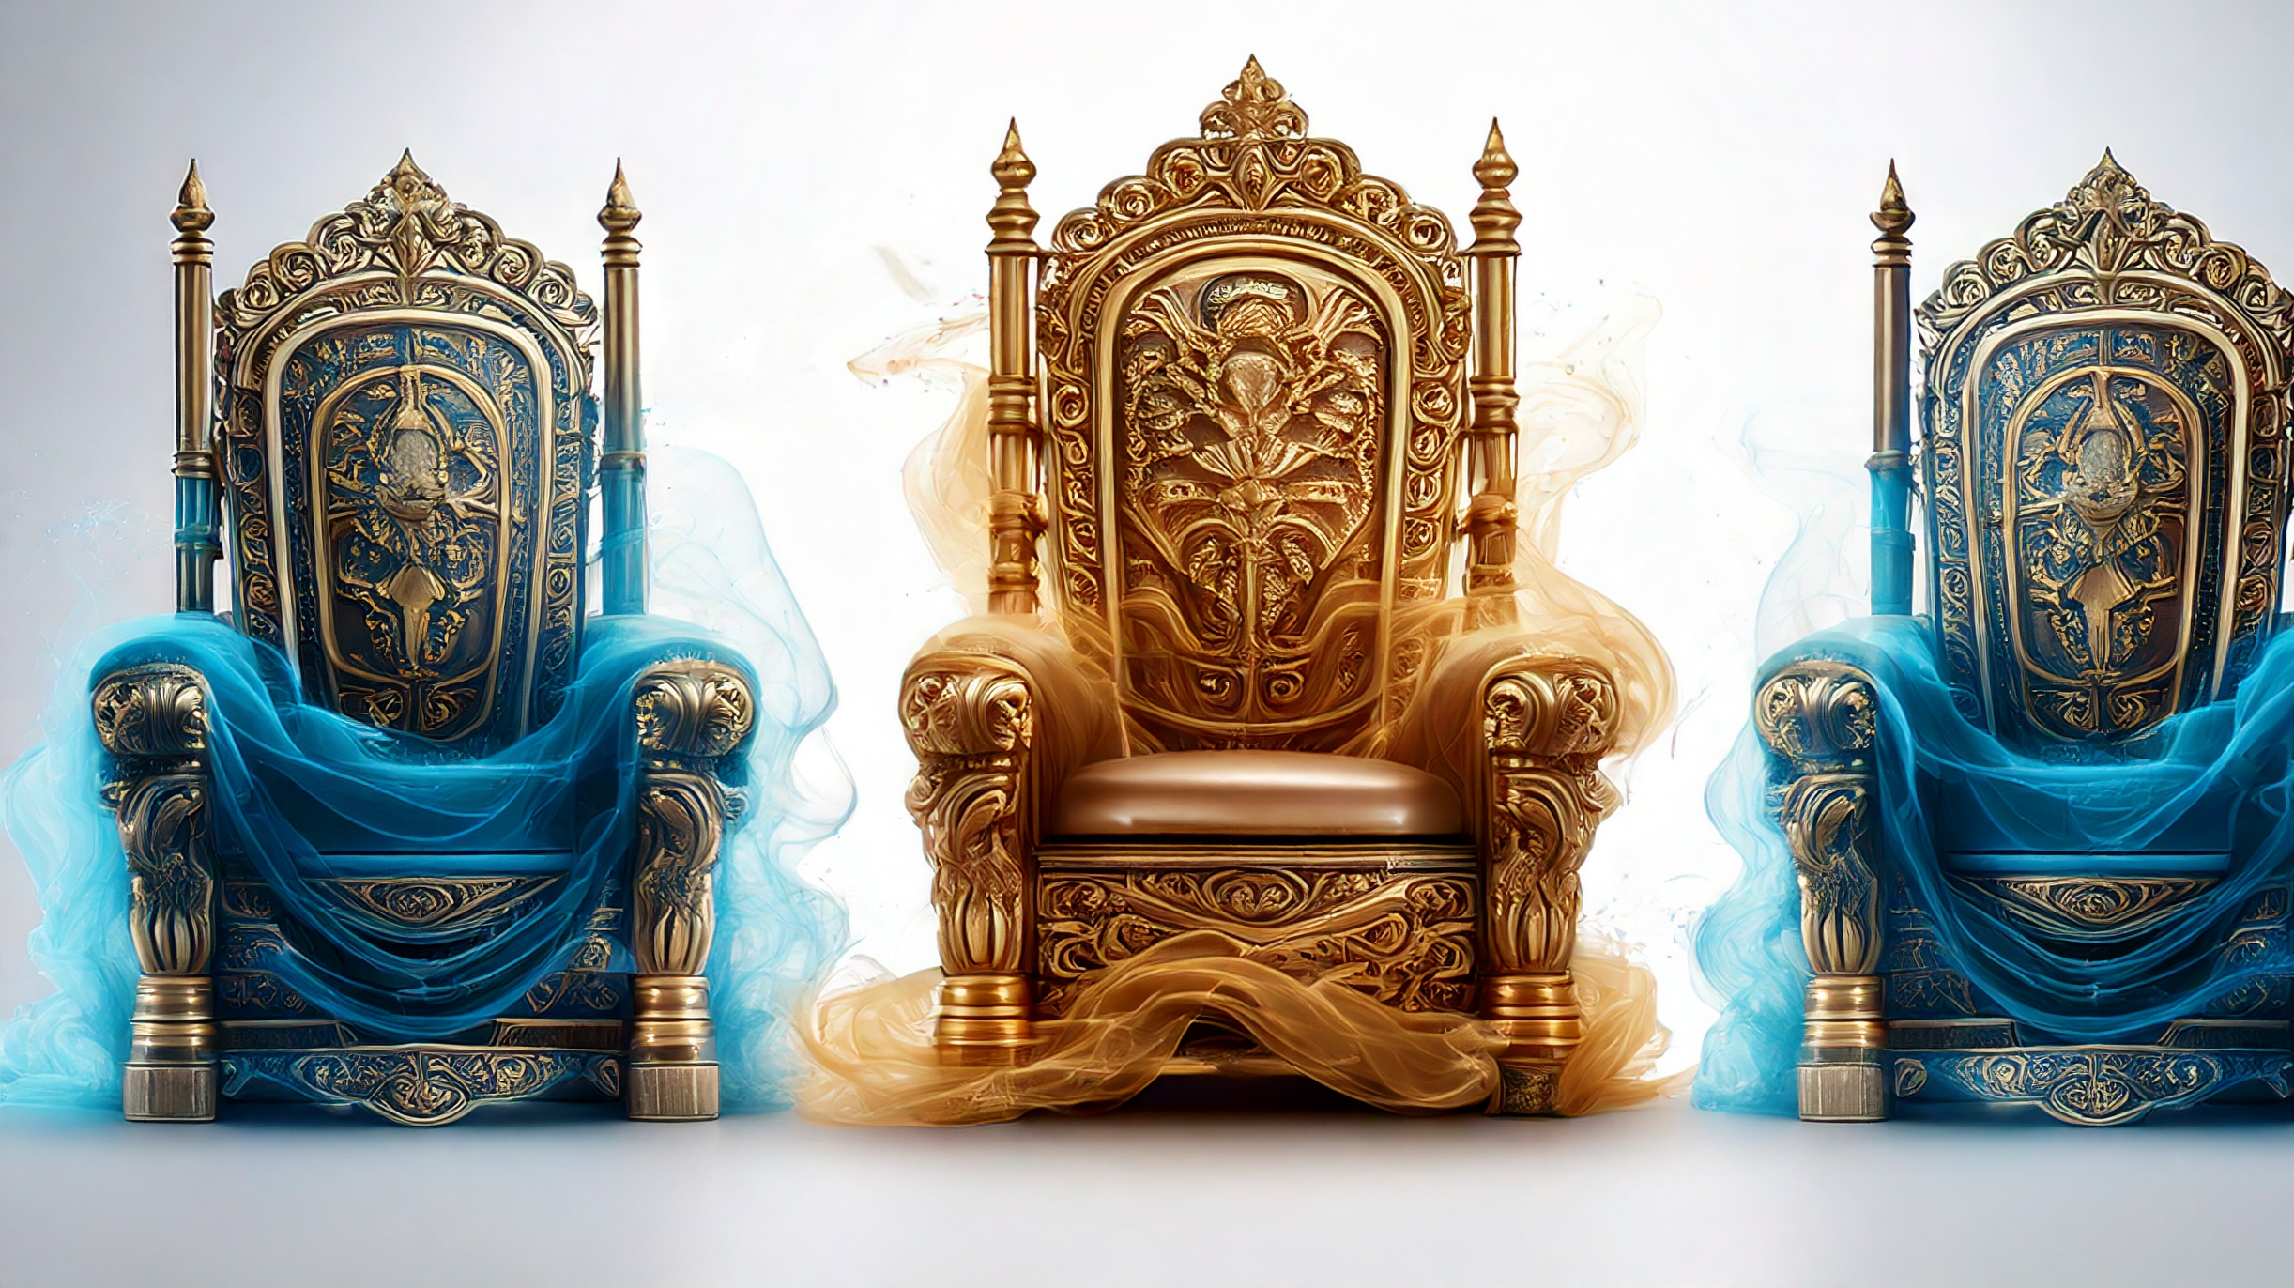
Gifts that Lead to Expectations
By Joseph Peters

Slide 2

Goal
Every Christian should be careful not to allow grace to lead to pride
For these three reasons

Slide 3
Reasons
Jesus Was Asked for More
Jesus Rebuked the Request
Jesus Corrects the Misconceptions

Slide 4
Preceding Context: Twelve Thrones
Then answered Peter and said unto him, Behold, we have forsaken all, and followed thee; what shall we have therefore? And Jesus said unto them, Verily I say unto you, That ye which have followed me, in the regeneration when the Son of man shall sit in the throne of his glory, ye also shall sit upon twelve thrones, judging the twelve tribes of Israel. And every one that hath forsaken houses, or brethren, or sisters, or father, or mother, or wife, or children, or lands, for my name’s sake, shall receive an hundredfold, and shall inherit everlasting life. But many that are first shall be last; and the last shall be first (Matt 19:27–30)

Slide 5
Preceding Context: Crucifixion Foretold
…So the last shall be first, and the first last: for many be called, but few chosen.
And Jesus going up to Jerusalem took the twelve disciples apart in the way, and said unto them, Behold, we go up to Jerusalem; and the Son of man shall be betrayed unto the chief priests and unto the scribes, and they shall condemn him to death, And shall deliver him to the Gentiles to mock, and to scourge, and to crucify him: and the third day he shall rise again (Matt 20:16–19).

Slide 6
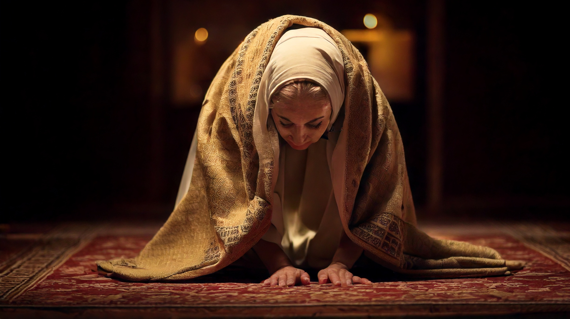
Jesus Was Asked for More

Slide 7
Jesus Was Asked for More
Then came to him the mother of Zebedee’s children with her sons, worshipping him, and desiring a certain thing of him. And he said unto her, What wilt thou? She saith unto him, Grant that these my two sons may sit, the one on thy right hand, and the other on the left, in thy kingdom (Matt 20:20–21).
And James and John, the sons of Zebedee, come unto him, saying, Master, we would that thou shouldest do for us whatsoever we shall desire. And he said unto them, What would ye that I should do for you? They said unto him, Grant unto us that we may sit, one on thy right hand, and the other on thy left hand, in thy glory (Mark 10:35–37).

Slide 8
Who Was She to Jesus
Among which was Mary Magdalene [1], and Mary the mother of James and Joses [2], and the mother of Zebedee’s children [3] (Matt 27:56).
There were also women looking on afar off: among whom was Mary Magdalene [1], and Mary the mother of James the less and of Joses [2], and Salome [3]… and many other women which came up with him unto Jerusalem (Mark 15:40).
Now there stood by the cross of Jesus his mother [4], and his mother’s sister [3], Mary the wife of Cleophas [2], and Mary Magdalene [1] (John 19:25).

Slide 9

Jesus Rebuked the Request

Slide 10
The Cup and Baptism
But Jesus answered and said, Ye [plural] know not what ye [plural] ask. Are ye [plural] able to drink of the cup that I shall drink of, and to be baptized with the baptism that I am baptized with? They [plural] say unto him, We [plural] are able (Matt 20:22).
But Jesus said unto them, Ye know not what ye ask: can ye drink of the cup that I drink of? and be baptized with the baptism that I am baptized with? And they said unto him, We can. And Jesus said unto them, Ye shall indeed drink of the cup that I drink of; and with the baptism that I am baptized withal shall ye be baptized: But to sit on my right hand and on my left hand is not mine to give; but it shall be given to them for whom it is prepared (Mark 10:38–40).

Slide 11
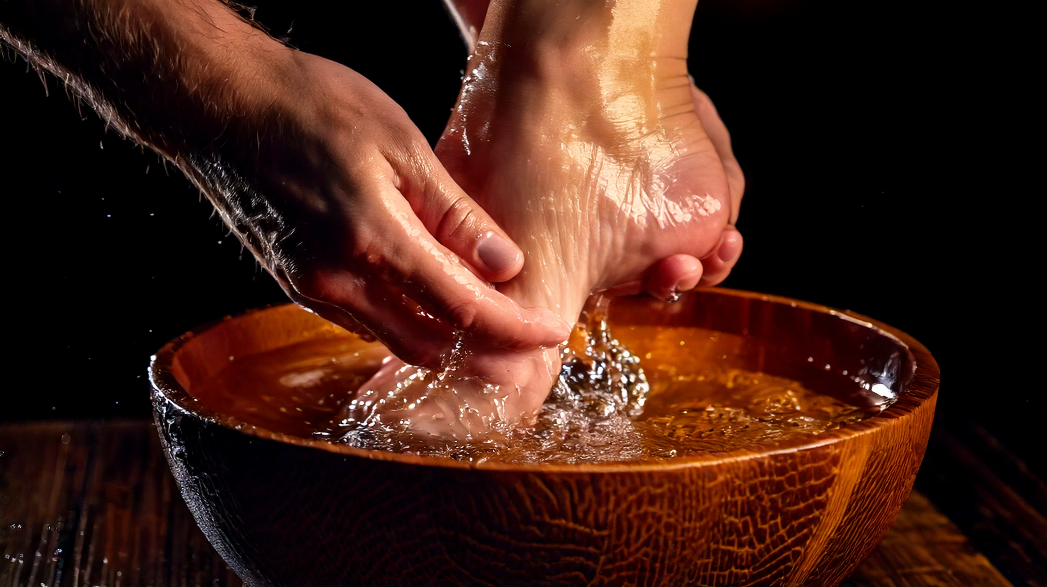
Jesus Corrects the Misconceptions

Slide 12
Jesus Corrects the Misconceptions
And when the ten heard it, they began to be much displeased with James and John. But Jesus called them to him, and saith unto them, Ye know that they which are accounted to rule over the Gentiles exercise lordship over them; and their great ones exercise authority upon them (Mark 10:41–42).
And there was also a strife among them, which of them should be accounted the greatest. And he said unto them, The kings of the Gentiles exercise lordship over them; and they that exercise authority upon them are called benefactors… (Luke 22:24–25).

Slide 13
A Reversal of Expectations
But so shall it not be among you: but whosoever will be great among you, shall be your minister [διάκονος]: And whosoever of you will be the chiefest, shall be servant [δοῦλος] of all. For even the Son of man came not to be ministered unto, but to minister, and to give his life a ransom for many (Mark 10:43–45).

Slide 14
Conclusion
Every Christian should be careful not to allow grace to lead to pride
For these three reasons

Slide 15
Reasons
Jesus Was Asked for More
Jesus Rebuked the Request
Jesus Corrects the Misconceptions

