Slide 1
God’s Great Plan for His People. Jer. 29:11; Mt. 29:18-20

Slide 2
Satan knows that we’re:
Planed on Purpose!
Designed to make a Difference!
Shaped for Significance!
(Gen. 1:26; Jer. 29:11;
Jn 10:10; Rev 4:11)

Slide 3
That’s why he seeks to sidetrack us from finding and pursuing the path that will lead to God’s Purposes & Peace.
This is the essence of Sin!
(Contrast Pr. 14:12 & Ps.16:11)
See also 1 Jn 4:4; 5:4

Slide 4
Satan uses “sin” to distract us from God’s goals (usually by pursuing our own).
This is often fueled by:
Callousness (Hardness) Mt 13:19
Conflict (Pressure/Persecution) Mt 13:20-21
Contamination/Clutter Mt 13:22
Carelessness/ Complacency (Acts 24:25; 1 Pt 5:8)
God’s priorities are just not important to us!

Slide 5
God’s purposes revealed in the Great Commandment (Mt. 22:36-40) remind us:
We’re planned for God’s Pleasure. (Loving Relationship with God / Worship) Rev 4:11
We’re formed for Fellowship.
(Loving Relationship with others) Eph 1

Slide 6
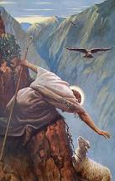
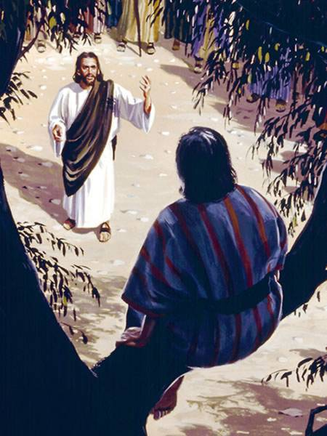
God’s Great Commission reveals that God’s Great Plan involves our:
1. Salvation: Mt 28:19
“Go and teach all nations”
“Go into all the world and Preach the gospel” Mk16:15
Remember Zacchaeus?
Luke 19:9-10 “This day is salvation come
…For the Son of man is come to seek
and to save
that which was lost.”

Slide 7
Salvation:
Establishes a relationship with God. Jn 1:12
“as many as received him, to them gave he power to become the sons of God”
2 Cor 6:18 “I will be a Father unto you, and ye shall be
my sons and daughters, saith the Lord Almighty.”

Slide 8
Salvation:
Enables the power/presence of God’s Spirit
Gal 4:6 “because ye are sons, God hath sent forth the Spirit of his Son into your hearts, crying, Abba, Father.”
1 Jn 4:4 “Greater is He that is in you,
Than he that is in the world”
Salvation ➔ Restoration Col. 1:13; Eph. 2

Slide 9
God’s Great Commission reveals His Great Plan!
2. Baptism: “baptizing them in the name
of the Father, Son, and Holy Spirit” Mt. 28:19
“baptizo” is used in every reference! (89 times)
“To immerse, make fully Wet.”
“Sprinkle” (rhantizo) or “Poured” (ekche’ō)
is never used in scripture of baptism.

Slide 10
2. Baptism:
Is an act of obedience! 1 Peter 3:21
“baptism (not the putting away of the filth of the flesh,
but the answer of a good conscience toward God”
Matthew 10:32 “Whosoever therefore shall confess me before men, him will I confess also before my Father which is in heaven.
But whosoever shall deny me before men,
him will I also deny before my Father ...”

Slide 11
2. Baptism: (from Bapto: to dip/dye)
Identifies us with Jesus! Romans 6:3-4
“Know ye not, that so many of us as were baptized into Jesus Christ were baptized into his death?
Therefore we are buried (associated) with him
by baptism into death:
that like as Christ was raised up from the dead by the glory of the Father,
even so we also should walk in newness of life.”

Slide 12
2. Baptism: (from Bapto: to dip/dye)
Identifies us with Christ’s Church Acts 2:41-42
“Then they that gladly received his word
(repent, believe vs 38) were baptized:
and the same day there were added unto them about three thousand souls.”
Baptism ➔ Identification
(with Christ and His Church)

Slide 13
The third dimension of this “Great Commission” equips us to “walk in newness of life”. Ro 6:4
3. Discipleship.
Mt. 28:20 “Teaching them to observe
(tereo: to guard, value, watch, keep)
all things whatsoever I have commanded you.”
Entellōmai’: from en: fixed position and
telos: to set out for a definite point or goal!

Slide 14
3. Discipleship.
A. Discipleship is the process whereby
1) We Grow to understand God’s Goals/Will.
2 Tim. 2:15 “study to show yourself approved…”
2Ti. 3:16 “All scripture is given by inspiration of God, and is profitable for doctrine, for reproof, for correction, for instruction in righteousness:
That the man of God may be perfect,
(ἄρτιος {ar’tios} renewed, complete, mature)
thoroughly furnished unto all good works.

Slide 15
A. Discipleship is the process whereby
2) We grow to value God and His will and
so choose to adjust our lives accordingly!
(Mt 28:20; Jms 1:22-25; 1 Jn 5:3)
Acts 4:42 “they continued stedfastly in the apostles' doctrine, fellowship, breaking of bread, and in prayers.”
Salvation is about our Restoration.
Baptism is about Association/Identification.

Slide 16
B. The Point (goal) of Discipleship is
Personal Transformation!
Ro 12:1-2 “present your bodies a living sacrifice, holy, acceptable unto God, which is your reasonable service.
And be not conformed to this world:
but be ye transformed by the renewing of your mind,
that ye may prove what is that good, (agathos: beneficial)
and acceptable, (euar’estos: fully agreeable, pleasing)
and perfect, (telios: complete, mature, the goal)
will of God.” (thelema: purpose, pleasure)

Slide 17
Into What?
Transformation?!?
Mt 10:24,25 “The disciple is not above his master,
nor the servant above his lord.
It is enough for the disciple
that he be as his master,
and the servant as his lord.”
Disciple: μαθητής (mathētēs)
literally means a learner or pupil.

Slide 18
1) This Was God’s Original Plan. Gen. 1:26
“Let us make man in our image, after our likeness.”
a) Not “God” But “Godly”(Like God) 1 Pt 1:15,16
(1) Heb. 1:3 tells us that Jesus is the “the brightness
of his glory, the express image of his person”
Charaktēr’: a replication, exact copy
(2) Jesus reveals the Character or God!
John 10:30 “I and my Father are one.”
John 14:9 “he that hath seen me hath seen the Father”

Slide 19
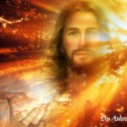
(2) Jesus revealed the Character or God!
John 1:14 “And the Word was made flesh, and dwelt among us, (and we beheld his glory, the glory as of the only begotten of the Father,)
full of grace and truth.”
God’s image (in/through) us has been marred by sin…
But can restored in us
through Grace and Truth!
(Eph. 2; Phil. 1:6; 2:13)

Slide 20
b) God Wants His Children To Grow Up To Become Like Him. 1 Peter 2:2
“As newborn babes, desire the sincere milk of the word,
that ye may grow thereby:”
Babies are blessings;
Heb. 5:12-13“when for the time ye ought to be teachers, ye have need that one teach you again which be the first principles of the oracles of God; and are become such as have need of milk, and not of strong meat. For every one that useth milk is unskilful in the word of righteousness:
until they refuse to grow up!
for he is a babe!”

Slide 21
b) God Wants His Children To Grow Up.
2 Pt. 3:18 “Grow in Grace and in the knowledge of our Lord and Savior Jesus Christ”
(2) He uses “all things” to accomplish this. Ro. 8:28,29
“And we know that all things work together for good to them that love God, to them who are the called according to his purpose.
For whom he did foreknow, he also did predestinate
to be conformed to the image of his Son…”

Slide 22
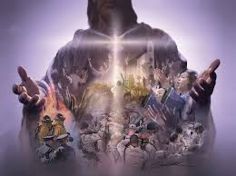
2) This is the essence of the word “Christian”.
Christianos’: a follower of (Like) Jesus Christ
3) This is the goal of Discipleship!
Not knowledge, but Transformation!
Acts 11:26 “a whole year they assembled themselves with the church, and taught much people.
And the disciples were called Christians first in Antioch.”

Slide 23
God’s Great Plan involves your:
Salvation: Responding to “the gospel!”
Restoration of A Personal Relationship with Him.
Baptism: Public identification and Association with
Him and His church.
Discipleship: Orientation/Education to enable
you to grow (Transformation)
“into the image of His son” (Romans 8:29)

Slide 24
What does a Mature Christian look (act) like?
He / She Acts like Jesus!
This is a lifelong Process called “Discipleship.” Mathētēs’: A learner, follower!
Just as it takes years for a child to develop the characteristics (and character) of their parents,
It takes time, training, and tenacity to develop
the qualities of Christ.

Slide 25
Conclusion: Discipleship
2) This is the 3rd part of the Great Commission: Mt. 28:20 “Teaching them to observe all things
whatsoever I have commanded you.”
This is part of God’s “Co-Mission” (Mt 11:28-30)
“take my yoke upon you and learn of me”

Slide 26
Conclusion: Discipleship
3) This is what “abiding in Christ” is all about!
Jn 15:1-4 “I am the true vine, and my Father is the husbandman. 2 Every branch in me that beareth not fruit he taketh away: and every branch that beareth fruit, he purgeth it, that it may bring forth more fruit.
3 ye are clean through the word which I have spoken unto you.
4 Abide in me, and I in you. As the branch cannot bear fruit of itself, except it abide in the vine;
no more can ye, except ye abide in me.”

Slide 27
Conclusion: Discipleship
Abiding in Christ allows the “Fruit of the Spirit”
To develop in our lives!
Gal 5:22-24 “But the fruit of the Spirit is love, joy, peace, longsuffering, gentleness, goodness, faith,
Meekness, temperance:
against such there is no law.
And they that are Christ's have crucified the flesh with the affections and lusts.”

Slide 28
Salvation Baptism Discipleship
Restoration + Association + Transformation
4) The results (fruit) of discipleship (maturity)
is ultimately Reproduction!
Jn 15:16 “I have chosen you, and ordained you,
Τίθημι (tithēmi) to place and appoint
that ye should go and bring forth fruit,
and that your fruit should remain!”

Slide 29
“The thief comes to destroy, kill, and steal.”
Jn 10:10a and Mt. 13:19-23
What’s the “thief” using to distract you from God’s Great plan for your life?
Pride
Pressure/Persecution?
Preoccupation? Misaligned Priorities?
Passivity?
He distracts in order to destroy!

Slide 30
“I am come that they might have life,
and that more abundantly.” Jn. 10:10
“My sheep hear my voice,
and I know them,
and they follow me!”
Jn 10:27

Slide 31
“My sheep hear my voice…
And they follow me!” Jn. 10:10
Will you purpose to learn to listen for
and to His Voice? Jn 10:27
Will you purpose to “Follow Him?”
Pr. 3:5,6
Will you purpose to help others
do the same?
2 Tim. 2:1,2

