Slide 1
Beginning with an “end” in view.
Freedom of Choice is a remarkable gift of God!
It can be both intoxicating and terrifying!
Eccl. 11:9“Rejoice, O young man, in thy youth;
let thy heart cheer thee in …thy youth,
and walk in the ways of thine heart,
and in the sight of thine eyes:
but know thou, that for all these things:

Slide 2
‎ mishpāṭ’:
A verdict.
From shāpaṭ’:
to vindicate
or punish.
“God will bring thee
into judgment.”
“and the books were opened”
Rev. 22:12

Slide 3
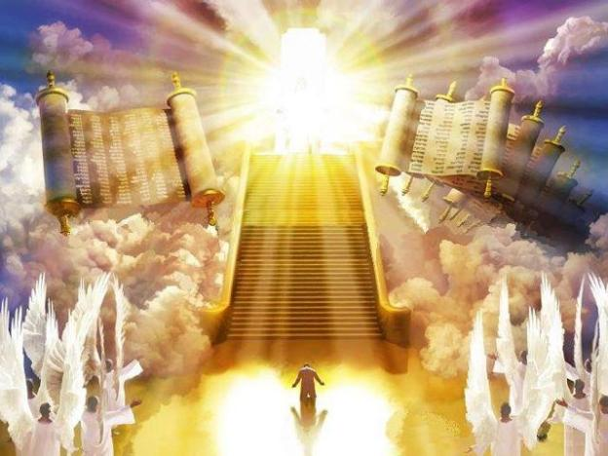
This Judgment is inevitable and universal!
Heb. 9:27 “it is appointed unto men once to die,
but after this the judgment:”
Kri’sis: a decision about justice in light of divine law.
“we must all appear before the judgment seat”
2 Cor. 5:10

Slide 4
Every legitimate “judgment” implies there must be:
1. A Judge Daniel 7:9-10
“I beheld till the thrones were cast down, and the Ancient of days did sit, whose garment was white as snow, and the hair of his head like the pure wool: his throne was like the fiery flame, and his wheels as burning fire. A fiery stream issued and came forth from before him: thousand thousands ministered unto him, and ten thousand times ten thousand stood before him:
the judgment was set,
and the books were opened.”

Slide 5
1. A Judge Daniel 7:9-10 “The Ancient of Days did sit…”
A. Who is this “ancient of days”?
Compare Dan. 7:9,10 with Rev. 1:12-15
Jn 5:22 “the Father … hath committed all judgment unto the Son”
Acts 10:42 “he (Jesus) commanded us to preach unto the people, and to testify that it is he which was ordained of God to be the Judge
of the quick and dead.”

Slide 6
1. A Judge Daniel 7:9-10 “The Ancient of Days did sit…”
A. Who’s this “ancient of days”?
B. Who will He “Judge”?
The Quick (zaō) Ep 2:1 “you hath he quickened..”
Given new life through Christ! (2 Cor 5:17)
2 Cor 5:9-11 “we must all appear before the judgment seat of Christ; that every one may receive the things done in his body, according to that he hath done, whether it be good or bad.
Knowing therefore the terror of the Lord, we persuade men…”

Slide 7
B. Who will He “Judge”?
The Quick (zaō) Ep 2:1
The Dead “Who were dead in …sins”
Rev 6:15-17 “kings ..great men…rich men…chief captains
…mighty men…every bondman, and every free man, hid themselves
…And said to the mountains and rocks, Fall on us, and hide us from the face of him that sitteth on the throne, and from the wrath of the Lamb: For the great day of his wrath is come;
and who shall be able to stand?”

Slide 8
B. Who will He “Judge”?
2. The Dead Rev. 20:11-15
Rev 20:11 “I saw a great white throne, and him that sat on it, from whose face the earth and the heaven fled
away; and there was found no place for them.
And I saw the dead, small and great, stand before God;
and the books were opened: … and the dead were judged

Slide 9
Every legitimate “judgment” implies there must be:
1. A Judge Daniel 7:9-10
2. Accurate Evidence. “the books were opened”
Rev. 20:12 “The dead were judged out of those things which were written in the books, according to their works ”

Slide 10
God is keeping careful records of our:
1) Actions: “I know thy works” Rev. 2:2-3:15 (7 times)
Pr 15:3 “The eyes of the LORD are in every place,
beholding the evil and the good.”
2) Words: Mt 12:36 “every idle word that men shall speak, they shall give account thereof in the day of judgment.”
3) Thoughts: Heb 4:12-13 “God is a discerner of the thoughts and intents of the heart… but all things are naked and opened unto the eyes of him with whom we have to do.”

Slide 11
“For there is nothing covered, that shall not be revealed; and hid, that shall not be known.” Mt 10:26

Slide 12
B. God’s “evidence” locker includes:
1) Our Disappointments: Ps 56:8 “Thou tellest my wanderings:
put thou my tears into thy bottle: are they not in thy book?”
2) Our Decisions: Mal. 3:16,17 “They that feared the Lord spake
often one to another and the Lord heart it …and a book of
remembrance was written …for them that feared the LORD...”
3) Our “Dreams” (Purposes or Value) Ps 139:16
“Thine eyes did see my substance, (ʿōṣem: Might) yet being unperfect; and in thy book all [my members] were written”
4) Our “Deeds” “According to their works” Rev. 20:12

Slide 13
Every legitimate “judgment” implies there must be:
1. A Judge Daniel 7:9-10
2. Accurate Evidence. Dan. 7:10, Rev. 20:12
A Consistent and Just Standard (Laws)
“Book of the Law” 263 x in the Bible
A. The Meaning of God’s Law:
1) “Law” (tôrâ) means: Precept (commandment) or
Statute (appointed boundary)
a) “Commandments” (miṣwâ) means to charge or commit
Comes From yārâ: meaning to point out, teach, aim at!

Slide 14
A Consistent and Just Standard (Laws)
B. God’s perfect “Law” reveals:
1) Our desperate condition! (Ro. 3:10,23)
Ro 7:7 “I had not known sin, but by the law: “
Gal. 3:10 "as many as are under the works of the law are under the curse...for cursed is everyone that continueth not in all things which are written in the book of the law to do them"
James 2:10 “whosoever shall keep the whole law, and yet
offend in one point, he is guilty of all.”

Slide 15
B. God’s perfect “Law” reveals:
2) Our desperate need of God’s Grace. Ps. 19:7
“The law of the LORD is perfect, converting the soul:”
The “conviction” it brings should bring us to repentance.
Gal 2:16 “a man is not justified by the works of the law, but by the faith of Jesus Christ… that we might be justified by the faith of Christ, and not by the works of the law:
for by the works of the law shall no flesh be justified.”
Gal. 3:24 "The law was our schoolmaster to bring us to Christ, that we might be justified by faith"
dikaioō (dik-ah-ya'-o) rendered innocent! Ro. 5:1

Slide 16
God’s Law (Nature) Requires Justice!
His “Truth” demands that his Law be upheld.
Ro 6:23 “For the wages of sin is death”
Ez 18:20 “The soul that sinneth, it shall die.”
His Grace made a way of pardon. Jn 1:14
“We beheld his glory…full of Grace and Truth”
Ps 85:9-10 “Surely his salvation is nigh them that fear him;
Mercy and truth are met together;
righteousness and peace have kissed each other. “

Slide 17
His Pardon comes at a Price! Ro 5:8
“God commendeth his love toward us, in that, while we were yet sinners, Christ died for us. “
Mt 1:21 “thou shalt call his name JESUS:
for he shall save his people from their sins.”
Ro. 6:23 “The wages of sin is death, but the gift of
God is eternal life, through Jesus Christ.”

Slide 18
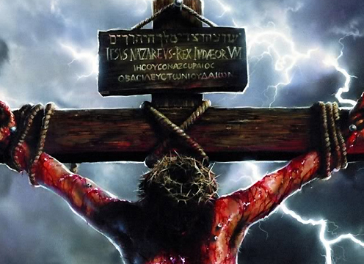
God’s Law (Nature) Requires Justice!
His “Justice” was satisfied by Christ.
“He hath made him to be sin for us...” 2 Cor. 5:21
“It is finished”
Jn 19:30
teleō: the debt has been paid and discharged!

Slide 19
The only way to received God’s Grace is to “receive” Christ. (Jn 1:12,13)
“He came unto his own but His own received him not.
But as many as received him to them gave he the power to become the sons of God.
Which were …born of God.”
Jn 3:18 “He that believeth on him is not condemned:
but he that believeth not is condemned already,
because he hath not believed in …the only …Son of God”
pisteuō: to entrust and commit to.

Slide 20
1 John 5:11-12 “this is the record, that God hath given to us eternal life, and this life is in his Son.
¹² He that hath the Son hath life;
and he that hath not the Son of God hath not life.”
This divides the human race into either the “quick” or the “dead.”
Which group are you in?

Slide 21
Begin with an end if view!
Eccl 11:9 “Rejoice, O young man, in thy youth; and let thy heart cheer thee in the days of thy youth, and walk in the ways of thine heart, and in the sight of thine eyes: but know thou,
that for all these things God will bring thee into judgment.” ‏
In light of this inevitable truth:
Eccl 12:1 “Remember now thy Creator in the days of thy youth, while the evil days come not, nor the years draw nigh, when thou shalt say, I have no pleasure in them;”

Slide 22
“The words of the wise are as goads, and as nails fastened by the masters of assemblies,
which are given from one shepherd… (rāʿâ: Pastor)
Let us hear the conclusion of the whole matter:
Fear God, and keep his commandments: for this is the whole duty of man. For God shall bring every work into judgment, with every secret thing, whether it be good, or whether it be evil.” Ecc. 12:11-14

Slide 23
Book of The Law

