Slide 1
God’s Library
“and the books were opened”
Rev. 22:12

Slide 2
There are events in our lives so significant
that God is keeping a journal of them!
➔Our Disappointments: Ps 56:8
“Thou tellest my wanderings: put thou my tears into thy bottle: are they not in thy book?”
➔Our Decisions: Mal. 3:16,17 “They that feared the
Lord spake often one to another and the Lord heart it
…and a book of remembrance was written before him
for them that feared the LORD...”

Slide 3
There are events in our lives so significant
that God is keeping a journal of them!
Our “Dreams” (Purposes or Value)
Ps 139:16 “Thine eyes did see my substance, (ʿōṣem: Might)
yet being unperfect; (golem: undeveloped, embryotic)
and in thy book all [my members] were written”
Jer. 29:11 “For I know the thoughts ‏(plans) that I think toward you, saith the LORD, thoughts of peace, and not of evil, to give you an expected end.”

Slide 4
The Book of “Works” Rev. 20:12
“the dead were judged out of those things which were written in the books…”
“according to their works”
Er’gon:
effort, actions, occupation.

Slide 5
The Book of “Works” Rev. 20:12
Types of “works” that will be “judged:”
1. “Wicked” works. (Found 3 x)
A. Neh. 9:34,35 in a Prayer of Repentance:
After God’s deliverance of the exiles, they realized and confessed their tendency to rebel and repeat “history”.
“neither our kings…princes…priests nor our fathers, kept thy law, nor hearkened unto thy commandments and thy testimonies, wherewith thou didst testify against them.

Slide 6
The Book of “Works” Rev. 20:12
“Wicked” works. Neh. 9:35
“For they have not served thee in their kingdom,
and in thy great goodness that thou gavest them, and in the large and fat land which thou gavest before them,
neither turned they from their wicked works.”
(raʿ maʿalāl’: evil, hurtful, wicked actions and choices.)
1) What made their “works” (choices) evil?
They elevated “their” Kingdoms above God’s!
“Thy Kingdom Come, Thy will be done…” Mt. 6:10

Slide 7
The Book of “Works” Rev. 20:12
“Wicked” works.
B. Ps 141:3-4 “Set a watch, O LORD, before my mouth; keep the door of my lips. Incline not my heart to any evil thing, to practise wicked works with men that work iniquity.”
“Wicked” (reh’shaʿ) wrong! iniquity
“Iniquity” (ʾāwen) exert after vanity, idolatry, perversity.
1) Iniquity = Self Will!
Is 53:6 “we have turned every one to his own way.”

Slide 8
“Wicked” works.
C. Col 1:21 “And you, that were sometime alienated and
enemies …by wicked works, yet now hath he reconciled”
Wicked here is ponēros’: hurtful, harmful, diseased
1) This is the natural condition of the human heart.
Jer 17:9-10 “The heart is deceitful above all things, and desperately wicked: who can know it?
I the LORD search the heart, I try the reins,
even to give every man according to his ways.”

Slide 9
“Wicked” works.
Wicked here is ponēros’: hurtful, harmful, diseased
1) This is the natural condition of the human heart.
2) It can become “reconciled” again through Faith.
“Reconciled” (apokatallas’sō)
➔ from apo: to take away (our Sin) Isaiah 1:18
➔ and katallasso: To change mutually!
a) We give our heart to God by Faith. (Pr. 23:26)
b) He “changes” it! Ro. 5:1; 2 Cor. 5:17; Eph. 2:8-9

Slide 10
“Wicked” works.
C. Col 1:21 “And you, that were sometime alienated and
enemies …by wicked works, yet now hath he reconciled”
3) Notice the context of this: Col 1:17-19
“He is before all things, and by Him all things consist.
He is the head of the body, the church: who is the beginning,
that in all things He might have the preeminence.
For it pleased the Father that
in Him should all fulness dwell.”
a) Who is “He” and “Him?”

Slide 11
“Wicked” works. Considering these three references, wicked works involve:
Elevating “My Kingdom” above God’s. (Neh. 9:35)
Pursuing “My Will” above God’s. (Ps. 141:4)
Doing so ultimately leaves us “unsatisfied” and
“alienated” from God’s plans because vs. 19:
“it pleased the Father that in him should all fulness dwell”
“Fulness” plē’rōma: Completing (God’s purposes)
Producing lasting satisfaction!

Slide 12
The Book of “Works” Rev. 20:12
“Wicked” works. (Ne. 9:35; Ps 141:4; Col. 1:21)
“GOOD WORKS” (15 times in Bible)
There are two types of “good” works:
A. Kalos: Beautiful, valuable, virtuous.
Mt 5:16 “Let your light so shine before men, that they may
see your good works, and glorify your Father…in heaven.”
Jn 10:32 “Many good works have I shewed you from my
Father; for which of those works do ye stone me?”

Slide 13
“GOOD WORKS” (15 times in Bible)
A. Kalos: Beautiful, valuable, virtuous.
1 Tim 5:24 “the good works of some are manifest beforehand;
and they that are otherwise cannot be hid.”
1 Tim 6:17-18 “Charge them that are rich in this world, that they
be not highminded, nor trust in uncertain riches, but in
the living God, who giveth us richly all things to enjoy;
That they do good, that they be rich in good works,
ready to distribute, willing to communicate;”
From koinōnos’: partner or share.

Slide 14
Types of “good” works:
A. Kalos: Beautiful, valuable, virtuous.
Titus 2:7 “In all things shewing thyself a pattern of good works”
Titus 2:14 “Who gave himself for us, that he might redeem us
from all iniquity, and purify unto himself
a peculiar (special) people, zealous of good works.
Titus 3:8 “these things I will that thou affirm constantly,
that they which have believed in God
might be careful to maintain good works. “
Titus 3:14 “let ours also learn to maintain good works for
necessary uses, that they be not unfruitful.”

Slide 15
“GOOD WORKS” (15 times in Bible) 2 types:
A. Kalos: Beautiful, valuable, virtuous.
Heb 10:23-24 “Let us hold fast the profession of our faith without wavering;
And let us consider one another
to provoke unto love and to good works:”

Slide 16
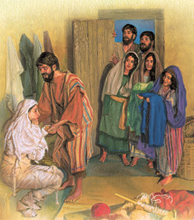
“GOOD WORKS” Types of “good” works:
A. Kalos: Beautiful, valuable, virtuous.
B. Agathos: Beneficial, practical.
Acts 9:36 “Tabitha (Dorcas) …was full of good works
and almsdeeds which she did.”
and all the widows stood by him weeping, and shewing the coats and garments which Dorcas made,
while she was with them.”

Slide 17
Types of “good” works:
B. Agathos: Beneficial, practical.
Eph 2:10 “we are his workmanship, (masterpiece!)
created in Christ Jesus unto good works, which God hath before ordained that we should walk in them.”
1 Tim 2:9-10 “women adorn themselves in modest
apparel… (which becometh women professing
godliness) with good works.”

Slide 18
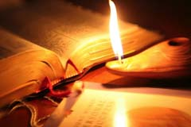
Types of “good” works:
B. Agathos: Beneficial, practical.
2 Tim 3:16-17 “All scripture is given by inspiration of God, and is profitable for doctrine, for reproof, for correction, for instruction in righteousness:
That the man of God may be perfect,
thoroughly furnished unto all good works.”

Slide 19
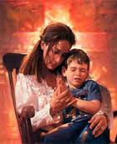
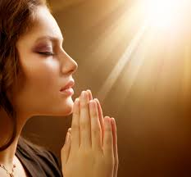
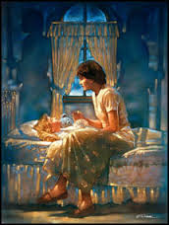
B. Agathos: Beneficial, practical.
1) A requirement for church “widow” support.1 Tim 5:9-10 “Let not a widow be taken into the number under threescore years old, having been the wife of one man,
Well reported of for good works;
if she have brought up children, if she have lodged strangers, if she have washed the saints' feet…relieved the afflicted,
if she have diligently followed every good work.”

Slide 20
Conclusion:
1) “Wicked” Works seem to be the byproduct of:
➔ Pursuing our personal “kingdoms” above
God’s. (Neh. 9:35)
➔Prioritizing our wills above God’s. (Ps. 141:4)
While we may achieve our goals, we’ll lack
true or lasting satisfaction. (Col. 1:19)

Slide 21
Conclusion:
2) “Good” Works seem to be the byproduct of our
choosing to do that which is intrinsically:
➔ Beautiful (Valuable)
Reflecting God’s grace and glory. (Mal. 3:17)
➔ Beneficial (Practical)
Serving God through serving others. (Gal. 5:13)

Slide 22
The Book of “Works” Rev. 20:12
“the dead were judged out of those things which were written in the books…”
“according to their works”
Er’gon: effort, actions, occupation.

Slide 23
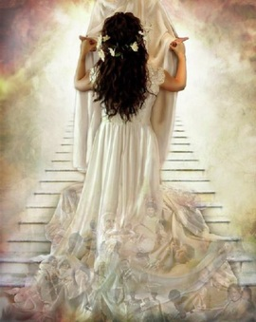
Rev 19:7
“Let us be glad and rejoice, for the marriage of the Lamb is come, and his wife hath made herself ready.
Rev 19:8
“And to her was granted that she should be arrayed in fine linen, clean and white:
for the fine linen is the righteousness of saints.”
Dikai’ōma: righteous works or deeds

Slide 24
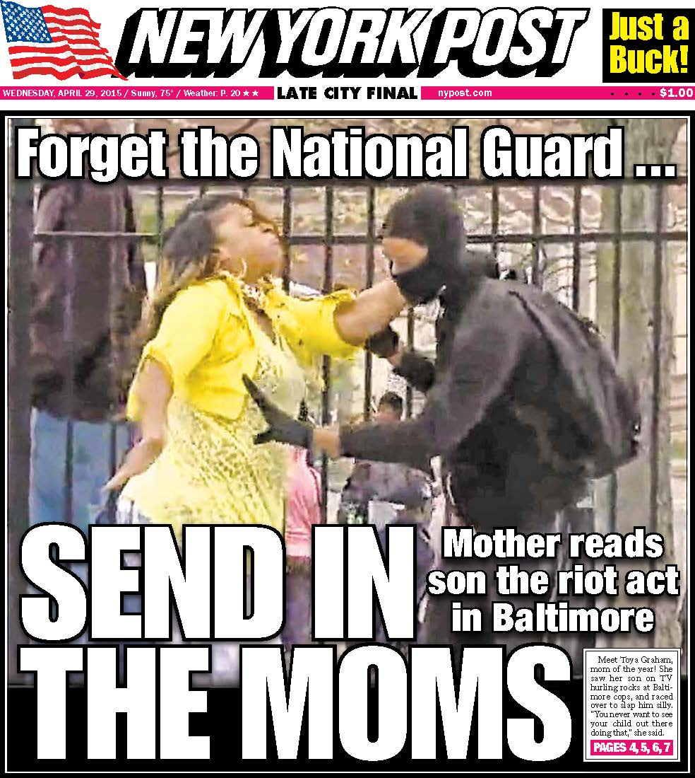
Application:
Who is the first and “natural” teacher of these things?
“The words of king Lemuel… that his mother taught him.
What, my son? and what, the son of my womb?
and what, the son of my vows?
Who Warns against “evil” or “wicked” works!
Give not thy strength unto women, nor thy ways to that which destroyeth kings.
It is not for kings, O Lemuel, it is not for kings to drink wine; nor for princes strong drink: Lest they drink, and forget the law, and pervert the judgment of any of the afflicted.”
Pr. 31:1-5

Slide 25
She Models the value of “good” works.
Pr 31:10“Who can find a virtuous woman?
Ḥayil: a power, strength, force, valor
Comes from ḥîl (khool) to travail, form, to bring forth
This is a very good definition of Motherhood!

Slide 26
Pr. 31:12 ”The heart of her husband doth safely trust in her…
She will do him good, not evil all …of her life.”
Ṭôb: beautiful and beneficial! (Kalos & Agathos)
Pr. 31:30,31 “Favor is deceitful, and beauty is vain:
but a woman that feareth the LORD,
she shall be praised.
Give her of the fruit of her hands;
and let her own works praise her in the gates.”
What (or who) are those?

Slide 27
Models the value of “good” works.
Pr 31:10“Who can find a virtuous woman?
for her price is far above rubies.
If you had to pay someone else to do the work of a Mother for her varying roles, you’d spend
$138,095 per year.
(Salary.com)
Based on 92 hour work week

Slide 28
There’s one other type of “Works” God mentions:
Hebrews 6:1 “repentance from dead works”
“Dead” works are things we do that have no value or impact.
Trying to “work” our way to heaven.
Ro. 10:3; Gal. 2:16; Eph. 2:9; Titus 3:5
“Many will say unto me in that day, Lord, Lord…
but I will say unto them, depart from me
ye that work iniquity”
Mt 7:22,23

Slide 29
There’s one other type of “Works” God mentions:
Hebrews 6:1 “repentance from dead works”
“Dead” works are things we do that have no value
2) Not learning (benefiting) from the “works” of
those who God sends to guide us. Pr 2:17
“Which forsaketh the guide of her youth,
and forgetteth the covenant of her God.”
What a tragedy to waste God’s gift of Mothers!

Slide 30
Book of Works

