Slide 2
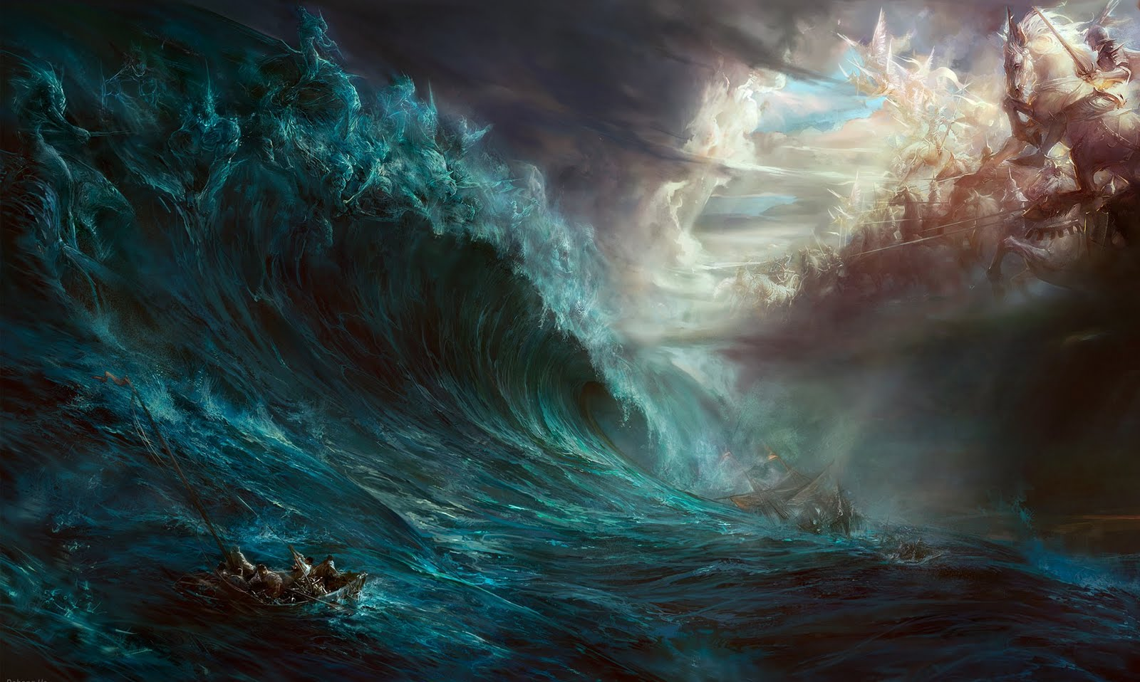
The most epic books or movies portray a battle between the forces of good and evil.

Slide 3
God often describes life in terms of a type of spiritual warfare. (2 Tim. 2:1-10)
As Christians, we are in enemy territory
(2 Cor 4:4; Eph. 2:1-3; 6:10-18; James 4:4; 1 Jn 2:15,16; 5:19; Phil 2:15)
on mission for our King and Commander in Chief.
(Col. 1:13; Phil. 2:13-16; 1 Peter 2:9)
Most are “unaware” of the battle
and therefore unprepared!
But none are unaffected!

Slide 4
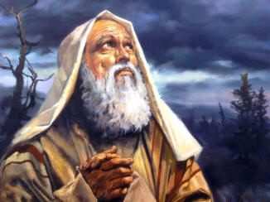
The first time the word “Command” is found in the Bible is in Gen 18:19 where God says of Abraham:
(which means the “Father of a multitude”.)
"For I know him, that he will command his children and his household after him,
and they shall keep the way of the LORD …;
that the LORD may bring upon Abraham that which he hath spoken”
(aka: Bless Him
and his descendants)

Slide 5
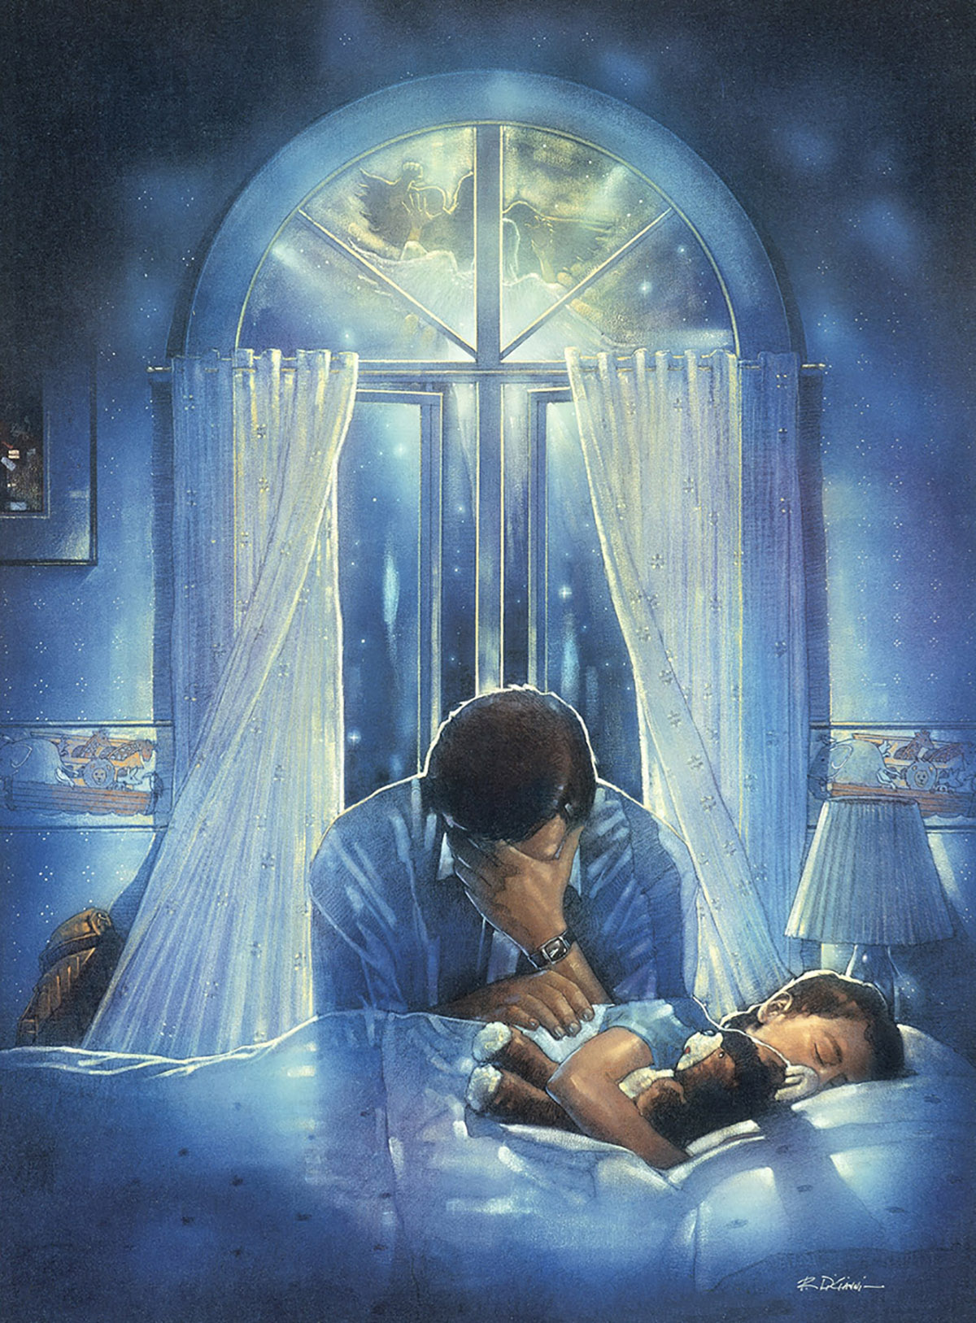
God has commissioned the Father to act as the “Point Man” in this spiritual battle,
With the responsibility to safely lead his family.

Slide 6
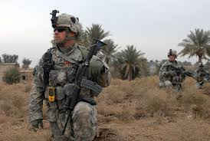
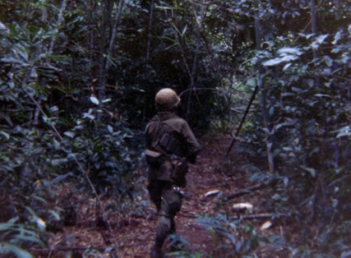
The Point Man is a military term describing the soldier who’s responsible for leading his unit through hostile or unsecured territory.

Slide 7
The danger is far more significant than safely navigating the jungles or deserts of a distant country.
We face an enemy that is infinitely more dangerous
and our success or failure has
eternal implications.
How do we succeed in our God given mission to safely lead our family “units” safely through this hostile world?

Slide 8
Accept your Responsibility!
A. To lead.
Eph 5:23 “For the husband is the head of the wife, even as
Christ is the head of the church, and he is the savior
(sōtēr’: protector, deliver) of the body…”
1 Thes 2:11-12 “We exhorted and comforted and charged
every one of you, as a father doth his children,
That ye would walk worthy of God, who hath
called you unto his kingdom and glory.”

Slide 9
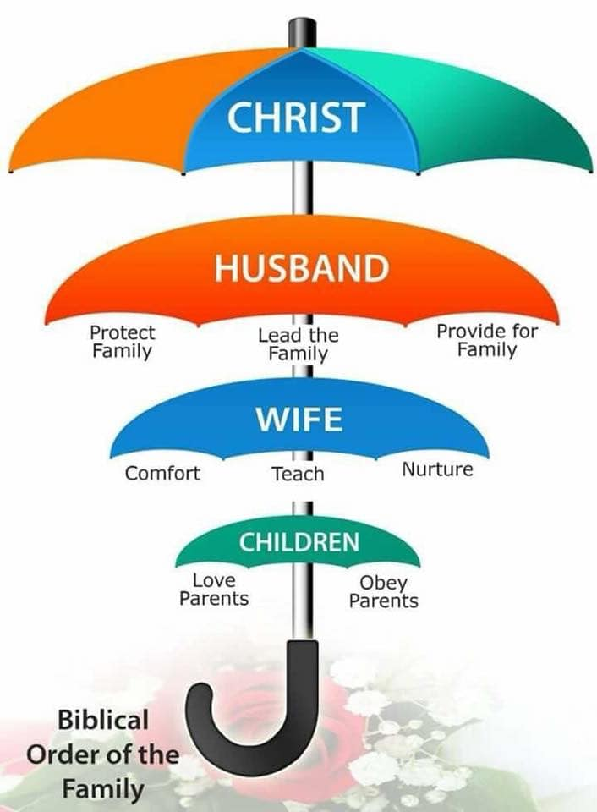
“While unpopular these days this is still Gods order”
The Replies to this face book post were alarming,
from both men and women.
1 Cor 11:3 “I would have you know that
the head of every man is Christ;
and the head of the woman is the man;
and the head of Christ is God.”
Eph 6:1,2 “Children, obey your parents
in the Lord: for this is right.
Honor thy father and mother…”

Slide 10
Don’t let your sin and shame stop you from leading your family.
They don’t need a perfect father.
They need a dad who can lead them
to know the Perfect Heavenly Father.

Slide 11
Accept your Responsibility!
B. To Love Ephesians 5:25
“Husbands, love your wives, even as Christ also loved the church, and gave himself for it;…
29 nourish and cherish,
even as the Lord the church:”
Eph 6:4 “fathers, provoke not your children to wrath:
but bring them up (ektrephō: to train, mature)
in the nurture and admonition of the Lord.”

Slide 12
If you don’t lead and love;
someone else will!

Slide 13
2. KNOW YOUR ENEMY! (Eph. 6:12)
“For we wrestle not against flesh and blood,
but against principalities, against powers, against the rulers of the darkness of this world, against spiritual wickedness in high places.”
A. Satan is the master and inventor of “Divide and Conquer.”

Slide 14
1. KNOW YOUR ENEMY! (Eph. 6:12)
A. Satan is the master of “Divide and Conquer.”
1) He seeks to divide the Family
(Spiritually, Emotionally, or Physically)
so as to leave them increasingly isolated
and therefore vulnerable to his attacks.
Mt 12:25 “every house divided against itself
shall not stand!”

Slide 15
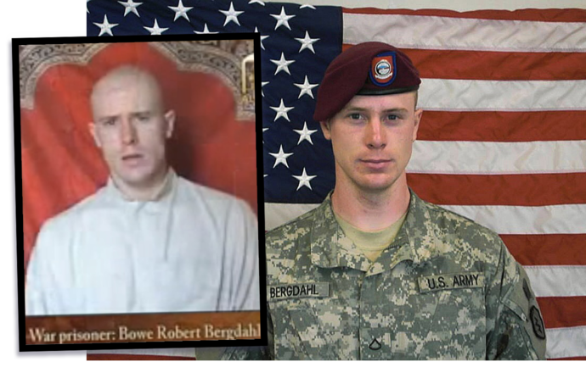
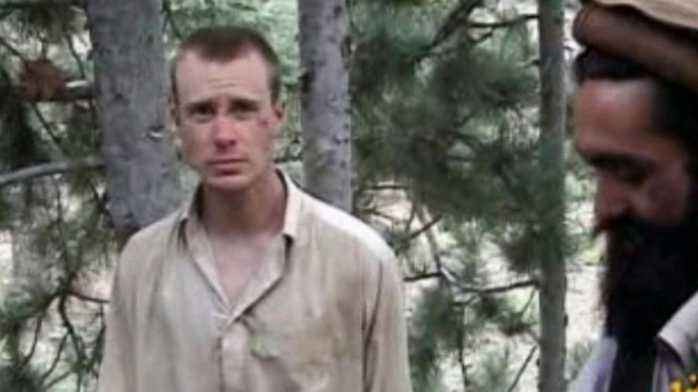
A. Satan is The master of Divide & Conquer!
B. In times of intense warfare:
1) Sometimes soldiers desert their point man to
find their own way, often resulting in their getting
ambushed & captured by the enemy.
a) In much the same way, family members can rebel
against the leadership of God’s Point Man
and end up a casualty of spiritual warfare.
(Sgt. Bowe Bergdahl)

Slide 16
Satan: The master of Divide and Conquer!
B. In times of intense warfare:
2) Sometimes Point Men (leaders) go AWOL,
leaving their families vulnerable to attack.
Mark 3:27 “No man can enter into a strong man's house, and spoil his goods, except he will first bind the strong man,
and then he will spoil
his house.”
See also 2 Tim. 2:4

Slide 17
A. Satan: The master of Divide and Conquer!
B. In times of intense warfare:
3) Sometimes the Point Men (Fathers) are
simply careless and lead their family “unit”
into danger. 1 Timothy 4:16
“Take heed unto thyself, and unto the doctrine; for in doing this thou shalt both save thyself,
and them that hear thee.”

Slide 18
At all times, the point man is the easiest target and will come under the greatest enemy fire!
Point Men (leaders) are under attack!
The most dangerous source of attack is from those in their own unit who are
(knowingly or unknowingly)
cooperating with the enemy!

Slide 19
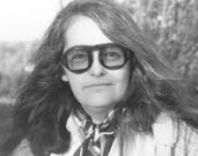
There are many forces at work seeking to sabotage the Father and Family.
Examples of some not so “friendly” fire include:
In a NYC home in the 60’s N.O.W. was conceived..
Dr. Kate Millett, 1st Chairwoman of NOW, Author “Sexual Politics”

Slide 20
Early meetings included the following “catechism”:
“Why are we here today?”
“To make revolution!”
“What kind of revolution?”
“The Cultural Revolution!”
“And how do we make Cultural Revolution?”
“By destroying the American family!”
“How do we destroy the family?”
“By destroying the American Patriarch!” (Father)

Slide 21
“And how do we destroy the American Patriarch?”
“By taking away his power!”
“How do we do that?”
“By destroying monogamy!” they shouted.
“How can we destroy monogamy?”
“By promoting promiscuity, eroticism, prostitution
and homosexuality!” they resounded.
Source: Marxist Feminism’s Ruined Lives. Mallory Millet (sister of Kate Millet) /www.frontpagemag.com/2014/mallorymillett/marxist-feminisms-ruined-lives/

Slide 22
These types of societal attacks on manhood has caused most men to withdraw into confusion and/or cowardness,
With devastating results!

Slide 23
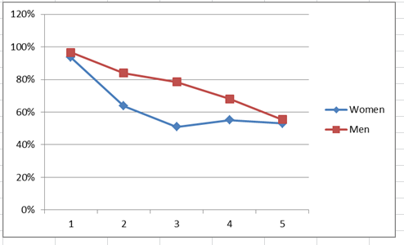
In 1st. Marriage x Sexual Partners

Slide 24
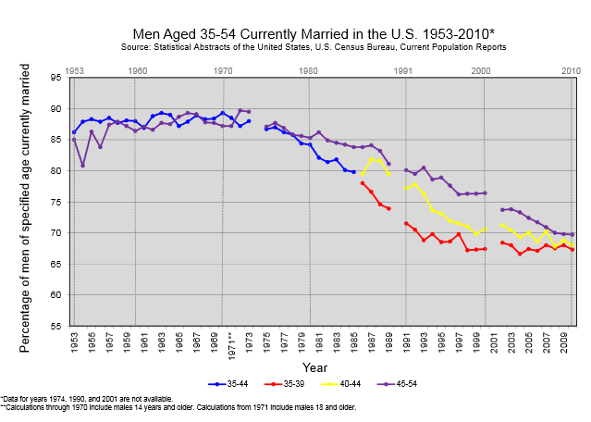

Slide 25
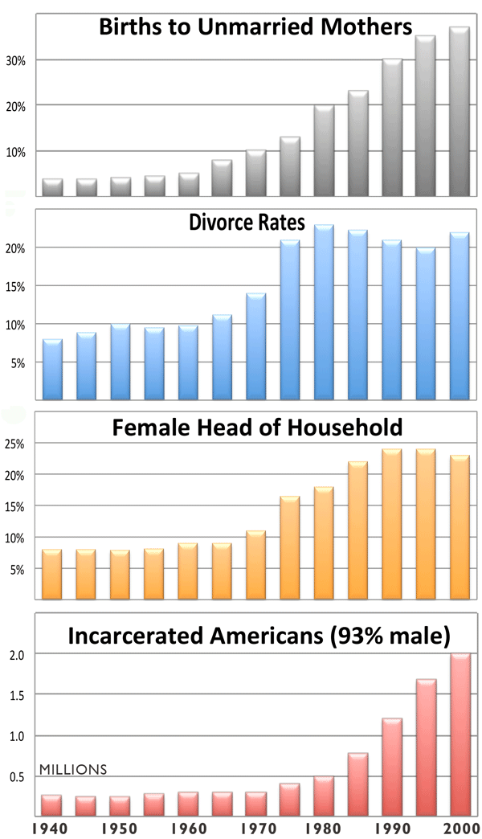

Slide 26
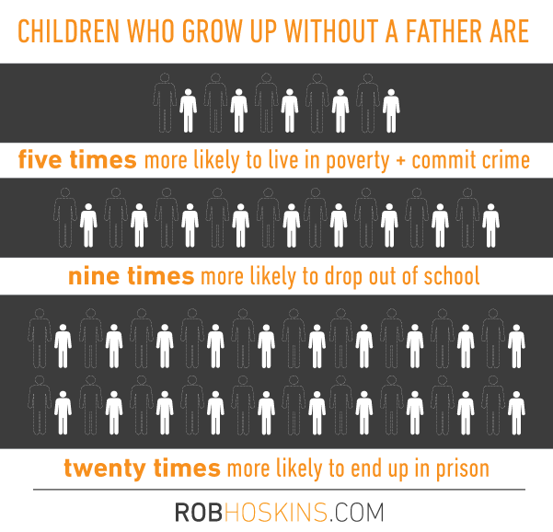

Slide 27
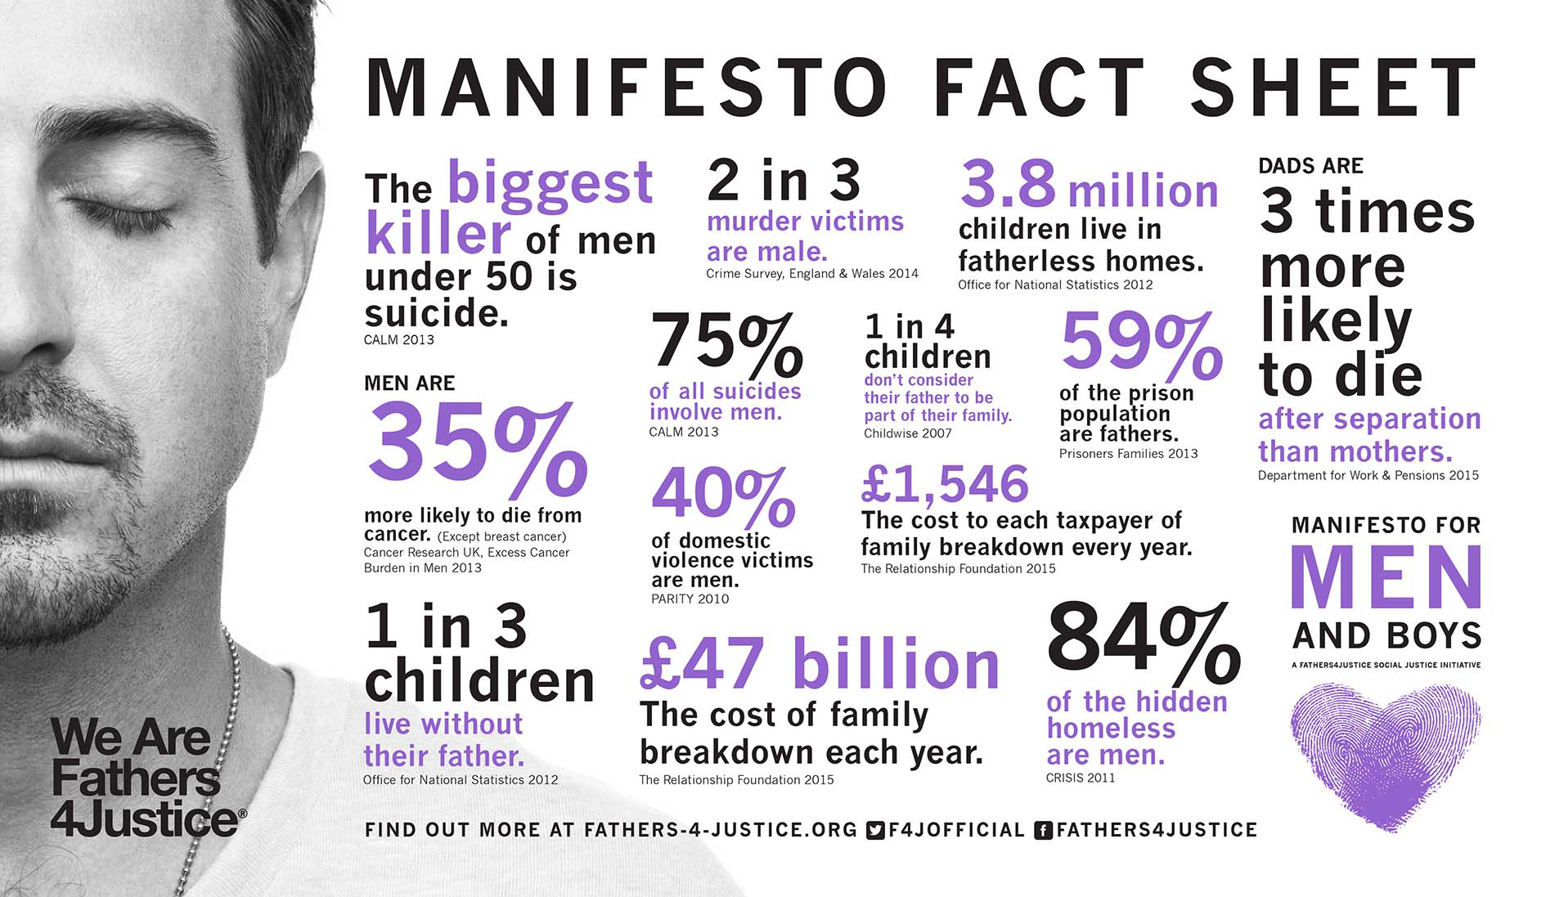

Slide 29
You are God’s “Point man”!
The real question is where
Are you leading them?

Slide 30
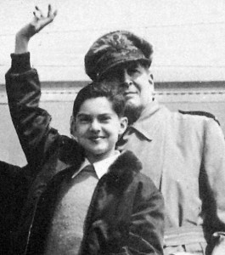
Conclusion: In June 1942, General Douglas MacArthur was named the “National Father of the Year”.
“By profession, I am a soldier and take pride in that fact.
But I am infinitely prouder to be a father….
And While the hordes of death are mighty,
the battalions of life are mightier still!
It is my hope that my son, when I am gone,
will remember me, not for the battle (WW2),
but in the home repeating with him our daily
prayer to “Our Father who art in heaven…”

Slide 31
Here’s a Prayer written by Him.
“Build me a son, O Lord, who will be strong enough to know when he is weak, brave enough to face himself when he is afraid,
one who will be proud and unbending in honest defeat,
and humble and gentle in victory.
Build me a son whose wishes will not take the place of deeds;
a son who will know Thee —
and that to know himself is the foundation stone of knowledge.
Lead him, I pray, not in the path of ease and comfort,
but under the stress and spur of difficulties and challenge.
Here let him learn to stand up in the storm;
here let him learn compassion for those who fail …”

Slide 32
“Build me a son whose heart will be clear, whose goal will be high; a son who will master himself before he seeks to master other men; one who will reach into the future, yet never forget the past.
And after all these things are his, add, I pray, enough of sense of humor, so that he may always be serious,
yet never take himself too seriously.
Give him humility, so that he may always remember the simplicity of true greatness, the open mind of true wisdom,
and the meekness of true strength.
Then, I, his father, will dare to whisper,
‘I have not lived in vain.'”

Slide 33
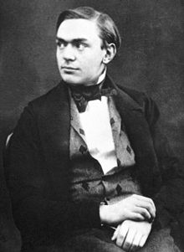
Alfred Nobel was a Swedish chemist who invented Dynamite (1867) at the age of 32.
He hoped and wrote that:
“My dynamite will lead to peace…”
In 1888 he picked up a French Newspaper and was shocked to read his own obituary.
Instead of referencing his 335 different inventions,
The newspaper obituary actually described him as:
“The merchant of death!”
He purposed to change his legacy, leaving 94% of his wealth to creating the foundation we know of as the “Nobel Peace Prize”.
(It was actually his brother who died)

Slide 34
2. Recognize the real Enemy
How can we “change” our legacy?
1. Accept our God-given Responsibility
Get equipped by cultivating the
qualities necessary to safely and
successfully lead your family.

Slide 35
P:
O:
I:
N:
M:
A:
N:
T:

