Slide 1
God has commissioned the Father to act as the “Point Man” in the spiritual battle for the hearts and souls of his family “unit”.

Slide 2
3. Get Equipped for the battle Eph. 6:10-18
How to be an effective “Point Man”
Accept your Responsibility Eph. 5,6
2. Know your enemy Eph. 6:12.

Slide 3
P:
O:
I:
N:
M:
A:
N:
T:

Slide 4
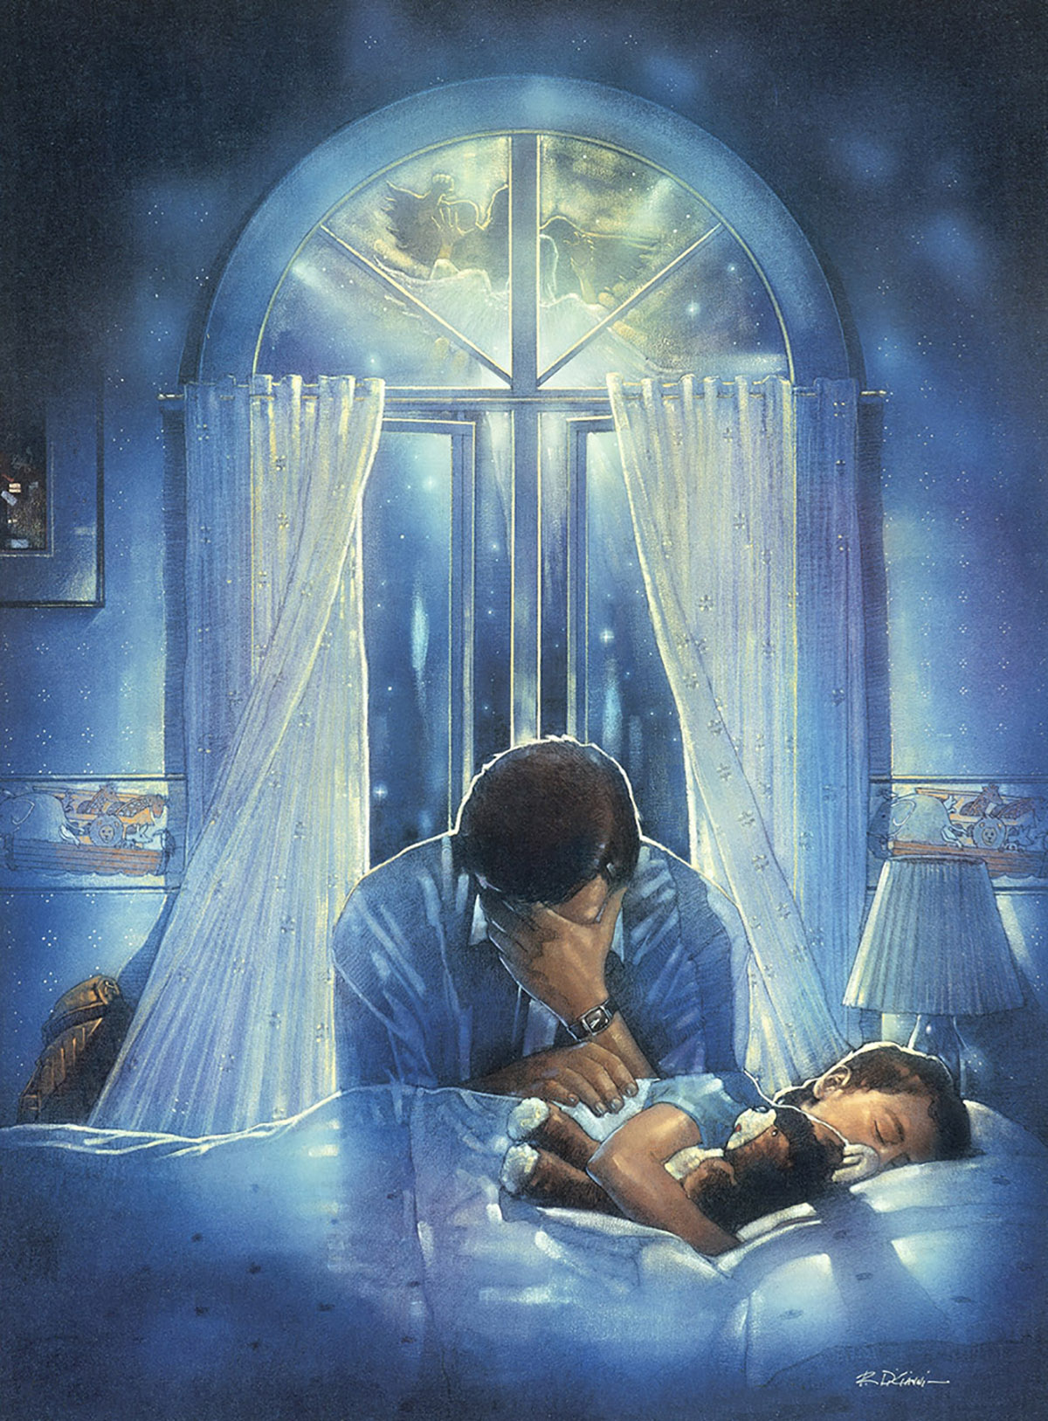
“P” for 1. Prayerful. Lk 18:1
“men ought always to pray, Proseuch’omai:
Pros (Toward)
euchomai: Focus, Worship, Request
and not to faint” ekkake’ō: weak, quit, fail.
Philippians 4:13
“I can do all things through Christ
which strengtheneth me.”

Slide 5
2. Provider 1 Timothy 5:8
P:
“if any provide not for his own,
and specially for those of his own house,
he hath denied the faith,
and is worse than an infidel.”
Said no woman… EVER!

Slide 6
3. Protector Mt. 12:29
P:
“first bind the strong man,
and then he will spoil his house”.
1 Pt 3:7 “husbands, dwell with them according to knowledge,
giving honor unto the wife,
as unto the
weaker vessel…”

Slide 7
4. Patient James 1:19-20
P:
“let every man be swift to hear, slow to speak, slow to wrath:
For the wrath of man worketh not the righteousness of God.”

Slide 8
5. Perseverance Ro. 12:11,12
P:
“Endure hardness as a good soldier of Jesus Christ…”
2 Tim. 2:3
“Not slothful in business; fervent in spirit; serving the Lord;
Rejoicing in hope; patient in tribulation; continuing instant in prayer”
Hypomen’ō: (Hupo) under & Meno: persevere, to remain
1 Cor 13:7 (love) ”Beareth all things, believeth all things, hopeth all things,
endureth all things.”

Slide 9
6. Partner 1 Pt 3:7
P:
“husbands, dwell with them according to knowledge, giving honor unto the wife,
as unto the weaker vessel,
and as being heirs together of the grace of life;
that your prayers be not hindered.”
See also 1 Cor. 11:1-12

Slide 10
P:
7. Patterned after Jesus
Ephesians 5:25,28
“Husbands, love your wives, even as Christ also
loved the church,
So ought men to love their wives ….”
and gave himself for it…

Slide 11
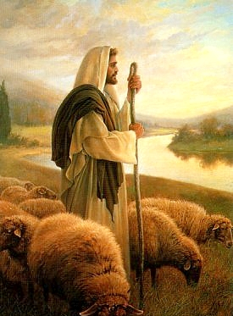
8. PERCEPTIVE
The Term “Bishop” in the NT is Episkopē’
Epi: after or over and skopos: to inspect or look.
It literally means to look out for or to look after!
That’s the Pastor’s (Shepherd’s) Job!
“feed the flock of God…,
taking the oversight thereof”
1 Peter 5:2; Acts 20:28
It’s also the Father’s Job!

Slide 12
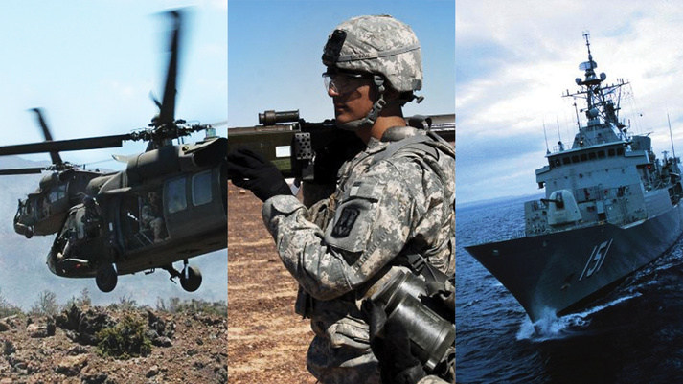
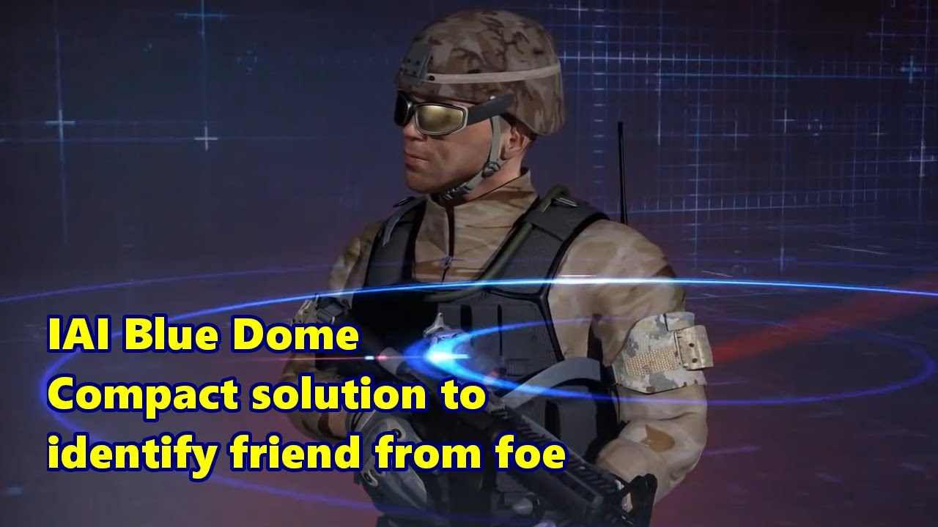
8. P: PERCEPTIVE
A. What should the point man “look out” for?
Danger from your surroundings. 2 Tim. 2:22
“that they may recover themselves out of the snare of the devil,
who are taken captive by him at his will.”
a) Military uses special equipment to
“Identify Friends or Foes” (IFF system)
What if it fails to work?
Or we ignore it?
Mt. 7:15 “Beware of false prophets which come to you in sheep’s clothing…”

Slide 13
P: PERCEPTIVE
A. What should the point man “look out” for?
2) Distractions 2 Tim. 2:4 “No man that warreth
entangleth himself with the affairs of this life
that he may please him who hath chosen him to be a soldier”
Mk 4:19 “the cares of this world, and the deceitfulness of riches, and the lusts of other things entering in,
choke (sympnig’ō: crowd, strangle) the word,
(and the relationship)
and it becometh unfruitful.”

Slide 14
A. What should the point man “look out” for?
3) The condition of your (family) Unit.
Proverbs 27:23 “Be thou diligent (yada) to know (yada)
the state of thy flocks, and look well to thy herds.”
Heb. 3:12-13 “Take heed, brethren, lest there be in any of you
an evil heart of unbelief, in departing from the living God.
But exhort one another daily…; lest any of you be hardened through the deceitfulness of sin.”
Heb. 10:23-24 “Let us consider one another…”
We all occasionally need a “Family Intervention!”

Slide 15
P: PERCEPTIVE
3) The condition of your (family) Unit.
(Strengths, Weaknesses, Abilities & Vulnerabilities)
1 Peter 3:7 “Likewise, ye husbands, dwell with them
according to knowledge (gnosis: understanding)
giving honor… as unto the weaker vessel”
What happens if you push your unit beyond their ability?
1 Tim. 6:3 “Fathers…provoke not your children to wrath..”

Slide 16
P: PERCEPTION
4) Of your enemy.
(An awareness of the tactics used by the enemy.)
1 Peter 5:8 “Be sober, be vigilant because your
adversary the devil…seeks whom he can devour…”
2 Cor 2:11 "Lest Satan should get an advantage of us:
for we are not ignorant of his devices.“
Rev 12:12 “Woe to the inhabitants of the earth!
For the devil is come down unto you, having great wrath,
because he knows that he hath but a short time.”

Slide 17
Isaiah 21:6, 11,12; Ezek. 3:17-19; 33:1-9 all speak of God appointing “watchman”.
Ez. 33:7 “So thou, man, I have set thee a watchman;
therefore thou shalt hear the word at my mouth,
and warn them from me.”

Slide 18
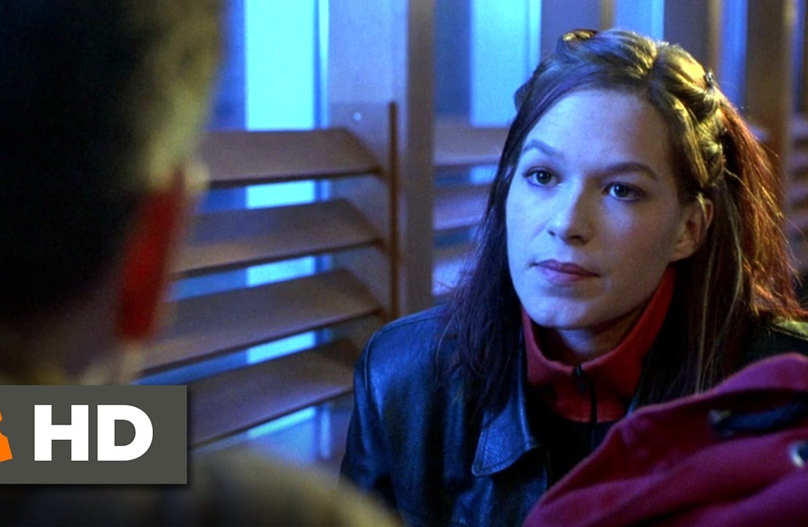
P: PERCEPTION
“I don’t understand why,
but I notice everything!”
Mat Damon
Of course this is a work of fiction,
But the fact is that Point men
who lack perception usually end up
leading their units into an ambush!

Slide 19
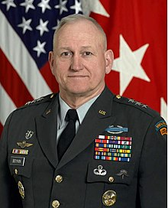
General Bill Boykin: Army Delta Force Commander,
Undersecretary of Defense for Intelligence for President Bush (2002 to 2007)
Currently Vice President of Family Research Council.
“Only 17% of Millennials (1982-2004)
are eligible for U.S. Military service!”
They can’t meet the standards!
(in spite of lowering them!!!)
What does this mean to the defense readiness of America?

Slide 20
Where are you most vulnerable? (1 Cor. 11:28)
Prayerful? ____
Providing? ____
Protecting? ____
Patient? ____
Persevering? ____
Partnering with your spouse? ____
Patterning your life after Christ? ____
Perceptive? ____
Will you purpose to prepare?

Slide 21
2 Tim. 2 opens with a challenge form men to be
“be strong in the grace that is in Christ Jesus. ² And the things that thou hast heard of me among many witnesses, the same commit thou to faithful men,
who shall be able to teach others also. ³ Thou therefore endure hardness, as a good soldier of Jesus. ⁴ No man that warreth entangles himself with the affairs of this life; that he may please him who hath chosen him to be a soldier. ⁵ And if a man also strive for masteries,
yet is he not crowned, except he strive lawfully.
The husbandman that laboureth
must be first partaker of the fruits.”

Slide 22
And closes with:
And the servant of the Lord must not strive;
but be gentle unto all men, apt to teach, patient,
25 In meekness instructing those that oppose themselves; if God peradventure will give them repentance to the acknowledging of the truth;
And that they may recover themselves
out of the snare of the devil,
who are taken captive by him at his will.”

Slide 23
Far too many men are spiritual prisoners of war in this spiritual battle that rages around us,
leaving their families vulnerable to Satan’s snares.
Malachi 4 (the last chapter of the Old Testament)
is about the last days. It closes with:
“he shall turn the heart of the fathers to the children, and the heart of the children to their fathers,
lest I come and smite the earth with a curse.”
Malachi 4:6

Slide 24
“And I sought for a man among them, that should make up the hedge, and stand in the gap before me for the land, that I should not destroy it:
but I found none!”
Will he find such a man in you?
Notes:
but I found none.”

