Slide 1
God has commissioned the Father to act as the “Point Man” in the spiritual battle for the hearts and souls of his family “unit”.

Slide 2
3. Get Equipped for the battle Eph. 6:10-18
To be an effective “Point Man” you must:
1. Accept your Responsibility Eph. 5,6
2. Know your enemy Eph. 6:12.

Slide 3
“In our society where masculinity is borderline a crime it is critical for the "point men" in our lives to remember they are indeed,
Their leadership and guidance
(with the Spirit of God driving them)
Is both NEEDED and IMPORTANT!”
Important!
Mt 12:29 “…first bind the strong man?
and then he will spoil his house.

Slide 4
How to be an effective “Point Man”
P:
P:
Prayerful…Provider…Protector
Patient…Persevering…Partner
Patterned after Jesus…
Perceptive.

Slide 5
How to be an effective “Point Man”
P:
O:
Observant (Aware, committed)
Open (honest) …Optimistic (courageous)
Obedient (to God)
Objective (Focused, Mission Minded!)

Slide 6
I: Inspires
P:

Slide 7
Inspires by being:
Intentional
2 Tim 2:4 “No man that warreth entangleth himself
…that he may please him who called him…”
A. Where are we (supposed to be) going?
“If the leader doesn’t know where he’s going,
it produces insecurity in those who follow him. (Pr. 29:18)
B. How can we safely lead them there?
(Ps 16:11; Pr. 3:5,6)
(Purposeful, deliberate!)

Slide 8
Inspires by being:
Intentional (Purposeful, deliberate)
Heb. 12:1,2 “we’re compassed with …witnesses, let us lay aside every weight, (onkos: hindrance)
and the sin (Harmati’a: offence, trespass)
which does so easily beset us…”
(Euperis’tatos: competes, distracts, thwarts)
(from hamartan’ō: to miss the mark)

Slide 9
Inspire by being…1. Intentional
2 Tim 4:7-9 “I have fought a good fight,
I have finished my course, I have kept the faith:
Henceforth there is laid up for me a crown of righteousness, which the Lord, the righteous judge, shall give me at that day:
and not to me only, but unto all them also that love his appearing.”
(See also Mt 6:19-34; 1 Cor 3, 9; Col. 3; Phil 3)
(See 1 Cor. 5:10)

Slide 10
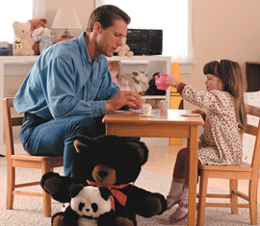
Inspires by being:
2. Involved! In order to be involve we must:
A. Be Interested. 1 Cor 13:5 “seeketh not her own”
1) Love always pursues!
B. Take Initiative John 13:17
“If ye know these things,
happy are ye if ye do them.”
Makarios: supremely blessed.

Slide 11
In order to be involved we must:
C. Be Intimate
“Deeply or closely personal; Familiar! Detailed or deep knowledge of. Close union or combination of parts.”
See 1Corinthians 12:26-27
John 15:15 “Henceforth I call you not servants;
for the servant knoweth not what his lord doeth:
but I have called you friends; for all things that I have heard of my Father I have made known to you.”

Slide 12
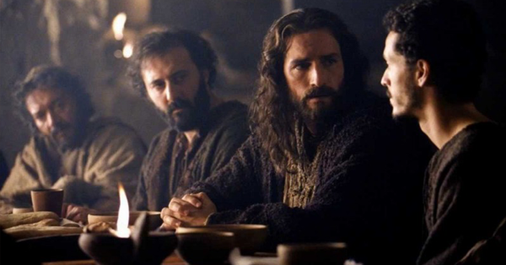
“He that hath my commandments, and keepeth them,
he it is that loveth me:
and he that loveth me shall be loved of my Father,
and I will love him,
and will manifest
myself to him”
John 14:21

Slide 13
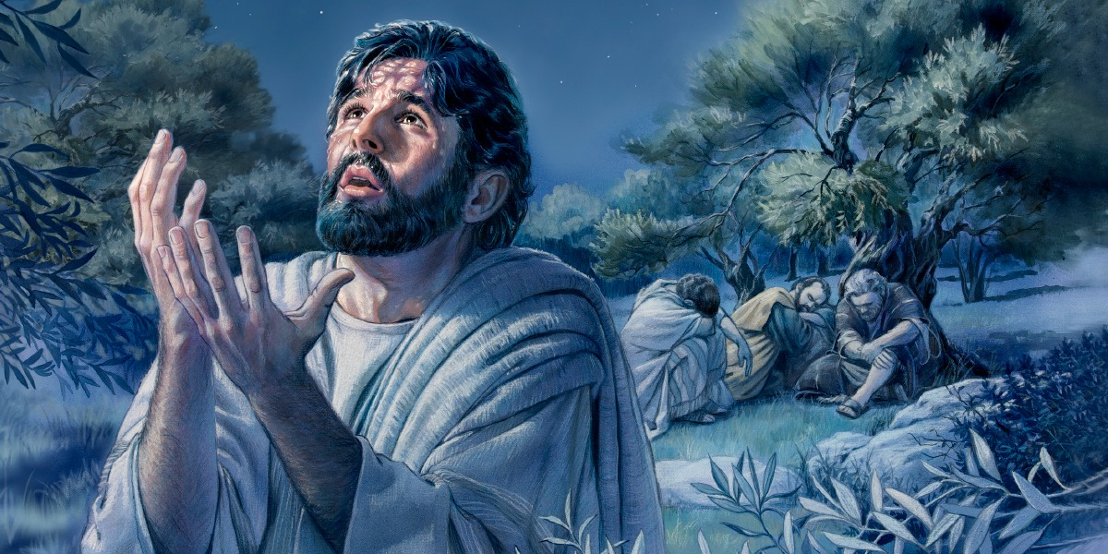
Intimacy requires vulnerability
“My soul is exceeding sorrowful, even unto death: tarry ye here,
and watch
with me.”
Matthew 26:38

Slide 14
In order to Inspire we must:
Be Intentional 2. Be Involved
3. Model personal Integrity Pr. 20:7
"The just man walketh in his integrity:
תֹּם‎ (Tom) upright; complete
his children are blessed after him."

Slide 15
In order to Inspire we must:
3. Model personal Integrity Pro 11:3
“The integrity of the upright shall guide them:
‏תֻּמָּה‎ (tummâ’) innocence
(From Tom: Upright, Complete)
but the perverseness of transgressors
shall destroy them.”

Slide 16
3. Model personal Integrity
King David “fed them according to the
integrity of his heart;
and guided them by the
skilfulness of his hands.”
Ps 78:72

Slide 17
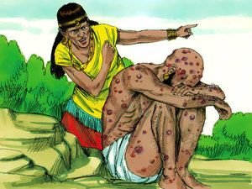
3. Model personal Integrity
A. Integrity involves:
1) Our Tongues. (What we say!) Job 2:9
“Dost thou still retain
thine integrity?
Curse God and die!”
Ps 141:3 “Set a watch, LORD, before my mouth;
keep the door of my lips.”

Slide 18
A. Integrity involves:
2) Our Track record. (What we do) Ps 26:1
“Judge me, O LORD; for I have walked in mine integrity: I have trusted also in the LORD;
therefore I shall not slide.”
Are your Words and your “Walk”
sending the same message?

Slide 19
A. Integrity involves:
2) Our Track record. (What we do)
Heb. 13:17 “Remember them that have
the rule over you,
Who have spoken to you the word of God,
whose faith follow,
Considering the end of their conversation.”
Anastrophē’: behavior
Hēge’omai: lead, command

Slide 20
A. Integrity involves:
3) Our Trustworthiness. Gen 18:19
“For I know him, that he will command his children and his household after him,
And they shall keep the way of the Lord to do justice and judgment,
that the Lord may bring upon Abraham
that which He hath spoken”

Slide 21
A. Integrity involves:
3) Our Trustworthiness.
We spend a lot of time wondering if we can really trust God?
I wonder how much time he spends wondering if He can really trust us?

Slide 22
Point men Inspire!
What does it really mean to “Inspire”:
1) To motivate.
2) To breathe in.
From the Latin: inspirer’e:
Originally used of a divine or supernatural being,
in the sense ‘impart a truth / idea to someone’.
“In Spirit”

Slide 23
God’s Spirit in you gives you:
The clarity to follow Him. (Jn 16:13; Ps. 16:11)
The confidence to lead others. (Phil. 2:13)
Ph 3:13-15 “forgetting those thing which are behind and reaching forth unto those things which are before.
I press toward the mark for the prize of the high calling of God in Christ Jesus.
Let us therefore, as many as be perfect,(telios: complete)
be thus minded:”

Slide 24
God inspires you so that
you can inspire others!
Phil. 3:17-20 "be followers together of me, and mark them which walk so as ye have us for an ensample.
For many walk, of whom I have told you often, and now …even weeping, that they are the enemies of …Christ:
Whose end is destruction, whose God is their belly, and whose glory is in their shame,
For our conversation is in heaven; from whence also we look for the Savior, the Lord Jesus Christ:”
who mind earthly things.

Slide 25
Can your family and friends follow you with the confidence to know that you’ll lead them toward
“the high calling of God in Christ Jesus”?

