Slide 1
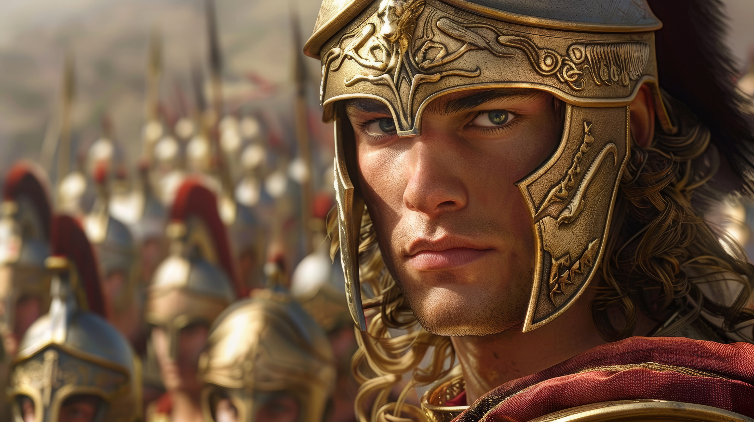
עִלָּיָא דִּֽי־שַׁלִּ֤יט
By Joseph Peters

Slide 2
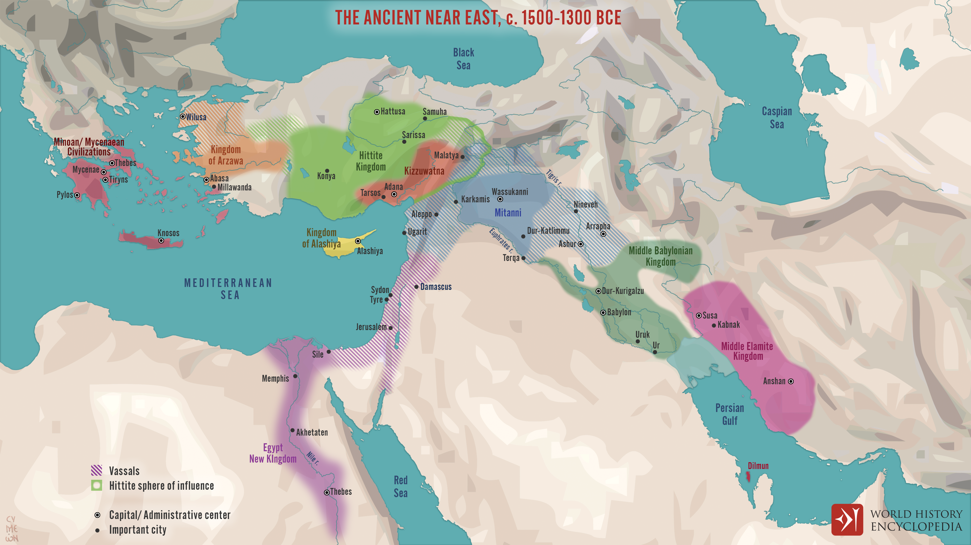

Slide 3
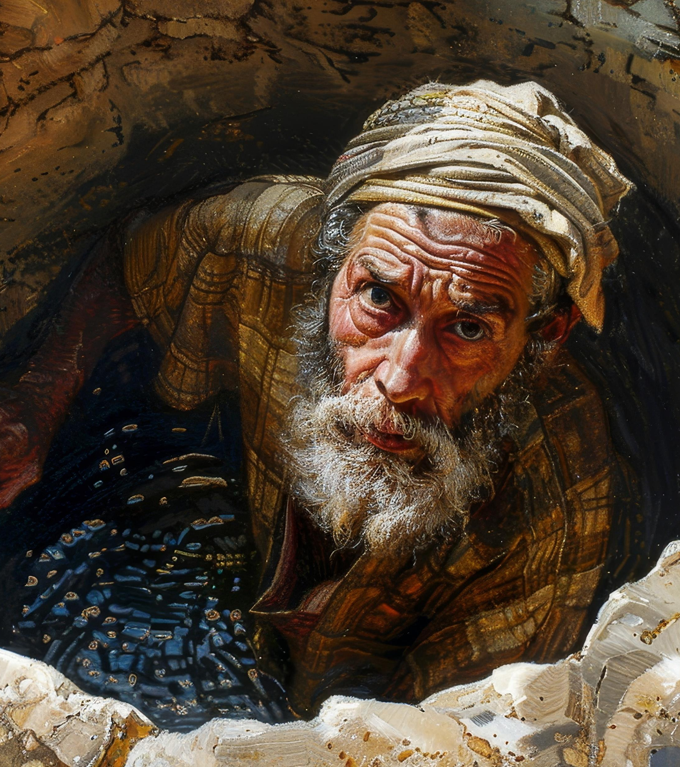
Jeremiah
11 Now Nebuchadrezzar king of Babylon gave charge concerning Jeremiah to Nebuzar-adan the captain of the guard, saying, Take him, and look well to him, and do him no harm; but do unto him even as he shall say unto thee.
Even they sent, and took Jeremiah out of the court of the prison (Jer. 39:11–12, 14a).

Slide 4
Objective
Everyone Should Trust that God is in Control
Because of These Three Examples

Slide 5
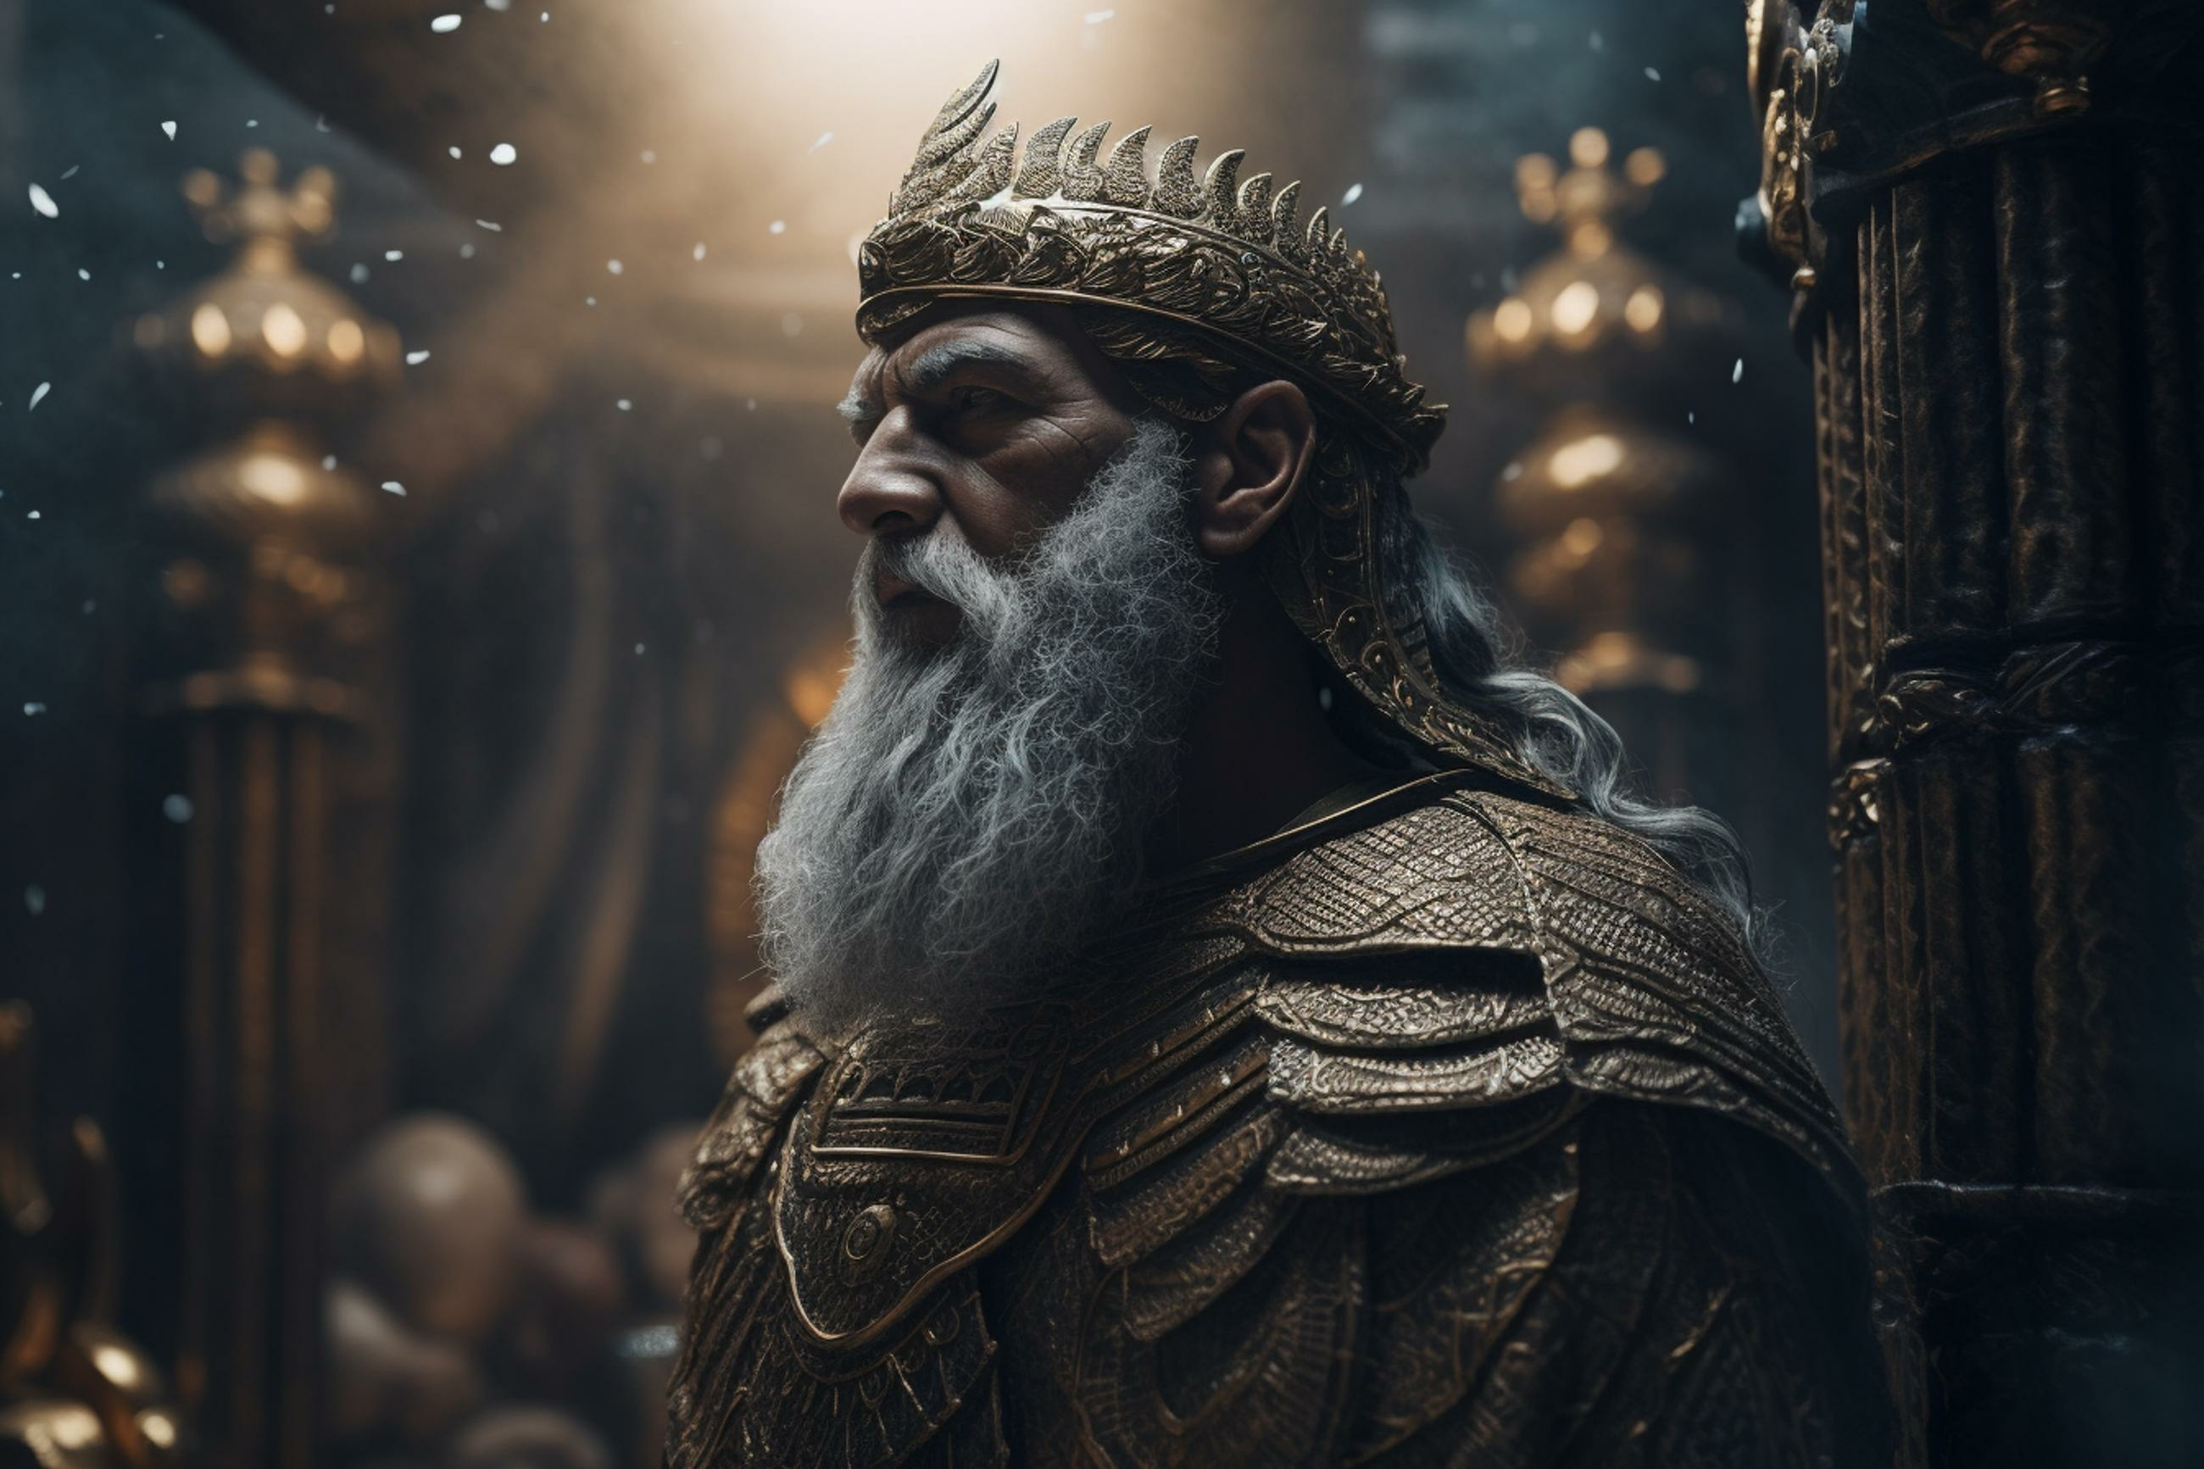
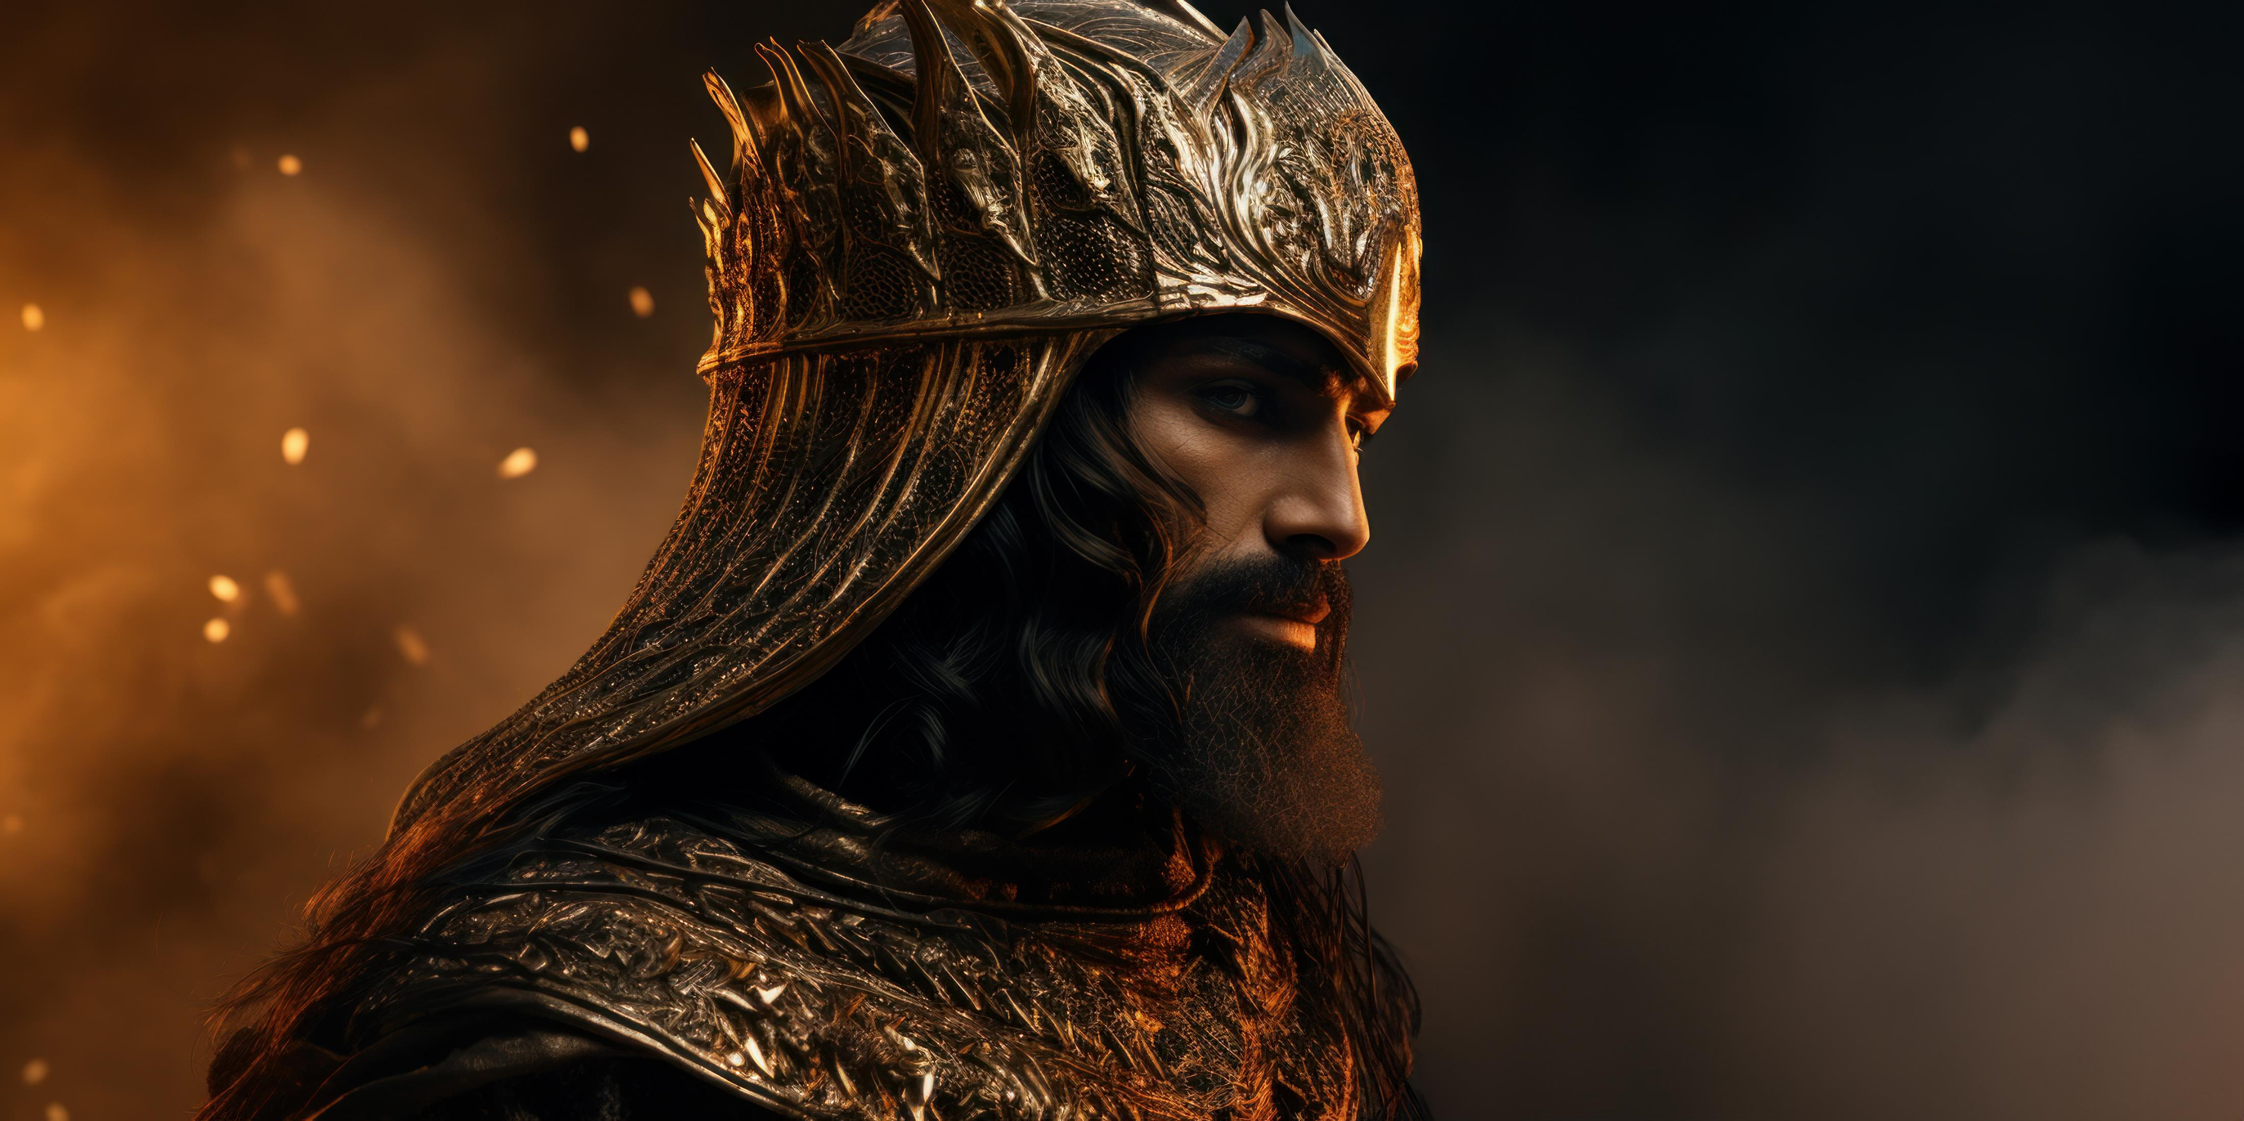
Rationale
God’s Control over Babylon
God’s Control over Medio-Persia
God’s Control over Greece

Slide 6
God’s Control over Babylon

Slide 7
Nebuchadnezzar’s Rise to Power
IN the third year of the reign of Jehoiakim king of Judah came Nebuchadnezzar king of Babylon unto Jerusalem, and besieged it. And the Lord gave Jehoiakim king of Judah into his hand…
And the king spake unto Ashpenaz the master of his eunuchs, that he should bring certain of the children of Israel, and of the king’s seed, and of the princes; (Dan. 1:1-2a, 3a)

Slide 8
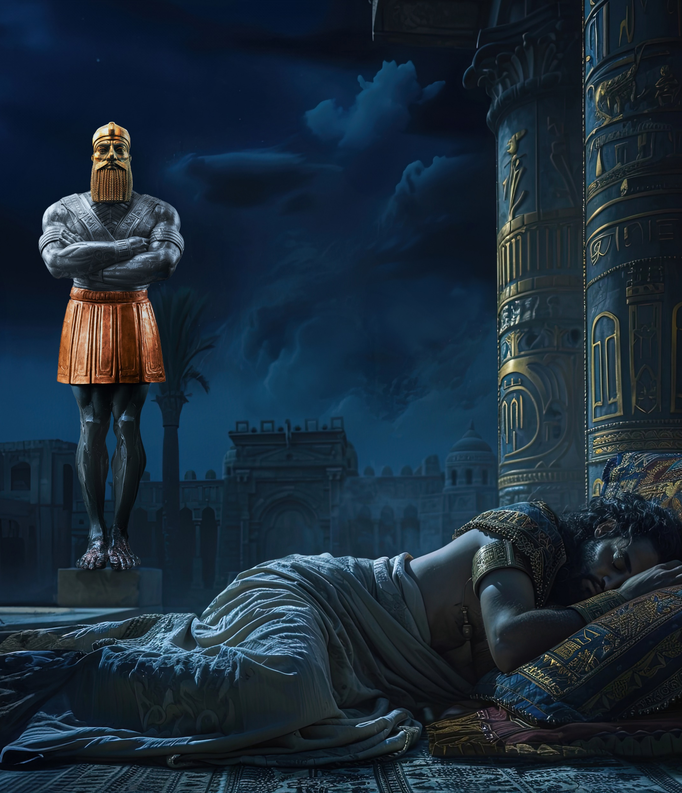
Nebuchadnezzar’s Dream
Image’s head was of fine gold, his breast and his arms of silver, his belly and his thighs of brass, His legs of iron, his feet part of iron and part of clay. Thou sawest till that a stone was cut out without hands, which smote the image upon his feet that were of iron and clay, and brake them to pieces. (Dan. 2:31–35.)

Slide 9
Nebuchadnezzar’s Pride and Fall
At the end of twelve months he walked in the palace of the kingdom of Babylon. The king spake, and said, Is not this great Babylon, that I have built for the house of the kingdom by the might of my power, and for the honour of my majesty? While the word was in the king’s mouth, there fell a voice from heaven, saying, O king Nebuchadnezzar, to thee it is spoken; The kingdom is departed from thee. And they shall drive thee from men, and thy dwelling shall be with the beasts of the field: they shall make thee to eat grass as oxen, and seven times shall pass over thee, until thou know that the most High ruleth in the kingdom of men, and giveth it to whomsoever he will. (Dan 4:29–32).

Slide 10
Nebuchadnezzar’s Humility and Restoration
And at the end of the days I Nebuchadnezzar lifted up mine eyes unto heaven, and mine understanding returned unto me, and I blessed the most High, and I praised and honoured him that liveth for ever, whose dominion is an everlasting dominion, and his kingdom is from generation to generation: And all the inhabitants of the earth are reputed as nothing: and he doeth according to his will in the army of heaven, and among the inhabitants of the earth: and none can stay his hand, or say unto him, What doest thou?
Da 4:34–35.

Slide 11
Nebuchadnezzar’s Humility and Restoration
At the same time my reason returned unto me; and for the glory of my kingdom, mine honour and brightness returned unto me; and my counsellers and my lords sought unto me; and I was established in my kingdom, and excellent majesty was added unto me. Now I Nebuchadnezzar praise and extol and honour the King of heaven, all whose works are truth, and his ways judgment: and those that walk in pride he is able to abase.
Da 4:36–37.

Slide 12
Daniel’s First Vision

Slide 13
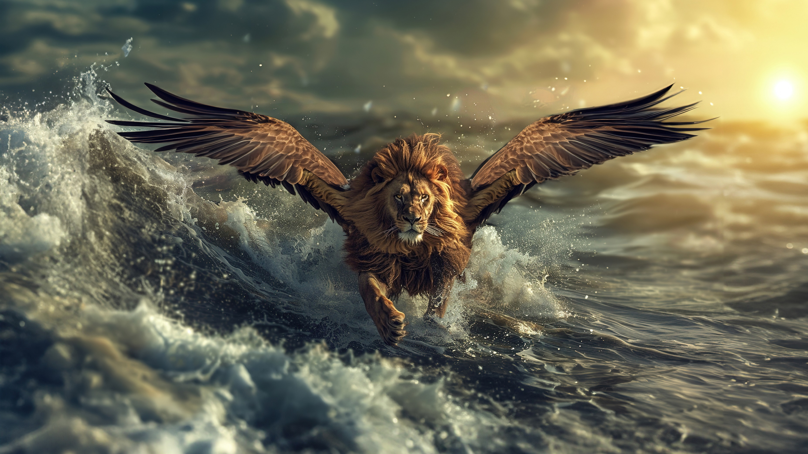

Slide 15
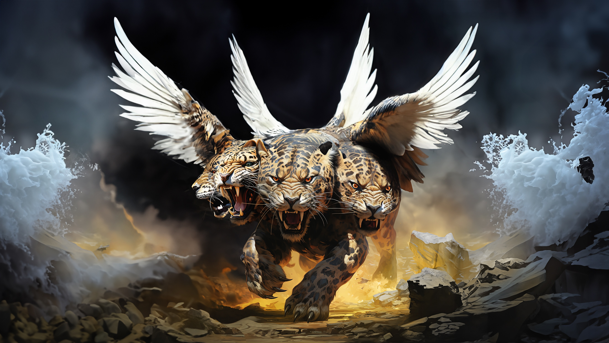

Slide 16
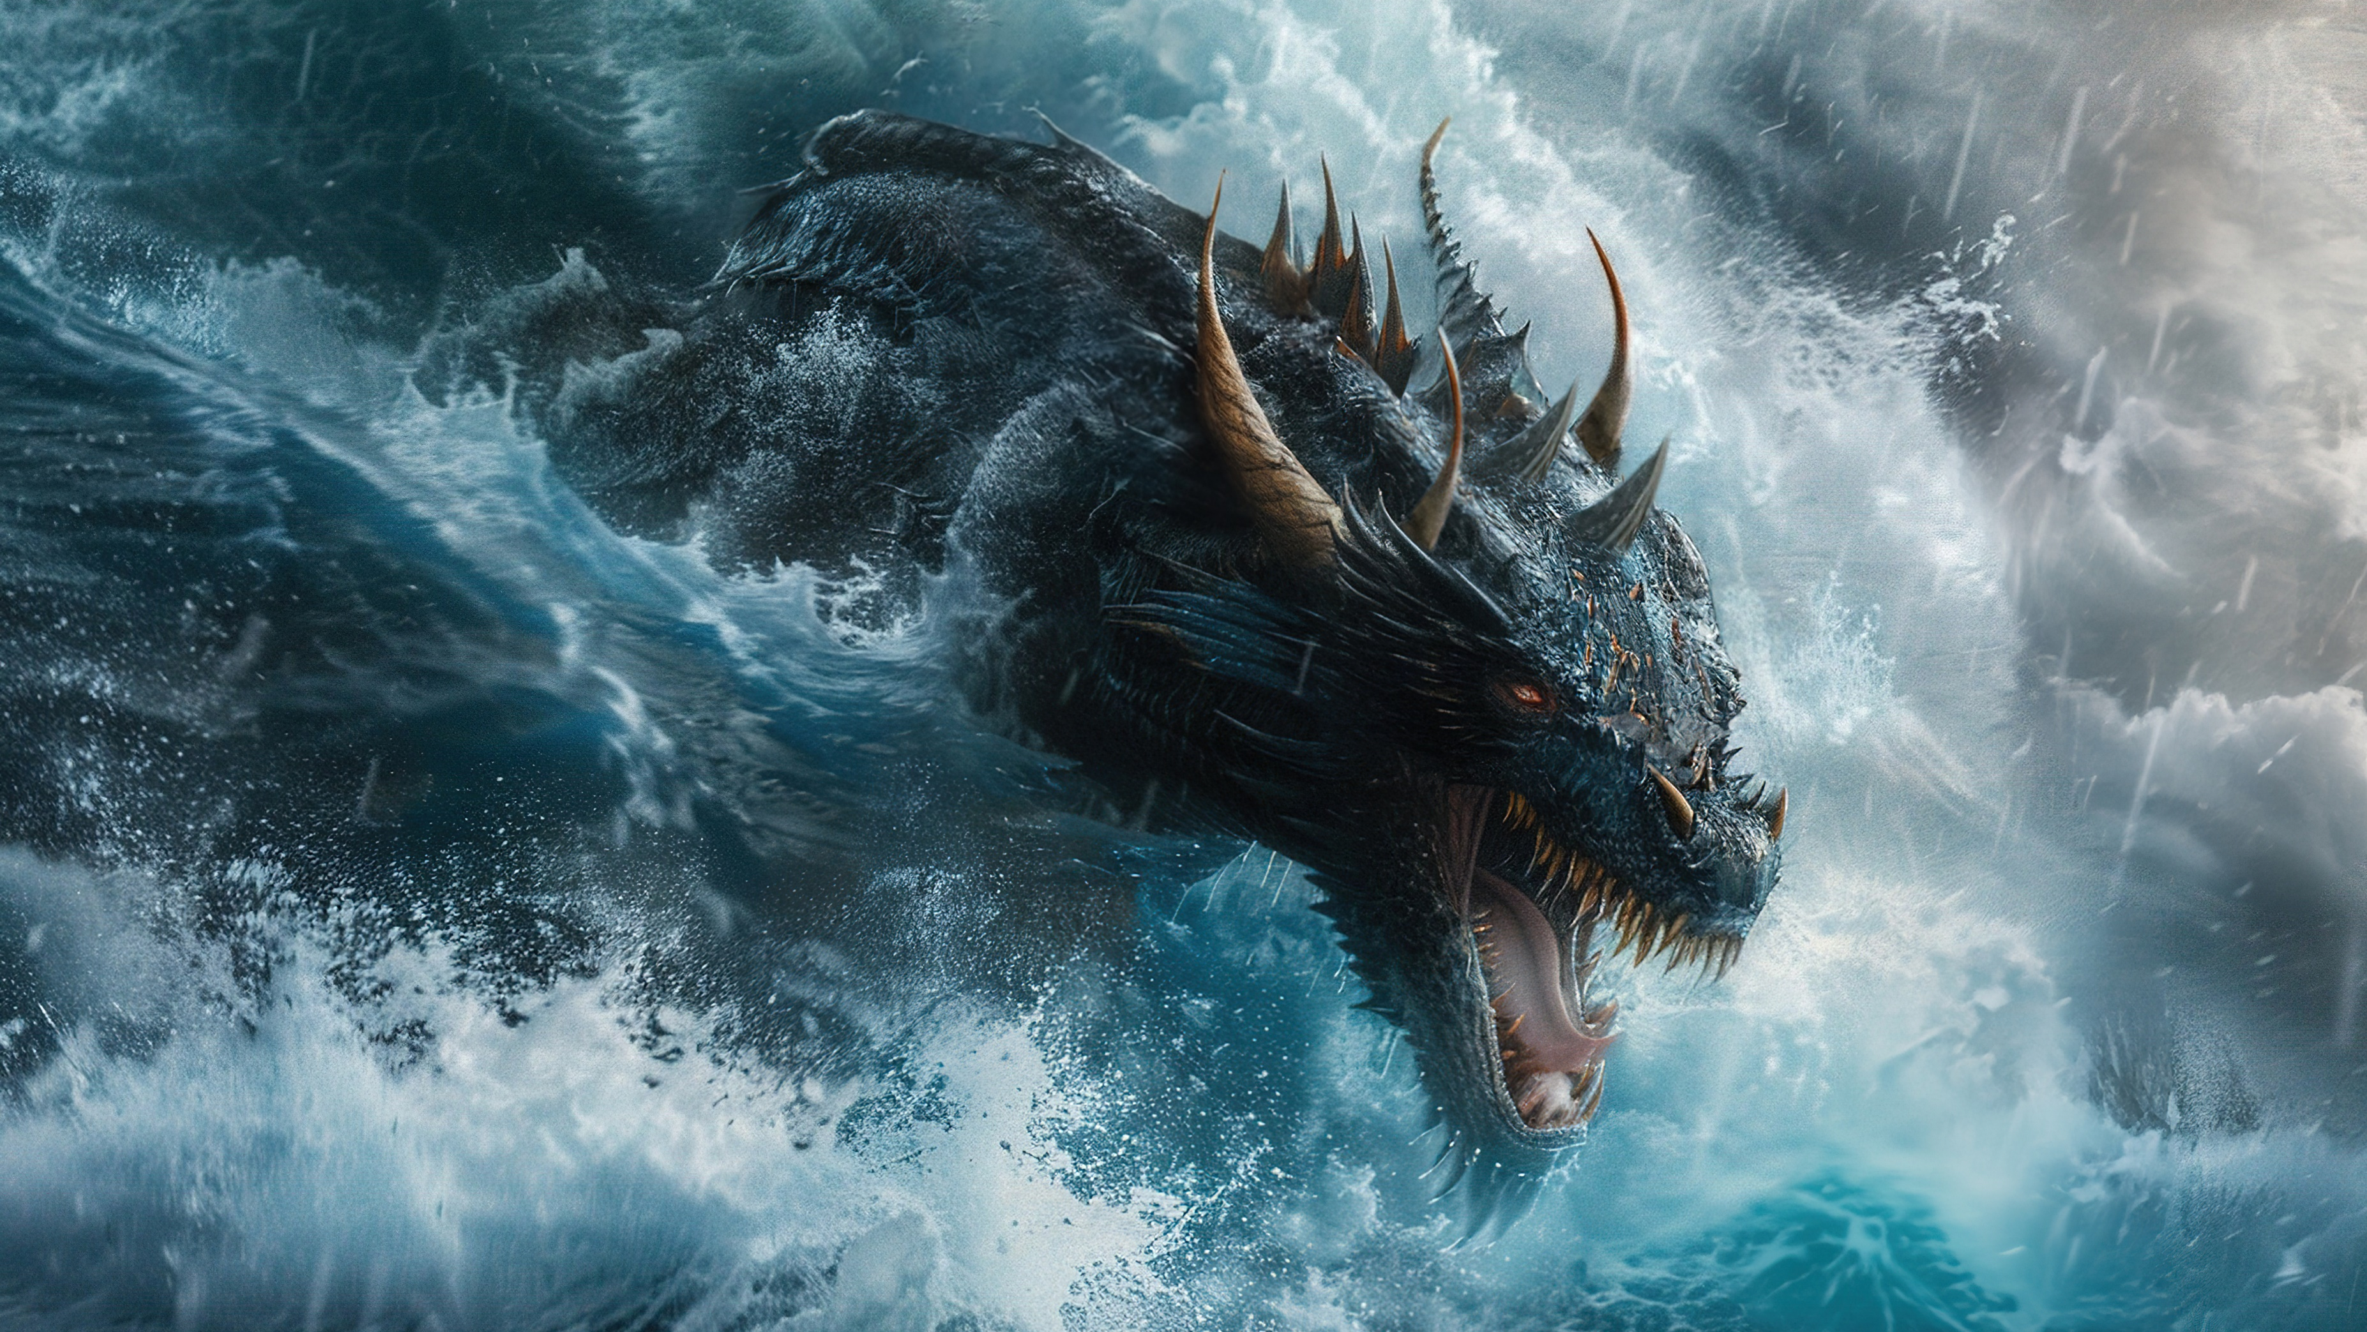

Slide 17
God’s Control over Medio-Persia

Slide 18
The Rise of the Medio-Persian Empire
The LORD has stirred up the spirit of the kings of the Medes, because his purpose concerning Babylon is to destroy it, for that is the vengeance of the LORD, the vengeance for his temple (Jer 51:11).
That saith of Cyrus, He is my shepherd, And shall perform all my pleasure: Even saying to Jerusalem, Thou shalt be built; And to the temple, Thy foundation shall be laid (Isa 44:28).
Thy kingdom is divided, and given to the Medes and Persians. (Dan 5:26–28).

Slide 19
Extra Biblical Record
But as it was, the Persians were upon them unawares, and by reason of the great size of the city—so say those who dwell there—those in the outer parts of it were overcome, yet the dwellers in the middle part knew nothing of it; all this time they were dancing and making merry at a festival which chanced to be toward, till they learnt the truth but too well (Herodotus, Hist. 1.191)
At last the ditches were completed. Then,* when he heard that a certain festival had come round in Babylon, during which all Babylon was accustomed to drink and revel all night long, Cyrus took a large number of men, just as soon as it was dark, and opened up the heads of the trenches at the river (Xen., Cyrop. 7.5.15).

Slide 20
Extra Biblical Record
Without any battle, he made him enter his town Babylon, sparing Babylon any calamity. He delivered into his (i.e. Cyrus’) hands Nabonidus, the king who did not worship him (i.e. Marduk) (Cyrus Cylinder: ANET 315–316).

Slide 21
God’s Control over Greece

Slide 22
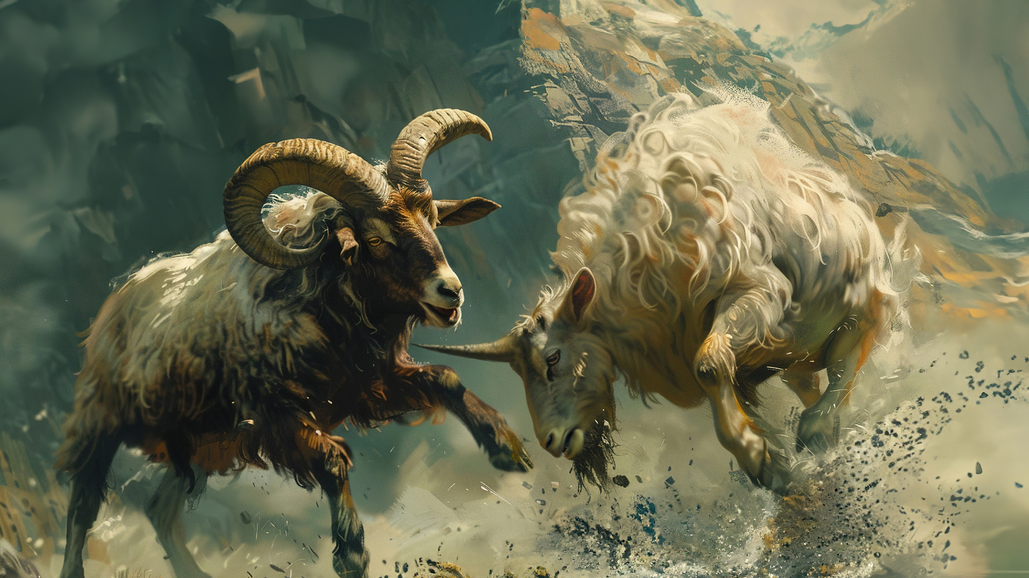

Slide 23
The Rise of Greece
The ram which thou sawest having two horns are the kings of Media and Persia. And the rough goat is the king of Grecia: and the great horn that is between his eyes is the first king. Now that being broken, whereas four stood up for it, four kingdoms shall stand up out of the nation, but not in his power (Da 8:20–22).

Slide 24
The fall of Greece/Antiochus/the Anti-Christ
And in the latter time of their kingdom, when the transgressors are come to the full, a king of fierce countenance, and understanding dark sentences, shall stand up. And his power shall be mighty, but not by his own power: and he shall destroy wonderfully, and shall prosper, and practise, and shall destroy the mighty and the holy people. And through his policy also he shall cause craft to prosper in his hand; and he shall magnify himself in his heart, and by peace shall destroy many: he shall also stand up against the Prince of princes; but he shall be broken without hand (Da 8:23–25).

Slide 25
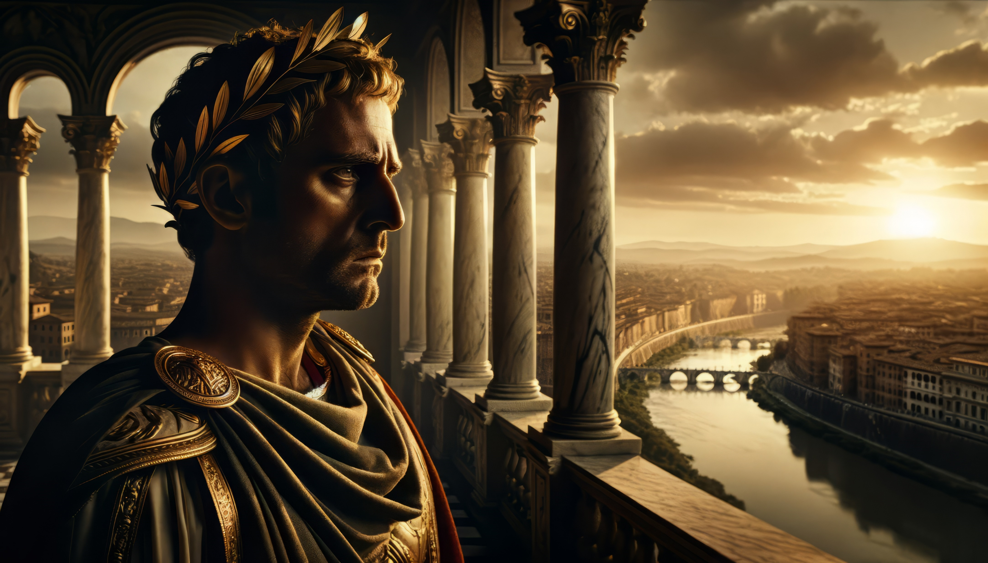

Slide 26
Conclusion
God’s Control over Babylon
God’s Control over Medio-Persia
God’s Control over Greece

