Slide 1
כִּֽי־אִתְּךָ֥ אֲנִ֛י
By Joseph Peters

Slide 2
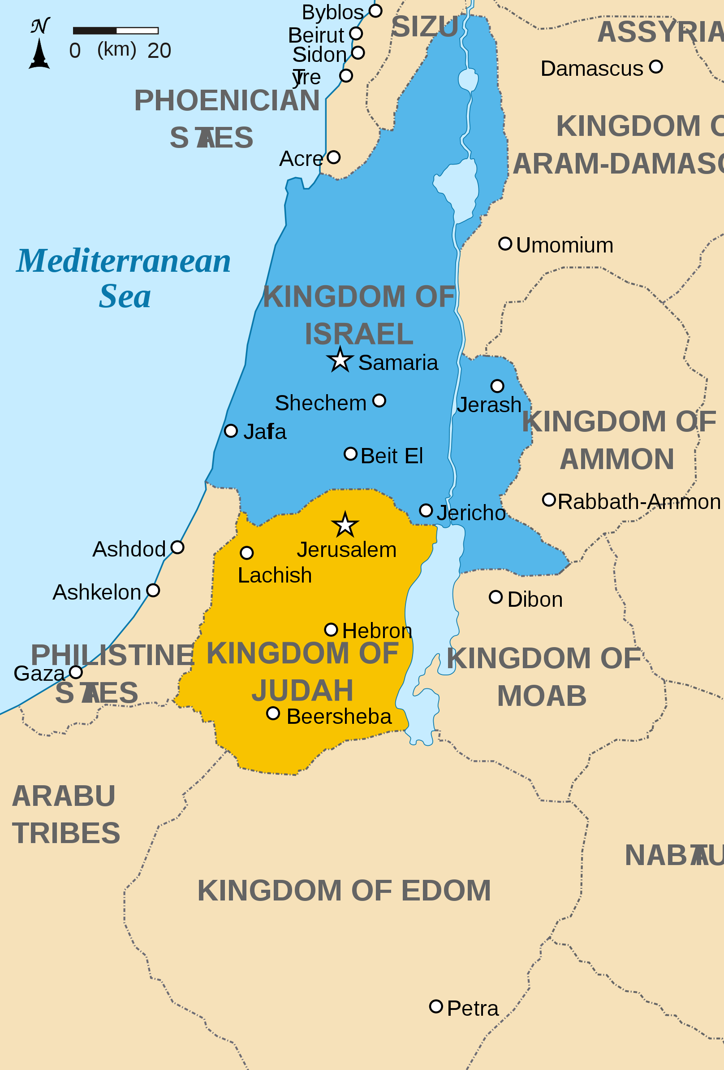
The Divided Monarchy
At what instant I shall speak concerning a nation, and concerning a kingdom, to pluck up, and to pull down, and to destroy it; If that nation, against whom I have pronounced, turn from their evil, I will repent of the evil that I thought to do unto them. And at what instant I shall speak concerning a nation, and concerning a kingdom, to build and to plant it; If it do evil in my sight, that it obey not my voice, then I will repent of the good, wherewith I said I would benefit them (Jer. 18:7-10)
Richardprins, . "Map of the Levant circa 830 BCE." World History Encyclopedia. Last modified April 26, 2012. https://www.worldhistory.org/image/285/map-of-the-levant-circa-830-bce/.

Slide 3
Objective
Everyone should obey God’s Commissions for them
For these three reasons

Slide 4
Rationale
God’s Word is Not a Suggestion
God Gives Us What we Need
God is Sovereign

Slide 5
Jeremiah 1:4

Slide 6
In the Days of Josiah
To whom the word of the LORD came in the days of Josiah the son of Amon king of Judah, in the thirteenth year of his reign….
Then the word of the LORD came unto me, saying, (Jer. 1:2, 4)

Slide 7
Jeremiah 1:5

Slide 8
Chosen to be Holy
Before I formed thee in the belly I knew thee; and before thou camest forth out of the womb I sanctified [הִקְדַּשְׁתִּ֑י, קדשׁ] thee, and I ordained thee a prophet unto the nations. (Jer. 1:5)
And ye shall be unto me a kingdom of priests, and an holy [קָדוֹשׁ] nation. These are the words which thou shalt speak unto the children of Israel (Exod. 19:6)

Slide 9
Jeremiah 1:6

Slide 10
Humility VS Excuse
And Moses said unto God, Who am I, that I should go unto Pharaoh, and that I should bring forth the children of Israel out of Egypt? (Exod. 3:11).
Then said I, Woe is me! for I am undone; because I am a man of unclean lips, and I dwell in the midst of a people of unclean lips: for mine eyes have seen the King, the LORD of hosts (Isa. 6:5)

Slide 11
The Objection
Then said I, Ah, Lord GOD! behold, I cannot speak: for I am a child (Jer. 1:6).
And Moses said unto the LORD, O my Lord, I am not eloquent, neither heretofore, nor since thou hast spoken unto thy servant: but I am slow of speech, and of a slow tongue (Exod. 4:10).

Slide 12
Jeremiah 1:7-8

Slide 13
God’s Response to Obstacles
And he said, Certainly I will be with thee… (Exod. 3:12a)
And the LORD said unto him, Who hath made man’s mouth? or who maketh the dumb, or deaf, or the seeing, or the blind? have not I the LORD? 12 Now therefore go, and I will be with thy mouth, and teach thee what thou shalt say (Exod. 4:11–12).
Then flew one of the seraphims unto me, having a live coal in his hand, which he had taken with the tongs from off the altar: 7 And he laid it upon my mouth, and said, Lo, this hath touched thy lips; and thine iniquity is taken away, and thy sin purged (Is 6:6–7).

Slide 14
God’s Response to Jeremiah’s Obstacles
But the LORD said unto me, Say not, I am a child: for thou shalt go to all that I shall send thee, and whatsoever I command thee thou shalt speak. Be not afraid of their faces: for I am with thee to deliver thee, saith the LORD Then the LORD put forth his hand, and touched my mouth. And the LORD said unto me, Behold, I have put my words in thy mouth (Jer. 1:7-9)

Slide 15
I Am With Thee
Thou therefore gird up thy loins, and arise, and speak unto them all that I command thee: be not dismayed at their faces, lest I confound thee before them. For, behold, I have made thee this day a defenced city, and an iron pillar, and brasen walls against the whole land, against the kings of Judah, against the princes thereof, against the priests thereof, and against the people of the land. And they shall fight against thee; but they shall not prevail against thee; for I am with thee, saith the Lord, to deliver thee (Jer. 1:17-19)

Slide 16
Our Commission
Go ye therefore, and teach all nations, baptizing them in the name of the Father, and of the Son, and of the Holy Ghost: Teaching them to observe all things whatsoever I have commanded you: and, lo, I am with you always, even unto the end of the world. Amen (Matt. 28:19-20)

Slide 17
Conclusion
God’s Word is Not a Suggestion
God Gives Us What we Need
God is Sovereign

