Slide 1
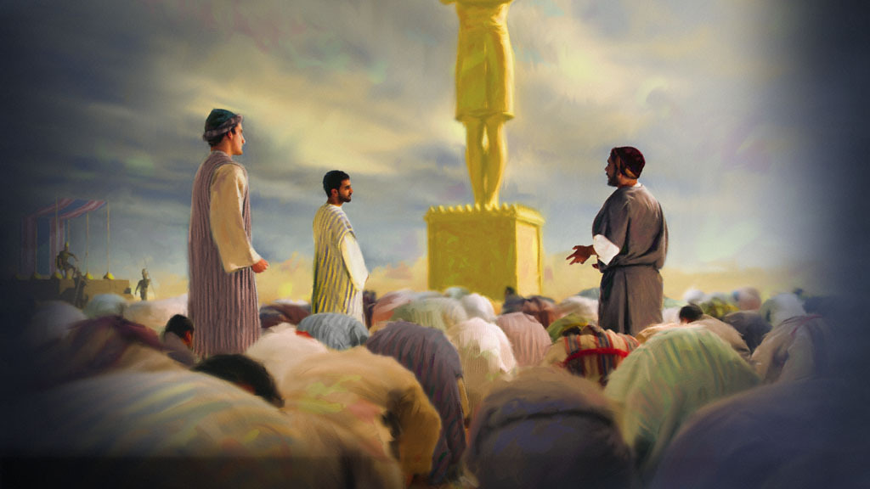
כֹּחַ ‏יהוה‎
-Joseph Peters
Confident Faith

Slide 2
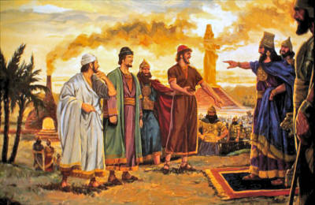
Hananiah, Mishael, and Azariah
Daniel 3:17 (KJV) ¹⁷ If it be so, our God whom we serve is able to deliver us from the burning fiery furnace, and he will deliver us out of thine hand, O king.
DWELLING in the Word - WordPress.com

Slide 3
Objective
Anyone can have this kind of confidence in God
How?
by understanding the powers of God

Slide 4
Rationale
God has power over His creation

Slide 5
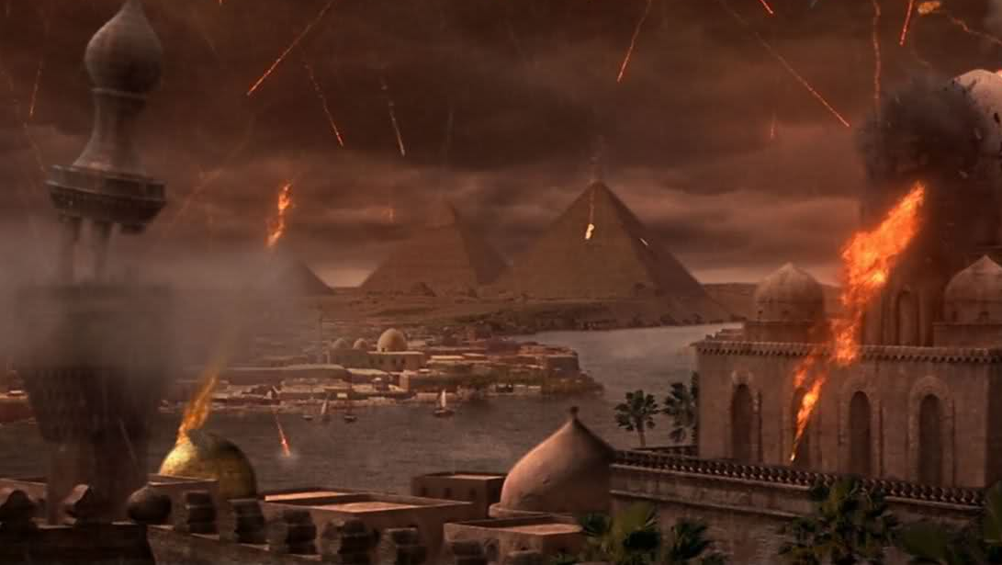
The plagues of Egypt
Heart in Formation - WordPress.com

Slide 6
Rationale
God has power over His creation
God has power over time and space

Slide 7
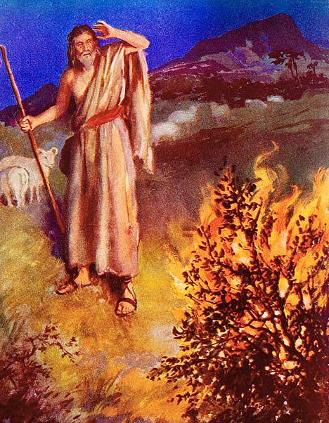
God has power over time and space
יהוה
“self-Existent or Eternal” Strong's Talking Greek & Hebrew Dictionary.‎
Exodus 3:14 “And God said unto Moses, I AM THAT I AM:”
firstyearteacherdiary.wordpress.com

Slide 8
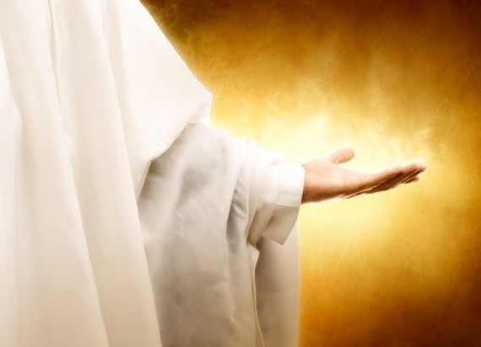
Power over distance
“Jesus saith unto him Go thy way; thy son liveth… the man believed… his servants met him, and told him, saying, Thy son liveth.” (John 4:50-51)
…but speak the word only, and my servant shall be healed…. And Jesus said unto the centurion, Go thy way; and as thou hast believed, so be it done unto thee. And his servant was healed in the selfsame hour. (Matthew 8:5-13)
Catholic Man Night

Slide 9
Rationale
God has power over His creation
God has power over time and space
God has power over circumstances

Slide 10
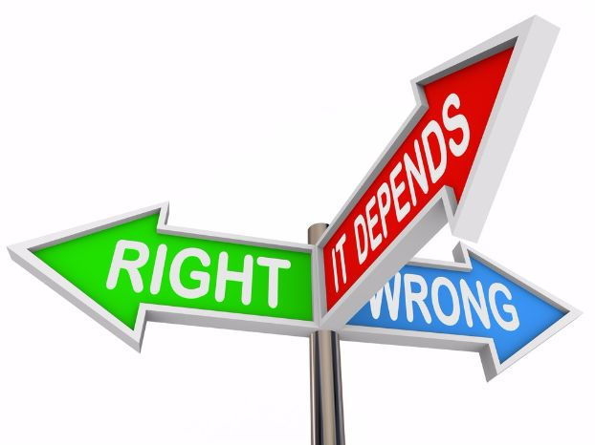
Deontology vs Consequentialism
Deontology - Duty oriented “the means are self justifying”$.^{1}$
Consequentialism – Goal oriented “the ends justify the means”$.^{2}$
Tes

Slide 11
Who’s in control
With the gift of free will, God has allowed mankind to have some power over choosing the means.
However, God is in control of the end result.
Therefore, do what’s right with what you have control over, and trust that God can made the end right

Slide 12
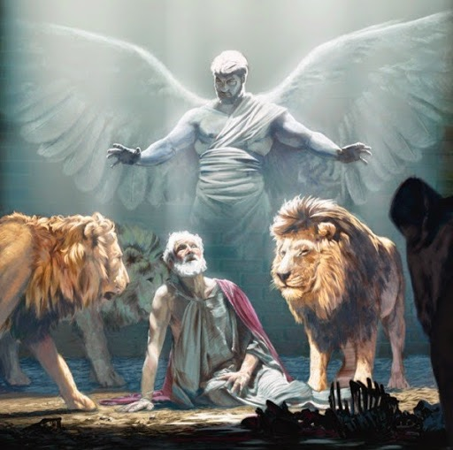
Daniel in the lions den
The king required that the people do the wrong thing or be punished
Daniel could have done the wrong thing and live another day to serve God
Instead, Daniel did the right thing and chose to trust that God could make the end right
infoboxx.info

Slide 13
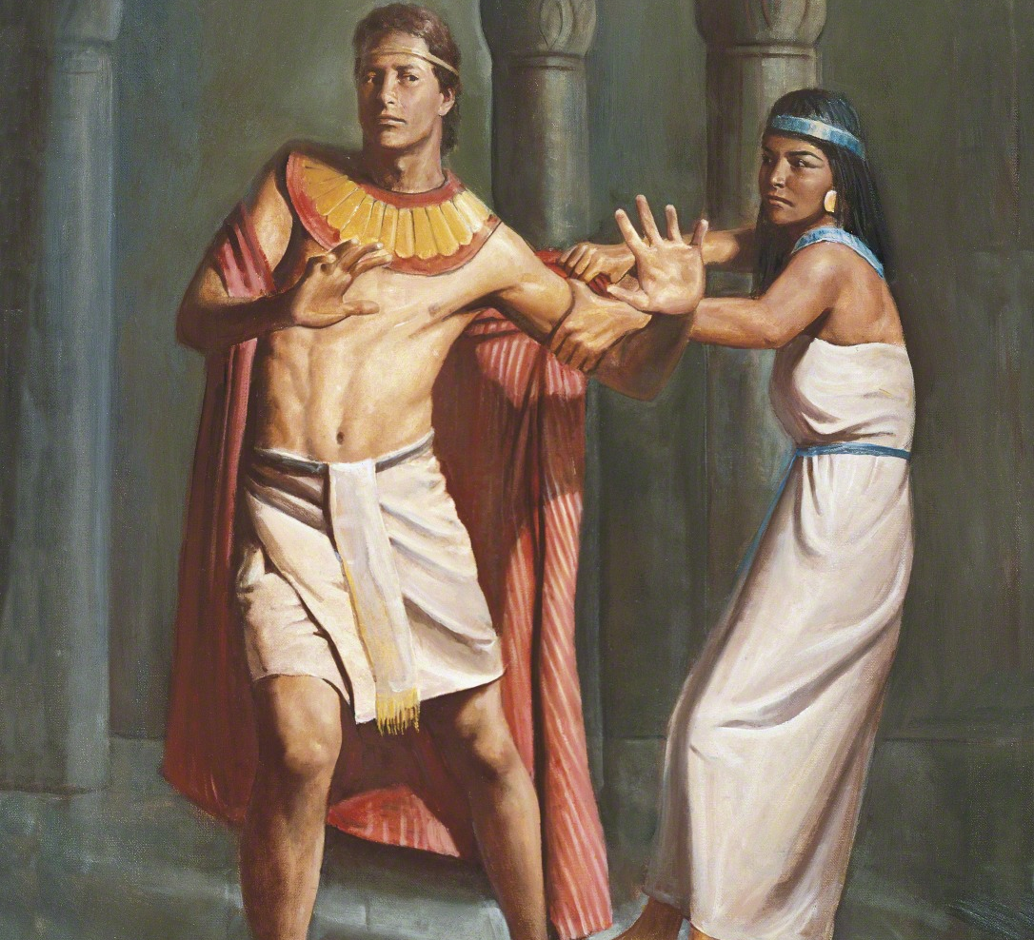
Joseph and Potiphar's wife
Joseph could have done it and never been caught.
By not doing it, he risked being accused.
However, Joseph did what was right and trusted that God could make the end result right
The Church of Jesus Christ of Latter-day Saints

Slide 14
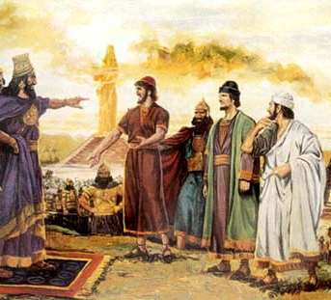
Shadrach, Meshach and Abednego
Daniel 3:15,17-18 (KJV)
…and who is that God that shall deliver you out of my hands?... ¹⁷ If it be so, our God whom we serve is able to deliver us from the burning fiery furnace, and he will deliver us out of thine hand, O king. ¹⁸ But if not, be it known unto thee, O king, that we will not serve thy gods, nor worship the golden image which thou hast set up.

Slide 15
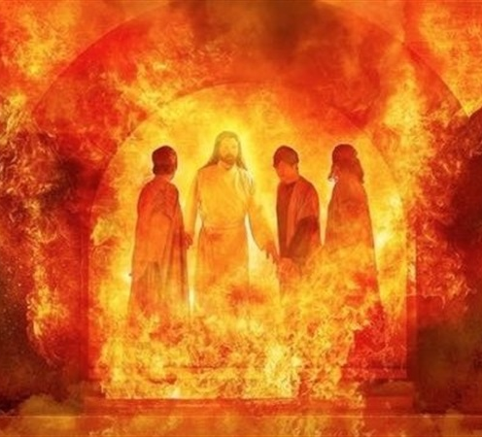
God has power over circumstances
Daniel 3:19-30
They did the right thing, even though they would pay for it with their lives in the end
However, they knew that God was in control of the end
They chose to follow God rather than man
God did a miraculous salvation
They were even promoted
Bible Study Tools

Slide 16
Summary
Anyone can have this kind of confidence in God by understanding the powers of God
- God has power over His creation
- God has power over time and space
- God has power over circumstances

Slide 17
Will you do what is right and trust God?

Slide 18
Bibliography
Foreman, Mark. A Comparison of Consequentialism and Deontology. Video transcript. 2015. Pg. 2
Ibid

