Slide 1
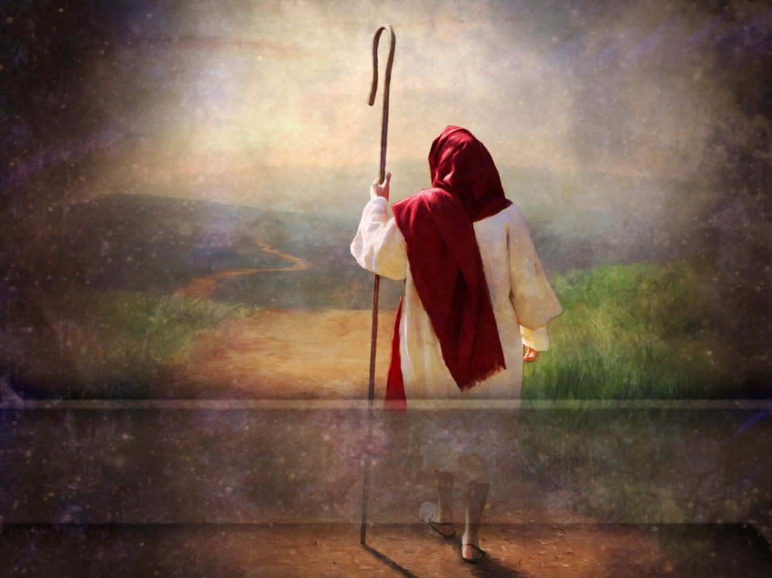
“My sheep hear my voice,
and I know them, and they follow me:”
John 10:27

Slide 2
We’re created for Communion!
(With God and each other)
“If we walk in the light,
as He is in the light,
we have fellowship
(koinonia)
one with another.” 1 John 1:7
koinonia means Fellowship, Communion,
partnership !

Slide 3
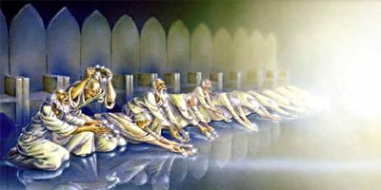
We’re all created (and called) on purpose,
and for specific purposes!
“Thou art worthy, O Lord, to receive glory and honor and power: for thou hast created all things,
for thy pleasure
Thel’ema: purposes
they are and were created.”
See also 1 Cor 3:9
and Mt. 11:28,29
Rev. 4:10,11

Slide 4
The scriptures are a record of various ways
God has communicated His plans
and purposes to His people.
(Heb 1:1) “God in sundry ways and divers manners spake in times past…”
These ways include:
Visions (Gen. 15); Angels (Gen 16); Dreams (Gen. 28);
Urim and Thummim (Ex. 28:30); Prophets (Dt. 18:18);
still small voice (1 Kgs 19:12); Miracles (Ex. 8:20-25)
and even an occasional donkey!
(Numbers 22; 2 Peter 2:16)

Slide 5
(Heb 1:1) “God in sundry ways and divers manners
spake in times past…”
“Hath…spoken unto us by His Son!”
Does God still speak to His people?
Does He still have anything to say to us?

Slide 6
“To day if ye will hear his voice,
Harden not your heart”
(Ps 95:7-8; Heb. 3:7,15; and 4:7)

Slide 7
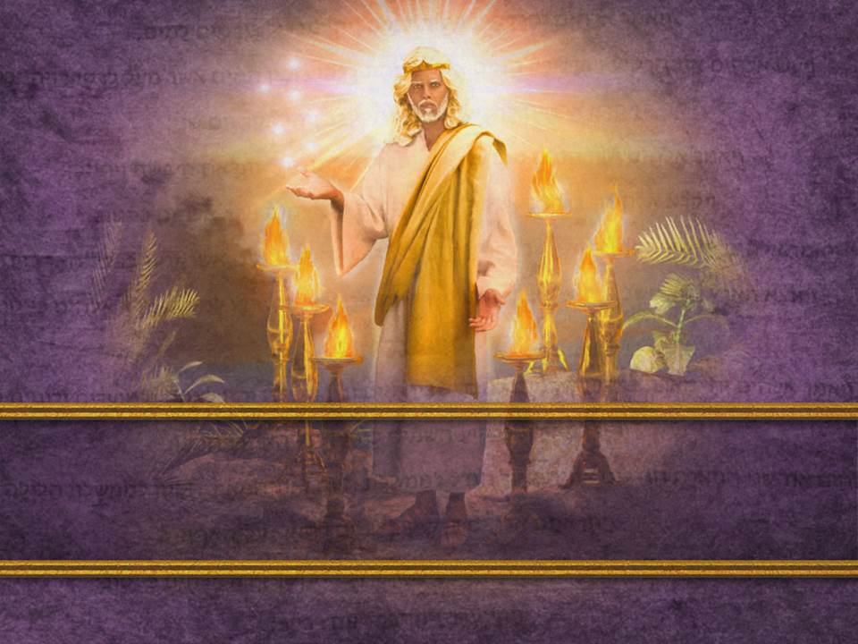
“He that hath an ear, let him hear
what the Spirit saith unto the churches."
(Rev. 2:7, 11,17,29; 3:6,13,22)

Slide 8
God knew some of His people would have “heart problems” and would either:
Not recognize his voice.
Not respond (obey) when He did speak.

Slide 9
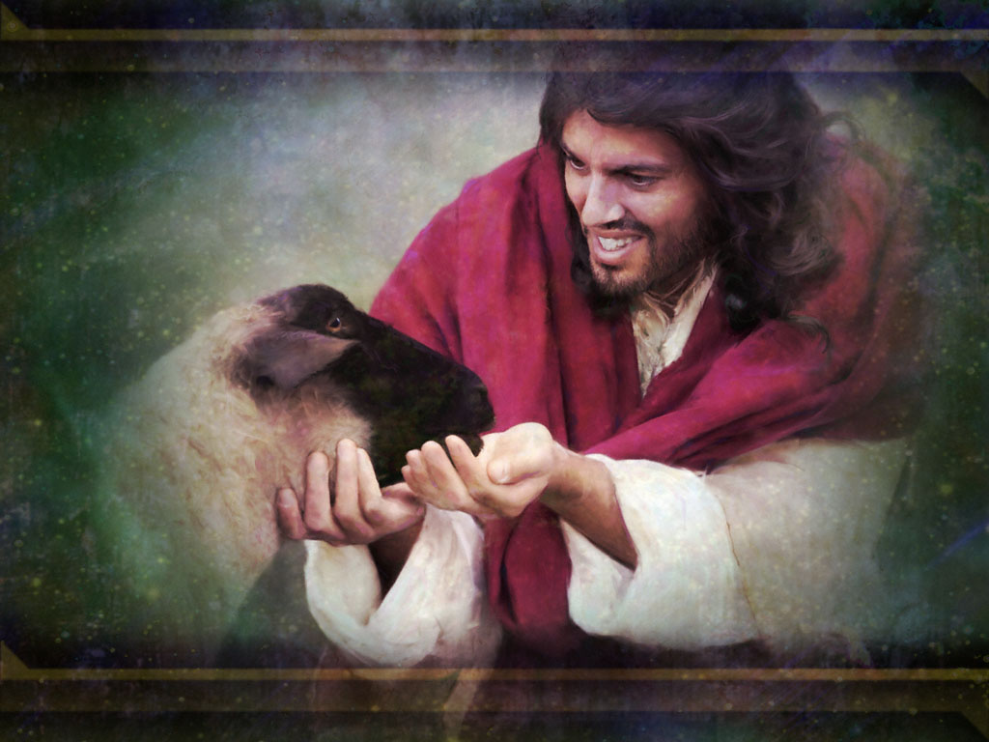
Why does God Speak to us?
Communion without Communication is impossible!

Slide 10
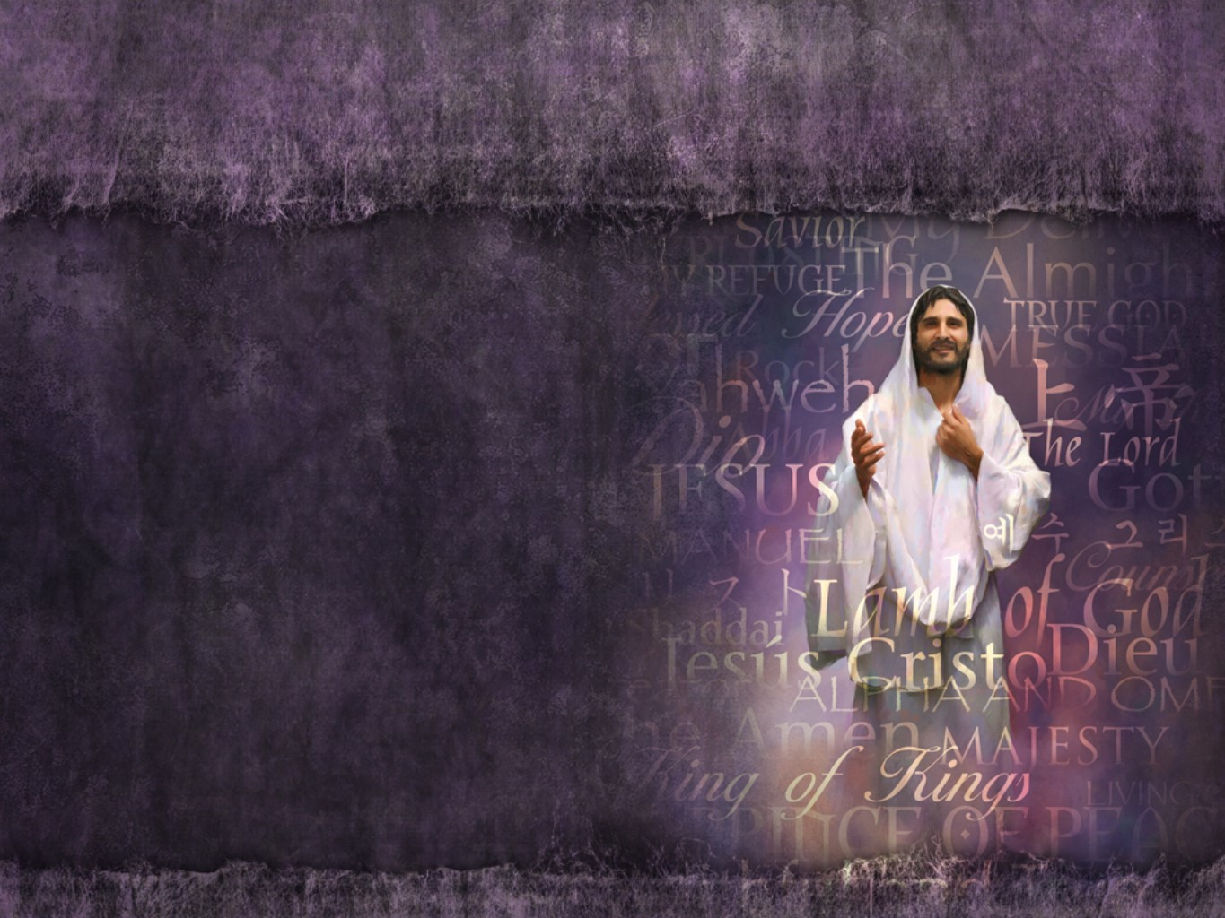
1. God Speaks to Reveal His Person!
Heb 1:1-3 “God…spake in time past unto the
fathers by the prophets,
Hath …spoken unto us by his Son,
whom he hath appointed heir of all things,
by whom also he made the worlds;
Who being the brightness of his glory,
and the express image of his person…”

Slide 11
1. God Speaks to Reveal His Person!
Heb 1:3 “the express image (charakter: exact copy)
We get our English word “Character” from this!
and upholding all things by the word of his power,
(see Col. 1:17)
when he had by himself purged our sins,
sat down on the right hand of the Majesty on high”

Slide 12
Jn 1:1 “In the beginning was the Word, and the Word was with God,
and the Word was God…
14 And the Word was made flesh, and dwelt among us,
(and we beheld his glory, the glory as of the only begotten of the Father,)
full of grace and truth.”

Slide 13
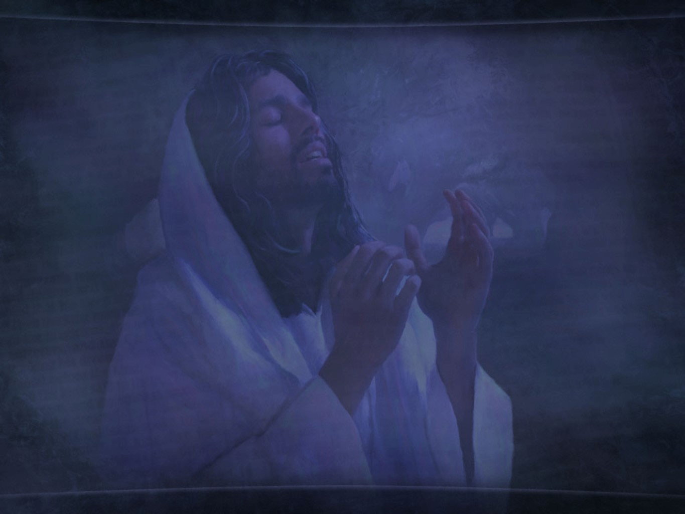
A. God wants us to know Him!
(John 17:3,4)
“this is life eternal,
that they might know thee
(ginos’ko: perceive, understand)
the only true God,
and Jesus Christ, whom thou hast sent.”

Slide 14
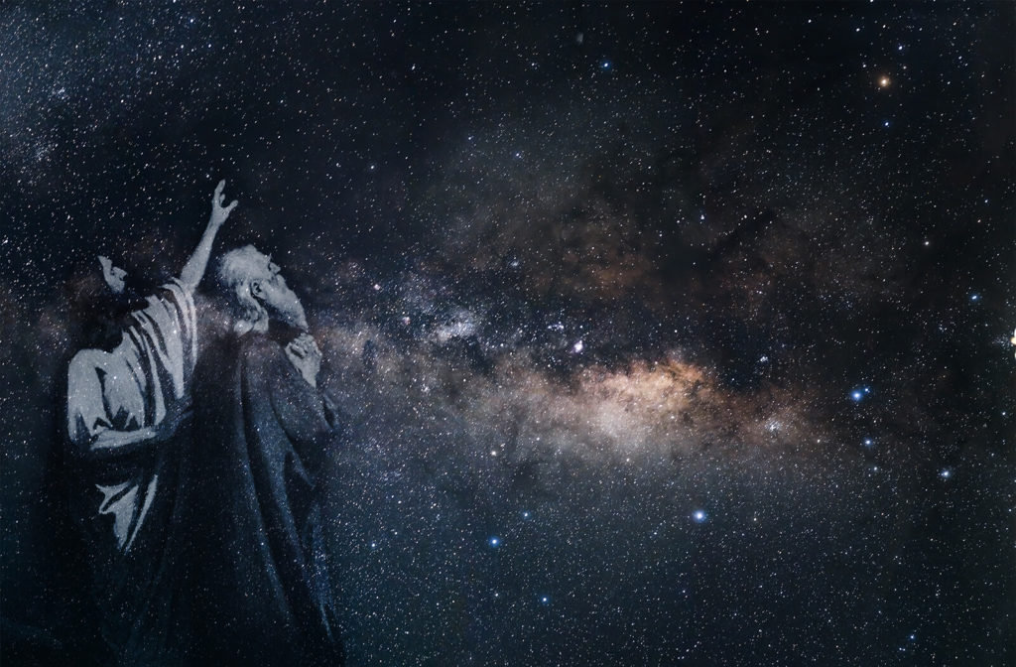
1) When God spoke, He usually began with an
introduction revealing some dimension of Himself.
(“I am the Lord…” found 164 times)
a) To an anxious Abraham:
Gen. 15:1 "I am thy shield, (meod: might)
and thy exceeding great reward.“
(śākār: Compensation)
Gen 17:1 "I am the Almighty God; (el shadday)
walk before me, (pânîym: presence)
and be thou perfect.“ (Tāmîm’: sincere, entire)

Slide 15
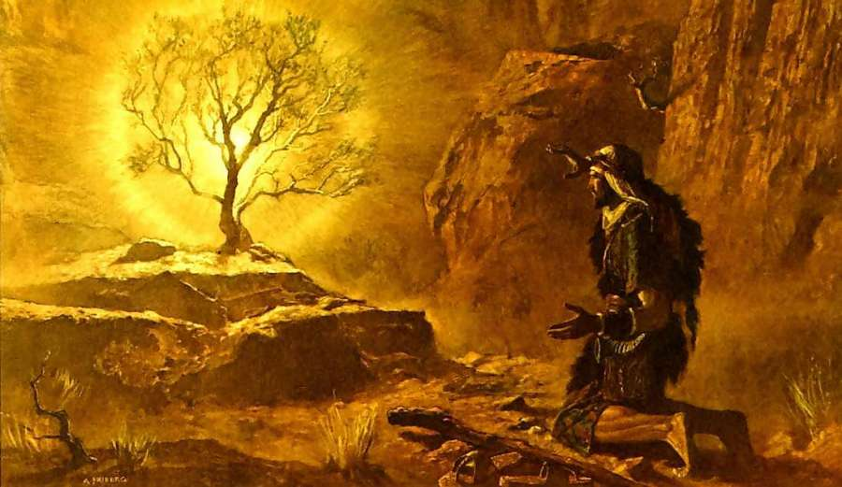
1) When God spoke, He usually began with an
introduction revealing some dimension of Himself.
(“I am the Lord…” found 164 times)
b) To a murmuring Moses: “God said unto Moses:
Exo 3:14
"I AM THAT I AM.“
Thus shalt thou say unto the children of Israel,
I AM hath sent me unto you.”

Slide 16
c) To an “Ill” Israel: At Marah (Exo 15:26)
“If thou wilt diligently hearken to the voice of the LORD thy God, and wilt do that which is right in his sight, and wilt give ear to his commandments,
and keep all his statutes,
(then) I will put none of these diseases upon thee…
for I am the LORD that healeth thee.”
יהוה‎ ָפָא
Yhwh rapa
(Jehovah Rapha)

Slide 17
A. God wants us to know Him.
1) God usually began with an introduction
revealing some dimension of Himself.
2) This allows us to come to know God better so
we can love and trust Him more. Pr 18:10
“The name of the LORD is a strong tower:
the righteous run into it, and is safe.”
B. This becomes the basis of our FAITH.
(Who we’re working for!)

Slide 18
1. God speaks to reveal his person.
B. This becomes the basis of our FAITH.
2 Kings 6, Elisha had no specific promise from God,
but he knew who he was working for!
Vs 16 “Fear not: for they that be with us are more than they that be with them.
And Elisha prayed, LORD, I pray thee,
open his eyes,
that he may see.”

Slide 19
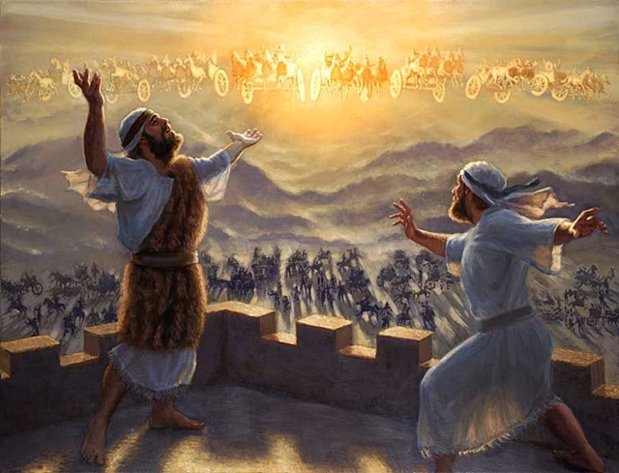
2Kings 6:17
17 And the LORD opened the eyes of the young man; and he saw: and, behold,
the mountain was full of horses and chariots of fire
round about Elisha.”

Slide 20
1. God speaks to reveal his Person.
2. God Speaks to reveal His Purposes!
Jer 29:11 “I know the thoughts (purposes, intentions) that I think toward you, saith the LORD, thoughts of peace,
and not of evil, to give you an expected end.”
A. God’s ways are beyond our natural understanding.
Is. 55:8 “My ways are not your ways.”
1) That’s why God’s Revelation must be elevated
above our limited Reasoning.
Is. 55:7 “Let the wicked forsake his way,
and the unrighteous man his thoughts:”

Slide 21
2. God Speaks to reveal His Purposes!
B. When God did speak, He usually gave some
specific directions.
Abraham: Gen. 12:1 ”go to a land that I will show thee.”
Moses: Ex. 3:10 ”I will send thee unto Pharaoh, that
thou mayest bring forth my people …out of Egypt."
Gideon: Judges 6:14 ”the LORD said, Go in this thy
might, and thou shalt save Israel from the
hand of the Midianites: have not I sent thee?"

Slide 22
2. God Speaks to reveal His Purposes!
1) This allows us to understand enough of God’s
will so we can make the necessary adjustments
to cooperate (partner) with Him. Mt 16:24
“If any man come after me, let him deny himself,
take up his cross and follow me”
2) God doesn’t “speak” for our entertainment,
but for our “equipping” for service.
(Eph. 4:11,12)

Slide 23
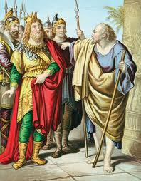
2. God Speaks to reveal His Purposes!
C. This becomes the basis of our FOCUS.
(Recognizing Who we’re working “WITH”.
1 Kgs 17:1 “Elijah …said unto Ahab,
As the LORD God of Israel liveth,
before whom I stand,
there shall not be dew nor rain these
years, but according to my word.”
1 Cor. 3:9 “We are laborers together with God”

Slide 24
Conclusion:
Virtually everyone that heard from God recognized:
Who they were speaking to!
2) What was expected of them!

Slide 25
Jesus closed his “Sermon on the Mount”
In Matthew 7:24-27 with this closing:
“Therefore whosoever heareth
(Akouo: to hear and hearken)
these sayings of mine,
and doeth them,
I will liken him unto a wise man,
which built his house upon a rock:”
See James 1:22

Slide 26
26 “every one that heareth these sayings of mine, and doeth them not,
shall be likened unto a foolish man,
which built his house upon the sand:
27 And the rain descended, and the floods came, and the winds blew,
and beat upon that house;
and it fell:
and great was the fall of it. “

Slide 27
Jn 10:27 “My sheep hear my voice,
and I know them, and they follow me:”
How will you respond to the shepherd’s voice?
Will you learn to listen? (Recognize His voice)
Will you choose to Follow Him? (Respond)

Slide 28
Amos 3:3 “Can two walk together,
except they be agreed?”
3) Will you make the adjustments necessary to “agree with” & partner with Him?
(See 1 Jn 1:6-10)

