Slide 1
Matthew 28:6-7
“go quickly, and tell his disciples
that he is risen from the dead;
and he goeth before you…”

Slide 2
“Follow Me!”

Slide 3
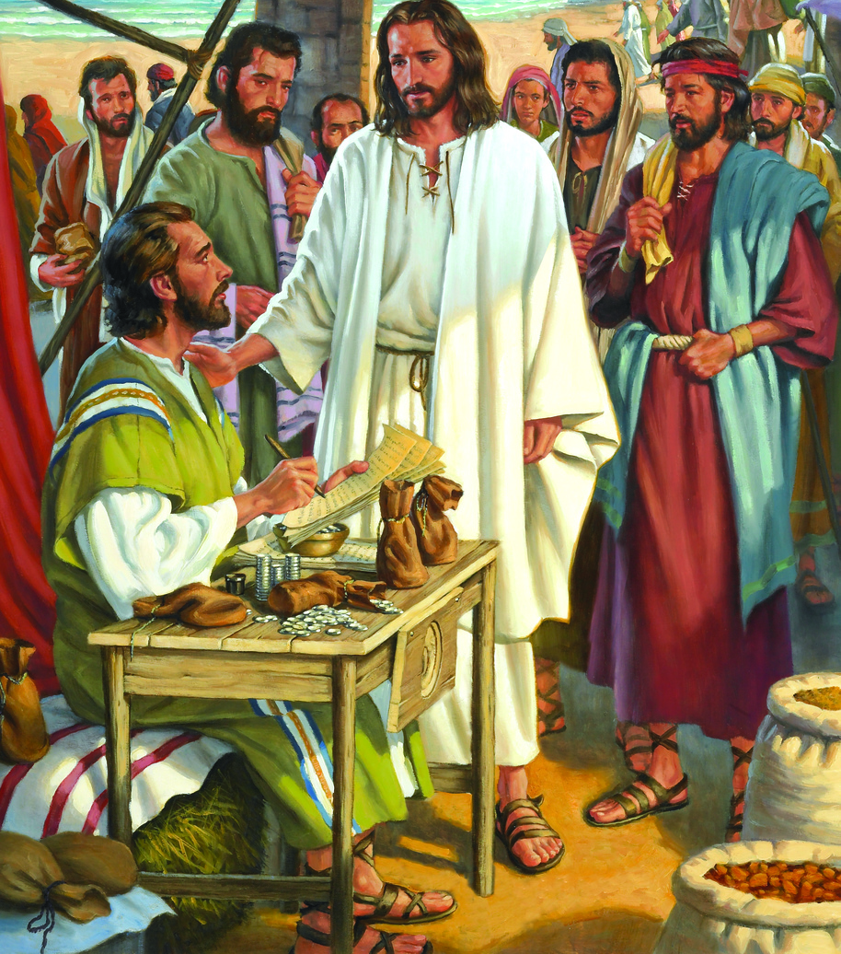
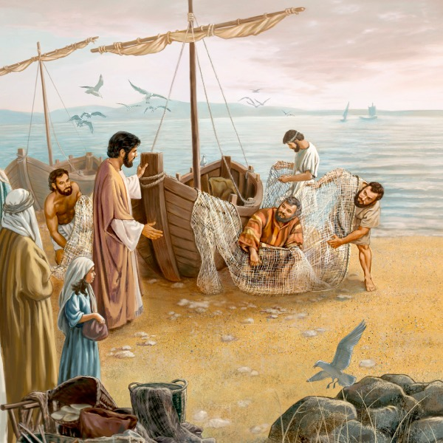
Jesus gave the command to “Follow Me” 17 times (before His crucifixion).
Mt. 4:19
Mt. 9:9

Slide 4
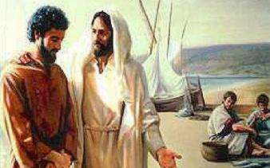
He repeated it after his resurrection!
Jn 21:19,22 “Follow Me”

Slide 5
Do you think he still expects us to Follow Him?
Luke 9:23 “He said to them all,
If any man will come after me,
let him deny himself,
and take up his cross daily,
and follow me. “

Slide 6
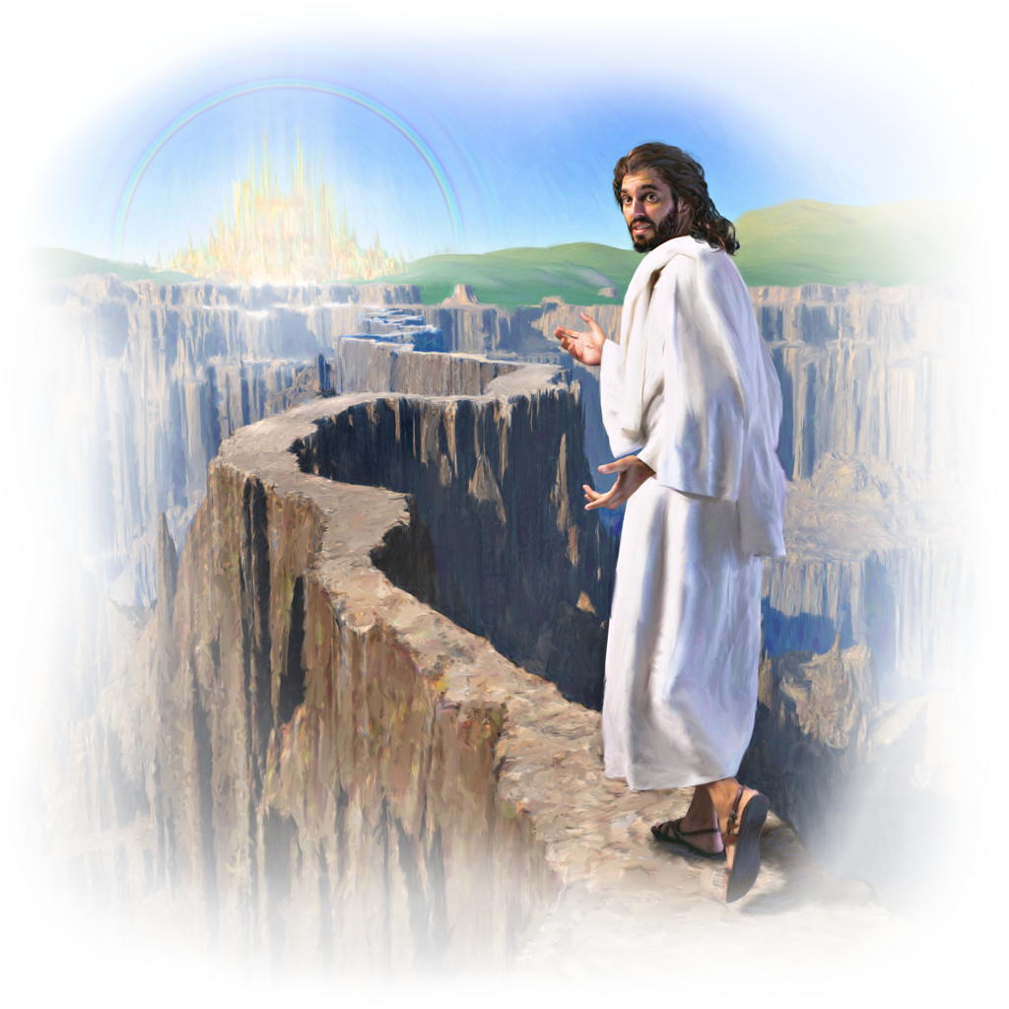
For those who desire to be “Christian,”
It’s critical that we understand what Jesus would do in our situations.
1 Pt 2:21 “hereunto were ye called…
that ye should
follow his steps…”

Slide 7
How can we recognize “His Steps”?
We can follow his Instructions. (Map)
Jn 14:15-17,26 “If ye love me, keep my commandments.
And …the Father…shall give you another Comforter, …
Even the Spirit of Truth…
26…he shall teach you all things…
Jn 16:13 “…he will guide you
into all truth… “
Psalm 119:105

Slide 8
How can we recognize “His Steps”?
We can follow his Instructions. (Map)

Slide 9
How can we recognize “His Steps”?
We can follow his example! 1 Pt 2:21
“…Christ also left us an example,
that we should follow in his steps.”
John 13:15 “For I have given you an example,
{hypod’eigma: a pattern}
that ye should do as I have done”

Slide 10
How can we recognize “His Steps”?
Heb 12:1,2 “run with patience the race that is set before us...
Looking unto Jesus …”
Aphora’ō: Considering
Heb. 12:3 “For consider him …,
lest ye be wearied and faint …”

Slide 11
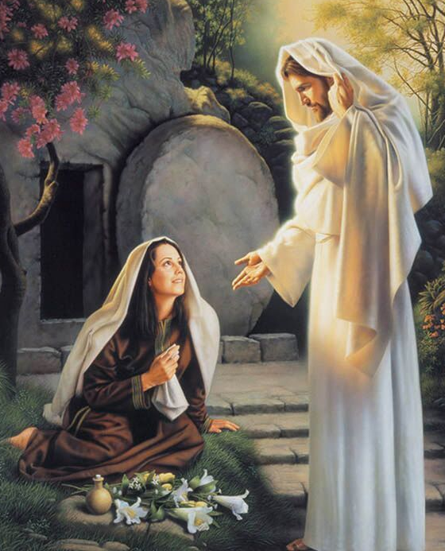
Heb. 12:3 “For consider him …”
Let’s consider how Jesus spent
his time after his resurrection.
1. First Appears to Mary
Mk 16:9-11 “When Jesus was risen early the first day of the week,
he appeared first to
Mary Magdalene,”

Slide 12
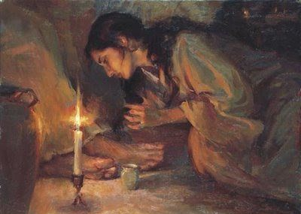
Heb. 12:3 “For consider him …”
First Appears to Mary
Mk 16:9 “out of whom he had cast seven devils”
A. Why Mary?
1) She loved Him.
Luke 7:47 “Her sins, which are many, are forgiven;
for she loved much”
Is your love proportional to His forgiveness?

Slide 13
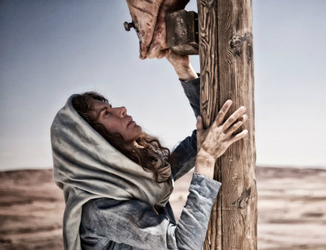
Heb. 12:3 “For consider him …”
Why Mary?
2) She served Him. Mk. 15:40,41
“There were also women looking on…
among whom was Mary Magdalene… Who also, when he was in Galilee,
followed and ministered unto him”
She served him while he was living, dying, and even after his death!
Luke 24:1-11

Slide 14
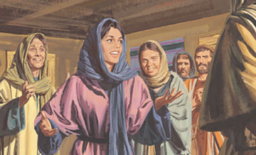
Why Mary?
3) She obeyed. Jn. 14:15 “If ye love me,
keep my commandments”
Mt 28:7 “go quickly, and tell his disciples that he is risen”
Mk 16:9-11 “ And she went and told them that had been with him, as they mourned and wept.
And when they had heard that he was alive, and had been seen of her,
(they) believed not.”

Slide 15
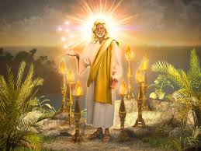
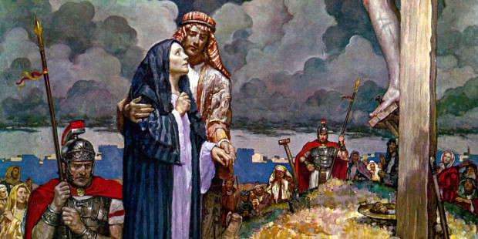
Heb. 12:3 “For consider him …”
1. First Appears to Mary
B. Jesus is a faithful friend, rewarding those who serve him faithfully!
John Came to Jesus at Calvary.
Jn. 19:26
Jesus came to John at Patmos!
Rev. 1

Slide 16
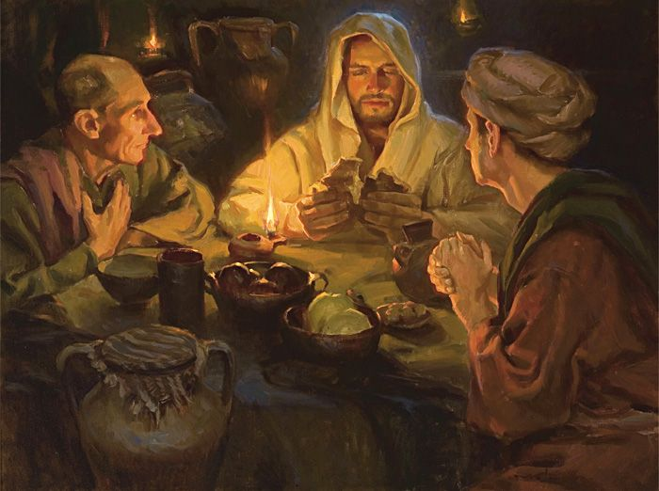
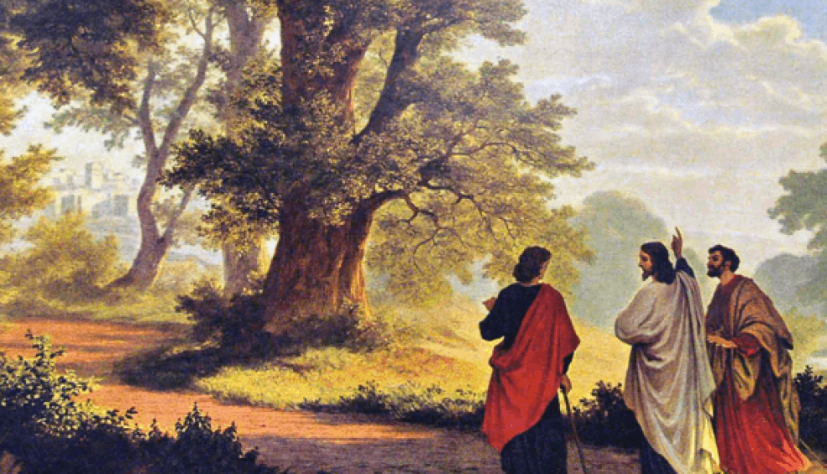
Heb. 12:3 “For consider him …”
2. Appears to 2 discouraged disciples. Lk 24
Luke 24:27 “And beginning at Moses and all the prophets,
he expounded unto them in all the scriptures the things concerning himself.”
Lk 24:32 “Did not our heart burn within us, while he talked with us by the way, and while he opened to us the scriptures?”
A. Has God ever given you a “holy heartburn?”

Slide 17
Heb. 12:3 “For consider him …”
2. Appears to discouraged disciples. Lk 24
B. Jesus meets us in our discouragement
and points us toward God’s Promises!
Jeremiah (the “Weeping” prophet) 15:16 ¹⁶ ”Thy words were found, and I did eat them;
and thy word was unto me the joy and rejoicing of mine heart:
for I am called by thy name, O LORD God of hosts.”

Slide 18
Heb. 12:3 “For consider him …”
3. Appears to Peter. 1 Cor. 15:5; Lk 24:33-35
“And they rose up the same hour, and returned to Jerusalem, and found the eleven gathered together, and them that were with them,
Saying, The Lord is risen indeed,
and hath appeared to Simon.
35 And they told what things were done in the way, and how he was known of them in breaking of bread.”

Slide 19
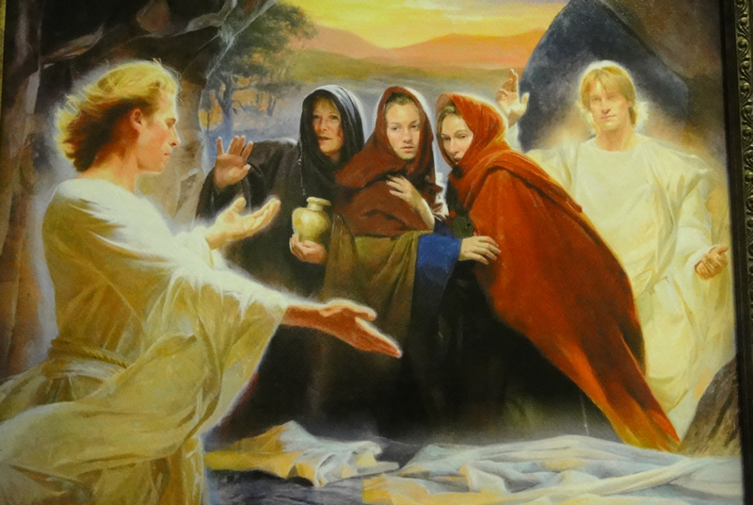
Heb. 12:3 “For consider him …”
3. Appears to Peter.
A. Notice the specific instructions to the women
Mark 16:7,8 “Be not affrighted: Ye seek Jesus, which was crucified: he is risen; he is not here:
behold the place where they laid him.
go … tell his disciples
and Peter
that he goeth before you”

Slide 20
Heb. 12:3 “For consider him …”
3. Appears to Peter. (1 Cor. 15:5)
B. Even though Peter denied Jesus,
Jesus didn’t deny Peter another chance.
2 Timothy 2:13
“If we believe not, yet he abideth faithful:
he cannot deny himself.”
Jesus doesn’t easily give up on people, (2 Pt. 3:9)
and neither should we!

Slide 21
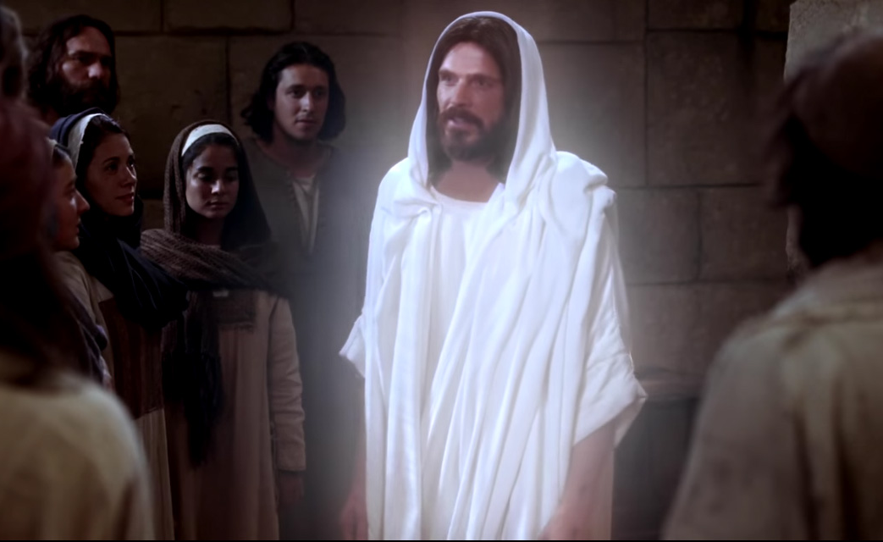
Heb. 12:3 “For consider him …”
4. Appears to Disciples. Luke 24:36-39
“Jesus himself stood in the midst of them, and saith unto them, Peace be unto you.
A. He rebuked them.
“But they were terrified and affrighted, and supposed that they had seen a spirit.
And he said …, Why are ye troubled?
and why do thoughts arise in your hearts?
Behold my hands and my feet, that it is I”

Slide 22
4. Appears to Disciples.
B. He reminds them. Luke 24:44-45
“These are the words which I spake unto you, while I was yet with you, that all things must be fulfilled, …concerning me.
Then opened he their understanding,
that they might understand the scriptures”
1) He did this by the Holy Spirit! Jn 16:13
“…He will guide you into all truth… “

Slide 23
4. Appears to Disciples.
B. He reminds them.
C. He “inspires” them!
In Jn 14:17 He promised “the Spirit of truth…
for he dwelleth with you,
In John 20:22 “he breathed on them, and saith,
Receive ye the Holy Ghost:”
Jn 20:24 “But Thomas…was not with them when Jesus came.
and shall be in you.

Slide 24
4. Appears to Disciples.
He rebukes, reminds, and inspires them.
Jn 20:24,25 “But Thomas…was not with them
when Jesus came.
The other disciples said… We have seen the Lord.
But he said unto them, Except I shall see in his hands the print of the nails, and put my finger into the print of the nails, and thrust my hand into his side, I will not believe!”

Slide 25
Heb. 12:3 “For consider him …”
4. Appears to Disciples.
D. He returns for Thomas. John 20:26
“after eight days again his disciples were within,
{Must have been a miserable 8 days for Thomas!}
and Thomas with them:
then came Jesus, the doors being shut,
and stood in the midst, and said,
Peace be unto you.”

Slide 26
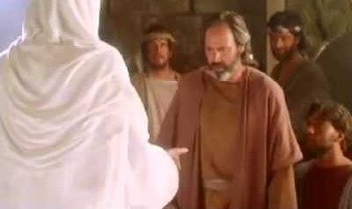
Heb. 12:3 “For consider him …”
4. Appears to Disciples. John 20:27
“Then saith he to Thomas,
(Jesus must have been listening!)
Reach hither thy finger, and behold my hands;
and thrust it into my side:
and be not faithless,
but believing.”

Slide 27
Heb. 12:3 “For consider him …”
4. Appears to Disciples.
D. He returns for Thomas.
1) Jesus knew where they were!
2) Jesus knew how they were!
(Confused, doubtful, anxious)
3) Jesus knew what they needed!
“Peace be unto you” Jn 20:21,27
(Hiding in fear)

Slide 28
How do we know what Jesus would do?
By considering what he did do!
He encouraged a faithful Mary.
He inspired 2 frustrated disciples.
He restored a backslidden Peter.
He emboldened the fearful apostles.
He challenged a doubting Thomas.

Slide 29
Application: Do you know any:
Faithful followers to encourage?
Frustrated people to inspire?
Fallen believers to restore?
Fearful followers to embolden?
Faithless “Thomas’” to challenge?

Slide 30
1 Peter 2:21 “For hereunto were ye called: because Christ also suffered for us,
leaving us an example,
that ye should
follow his steps”

Slide 31
Isaiah 61:1-3
Luke 4:18

