Slide 1
“Follow Me!”

Slide 2
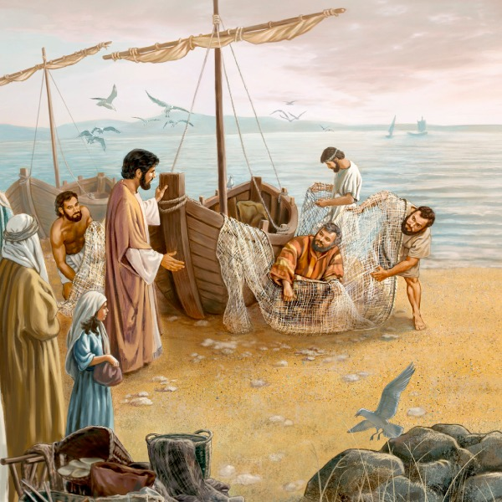
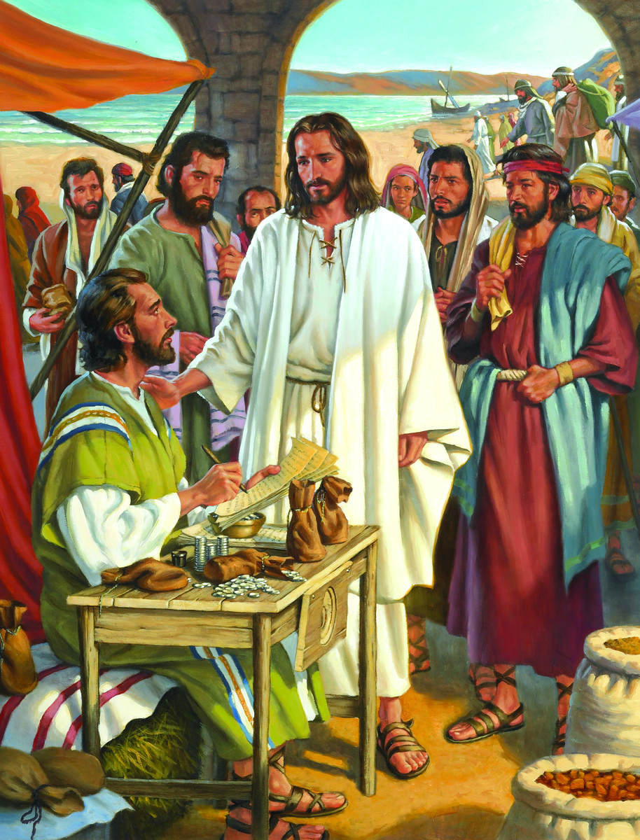
Jesus consistently invited people to Follow Him during his ministry!
Mt. 4:19
Mt. 9:9

Slide 3
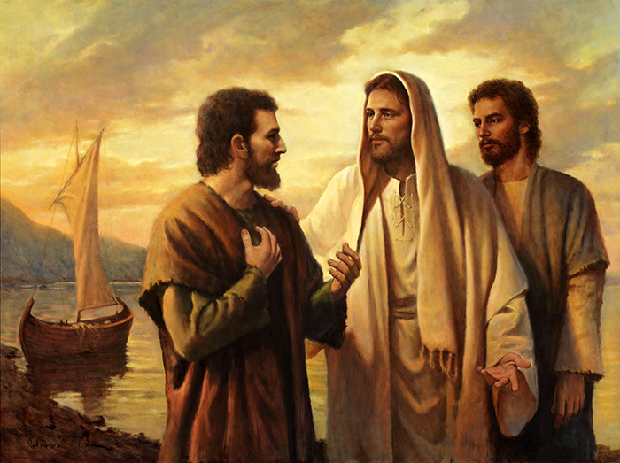
He repeated this invitation after his resurrection!
Jn 21:19,22 “Follow Me”

Slide 4
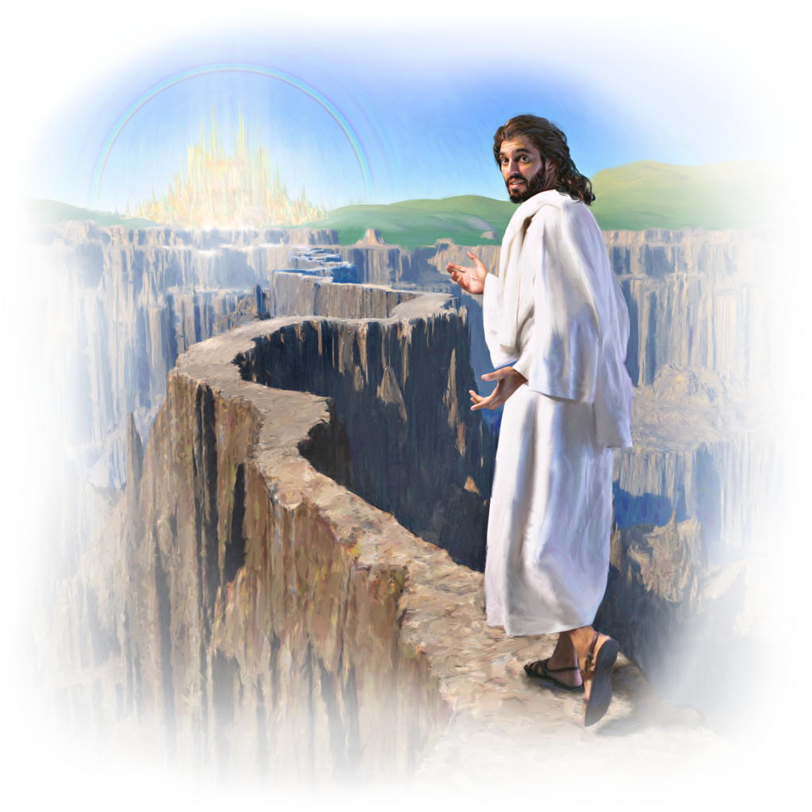
And He repeats it still!
1 Pt 2:21 “hereunto were ye called…
that ye should follow his steps…”
Epakolouthe’ō: accompany him!
If we’re to “walk worthy of the vocation wherewith we are called” (Eph. 4:1),
It’s critical that we understand what Following Jesus actually looks like.

Slide 5
How can we recognize “His Steps”?
We can follow his Instructions.
Jn 14:15-17,26 “If ye love me, keep my commandments.
And …the Father…shall give you another Comforter, …
Even the Spirit of Truth…
26…he shall teach you all things…
Jn 10:27 “My sheep hear my voice,
and I know them,
and they follow me!”

Slide 6
How can we recognize “His Steps”?
We can follow his example! 1 Pt 2:21
“…Christ also left us an example,
{Hypogrammos’: a copy for imitation.}
that we should follow in his steps.”
John 13:15 “For I have given you an example,
that ye should do as I have done.”
What did he choose to do?

Slide 7
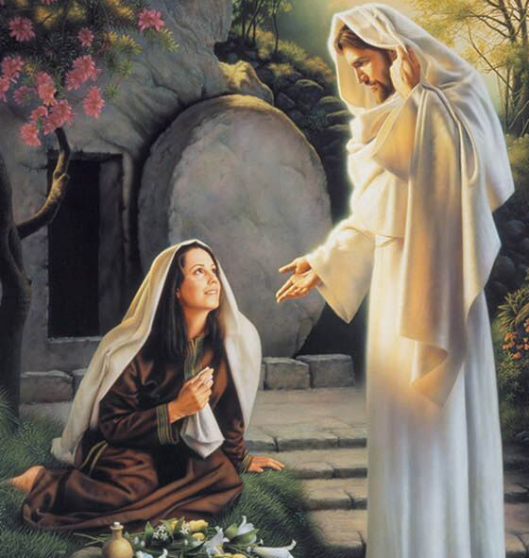
Heb. 12:3 “For consider him …”
Last week we began to consider Jesus’ priorities
after His resurrection.
He encouraged a
faithful Mary
Mk 16:9-11 “he appeared first to
Mary Magdalene,”
See also John 20

Slide 8
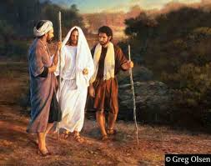
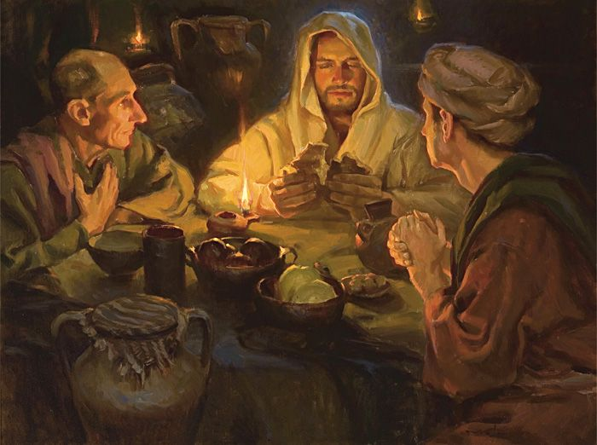
Heb. 12:3 “For consider him …”
2. He inspired some discouraged disciples.
Luke 24:27 “And beginning at Moses and all the prophets,
he expounded unto them in all the scriptures the things concerning himself.”
Lk 24:32 “Did not our heart burn within us, …
while he opened to us
the scriptures?”

Slide 9
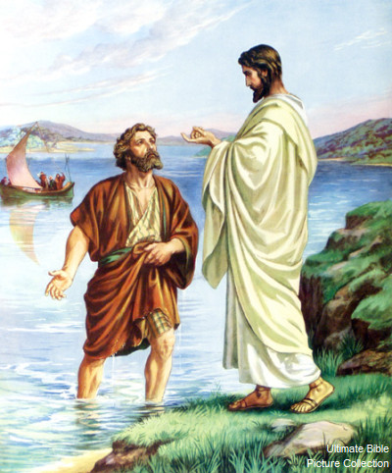
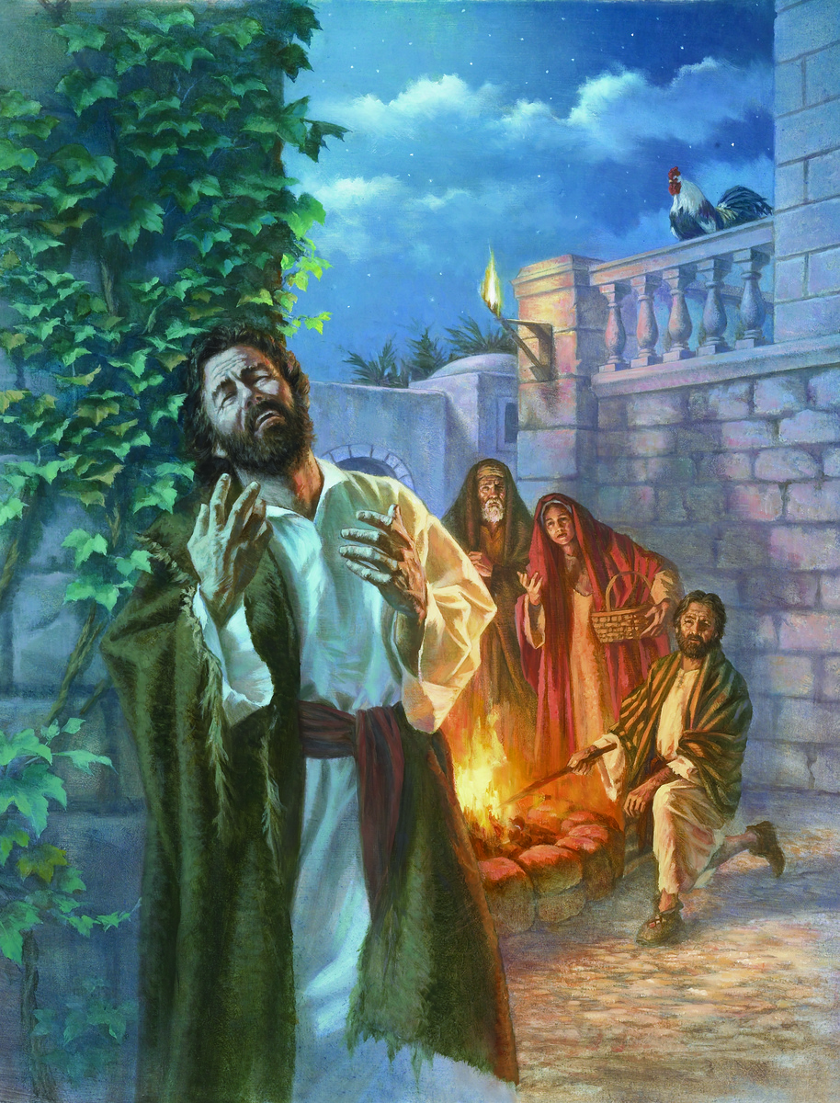
Heb. 12:3 “For consider him …”
3. He restored a backslidden Peter 1 Cor 15:5
Lk 24:33-35 “they rose up and returned to Jerusalem,
Saying, The Lord is risen indeed,
and hath appeared
to Simon.”

Slide 10
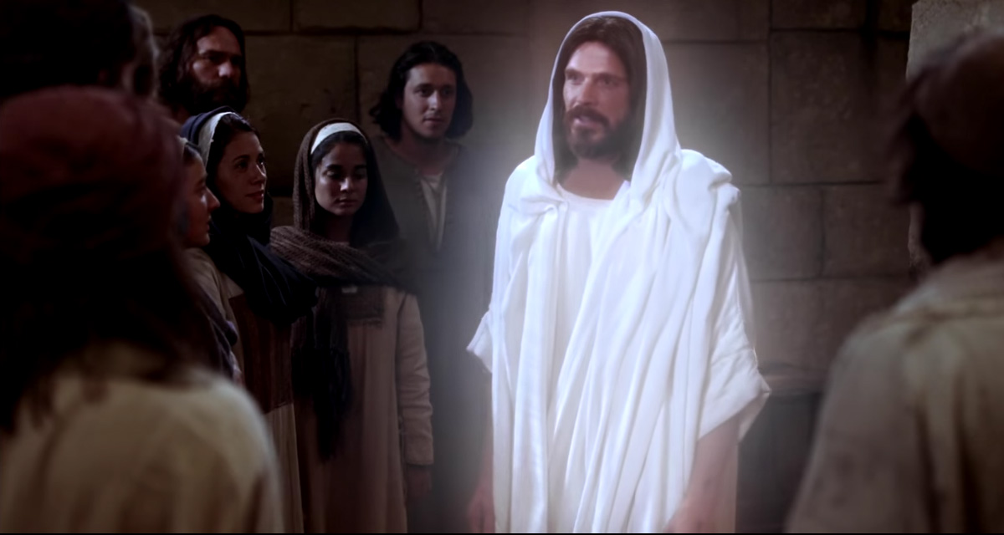
Heb. 12:3 “For consider him …”
4. He emboldened the fearful apostles. Jn 20:21
“Peace be unto you: as my Father hath sent me,
even so send I you.”
“But Thomas, …,
was not with them when Jesus came.”

Slide 11
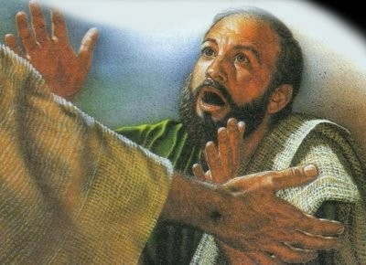
Heb. 12:3 “For consider him …”
5. He challenged a doubting Thomas. Jn 20:26
“after eight days again his disciples were within,
and Thomas with them:
then came Jesus, the doors being shut, and stood in the midst, and said,
Peace be unto you.”
27 …Be not faithless, but believing.”

Slide 12
Jesus told them he’d meet them in Galilee (Mt 28:10)
But several weeks went by before Jesus reappeared.
When he did finally appear to them:
6. He reminded the drifting disciples of His
priorities. Jn 21
A. Several of them had gone back to their fishing boats.
John 21:3 “Peter saith unto them, I go a fishing.
They (6 of them) say unto him, We also go with thee. ..;
and that night they caught nothing.”
(And what theirs should be!)

Slide 13
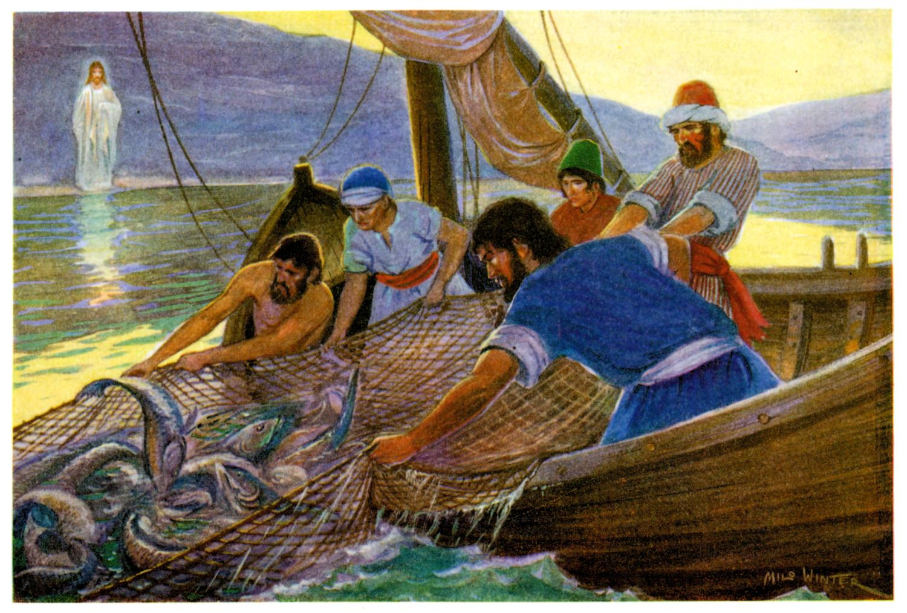
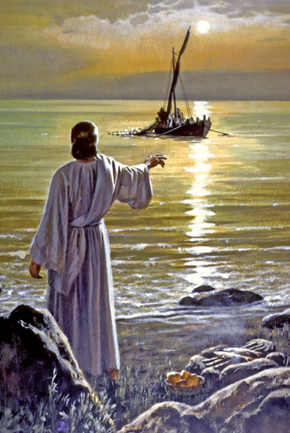
6. He reminded the drifting disciples. Jn 21
B. Jesus gave them specific instructions. Jn 21:5-6 “Then Jesus …said unto them, Cast the net on the right side of the ship, and ye shall find.
They cast and now they were not able to draw it for the
multitude of fishes.”
Sound familiar?
(See Luke 5:4-10)

Slide 14
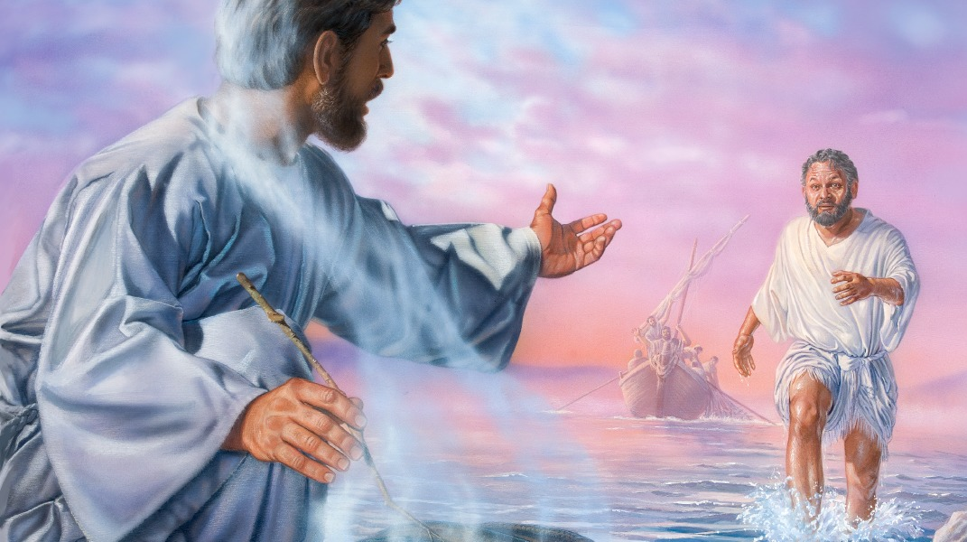
6. He reminded the drifting disciples. Jn 21
C. After they obeyed, they finally recognize Jesus.
7 “It is the Lord!
Now when Peter heard that it was the Lord,
he …did cast himself into the sea.”
9 “they saw a fire of coals there, and fish laid thereon, and bread…
12 “come and dine”

Slide 15
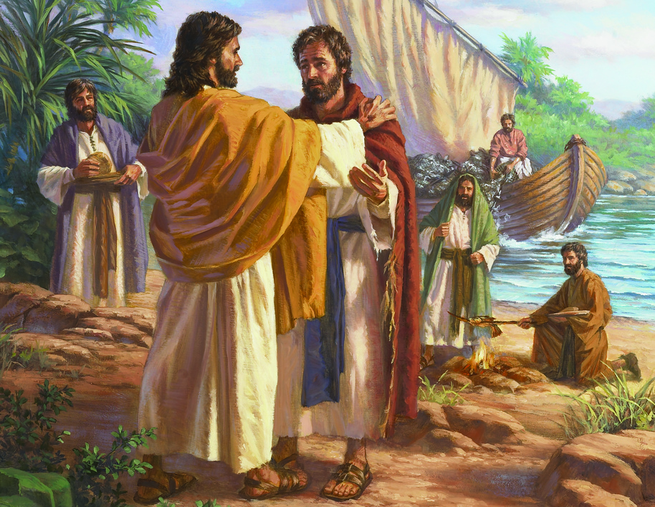
6. He reminded the drifting disciples. Jn 21
D. After Breakfast, He questions Peter. (3x)
“lovest thou me more than these?” vs 15,16,17
What are the “these” in your life that compete with God’s will?
2) Why did he ask 3 times?
3) Notice Jesus’ command 15-17
“Feed my lambs…sheep”
Realign your priorities and agenda to Mine!

Slide 16
“lovest thou me more than these?” vs 15,16,17
agapaō: involves unconditional commitment
4) Notice Peter’s answer:
“Lord thou knowest that I love thee.” 15,16,17
Phileō: I’m fond of you
a) Phileo love is about comfort.
b) Agape love is about commitment.
Comfort and commitment are not always synonymous!

Slide 17
Conclusion:
What happens when “commitment”
is no longer comfortable?
(The quality & Kind of our Love
is tested and revealed.)
Many are “fond” of Jesus,
but few are really “focused” (committed to)
Him and His agenda.

Slide 18
In Luke 9 Jesus is heading toward Jerusalem.
1) The Samaritans refused him passage.
Lk 9:52-54 “when the time was come that he should be received up, he stedfastly set his face to go to Jerusalem,
And sent messengers before his face: and they went ...into a village of the Samaritans, to make ready for him.
And they did not receive him, because his face was as though he would go to Jerusalem.”
When His agenda didn’t agree with theirs,
They rejected Him!

Slide 19
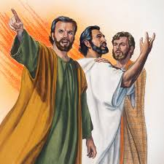
Lk 9:54 “when James and John saw this, they said, Lord, wilt thou that we command fire to come down from heaven, and consume them, even as Elias did?
But he turned, and rebuked them, and said,
Ye know not what manner of spirit ye are of.
For the Son of man is not come
to destroy men's lives,
but to save them.
And they went to another village.”

Slide 20
2) Others wanted to follow him but when His
agenda became uncomfortable,
Most simply walked away.
Luke 9:57-60 “as they went in the way, a man said,
Lord, I will follow thee withersoever thou goest.
(Remember where he was heading!?!?)
58 …Foxes have holes, and birds of the air have nests; but the Son of man hath not where to lay his head.

Slide 21
When His agenda became uncomfortable,
others simply walked away. Luke 9:59-61
“And he said unto another, Follow me.
But he said, Lord, suffer me first to go
and bury my father.
60 Jesus said unto him, Let the dead bury their dead:
but go thou and preach the kingdom of God.
61 “And another said, Lord, I will follow thee;
but let me first go bid them farewell, which are at home.
(wait until he dies!)

Slide 22
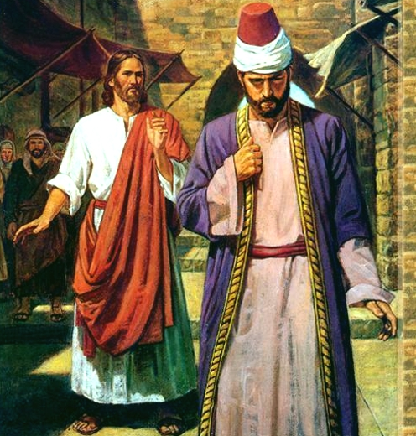
62 And Jesus said unto him,
No man, having put his hand to the plough, and looking back,
is fit for the kingdom of God.”
We cannot really follow Jesus until we deal with this
“Me first” tendency!
“I am crucified with Christ…”
Gal. 2:20,21; Col. 3

Slide 23
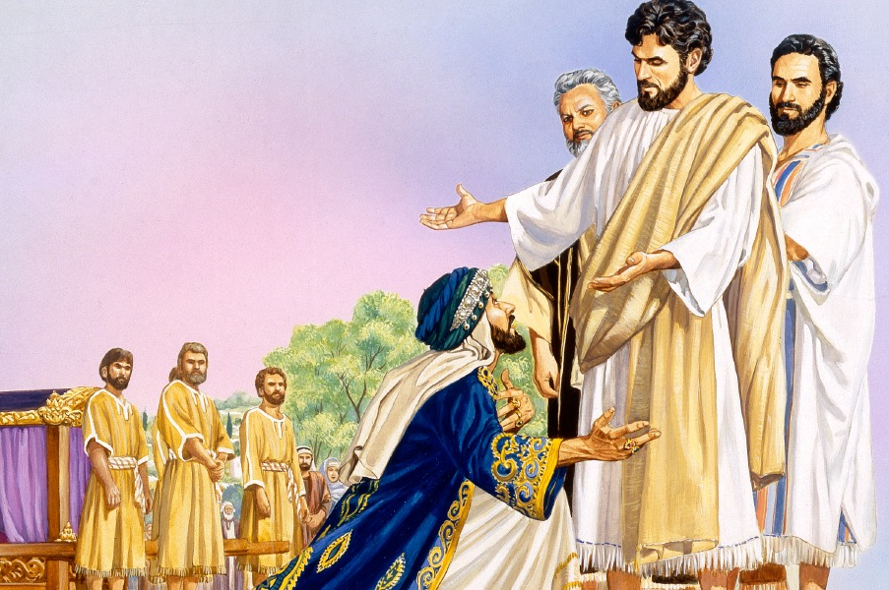
3) It’s hard to surrender our own agendas.
“Jesus loved him, and said unto him, One thing thou lackest:
go thy way, sell whatsoever thou hast, and give to the poor,
and thou shalt have treasure in heaven:
and come, take up the cross, and follow me.
And he was sad …, and went away grieved:
for he had great possessions.”
Mk 10:21-22

Slide 24
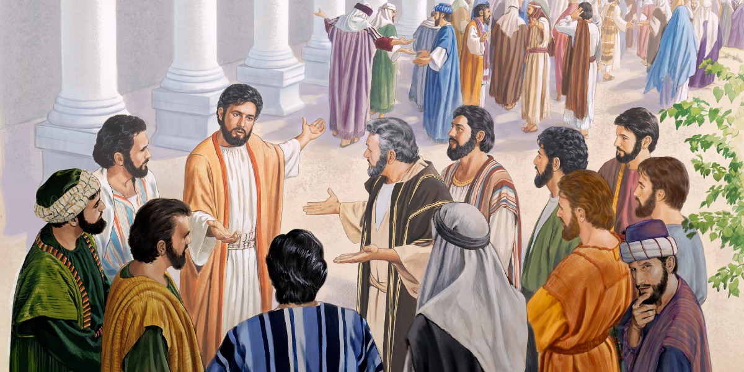
Jn 6:66-67 “From that time many of his disciples
went back, and walked no more with him”.
67 “Then said Jesus …, Will ye also go away?”

Slide 25
John 20:30-31
“Many other signs truly did Jesus in the presence of his disciples, which are not written in this book:
But these are written, that ye might:
believe that Jesus is the Christ, the Son of God;
Pisteu’ō: entrust, commit to
and that believing ye might have life (Jn 10:10)
through his name.”
On’oma: authority!

Slide 26
Mt 28:16-18 “Then the eleven disciples went away into Galilee, into a mountain where Jesus appointed them.
And when they saw him, they worshipped him:
but some doubted.
And Jesus came and spake unto them, saying,
All power is given unto me in heaven and in earth.

Slide 27
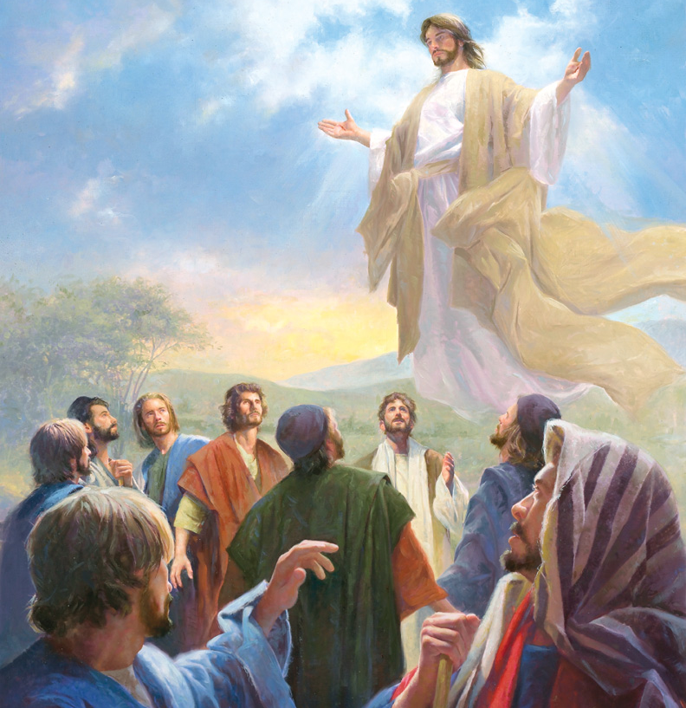
Matthew 28:19-20 “Go ye therefore, and teach all nations, baptizing them in the name of the Father, and of the Son, and of the Holy Ghost:
Teaching them to observe all things
whatsoever I have commanded you:
and, lo, I am with you always,
even unto the end of the world. Amen.”

Slide 28
Are you really only “fond of Jesus?”
Or are you truly willing to “follow Him?”

Slide 29
1 Pt 2:21 “hereunto were ye called
…that ye should
follow his steps…”
Epakolouthe’ō: accompany him!
Are you willing to accompany Him on His Great
“co-mission?”
1 Cor 3:9; Mt.11:29

