Slide 1
Σπουδάσον γραφή
By Joseph Peters

Slide 2
The Necessity of Truth
Truth is self existent
Truth is to be discovered, not created
Truth is neglected in our society
Truth must be the priority of churches

Slide 3
Objective
Anyone can more accurately interpret Scripture
By taking these four steps

Slide 4
Rationale
Seek to understand the original context
01
Let God’s Word guide you.
02
Determine the theological principles
03
Apply those principles to your current context
04

Slide 5
Seek to Understand the Original Context

Slide 6
Seek to understand the original context
If your interpretations fits your context, but not the original context, then it is not the right interpretation.

Slide 7
Examples
Example: Jeremiah 29:11
“For I know the thoughts that I think toward you, saith the LORD, thoughts of peace, and not of evil, to give you an expected end.”
Romans 8:28
“And we know that all things work together for good to them that love God, to them who are the called according to his purpose.”

Slide 8
Let God’s Word Guide You

Slide 9
Let God’s Word Guide You
Our Beliefs should be shaped by God’s Word, God’s Word should not be shaped by our beliefs.

Slide 10
Example 1
Leviticus 18:22
Thou shalt not lie with mankind (זָכָר), as with womankind: it is abomination
Leviticus 20:13a
If a man also lie with mankind (זָכָר), as he lieth with a woman, both of them have committed an abomination…

Slide 11
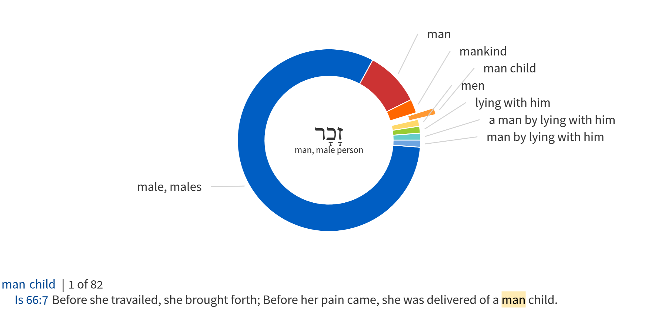

Slide 12
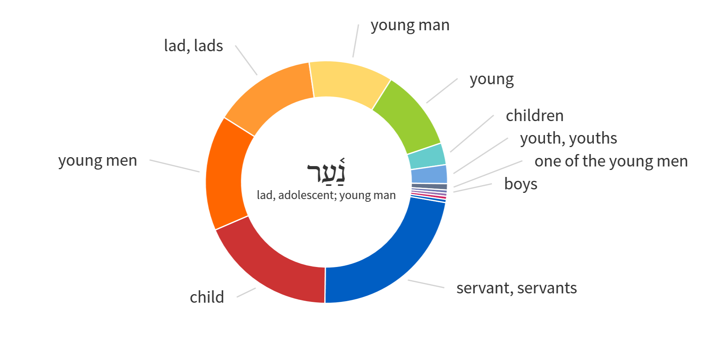
Used 240 times

Slide 13
Which is Possible and which is Likely
Leviticus 18:22
Thou shalt not lie with mankind, as with womankind: it is abomination
Or
Leviticus 18:22
Thou shalt not lie with young boys, as with womankind: it is abomination

Slide 14
Example 2
Exodus 21:22,23 NKJV
22 “If men fight, and hurt a woman with child, so that she gives birth prematurely, yet no harm follows, he shall surely be punished accordingly as the woman’s husband imposes on him; and he shall pay as the judges determine.
23 But if any harm follows, then you shall give life for life,

Slide 15
Determine the Theological Principles

Slide 16
Determine the theological principles
The original context will likely be different than our current context.
However, if it is in the Bible, then there is likely a timeless and universal principle that can be learned from it.

Slide 17
Example 1
Bad Example:
The story of David teaches us that we should attack tall people to prove God’s dominance over height
Good example:
The story of David reminds us that we should not be afraid of opposition, knowing that God can help us overcome.

Slide 18
Example 2
Bad Example:
The story of Job teaches us that, if we have a big family, God will take it away
Good Example:
The story of Job reminds us that, even when we do not understand, God is still in control and has a purpose.

Slide 19
Example 3
Bad Example:
The story of Noah teaches us the importance of building boats
Good Example:
The story of Noah reminds us that we should always take God seriously, even if we might not understand.

Slide 20
Apply those Principles to Your Current Context

Slide 21
Apply those principles to your current context
Information without application is pointless
James 1:22
But be ye doers of the word, and not hearers only, deceiving your own selves.

Slide 22
Rationale
Seek to understand the original context
01
Let God’s Word guide you.
02
Determine the theological principles
03
Apply those principles to your current context
04

Slide 23
Bibliography
Barrick, William D., “Exegetical Fallacies: Common Interpretive Mistakes Every Student Must Avoid.” The Master’s Seminary Journal, vol. 19, no. 1, Spr 2008.
Carson, D. A. Exegetical Fallacies, Grand Rapids: Baker Academic, 1996.
Duvall, J. Scott and J. Daniel Hays, Grasping God’s Word: A Hands-On Approach to Reading, Interpreting, and Applying the Bible, Grand Rapids: Zondervan, 2012.
Duvall, J. Scott and J. Daniel Hays, Journey into God’s Word: Your Guide to Understanding and Applying the Bible. Grand Rapids: Zondervan, 2008.
Kaiser, Walter C. Jr. and Moises Silva, Introduction to Biblical Hermeneutics: The Search for Meaning. Grand Rapids: Zondervan, 2007.
Klein, William W., Craig L. Blomberg, and Robert L. Hubbard Jr., Introduction to Biblical Interpretation, Third Edition. Grand Rapids, MI: Zondervan, 2017.
Köstenberger, Andreas and Richard Patterson, Invitation to Biblical Interpretation: Exploring the Hermeneutics Triad of History, Literature, and Theology, Grand Rapids: Kregel Publications.

