Slide 1
Ἰάκωβος καὶ πίστις
By Joseph D. Peters

Slide 2
Objective
Everyone can grow in their faith in Christ
Through these three things

Slide 3
Rationale
Through Trials
Through Doing
Through Relying

Slide 4
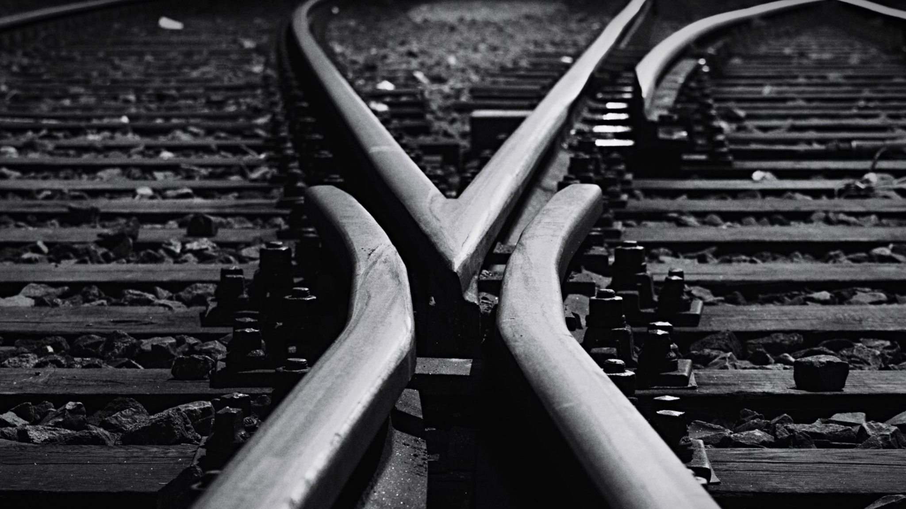
Through Trials

Slide 5
Peter and James P1
James 1:2-4, 12 (NKJV)
2 My brethren, count it all joy when you fall into various trials, 3 knowing that the testing of your faith produces patience. 4 But let patience have its perfect work, that you may be perfect and complete, lacking nothing.
12 Blessed is the man who endures temptation; for when he has been approved, he will receive the crown of life which the Lord has promised to those who love Him.

Slide 6
Peter and James P2
1 Peter 1:6-9
6 In this you greatly rejoice, though now for a little while, if need be, you have been grieved by various trials, 7 that the genuineness of your faith, being much more precious than gold that perishes, though it is tested by fire, may be found to praise, honor, and glory at the revelation of Jesus Christ, 8 whom having not seen you love. Though now you do not see Him, yet believing, you rejoice with joy inexpressible and full of glory, 9 receiving the end of your faith—the salvation of your souls.

Slide 7
Responding through God’s Wisdom
James 1:5-6, 19-20.
5 If any of you lacks wisdom, let him ask of God, who gives to all liberally and without reproach, and it will be given to him. 6 But let him ask in faith, with no doubting, for he who doubts is like a wave of the sea driven and tossed by the wind....
19 So then, my beloved brethren, let every man be swift to hear, slow to speak, slow to wrath; 20 for the wrath of man does not produce the righteousness of God

Slide 8
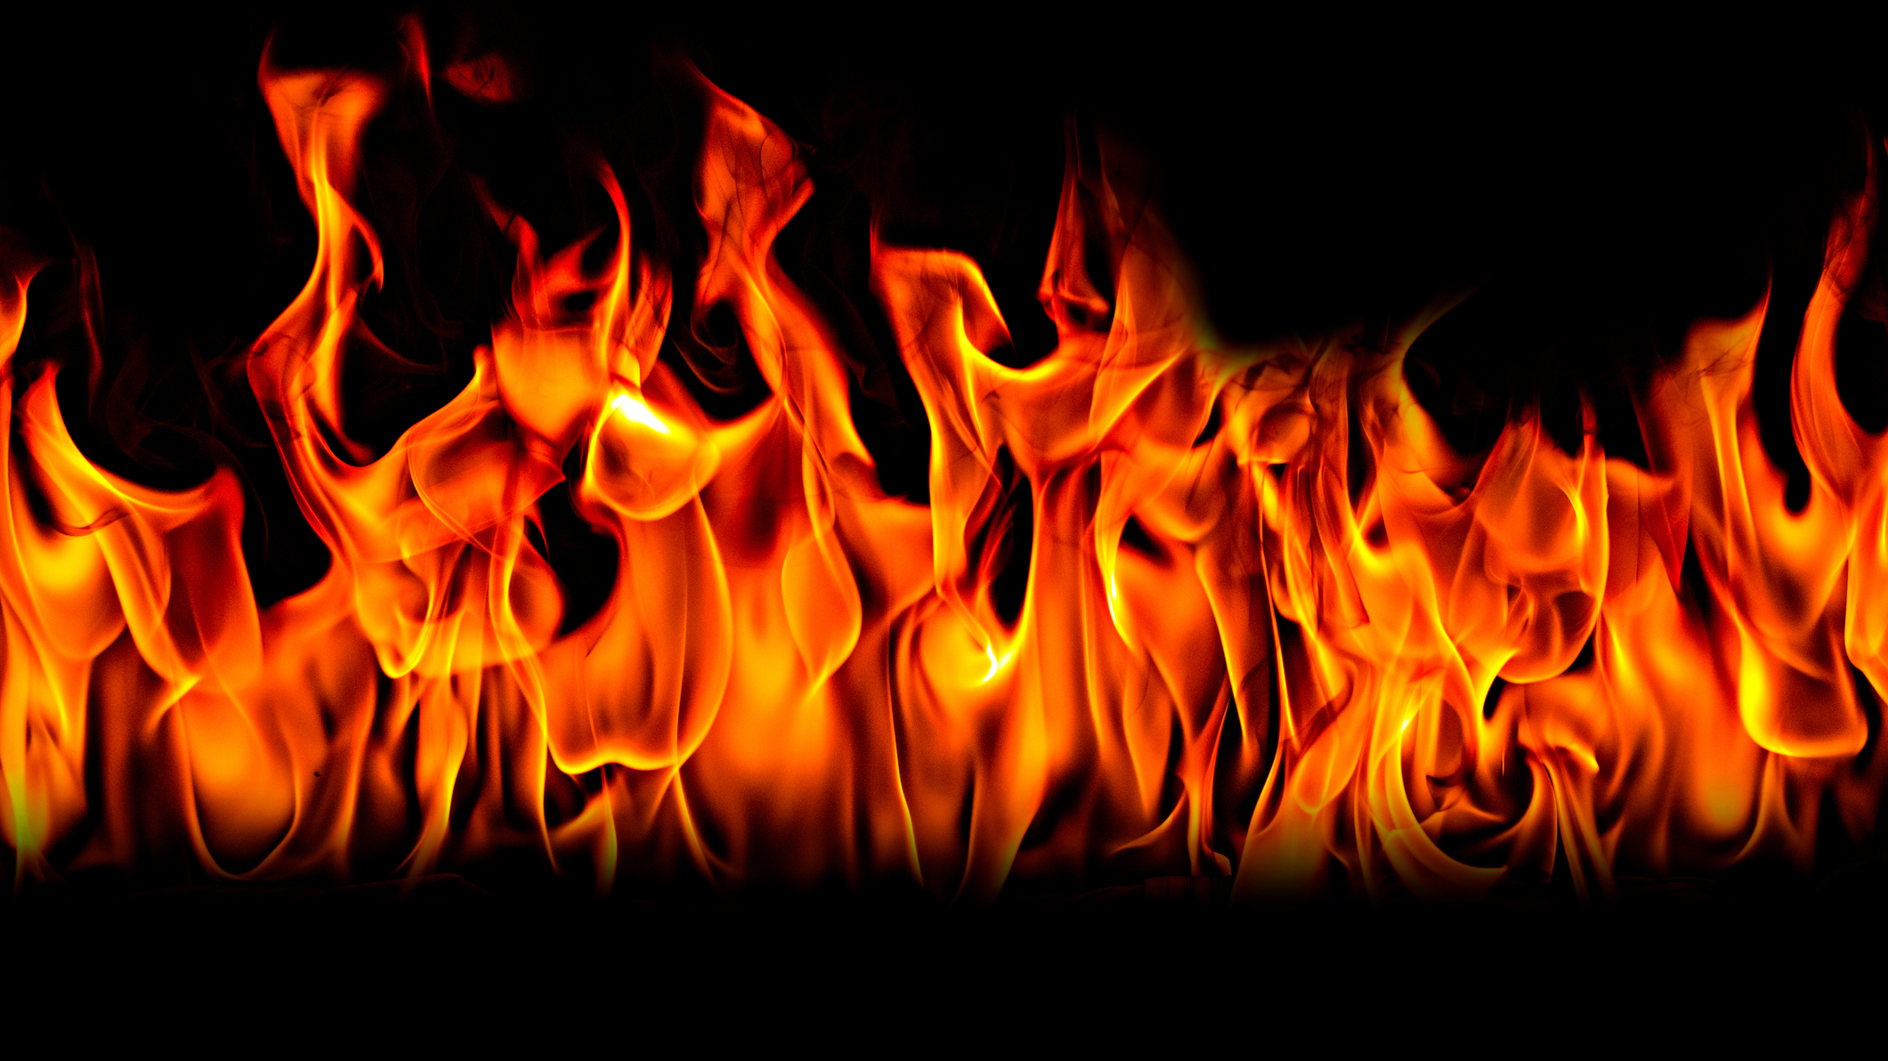
Shadrach, Meshack, Abednego
Faced with a situation where they needed to follow God or follow the king.
The king claimed that God could not save them from him putting them to death
They disagreed, claiming that God could save them, but that even if He chose not to, they would still follow him.
God did save them
The king promoted them.

Slide 9
Through Doing

Slide 10
Take Action
James 1:22-25
22 But be doers of the word, and not hearers only, deceiving yourselves. 23 For if anyone is a hearer of the word and not a doer, he is like a man observing his natural face in a mirror; 24 for he observes himself, goes away, and immediately forgets what kind of man he was. 25 But he who looks into the perfect law of liberty and continues in it, and is not a forgetful hearer but a doer of the work, this one will be blessed in what he does.

Slide 11
Showing Faith through Works
James 2:14-18
14 What does it profit, my brethren, if someone says he has faith but does not have works? Can faith save him? 15 If a brother or sister is naked and destitute of daily food, 16 and one of you says to them, “Depart in peace, be warmed and filled,” but you do not give them the things which are needed for the body, what does it profit? 17 Thus also faith by itself, if it does not have works, is dead.
18 But someone will say, “You have faith, and I have works.” Show me your faith without your works, and I will show you my faith by my works

Slide 12
Showing Faith through Works P2
Matthew 7:15-20
15 “Beware of false prophets, who come to you in sheep’s clothing, but inwardly they are ravenous wolves. 16 You will know them by their fruits. Do men gather grapes from thornbushes or figs from thistles? 17 Even so, every good tree bears good fruit, but a bad tree bears bad fruit. 18 A good tree cannot bear bad fruit, nor can a bad tree bear good fruit. 19 Every tree that does not bear good fruit is cut down and thrown into the fire. 20 Therefore by their fruits you will know them.

Slide 13
Showing Faith through Works P3
Galatians 5:19-20, 22-23 (NKJV)
Now the works of the flesh are evident, which are: adultery, fornication, uncleanness, lewdness, 20 idolatry, sorcery, hatred, contentions, jealousies, outbursts of wrath, selfish ambitions, dissensions, heresies
22 But the fruit of the Spirit is love, joy, peace, longsuffering, kindness, goodness, faithfulness, 23 gentleness, self-control. Against such there is no law.

Slide 14
Ananias and Saphira
Barnabas sold some land and gave it to the Church, furthering his reliance/faith on God
Ananias and Saphira did the same but kept some of the money, furthering their reliance/faith in money and deceit
They both died.

Slide 15
Through Reliance

Slide 16
The Faith of the Poor P1
James 1:9-11,
9 Let the lowly brother glory in his exaltation, 10 but the rich in his humiliation, because as a flower of the field he will pass away. 11 For no sooner has the sun risen with a burning heat than it withers the grass; its flower falls, and its beautiful appearance perishes. So the rich man also will fade away in his pursuits.

Slide 17
The Faith of the Poor P2
James 2:5-7
5 Listen, my beloved brethren: Has God not chosen the poor of this world to be rich in faith and heirs of the kingdom which He promised to those who love Him? 6 But you have dishonored the poor man. Do not the rich oppress you and drag you into the courts? 7 Do they not blaspheme that noble name by which you are called?

Slide 18
The Rich Man and Lazarus
Jesus tells the story of two people from opposite economic circumstances (one rich, one poor).
After death, the poor man was comforted in paradise, whereas the rich man suffered in Hell.

Slide 19
The Rich Young Ruler
There was a young rich ruler who followed the Law of God
He asked Jesus how to go to Heaven
Jesus, out of love, told him that he was lacking only one thing.
He needed to give all His wealth away and follow Christ
The man left sad
Jesus explains the difficulty for the rich to go to Heaven because of their faith in riches

Slide 20
Conclusion
Everyone can grow in their faith in Christ, Through these three things
Through Trials
Through Doing
Through Relying

