Slide 1
Stress is an inevitable part of modern society.
It’s responsible for a series of physical, relational
and spiritual problems.
In fact the CDC estimates that 90% of all US illness is stress related.

Slide 2
Why is Holiday season so particularly stressful?
Unresolved family issues.
Insecurities
Financial pressures
Expectations

Slide 3
Jesus spoke clearly about how the
“Cares of this world, and the deceitfulness of riches”
would tend to choke us. (Mk 4:19)
Can you associate?

Slide 4
Mt 11:28 “Come unto me, all that labor and are heavy laden, and I will give you rest.
29 Take my yoke upon you and learn of me
…ye shall find rest for your souls.”

Slide 5
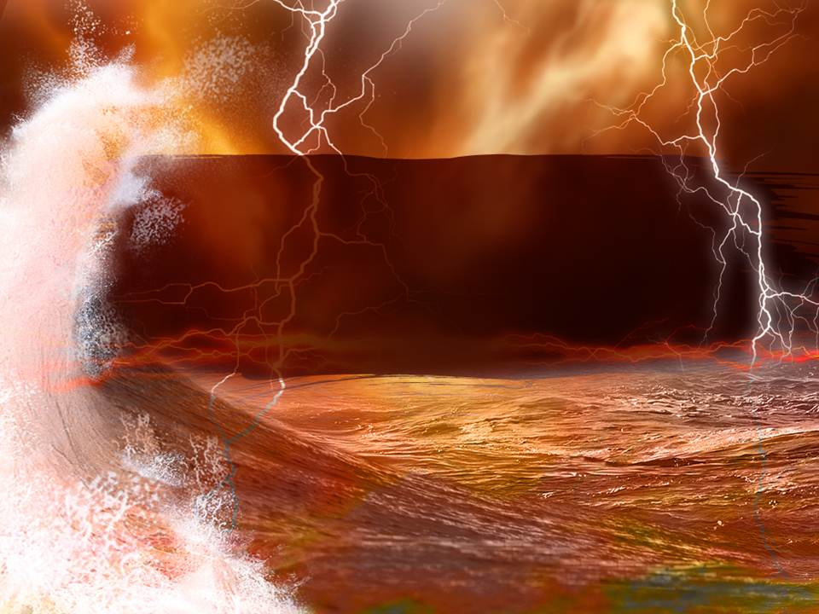
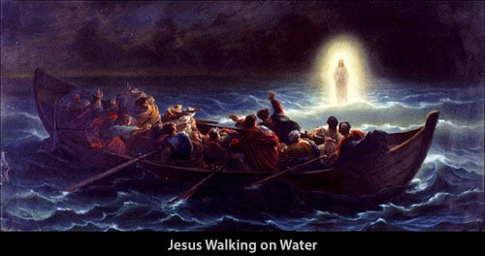
He graphically illustrated this in Mt. 14
John was beheaded. Vs 1-12
Jesus went to desert place to reflect. Vs 13
The multitudes followed him and he fed them. Vs 14-21
He “Constrains” the disciples to cross the sea (alone) vs 22
Jesus prays and then walks across the sea to meet them. 23,24
They panic at the sight. Vs 26
”It is I; be not afraid” 27

Slide 6
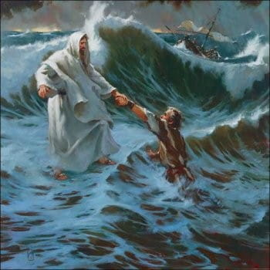
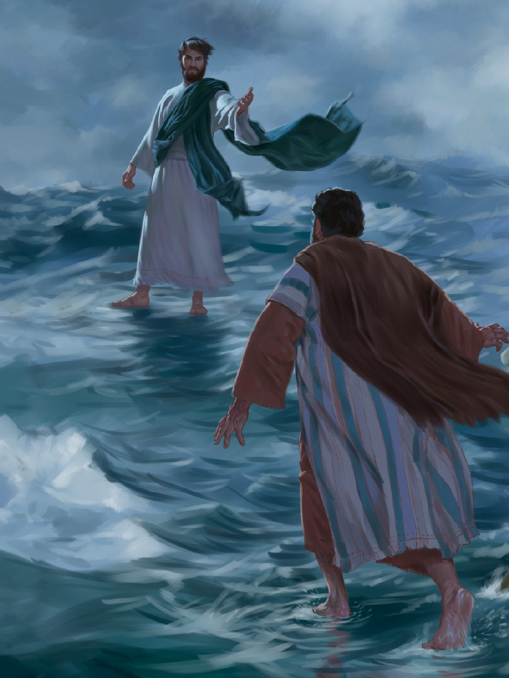
He graphically illustrated this in Mt. 14
“If it be thou, bid me come unto thee on the water.” 28
“Come!” vs 29
“But when he saw the wind boisterous, he was afraid; and beginning to sink,
he cried, saying, Lord, save me!” 30

Slide 7
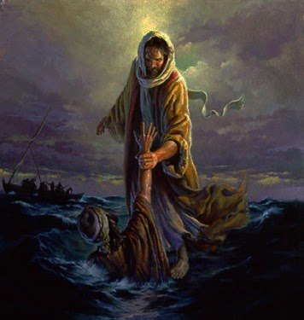
He graphically illustrated this in Mt. 14
“And immediately Jesus
stretched forth his hand,
and caught him,
and said unto him,
O thou of little faith,
wherefore didst thou doubt?

Slide 8
Peter learned that it’s safer in the storm with Jesus,
than in the boat without Him!
Jesus’ Strategy for Stress.

Slide 9
We tend to blame our stress on people or problems that pressure us.
Stress is actually a bi- product of how we respond to these pressures.
Jesus was under almost constant “demands”,
yet he never seemed rushed, worried or stressed.

Slide 10
Jesus’ solution for a stress less life:
“Come unto me, all ye that labor and are heavy laden, and I will give you rest. Take my yoke upon you, and learn of me…and ye shall find rest unto your souls.
For my yoke is easy, and my burden is light.” Mt 11:28-30
Labor (Kopia’o) weary
Heavy laden (phortiz’o) over loaded.
Rest (anapau’ō) To stop and refresh.
Easy (chrēstos’) fitted; usefully employed.

Slide 11
Jesus modeled several principles that will help us in dealing with the “stressors” in our lives.
1. IDENTIFICATION: I Must Know Who I Am.
A. Jesus Knew Who He Was. (Mt. 17:5; Jn. 8:18)
“I am the Bread of Life, the Way, Truth, Life ... the Light of the world . . . the Son of God . . . the Messiah . . the door, the good shepherd, the vine . .
the resurrection and the life…”
(Jn. 8:12, Mk. 14:62, Jn. 6:35, Jn. 11:25 14:6, 15:1, etc)

Slide 12
IDENTIFICATION: I Must Know Who I Am.
1) Jesus’ clarity offended others. Jn 8:12-14
“I am the light of the world: he that followeth me shall not walk in darkness, but shall have the light of life.
The Pharisees therefore said unto him, Thou bearest record of thyself; thy record is not true.
Jesus answered and said unto them,
Though I bear record of myself, yet my record is true:
for I know whence I came, and whither I go”.

Slide 13
1. IDENTIFICATION: I Must Know Who I Am.
B. We Need to Understand Who We Are!
1) If you don’t settle this issue of identity,
others will determine it for you. (Ro. 12: 2)
2) God wants us to know & be ourselves. (Ro. 12:3)
“For I say, through the grace given unto me, to every man that is among you, not to think of himself more highly than he ought to think; but to think soberly,
according as God hath dealt to every man the measure of faith.”

Slide 14
Jesus’ Strategy for Stress.
1. Identification: I Must Know Who I Am.
2. DEDICATION: I must Know
Who I’m Trying To Please. Jn 5:28-29
“I do nothing of myself; but as my Father hath taught me, I speak these things.
And he that sent me is with me:
for I do always those things that please him.”
Arestos’: agreeable

Slide 15
2. DEDICATION: Who am I Trying To Please?
A. Once you know who you are,
you must realize whose you are!
Ro 6:17-18 “ye were the servants of sin, but ye have obeyed from the heart that form of doctrine which was delivered you.
Being then made free from sin,
ye became the servants of righteousness.”

Slide 16
2. DEDICATION: Who am I Trying To Please?
A. Once you know who you are,
you must realize whose you are!
(2 Cor. 5:20) “Now then we are ambassadors for Christ, as though God did beseech you by us:
we pray you in Christ's stead,
be ye reconciled to God.”
Katallos’so: changed mutually
(2 Cor. 3:18; Ro. 12:1,2)

Slide 17
2. DEDICATION: Who am I Trying To Please?
B. Pleasing everyone is impossible…
(and therefore highly stressful!)
1) Even God Can’t Please Everybody.
One Of Satan’s Most Effective lies Is That
I Must Be Liked (or approved) By Everyone.
Pr 29:25 "The fear of man bringeth a snare: "

Slide 18
2. DEDICATION: Who am I Trying To Please?
C. HOW DID JESUS HANDLE THIS?
He sought to please only one…, His Father.
John 5:30 "I seek not mine own will, but the will
of the Father which hath sent me."
1) You’ll do the right thing by pleasing God.
2) It will simplify your life if you only have to focus
on pleasing Him. (Rather than everyone else)
3) It will spare you the consequences of the wrong
choices.

Slide 19
Jesus’ Strategy for Stress.
1. Identification: I Must Know Who I Am.
2. Dedication: Who I try To Please.
3. PRIORITIZATION: I must know
what I want to accomplish!
The Main thing is to keep the main thing,
THE MAIN THING! (Mt 6:33)

Slide 20
3. PRIORITIZATION: I must know
what I want to accomplish!
A. No One Has Time To Do Everything!
Eph. 5:16,17 “redeeming the time, because the days are evil. Wherefore be not unwise,
but understanding what the will of the Lord is.
Phil. 3:13 “This one thing I do…
14 I press toward the mark for the prize of the
high calling of God in Christ Jesus”

Slide 21
3. PRIORITIZATION: I must know
what I want to accomplish!
B. In life You will either be
1) Guided by PRIORITIES (Proactive)
2) Or goaded by PRESSURES. (Reactive)
Either toward God’s “Expected end” (Jer. 29:11-14)
or Satan’s “Eternal Waste” (Mt. 7:13; Pr. 14:12)
“There is a way that seemeth right to a man,
But the end thereof are the ways of death”

Slide 22
3. PRIORITIZATION: I must know
what I want to accomplish!
C. Jesus Modeled this Principle Of Priorities.
Jn 9:4-5 “I must work the works of him that sent me, while
it is day: the night cometh, when no man can work.
As long as I am in the world, I am the light of the world.
Luke 4:43 “I must preach the kingdom of God to
other cities also: for therefore am I sent.”

Slide 23
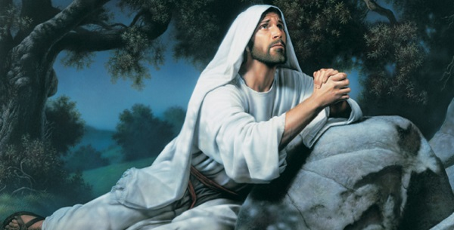
“Now is my soul troubled;
and what shall I say?
Father, save me from
this hour:
Jn 12:27
but for this cause came I unto this hour.”

Slide 24
Conclusion: Jesus’ Strategy for Stress involves:
1) Identification: Who (and whose) are you?
2) Dedication: What will you seek to accomplish?
3) Prioritization: How & When will you do it?
What’s driving You?
Where’s it driving you?
Will you be Guided by God’s Principles and Priorities (Ps. 16:11)…
Or Goaded by Satan’s Pressures and Problems? (Eph. 2:1-3)

Slide 25
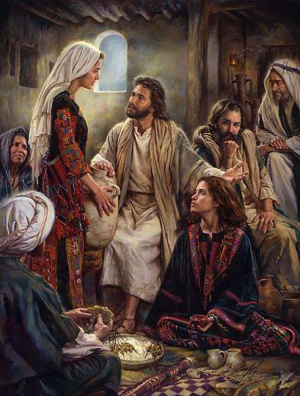
Luke 10:41,42 “Martha, Martha, thou art careful and troubled about many things:
Mary hath chosen that good part,
which shall not be taken
away from her.”
But one thing is needful:
Careful: mer'-im-nah: Distracted!
Troubled: toor-bad'-zo: Crowded!
Needful: Chreia: required, necessary
Good: agathos: beneficial
Will you choose the good part?

Slide 26
Jesus’ Principles for a Stress-less Life

