Slide 1
יוֹנָה הָגָּדֹל אָח ‏‎
By Joseph Peters
JW.org

Slide 2
The Audience and Circumstance
Luke 15:1-3 (KJV) ^{1 “}Then drew near unto him all the publicans and sinners for to hear him. ² And the Pharisees and scribes murmured, saying, This man receiveth sinners, and eateth with them. ³ And he spake this parable unto them, saying…”

Slide 3
The Prodigal Son
Luke 15:11-32
The younger son abandoned and dishonored his father
He returned to his father in humility and repentance
The father did not hold his sins against him
snarkandgrace.wordpress.com

Slide 4
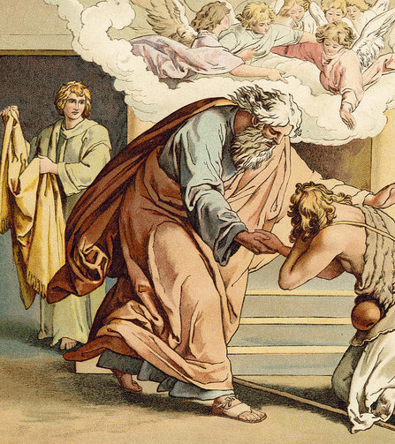
The Older Son
Luke 15:11-32
The older son remained with his father and obeyed him
He did not seem interested in bringing the younger brother back to their father.
When hearing of the younger brother being forgiven, he became angry.
Fine Art America

Slide 5
Objective
No one should discriminate who should be evangelized but, instead, should witness to all people (Matthew 28:18-20).
For these three reasons

Slide 6
Rational
We shouldn’t have double standards for God’s mercy
God’s love and mercy can extend to anyone
Christ has called us to be a witness to all

Slide 7
Who was Jonah? OT
2 Kings 14:25 (KJV) ^{25 “}He restored the coast of Israel from the entering of Hamath unto the sea of the plain, according to the word of the LORD God of Israel, which he spake by the hand of his servant Jonah, the son of Amittai, the prophet, which was of Gathhepher.”

Slide 8
Who was Jonah? NT
Matthew 12:39-41 (KJV) ^{39 “}But he answered and said unto them, An evil and adulterous generation seeketh after a sign; and there shall no sign be given to it, but the sign of the prophet Jonas: ⁴⁰ For as Jonas was three days and three nights in the whale's belly; so shall the Son of man be three days and three nights in the heart of the earth. ⁴¹ The men of Nineveh shall rise in judgment with this generation, and shall condemn it: because they repented at the preaching of Jonas; and, behold, a greater than Jonas is here.”

Slide 9
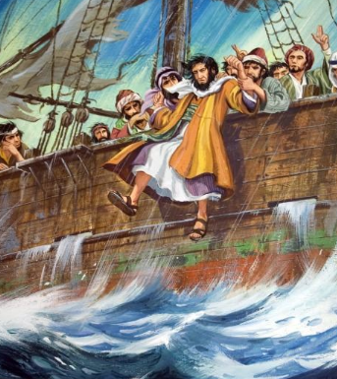
Rebellious Jonah
Jonah 1
God calls Jonah to preach against Nineveh
Jonah runs away
God sends a storm
Jonah does not repent
Jonah is thrown overboard
God delivers him with a sea creature
graceofgod-christ.blogspot.com

Slide 10
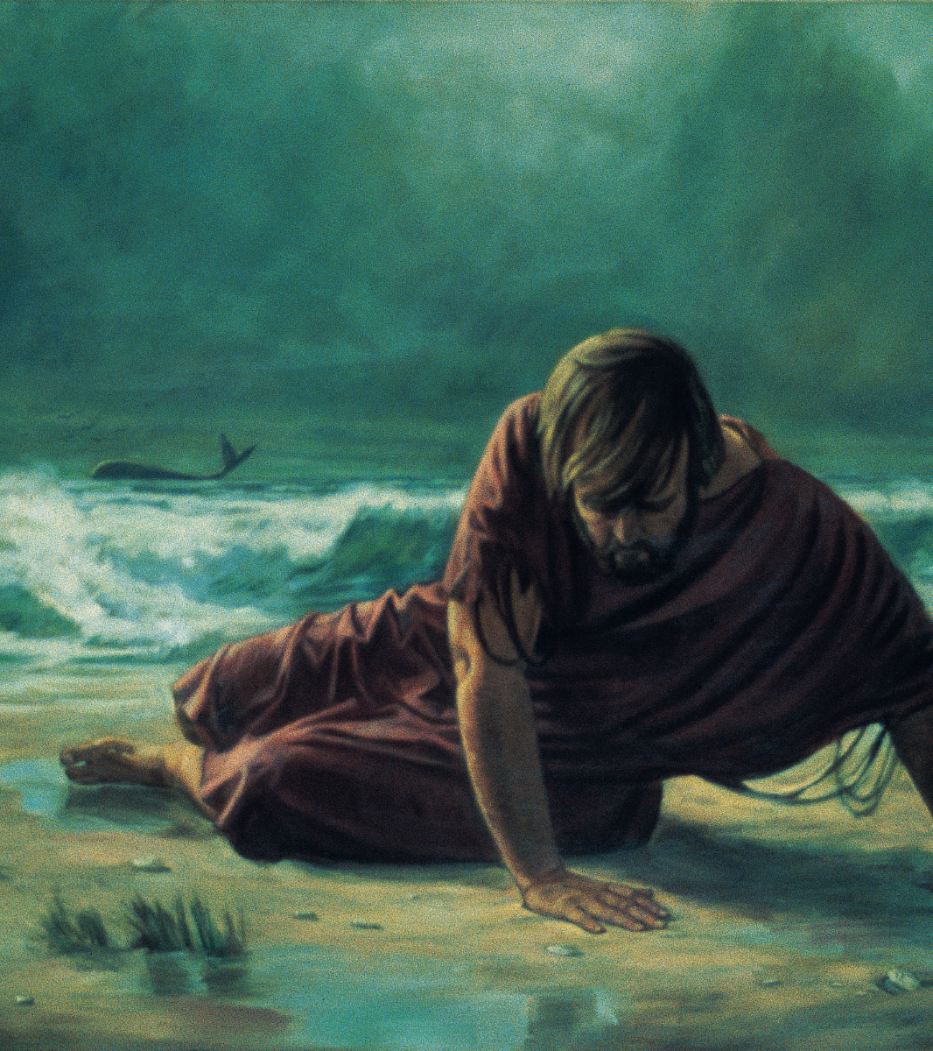
Jonah is delivered P1
“…out of the belly of hell cried I, and thou heardest my voice” (Jonah 2:2b KJV).
Hell, is,שְׁאוֹל transliterated sheol, (the grave or place of the dead).
In some ancient eastern cultures, the place of the dead was believed to be a three-day journey.
James Strong, Strong’s Exhaustive Concordance of the Bible. (Nashville: Crusade Bible Publisher. 1890). Strong Number 7585.
Robert B. Chisholm, Handbook on the Prophets. Ppbk Ed. (Grand Rapids, MI: Baker Publishing, 2009). 412.
Esoteric Meanings

Slide 11
Jonah is delivered P2
Jonah, when struggling to swim, remembered God and prayed
Jonah prays and thanks God for delivering him
Jonah 2:9 (KJV) “But I will sacrifice unto thee with the voice of thanksgiving; I will pay that that I have vowed. Salvation is of the LORD”.
Jonah is delivered from the sea creature
Esoteric Meanings

Slide 12
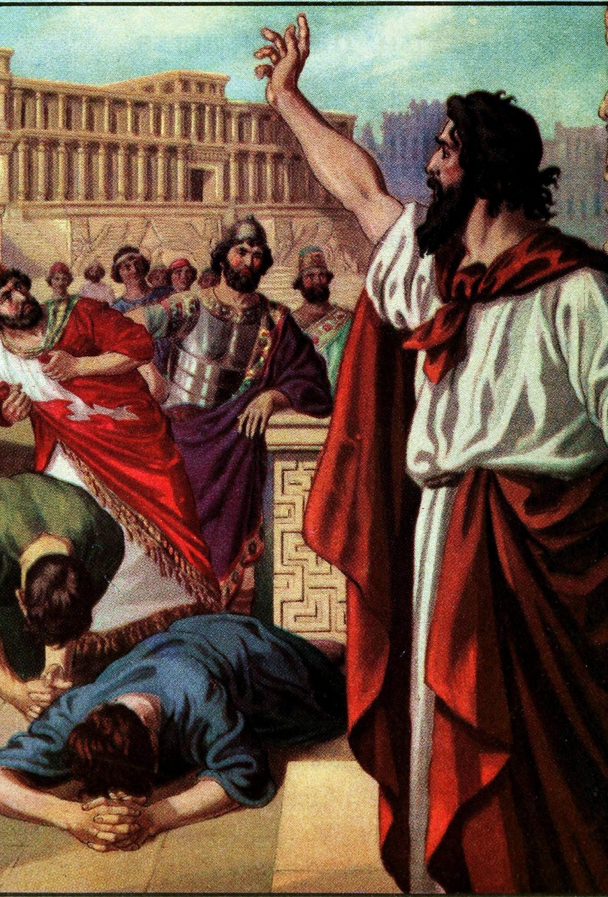
Preaching to Nineveh
Jonah 3:2-4 (KJV) “Arise, go unto Nineveh, that great city, and preach unto it the preaching that I bid thee. ³ So Jonah arose, and went unto Nineveh, according to the word of the LORD. Now Nineveh was an exceeding great city of three days' journey. ⁴ And Jonah began to enter into the city a day's journey, and he cried, and said, Yet forty days, and Nineveh shall be overthrown”.
The Messianic Prophecy Bible Project

Slide 13
Nineveh is Fortified
Some evidence suggests that Nineveh had two walls, an outside wall, and a large inner wall that was around the actual city
The inner wall is believed to have been 50’ wide, and 100’ tall
120,000 people (Jonah 4:11).
John D. Hannah, The Bible Knowledge Commentary: Old Testament. edited by J.F. Walvoord, and R.B. Zuck. (Colorado Springs: David C. Cook, 1985). 1468

Slide 14
Nineveh Repents P1
Jonah 3:5-9 (KJV) ⁵ So the people of Nineveh believed God, and proclaimed a fast, and put on sackcloth, from the greatest of them even to the least of them. ⁶ For word came unto the king of Nineveh, and he arose from his throne, and he laid his robe from him, and covered him with sackcloth, and sat in ashes.
holyspiritspeaks.org

Slide 15
Nineveh Repents P2
Jonah 3:5-9 (KJV) ^{7 “}And he caused it to be proclaimed and published through Nineveh by the decree of the king and his nobles, saying, Let neither man nor beast, herd nor flock, taste any thing: let them not feed, nor drink water: ⁸ But let man and beast be covered with sackcloth, and cry mightily unto God: yea, let them turn every one from his evil way, and from the violence that is in their hands. ⁹ Who can tell if God will turn and repent, and turn away from his fierce anger, that we perish not?”

Slide 16
Prodigal Nineveh
Jonah 3:10 (KJV) ¹⁰ And God saw their works, that they turned from their evil way; and God repented of the evil, that he had said that he would do unto them; and he did it not.
snarkandgrace.wordpress.com

Slide 17
Elder Brother Jonah
Jonah 4:1-2 (KJV) ¹ But it displeased Jonah exceedingly, and he was very angry. ² And he prayed unto the LORD, and said, I pray thee, O LORD, was not this my saying, when I was yet in my country? Therefore I fled before unto Tarshish: for I knew that thou art a gracious God, and merciful, slow to anger, and of great kindness, and repentest thee of the evil.

Slide 18
Elder Brother Jonah
Jonah 4:3-4 (KJV) ³ Therefore now, O LORD, take, I beseech thee, my life from me; for it is better for me to die than to live. ⁴ Then said the LORD, Doest thou well to be angry?

Slide 19
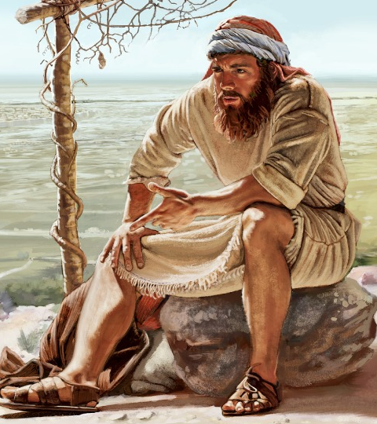
He Wants Destruction
Jonah thinks his complaining has changed God’s mind
He builds a small structure for shade so that he can see the destruction
God sends a plant to help the shade
God destroys the plant
Jonah becomes angry
JW.org

Slide 20
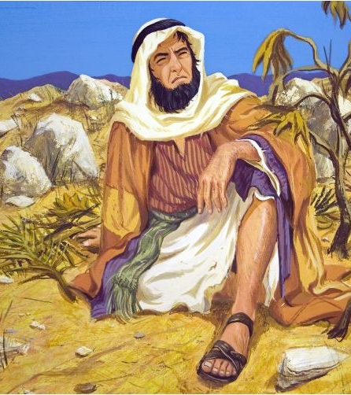
Jonah’s Anger
Jonah 4:8-9 (KJV) ⁸ And it came to pass, when the sun did arise, that God prepared a vehement east wind; and the sun beat upon the head of Jonah, that he fainted, and wished in himself to die, and said, It is better for me to die than to live. ⁹ And God said to Jonah, Doest thou well to be angry for the gourd? And he said, I do well to be angry, even unto death.

Slide 21
God the Father
Jonah 4:10-11b (KJV) ¹⁰ Then said the LORD, Thou hast had pity on the gourd, for the which thou hast not laboured, neither madest it grow; which came up in a night, and perished in a night: ¹¹ And should not I spare Nineveh, that great city, wherein are more than sixscore thousand persons that cannot discern between their right hand and their left hand…

Slide 22
Application
We shouldn’t have double standards for God’s mercy
1
God’s love and mercy can extend to anyone
2
Christ has called us to be a witness to all
3

