Slide 1
Eph 6:10-18; 2 Cor 10:3-5; 2 Cor 2:11
“Lest Satan should get an advantage of us: for we are not ignorant of his devices.”

Slide 2
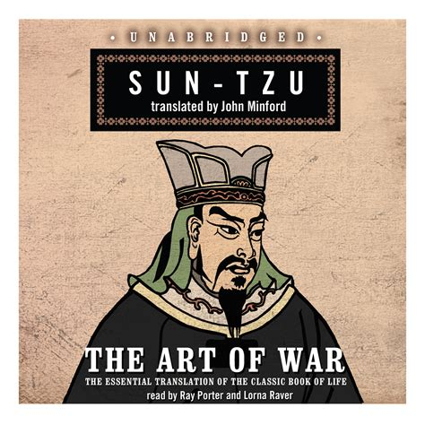
“If you know the enemy and know yourself,
you need not fear the result of a hundred battles.
If you know yourself but not the enemy,
for every victory gained
you will also suffer a defeat.
If you know neither the enemy nor yourself,
You’ll succumb in every battle.” 5th century BC

Slide 3
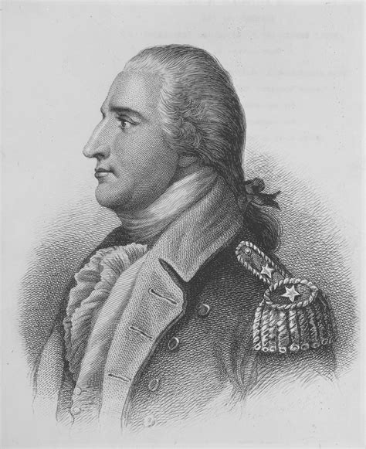
Knowing yourself, your adversaries
and your allies are critical,
not only to a military campaign,
but to a peaceful, purposeful and productive life.
If you confuse an adversary with an ally,
You’re vulnerable to sabotage
and betrayal!
Remember Benedict Arnold?

Slide 4
It’s dangerous to confuse ally and adversary!
That’s why God warned Israel: Ex 34:12
“Take heed (shamar: watch, guard, protect) to thyself,
lest thou make a covenant with the inhabitants of the land whither thou goest,
lest it be for a snare (môqēsh: hook/trap)
in the midst of thee:“
“Take heed to thyself” is mentioned 4 times
in Deuteronomy. (Dt. 4:9; 12:13,19,30)

Slide 5
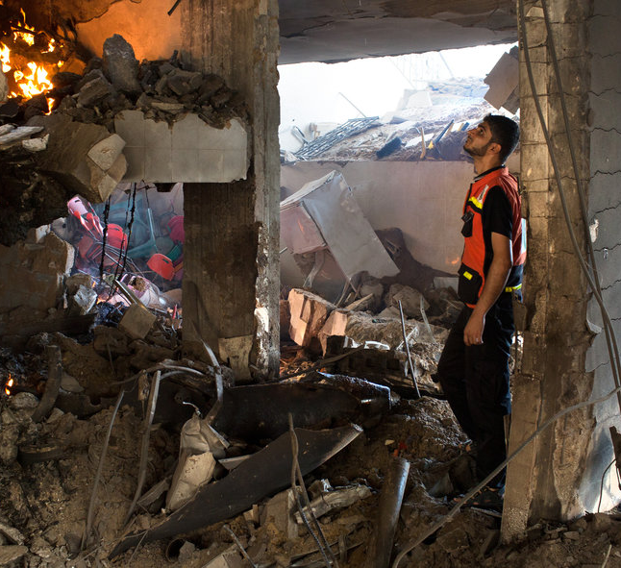
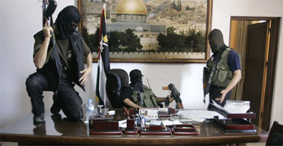
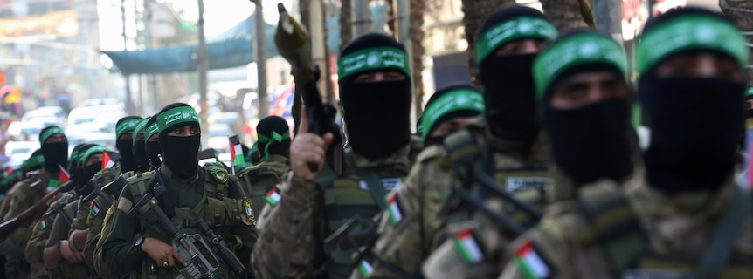
Hamas in Gaza

Slide 6
2 weeks ago we focused on how we can know and trust our chief ally because his nature is: Pure, Perceptive, Preserving, Powerful,
and Personal. (Ex. 3-19)
It’s critical to recognize, however,
that God is not just our “ally” (co-pilot),
but is actually our “Commander in chief”.
Joshua 4:13,14 identifies him as:
“the Captain of the host of the LORD”

Slide 7
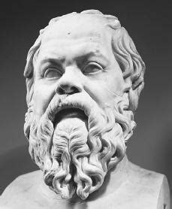
“To know thyself is the beginning of wisdom.”
Socrates 400 BC
Last week we focused on the importance of knowing ourselves.
What is it about our nature that makes us so vulnerable to “The devices of the devil”?

Slide 8
Our perception is limited. 1 Cor. 13:12
“now we see through a glass darkly”
(ai’nigma: obscured, enigma) (2 Cor 4:4, 16-18)
This lack of accurate perception causes us:
To question “orders”. (Commands)
To complain about “ordeals”. (Crisis)
Ordeal: Difficult or painful experiences,
especially those that severely tests character
or endurance. (See James 1:2-5)

Slide 9
Another aspect of our nature that leaves us vulnerable to Satan’s devices is our Propensity for Perversion.
1 Cor 10:5-7 “…They were overthrown in the wilderness.
Now these things were our examples, to the intent
we should not lust after evil (kakos: worthless) things,
as they also lusted. (epithumeo: superimposed passion)
(Perverted Physical Practices)

Slide 10
Another aspect of our nature that leaves us vulnerable to Satan’s devices is our propensity for perversion.
1 Cor 10:7 “Neither be ye idolaters,
as were some of them;
As it is written ‘The people sat down to eat and drink, and rose up to play.’”
(Perverted Spiritual practices)

Slide 11
The Definitions of Perversion.
A. English Definitions:
1) Perverted (adjective):
1 Jn 5:19 “The whole world lieth in wickedness”
2) Perversion/ Perverseness (as a noun)
a) a perverted (twisted) form: an aberrant sexual
practice or interest, especially when habitual.
b) The act of perverting or the condition of being
perverted (corrupted!)
Corrupt

Slide 12
The Definitions of Perversion.
Perversion: the act of perverting.
3) To Pervert: A transitive verb meaning:
a) to cause to turn aside or away from what is good,
true or morally right: CORRUPT
or to cause to turn aside or away from what is
generally done or accepted : MISDIRECT
b) to divert to a wrong end or purpose: MISUSE
to twist the meaning or sense of:
MISINTERPRET (2 Pt 3:5)

Slide 13
2. The Dimensions of Perversion.
A. Distortion Pr 10:8-9
“The wise in heart will receive commandments:
but a prating fool shall fall.
He that walketh uprightly walketh surely:
but he that perverteth his ways shall be known.”
ʿāqash (verb): to knot, twist, distort
1) At this stage we begin to distort (redefine)
right and wrong. (See Gen. 3:5)

Slide 14
2. The Dimensions of Perversion.
B. Subversion Pr 19:1-3
“Better is the poor that walketh in his integrity,
than he that is perverse in his lips, and is a fool.
Also, that the soul be without knowledge, it is not good; and he that hasteth with his feet sinneth.
The foolishness of man perverteth his way:
and his heart fretteth against the LORD.”
Sālap: to subvert, pervert, overthrow
1) Subtly work to overthrow God’s Standards.

Slide 15
2. The Dimensions of Perversion.
C. Deception Jer 3:20-21 “as a wife treacherously
departeth from her husband,
so have ye dealt treacherously with me…
A voice was heard upon the high places,
(where they worshipped idols)
weeping and supplications (prayers) of …Israel:
for they have perverted their way…”
ʿāwâ: to make crooked, twisted. “Iniquity” 4x

Slide 16
Jer 3:21 “for they have perverted their way,
and they have forgotten the LORD their God.”
1) At this point our self /satanic deception
(twisted beliefs, spawned by twisted spirits)
begins to affect our “ways.”
(derek: manner of life, behavior)
Is. 53:6 “all we like sheep have gone astray,
we have turned every one to his own way,
the Lord laid on him the iniquity of us all”
(ʿāwōn: perversity {from ʿāwâ})

Slide 17
Jer 3:21 “for they have perverted their way,
and they have forgotten the LORD their God.”
1) At this point our self and/or satanic deception
(twisted beliefs, spawned by twisted spirits)
begins to affect our “ways.” (derek)
1 Tim 4:1-2 “Now the Spirit speaketh expressly, that in the latter times some shall depart from the faith,
giving heed to seducing spirits, and doctrines of devils;
Speaking lies in hypocrisy;
having their conscience seared with a hot iron; “

Slide 18
2. The Dimensions of perversion.
D. Rebellion Jer 23:36 “the burden of the LORD
shall ye mention no more: for every man's word shall be his burden; (maśśāʾ: desire)
for ye have perverted the words of the living God,
of the LORD of hosts our God.”
Hāpak’: overturn, change.
1) Rebelling against God’s standards and
replacing them with our own. (Gen. 3:1; Jdg 17:6; 21:25)

Slide 19
The Definitions of Perversion The Dimensions of Perversion
3. The Progression (Digression) of Perversion.
As Israel moved further from God, their
perversions took on new forms and intensities.
A. Distortion. Pr 10:8-9 ʿāqash: to twist/distort
This ultimately comes from Satan (Jn 8:44) through:
1) Others: 2Tim 3:13 “evil (poneros) men and seducers shall
wax worse and worse, deceiving, and being deceived.”
2) Our own selfish mind/flesh. Titus 3:3 “we ourselves also
were sometimes foolish, disobedient, deceived, serving divers
lusts and pleasures, living in malice and envy, hateful…”

Slide 20
3. The Progression (Digression) of Perversion.
A. Distortion Pr 10:8-9 ʿāqash: to twist/distort
B. Subversion: Pr 19:1-3 Sālap’: subvert (undermine)
a) This is when our own deceptions begins to affect
& undermine our (and others’) faith. 2 Tim 2:17-18
“their word will eat as doth a canker: (gangraina)
of whom is Hymenaeus and Philetus;
Who concerning the truth have erred, (astocheō: deviated)
saying that the resurrection is past already;
and overthrow (anatrepō: subvert) the faith of some.”

Slide 21
Distortion ➔ Subversion ➔
C. Déception: Jer. 3:21,23 “perverted their way”
ʿāwâ: to make crooked, twisted. “Iniquity” 4x
1) Once the foundation of truth has been undermined;
it’s replaced by falsehood and lies. (Col. 2:8)
“Beware lest any man spoil you through philosophy
and vain deceit, after the tradition of men,
after the rudiments of the world,
2) We become spiritual “adulterers”.
(Compare Jer. 3:20 with James 4:4-8)
and not after Christ.”

Slide 22
Distortion ➔ Subversion ➔ Déception ➔
Jer. 3:21,23 “they have perverted their way”
D. Rebellion Jer 23:36 Hāpak’: overturn, change.
“ye have perverted the words of the living God”
1) We change God’s Standard of right and wrong! Is 5:20-21
“Woe unto them that call evil good, and good evil;
that put darkness for light, and light for darkness…!
Woe unto them that are wise in their own eyes…!”
Ro. 1:22 “Professing themselves to be wise,
they became fools.”

Slide 23
D. Rebellion Jer 23:36 Hāpak’: overturn, change.
“ye have perverted the words of the living God”
2) Rebellion puts us in partnership with Satan.
This is what Paul warned about in 1 Cor. 10:20-22
“I would not that ye should have fellowship with devils.
(Koinonia: fellowship, communion, partnership!)
Ye can’t drink the cup of the Lord, and the cup of devils: ye cannot be partakers of the Lord's table,
and of the table of devils.
Do we provoke the Lord to jealousy?”

Slide 24
D. Rebellion Jer 23:36 Hāpak’: overturn, change.
“ye have perverted the words of the living God”
1) Here we change God’s Standard of right and wrong!
2) This puts us in fellowship/partnership with Satan
3) Rebellion gives Satan overt access/influence. 1Sam. 15:21
“Rebellion is as the sin of witchcraft,
And stubbornness is iniquity and idolatry.
With tragic consequences!
Because you’ve rejected the word of the Lord,
He has rejected thee…”

Slide 25
The Corinthian Christians must have wondered
What ancient Israel’s sins had to do with them.
They were guilty of the same sins Israel committed: Immorality (1 Cor. 5,6); Idolatry (1 Cor 8 and 10);
And Ingratitude/murmuring (2 Cor 12:20,21)
“…there be debates, envyings, wraths, strifes, backbitings, whisperings, swellings, tumults:
… I shall bewail many which have sinned already,
and haven’t repented of the uncleanness and fornication and lasciviousness which they have committed.”

Slide 26
This digression of perversion is clearly happening to our country and world. (1 Jn 5:19)
Is it possible that we’ve been caught up in it?
Do we have a distorted view of Right & Wrong?
Has our culture in any way subverted (undermined) our faith and values? (2 Cor 4:4)
Have we been deceived (spoiled) by the world’s values resulting in our spiritual infidelity. (James 4)
Are we in rebellion (in any area) to God’s word
and ways? (1 Sam. 15:21; Phil. 3:18,19)

Slide 27
Jer 3:20 “as a wife treacherously departeth from her husband, so have ye dealt treacherously with me…”
Our fallen human nature is prone to deceitful infidelity and perversion.
21 …for they have perverted (ʿāwâ: twisted) their way
Have our ways drifted from God’s ways?
And they have forgotten (shākaḥ’: oblivious of)
their God.”
Have we been oblivious of our God?

Slide 28
Our nature is prone to perversion; But Thankfully God’s nature is Redemptive!
His Redemption is conditioned by our repentance.
22 “Return, (shûb: turn back, restore {see Ps. 23:3})
ye backsliding (shôbāb: idolatrous, {from shûb}) children,
and I will heal (rāpāʾ) your backslidings.”
(Remember Marah? {Ex 15:26})
Are you willing to return To Him?

Slide 29
Jer. 3:22b
“Behold, we come unto thee;
for thou art the LORD our God.”
Is He your truly your Lord and God?

