Slide 1
Lessons in the Deserts of Life.
“Neither murmur ye,
as some of them murmured,
and were destroyed of
the destroyer.”
John 10:10; Rev. 9:11
1 Cor 10:10,11
Now all these things happened unto them for ensamples:
and they are written for our admonition.”

Slide 2
Lessons in the Desert.
Mt 7:15 “Strait is the gate and narrow is the way
that leads to life, and few there be that find it…”
The gate to God is “strait” (stenos: cluttered)
and the path from there is “narrow”!
Thli’bō: trouble 4, afflict 3, narrow 1, throng 1
suffer tribulation 1
John 16:33; Acts 14:22; 1 Thes. 3:4

Slide 3
That’s 7 deserts in the first 18 months!

Slide 4
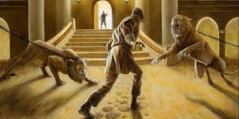
These desert experiences were part of God’s plan to reveal and/or develop their faith.
“Is thy strength so small?
Fear not the lions, for they are chained, and are placed there
for trial of faith where it is,
and for discovery of those that have none!
Keep in the midst of the path,
and no hurt shall come unto thee.”
The Pilgrim's Progress by John Bunyon: 1678

Slide 5
God is seeking to grow and guide us so
that we can experience the delight of His
blessings and purposes. (Jer. 29:11; Rev. 4:11)
Ro. 8:22,28,29 “all things work together for good to them that love God…called according to His purpose.
Whom he did foreknow he also did predestinate to be conformed to the image of His Son…”

Slide 6
Zemān: appointed occasion
Ḥēp’es:̣ purpose, pleasure,
desire; valuable matter

Slide 7
Eccl 3:11 “He hath made every thing beautiful in his time:
(yāpeh’: bright) see Mal. 3:17
also He hath set the world
in their heart…”
Ôlām’: the ages, eternity!
Job 23:10, 14,16 “He knoweth the way that I take:
when he hath tried me,
For he performeth the thing that is appointed for me…
He maketh my heart soft…”
I shall come forth as gold….

Slide 8
Satan takes advantage of the difficult “desert” seasons and “as a roaring lion” (1 Pt. 5:8) or deceptive serpent (2 Cor. 11:3) seeks to seduce or sidetrack us from God’s plan.
This is the essence of sin (harmartano).
to miss the mark
and so not share in the prize.

Slide 9
During “desert” seasons he takes advantage of our selfish natures to influence us to react or rebel against God’s Guidance.
This rebellious attitude usually leaks out of our lips in the form of murmuring and / or complaining.

Slide 10
Review: Complaining is…
Contagious! Num.11:4,5
Corrupting Vs. 5-15
1) It Blinds us! (To God’s goodness and
Satan’s goals) Nu. 11:5,6
2) It Binds us! (To Satan through bitterness)
Eph. 4:26 “neither give place to the devil”
3) It begrudges God’s blessings. (vs 7,8,10)

Slide 11
4) Criticism burdens others!
Moses questions his calling. Nu. 11:10-15
“Moses was displeased…and said, 13 Whence should I have flesh to give … all this people? 14 I am not able to bear all this people alone, …it is too heavy for me!”
15 “if thou deal thus with me, kill me”
5) It Blames God! Vs. 11
“Wherefore hast thou afflicted thy servant?”

Slide 12
God responds to this crisis by.
Providing Partners for Moses. 16,17,24-30
A. Moses selected them. Vs 16
“Gather unto me seventy men of the elders of Israel, whom thou knowest to be the elders of the people, and officers over them; and bring them unto the tabernacle,
that they may stand with thee.”
1) Were these the same 70 Elders from Ex. 24?
If so, where had they been during the Crisis?

Slide 13
Providing Partners for Moses. 16,17,24-30
A. Moses selected them. Vs 16
B. God sanctified them. Vs 17
^{17 “..}I will take of the spirit which is upon thee,
and will put it upon them;
1) Whose Spirit was this? (Ex. 3:12; 33:14)
and they shall bear the burden of the people with thee, that thou bear it not thyself alone.”

Slide 14
God responds to this crisis by.
Providing meat for the People. 18-23; 31-34
“Sanctify yourselves to morrow, and ye shall eat flesh: ¹⁹ Ye shall not eat one…two…five…ten…nor twenty days;
²⁰ But even a whole month, until it come out at your nostrils, and it be loathsome unto you:
because that ye have despised the LORD which is among you, and have wept before him, saying,
Why came we forth out of Egypt?”

Slide 15
God responds to this crisis by.
Providing meat for the People. 18-23; 31-34
A. Moses Doubted. Vs 21,22
22 “Shall the flocks be slain for them, to suffice them? or all the fish of the sea be gathered together for them?
23 And the LORD said unto Moses, Is the LORD'S hand waxed short? thou shalt see now whether my word shall come to pass unto thee or not.
24 Moses …told the people the words of the LORD”
1) He still obeyed in spite of his doubt!

Slide 16
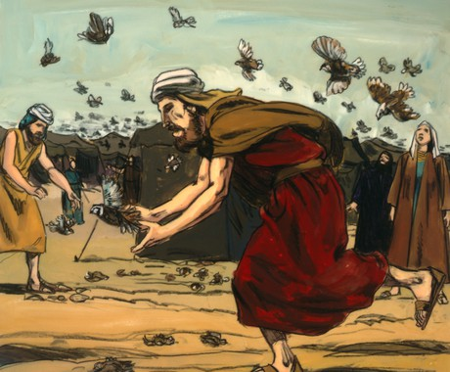
B. God delivered {}. 31-32
“the LORD brought quail from the sea, and let them fall by the camp…, round about the camp, and as it were two cubits high upon the face of the earth.
the people stood up all that day and night
and the next day…
and gathered the quails”

Slide 17
God responds to this crisis by.
Providing meat for the People. 18-23; 31-34
A. Moses Doubted. Vs 21,22
B. God Delivered. Vs 31
C. The people Desired (lusted) Vs 32
“he that gathered least gathered ten homers:”
(That’s about 60 bushels each!)

Slide 18
D. God Disciplined. 33,34
1) He previously warned (vs 20) they’d eat it
“until it come out at your nostrils,
and it be loathsome unto you:
because ye have despised the LORD among you”
33 “And while the flesh was yet between their teeth, ere it was chewed, the wrath of the LORD was kindled against the people, and the LORD smote the people with a very great plague.”

Slide 19
Conclusion:
1) The Lord took Israel out of Egypt in one night,
but it took Him forty years to take Egypt out of Israel."
Philippians 2:13-14
“it is God which worketh in you both to will and to do of his good pleasure.
Do all things without murmurings and disputings…that ye may be the sons of God.”

Slide 20
2) Our reactions (choices) in the desert reveal the condition of our heart! Deut. 8:2
“thou shalt remember all the way which the LORD thy God led thee …in the wilderness,
to humble thee, and to prove thee,
to know (reveal) what was in thine heart,
whether thou would keep his commandments, or no.”

Slide 21
Conclusion:
3) God often judges us by letting us have
our own way! Ps 106:13-15
“They soon forgat his works;
they waited not for his counsel:
But lusted exceedingly in the wilderness,
and tempted God in the desert.
And He gave them their request;
but sent leanness into their soul.”

Slide 22
Conclusion:
This is still happening! (Rom. 1:24, 26, 28).
²⁴ ”God also gave them up to uncleanness through the lusts of their own hearts, ²⁵ Who changed the truth of God into a lie, and worshipped & served the creature…,
²⁶ For this cause God gave them up unto vile affections:
28 as they did not like to retain God in their knowledge,
God gave them over to a reprobate (worthless) mind”

Slide 23
4) Desert experiences reveal if we’ll:
a) Resist God or Satan: James 4:6-8
“God resisteth the proud, but giveth grace unto the humble. Submit yourselves therefore to God. Resist the devil, and he will flee from you. Draw nigh unto God”
Both God and Satan have plans for us!
Jn 10:10 “the thief comes to steal…kill…destroy,
I am come that they might have life
And that more abundantly.”

Slide 24
The heart of resisting God is usually rebellion:
Either Active {“I won’t”} or passive {“I don’t”}!
1 Sam. 15:23 “rebellion is as the sin of witchcraft”
merî: rebellion comes from marah: bitterness!
“…and stubbornness (pāṣar’: to urge, press, peck at)
is as iniquity (ʾāwen: exert oneself for nothing; vanity)
and idolatry” (terāpîm’: seek help/healing from Satan)
This gives Satan the opportunity to draw us back to him.

Slide 25
4) Desert experiences reveal if we’ll:
a) Resist (God or Satan)…
b) Repent (metanoe’ō) to reconsider
(1) This involves Recognizing what’s at really at stake.
(2) This enables us to recover from the snares and
strategy (purposes) of Satan. 2 Tim. 2:25-26
“if God will give them repentance to the acknowledging of the truth; that they may recover themselves
out of the snare (pagis: strategem) of the devil,
who are taken captive by him at his will.”

Slide 26
4) Desert experiences reveal if we’ll:
a) Resist (God’s will and ways or Satan’s)
b) Repent: (Recognize what’s really at stake.)
c) Recommit: Allowing God to guide and grow us.
“Present your bodies a living sacrifice, holy, acceptable unto God, which is your reasonable (logikos) service.
Be not conformed …but transformed by the renewing of your mind, that ye might prove (approve) what is that
Good, and acceptable, and perfect will of God.”
Romans 12:1,2

Slide 27
Application:
Are you resisting Satan’s plans,
Do you need to Repent:
➔Recognize what’s really at stake!
➔ Reconsider your choices.
3) Are you willing to Recommit to God so He can
Guide and Grow you, preparing you for
“The Promised Land”? (Ro. 8:28,29)
or God’s?

Slide 28
Ps 138:7-8 “Though I walk in the midst of trouble, thou wilt revive me: thou shalt stretch forth thine hand against the wrath of mine enemies, and thy right hand shall save me.
The LORD will perfect (gāmar’: complete)
that which concerneth me!”
Will you cooperate with Him?

Slide 29
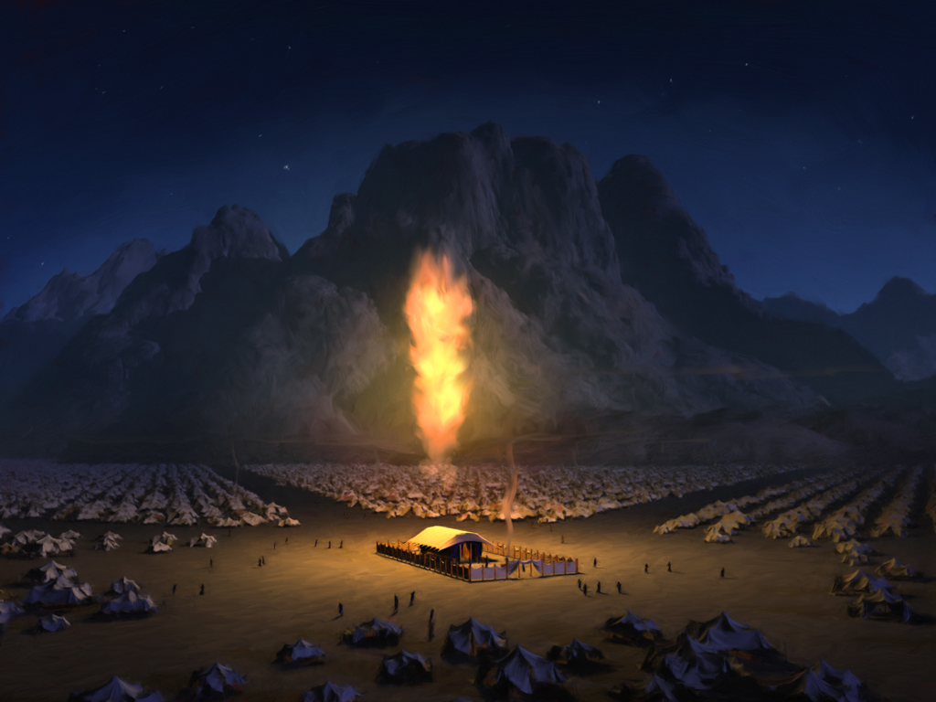
This Tab

