Slide 1
“They that wait on the Lord shall… mount up with wings…

Slide 2
Pr 31:10 ”Who can find a virtuous woman?”
‏חַיִל‎ (ḥayil) Literally “a force”
army 56 x; valor 37x; strength, power, or might 32x; host 29x; forces 14x; Riches or Wealth 21x.
A “Virtuous” woman is a women
of Strength!
“Strength and honor are her clothing”
Pr. 31:25

Slide 3
Where does that strength come from?
“They that wait upon the Lord shall renew their strength;
They shall mount up with wings as Eagles”
Isaiah 40:31

Slide 4
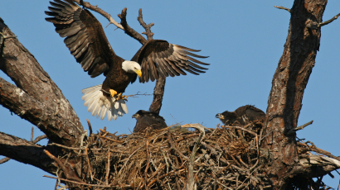
“As an eagle stirreth up her nest, fluttereth over her young, spreadeth abroad her wings, taketh them,
Why “like Eagles”?
Deut. 32:11,12
beareth them on her wings:
so the Lord …did lead him…”

Slide 5
“As an eagle stirs up her nest”
Deut. 32 reminds us that God intentionally grows us much the same way as a Mother Eagle prepares her young for flight.
Why does God “Stir up” our Nests?

Slide 6
1. Move us out of our comfort zones.
Nests are places of preparation,
not destination!
A. The Comfort of the nest.
1) Built with great care and effort.
a) Huge (>5’ and weigh up to 1 ton)
b) Comfortable.
c) High. Usually >75’ in trees or cliffs.

Slide 7
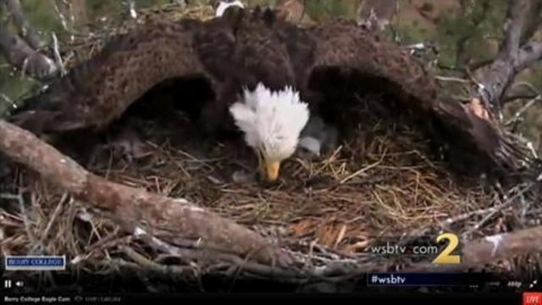
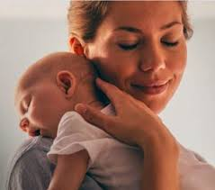
1. Move us from our comfort zones.
2) Mom’s have a powerful “nesting” instinct!
They’re natural “comforters”.
“keepers at home” Titus 2:5
Oikourgos’: domestically inclined,
guardians of the “nest”.

Slide 8
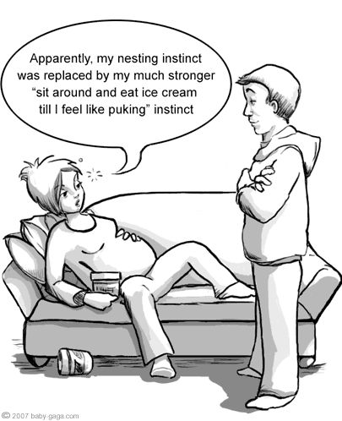
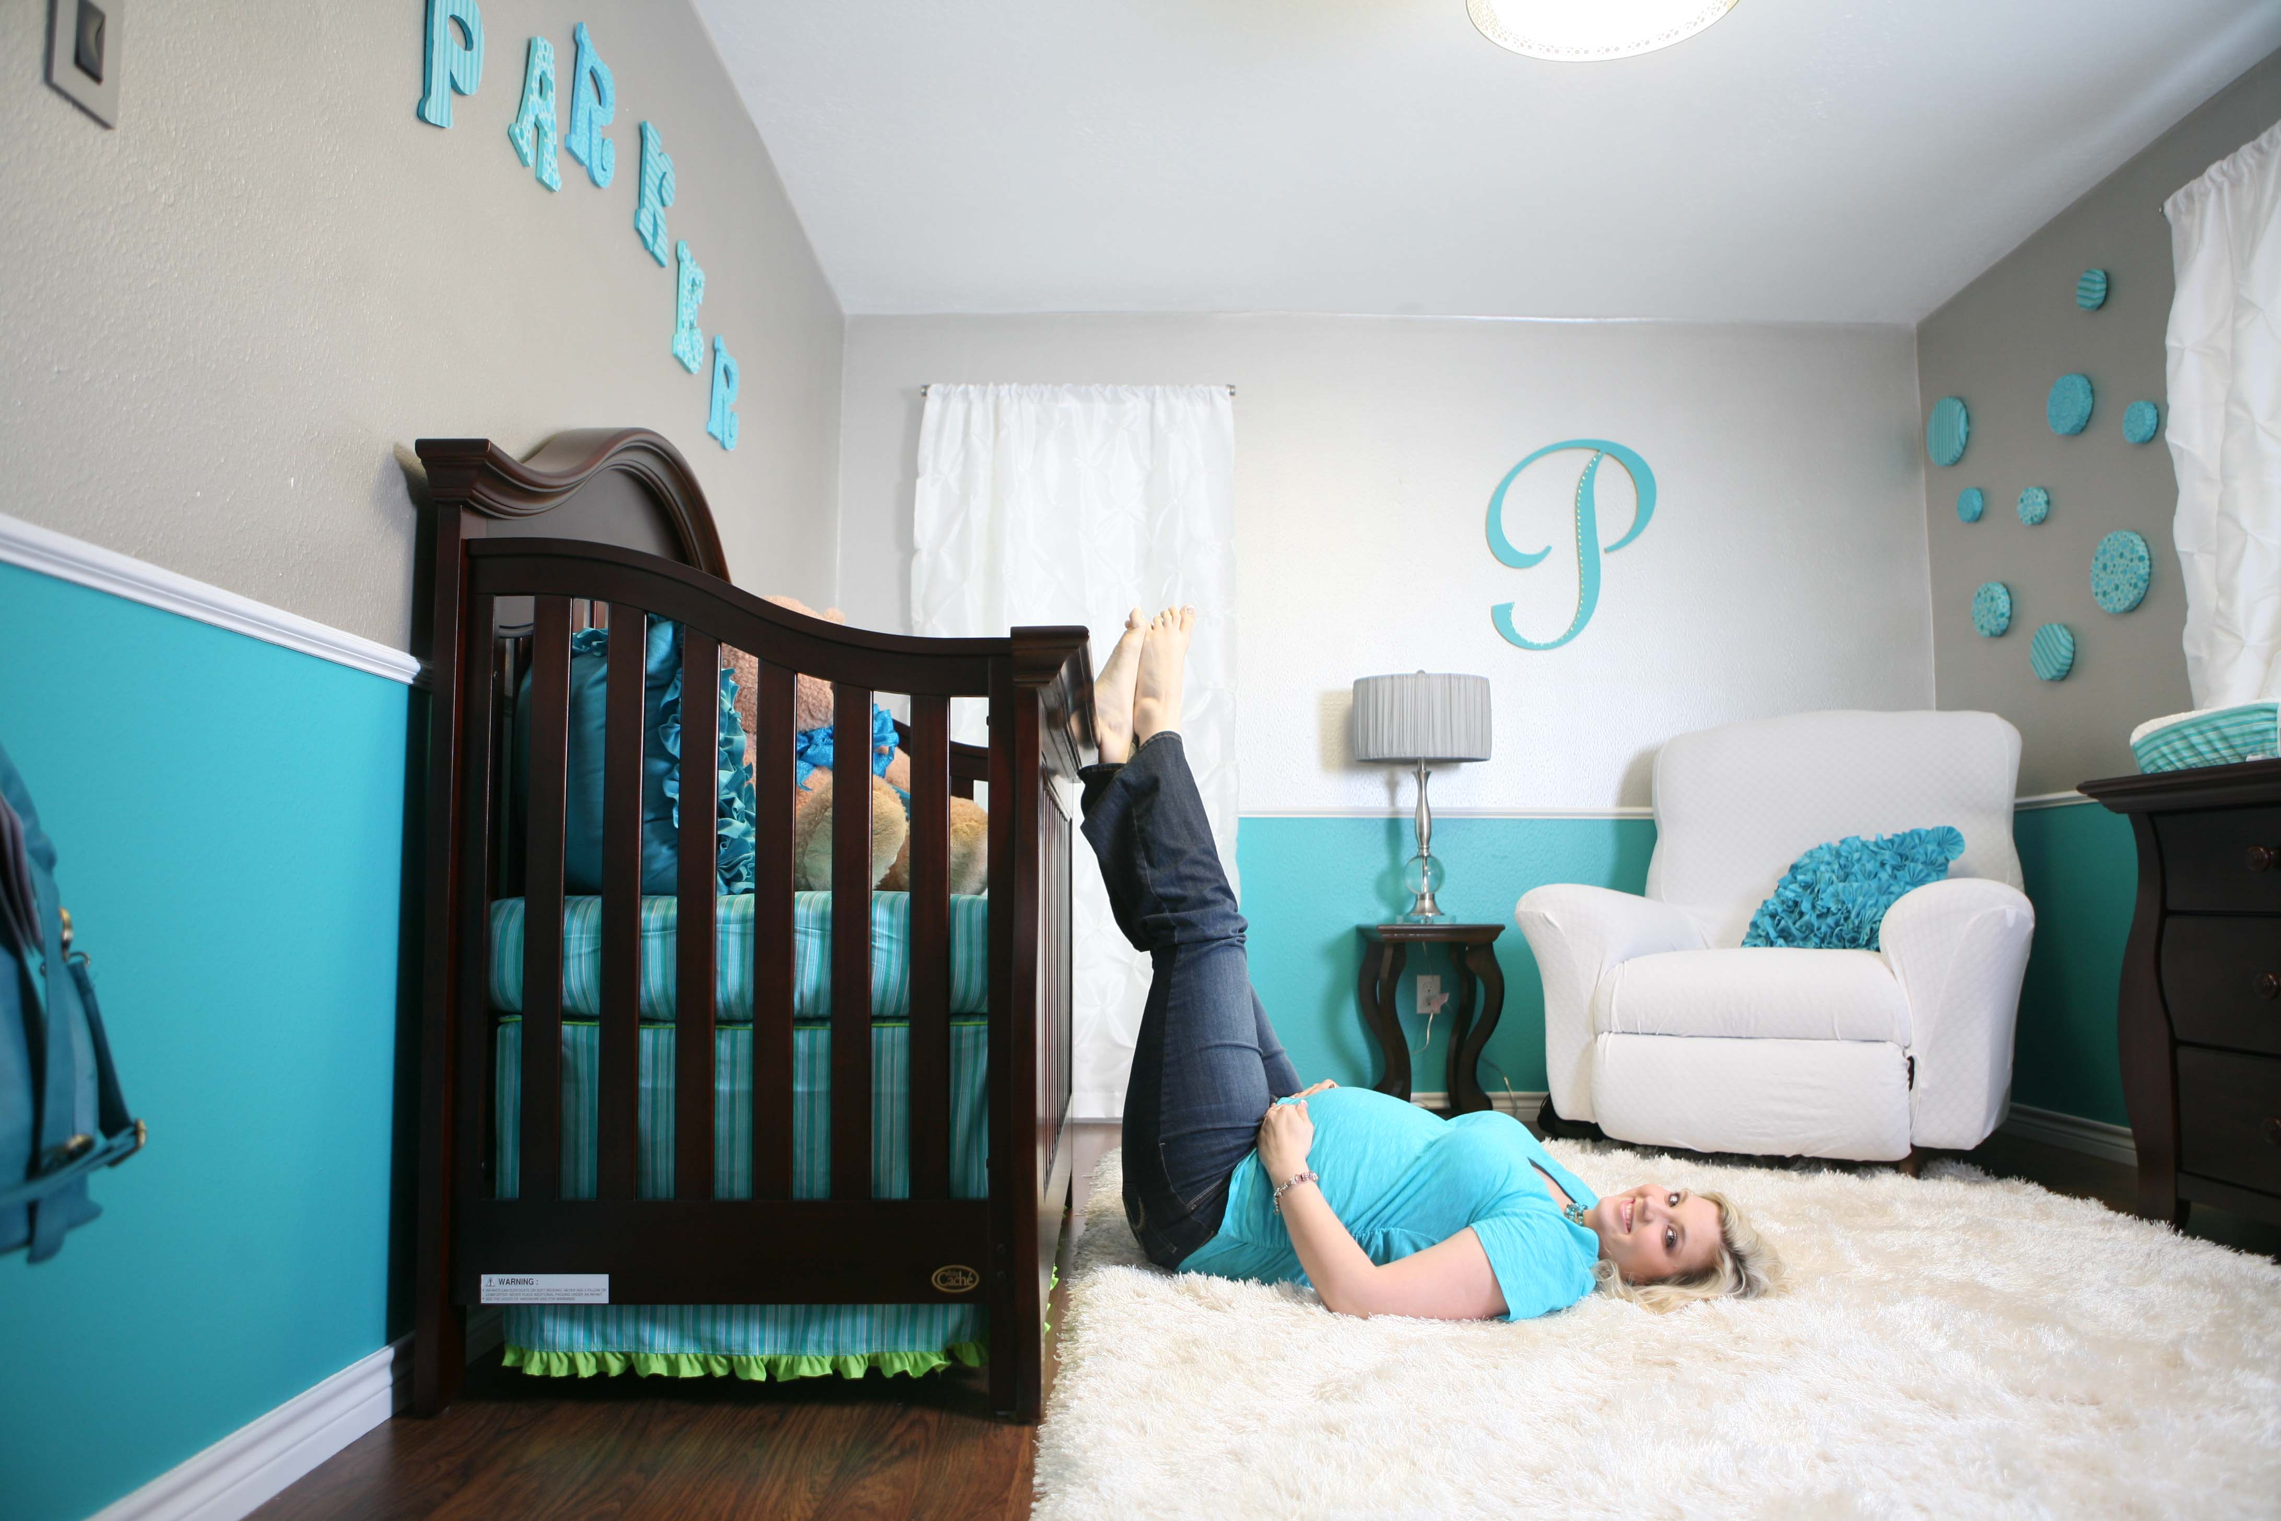
Mom’s have a powerful “nesting” instinct!

Slide 9
B. The Challenge of Change
“As an eagle stirreth up her nest, fluttereth over her young…” Deut. 32:11
Mom “stirs up the nest” by:
a) Removing the comfortable “lining”.
Stirreth: ʽûr: to wake up!
(opening the eyes)

Slide 10
B. The Challenge of Change
Mom (and God) “stirs up the nest” by:
b) Motivating responsible independence
“fluttereth over her young”
raw-khaf’: to move or shake.
It’s easy to grow apathetic in the comfort of the nest!

Slide 11
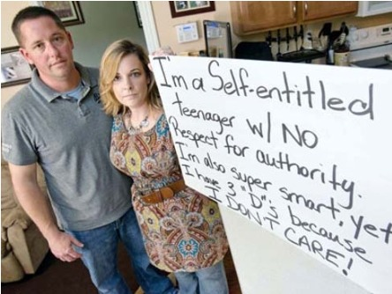
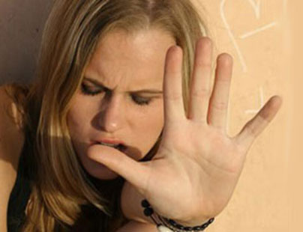
B. The Challenge of Change
Moving a child from complete dependence to independent “flight” is a painful journey!
(for Mom and child)

Slide 12
Why does God to stir up our nests?
Moves us from our comfort zones.
Reminds us of our own inadequacy.
A. The Provision Of The Parent.
1) In the nest, everything is provided for.
It is easy to live off of the labor of others.
But momma won’t be around forever!

Slide 13
2. Remind us of our own inadequacy.
A. The Provision Of The Parent.
B. The Presumption Of The Proud
1) Young eagles gain a pound every 5 days.
a) They’re almost full size by 6 weeks.
2) Their wings are developed by 8
weeks and they feel “grown up.”
Their Bodies have outgrown their brains!

Slide 14
2. Remind us of our own inadequacy.
B. The Presumption Of The Proud
3) Parents drop live food in the nest for them.
4) Soon they feel they don’t “need” mom.
(but they’re still in the nest!)
5) They begin to “fight” mom over the food!
Dt. 32:15 “But Jeshurun waxed fat,
and kicked”

Slide 15
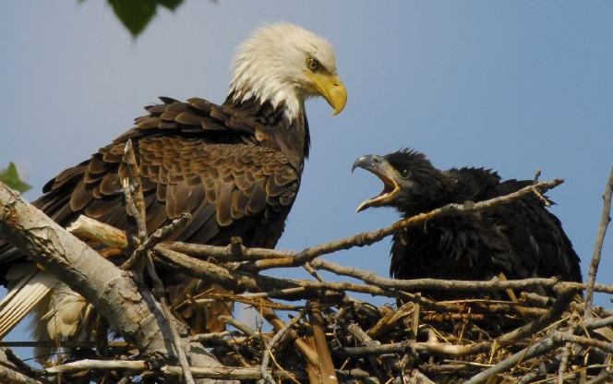
2. Remind us of our own inadequacy.
6) The parents progressively and
intentionally bring less and less food!
The young begin to resent their parents!

Slide 16
2. Remind us of our own inadequacy.
It’s usually the immature who think they can handle the world alone!
“Without me ye can do nothing!” Jn 15:5
It’s often through failure that we’re humbled,
and through humility that we find success!
1 Pt. 5:6 “God resists the proud but gives grace to the humble.”

Slide 17
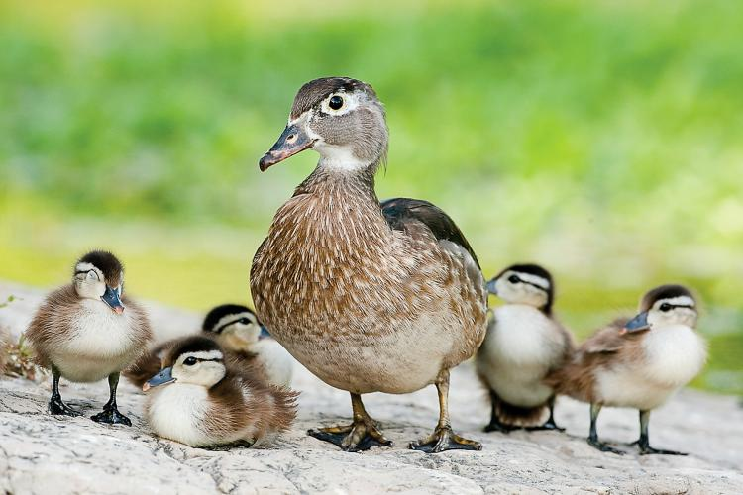
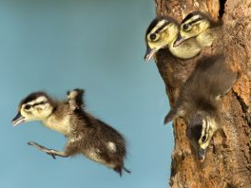
The “turbulent teens years”
take a terrible toll!
Mom (and God) knows that there’s danger in staying in the nest too long!
So they’re willing to pay the “toll”!
Wood Ducks have to leave the Nest after only 1 day!

Slide 18
"Arise ye, and depart;
for this is not your rest:
because it is polluted,
it shall destroy you,
even with a sore destruction." (Micah 2:10)
Destruction: ḥēbel: Cord or noose, ruin!

Slide 19
Why does God to stir up our nests?
Move us from our comfort zones.
Remind us of our own inadequacy.
To Teach us to Fly!
“Mount up with wings as eagles” Is. 40:31

Slide 20
3. Teach us to Fly.
A. Preparation for flight.
1) Mom Stops dropping food in the nest!
2) Holds it just out of their reach, forcing
them to “jump up” to get it.
3) They lose a lot of “baby fat” doing this.
(What he thinks is cruelty is actually preparing him for flight!)

Slide 21
3. Teach us to Fly.
B. Separation from the nest.
1) His hunger drives him to the edge.
2) His wings catch the wind and he glides
to a landing to find his own food.
3) He usually fails to find food and
doesn’t know how to fly from the ground!

Slide 22
3. Teach us to Fly.
C. Now He’s Finally Teachable!
1) The parents watch from a distance.
2) If he fails to find food, they help him.
3) They teach him how to “take off” and
hunt.

Slide 23
Is God Stirring up our nests?
Moving us from our comfort zones?
Or making them less “comfortable”?
Reminding us of our own inadequacy?
Teaching us to Fly?

Slide 24
Is God Stirring up our nests?
Many of our “hard times” may simply be
“preparations for flight!”.
We’re not called to “succeed”, but to obey.
Therefore, our failures need not be final!
Faith doesn’t grow through comfort,
But through Crisis!

Slide 25
God is watching, and waiting
just beyond our obedience
to bless us and
take us to the next phase.

Slide 26
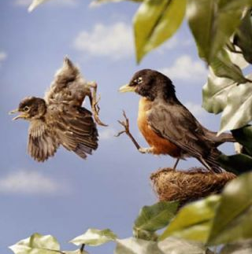
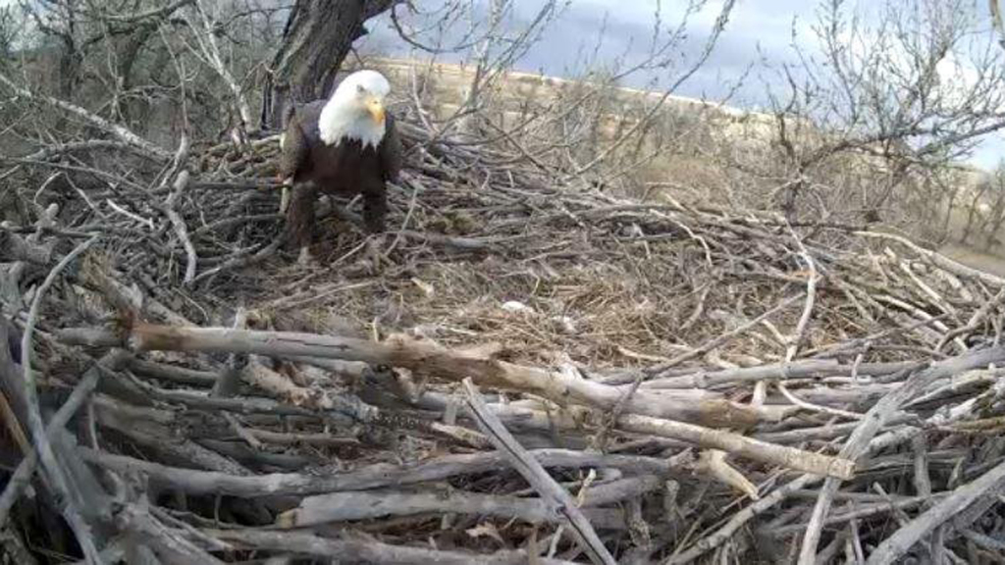
Parenting is an exhausting job!
It’s easy to get disappointed and discouraged!

Slide 27
“They that wait upon the Lord shall renew their strength; They shall mount up with wings as Eagles” Isaiah 40:31
Wait {kaw-vaw'} means to bind together.
Are you willing to “bind” your heart, soul, and mind together with God to accomplish
His Purposes
through you?

Slide 28
A Mother’s Prayer
Had I been Joseph’s mother
I’d have prayed protection
from his brothers. “God, keep him safe. He is so young,
so different from the others.”
Mercifully, she never knew
there would be slavery and prison, too.

Slide 29
Had I been Moses’ mother
I’d have wept to keep my little son: praying she might forget the babe
drawn from the water of the Nile. Had I not kept him for her
nursing him the while,
was he not mine? –
and she but Pharaoh’s daughter?

Slide 30
Had I been Daniel’s mother
I should have pled ‘Give Victory!’ –this Babylonian horde,
godless and cruel– Don’t let him be a captive–
better dead, Almighty Lord.’

Slide 31
Had I been Mary, Oh, had I been she, I would have cried as never mother cried, ‘Anything, O God, anything…
–but crucified.’
With such prayers importunate my finite wisdom would assail Infinite Wisdom.
God, how fortunate that
Infinite Wisdom should prevail.”

