Slide 1
Mothers: God’s “not so silent” Partners!

Slide 2
Everyday can be a “handful” for mom!
A young mother asked her 4 year old son on the eve of his fifth birthday what he would be tomorrow.
After counting his fingers, he confidently declared:
“Tomorrow,
I’ll be
a handful!”

Slide 3
Mothers: God’s not so silent Partners.
Motherhood is one of the clearest pictures of Divine Partnerships we have available to us.
Women become mothers for different reasons,
But there are no “Divine” accidents.
1 Cor. 3:9 “we are laborers together with God.”

Slide 4
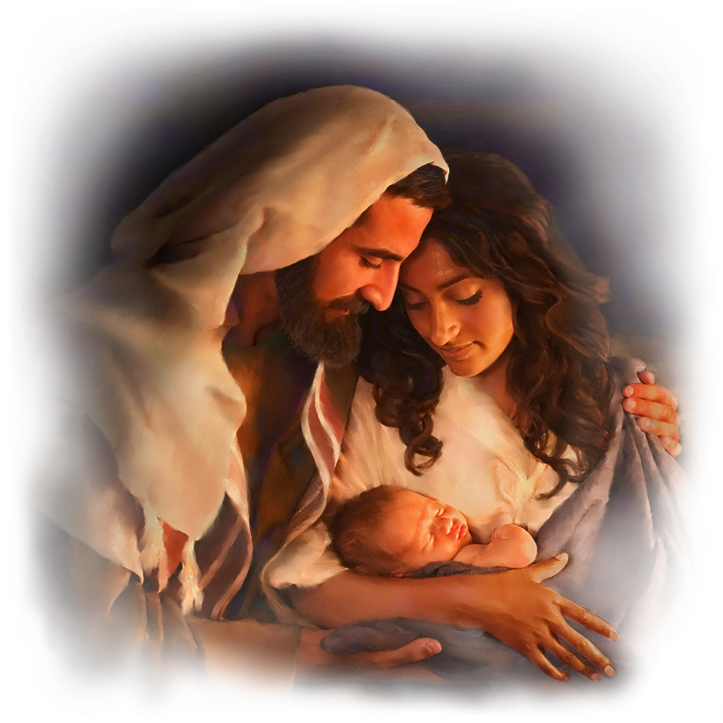
Nowhere is this more clearly or beautifully illustrated than with Motherhood.
Ps. 127:3 “children are an heritage
(Naḥalâ’: portion/ possession) of the LORD:
and the fruit of the womb is his reward.”
This morning I’d like to look at History’s most famous “mother” to illustrate this truth.

Slide 5
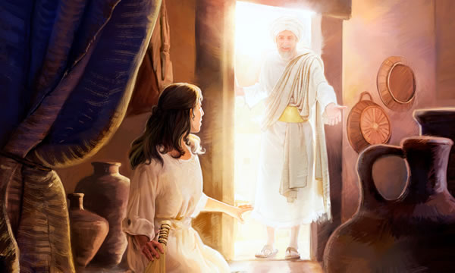
1. Moms Partner with God in a child’s Procreation. (Mary) Lk 1:28
“Hail, thou that art highly favored, (charito’ō)
graced, endue with special honor!
the Lord is with thee.”
A. It Doesn’t Always Seem Like A “Blessing.”

Slide 6
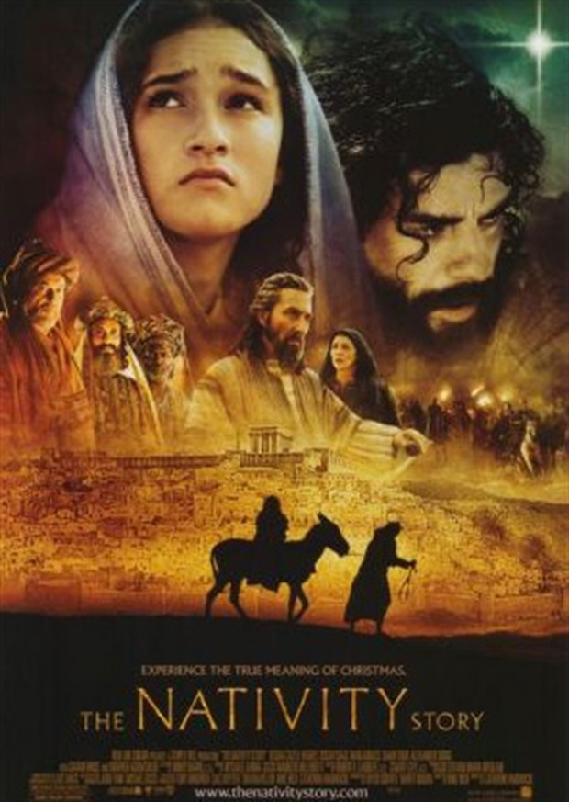
1. Moms Partner with God in a child’s Procreation.
“Hail, thou that art highly favored, (charito’ō)
A. It Doesn’t Always Seem Like A Blessing.
1) Pregnancy is rarely easy or convenient.
Mary’s pregnancy was particularly
complicated as She was:
a) Unmarried!
b) Forced to travel during final stages.
c) Forced to give birth in a stable!

Slide 7
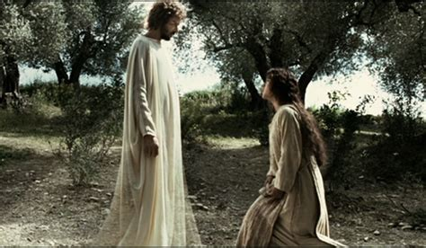
1. Partner with God in a child’s Procreation.
Notice Mary’s Response to God’s Invitation. Lk 1:38 “Behold the handmaid of the Lord;
be it unto me according to thy word.”
Just as Mary “submitted” to God’s will,
Motherhood involves a steady
diet of “submission”
to the incredible task
before them.

Slide 8
2) God’s still partnering with Mothers! Ps 139:16 “Thine eyes did see my substance, yet being unperfect; (embryotic) and in thy book all my members were written, which in continuance were fashioned,
when as yet there was none of them.”
Jer 1:5 “Before I formed thee in the belly I knew thee;
before thou camest forth out of the womb
I sanctified thee, and I ordained thee a
a prophet to the nations!”

Slide 9
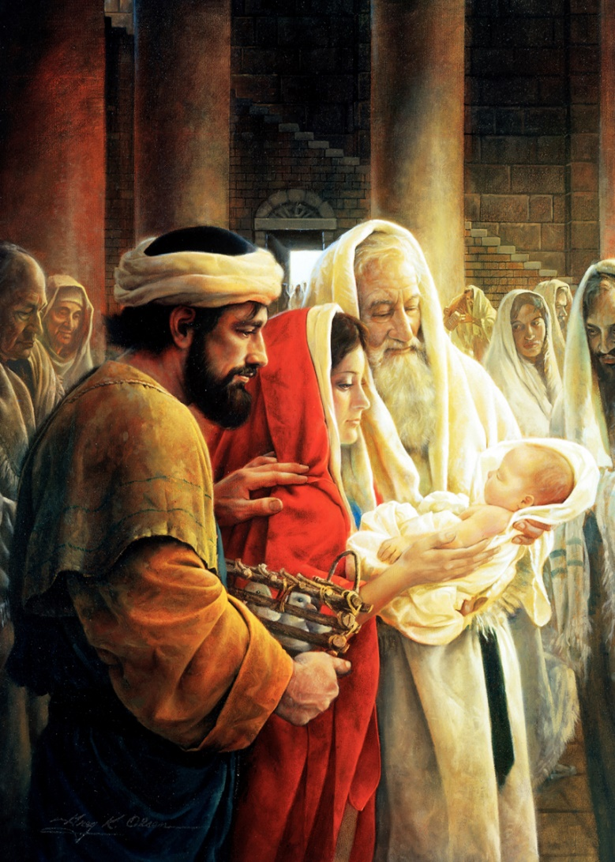
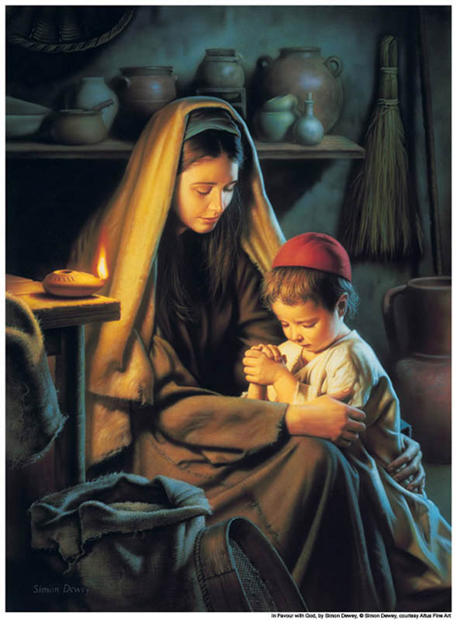
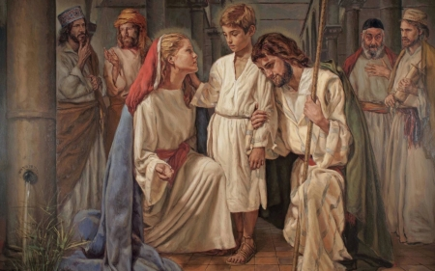
Mary also modeled partnering with God
2. In Her Child’s Preparation

Slide 10
2. Partner in the Child’s Preparation
A. God uses flawed instruments to work
with and through! 2 Cor 4:7
“we have this treasure in earthen vessels”
1) Even Mary wasn’t “immaculate!” (perfect)
Pope Pius declared her “immaculate conception” in 1854
teaching she any taint of sin!
Mary knew better! Lk 1:47 “my spirit hath rejoiced in God
my savior!”
(Ro. 3:10,23)

Slide 11
A. God uses flawed instruments
1) Mary wasn’t “immaculate!” Ro. 3:10,23
a) At least twice during Jesus’ ministry,
Mary tried to “but in” and direct him.
Jesus “rebuked” her. (John 4:4; Mt 12:48-50)
b) Mary didn’t allow her “mistakes” to stop her!
(1) She learned from them
(2) Leaned on God
(3) Kept on loving and serving!

Slide 12
A. God uses flawed instruments to work with/through!
Because There are no other kind! (Ro. 3:10;23)
2) The Proverbs 31:10-31 Woman has
“intimidated” women for 3000 years!
Pr. 31:10 “Who can find a virtuous woman?
for her price is far above rubies.”
a) Virtuous (ḥayil) doesn’t mean
flawless:
but Faithful and Forceful!

Slide 13
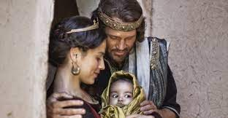
Pr. 31:10 “Who can find a virtuous woman?
for her price is far above rubies.”
b) This was inspired by Bathsheba! Pr 31:1
“The words of King Lemuel, the prophecy that
his mother taught him.”
(1) Bathsheba called him Lemuel. (Dedicated to God)
(2) “David called his name Solomon“ (Peace) 2 Sam. 12:24
(3) “and the Lord loved him …
and called his name Jedidiah”
(Beloved of God!) 2 Sam 12:24,25

Slide 14
Pr. 31:10-31 is poem based on the 22 letters of the Hebrew Alphabet.
Aleph: אֵשֶׁת־חַיִל מִי יִמְצָא וְרָחֹק מִפְּנִינִים מִכְרָהּ׃
“Who can find a virtuous woman…”
Bet: בָטַח בָּהּ לֵב בַּעְלָהּ וְשָׁלָל לֹא יֶחְסָר׃
“The heart of her husband doth…trust…”
Gimmel: גְּמָלַתְהוּ טֹוב וְלֹא־רָע כֹּל יְמֵי חַיֶּיה
“She shall do him good and not evil…”
Dalet: דָּרְשָׁה צֶמֶר וּפִשְׁתִּים וַתַּעַשׂ בְּחֵפֶץ כַּפֶּיהָ׃
“She …works willingly with her hands”
Hey: הָיְתָה כָּאֳנִיֹּות סֹוחֵר מִמֶּרְחָק תָּבִיא לַחְמָהּ׃
“She’s like merchant ships…”

Slide 15
Let me suggest a modern “equivalent” to Pr. 31:10-31
“A: for the Apple pies she bakes;
B: for the Breakfasts she makes.
C: for all the Cleaning she does;
D is for the Dinners we love.
E is for Every time we Call;
F is for every time we Fall.
G is for the Grace she gives;
H is for How sacrificially she lives.

Slide 16
Let me suggest a modern “equivalent” to Pr. 31:10-31
I is for the Integrity she shows;
J is for Justice she ‘bestows’.
K is for Keeping us in line;
L is for Loving us all the time…
M: for Many ways she shows (Love)
N: for the courage to say NO!
… “Z is for the Zoo she manages each day!”

Slide 17
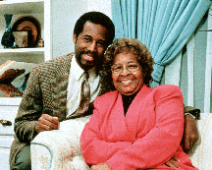
God’s not looking for the “Perfect Partner”,
just one who will let Him work through her!
Sonya Carson had her sons write monthly book reports.
It was years later that Ben learned she was illiterate!
“She gave us what she had - interest, accountability,
and the courage to demand extra work.”
(Gifted Hands, 1990, Ben Carson).
Ben became the Director of Pediatric Neurosurgery at Johns Hopkins at 33!
Dr. Ben Carson and his mother Sonya!

Slide 18
B. There’s no Job More Important or difficult
than Shaping / guiding a Human Heart.
Pr. 1:8,9 “forsake not the law of thy mother:
they shall be an ornament of grace unto thy head”
Pr. 22:6 “Train up a child in the way he should go…”
1) There’s a difference between the “way they should”
and the “way they want to go!”
Pr. 22:15 “Foolishness is bound in the
heart of a child…”
Pr. 29:15 “a child left to himself
brings his mother to shame.”

Slide 19
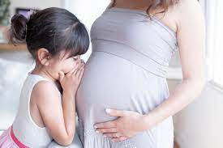
Mothers: Partners in the Procreation, Preparation
3. Partners in the Separation (Struggles/ Pain) of
the child. (A Mother’s job is never done!)
A little year old girl watched as her pregnant mother struggled to get into her “regular” clothes.
She innocently asked: “Mom, now that you’re
going to have a baby,
are you going to have to wear
'eternity' clothes?”

Slide 20
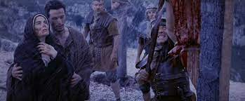
Mothers: Partners in the Procreation, Preparation
3. Partners in the Separation (Pain) of the child
A. Mary associated with Jesus,
1) During his maturing (Lk 2)
2) His ministry Her name
is often among the disciples.
3) His misery! While His
“disciples forsook him
and fled”,
Jn 10:25,26 “behold thy son”
she stood faithful.

Slide 21
3. Partners in the Separation (Pain) of the child
A. Mary associated with Jesus during his:
3) His misery!
Simeon had predicted this! Lk 2:34,35
“Behold, this child is set for the fall and rising again of many in Israel; and for a sign which shall be spoken against;
(Yea, a sword shall pierce through thy own soul also,.”
His pain cut deeply into her Mother’s heart!
Many a mother has felt this pain!

Slide 22
3. Partners in the Separation (Pain) of the child
“a sword shall pierce through thine own soul”
B. Despite the pain,
she remained.
You'll find mothers like that in the halls of hospitals, counselors' offices, and mortuaries!

Slide 23
C. God uses an eagle to illustrate these
Challenges of Change. Deut. 32:11,12
The similarities between parenting and preparing young eagles for flight are amazing!
“As an eagle stirreth up her nest, fluttereth over her young, spreadeth abroad her wings, taketh them,
beareth them on her wings:
So the LORD … did lead him”

Slide 24
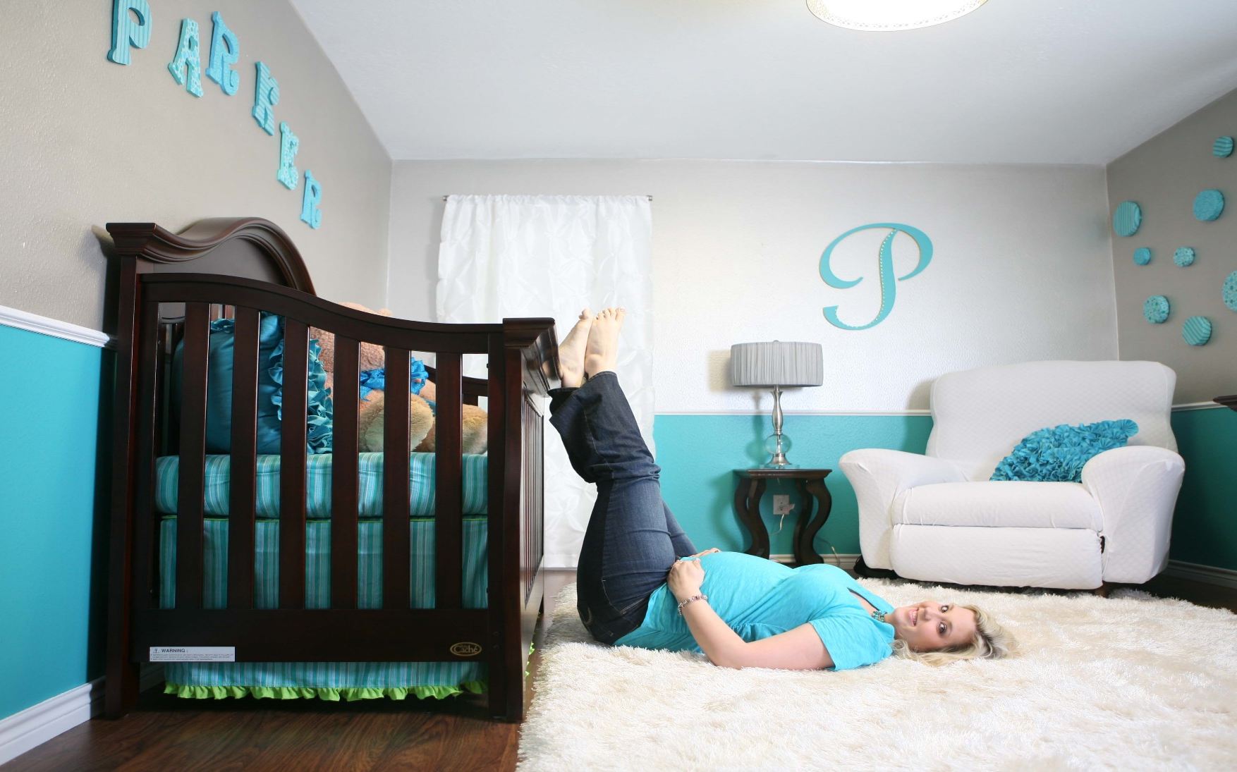
C. God illustrates this with eagles. Dt 32:11,12
1) Moms have a powerful “nesting” instinct!

Slide 25
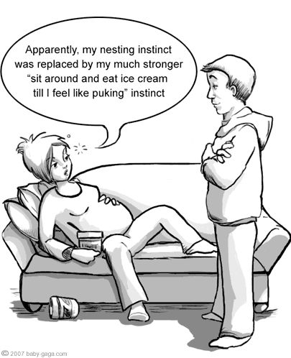
C. God illustrates this with eagles. Dt 32:11,12
1) Moms have a powerful “nesting” instinct!

Slide 26
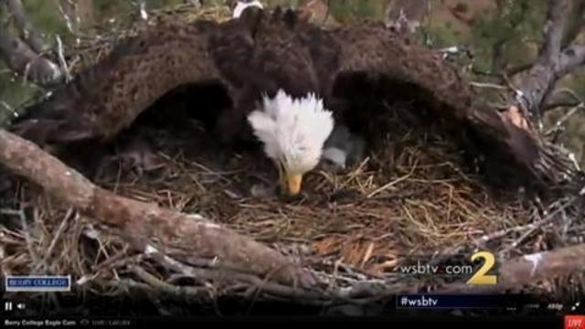
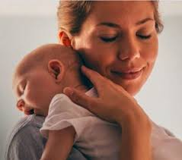
1) Mom’s have a powerful “nesting” instinct!
They’re natural “comforters”.
“keepers at home” Titus 2:5
Oikourgos’: domestically inclined,
guardians of the “nest”.

Slide 27
2) Moving a child from complete dependence
to independent “flight” is a precarious Process!
a) If you think the “Terrible Twos” were rough,
Wait for the “Turbulent Teens years”!

Slide 28
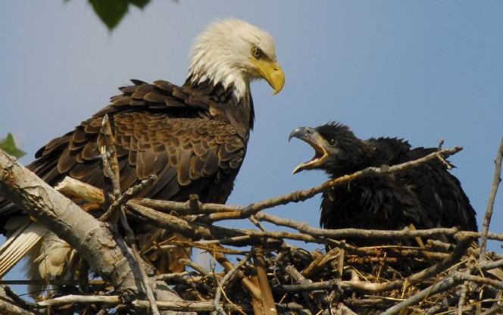
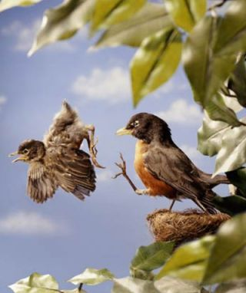
b) Parents (and God) knows that there’s danger in staying in the nest too long!
So they’re willing to pay the price of preparation!

Slide 29
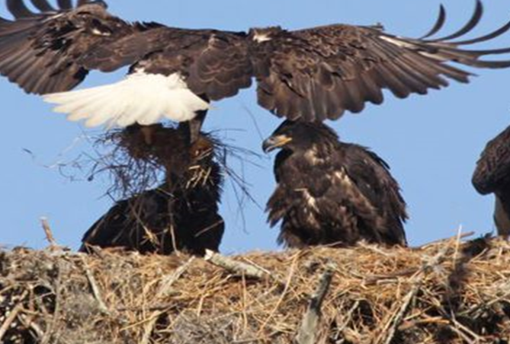
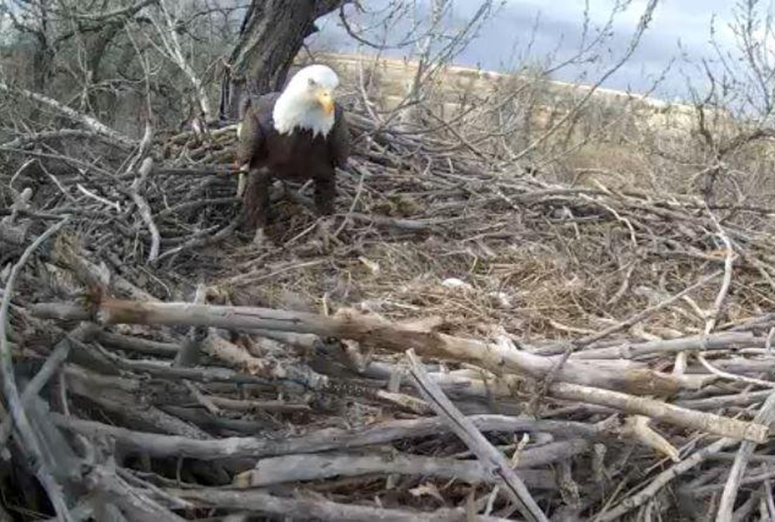
Parenting is an exhausting job!
It’s easy to get disappointed and discouraged!

Slide 30
3) Is God Stirring up your nests?
a) Many of our “hard times” may simply be
“preparations for flight!”.
b) We’re not called to “succeed”, but to obey.
c) Therefore, our failures need not be final!
d) Faith doesn’t grow through comfort,
But through Crisis!

Slide 31
Perhaps Mary was chosen because she could most clearly represent the heart of most mothers who share and bear the:
The Struggles of Procreation
The Battles of Preparation
The Pain of Separation (watching them struggle)
Mothers never relinquish the title, even if the child is rebellious, harsh, foolish or cruel.
Their heart just will not allow it.

Slide 32
Mary never quit and so had the privilege to see God's entire plan played out.
She suffered through the rejection and
crucifixion of her son;
but endured to celebrate his resurrection!
She was privileged to be a part of the small
group that witnessed the birth of the
Church on the Day of Pentecost (Acts 1:14)
“Be not weary in well doing, for in due season ye shall reap, if ye faint not.”
Gal. 6:9

Slide 33
In one comic the kids of Family Circus were discussing babies.
One of the young experts announced:
"Storks don't bring babies.
Some of the other children had different ideas,
but the best was saved for last.
They come UPS."
"Babies are connected to their mothers
by a biblical cord."

Slide 34
“They that wait upon the Lord shall renew their strength; They shall mount up with wings as Eagles”
Wait {qāwâ} means to bind together.
Are you willing to “bind” your heart, soul, and mind together with God to accomplish
His Purposes
through you?

Slide 35
their mother leaning hard on Thee”.
“Lord, who am I to show the way, to my children day by day; so prone myself to go astray.
I teach them knowledge, but I know, how feeble and how low, the candle of my knowledge glows.
Lord, if their guide I still must be,
Oh let all of my children see,

Slide 36
“They that wait on the Lord shall… mount up with wings…

