Slide 1
Mothers on Mission

Slide 2
Heb. 1:1-3 “God who …spake in times past by the prophets
…hath spoken unto us by his Son,
whom he hath appointed heir of all things,
by whom also he made the worlds.
Who being the brightness of His glory and the express image (charaktēr) of his person,
and upholding all things by the word of his power,
when he had by himself purged our sins,
sat down on the right hand of the Majesty on high”

Slide 3
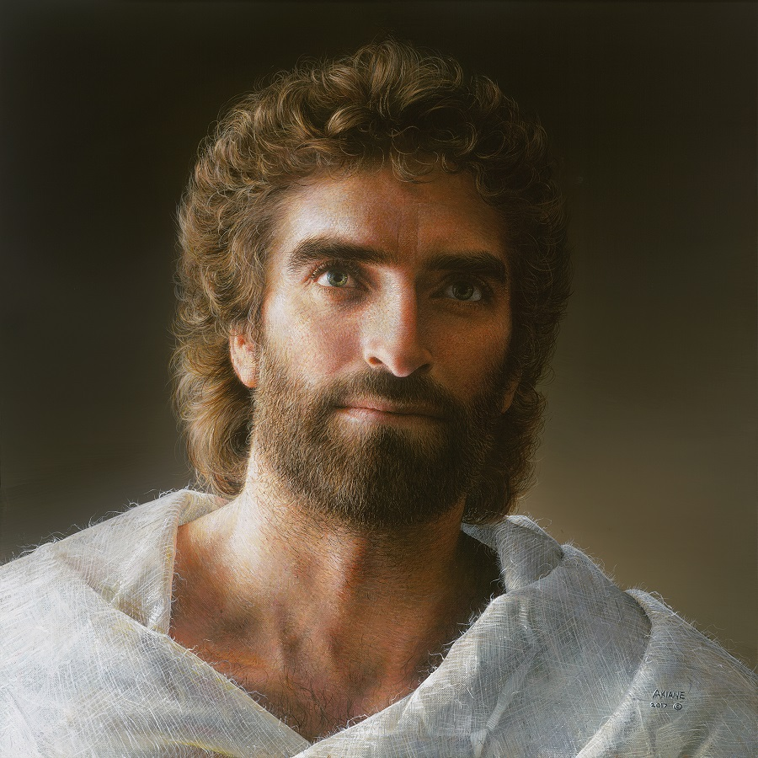
Jn 1:14 “And the Word was made flesh, and dwelt among us, (and we beheld his glory, the glory as of the only begotten of the Father,)
full of grace and truth….
16 And of his fulness have all we received,
and grace for grace.”
Akaine Gallery

Slide 4
Since Jesus came to “declare” (Jn 1:8)
God’s ‘Character’
And “God is Love” (1 Jn 4:9);
It shouldn’t surprise us that genuine love motivated and characterized every aspect of
his life and ministry.
Unlike the Priests, pharisees and rabbis of his day
(who had little time for women and children)
Jesus went out of his way to minister to them!

Slide 5
The Fidgeting children in Mt 19
14 “Suffer little children,
and forbid them not, to come unto me:
for of such is the kingdom of heaven.”

Slide 6
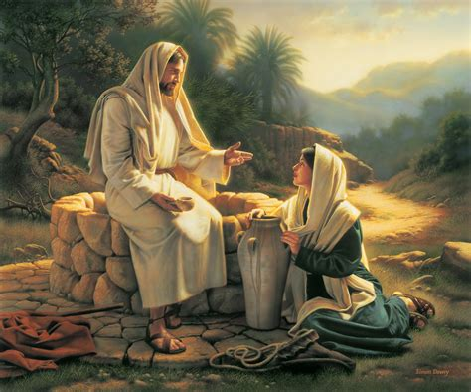
The Frustrated (Samaritan) women
John 4:4 “he must needs go through Samaria.”

Slide 7
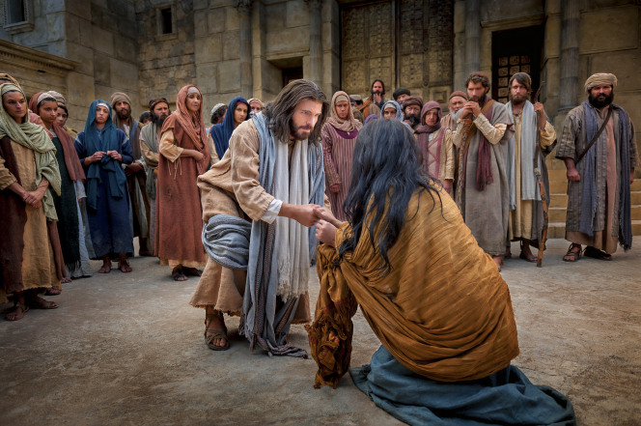
The Fallen (Jewish) woman
John 8:11 “Neither do I condemn thee.
Go and sin no more.”

Slide 8
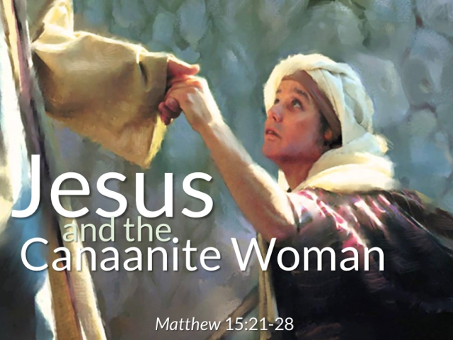
The Fearful (Gentile) Woman
Matthew 15:21-28; Mark 7:24-30

Slide 9
Mt 15:21-24 “Jesus …departed into the coasts of Tyre ….
And, behold, a woman of Canaan came out of the same coasts, and cried unto him, saying,
Have mercy on me, O Lord, thou Son of David;
my daughter is grievously vexed with a devil.
But he answered her not a word.
And his disciples came and besought him, saying,
Send her away; for she crieth after us.
But he answered and said, I am not sent but unto
the lost sheep of the house of Israel.”

Slide 10
Mt 15:25-28 “Then came she and worshipped him, saying, Lord, help me.
But he answered and said, It is not meet to take the children's bread, and to cast it to dogs.
And she said, Truth, Lord: yet the dogs eat of the crumbs which fall from their masters' table.
Then Jesus said… O woman, great is thy faith:
be it unto thee even as thou wilt.
And her daughter was made whole
from that very hour.”

Slide 11
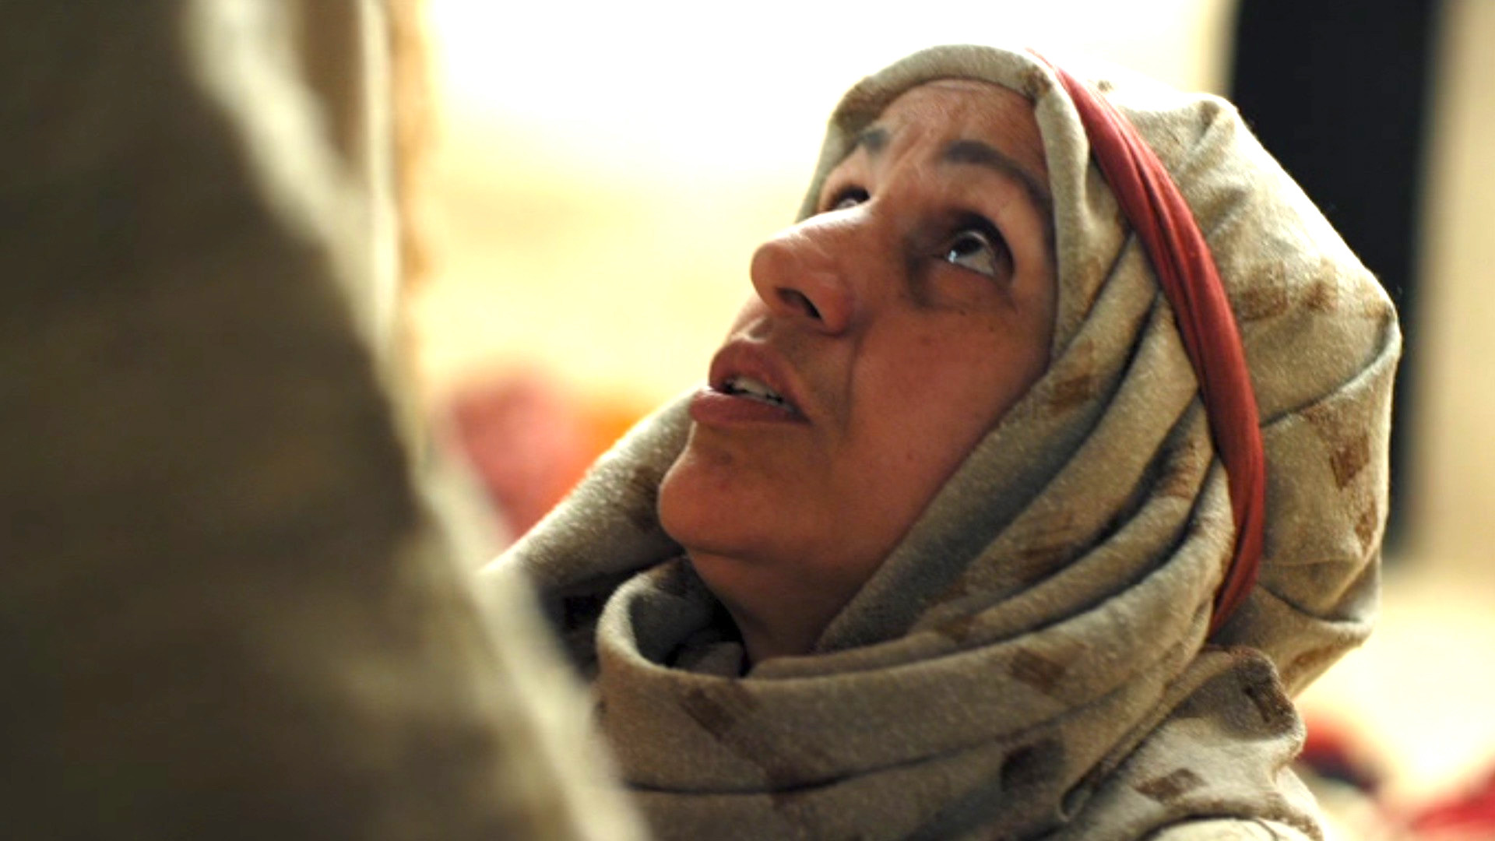
Notice her Problem(s)! Vs 22
A. She was a Gentile (Idol worship culture)
“a woman of Canaan came …, and cried unto him,
Have mercy on me, O Lord, thou Son of David;”
1) She originally appealed to him
as the Jewish Messiah!
But she wasn’t Jewish!

Slide 12
Her daughter had been “infected” by her cultural “gods”. 22b
“my daughter is grievously (kakōs: infected/diseased) vexed with a devil.”
(Daimoniz’omai: Demonized!)
She recognized what most don’t/won’t:
1) Demons are real! (Eph 6:10-18; 1 Tim 4:1)
2) They’re after our children!
3) Our choices give them liberty/influence!
1. Her Problem
Eph. 4:26,27; 2 Tim. 2:24-26; 1 Pt 5:8

Slide 13
2. Notice her Plan vs 22
A. Who: She went to Jesus!
“and cried unto him, Have mercy on me, O Lord”
1) Mt 6:33 says to: “Seek first the Kingdom of God…”
But We naturally seek everything else first!
Friends, Family, Doctors, Drugs, Specialists, Self medication.

Slide 14
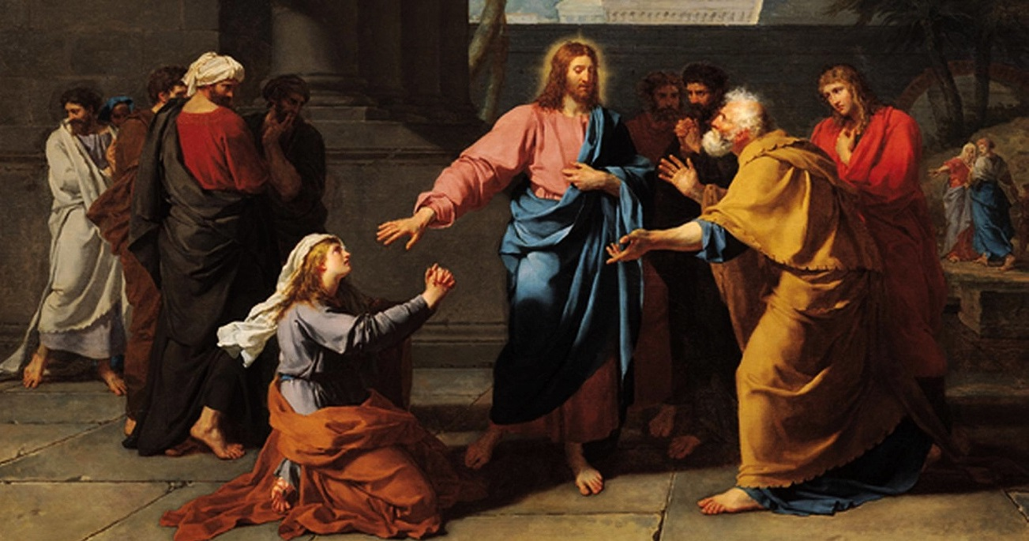
How: She came to him with:
1) Passion. “and cried”
(Kraugazō: to cry out loud)
Jms 5:16 “The effectual, fervent (energeo) prayer…
2. Her Plan
availeth (ischyō: prevails) much”

Slide 15
How: She went to Him with:
2) Persistence. 23-25
23 “He answered her not a word…
his disciples said send her away…
24 I’m …sent …unto lost sheep of Israel
25 Then she came and worshipped him
saying, Lord help”
a) Remember Jesus’ parable of the
unjust judge? (Lk 18:1-8)
2. Her Plan

Slide 16
3) With Poverty (Humility) 22
“have mercy (elee’o:compassion) on me (?)
Lord” (kyrios: master, owner)
a) Evidenced by 25-27 “Lord help me….
But he …said, It’s not meet (kalos) to take the children’s bread, and to cast it to dogs.
(Kynar’ion: Pet, puppy. {not kyon Ph. 3:2})
And she said, Truth, Lord:
yet the dogs eat of the crumbs which fall from their masters' table.”
(I’m unworthy!)
2. Her Plan

Slide 17
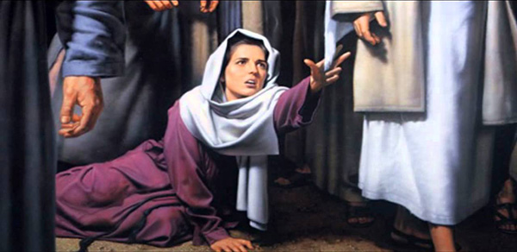
3. She found a Provider
A. She’d probably exhausted her other options.
Mk 5:25,26 “a woman had an issue of blood 12 years.
And had suffered many things of many physicians,
and had spent all that she had,
and was nothing bettered,
but rather grew worse”

Slide 18
B. She had to overcome:
1) Her guilt/failure.
2) Her cultural taboos.
3) Jesus’ Silence Vs 23 (Job 23:10)
4) The Apostle’s rejection. Vs 23
5) Jesus testing her with the
“Insulting” Parable (Vs 26)
2. Her Provider

Slide 19
C. But her passion, persistence
& poverty finally resulted
in her Provision!
28 “Then Jesus answered and said
O woman, great is thy faith:
be it unto thee even as thou wilt.
2. Her Provider

Slide 20
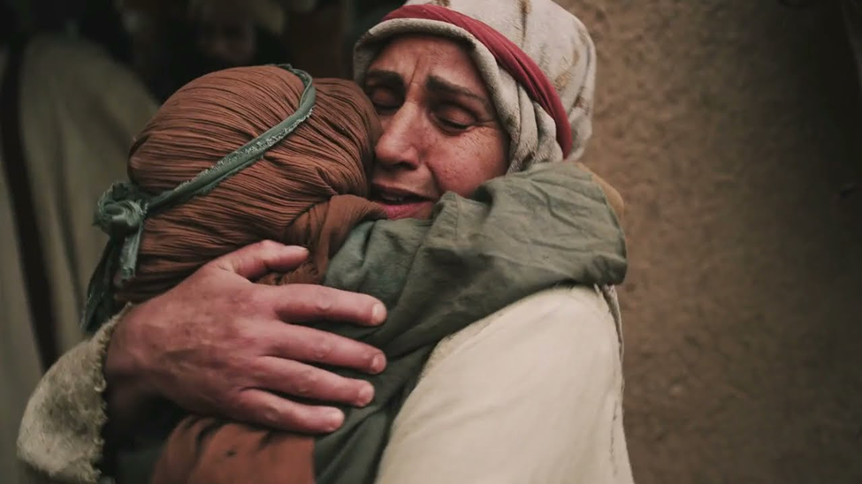
“And her daughter was made whole from that very hour.”
This is why Jesus came. Ps 23:3; Isaiah 61:1-3
“to give unto them beauty for ashes…
Joy for mourning…
Praise for heaviness”
3. Her Provider

Slide 21
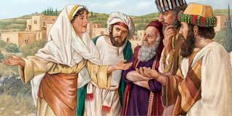
Can you imagine what the
“Rest of her Story”
Must have been like?
Would she be like the Samaritan woman who won her village to Christ? Jn 4:39
Or Keep it to herself?
Conclusion

Slide 22
What about you?
What’s your Problem?
What’s your Plan?
Who’s your Provider?

Slide 23
Jer 29:11 “For I know the thoughts that I think toward you, saith the LORD,
thoughts of peace, not evil,
to give you an expected end.

Slide 24
Jer 29:12 “Then shall ye call upon me
and I will answer you.
13 And ye shall seek me, and find me,
What/Who are you really seeking?
(2 Chr. 7:14; Ps 27:8; Is. 55:6)

Slide 25
Jer 29:13 “And ye shall seek me, and find me,
when ye shall search for me
with all your heart.
How are you seeking it (Him)?
Persistently? Jms 4:2-4
Passionately? Jms 4:8
Humbly? James 4:6,10

Slide 26
14 “And I will be found of you,
saith the LORD
And turn away your captivity!”

Slide 27
Is. 61:1-3 “that they might be called trees of righteousness, the planting of the Lord,
That HE might be glorified!”
What will you do with God’s gracious gifts?
Or Keep them to yourself?
Share them with others?

