Slide 1
Perspective is Powerful!
Last week we examined God’s Perspective about
What we are: 1 Peter 2:9
“we are a chosen generation,
a royal priesthood, an holy nation,
a peculiar (purchased) people”

Slide 2
Last week we examined God’s Perspective about Where we are: 1 Peter 2:9,11
“called you out of darkness into his marvellous light:…¹¹ I beseech you as strangers and pilgrims, abstain from fleshly lusts, which war against the soul”
We’re in a World that’s
Dark, Deceitful, and Dangerous.

Slide 3
Why we are: 1 Peter 2:9,10
“that ye should shew forth the praises of him who hath called you out of darkness into his marvellous light:
Which in time past were not a people, but are now the people of God”
Focus, Follow, “Fish” and Fight evil!

Slide 4
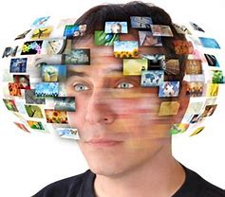
Satan tries to deceive or distract us from God’s Perspective so that we drift through life with little eternal
Effect or impact!

Slide 5
Jesus calls us to focus on the vital!
His first “message” was: “Repent
(metanoe’ō: rethink, reconsider)
for the Kingdom of Heaven is at hand!” Mt. 4:17
“Seek ye first the kingdom of heaven”

Slide 6
In order to avoid the deceptions and distractions of the Devil,
we need to plot a true course that “reconsiders” God’s Kingdom
and our role in it!

Slide 7
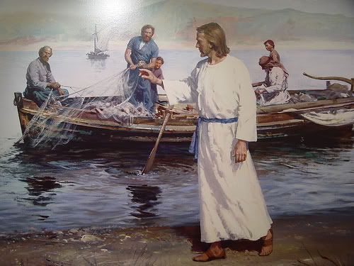
After the call to repentance he invites: “follow me and I will make you fishers of men.”
Mt. 4:19
halieus’ (from hals):
Which means
a Sailor!

Slide 8
Navigating the New Year.
(Part 2)

Slide 9
What’s Needed to “Navigate” life Successfully?

Slide 10
“Begin with an end in view!”
Destination (Destiny!)
Satan seeks to distract us by focusing on the journey.

Slide 11
Isn’t that “Sweet”?

Slide 12
What happened to the Rich Business man who decided to “Just Enjoy the Journey?”
Lk 12:19-20 “Soul, thou hast much goods laid up for many years; take thine ease,
eat, drink, and be merry.
But God said unto him, Thou fool!
This night thy soul shall be required of thee:
then whose shall those things be,
which thou hast provided?”

Slide 13
Luke 12:21 “So is he that layeth up treasure for himself, and is not rich toward God.
Notice Vs 31,32
“But rather seek ye the kingdom of God;
and all these things shall be added unto you.
³² Fear not, little flock; for it is your Father's good pleasure to give you the kingdom.”

Slide 14
Destination (Destiny!)
1.What’s your desired end?
This should be related to
your “Why”! (Rev. 4:11)
1) Why are you really here?

Slide 15
1.What’s your desired end?
Why are you really here?
B. If you have the wrong answer:
1)You’ll plot the wrong course!
2) You’ll waste time.
3) You’ll end up “wasting” your life!
“Vanity of Vanities” Eccl.

Slide 16
Begin with an end in view
2. Without a clear destination you
won’t know when you drift.
“Where there is no vision,
(clarity, revelation, purpose, Destination!)
people perish” Pr. 29:18
(get sidetracked, drift!)

Slide 17
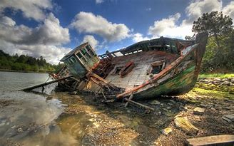
2. Destination Drift 1 Tim. 1:5,6,19
“Now the end of the commandment is charity out of a pure heart, and of a good conscience, and of faith unfeigned:
From which some have swerved...
¹⁹ Holding faith, and a good conscience; which some having put away concerning faith have made shipwreck!”

Slide 18
2. “Destination” or Drift?
A. The “current” of changing cultures will
seldom take you to a safe harbor!
Ph 3:14 “I press toward the mark for the prize of
the high calling of God in Christ Jesus”
vs. 18,19 “For many walk…whose end is destruction
who mind earthly (temporary) things.”
Phroneo: entertain, regard, focus on

Slide 19
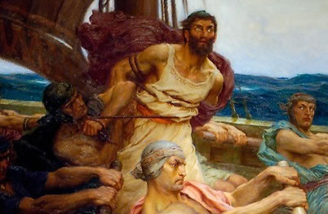
2. “Destination” or Drift?
Remember Odysseus and the sirens?

Slide 20
3. Navigate by the permanent!
That’s why sailors navigate by stars!
A. Temporary goals should line up
with permanent, long range goals.
1) Otherwise they’ll take you off Course!
B. Temporary delays may become
Detours to Destruction! Mt 7:13

Slide 21
B. Destructive Detours! Mt. 7:13
“broad is the way that leadeth to destruction.”
apō’leia: ruin, loss, waste!
Homer’s Odyssey (750 BC) illustrates this.
It’s is about King Odysseus’ journey home
after the 10 year Trojan war.
2) While he was anxious to return to his wife
Penelope, and his Kingdom,
he kept getting sidetracked.

Slide 22
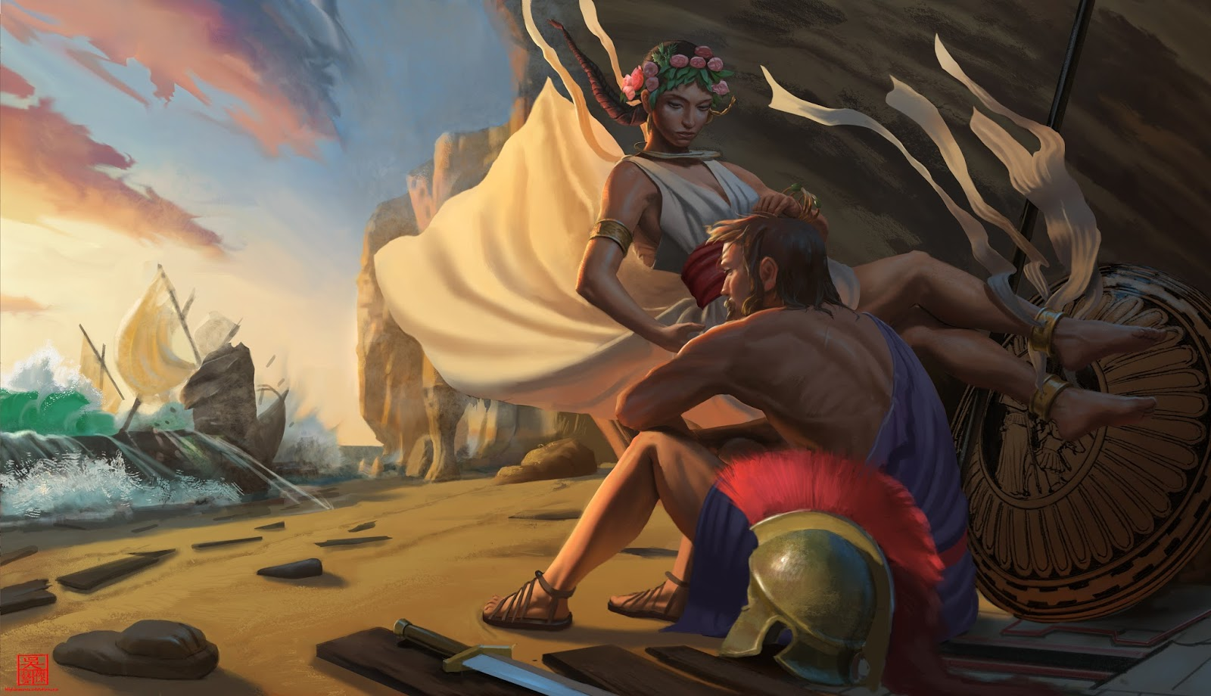
And was trapped for 7 years by the Nymph Calypso.
He became shipwrecked on Ogygia

Slide 23
To Navigate Successfully you need:
A Final Destination:
Where do you want to end up?
An Accurate Location:
Where are you now?
A Clear Direction:
How will you get from here to there?

Slide 24
Destination, Location, Direction;
most fail to consider that we have:
A Limited Duration! (Ps 90:12
Time’s running out!
“Thou fool, this night shall thy soul be required of thee!” Lk 12:20

Slide 25
Lot became enamored with the wealth of Sodom and decided to “sojourn” there. Gen. 19:9.
Gur: to “Turn aside from the road”.
God delivered him and his family before judging the cities,
but warned them not to look back.

Slide 26
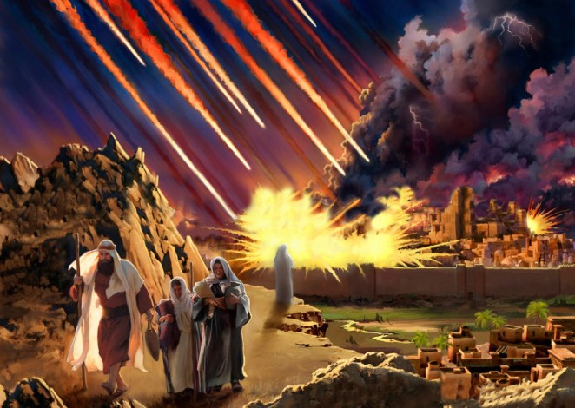
“Remember
Lot’s Wife”
Luke 17:32

Slide 27
What’s your desired end?
God has a desired “end” for you! Jer. 29:11
“For I know the thoughts (purposes) that I think toward you, saith the LORD,
thoughts of peace, and not of evil,
to give you an expected end.”
ʾaḥarît’ Tiqwâ: Hopeful Reward!

Slide 28
Will you “work” with God to plot your course?
Ps 37:3-5 “Trust in the LORD, and do good; so shalt thou dwell in the land, and verily thou shalt be fed. Delight thyself also in the LORD; and he shall give thee the desires of thine heart. Commit thy way unto the LORD; trust also in him; and he shall bring it to pass.”

Slide 29
Are you ready to Navigate your New Year?

