Slide 1
The Bible is God’s revelation of himself
as He deals with humanity.

Slide 2
It doesn’t reveal every detail about everything;
But it does reveal enough for us to know Him and His Nature and Will.
Ps. 33:12 “Blessed is the nation whose God
is the LORD; and the people whom he hath chosen for his own inheritance.“ (naḥalâ’: possession)
Ps 16:4 “Their sorrows shall be multiplied
that hasten after another god…”

Slide 3
Dt 29:26,27 “they went and served other gods and the anger of the LORD was kindled against this land,
to bring upon it all the curses that are written…”
29 The secret things belong to the LORD our God:
but those things which are revealed belong unto us and to our children for ever,
that we may do all the words of this law.”
(See also John 20:30,31; 21:25)

Slide 4
Last week we learned that God’s blessing is a byproduct of our obedience to Him.
Ex. 19:5 “If you’ll obey my voice indeed…
then ye shall be a peculiar treasure unto me…”
Deut. 11:26-28 “Behold, I set before you this day
a blessing (berākâ’: prosperity, protection, peace)
and a curse; (qelālâ’: to make vile)
A blessing, if ye obey the commandments of the LORD your God, which I command you this day:”

Slide 5
Dt. 11:26-28 “set before you a blessing and a curse;
Disobedience would result in the removal of the peace and protection of God’s blessing,
Exposing ourselves to the “curse” of God’s enemies.
…And a curse, if ye will not obey the commandments of the LORD your God,
but turn aside out of the way which I command you
(the essence of sin {Hamartano: miss the mark})
to go after other gods…”

Slide 6
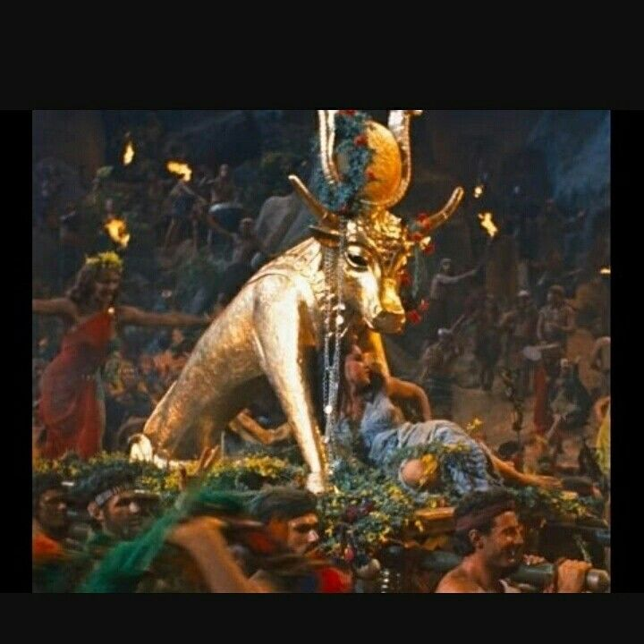
In Exodus 19 Israel chose the blessing.
8 “And all the people answered together, …
All that the LORD hath spoken we will do. “
Within a month or so Ex. 32:4:
“These be thy gods,
which brought thee up
out of …Egypt.”

Slide 7
How does a person, family, church, or nation go from Blessed to Cursed?
Ignorantly or intentionally they
“go after other gods.” (Dt 11:28)
Ps 16:4 “Their sorrows shall be multiplied that hasten after another god.”

Slide 8
Ps 16:4 “Their sorrows shall be multiplied
that hasten after another god…”
Who are these “other gods”?
Where did they come from?
What do they want?

Slide 9
The first of the 10 commandments Ex 20:3
“thou shalt have no other gods before me!”
These other “gods” are Fallen angels.
1 Cor. 10:20 “the things which the Gentiles sacrifice,
they sacrifice to devils, (daimon’ion: demons!)
and not to God:
and I would not that ye should have
Fellowship (koinōnos’: partnership) with devils.”

Slide 10
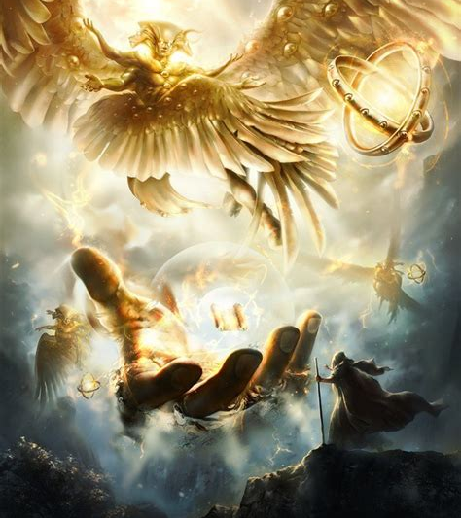
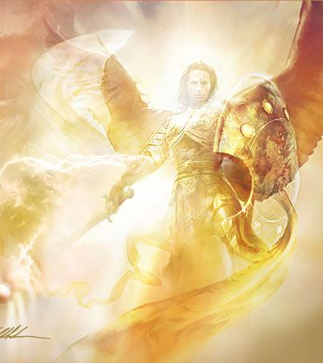
Understanding Angels.
1. What they are!

Slide 11
A. Angels are Created Spirit Beings.
Gen. 1:1 “In the beginning God created…”

Slide 12
3 “All things were made by him;
without him was not any thing made.”
That means that these “gods” (elohim)
(from eloah: strength, power)
Were created beings, made by el ʿelyôn.
“The Most High God”
(Gen 14:18-22; Nu. 24:6; Dt 32:8, etc)

Slide 13
Col 1:16 “by him were all things created,
that are in heaven, and that are in earth,
whether they be thrones, or dominions,
principalities, or powers:
all things were created
by him,
and for him:
17 And he is before all things,
and by him all things consist.”

Slide 14
Col. 1:18 “And he is the head…
the firstborn from the dead;
that in all things he might
have the preeminence.”
(Prōteu’ō: first in rank
and influence!)
Ex 20:3 “thou shalt have no other gods
before me!”

Slide 15
1. What They (Angels) are.
B. They have great (delegated) power.
O.T. “angel” (malʾāk’) deputy, dispatch, ambassador
N.T. “angel” (angelos) messenger
1) They are higher than man. Ps. 8:4,5; Heb 2:6,7
“What is man that thou art mindful of him…
Thou madest him a little lower than the angels;
(Elatto’ō: less in rank, power, influence)
and didst set him (man) over the works of thy hands:”
Gen. 1:26-28

Slide 16
2. Why they are:
A. They were created to serve. Heb 1:14
“Are they not all ministering spirits, (leitourgikos’: public servants)
1) All were created to Serve God. (Rev. 4:11; Col. 1:6)
“all things were created by Him and for Him”
2) Some were created to Serve Us! (Heb 1:14b)
“…sent forth to minister (diakonia) for them
who shall be heirs of salvation? “

Slide 17
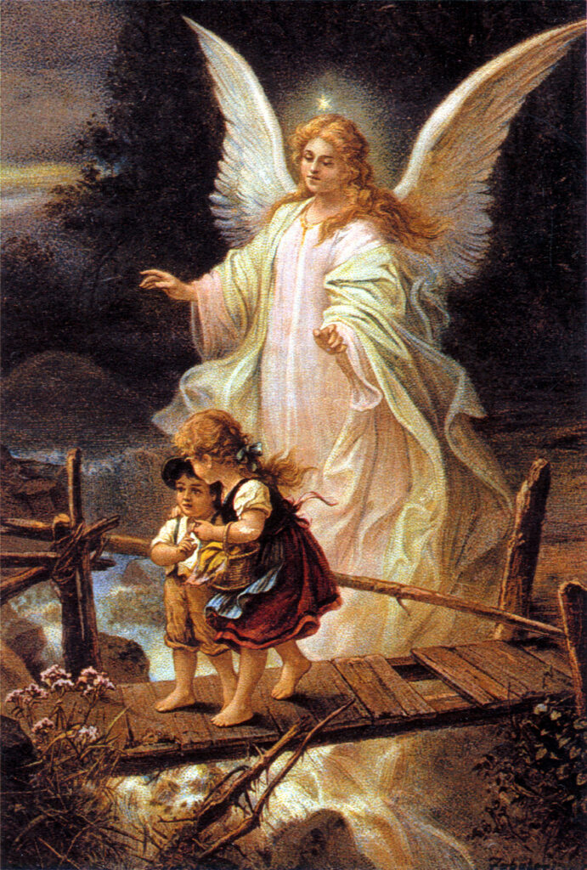
A. Angels were created to serve. Heb 1:14
2) Some Serve Us! (Heb 1:14b)
Mt 18:10 “Take heed that ye despise not one of these;
for I say unto you,
That in heaven their angels do always behold the face of my Father which is in heaven.”

Slide 18
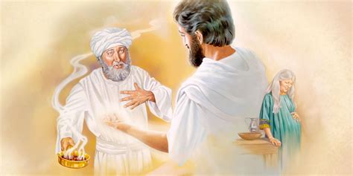
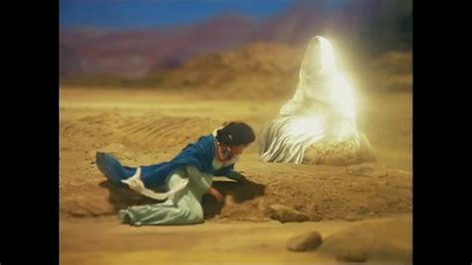
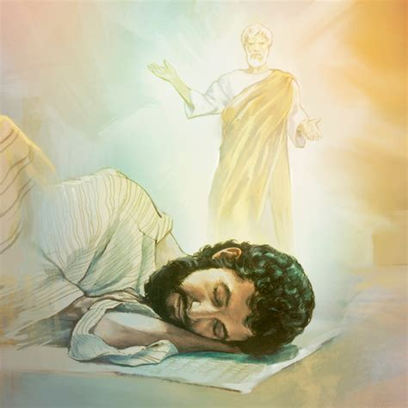
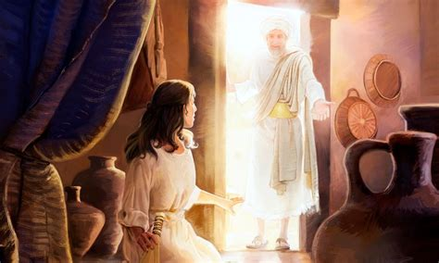
2) Some Serve Us (Heb 1:14b) by providing:
a) Direction.
((4)
(1) Hagar Gen. 16:7-9
(2) Zacharias: Lk 1:11-20
4) Joseph: Mt 2:13
3) Mary:
Lk 1:26-38

Slide 19
2) Some Serve Us (Heb 1:14b) by providing:
b) Information
(1) Hagar (Gen. 16:10-12) 13 “Thou God, seest me …”
(2) Daniel Dan 8:16 “Gabriel, make this man to understand”
(3) Samson’s parents. Jdgs 13:8 “Manoah intreated the LORD, and said, O my Lord, let the man of God which thou didst send come again unto us, and teach us what we shall do unto the child that shall be born.”
(4) Gideon Judges 6:12➔ “The Lord is with thee…”

Slide 20
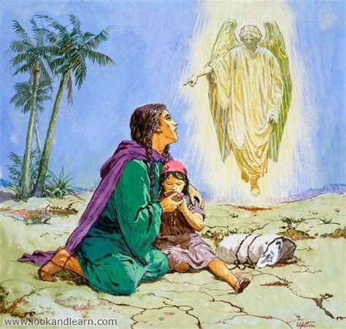
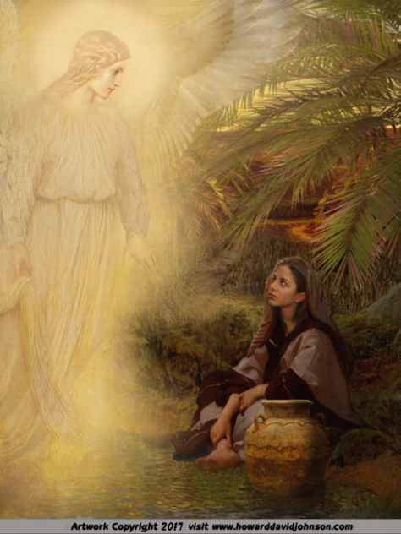
2) Some Serve Us (Heb 1:14b) by providing:
c) Protection.
1) Hagar Gen. 16:14 “therefore the well was called
beʾēr (well) laḥay (of life) rōʾî” (from God who sees)
Gen. 21:10-21
“And God opened her eyes, and she saw a well of water;
and she went, and filled the bottle with water, and gave the lad drink. “

Slide 21
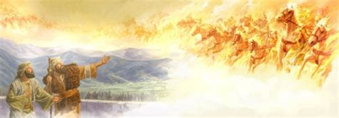
2) Elisha: 2 Kgs 6:16-17 “Fear not: for they that be with us are more than they that be with them.
LORD, I pray thee, open his eyes, that he may see.
And the LORD opened the eyes of the young man;
and he saw: and, behold, the mountain was full of horses
horses and chariots of fire
round about Elisha.”

Slide 22
3) Us! Ps 34:7 “The angel of the LORD encampeth round about them that fear him,
and delivereth them.”
(ḥālas’̣: Strengthen, Deliver, Equip)
Isaiah 41:10 “Fear thou not; for I am with thee:
be not dismayed; for I am thy God:
I will strengthen thee; (ʾāmēs’̣: fortify)
yea, I will help thee, (ʿāzar’: surround, protect)
yea, I will uphold thee (tāmak: sustain)
with the right hand of my righteousness.”

Slide 23
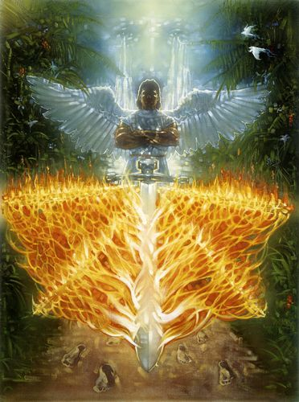
3. How they are… (Organized)
A. They are organized by Rank and Purpose.
1) Cherubim (mentioned 65x)
a) Guarding Eden. (Gen. 3:24)
“So he drove out the man;
and he placed at the east of the garden of Eden Cherubims,
and a flaming sword which turned every way, to keep the way of the tree of life.”

Slide 24
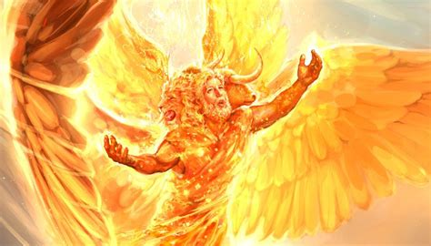
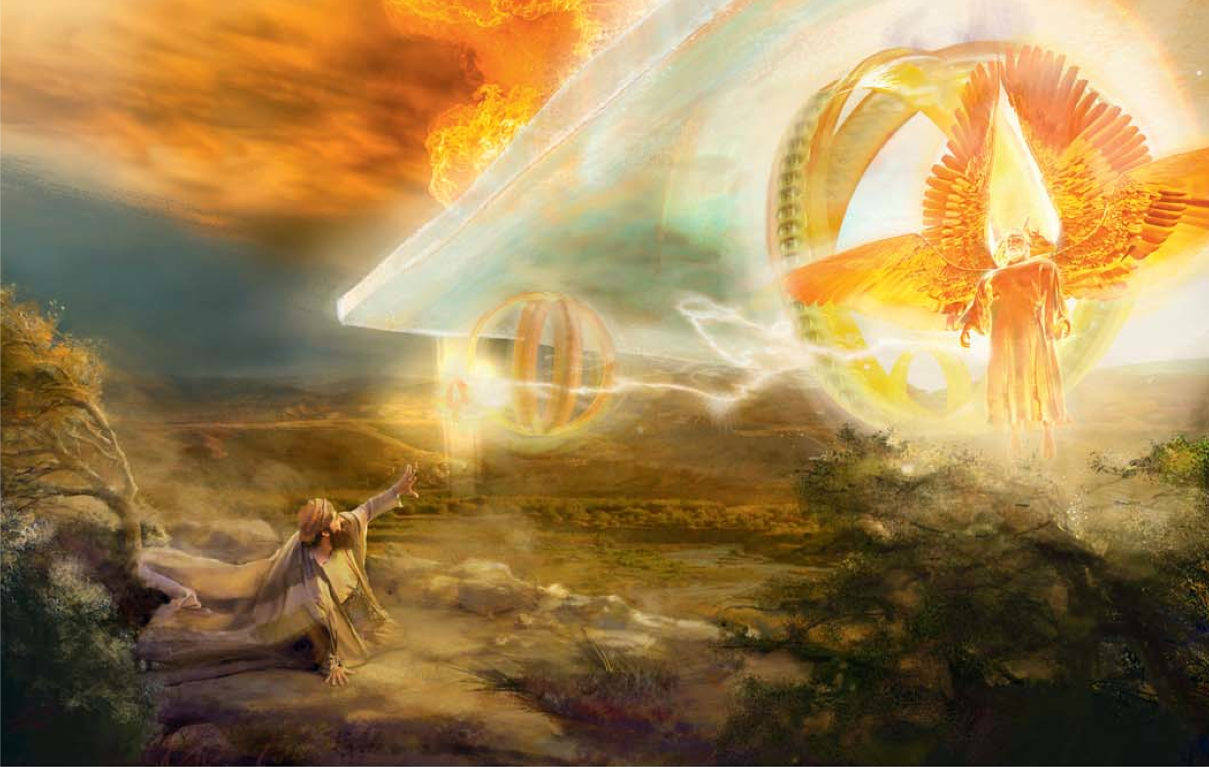
They are organized by Rank and Purpose.
1) Cherubim (mentioned 65x)
b) Before God’s Throne. Ps. 80:1; 99:1; Is 37:16; Rev. 4
“…dwellest between the cherubims…?
Ezekiel 1

Slide 25
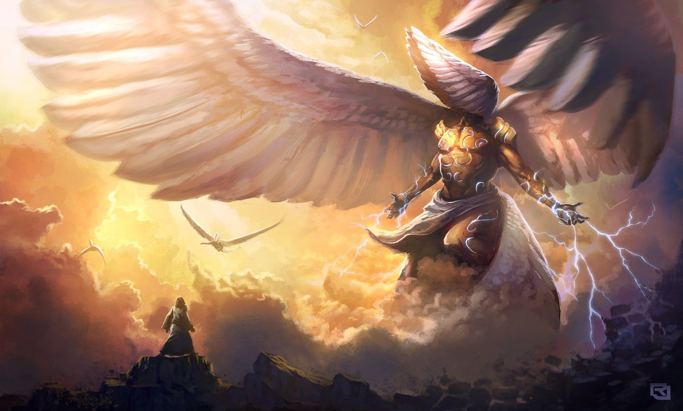
A. There are different types/ranks.
2) Seraphims: Is 6:1-3 “I saw the Lord upon a throne,
high and lifted up, and his train filled the temple.
Above it stood the seraphims:
each one had six wings… And one cried unto another,
Holy, holy, holy, is the LORD of hosts:
the whole earth is
full of his glory.”

Slide 26
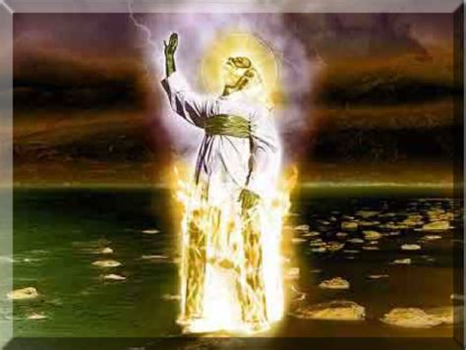
3) Messengers. Daniel 10:5-6
5 “behold a certain man clothed in linen, whose loins were girded with fine gold:
6 His body also was like the beryl, and his face as the appearance of lightning, and his eyes as lamps of fire,
and his arms and his feet like …brass,
and the voice of his words like the voice of a multitude. …”

Slide 27
3) Messengers. Daniel 10:11-13
11 “And he said, O Daniel, a man greatly beloved, understand the words that I speak unto thee,
… for unto thee am I sent. ..
12 Fear not, Daniel: for from the first day that thou didst set thine heart to understand,
and to chasten thyself before thy God,
thy words were heard,
and I am come for thy words.”

Slide 28
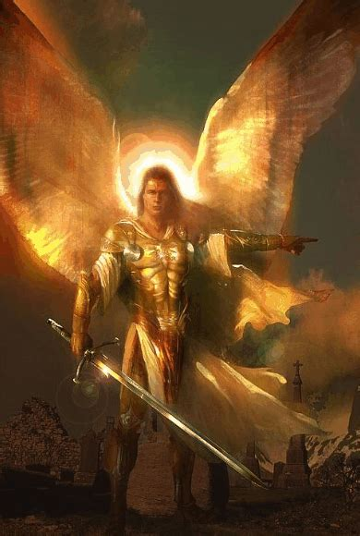
4) Principalities (Captains) Daniel 10:13,20-21
13 “But the prince (sar: captain) of the kingdom of
Persia withstood me one and twenty days:
but Michael, one of the chief princes, came to help me…
sar (captain) riʾshôn (first)
20 “I will return to fight the prince of Persia…
…lo, the prince of Grecia shall come,
21 None holdeth (helps) me in these things
but Michael, your prince…”

Slide 29
Ex. 20:3 “Have no other gods before me”
Who are the “other gods”? Fallen angels
1Cor 10:20 “they sacrifice to devils” (daimon’ion: demons!)
2. What are they created for? To serve God and us.
Heb 1:14 “Are they not all ministering spirits,
How are they (organized). Eph. 6:12
“For we wrestle …against principalities, against powers, against the rulers of the darkness of this world, against spiritual wickedness in high places.”

Slide 30
4. What do they want? Jn 10:10
To deceive and distract in order to destroy.
Col 2:18,19 “Let no man beguile (seduce) you of your reward in a voluntary humility and worshipping of angels, intruding into those things which he hath not seen, vainly puffed up by his fleshly mind.
And not holding (krateo: holding to to) the Head, (Jesus)
from which all the body by joints and bands having nourishment ministered, and knit together,
increaseth with the increase of God.”

Slide 31
Why learn about these “other gods”?
Information: Intelligence. 2 Cor 2:11
“Lest Satan should get an advantage of us: for we are not ignorant of his devices.” (no’ēma: purposes)
2) Application: Training: 2 Tim 2:3,4 “endure
hardness, as a good soldier of Jesus Christ.
No man that warreth entangleth himself
with the affairs of this life;
that he may please him who has chosen him
to be a soldier.”

Slide 32
Why learn about these “other gods”?
Information: Intelligence. 2 Cor 2:11
Application: Training: 2 Tim 2:3,4; 15, 3:16,17
Protection: Recovery/Victory 2 Tim. 2:24-26
Eph. 6:10-11 “Finally, …, be strong in the Lord,
and in the power of his might.
Put on the whole armor of God,
that ye may be able to stand
against the wiles of the devil.

Slide 33
Eph 6:13 “Wherefore take unto you the whole armor of God,
that ye may be able to withstand
in the evil (poneros: infected) day,
and having done all, to stand.”
(His’tēmi: to abide firm)

Slide 34
James 4:7 “Submit yourselves therefore to God. Resist the devil, (anthis’tēmi: stand against)
and he will flee from you.”
In order to resist the devil,
we need to learn to recognize him!
“Lest Satan should get an advantage of us:
for we are not ignorant of his devices.”
Corinthians 2:11

