Slide 1
Eph 6:10-18; 2 Cor 10:3-5; 2 Cor 2:11
“Lest Satan should get an advantage of us: for we are not ignorant of his devices.”

Slide 2
There’s a cosmic war being waged for the hearts and souls of humanity.
The Bible repeatedly warns us about the nature of this conflict as well as the Powers and Personalities behind this struggle.
In this age-old
conflict,

Slide 3
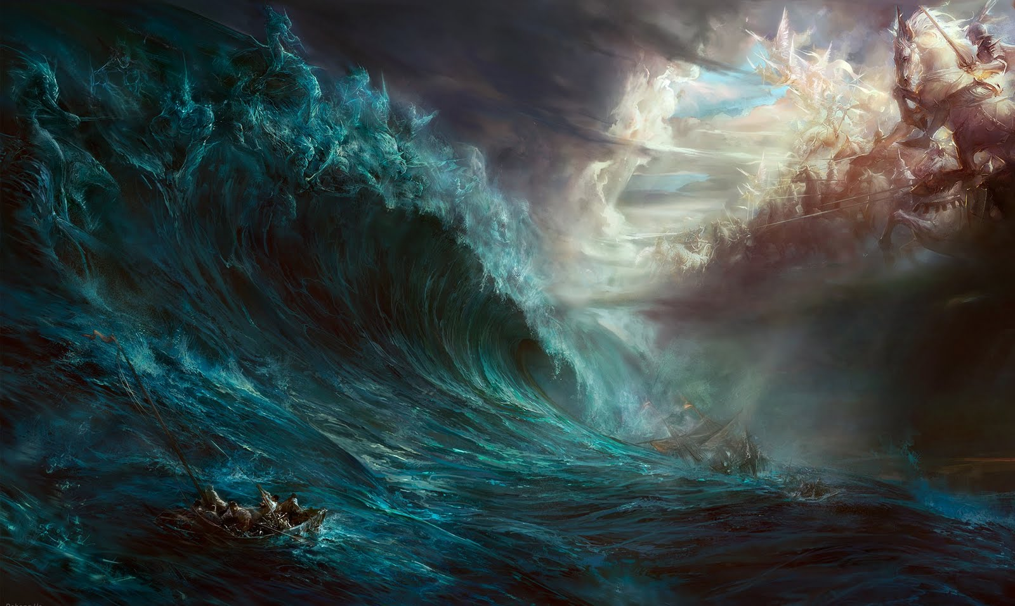
There is no neutral ground!
“He that is not with me
is against me!” Mt 12:30

Slide 4
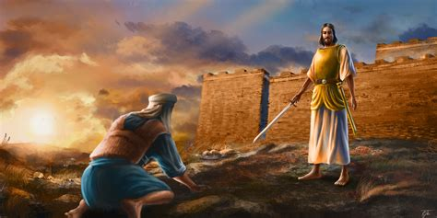
One side of this spiritual war is led by Jesus Christ who introduced himself to Joshua as:
“Captain of the host of the LORD!
And Joshua fell on his face to the earth,
and did worship, and said unto him,
What saith my lord
unto his servant?”
Joshua 5:14

Slide 5
The other side is led by Satan who also goes
by many names.
Rev 9:11 “they had a king over them, which is the angel of the bottomless pit, whose name
in the Hebrew tongue is Abaddon, (destruction)
(Job 26:6; 28:22; 31:12; Psalm 88:11; Prov 15:11)
but in the Greek …Apollyon” (destroyer)
Mt 12:24 “Beelzebub the prince of the devils.”
(Literally the “dung god”)

Slide 6
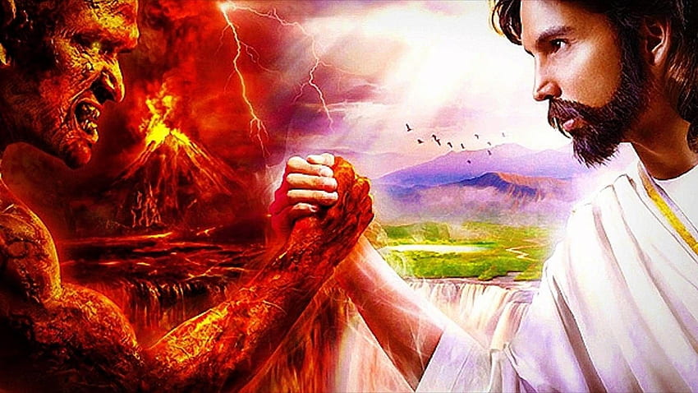
Both are seeking Partners in this cosmic conflict.
Our choices align us with one of them.

Slide 7
God uses ancient Israel to illustrate this struggle, and our part in it. 1 Cor 10
11 “these things happened unto them for ensamples:
and they are written for our admonition...
12 let him that thinketh he stands, Take heed lest he fall.
14 Wherefore, my dearly beloved, flee from idolatry…
20 …the things which the Gentiles sacrifice,
they sacrifice to devils, (daimon’ion: demons)
I would not that ye should have
fellowship (koinonos’: partnership) with devils.”

Slide 8
Our Personal Exodus Story 2 Cor 6:14-18
“Be ye not unequally yoked together with unbelievers: for what fellowship hath righteousness with unrighteousness? and what communion hath light with darkness? And what concord hath Christ with Belial?
or what part hath he that believeth with an infidel?
And what agreement hath the temple of God with idols?
for ye are the temple of the living God;
as God hath said, I will dwell in them, and walk in them; and I will be their God, and they shall be my people.

Slide 9
Our Personal Exodus Story 2 Cor 6:14-18
Wherefore come out from among them,
and be ye separate, saith the Lord,
and touch not the unclean thing;
(Akath’artos: lewd, demonic)
and I will receive you,
And will be a Father unto you,
and ye shall be my sons and daughters,
saith the Lord Almighty.”

Slide 10
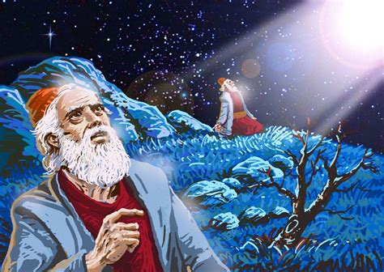
1. Israel was initially in bondage to the
Pharaoh and “gods” of Egypt. Ex. 1,2
A. God warned of this 400 years earlier.
Gen 15:13 “He said to Abram, Know of a surety that
thy seed shall be a stranger
in a land that is not theirs,
and shall serve
and afflict them
four hundred years;”

Slide 11
A. God warned of this 400 years earlier.
Gen 15:14,16 “And also that nation, …will I judge
And afterwards will they come out with great substance.
But in the fourth generation they shall come here again:
for the iniquity of the Amorites is not yet full.”
God gave the Canaanites 400 years to repent!

Slide 12
B. God delivered them from their bondage
Ex 6:6-7 “I am the LORD, and I will bring you out from under the burdens of the Egyptians, and I will rid you out of their bondage, and I will redeem you with a stretched out arm, and with great judgments:
And I will take you to me for a people,
…and ye shall know that I am the LORD your God…”
1) The 10 plagues were specifically targeted
“against all the gods of Egypt I will execute judgment: I am the LORD. …” Ex 12:12

Slide 13
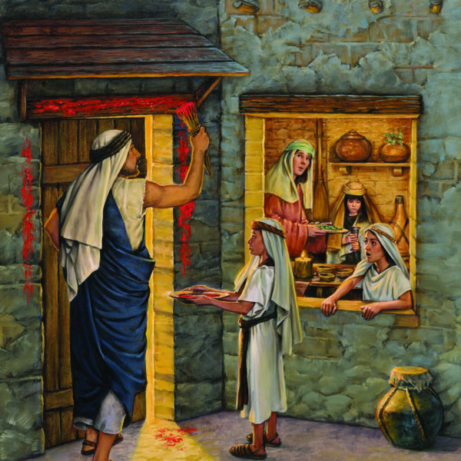
B. God delivered them from their bondage
2) The final plague had a final price! Ex 12:13 “And the blood shall be to you for a token …:
and when I see the blood,
(of the Passover lamb)
I will pass over you,
and the plague shall not be
upon you to destroy you,
when I smite the land of Egypt.”

Slide 14
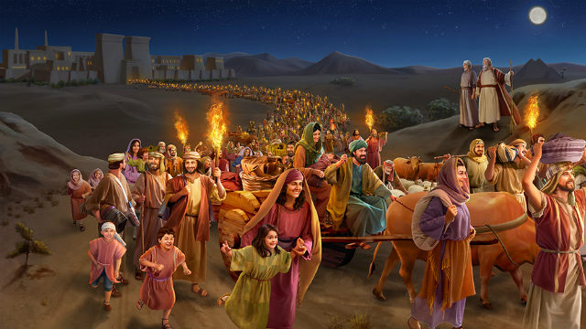
There was initial excitement / enrichment.
Ex 12:36 “And the LORD gave the people favor in the sight of the Egyptians, so that they lent unto them such things as they required. And they spoiled the Egyptians.
1) God had also foretold this. Genesis 15:14
“that nation…will I judge: and afterward shall they come out with great substance.”

Slide 15
D. God orchestrated a clean and complete
break from Egypt (and her gods). Ex 14:2-4
“Speak unto Israel, that they turn before Pihahiroth, between Migdol and the sea,
over against Baalzephon:
before it shall ye encamp by the sea.

Slide 16
God intentionally led them into a trap!
“between a rock and a hard place!”

Slide 17
D. God orchestrated a clean and complete
break from Egypt (and her gods). Ex 14:2-4
2) God was setting the stage for a great battle!
“For Pharaoh will say They are entangled in the land..
And I will harden Pharaoh's heart, that he shall follow after them; and I will be honoured upon Pharaoh,
that the Egyptians may know that I am the LORD. “
It was clear that Pharaoh (and Egypt’s “gods”)
didn’t want to let Israel go.

Slide 18
https://wyattmuseum.com/discovering/red-sea-crossing

Slide 19
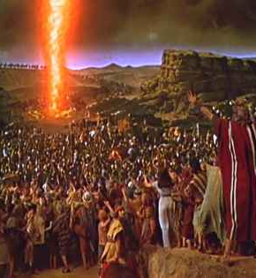
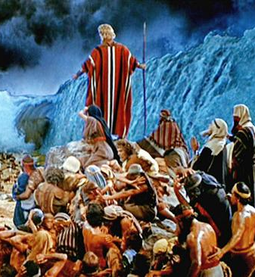
Ex. 14:19-20
Ex. 14:26-31

Slide 20
E. The crossing of the Red sea was the start of
a new life, Purpose and Partnership Ex 19:4-6
“Ye have seen what I did unto the Egyptians, and how I bare you on eagles' wings, and brought you unto myself.
Now therefore, if ye will obey my voice indeed, and keep my covenant, then ye shall be a peculiar treasure unto me above all people: for all the earth is mine:
And ye shall be unto me a kingdom of priests,
and an holy nation.”

Slide 21
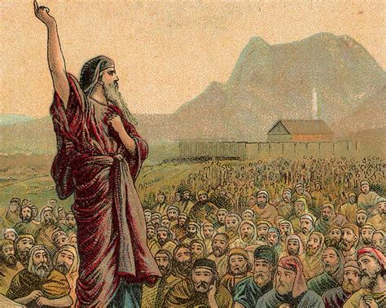
Israel initially accepted this covenant partnership. Ex 19:7-8 “Moses came and called
for the elders of the people, and laid before their faces all these words which the LORD commanded him.
And all the people answered together, and said,
All that the LORD hath spoken
we will do.”

Slide 22
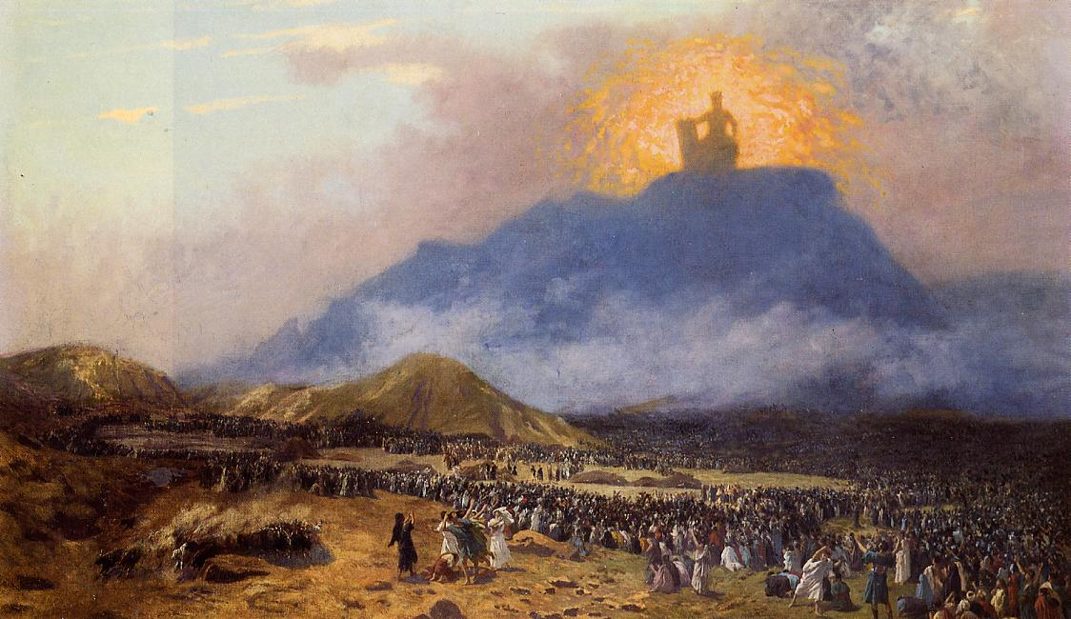
2) The 10 Commandments were the conditions
of this covenant.
Ex 20:1-3 “And God spake all these words, saying,
I am the LORD thy God, which have brought thee out of the land of Egypt, out of the house of bondage.
Thou shalt have no other gods before me.”

Slide 23
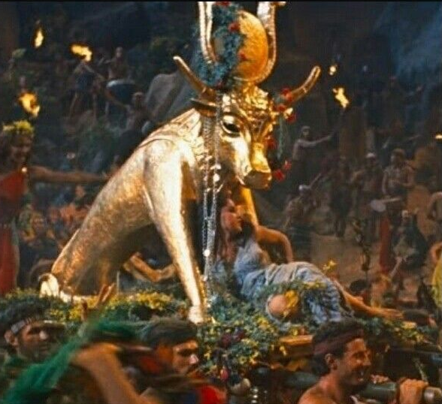
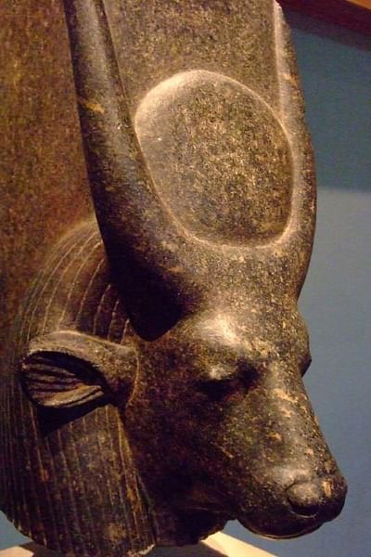
F. Satan quickly seduced them to return to the
“gods” they had known in Egypt.
1) Soon they declared: “These (hep) be thy gods, which brought thee out of Egypt.” Ex. 32:4
Hep was the Egyptian “god” of fertility.
Associated with the goddess Hathor (Isis) daughter
of Ra and Mother of Horus.
Hathor
(Isis)
She was the sky goddess
of love, fertility, and sex
hep/hapi
https://egyptianmuseum.org/deities-hathor

Slide 24
Although God redeemed Israel and called them into a Partnership with Him,
Satan continued to seduce them to betray God and embrace the “gods” of this world.
Their 4000 year history is a record of this cycle of seduction!
History is really “His” Story!

Slide 25
1Cor. 3:11 “these things happened unto them for ensamples:
…for our admonition...” (Nouthesia: warning)
Like Ancient Israel:
1) Humanity is in Bondage.
Egypt is a type of the “World” in the Bible.
Satan as “the god of this world” (2 Cor 4:4; Eph 2:1-3)
holds mankind in bondage to the seduction of sin.
Jn 8:34 “Whosoever committeth sin
is the servant of sin.” (also Ro. 6:17)

Slide 27
2) God paid a great price for our redemption.
Jn 1:29 “Behold the lamb of God that taketh away the sin of the world”
1 Pt 1:18-19 “ye were not redeemed with corruptible things, … But with the precious blood of Christ,
as of a lamb without blemish and without spot:”
1 Cor 5:7 “Christ our passover is sacrificed for us:”
Jn 3:3; 16-18 “God so loved the world that he gave his only begotten son. That whosoever believeth in him, should not perish, but have everlasting life.”

Slide 28
3) God desires we make a clean break with the “gods” of this world. (Symbolized by baptism!)
1Cor 10:1-2 “all our fathers were … baptized unto Moses in the cloud and in the sea;”
Ro 6:3-4 “Know ye not, that so many of us as were baptized into Jesus Christ were baptized into his death?
Therefore we are buried with him by baptism into death:
that like as Christ was raised up from the dead by the glory of the Father,
even so we also should walk in newness of life.”

Slide 29
4) God invites us to partner with him in
reaching the world. (Mt 28:18-20; Acts 1:8; 1 Cor 3:9) 1 Pt 2:9-11 “ye are a chosen generation, a royal priesthood,
an holy nation, a peculiar people; that ye should shew forth the praises of him who hath called you out of darkness
into his marvellous light:
Which in time past were not a people,
but are now the people of God…
Dearly beloved, I beseech you as strangers and pilgrims, abstain from fleshly lusts,
which war against the soul”

Slide 30
5) Satan is ever seeking to seduce us into infidelity
by neglecting God and embracing (flirting with)
the world and it’s gods!
(aka: values!)
James 4:4-10 “Ye adulterers and adulteresses, know ye not that the friendship of the world is enmity with God?
whosoever therefore will be a friend of the world is the enemy of God…7 Submit yourselves therefore to God. Resist the devil, and he will flee from you.
8 Draw nigh to God, and he will draw nigh to you. Cleanse your hands, ye sinners;
and purify your hearts, ye double minded.”

Slide 31
1 Jn 2:14-17 “I have written unto you, … because ye have known him that is from the beginning... …because ye are strong, and the word of God abideth in you,
and ye have overcome the wicked one.
Love not the world, neither the things …in the world.
If any man love the world, the love of the Father is not in him.
For all that is in the world, the lust of the flesh, and the lust of the eyes, and the pride of life,
is not of the Father, but is of the world.
And the world passeth away, and the lust thereof:
But he that doeth the will of God abides forever!”

Slide 32
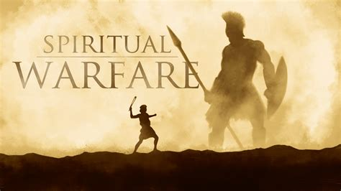
6) God had plans for Israel to “take back” the
promised land from the “giants” and “gods”
who had corrupted it.
In much the same way, there are still battles to fight and “giants” that would seek to rob us
of the inheritance
(Purposes and Partnership)
that God has called us to!
John 10:10

Slide 33
“He that is not with me is against me!” Mt 12:30

Slide 34
Eph. 6:11
“Put on the whole armor of God,
That ye may be able to stand against the wiles of the devil.”
For we wrestle not against flesh and blood,
but against principalities, against powers,
against the rulers of the darkness of this world,
against spiritual wickedness in high places.”

Slide 35
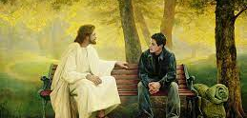
Where are you in your personal “Exodus” story?

