Slide 1
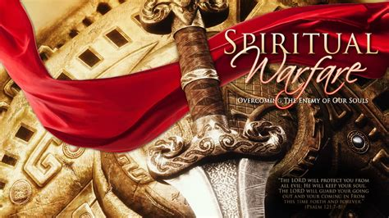
“Be Strong in the Lord, and in the power of His Might.”
Eph 6:10

Slide 2
Peace is not the absence of Pain or Problems,
but an awareness of the Power, Promises, Purposes and Partnership
with “the Prince of Peace”! (Is. 9:6)
“Take my yoke upon you and learn of me…,
And ye shall find rest unto your souls.”
Mt 11:28,29
“Peace” (Eirene: from eiro: meaning to join)

Slide 3
“Peace” (Eirene: from eiro: meaning to join)
That means that our Peace
(Or lack thereof)
is related to who or what we Join.

Slide 4
Last week we discussed that God’s plan for delivering the world from the bondage of the false gods that enslaved them involved:
Exposing their impotence (Ex. 12:12; 19:4)
“Against the gods of Egypt will I execute judgment,
I am the LORD!”
Enlisting His people to partner with him in reaching/redeeming the world. (Ex. 19:5,6)
“Ye shall be unto me a kingdom of Priests”

Slide 5
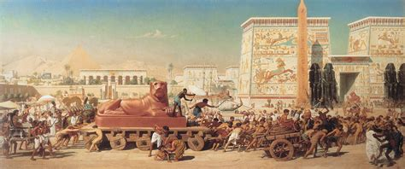
After delivering Israel from the bondage of Egypt (and her gods) Ex. 4-18

Slide 6
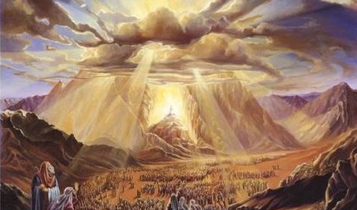
He led them to Mt. Sinai.
Where he invited them to join him in this Priestly Partnership.

Slide 7
God’s offer of a Priestly Partnership
1. It was a Personal Partnership. Ex 19:4
“ye have seen what I did unto the Egyptians,
And how I bear you on eagles wings,
and brought you unto myself.”
A. God is both relevant and relational!
Jn 14:21 “He that hath my commands and keepeth them,
He it is that loveth me…”
1 Jn 4:8 “for God is love”

Slide 8
God’s Priestly Partnership was:
1. A Personal (Relational) Partnership
2. A Precious (Valuable) Partnership
Ex 19:5 “if ye will obey … and keep my covenant,
then ye shall be a peculiar treasure unto me…
(Segulla: Purchased, Protected & Precious treasure)
…above all people: for all the earth is mine:”
Ps139:17 “How precious also are thy thoughts unto me,
O God! how great is the sum of them!”

Slide 9
God’s Priestly Partnership was:
2. A Precious (valuable) Partnership
A. Because of the Price to establish it. Ex 6:6-7
“I am the LORD, and I will bring you out from under the burdens of the Egyptians, and I will rid you out of their bondage, and I will redeem you with a stretched out arm, and with great judgments:
And I will take you to me for a people,
and I will be to you a God:
and ye shall know that I am the LORD your God”

Slide 10
2. It was a Precious (valuable) Partnership
B. Because of the Purpose of it.
The Redemption of the World!
Ps 49:8 “the redemption of their soul is precious”
Yāqar: valuable and rare
Ps 126:6 “He that goeth forth and weepeth,
bearing precious seed,
shall doubtless come again with rejoicing,
Bringing his sheaves with him.”

Slide 11
C. Because of the Process involved to prepare them.
Is 43:1-4 “Thus saith the LORD that created thee, and he that formed thee, …Fear not: for I have redeemed thee, I have called thee by thy name; thou art mine.
2 When thou passest through the waters, I will be with thee;
and through the rivers, they shall not overflow thee:
when thou walkest through the fire, thou shalt not be burned; neither shall the flame kindle upon thee.
For I am the LORD thy God, the Holy One of Israel...
4 Since thou wast precious in my sight,
thou hast been honourable, and I have loved thee…”.

Slide 12
Mal. 3:17 “They shall be mine saith the Lord, in that day when I make up my jewels… (segulla)
18 Then shall ye return, and discern between the righteous and the wicked, between him that serveth God and him that serveth him not.”

Slide 13
3. It was a Practical Partnership Ex. 19
Ex 19:5 “if ye will obey … and keep my covenant,
then ye shall be a peculiar treasure unto me…
And ye shall be unto me a kingdom of priests…”
Mamlākâ (dominion, rule) kōhēn (priests)
A. God had a job for them to do! (1 Cor 3:9)
1) They were to represent Him to the world.
2) He wanted to use them to reflect himself,
in order to reach, teach, and redeem the world.

Slide 14
3. It was a Practical Partnership Ex. 19:5
“ ye shall be unto me a kingdom of priests…”
Zech 8:22-23 “many people and strong nations shall come to seek the LORD …and to pray before the LORD.
…In those days it shall come to pass, that ten men shall take hold out of all languages of the nations, even shall take hold of the skirt of him that is a Jew, saying,
We will go with you:
for we have heard that God is with you.”

Slide 15
God’s Priestly Partnership
4. Was to be a Pure (exclusive) Partnership
Ex 19:5 “ye shall be unto me a kingdom of priests
and an holy (qādôsh’: sacred, sanctuary) nation.”
From qādash: clean, dedicated, sanctified.
A. They had to be holy to reflect/represent a Holy God
Lev 11:44-45 “I am the LORD your God:
ye shall therefore sanctify yourselves, (qādash)
and ye shall be holy; for I am holy:” (qādôsh’)

Slide 16
While God’s Priestly Partnership was:
Personal (Relational), Precious (Valuable) Practical (Essential), and Pure;
5. It was also a Conditional Partnership Ex 19:5
“Now therefore, if ye will obey my voice indeed,
and keep (shamar: guard, hedge) my covenant,”
(berît: league, confederacy, {partnership})
From bara: to select, care for, nourish
God uses berît to describe marriage! (Mal. 2:14)
“then ye shall be a peculiar treasure unto me”

Slide 17
Moses experienced this partnership in Ps 91
1 ”He that dwelleth in the secret place of the most High shall abide under the shadow of the Almighty.
2 I will say of the LORD, He is my refuge and my fortress: my God; in him will I trust.
3 Surely he shall deliver thee from the snare of the fowler, and from the noisome pestilence.
He shall cover thee with his feathers,
and under his wings shalt thou trust:
his truth shall be thy shield and buckler. “

Slide 18
Moses experienced this partnership in Ps 91
“Because he hath set his love upon me,
therefore will I deliver him:
I will set him on high,
because he hath known my name.
He shall call upon me, and I will answer him:
I will be with him in trouble; I will deliver him,
and honour him. (kābēd: make “weighty”)
With long life will I satisfy him,
and shew him my salvation.”

Slide 19
God’s Still looking for Partners that are:
Personal: Jn 14:21 “He that hath my commandments, and keepeth them,
he it is that loveth me: and he that loveth me shall be loved of my Father, and I will love him,
and will manifest myself to him.”
Jn 1:12 “but as many as received him, to them gave he power to become the sons of God,
even to them that believe on his name.”

Slide 20
God’s Still looking for Partners that are:
2) Precious: 2 Pt 1:1-2
“Peter, a servant and an apostle of Jesus Christ,
to them that have obtained like precious (Tim’ios: valuable, honorable) faith (pistis: persuasion)
through the righteousness of God
and our Savior Jesus Christ:
2 Grace and peace be multiplied unto you through the knowledge of God, and of Jesus our Lord

Slide 21
God’s Still looking for Partners that are:
2) Precious:
a) Because of the Price. 1 Peter 1:18,19
“ye were not redeemed with corruptible things…
But with the precious blood of Christ, as of a lamb…”
b) Because of the Purpose. 1 Pt 2:8,9
“…that ye should shew forth the praises of him who hath called you out of darkness
into his marvellous light:”

Slide 22
c) Because of the Process required. 1 Pt 1:4-7
“To an inheritance incorruptible, and undefiled,
and that fadeth not away, reserved in heaven for you,
5 Who are kept by the power of God through faith unto salvation ready to be revealed in the last time.
6 Wherein ye greatly rejoice, though now for a season, …, ye are in heaviness through manifold temptations:
7 That the trial of your faith, being much more precious than of gold that perisheth, though it be tried with fire,
might be found unto praise and honor and glory
at the appearing of Jesus Christ:”

Slide 23
God’s Still looking for Partners that are:
1) Personal 2) Precious:
3) Practical: God has a job for us to do!
Mt. 28:18-20; 1 Cor 3:9; Acts 26:18
“To open their eyes, and to turn them from darkness to light, and from the power of Satan unto God,
that they may receive forgiveness of sins,
and inheritance among them which are sanctified by faith that is in me.”

Slide 24
God’s Still looking for Partners that are:
Personal 2) Precious 3) Practical
4) Pure 2 Cor 6:14-16 “Be not unequally yoked together for what fellowship hath righteousness with unrighteousness?
and what communion hath light with darkness?
And what concord hath Christ with Belial?
And what agreement hath the temple of God with idols?
for ye are the temple of the living God;
as God hath said, I will dwell in them, and walk in them; and I will be their God, and they shall be my people.

Slide 25
God’s Still looking for Partners that are:
4) Pure 2 Cor 6:17-18 “Wherefore come out from
among them, and be ye separate, saith the Lord,
and touch not the unclean thing;
and I will receive you,
And will be a Father unto you,
and ye shall be my sons and daughters,
saith the Lord Almighty.”
1 Jn 1:5-10; 3:1-3

Slide 26
God’s offer of a Priestly Partnership is both Relational (Mt 16:24)“If any man will come after me;
5) And Conditional. (Mt 16:24-26) “let him deny himself, take up his cross, and follow me.
For whosoever will save his life shall lose it:
and whosoever will lose his life for my sake shall find it.
For what is a man profited, if he gain the whole world,
and lose his own soul?
or what shall a man give in exchange for his soul?”

Slide 27
Israel failed to fulfil this Partnership Ez. 22:26-30
26 “Her priests have …profaned mine holy things: …
Her princes in the midst thereof are like wolves…
28 And her prophets have daubed them with untempered morter, seeing vanity, and divining lies unto them, …
The people of the land have used oppression, …
30And I sought for a man among them, that should make up the hedge, and stand in the gap before me for the land, that I should not destroy it:
But I found none!”

Slide 28
God’s still looking for Priestly Partners who will honor and represent Him with integrity.
Will he find one in you?

Slide 29
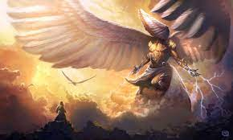
“I heard the voice of the Lord saying
Who shall I send, and who will go for us?
“Then said I, Here am I; send me!”
What will you say?
Isaiah 6:8

