Slide 1
Eph 6:10-18; 2 Cor 10:3-5; 2 Cor 2:11
“Lest Satan should get an advantage of us: for we are not ignorant of his devices.”

Slide 2
In 1 Cor 10 God gives us some insights into the attitudes that produced the actions that led to Israel’s corruption and eventual destruction.
1 Cor 10:5-7 “But with many of them God was not pleased:
for they were overthrown in the wilderness.
Now these things were our examples, to the intent we should not lust after evil things, as they also lusted.
Neither be ye idolaters, as were some of them;
As it is written ‘The people sat down to eat and drink,
and rose up to play.’”

Slide 3
1 Cor 10:8-11 “Neither let us commit fornication,
as some of them committed,
and fell in one day three and twenty thousand.
Neither let us tempt Christ, as some of them also tempted, and were destroyed of serpents.
Neither murmur ye, as some of them also murmured, and were destroyed of the destroyer.”
Olothreutēs’: to ruin, destroy, (a venomous serpent)
Now all these things happened unto them for ensamples: and they are written for our admonition,
upon whom the ends of the world are come.”

Slide 4
10:14 “Wherefore, my dearly beloved, flee from idolatry.
The Exodus Story (and Israel’s history) teaches us a lot about God’s Nature,
as well as that of our own (Pr 19:3);
And How Satan uses our fallen nature
to pull us away from our gracious God!
20 “…I would not that ye should have
fellowship with devils!”

Slide 5
Last week we saw God’s Nature is:
Pure/Holy Ex 3:5 “put off thy shoes …
for the place whereon thou standest is holy ground.”
Perceptive/Aware Ex 3:7 “I’ve surely seen the
affliction of my people which are in Egypt, and have heard their cry by reason of their taskmasters;
for I know their sorrows;”

Slide 6
Preserving/Redemptive Ex 3:8 “I’m come down to deliver them (from) the Egyptians, and to bring them up …unto a land flowing with milk and honey;”
Powerful/Almighty! Noticed how HE:
Delivered (Ex. 3:19,20; 12-14); Directed (Ex 13:21):
Protected (Ex 14:13,14); and Provided (Ps. 78)
Persona/Relational Ex. 3:10-12
“I will send thee to Pharaoh…
Certainly I will be with thee…”

Slide 7
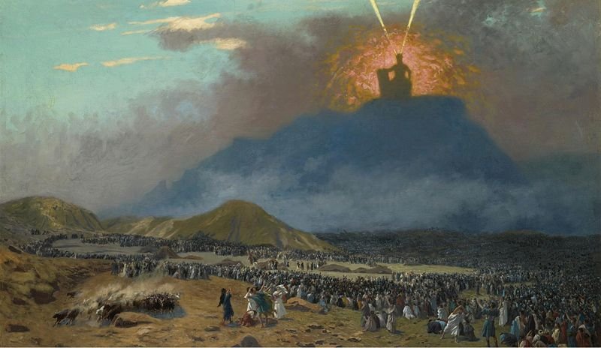
5. Personal/Relational.
Ex 19:4 “Ye have seen what I did unto the Egyptians
and how I bare you on eagles' wings,
and brought you unto myself.
5 Now therefore, If you’ll obey my voice indeed…
then ye shall be a peculiar treasure unto me…
6 And ye shall be unto me a kingdom of priests,
and an holy nation.”

Slide 8
While God’s Nature is Perceptive
Israel (and our) Nature was/is:
1. Imperceptive/Unaware
Since we’re so limited in our perception or awareness of what’s actually happening
“behind the scenes” (or our human senses),
We’re prone to make hasty judgments
and Complain about current circumstances.
(Remember the story of Job!?!?)

Slide 9
1. Imperceptive/Unaware
Israel’s Exodus illustrated this:
A. After the 10 plagues God directly, visibly and
miraculous Led them (Ex. 13:21,22)
“the LORD went before them by day in a pillar of cloud to lead them the way; and by night in a pillar of fire,
to give them light; to go by day and night:”
He took not away the pillar of the cloud by day,
nor the pillar of fire by night, from before the people.”
Prone to Complain

Slide 10
A. God visibly and miraculously led them.
1) To (and through) the Red sea. Ex. 14:10-12
“The Egyptians marched after them; and they were sore afraid …Because there were no graves in Egypt, hast thou taken us away to die in the wilderness? wherefore hast thou dealt thus with us, to carry us forth out of Egypt?
Is not this the word that we did tell thee in Egypt, saying, Let us alone, that we may serve the Egyptians?
For it had been better for us to serve the Egyptians,
than that we should die in the wilderness.”

Slide 11
2) God Led them to Marah. Ex 15:23-25
“And when they came to Marah, they could not drink of the waters of Marah, for they were bitter:
And the people murmured against Moses, saying, What shall we drink?
And he (Moses) cried unto the LORD;
and the LORD shewed him a tree,
which when he had cast into the waters,
the waters were made sweet:”

Slide 12
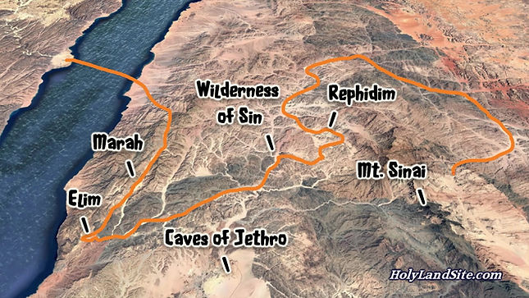
“And they came to Elim, where were 12 wells,
and 70 palm trees:
and they encamped there by the waters.”
Ex 15:27
12 miles
a) If there was an oasis 12 miles beyond Marah,
why lead them to Marah in the first place?

Slide 13
Why lead them to Marah in the first place?
25 “ there he made for them a statute and an ordinance,
and there he proved them. (nāsâ: tested)
26 And said, If thou wilt diligently hearken to the voice of the LORD thy God, and wilt do that which is right in his sight, and wilt give ear to his commandments,
and keep all his statutes,
(then) I will put none of these diseases upon thee,
which I have brought upon the Egyptians:
for I am the LORD that healeth thee.”

Slide 14
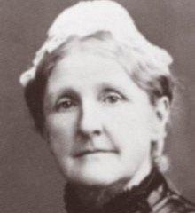
Ex. 15:25 “and there he proved them. (nāsâ: tested)
b) In much the same way God sometimes leads us to (& through) “Troubled waters” To Test us.
(Is. 41:10; 43:1-5; 2 Sam. 22:34; Ps. 18:33)
Hab. 3:19 “The LORD God is my strength,
he will make my feet like hind’s feet, and he will make me to walk upon mine High places!”
Missionary to Haifa, Israel
1932-1982

Slide 15
Contrast God’s Nature to Israel (& ours)!
1. Imperceptive/Unaware (Prone to Complain)
A. God miraculously Led them (Ex. 13:21,22)
B. God miraculously Fed them. (Ex. 16)
2 “the whole congregation of the …Israel murmured
…Would to God we had died …in the land of Egypt, when we sat by the flesh pots,
and when we did eat bread to the full;
for ye have brought us forth into this wilderness,
to kill this whole assembly with hunger.”

Slide 16
B. God miraculously Fed them. Ex. 16:4
“Then said the LORD unto Moses,
Behold, I will rain bread from heaven for you;
and the people shall go out and gather …every day,
that I may prove (nāsâ) them,
whether they will walk in my law, or no.
6 in the morning, ye shall see the glory of the LORD;
for he hears your murmurings
against the LORD”
He’s Aware!

Slide 17
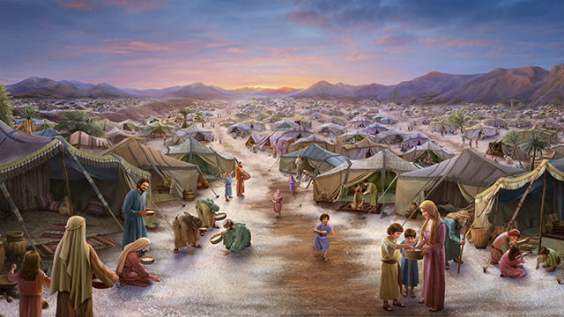
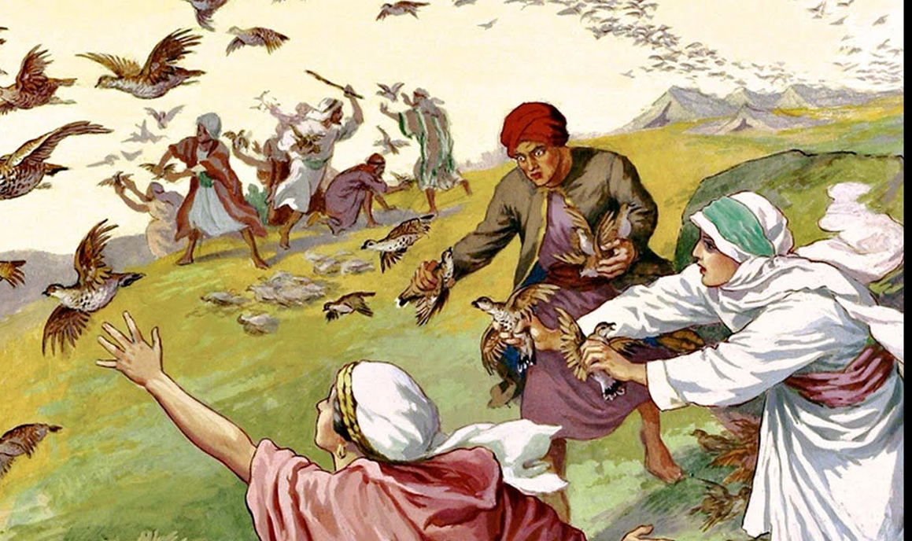
1) Miracle Manna Ex. 16:4 “I will rain bread
from heaven for you…”
Ps 78:24 “rained down manna upon them to eat, and had given them of the corn of heaven.
25 Man did eat angel’s food…”
2) Miracle Meat.
Ex. 16:13; Ps 78:27

Slide 18
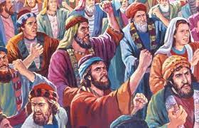
3) After 40 years of God’s provision: Nu 21
4 “the soul of the people was much discouraged …
5 And the people spake against God, and against Moses,
Wherefore have ye brought us up out of Egypt to die…? for there is no bread,
neither is there any water;
and our soul loatheth this light bread.”

Slide 19
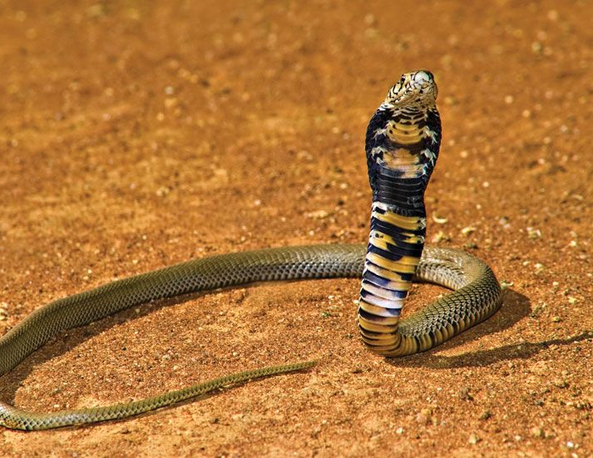
3) After 40 years of God’s provision: Nu 21
a) The consequences of their complaining!
6 “And the LORD sent fiery (śārāp)
serpents among the people”
(Probably Saw Scaled vipers)
(1) Where had the serpents been for 40 years?
They’re native to the desert region,
but God had protected them.
Job 1:10 “Hast thou not made an hedge about him?”

Slide 20
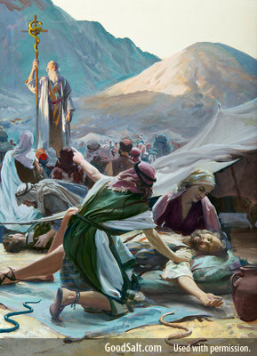
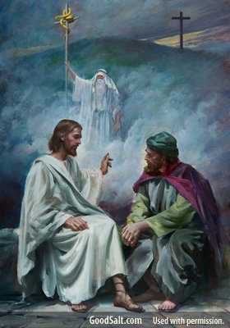
6 And the LORD sent fiery serpents among the people”
b) Even then God made provision.
Repentance brought Restoration Vs 7-9 “we have sinned…spoken against the LORD”
Jesus used this to reach Nicodemus in Jn 3:14-18

Slide 21
C. God miraculously Watered them. Ex. 17:1-3
“…and there was no water for the people to drink.
Wherefore the people did chide (grapple) with Moses, …
…And Moses said unto them, Why chide ye with me? wherefore do ye tempt the LORD?
And the people thirsted there for water; and … murmured against Moses, and said,
Wherefore is this that thou hast brought out of Egypt,
to kill us and our children …with thirst?”

Slide 22
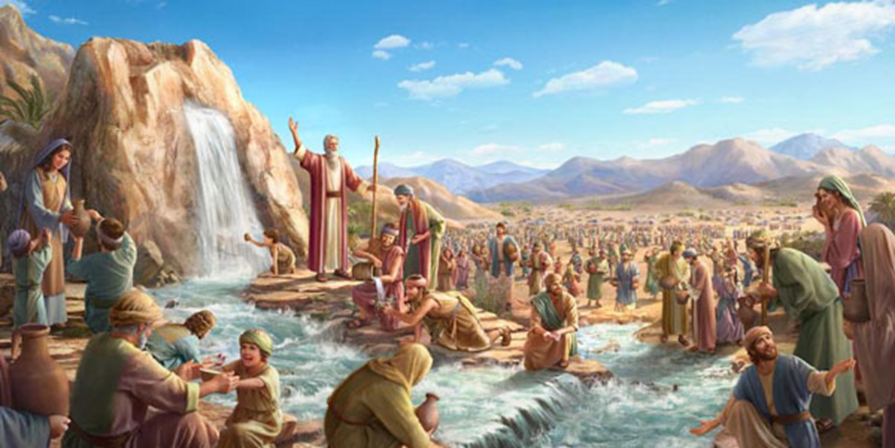
vs 4 “and Moses cried unto the LORD…
what shall I do…they be almost ready to stone me?
5 “the LORD said unto Moses…
6 I will stand before thee there upon the rock in Horeb;
and thou shalt smite the rock, and there shall come
water out of it that
the people may drink.
And Moses did so in the sight of the elders of Israel.”

Slide 23
Conclusion: Unlike God, we’re naturally Imperceptive/Unaware (aka: Limited!)
And therefore, prone to murmur and complain!
1 Cor. 10:6-10 “Now these things were our examples, to the intent we should not lust after evil things,
as they also lusted….
Neither murmur ye, as some of them also murmured, and were destroyed of the destroyer.”
Satan is at work when we complain!

Slide 24
Ex. 17:1 “Israel journeyed …according to the commandment of the LORD,
and pitched in Rephidim:”
They were exactly where God had led them,
and problems came anyway!
God is Aware and Actively at work,
Particularly in the trials of life!
(James 1:2-5; 1 Pt 1:6-9)

Slide 25
They were exactly where God had led them, and problems came anyway!
1) There was no natural water in Rephidim
Vs 1 “there was no water for the people to drink.”
God Miraculously Provided water
AFTER
they realized their hopelessness!

Slide 26
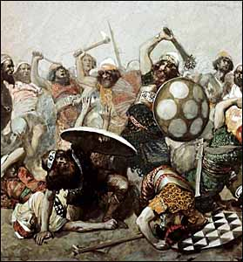
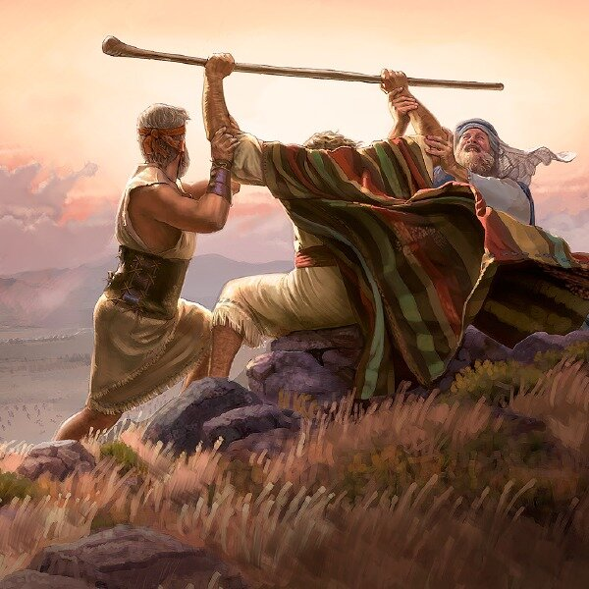
They were exactly where God had led them, and problems came anyway!
1) There was no water in Rephidim. Vs 1-7
2) The Amalekite armies attacked them! Vs 8-16
“Then came Amalek, and fought with Israel”
Attacks often come when we’re weak.
Notice how they found courage and victory
Vs 11-13 (1 Jn 5:4)

Slide 27
Ex 17:14-15 “And the LORD said unto Moses, Write this for a memorial in a book, and rehearse it in the ears of Joshua: for I will utterly put out the remembrance of Amalek from under heaven.
(Remember Saul’s order in 1 Sam. 15?)
And Moses built an altar,
and called …it Jehovahnissi:”
The Lord is my banner
or standard!

Slide 28
Ex. 17:7 “And he called the name of the place Massah, (to test, try, prove)
and Meribah, (to contend, place of strife)
because of the chiding of the children of Israel,
and because they tempted the LORD, saying,
Is the LORD among us, or not?”
If there’s no “strife”, (contest/challenge)
Can there really be a “test”?
James 1:2-5; 1 Pt 1:6-9

Slide 29
This took place at Rephidim, which literally means “to spread and / or support”!
What has to “spread” in order to “Support?”
Is 61:1-3 “The Lord hath anointed me to…
bind up the broken hearted…liberty to the captives…
The opening of the prison to them that are bound…
To give unto them beauty for ashes, the oil of joy for mourning, the garment of praise for the spirit of heaviness;
that they might be called trees of righteousness,
the planting of the LORD,
that he might be glorified.”

Slide 30
During difficult times:
Satan’s at work to whither us. (Mt 15:5,6; 20,21)
God are at work to deepen and develop us.
Phil 2:12-14 “Wherefore, my beloved, as ye have always obeyed, not as in my presence only, but now much more in my absence, work out your own salvation with fear and trembling.
For it is God which worketh in you both to will and to do of his good pleasure.

Slide 31
14 “Do all things without murmurings (grumbling)
and disputings: (debates)
15 That ye may be blameless (am’emptos: irreproachable)
and harmless, (aker’aios: unmixed, innocent)
the sons of God, without rebuke,
in the midst of a crooked and perverse nation,
among whom ye shine as lights in the world;
16 Holding forth the word of life;
that I may rejoice in the day of Christ,
that I have not … labored in vain.”

Slide 32
“Through it all” Andrea Crouch 1971
“I’ve had many tears and sorrows.
I’ve had questions for tomorrow.
There’s been times I didn’t know right from wrong.
But in every situation
God gave me blessed consolation
That my trials come to only make me strong.
Through it all, I’ve learned to trust in Jesus…

Slide 33
“I thank God for the mountains! I thank Him for the valleys!
I thank Him for the storms
He’s brought me through!
For if I’d never had a problem,
I wouldn’t know that He could solve them.
I’d never know what faith in God could do!
Through it all, I’ve learned to trust in Jesus…
I’ve learned to depend upon His word.”

Slide 34
“Through it all”
Are you growing weary, worried, and withered
in your faith? (Mt 13:20,21)
Or are you growing deeper in your assurance of God’s Awareness and Ability to use “all things” to work together for your good and His glory?
(Romans 8:28,29; 1 Jn 4:4; 5:4)
Phil. 4:13 “I can do all things through Christ, which strengtheneth me.”

