Slide 1
“My sheep hear my voice, and I know them, and they Follow Me!” John 10:27

Slide 2
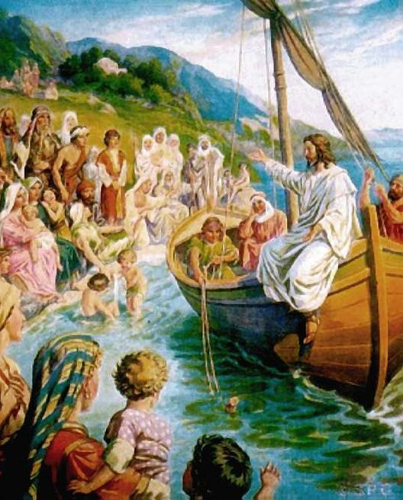
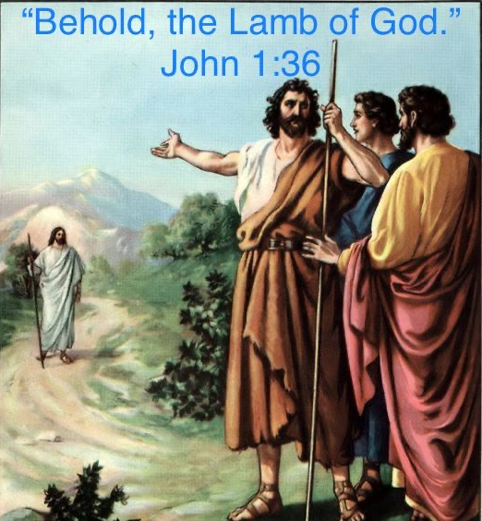
Notice How God Guided and Grew Peter:
1. Begins as Curious: Jn 1:29-43
A. Andrew was a disciple of John.
1) He heard John’s declaration. v36
2) He followed Jesus. Vs 37-39
3) He shares with Peter. John 1:40-42
“He first findeth his own brother Simon, and saith
We have found the Messias, (the Christ) And he brought him to Jesus.
B. Peter spends time with Jesus. Luke 5

Slide 3
2. Curiosity becomes Conviction
A. Communicated through Preaching truth. Lk 5
B. Reinforced with Relationship! Lk 5:3-8
1) Jesus had spent the day with Peter in the boat.
2) Gave Peter specific instructions
that he partially and hesitantly obeyed. Vs 4,5
3) Miraculous supply of fish. Vs 6-7
4) Peter under conviction. 8 “I am a sinful man,
O Lord” (Kyrios) Supreme Authority!

Slide 4
3. Conviction leads to a Call to Follow Christ Lk 5:11 they forsook all, and followed him.”
Truly following involves a call to:
Listen Mt 4:23 “Jesus went about all Galilee, teaching in their synagogues, and preaching the gospel of the kingdom…”
2) Look: Witnessed Miraculous Ministry: Mt 4:23,24
“and healing all manner of sickness and disease among the people.
And his fame went throughout all Syria…”

Slide 5
Curiosity➔ Conviction ➔ Call
3) Learn Mt 11:28,29 “Learn of me”
Jesus’ ministry challenged Peter’s prejudices.
a) Touching Lepers. Mt. 8:2,3
b) Healed Roman Centurion’s servant (8:5-13)
c) Healed Peter’s Mother in law. (8:14-15)
Leave comfort zones. (Mt 8:18-24)
“When He entered the ship, his disciples followed him…”

Slide 6
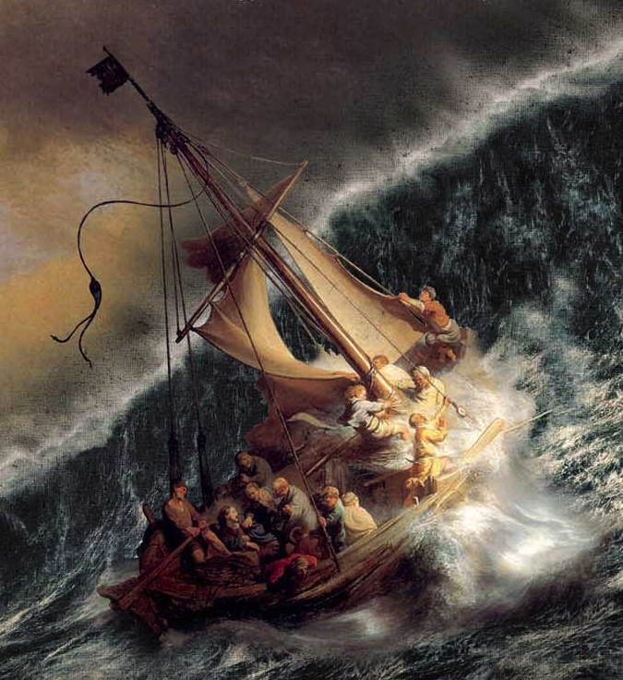
The call to follow Christ will lead to:
4. CRISIS: They ran into a terrible Storm.
Mt 8:24 “a great tempest… the ship was covered with waves”
The Root of the Crisis. Mk 4:38 “we perish”
B. The Response of the Disciples.
1) Doubt. Mk 4:38 “Carest thou not…?”
2) Fear. Mk 4:40 “why are ye so
fearful?”
Apol’lymi: To Destroy (Rev 9:11)

Slide 7
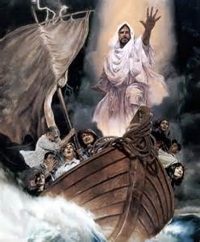
C. The Rebuke of the Lord. Mt 8:26; Mk 4:41
Rebuked the storm. Mk 39 “he arose, and rebuked the winds; and said Peace be Still!
And the wind ceased and there was a great calm”
2) Rebuked the Disciples. 40
Why are ye so fearful, (deilos: faithless)
How is it that ye have no faith?

Slide 8
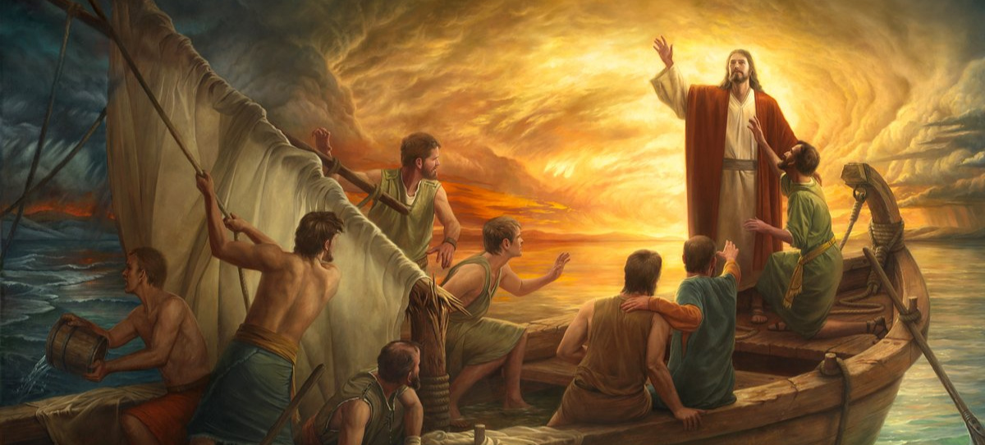
D. Reaction of the Disciples Mk 4:41
“And they feared exceedingly, and said
What manner of man is this,
That even the wind and the sea obey him? “
Do you think they learned the lesson of this Crisis?
Why/Why Not?

Slide 9
God will continue to allow (or create) Crises until He’s accomplished his purposes.
James 1:2-4 “Count it all joy when ye fall into divers temptations; (peirasmos: putting to proof) Knowing that the trying (dokim’ion: testing for trustworthiness) of your faith worketh patience. (Hypomonē: cheerful endurance)
But let patience have her perfect (teleios: complete) work,
that ye may be perfect and entire, (holoklēros: complete in every part) wanting (leipo: lacking) nothing.”

Slide 10
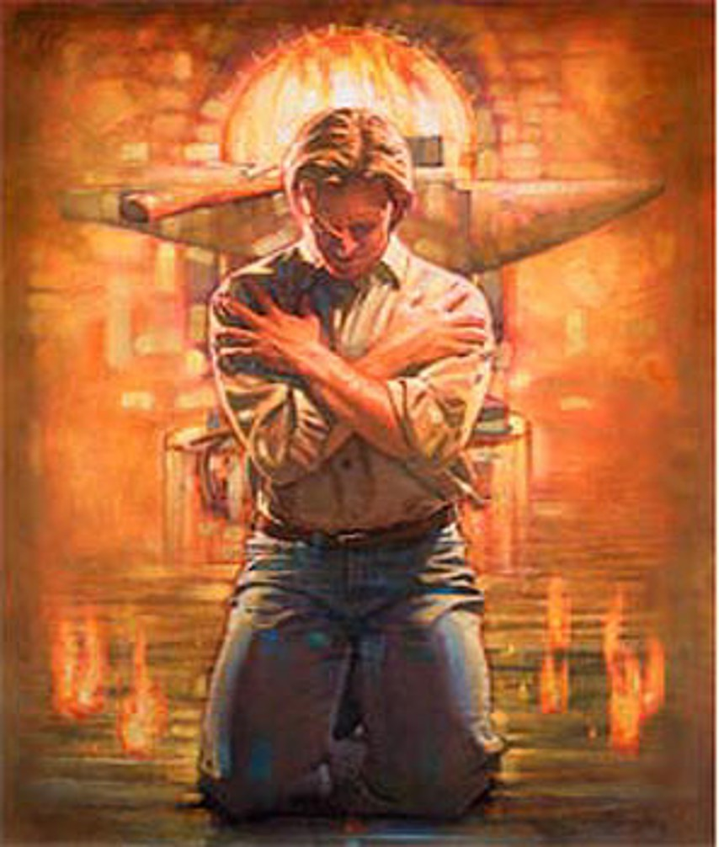
Isaiah 48:10-11
“I have refined thee,
but not with silver;
I have chosen thee in the furnace of affliction.
For mine own sake, will I do it:
for how should my name be polluted?
and I will not give my glory unto another.”

Slide 11
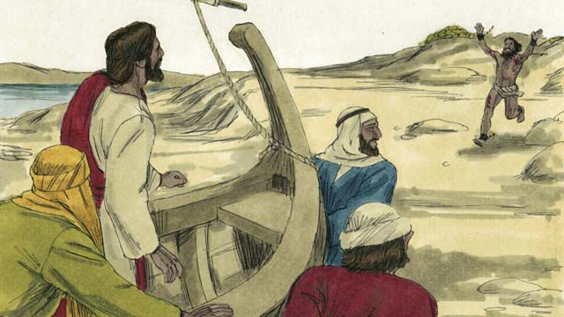
The call to follow Christ will lead to:
4. CRISIS (Continues) Mk 5:1,2
“they came over unto the other side of the sea,
into the country of the Gadarenes.
And when he was come out of the ship, immediately there met him out of the tombs a man with an unclean spirit”

Slide 12
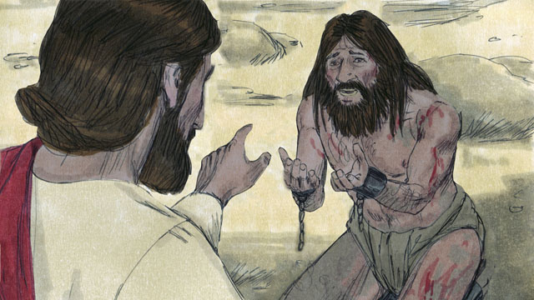
The call to follow Christ will lead to:
4. CRISIS (Continues) Mk 5:6,7
he ran and worshipped him,
But when he saw Jesus …
And cried with a loud voice… What have I to do with thee, thou Son of the most high God?
I adjure thee by God, that thou torment me not. “
What does this reveal?
About the storm?
About Jesus’ power? (Phil. 2:10; Col. 1:16)
About the man?

Slide 13
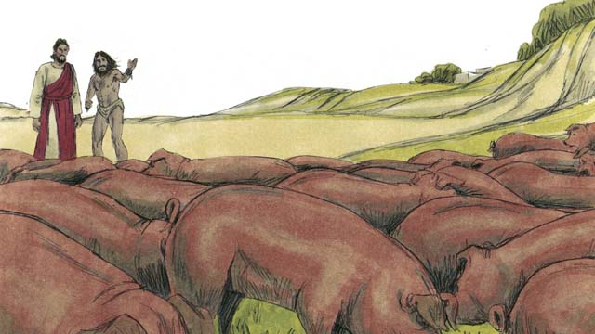
The call to follow Christ will lead to:
4. CRISIS (Continues) Mk 5:8-12
“Come out of the man, thou unclean spirit.
…What is thy name? And he answered, saying,
My name is Legion: for we are many.
And he besought him much that he would not send them away out of the country. …
12 …send us into the swine”

Slide 14
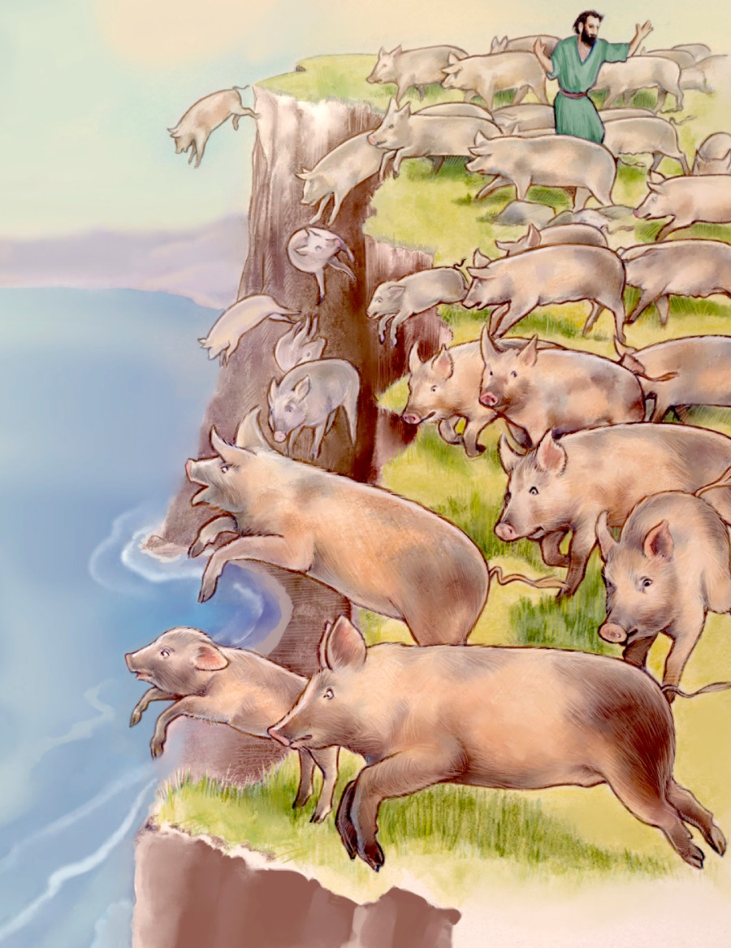
4. CRISIS (Continues) Mk 5:13,14
“the unclean spirits went out, and entered into the swine:
and the herd ran violently down a steep place into the sea,
(they were about 2000)
And they that fed the swine fled,
and told it in the …country.
And they went out to see what it
was that was done.”

Slide 15
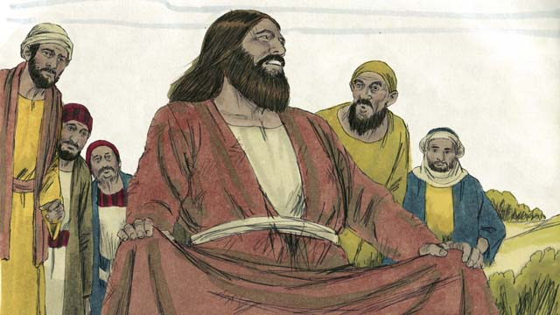
Mk 5:15,17 “And they come to Jesus, and see him that was possessed with the devil, and had the legion, sitting, and clothed, and in his right mind:
and they were afraid.
17 And they began to pray him (Jesus) to depart out of their coasts.”
What does this reveal?

Slide 16
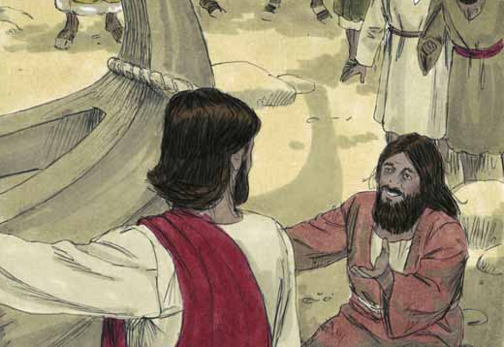
4. CRISIS (Continues) Mk 5:18,19
“he that had been possessed with the devil prayed him that he might be with him.
Howbeit Jesus suffered him not, but saith unto him.
Go home to thy friends, and tell them how great things the Lord hath done for thee, and hath had compassion on thee.”

Slide 17
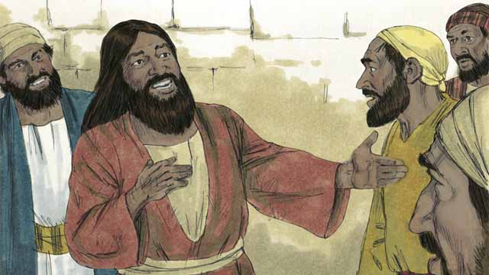
4. CRISIS (Continues) Mk 5:20
“And he departed, and began to publish in Decapolis how great things Jesus had done for him:
and all men did marvel. “

Slide 18
Observations:
1) The Disciples failed to recognize who Jesus
really was (Mk 4:41) but the Demoniac
immediately recognized Him
and worshipped! (Mk. 5:6)
2) Jesus had the power to send them to hell...
Mt 8:29 “art thou come hither to torment us before the time?”
Lk 8:31 “They besought him that he would not command
them to go out into the deep.”

Slide 19
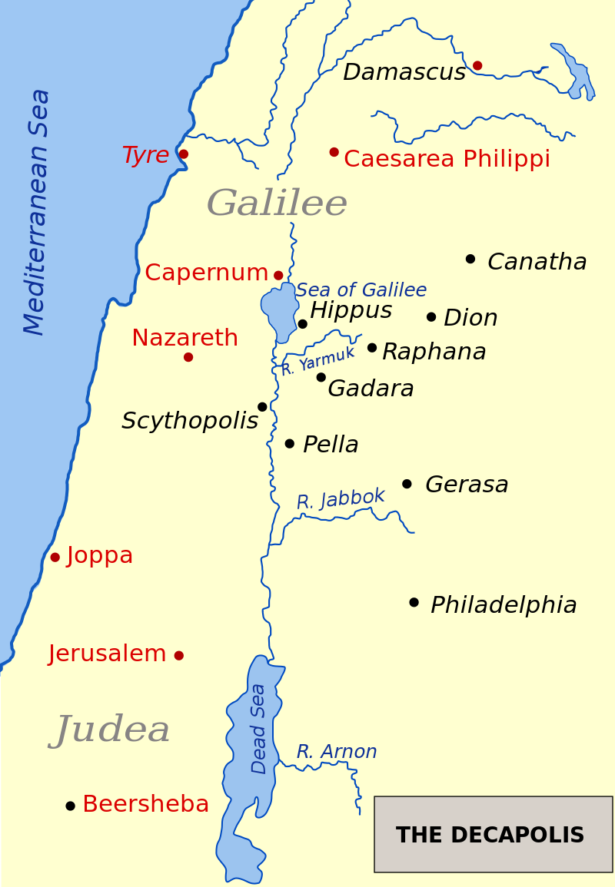
2) Why didn’t Jesus send the demons to hell?
Perhaps they had a “right” to be there!
The “country of the Gadarenes” was part of Decapolis (10 cities) around the sea of Galilee.
They were a mixture of Jews &Gentiles.
(like the Samaritans on the West Side)
Perhaps the “Jews” had compromised and invited the Demonic presence/ principality.

Slide 20
Observations:
3) It seems the people were more comfortable
with the Demoniac before He met Jesus,
than they were after!
Why do you think this might have been so?
What was their response to Jesus?
(Mt 8:34; Mk 5:17; Luke 8:37)
What was their motive?
They’d rather live with their fear of Satan
than God!
(Fear!)

Slide 21
4) Why didn’t Jesus allow the healed man to join them?
Luke 8:39 “Return to thine own house, and shew how great things God hath done unto thee. And he …published throughout the whole city how great things Jesus had done unto him.
Mk 5:20 “and he…began to publish in Decapolis
how great things Jesus had done for him:
and all men did marvel. “
He became a missionary to 10 cities!

Slide 22
5) Do you think the disciples (and Peter) might have had
Similar questions about these events?
If so, why didn’t they ask them?
After another Demoniac deliverance Lk 9:43-46 “And they were all amazed at the mighty power of God.
But while they wondered every one at all things which Jesus did,
he said unto his disciples, Let these sayings sink down into your ears: for the Son of man shall be delivered into the hands of men.
But they understood not this saying, and it was hid from them,
that they perceived it not:
and they feared to ask him of that saying.
Then there arose a reasoning among them,
which of them should be greatest.”

