Slide 1

Trusting the God Who Walks on the Storms
Last week’s message by Pastor Daniel
Recent messages have focused on Faith,

Slide 2

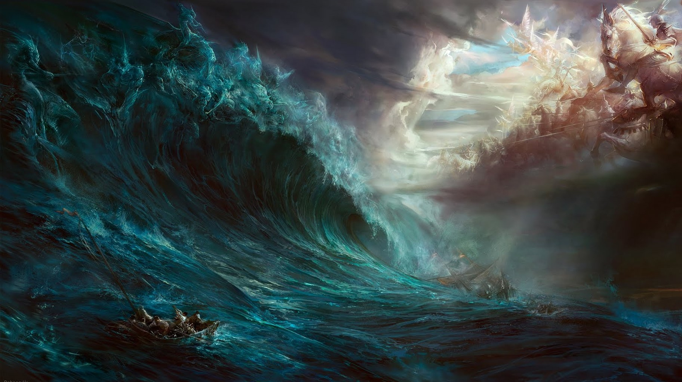
Particularly during the stormy seasons of life.

Slide 3
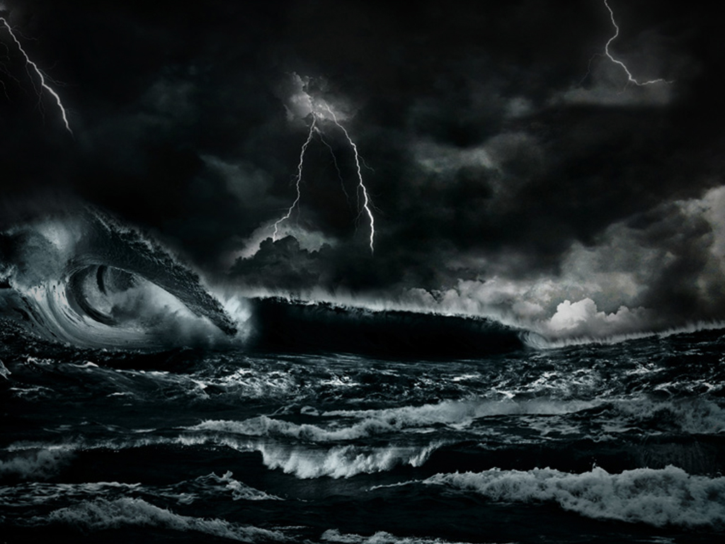
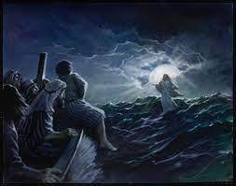
How can we Praise God in the storm?
How can we partner with him after the storm?
The answer to both questions is the same!
Mt 8:26; 14:31; Is. 41:8

Slide 4
1. There are many types of storms.
A. Natural, physical storms: “Acts of God”
Jonah 2; Mt. 14; Acts 28 (Euroclydon)
B. Emotional, relational, financial, health, etc.
storms. Acts 15:36-41; James 1:3-5; 2 Cor 1:3,4)
C. Spiritual storms 2 Cor 4:7-10; 16-18
Often a combination of all three!
(Mt 8:23-27)

Slide 5
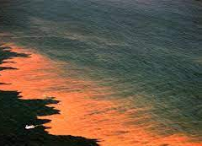
2. Storms have many blessings/purposes.
A. Natural, physical storms: “Acts of God”
1) Purification (removing pollutants from the air
land and water.
(Break up HAB {harmful algae
bloom} that produces “red tide”)
2) Soften the soil so Nutrients are absorbed.
3) Equalize temp/pressure in the atmosphere

Slide 6
2. Storms have many purposes. (Blessings)
B. Emotional, relational storms. Acts 15:36-41
1) Expose Carnality. (1 Cor 3; 1 Cor 11:18,19)
2) Facilitate maturity and growth. (Eph. 4:15)
C. Spiritual storms
1) Develop faith/dependence. (Is. 41:10; 43:1-3;
Job 13:15)
Songs “Through it all” Laura Story’s “Blessings”
Casting Crowns “I’ll praise you in the storm”

Slide 7
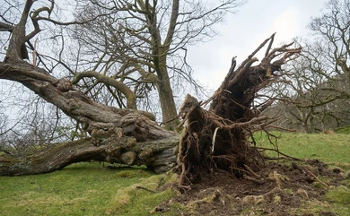
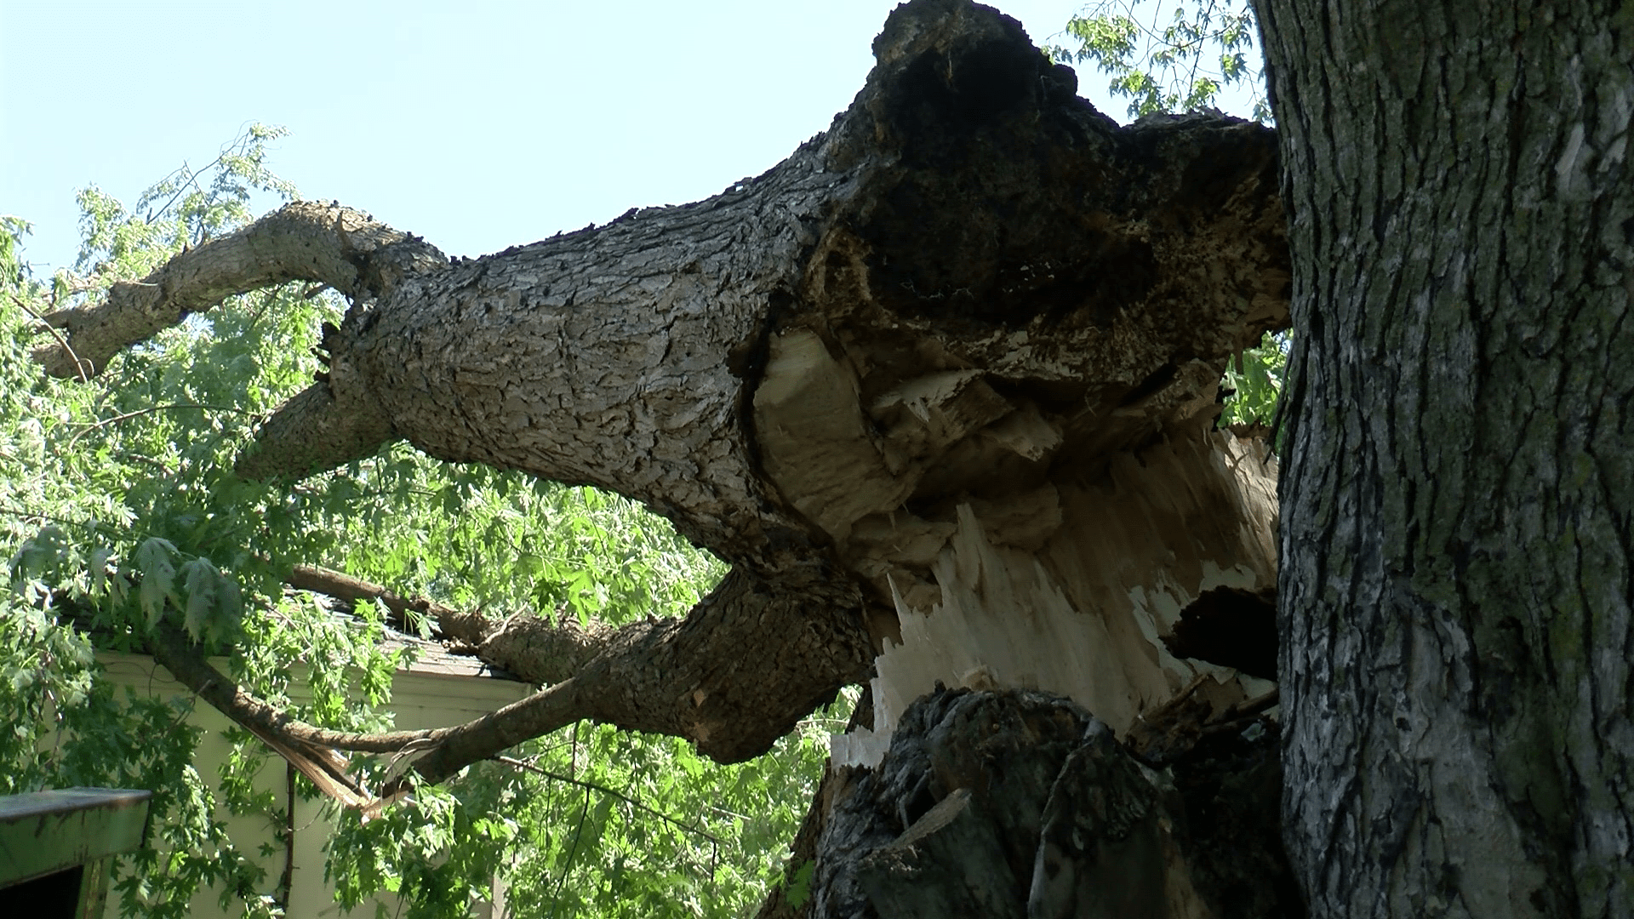
D. Storms often reveal what would
otherwise would remain hidden.
1) Shallow Roots
2) Rot
Remember Matthew 7:24-27:

Slide 8
3. Storms may have long range and long
term effects/consequences.
A. They affect weather for great distances
1) Hurricane Helene made landfall in Fl,
but devastated many surrounding states.
B. Many leave a trail of destruction.
1) Helene caused 250 deaths, $78 billion in damage, long term power outages, triggered floods, tornadoes and landslides. (2000 in NC alone)

Slide 9
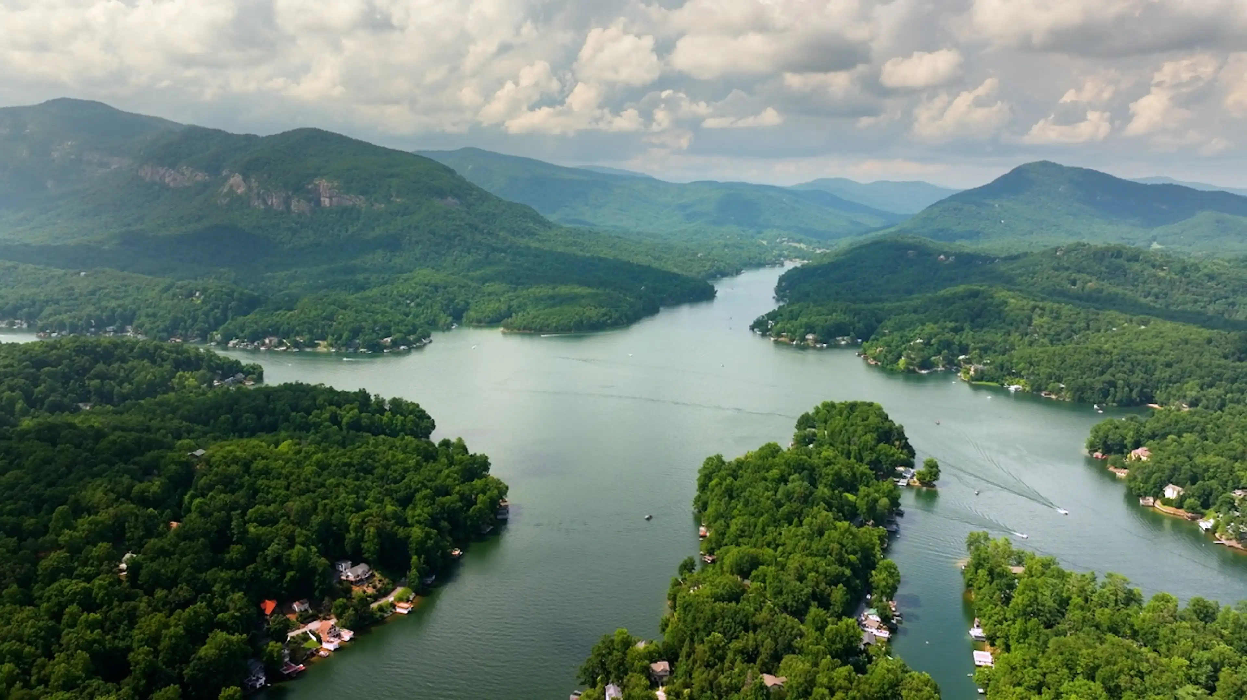
4. Storms require clean up efforts that challenge
our resources, patience and commitment.
Lake Lure, NC Before Helene

Slide 10
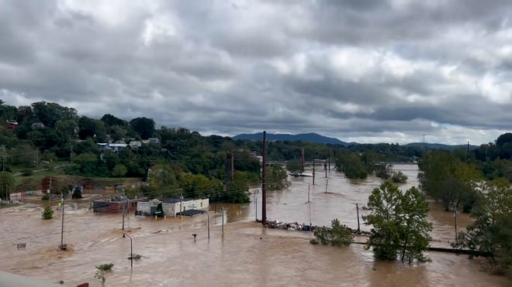
Lake Lure During Helene

Slide 11
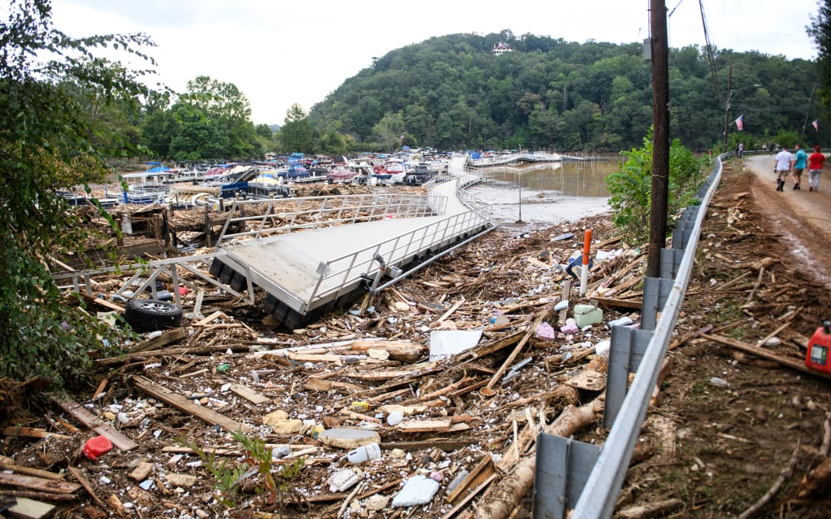
Lake Lure immediately after Helene

Slide 12
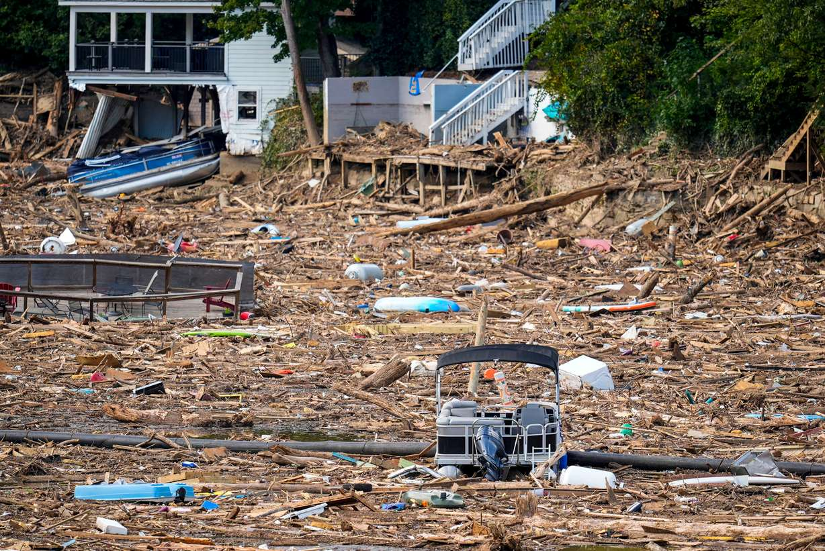
Lake Lure immediately after Helene

Slide 13
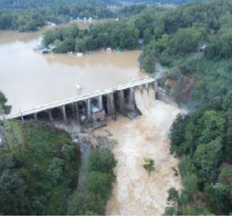
The dam was beginning to fail so they intentionally had to relieve the pressure. flood
Creating more flooding and damage!

Slide 14
4. Storms require clean up efforts that challenge
our resources, patience and commitment.
A. Initial Cleanup costs! (2 ½ months after the storm)
1) Over 33,000 cubic yards of debris were removed
from the lake area/roads.
2) Over 18,331 tons of sediment and silt were
removed from the Town of 1390 people.
3) Total initial costs: > $300 million!
That was just the beginning!
ttps://www.townoflakelure.com/community/page/lake-lure-storm-recovery-updates-122024

Slide 15
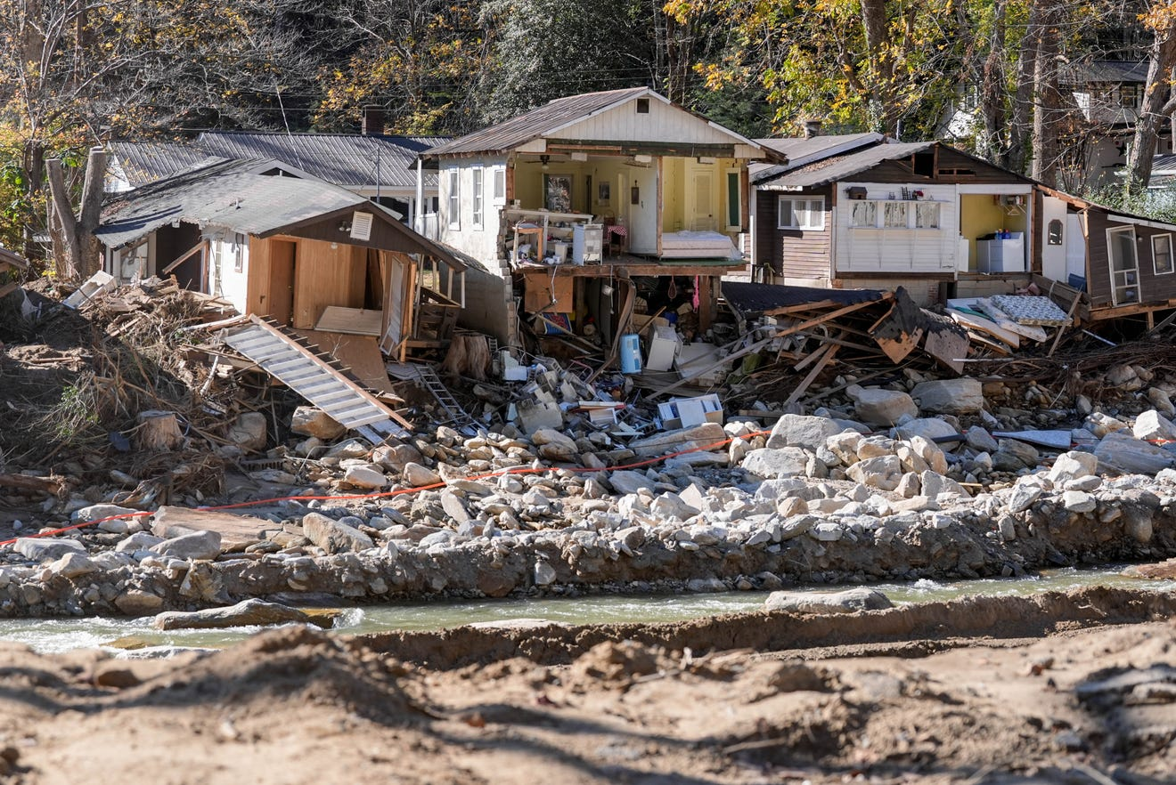
As of 12/19/24: (2 ½ months later)

Slide 16
4. Storms require clean up efforts that challenge
our resources, patience and commitment.
B. Eventual clean up costs/ efforts.
1) After the initial cleanup, they realize that much
of the debris had sunk to the bottom of the lake.
a) The longer the initial clean up took,
the more debris “settled” beyond sight.
2) They decided (due to the safety hazard of hidden debris)
to partially drain the lake to enable a “deep
cleaning.”

Slide 17
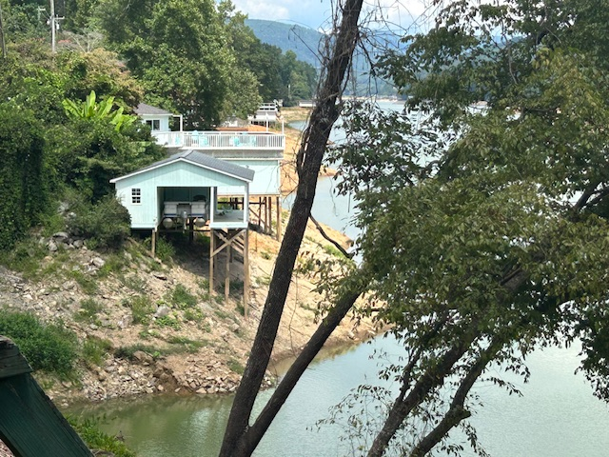
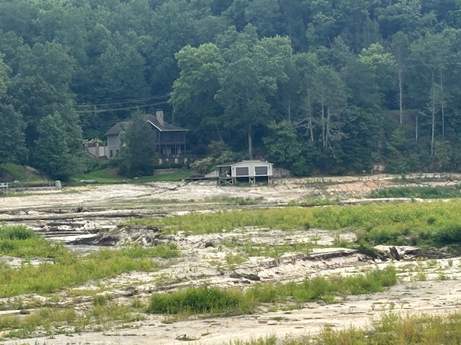
B. Eventual clean up efforts.
3) This deep cleaning will continue throughout 2026,
with significant cost and inconvenience.
11 months after the initial storm.

Slide 18
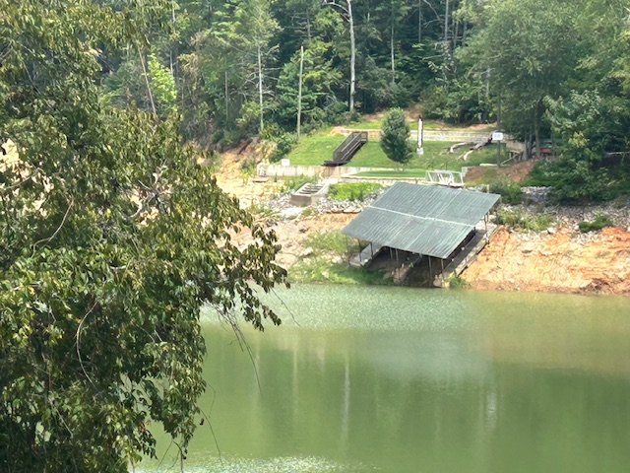
Aug 2025

Slide 19
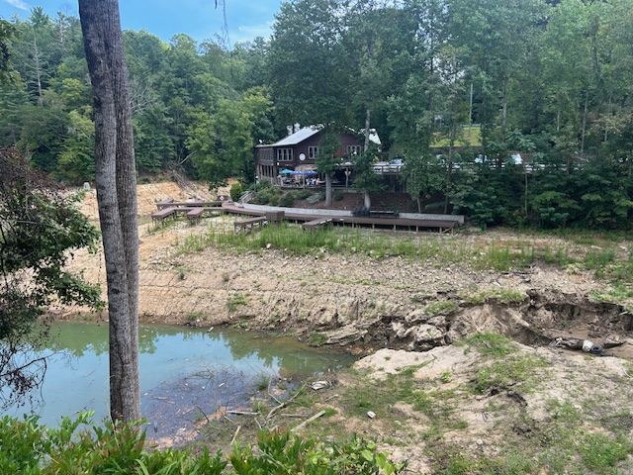
Aug 2025
Aug 2025

Slide 20
Conclusions:
Storms are inevitable and uncontrollable.
There are always clean up costs.
(Financial, Emotional, Relational, Spiritual)
3) They usually leave or reveal debris (sin,
selfishness, attitudes, etc) that we must clean up.
4) The longer we delay dealing with the debris,
the > chance it will “sink” into our soul.
5) These often surface later to damage us/others.

Slide 21
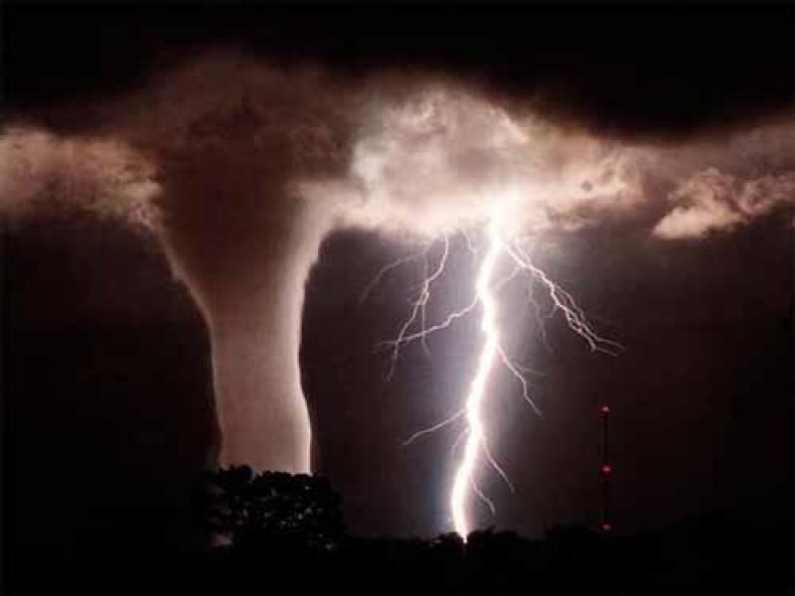
6) Regardless of the source of the storm:
“The LORD hath his way (derek: direction, manner)
in the whirlwind (sûp̄â: hurricane: from sup: to consume)
and in the storm, (śᵊʿārâ’: tempest
from śaʿar:
to frighten)
and the clouds are
the dust of his feet.”
Nahum 1:3

Slide 22
Application:
What’s the “Lord’s Way” (direction) in the storm?
To reveal that which was rotten, or shallow
but ignored through ignorance or indifference.
Ps. 19:12a “Who can understand his errors?
(šāḡâ: ravaged or led astray by ignorance)
12b …secret faults.” (sāṯar: concealed)

Slide 23
What’s the “Lord’s Way” (direction) in the storm?
2) To unite us together with others for mutual
accountability, perspective and support.
a) Our “secret faults” may not be secret to them!
b) We need others to help and challenge us to:
➔ Recognize what’s hidden to us. (Heb. 3:12,13)
➔ Repent of them. (10:23-25)
➔ Restore us to blessed fellowship. (Gal. 6:1-5)

Slide 24
3) To bring us to clarity, conviction and cleansing. Ps. 19:12b “cleanse me from secret faults. (sāṯar: concealed)
13 Keep back thy servant also from presumptuous sins;
(zēḏ: arrogance, insolence, pride)
What we know has been rotten and wrong,
but have rationalized it.
Until our “secret faults and presumptuous sins” have been recognized, repented of and confessed, they will:
“have dominion (māšal: rule) over me:” vs 13b
(See 1 John 1:5-10)

Slide 25
What’s the “Lord’s Way” (purpose) in the storm?
4) To grow us in and by His grace. Ps. 19:13b
“cleanse thou me (from secret faults and presumptuous sins) then shall I be upright, (tāmam: clean, complete)
and I shall be innocent (nāqâ: acquitted, cleared)
from the great transgression.” (pešaʿ: rebellion, revolt)
If the greatest commandment is to love God preeminently
(Dt. 6:4,5; Mt. 22:36-38)
Then the greatest transgression / rebellion
is to love ourselves more! (Gen. 3:5; Ex. 20:3; 1 Sam 15:23)

Slide 26
What’s the “Lord’s Way” (purpose) in the storm?
5) To give us confidence and clarity in our
relationship with God (and others)
Ps. 19:14 “Let the words of my mouth,
and the meditation of my heart,
be acceptable in thy sight, O LORD,
my strength, and my redeemer.”

Slide 27
“The LORD hath his way in the whirlwind
and in the storm” Nahum 1:3
Nahum (naḥûm’: comfortable)
From nāḥam’: to sigh,
be sorry, repent.
The root of true comfort is repentance!
(Change our thinking!)

Slide 28
Few have faced Storms as destructive as Job;
and throughout (and after) the storms he felt isolated from his family and friends;
And even his God! Job 23:8-10
“Behold, I go forward, but he is not there; and backward, but I cannot perceive him: On the left hand,
where he doth work,
he hideth himself on the right hand, that I cannot see him:
But he knoweth the way that I take: when he
hath tried me,
but I can’t behold him:
I shall come forth as gold.

Slide 29
Job 23:11-14
“My foot hath held his steps, his way have I kept, and not declined. Neither have I gone back from the commandment of his lips;
I have esteemed the words of his mouth
more than my necessary food.
But he is in one mind, and who can turn him?
and what his soul desireth, even that he doeth.
For he performeth the thing that is appointed for me:
and many such things are with him.”

Slide 30

Job 23:15-16
“Therefore am I troubled (bāhal’: vexed, agitated)
at his presence:
when I consider, I am afraid of him.
For God maketh my heart soft”
(rāḵaḵ’: tender)

Slide 31
In Job 38 God showed up with no explanations, and 4 chapters of questions Job couldn’t answer,
that Job finally understood. Job 42:5,6
“I have heard of thee by the hearing of the ear: but now mine eye seeth (recognizes, perceives) thee.
Wherefore I abhor (maas’: reject) myself, (his reasoning)
and repent in dust and ashes.”
Nāḥam’ (sigh, repent {47x}, comfort)
Repentance and trust precedes comfort!

Slide 32
Will you Purpose to Trust
& Praise God in the Storm?
Romans 8:28,29; James 1:2-5

Slide 33
Will You Purpose to Partner with Him after the storm?

