Slide 1
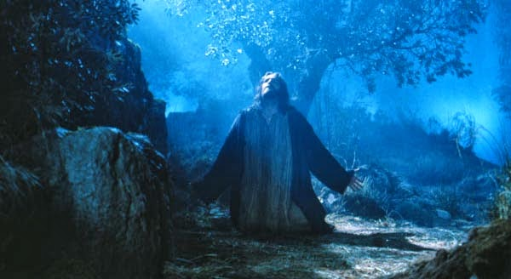
“Lord, teach us to pray.”
Luke 11:1

Slide 2
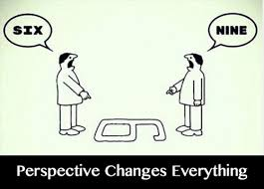
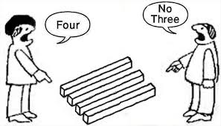
We don’t see life as it is,
But as we are!
We process what we see through our past experiences and understanding.
These affect our perception
and perspective!

Slide 3
Our perspective affects our priorities!
Our priorities affect our Prayers!
If our perspective and priorities are wrong, (“Miss the mark”)
then our prayers will be wrong!
James 4:1-3 “ye ask and receive not
Because ye ask amiss…”

Slide 4
“ye ask amiss…”
Kakos: diseased (infected by the flesh)
intrinsically worthless.
If we don’t realign our perspectives so that they’re in harmony with God’s,
Then our prayers (and life purposes)
will be “intrinsically worthless!”
“what doth it profit if he gain the world,
And lose his own soul?” Mk 8:36

Slide 5
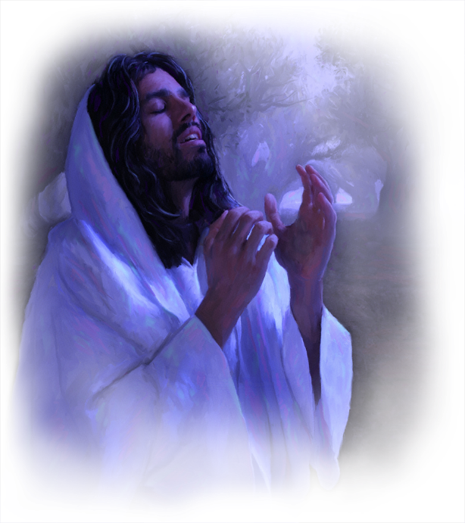
Our praying should influence our perspectives and priorities!
(2 Cor. 3:18; Phil. 2:1-11)
“let this mind be in you…”
Lk 22:42 “Not my will,
but thine be done”
Prayer is ultimately about perspective!!

Slide 6
“the prayer of faith” James 5:15
Pistis: assurance, persuasion!
Persuaded of what?
“this is the confidence that we have in him, that, if we ask any thing according to his will, He heareth us:” 1 John 5:14

Slide 7
The Lord’s Prayer is as much about Perspective as it is prayer.
“Lord, teach us to pray”
The first word of this request is the key to unlocking the power of prayer!
Lord (ky’rios) Supreme Authority
Pray (Proseu’chomai) Pros: movement toward
and euchomai: (verb) Pray, supplicate

Slide 8
“After this manner pray:”
It’s Personal!
“Our Father”
He’s not Santa, He’s “Abba” Ro. 8:15,16
“ye have not received the spirit of bondage again to fear; but ye have received the Spirit of adoption, whereby we cry, Abba, Father.
The Spirit itself beareth witness with our spirit, that we are the children of God:”

Slide 9
It’s Personal!
“Our Father”
Ro. 8:17,18 “And if children, then heirs;
heirs of God, and joint-heirs with Christ;
if so be that we suffer with him,
that we may be also glorified together.
For I reckon that the sufferings of this present time are not worthy to be compared with the glory which shall be revealed in us.”

Slide 10
“After this manner pray:”
2. “Who art In heaven”
It’s about Perspective!
Is. 55:6-9 “my ways are not your ways,
as the heavens are higher than the earth, so are my ways higher than your ways,
and my thoughts than your thoughts.”

Slide 11
“After this manner pray:”
3. “Hallowed by thy name”
It’s (He’s) Powerful! (Awe-full!)
Gen 18:14 “Is any thing too hard for the LORD?”
Eph 3:20 “Now unto him that is able to do exceeding abundantly above all that we ask or think,
according to the power that worketh in us”

Slide 12
“After this manner pray:”
4. “Thy Kingdom Come”
It’s Partisan. Joshua 24:15
“if it seem evil (worthless) unto you to serve the Lord, choose you this day whom ye will serve;
but as for me and my house,
we will serve the LORD.”

Slide 13
4. “Thy Kingdom Come” Partisan!
1 Kings 18:21 “How long halt ye between two
opinions?” (sâʿîph: remain divided)
James 1:8“A double minded (dip’sychos: two souled!)
man is unstable in all his ways.”
Remember Laodicea? (Rev. 3:16)
Jms 1:7 “Let not that man think that he shall receive anything of the Lord.” (kyrios)

Slide 14
“After this manner pray:”
5. “Thy Will be done”
It’s Purposeful! Ro. 8:29,29
“All things work together for good to them that love God… to those who are called according to His purpose”
Klētos’: invited and appointed! (2 Cor. 5:20)

Slide 15
5. “Thy Will…” It’s Purposeful!
Jer 29:11 “For I know the thoughts (plans)
that I think toward you, saith the LORD, thoughts of peace, (shalom: completed)
and not of evil, (ra: wrong, harm, hurt)
to give you an expected end.” (tiqwâ’)
Hope, “the thing that I long for!” Job 6:8
Who’s the “I” here? (Ps. 37:3-5)

Slide 16
5. “Thy Will…” It’s Purposeful!
Jer 29:12-14 “Then shall ye call upon me, and ye shall go and pray unto me,
and I will hearken unto you.
And ye shall seek me, and find me, when ye shall search for me with all your heart.
And I will be found of you…”

Slide 17
“After this manner pray:”
6. “Give us…our daily bread”
It’s Practical Mt 6:30
“consider the birds…the lilies,
If God so clothe the grass of the field,
…shall he not much more clothe you,
O ye of little faith? “

Slide 18
“After this manner pray:”
7. “Forgive us …as we forgive”
It’s Purifying! 1 Jn 1:6-9
“But if we walk in the light, as he is in the light, we have fellowship…,
and the blood of Jesus Christ his Son cleanseth us from all sin.”

Slide 19
It’s Purifying! James 5:16
“Confess your faults one to another,
and pray one for another,
that ye may be healed.
The effectual fervent
prayer of a righteous man
availeth much.”
(energeo)

Slide 20
“After this manner pray:”
8. “Lead us not into temptation…”
It’s Persevering James 1:2-4
“The trying of your faith worketh patience.
But let patience have her perfect work,
that ye may be perfect and entire,
wanting (lacking) nothing.”

Slide 21
“After this manner pray:”
9. “Deliver us from Evil”
It’s Protective Jude 24-25
“Now unto him that is able to keep you from falling, and to present you faultless before the presence of his glory with exceeding joy,
To the only wise God, be glory and majesty, dominion and power, now and forever.”

Slide 22
Conclusion:
Instead of our perspectives/ priorities influencing our prayers,
Our Praying should influence our perspectives and priorities!
Mt 4:17 “Repent: (reconsider)
for the kingdom of heaven is at hand.”

Slide 23
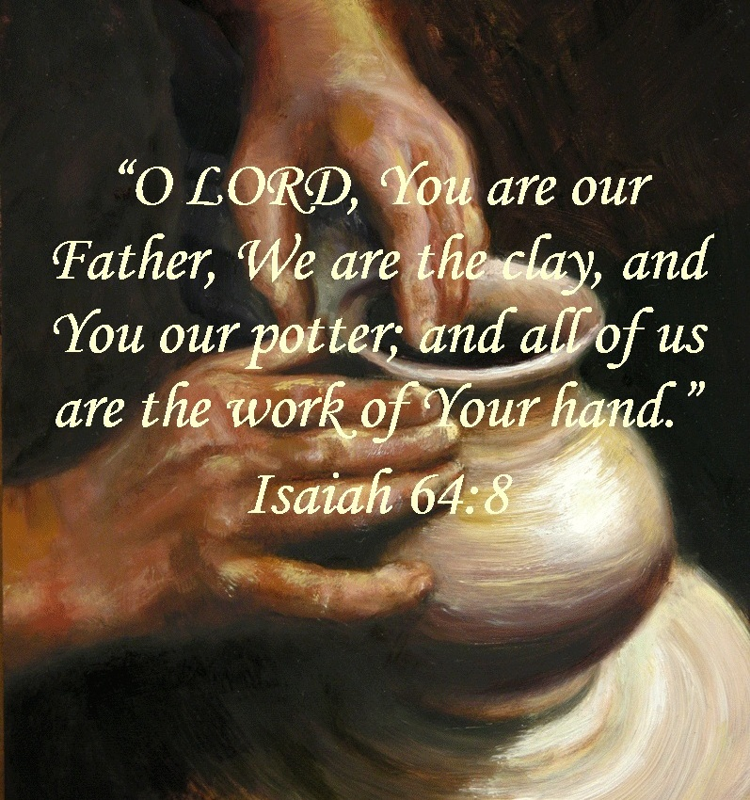
Ps 37:3-4
“Trust in the LORD, and do good…and verily thou shalt be fed.
Delight thyself in the LORD;
Anag: soft and pliable! (Is. 64:8)
and he shall give thee the desires
of thine heart.

Slide 24
Ps 37:5
“Commit thy way unto the LORD;
Galal: roll in on Him
trust also in him;
Bāṭaḥ’: put confidence in
and he shall bring it to pass.”

Slide 25
Mt. 6:13 “For thine is the kingdom
(Basileia: rule, royalty, realm)
And the power, (dyn’amis: power, ability)
And the glory (doxa: honor, worship)
Forever. (eis aeon: into perpetuity)
Amen!” (Surely, it will be!)

Slide 26
Mt 6:24 “No man can serve two masters:
(Kyrios: Supreme authority!)
for either he will hate the one, and love the other; or else he will hold to the one, and despise the other.
Ye cannot serve God and mammon.”

Slide 27
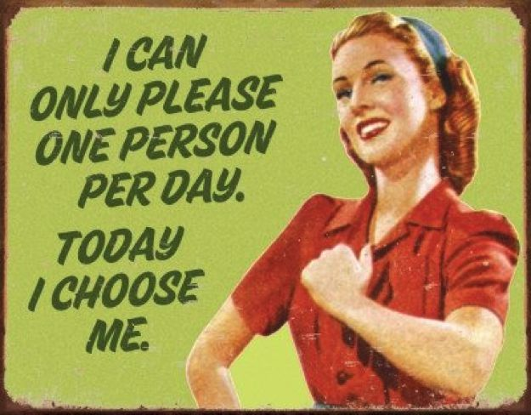
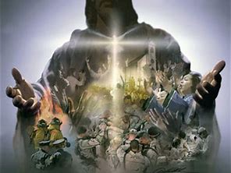
Joshua 24:15 “Choose ye this day
whom ye will serve…
As for me and my house,
We will serve ___________!”

Slide 28
---- mine!
Mt. 6:13 “For thine
is the kingdom (rule, royalty, realm)
And the power, (dyn’amis: power, ability)
And the glory (doxa: honor, worship)
Forever. (eis aeon: into perpetuity)
Amen!” (Surely, it will be!)

