Slide 1
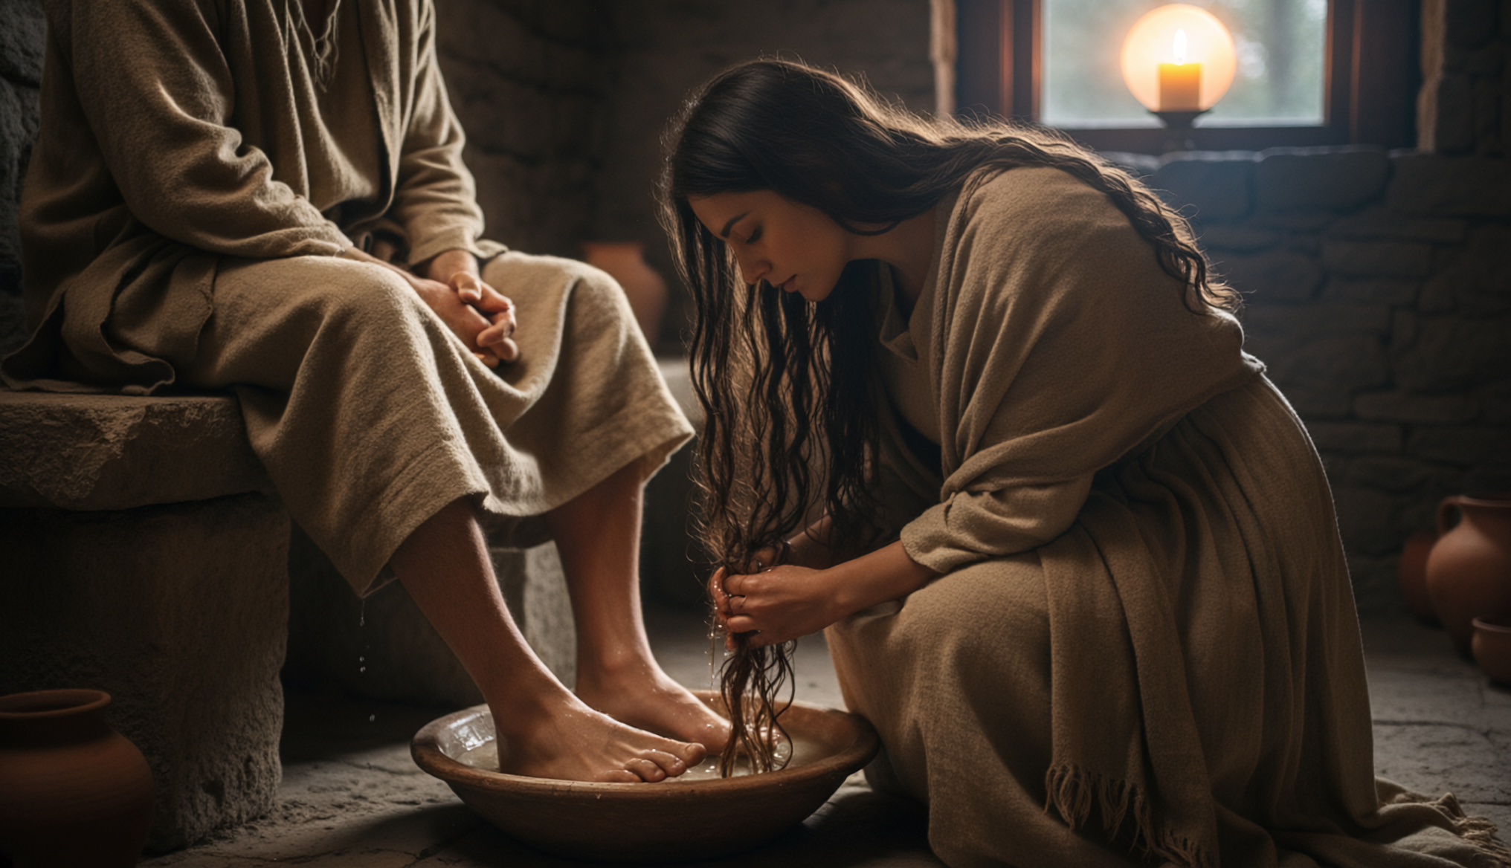
Preparation for Burial
By Joseph Peters

Slide 2


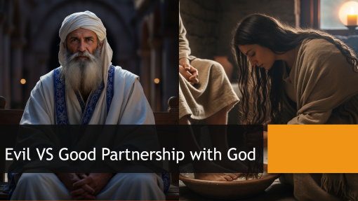


Summary of the Series

Slide 3

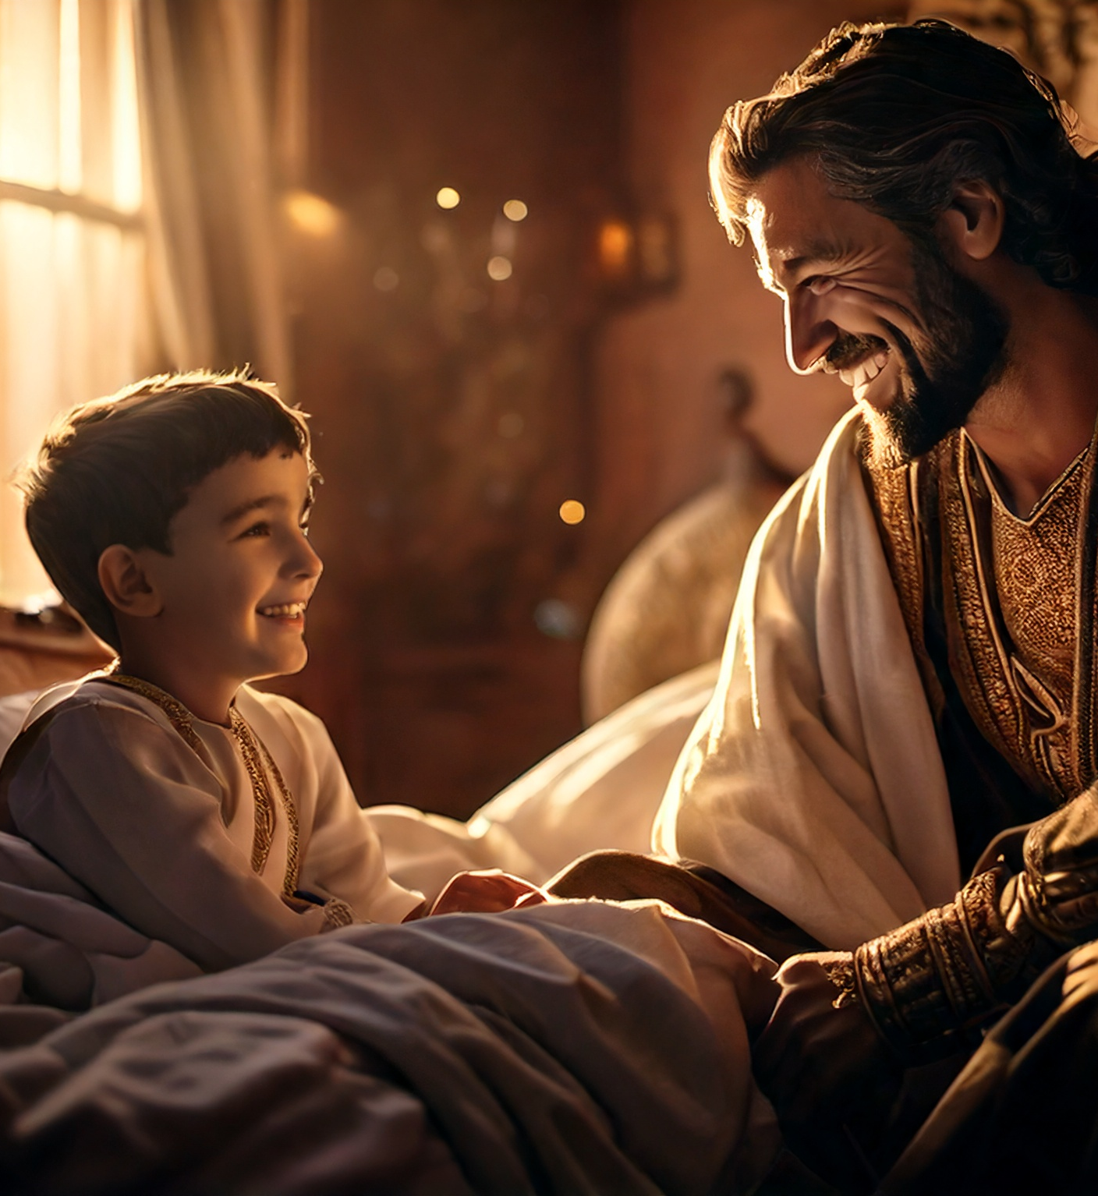
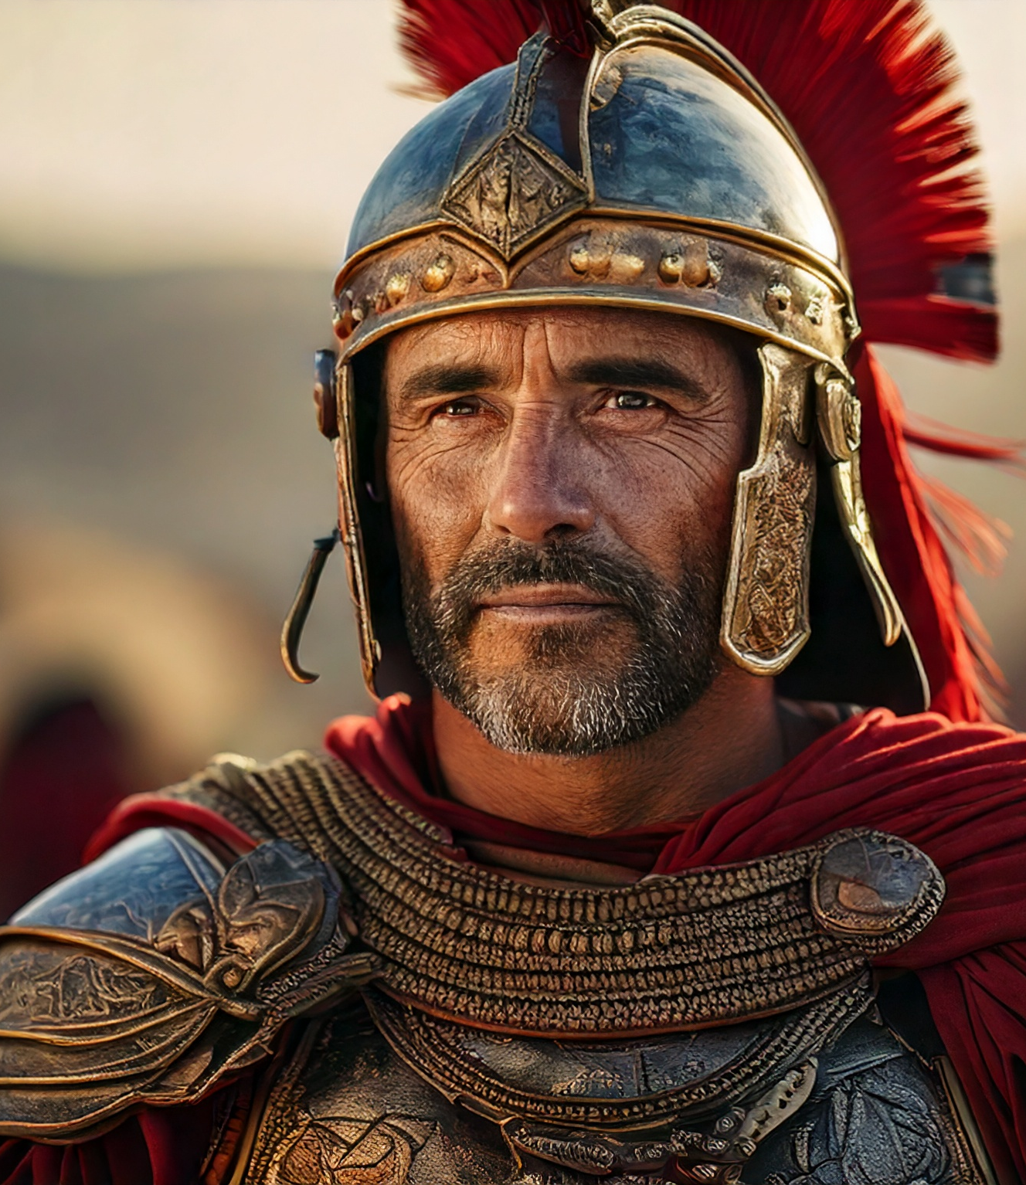
Hesitant VS Amazing Faith

Slide 4


Questioning VS Confirmation

Slide 5
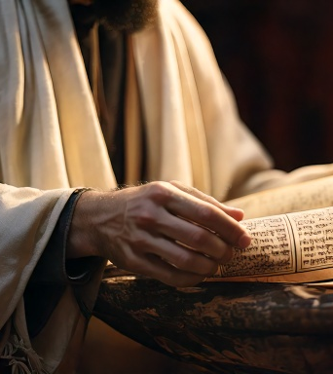

Rejection VS Acceptance

Slide 6

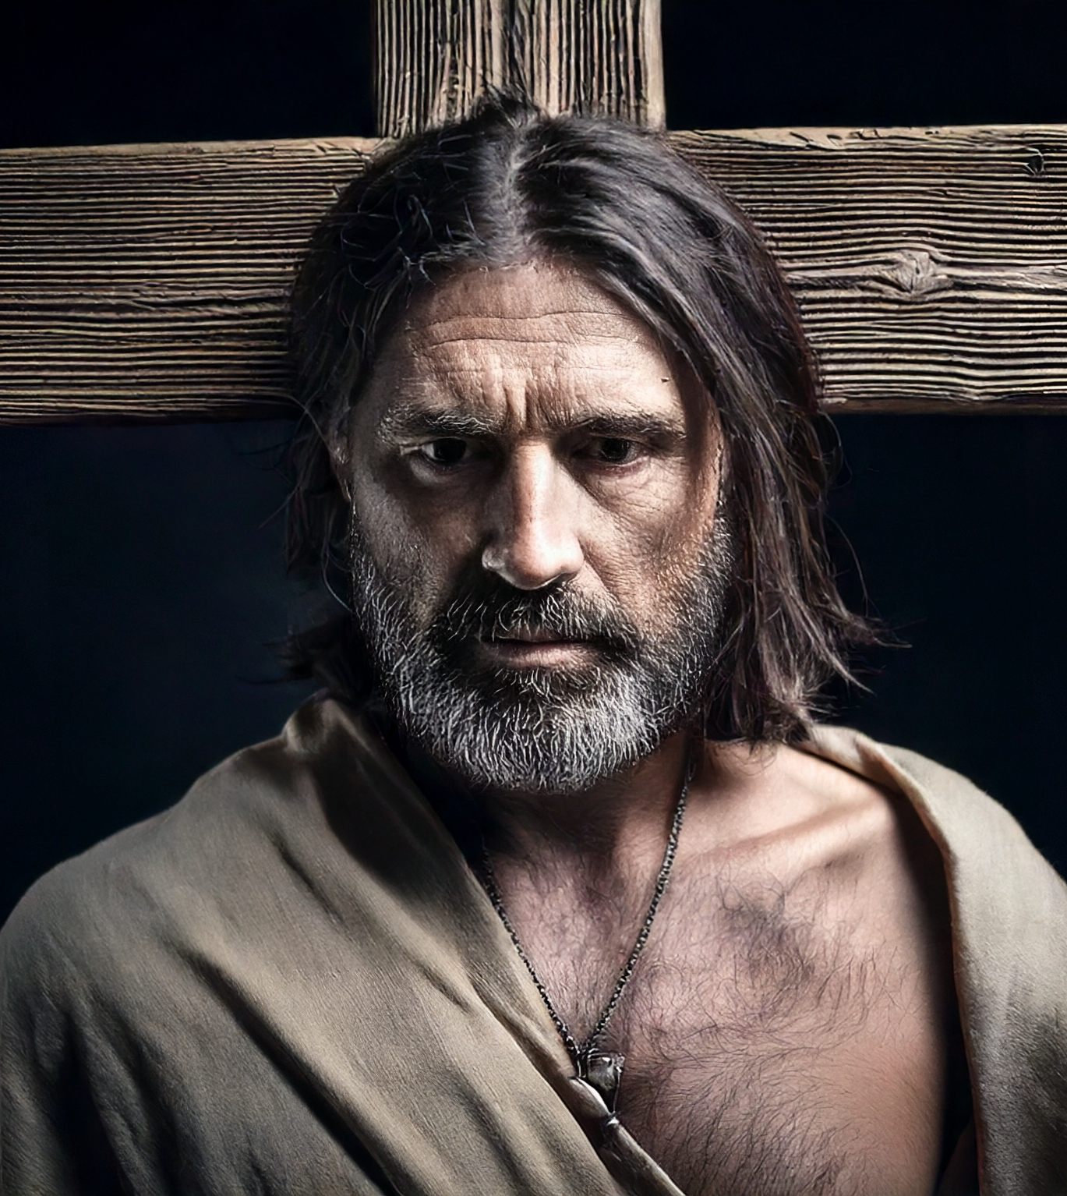
Discontentment VS Humility

Slide 7
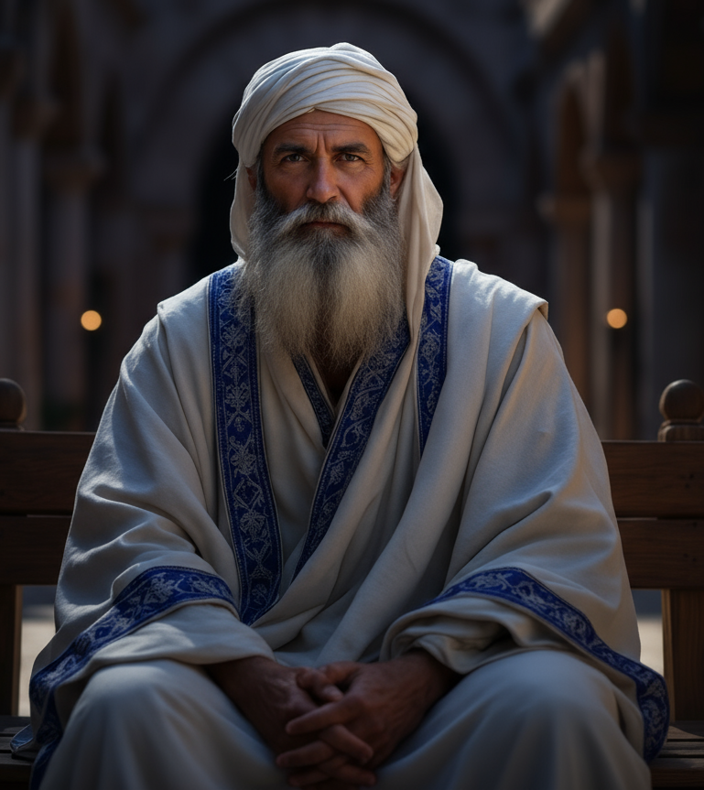
Evil VS Good Partnership with God

Slide 8
Goal
Every Christian Should Prioritize Serving Christ in Humility
For these Three Reasons

Slide 9
Reasons
Mary Humbly Sacrificed
Others Complained
Jesus Corrected Them

Slide 10
Context
Then assembled together the chief priests, and the scribes, and the elders of the people, unto the palace of the high priest, who was called Caiaphas, And consulted that they might take Jesus by subtilty, and kill him. But they said, Not on the feast day, lest there be an uproar among the people (Matt 26:3–5).
Then from that day forth they took counsel together for to put him to death (John 11:53.

Slide 11
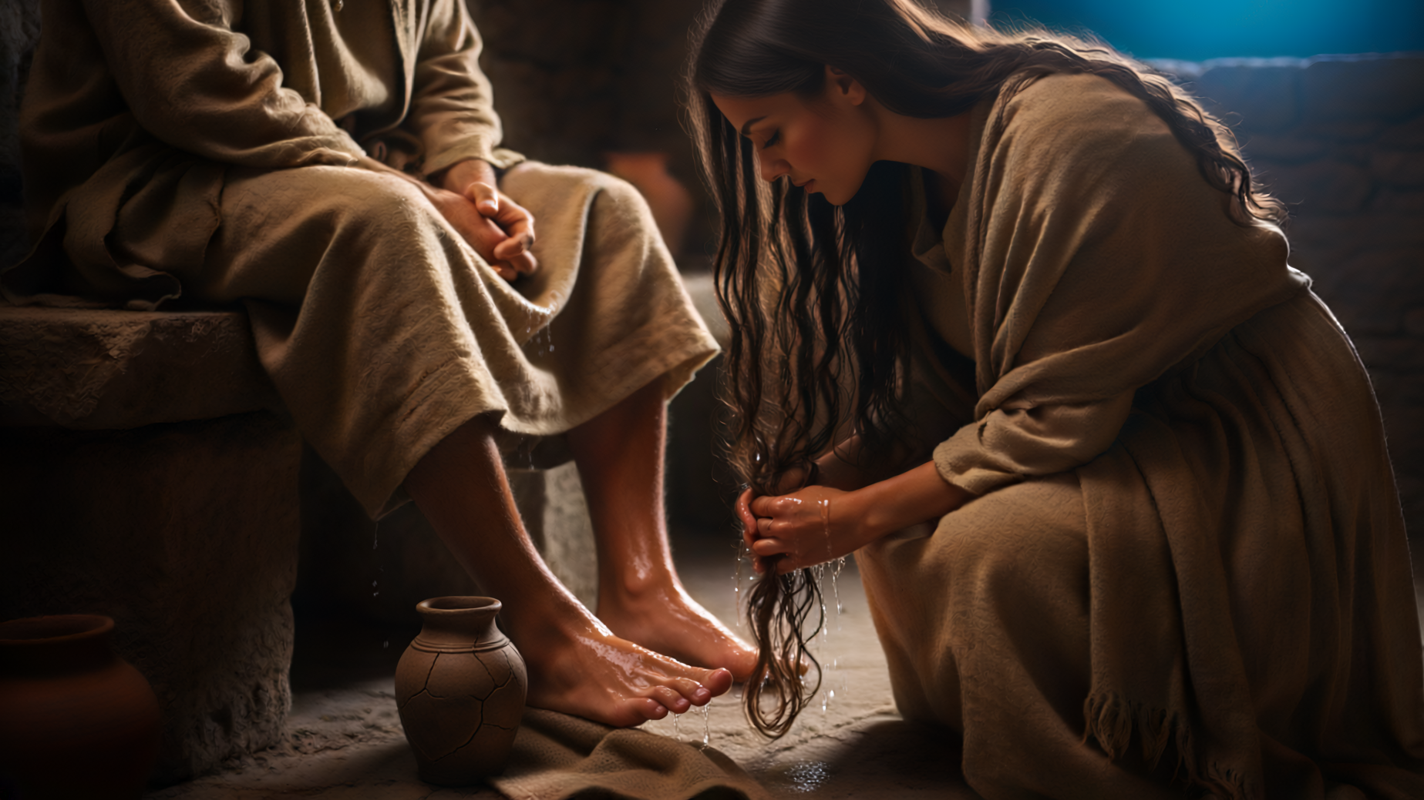
Mary Humbly Sacrificed

Slide 12
Anointing Jesus
Now when Jesus was in Bethany, in the house of Simon the leper, There came unto him a woman having an alabaster box of very precious ointment, and poured it on his head, as he sat at meat (Matt 26:6–7).
Then Jesus six days before the passover came to Bethany, where Lazarus was which had been dead, whom he raised from the dead. There they made him a supper; and Martha served: but Lazarus was one of them that sat at the table with him. Then took Mary a pound of ointment of spikenard, very costly, and anointed the feet of Jesus, and wiped his feet with her hair: and the house was filled with the odour of the ointment (John 12:1–3).

Slide 13
The Sinful Woman
And one of the Pharisees desired him that he would eat with him. And he went into the Pharisee’s house, and sat down to meat. And, behold, a woman in the city, which was a sinner, when she knew that Jesus sat at meat in the Pharisee’s house, brought an alabaster box of ointment, And stood at his feet behind him weeping, and began to wash his feet with tears, and did wipe them with the hairs of her head, and kissed his feet, and anointed them with the ointment (Luke 7:36–38).

Slide 14
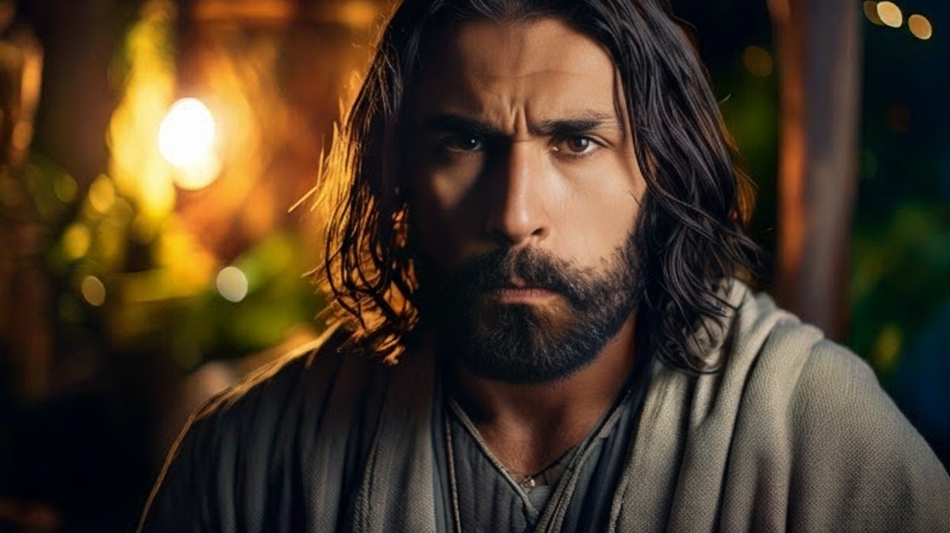
Others Complained

Slide 15
Judas’ Wickedness Revealed
But when his disciples saw it, they had indignation, saying, To what purpose is this waste? For this ointment might have been sold for much, and given to the poor (Matt 26:8–9).
Then saith one of his disciples, Judas Iscariot, Simon’s son, which should betray him, Why was not this ointment sold for three hundred pence, and given to the poor? This he said, not that he cared for the poor; but because he was a thief, and had the bag, and bare what was put therein (John 12:4–6).

Slide 16
The Pharisees Reaction
Now when the Pharisee which had bidden him saw it, he spake within himself, saying, This man, if he were a prophet, would have known who and what manner of woman this is that toucheth him: for she is a sinner (Luke 7:39).

Slide 17

Jesus Corrected Them

Slide 18
Anointing For Burial
When Jesus understood it, he said unto them, Why trouble ye the woman? for she hath wrought a good work upon me. For ye have the poor always with you; but me ye have not always. For in that she hath poured this ointment on my body, she did it for my burial. Verily I say unto you, Wheresoever this gospel shall be preached in the whole world, there shall also this, that this woman hath done, be told for a memorial of her (Matt 26:10–13).
Then said Jesus, Let her alone: against the day of my burying hath she kept this. For the poor always ye have with you; but me ye have not always (John 12:7–8).

Slide 19
Forgiving a Sinner
And Jesus answering said unto him, Simon, I have somewhat to say unto thee. And he saith, Master, say on. There was a certain creditor which had two debtors: the one owed five hundred pence, and the other fifty. And when they had nothing to pay, he frankly forgave them both. Tell me therefore, which of them will love him most? Simon answered and said, I suppose that he, to whom he forgave most. And he said unto him, Thou hast rightly judged (Luke 7:40–43).

Slide 20
Forgiving a Sinner P2
And he turned to the woman, and said unto Simon, Seest thou this woman? I entered into thine house, thou gavest me no water for my feet: but she hath washed my feet with tears, and wiped them with the hairs of her head. Thou gavest me no kiss: but this woman since the time I came in hath not ceased to kiss my feet. My head with oil thou didst not anoint: but this woman hath anointed my feet with ointment (Luke 7:44–46).

Slide 21
Forgiving a Sinner P3
Wherefore I say unto thee, Her sins, which are many, are forgiven; for she loved much: but to whom little is forgiven, the same loveth little. And he said unto her, Thy sins are forgiven. And they that sat at meat with him began to say within themselves, Who is this that forgiveth sins also? And he said to the woman, Thy faith hath saved thee; go in peace (Luke 7:47–50).

Slide 22
Gospel: | Matthew | Mark | Luke | John
Location? | Bethany | Bethany | _____________ | Bethany
Whose House? | Simon the Leper | Simon the Leper | Simon the Pharisee | _____________
By Whom? | A Woman | A Woman | A Sinful Woman | Mary
Where at? | Head | Head | Feet | Feet
Upset Who? | The Disciples | Some People | Simon the Pharisee | Judas
For What? | Anointed For Burial | Anointed For Burial | Appreciation | Anointed for Burial

Slide 23
Goal
Every Christian Should Prioritize Serving Christ
For these Three Reasons

Slide 24
Reasons
Mary Sacrificed for Jesus
The Disciples Complained that it was a Waste
Jesus Corrected Their Misconceptions

