Slide 1
Principles for a Productive life
John 10:10 “The thief cometh not,
but for to steal…kill, and to destroy:
I am come that they might have life,
and that they might have it
more abundantly.”
(perissos’: beyond superabundant)
Ro. 8:37 “More than conquerors”

Slide 2
Principles for a Productive life!
1 Cor 3:9 “we are laborers together (συνεργός: synergos) with God.
We are God’s husbandry”
(Γεώργιον: geōr’gion: farm/garden)

Slide 3
Productive farms/ lives require:
Proactive Planning. Pr. 29:18
Practical Preparation. Hosea 10:12
Purposeful Planting. Gal. 6:7,8
Persistent Protecting. Job 1:10

Slide 4
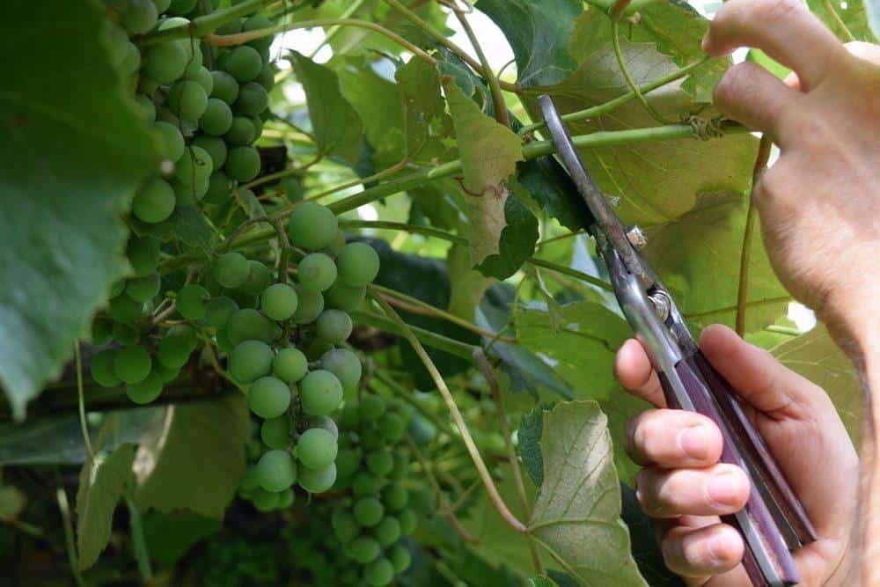
Even with these, your garden (life) will not produce its potential without some
Painful Pruning.

Slide 5
Part 5: Pruning for a Productive Life.
Lessons in the Vineyard from John 15
Jesus used the grape vine to remind us that God is actively at work in our lives seeking to enable us to be “fruitful”. (Productive)

Slide 6
Lessons in the Vineyard from John 15
The extent of our fruitfulness depends on our quality of our relationship with Christ.
Vs 4 "Abide in me, and I in you.
As the branch cannot bear fruit of itself,
except it abide in the vine;
no more can ye, except ye abide in me."

Slide 7
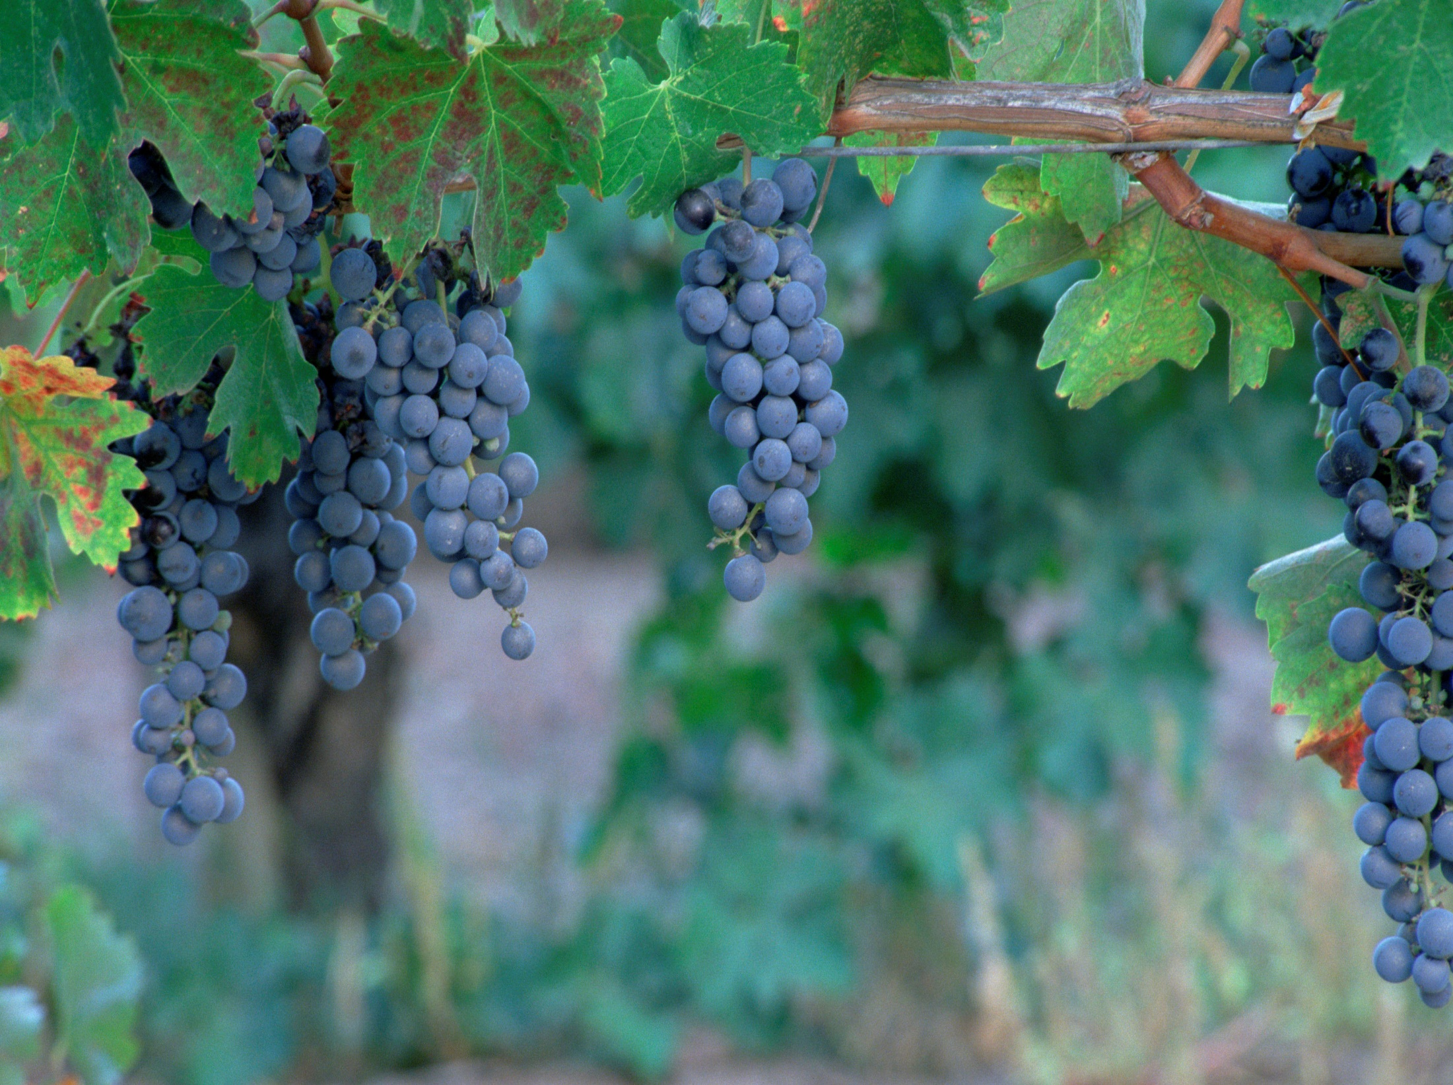
Pruning for a Productive Life.
Lessons in the Vineyard
John 15
The Picture: Vs 1,5
“I am the true vine,
my father is the Husbandman…
ye are the branches.”

Slide 8
Pruning for a Productive Life.
Lessons in the Vineyard
The Purpose: Jn 15:16
“I have chosen you and ordained you (tith’ēmi: appointed, placed)
… To bring forth fruit”

Slide 9
Pruning for a Productive Life.
Lessons in the Vineyard
The Process: vs 2-10
“every branch that beareth fruit,
he purgeth it,
that it may bring forth more fruit.”

Slide 10
God (as the “husbandman” vs 1) is in the fruit business and uses “all things” (Ro. 8:28)
to help us develop an abundant harvest.
Jn 15:8 “Herein is my Father glorified,
that ye bear much fruit;
so shall ye be my disciples.”
One condition of our fruitfulness is our Response to the Father as he seeks to prune and position us for maximum benefit.

Slide 11
“every branch that beareth fruit he purgeth,
that it may bring forth more fruit”
The Dimensions Of Purging. Vs 2,3
Kathai’ro, actually has a double meaning:
To Cleanse:
It comes from the root word “katharos’” meaning to make clean, clear, and pure.

Slide 12
The Dimensions Of Purging. Vs 2,3
A. To Clean. Vs 3
The medium for cleansing is God’s Word.
Jn 15:3 “Ye are clean through the word (logos)
which I have spoken unto you.”
Ps 119:9 “Wherewithal shall a man cleanse his way?
by taking heed thereto according to thy word.“
Eph 5:26 “That he might sanctify and cleanse it (us)
with the washing of water by the word”
rhema: specific utterance, matter, topic, command

Slide 13
The Dimensions Of Purging. Vs 2,3
A. To Clean. (1 Jn 1:5-10)
2) The Process for Cleansing involves:
a) Exposure/truth produces conviction. 1 Tim. 3:16
b) Conviction produces recognition. (1 Jn 1:6)
c) Recognition leads to repentance. (1 Jn 1:7)
(metanoe’o: change of mind, compunction)
d) Repentance produces Confession. (1 Jn 1:9)
“If we confess (Homologeo: to acknowledge)
our sins” (hamartia: offence)

Slide 14
2) The Process for Cleansing involves:
e) Confession produces forgiveness & Cleansing.
1 Jn 1:9 “If we confess our sins,
He is faithful and just
to forgive us (aphiēmi: send away) our sins
and to cleanse us
from all unrighteousness.”

Slide 15
The Dimensions Of Purging. Vs 2,3
A. To Clean. 1 Jn 1:5-10
3) The longer we walk in unconfessed sin:
a) The greater the risk of self deception.
1 Jn 1:8; James 1:22-26
b) The greater the chance of spiritual infection! 1 Jn 2:9-19; 1 Jn 5:19
{Poneros’ = infection}
Requiring the next dimension of Purging.

Slide 16
The Dimensions Of Purging. Vs 2,3
A. To Clean. 1 Jn 1:5-10
B. To Cut: kathairō also means to prune/cut 1) “Cutting” is required to:
a) To cut away dead or dying (infected) growth.
b) Allow Sunlight to reach the other branches.
c) Increase the size and quality of the fruit.
d) Encourage new Growth (or growth in a new
direction) and fruit to develop.

Slide 17
The Dimensions Of Purging. Vs 2,3
A. To Clean. 1 Jn 1:5-10
B. To Cut: kathairō also means to prune/cut 2) God’s word is the primary medium for this
“pruning”. Heb. 4:12
“the word of God is quick, and powerful, and sharper than any two-edged sword, piercing even to the dividing asunder of soul and spirit, and of the joints and marrow,
and is a discerner of the thoughts
and intents of the heart.”

Slide 18
The Dimensions Of Purging. Vs 2,3
2. The Motivations for Purging
A. TO DISCIPLINE (Hebrews 12:5-13)
Discipline deals with Sin in our lives.
1) Discipline is a Part of being a child of God. Vs 7,8
“If ye be without chastisement…
(He cares enough to confront! Rev. 3:19)
a) You can’t be a “disciple” without experiencing
occasional “discipline.”
then are ye bastards”

Slide 19
1) Discipline is a Part of being a child of God.
2) Discipline is Painful. Heb. 12:11
"no chastening for the present seemeth to be joyous,
but grievous:” (lype’: sad, heavy, sorrowful)
3) Discipline is Purposeful. Heb. 12:10,11
“nevertheless afterward it yieldeth the peaceable fruit of
righteousness
Vs 10 “they (fathers) chastened us after their own pleasure;
but he (our heavenly Father) for our profit,
that we might be partakers of his holiness.”
unto them which are exercised thereby."

Slide 20
2. The Motivations for Purging
A. TO DISCIPLINE (Hebrews 12:5-13; Rev 3:19)
4) Discipline is usually Progressive. Hebrews 12:5-6
“ye have forgotten the exhortation which speaketh unto you as unto children,
My son, despise not thou the chastening of the Lord,
nor faint when thou art rebuked of him:
6 For whom the Lord loveth he chasteneth,
and scourgeth every son whom he receiveth.”

Slide 21
4) Discipline is usually Progressive. Heb. 12:5,6
a) Rebuke (vs 5): elen’cho: convince or tell a fault.
(1) This stage involves gentle, verbal conviction.
b) Chastening (vs 5): paidei’a: correction, training
from paideu’ō: to educate. This comes from “paiō”
meaning “to sting or strike” with mild blow.
(1) Chastening implies increased “Pressure”,
Often accompanied by some physical pain.

Slide 22
4) Discipline is usually progressive.
c) Scourging (Heb 12:6): mastigo’o: to flog or whip.
(What the Romans did to Jesus! John 19:15)
(1) This is the result of ignoring the other
stages.
(2) It is increasingly painful and serious.
“God whispers through pleasure,
but shouts through pain.” (CS Lewis)

Slide 23
4) Discipline is usually progressive.
c) Scourging (Heb 12:6): mastigo’o: to flog or whip.
(What the Romans did to Jesus! John 19:15)
(3) Continued disobedience can result in being
“cut off.” (See Jn 15:2,6 and 1 Cor 11:30)
Pr 29:1 “he that being often reproved, hardeneth his heart, shall suddenly be destroyed
And that without remedy!”
See Proverbs 1:20-31
“turn at my reproof!”

Slide 24
5) The length and breadth of God’s Discipline
depends on our response to Him. (Heb 12:11)
"Now no chastening for the present seems to be joyous, but grievous:
nevertheless afterward it yieldeth the peaceable fruit of righteousness
unto them which are exercised thereby.“
Gymnazo: trained!

Slide 25
2. Motivations for Purging
A. To Discipline: Deals with the sin in our lives.
B. To Direct: Deals with “self” in our lives.
Jn 15:2 “every branch that beareth fruit, he purgeth it”
1) Pruning is necessary to deal with (direct)
the “wild nature” of the vine.
(a) We want to “direct our own paths.” (Pr 3:5-6)
Left alone, Grape branches tend to grow “wild”
(Is 5:2), working their way down into the dirt
or getting tangling between themselves.

Slide 26
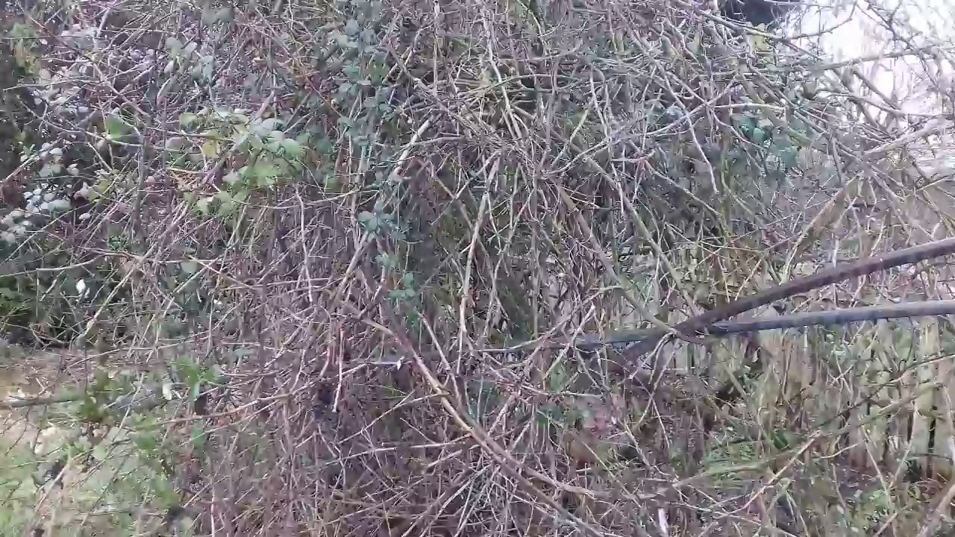
This blocks the leaves exposure to the sun,
starving the branch of nutrients necessary to develop healthy fruit.
Pruning is the only solution!

Slide 27
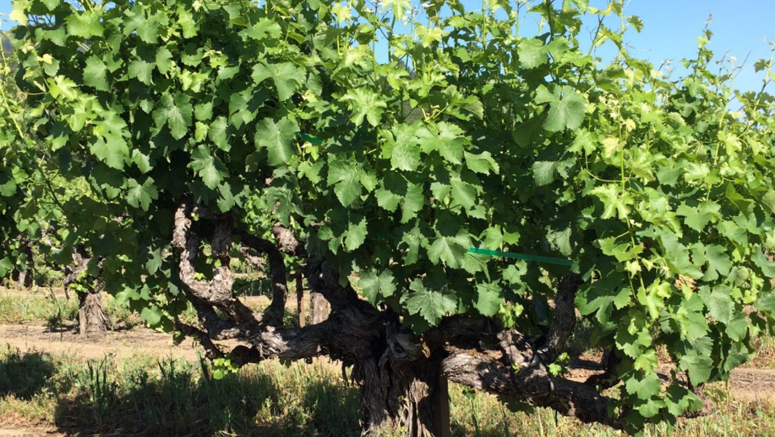
b) We’re too often content with leaves. (looks)
“When there’s not enough fruit to store the carbohydrates,
A grapevine will over-compensate with increased foliage.” (leaves)
(Ohio State Horticulture and Crop Science fact sheet)
Remember the “cursed” fig tree of Mt 21:19!
God’s looking for
Lasting Fruit!
(Jn 15:16)

Slide 28
Rev. 3:19 “as many as I love I rebuke and chasten,
Be zealous therefore and repent!”
The greatest judgment God could bring to a us would be to get out of our way {let us alone}
giving us own way unchallenged!
(Pr 14:12; 16:25; Mt. 7:13; Pr. 1:20-31)
Hosea 4:17-18 “Ephraim is joined to idols:
let him alone. “
‎(yānaḥ: let alone or withdraw from)
{Remember the “hedge of protection?}

Slide 29
Mt 15:8-14 “This people draweth nigh unto me with their mouth, and honoureth me with their lips;
but their heart is far from me.
9 But in vain they do worship me,
teaching for doctrines the commandments of men…
12 …Knowest thou that the Pharisees were offended?
13 … Every plant, which my heavenly Father hath not planted, shall be rooted up.
14 Let them alone: (aphi’ēmi: let it/them go)
they be blind leaders of the blind. “

Slide 30
CONCLUSION: Many confuse the pain of “discipline” and that of “direction.”
Heb. 12:1,2 “let us lay aside every weight and the sin which so easily besets us and run with patience the race set before us.”
Although they have some similar characteristics, it is important to rightly discern what God is trying to accomplish so that we can respond correctly.
How can we determine if the pain in our lives is due to discipline or direction?

Slide 31
Questions | Discipline | Direction
What’s happening? | Pain | Pain
Why’s it happening? | You’re Sinning | You’re doing right.
What’s your level of Fruit? | Little or None. | Some fruit
What’s God looking for? | Spiritual Fruit | More fruit
What needs to go? | Sin in my life. | Self rule in my life.
How should you feel? | Guilty, sad | Relief, trust
What should you do? | Repent / Confess. | Release /Cooperate.
When does the pain stop? | When I stop sinning. | When God’s finished. Ro. 8:28,29

Slide 32
John 15:5
“I am the vine,
ye are the branches:
He that abideth in me,
and I in him,
the same bringeth forth much fruit:
for without me ye can do nothing.”

Slide 33
Are you in a season of Production or Pruning?
Of cleansing or cutting?
What’s the Husbandman
trying to accomplish in & through your life?
How are/will
you respond?

