Slide 1
“Immanuel…God with us!” Mt 1:23
The Privilege and Price of Partnering with God.

Slide 2
Many poems, stories, movies and songs have tried to capture the spirit of this remarkable season.
Andy Williams described it on his 1963 Christmas Album as
“The Most Wonderful Time of the Year!”
Christmas has a way of shifting our focus
away from ourselves and towards others,
(and perhaps even God)
as we reflect on the Wonder of the Incarnation.

Slide 3
Maybe that’s why there’s so much effort to “distract” us during this season!
I had to go through hundreds of “Christmas” images before I found one about Christ or God.
The rest focused on Frosty, Santa, Rudolph, decorations or family gatherings.

Slide 4
“Wonderful” may not fit Mary and Joseph’s experiences,
but they were filled with Wonder at the birth of Immanuel
Is 9:6 “unto us a child is born, unto us a son is given:
and the government shall be upon his shoulder:
and his name shall be called Wonderful,
Counsellor, The mighty God,
The everlasting Father,
The Prince of Peace.”
Lk 2:19 “But Mary kept all these things and pondered them in her heart”

Slide 5
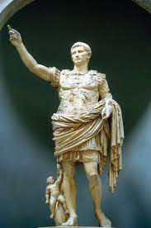
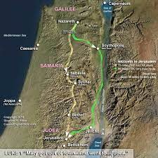
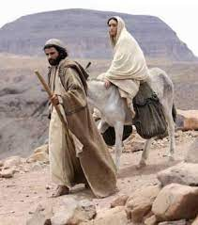
Luke 2 reveals that God moved the Emperor
Caesar Augustus (“Sacred, exalted one”)
to order an empire wide census so that the
prophecy of Micah 5:2 could be fulfilled.
This moved, not only Mary and Joseph,
(about 100 miles)
but an entire empire!

Slide 6
Lk 2:8-20 reveals that the Shepherds,
after they received the angelic message left their flocks to investigate the “good news”. (vs 15, 16)
17 “and when they had seen it, they made known abroad the saying which was told them.
such that “all they that heard it
wondered at those things” (vs 18)
Scripture is silent about whether any of those who heard and wondered ever bothered to wander over to the stable to see for themselves what God was doing.

Slide 7
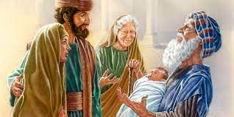
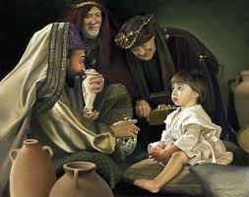
There would eventually be brief visits from Anna and Simeon at Jesus’ dedication.
(Lk 2:25-38)
And the Magi (Wise Men) would eventually bring their gifts and worship the young
“King of Kings”.
Mt 2:1-12

Slide 8
But even those who welcomed or even noticed
the Christ Child returned to their own lives.
The shepherds returned to their flocks.
Anna and Simeon returned to their homes.
The Wise Men made the long trip back home
Mt 2:12 “being warned of God in a dream that they should not return to Herod, they departed into their own country another way.”

Slide 9
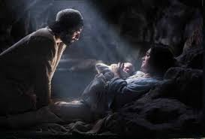
Leaving Mary and Joseph alone to face their new roles and responsibilities of raising Immanuel.
“God with us!”

Slide 10
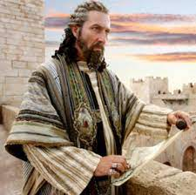
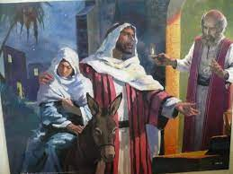
Modern Christmases are still like that.
Some are threatened by
the claims of Christ!
Others simply have no “room” in their busy lives to even consider him.

Slide 11
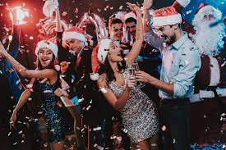
Most miss its significance entirely,
Distracted by the traditions or celebrations
of everything
but Jesus!

Slide 12
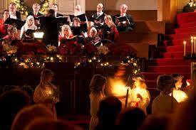
Others may be challenged with the revelation and reflection of the “reason for the season”,
usually followed by eventual resignation as the season passes and we get back to life as normal.
Perhaps grateful for the experience/memories,
but effectively,
no different than they were before.

Slide 13
What made Mary and Joseph “Different?”
1. Others were Challenged,
A. The Birth Of a Child Changes Us!
Friends may “check in,”
1) Wherever They Went, They Brought Jesus.
Jerusalem, Bethlehem, Egypt, Nazareth, Jerusalem.
They were Changed!
Families “Change”!
2) As soon as they realized that they had left him behind,
they immediately changed their agenda.
(Luke 2:42-50)

Slide 14
1. Others were Challenged, They were Changed!
Today billions acknowledge and even celebrate the birth of Jesus.
The vast majority will acknowledge: "That was nice"
and then simply get on with “their” life ultimately:
“because there was no room for them…” Lk 2:7
Relatively few, who having “met” Jesus Christ,
will determine to make the adjustments necessary
to “make room” for him in their lives.

Slide 15
What made Mary and Joseph “Different?”
Others were Challenged, They were Changed!
Others Noticed Christ,
A. Raising Children Is A Growing Experience!
1) You must love and “learn” your child.
2) As they grow, they change, and so do you,
so your relationships requires constant
care and development.
They Nutured Him!

Slide 16
2. Others Noticed Christ, They Nourished Him!
A. Raising Children Is A Growing Experience!
B. Growing Relationships require growing people!
2 Pt 1:5-7 “beside this, giving all diligence, add to your faith virtue; and to virtue knowledge; And to knowledge temperance; and to temperance patience; and to patience godliness; And to godliness brotherly kindness;
and to brotherly kindness charity. “
2 Peter 3:18 “Grow in Grace and in the knowledge
of our Lord (kyrios: supreme authority)
and Savior (soter: deliverer) Jesus Christ”

Slide 17
2. Others Noticed Christ, They Nourished Him!
C. Relationships that aren’t nourished deteriorate!
Eph 5:25,28-29 “Husbands love your wives as Christ loved the church and gave himself for it…He that loveth his wife loveth himself.
For no man ever yet hated his own flesh;
but nourisheth (Ektre’phō: cherish, value, mature)
and cherisheth it, (Thal’pō: to warm, foster growth.
even as the Lord the church:”
Titus 2:4 “teach them to love their husbands…, children”
1) Entropy deteriorates and will eventually destroy!
(physically, emotionally, relationally, spiritually)

Slide 18
C. Relationships that aren’t nourished deteriorate!
1) Entropy deteriorates and will eventually destroy!
2) Energy (effort) is required to resist/reverse it!
2 Pt 1:5-7 “giving all diligence, add to your faith…”
Gal. 6:7-8 “whatsoever a man sows, that shall he also reap…
vs 9 … and let us not grow weary in welldoing
for in due season we shall reap, if we faint not.
vs 10 As we have therefore opportunity,
let us do good unto all men,
especially unto them who are of the household of faith.”

Slide 19
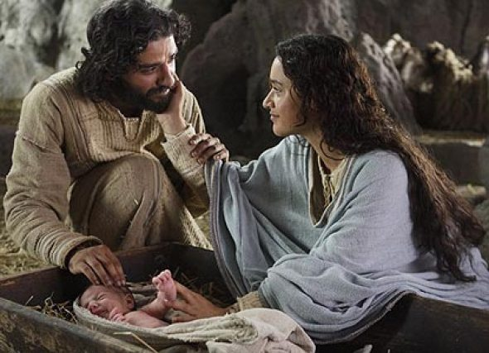
2. Others Noticed Christ, They Nourished Him!
While others “returned” to their lives...
Mary and Joseph “rededicated” themselves to
nurture and develop their relationship with Jesus!
Lk 1:46,47 “My soul doth magnify the Lord,
And My spirit hath rejoiced in God my savior!”

Slide 20
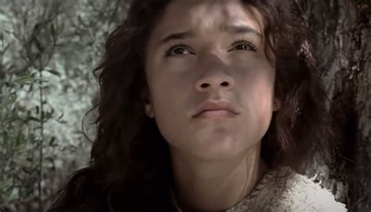
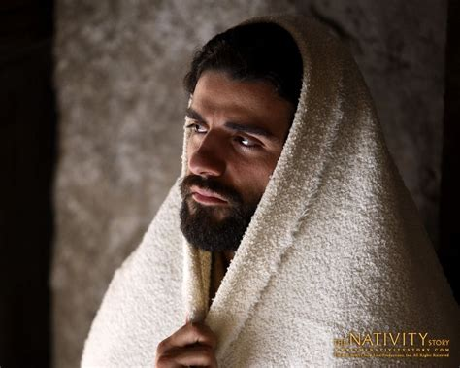
What made Mary and Joseph “Different?”
They allowed their relationship with Christ to not just “challenge” them, but to Change them!
They didn’t just “notice” him,
but Nourished their relationship with Him!

Slide 21
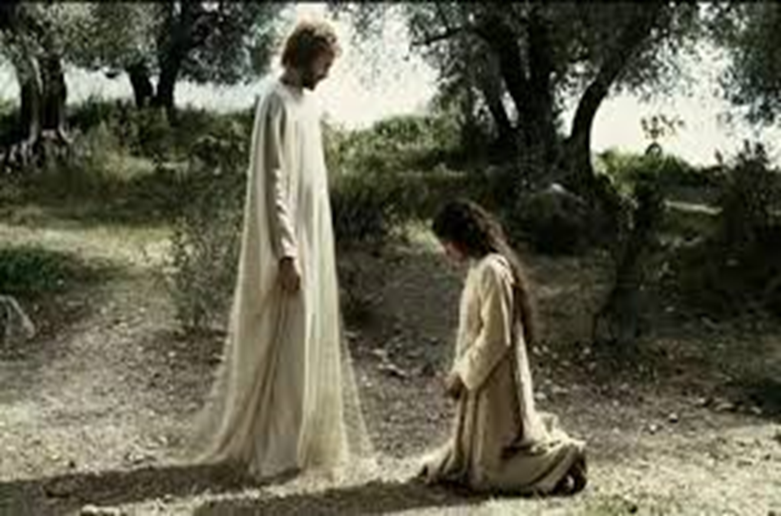
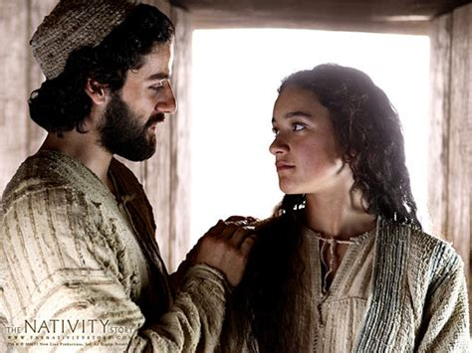
The secret of their difference is in their devotion!
Mt 1:24 “Then Joseph being raised from sleep did as the angel of the Lord had bidden him.”
“Behold the handmaid of the Lord; be it unto me according to thy word.” Luke 1:38

Slide 22
For them, their relationship with Immanuel Changed Everything!
What about for you?
Are you willing to let Christ
Change you?
(2 Cor. 3:18)
Are you willing to Nourish this relationship?
(Jn 14:21)

Slide 23
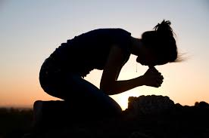
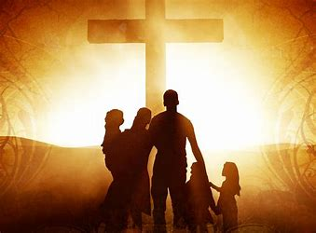
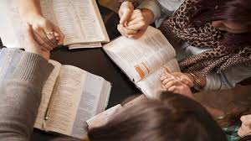
What are you doing to Nourish your relationship:
With Jesus?
(Jn 14:21)
With your family?
(Eph. 5:22-6:4)
With God’s Family?
(Heb. 10:23-25)

Slide 24
eiro: to Join!
“His name shall be called
Wonderful…
Are you willing to Join (Partner with) God?

