Slide 1
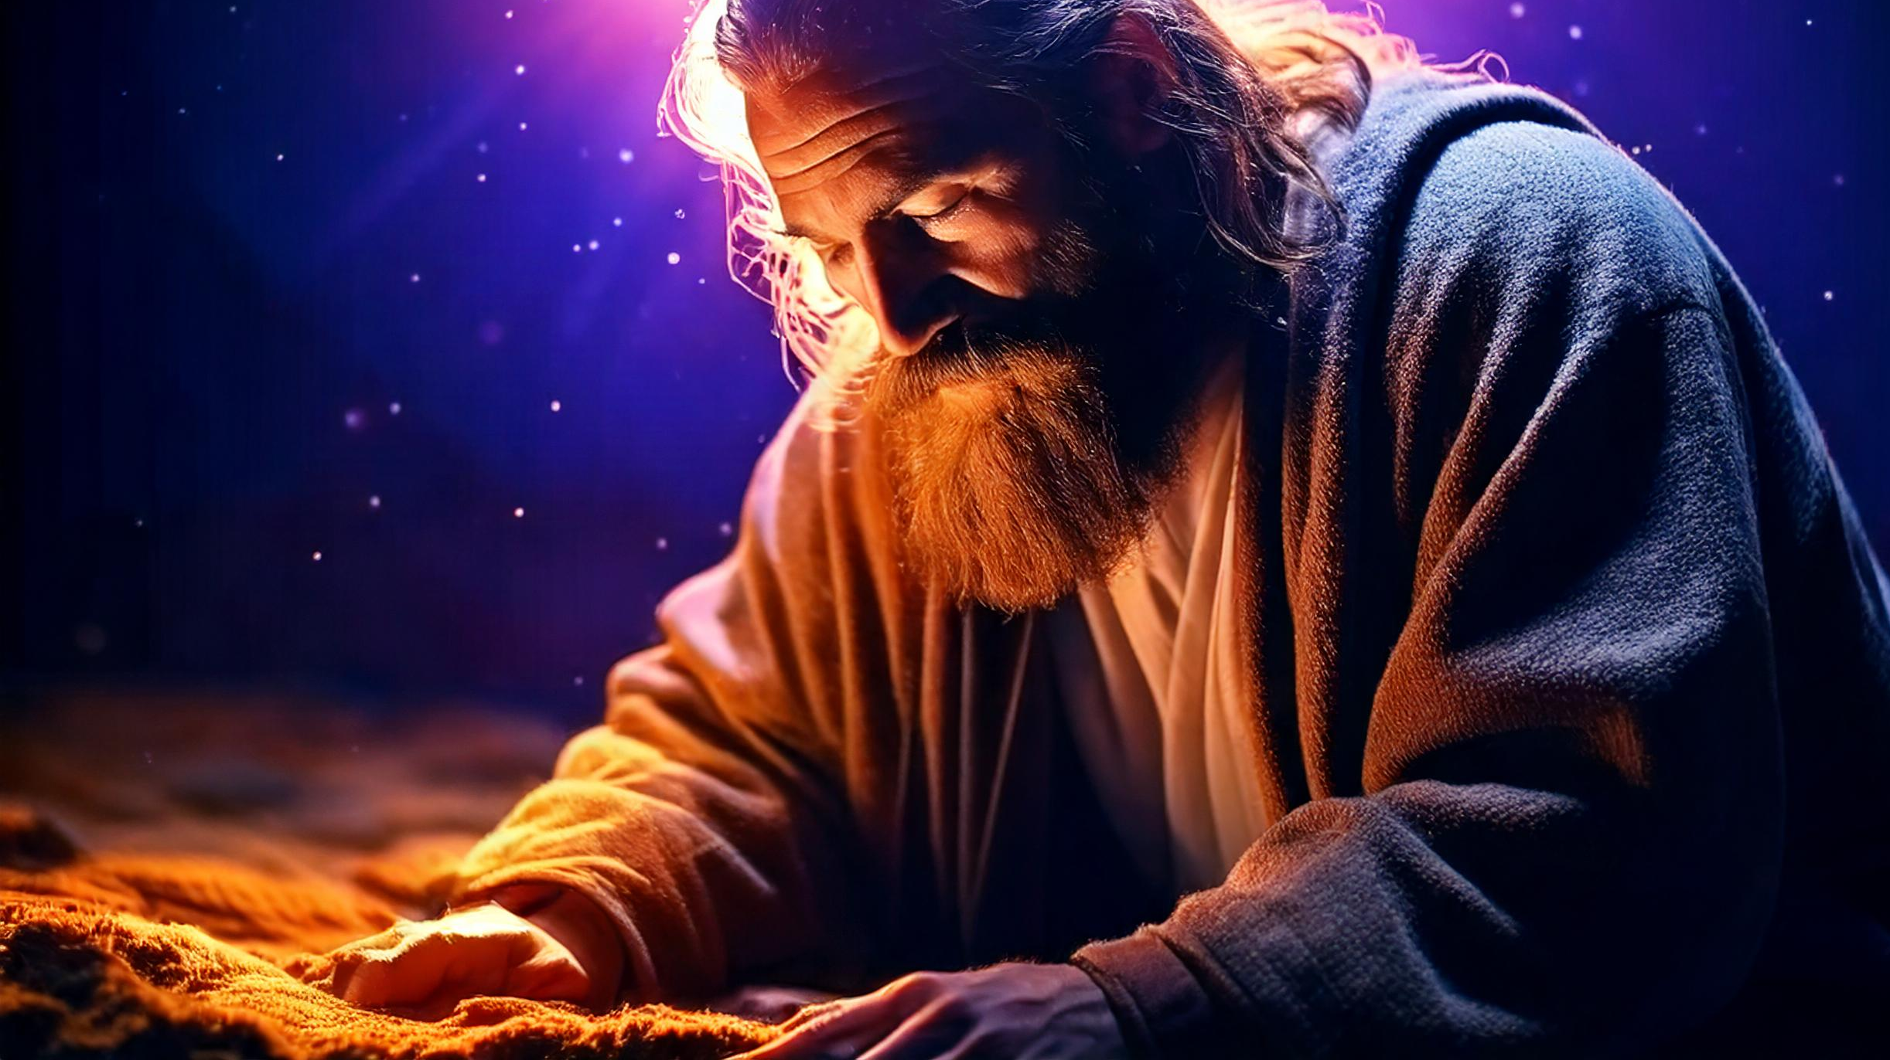
Worship and Honor
-Ptr Daniel Peters

Slide 2
The Goal of this Lesson
Any Christian can avoid improper worship
By following these three concepts

Slide 3
Reasons/ Concepts
Worship is a lifestyle, not an event
Worship is about what God wants, not what we want
Worship involves sacrifice and honor, not manipulation

Slide 4
Worship is a lifestyle, not an event

Slide 5
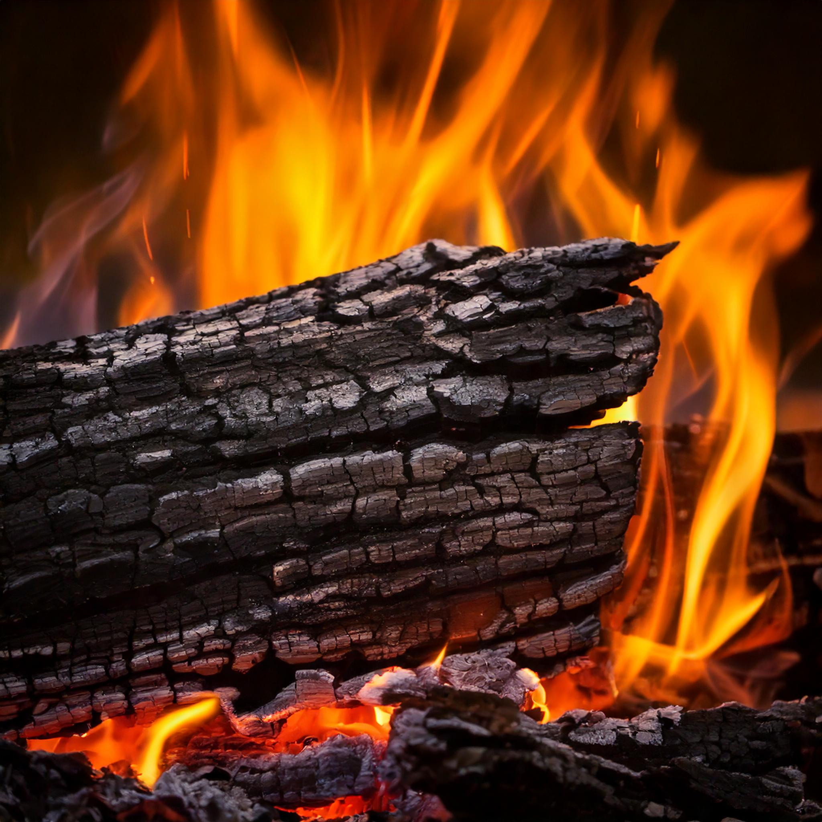
Impressive Intensity VS Strong Consistency

Slide 6
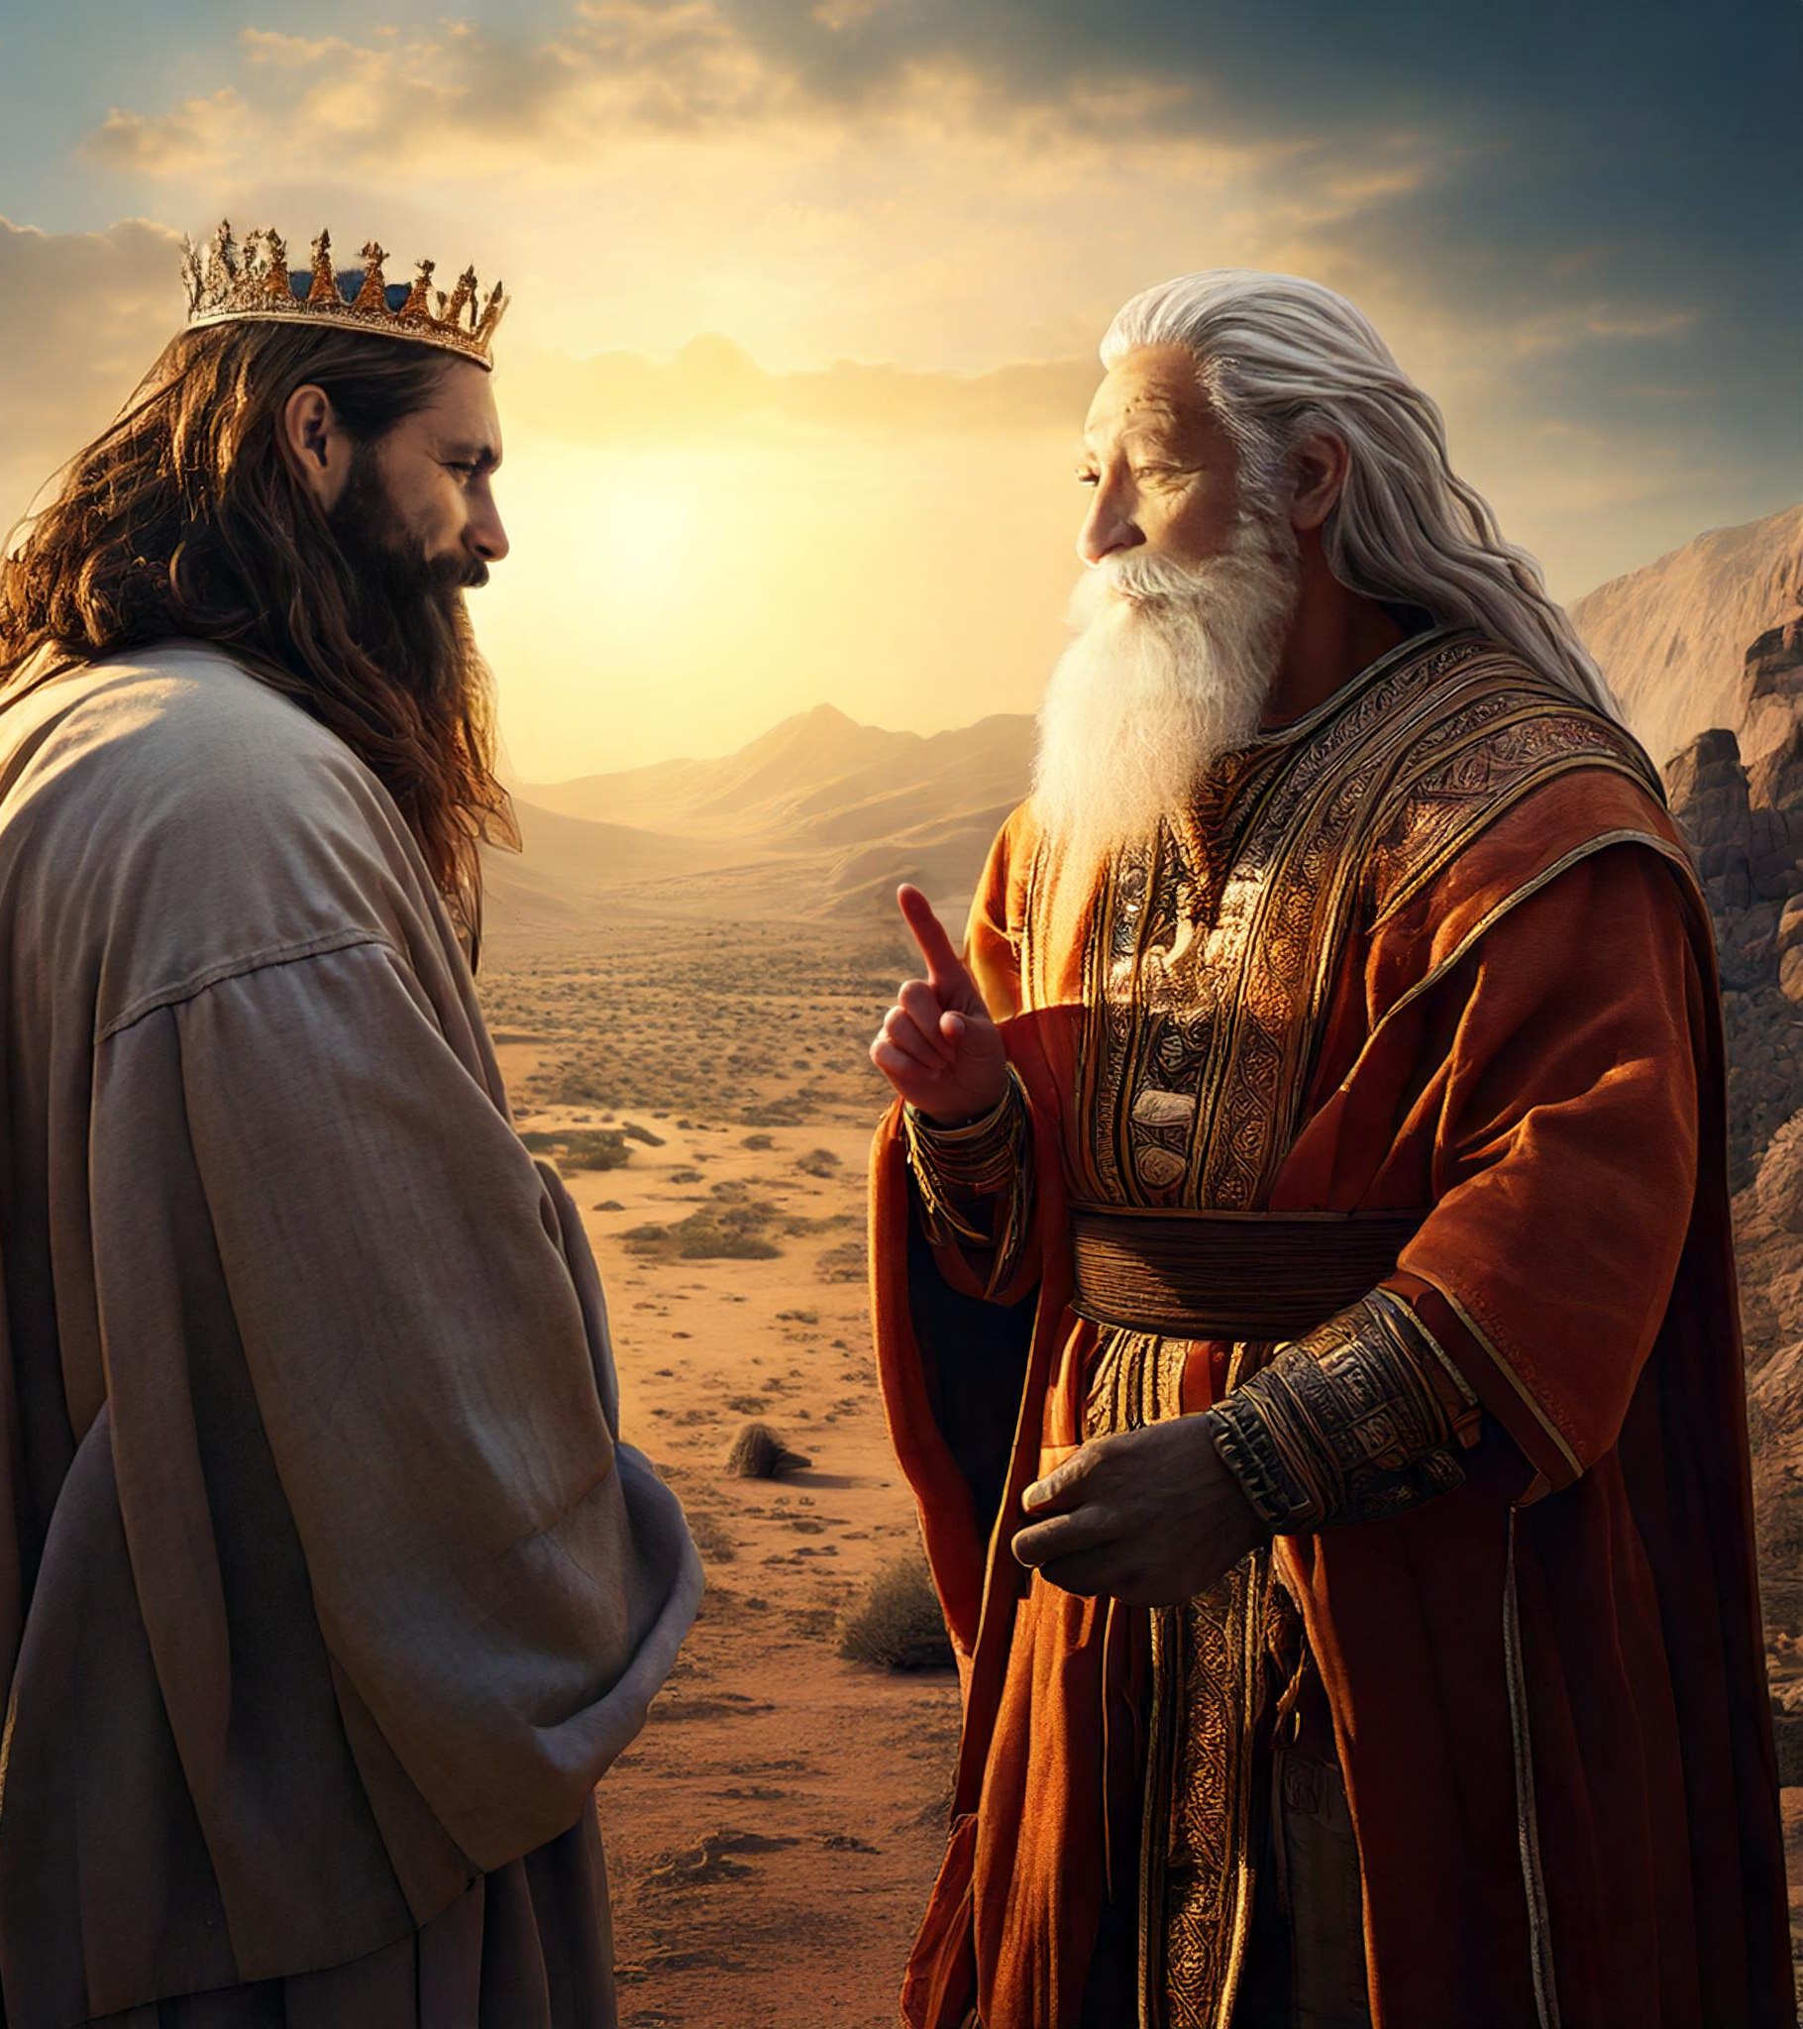
Obedience VS Sacrifice
And Samuel said, “Has the LORD as great delight in burnt offerings and sacrifices, as in obeying the voice of the LORD? Behold, to obey is better than sacrifice, and to listen than the fat of rams (1 Sam 15:22).

Slide 7
Worship is about what God wants, not what we want

Slide 8
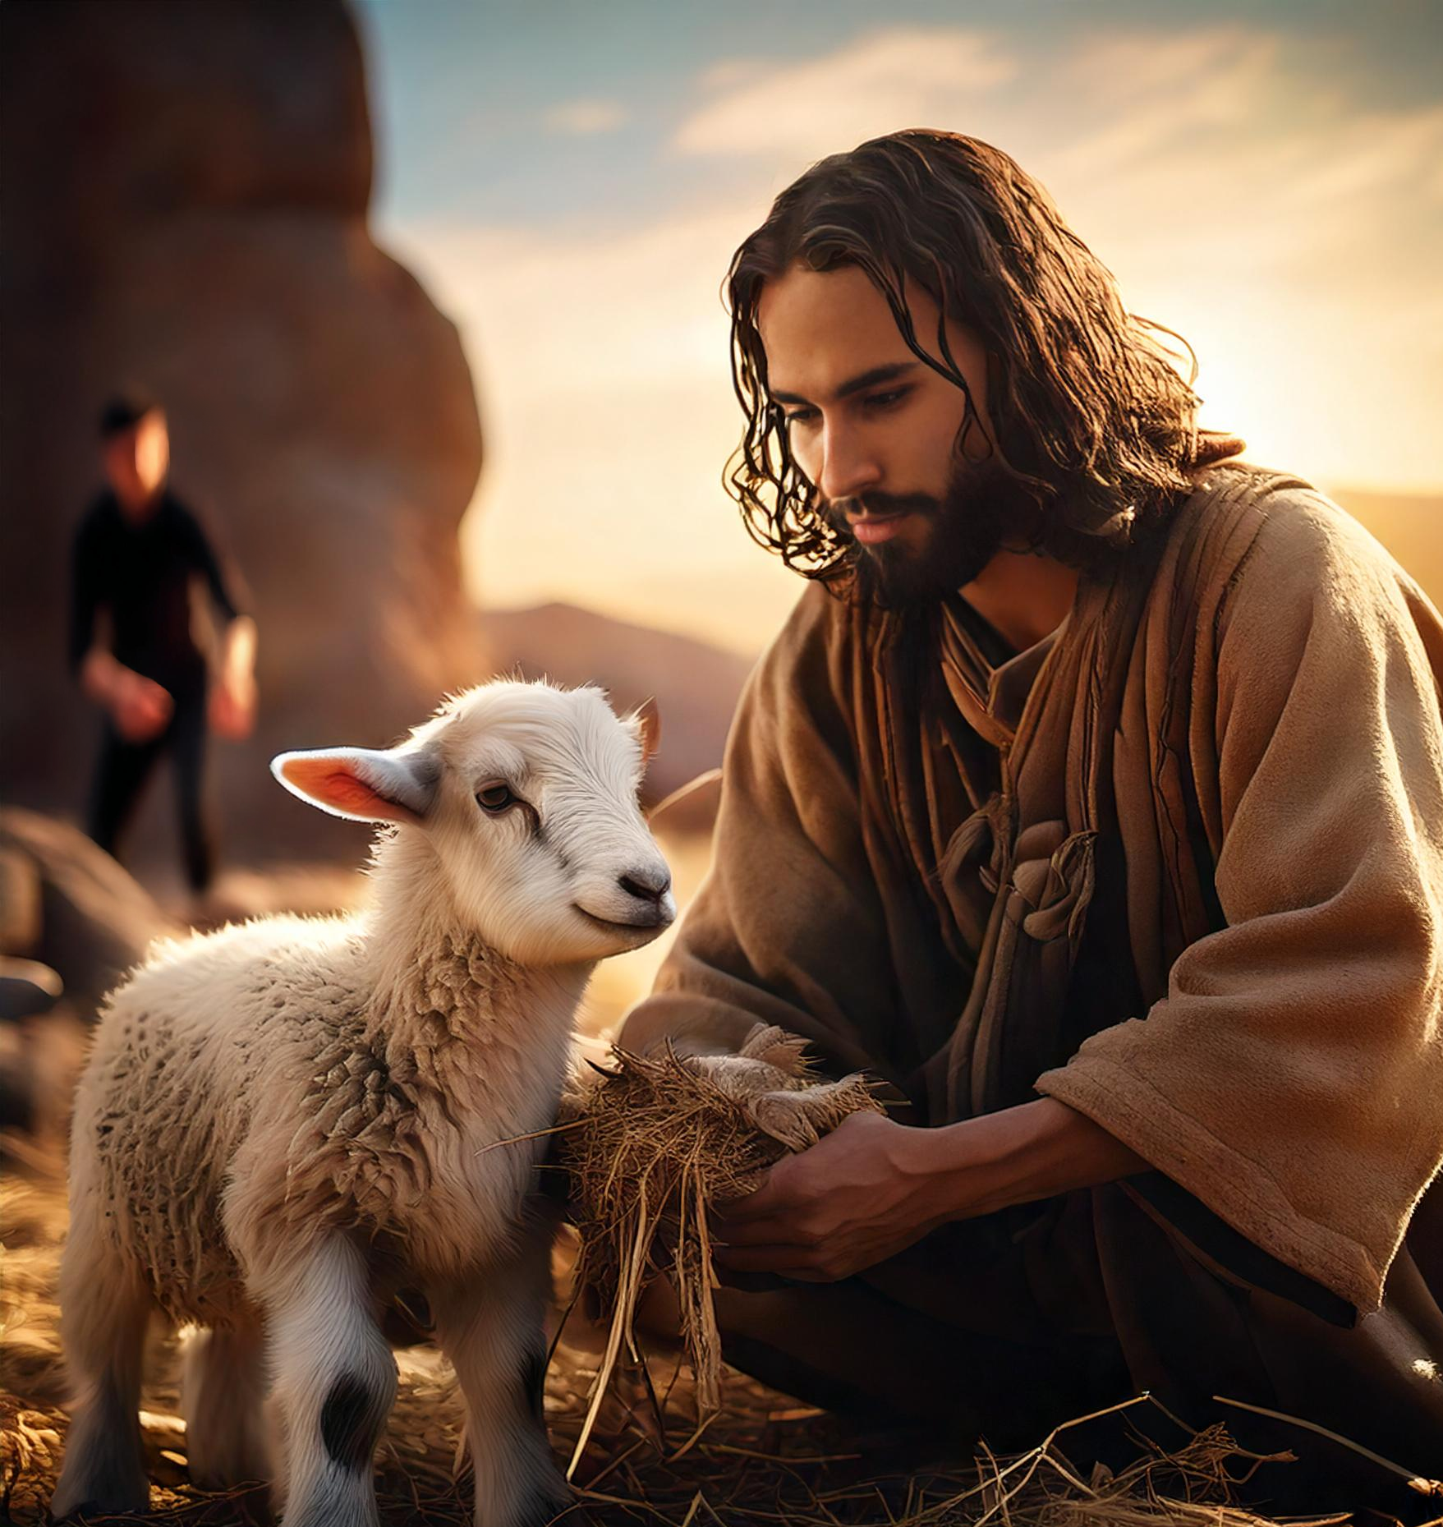
Cain and Abel
In the course of time Cain brought to the LORD an offering of the fruit of the ground, and Abel also brought of the firstborn of his flock and of their fat portions. And the LORD had regard for Abel and his offering, but for Cain and his offering he had no regard. So Cain was very angry, and his face fell (Gen 4:3–5).

Slide 9
The Children of Israel
And he received the gold from their hand and fashioned it with a graving tool and made a golden calf. And they said, “These are your gods, O Israel, who brought you up out of the land of Egypt!” When Aaron saw this, he built an altar before it. And Aaron made a proclamation and said, “Tomorrow shall be a feast to the LORD” (Exod 32:4–5).

Slide 10
Worship involves sacrifice and honor, not manipulation

Slide 11
Thanksgiving VS Manipulation
“Hear, O my people, and I will speak; O Israel, I will testify against you. I am God, your God. Not for your sacrifices do I rebuke you; your burnt offerings are continually before me. I will not accept a bull from your house or goats from your folds. For every beast of the forest is mine, the cattle on a thousand hills. I know all the birds of the hills, and all that moves in the field is mine. “If I were hungry, I would not tell you, for the world and its fullness are mine. Do I eat the flesh of bulls or drink the blood of goats? Offer to God a sacrifice of thanksgiving, and perform your vows to the Most High, and call upon me in the day of trouble; I will deliver you, and you shall glorify me” (Ps 50:7–15).

Slide 12
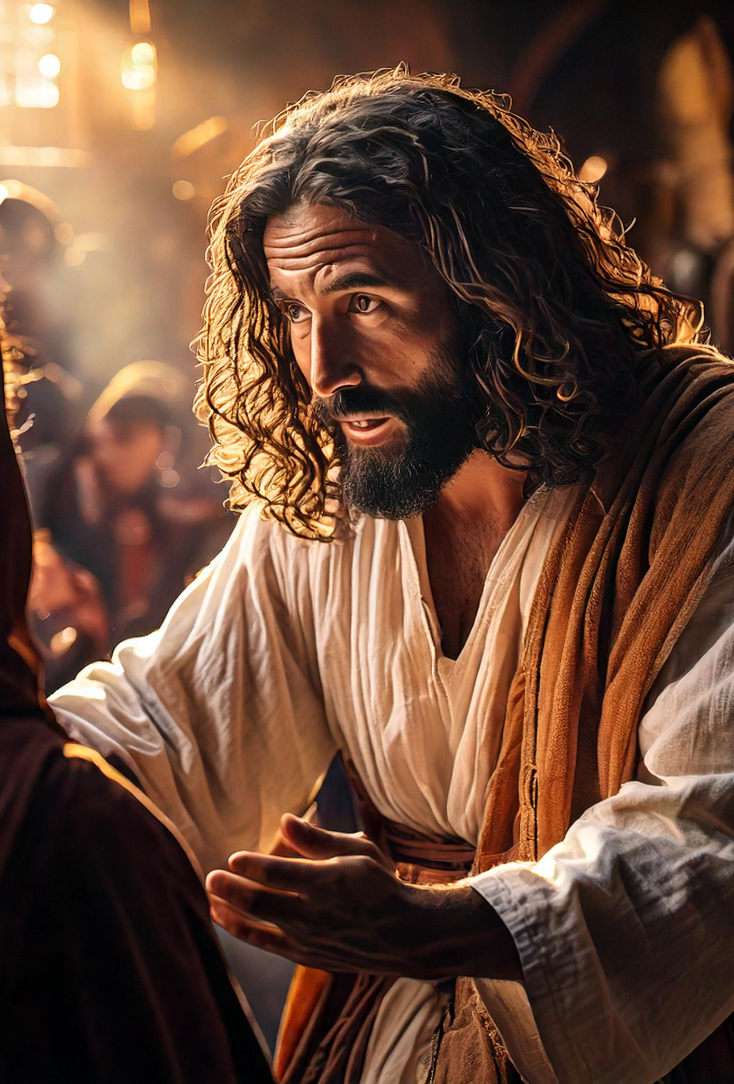
Motivation VS Obligation
This people honors me with their lips, but their heart is far from me; in vain do they worship me, teaching as doctrines the commandments of men (Mt 15:8–9).

Slide 13
Conclusion
Any Christian can avoid improper worship
By following these three concepts

Slide 14
Reasons/ Concepts
Worship is a lifestyle, not an event
Worship is about what God wants, not what we want
Worship involves sacrifice and honor, not manipulation

