Slide 2
“Thou wilt shew me the path of life:
in thy presence is fulness of joy;
at thy right hand there are pleasures
for evermore.”
Ps 16:11

Slide 3
We recently discussed how that finding God’s promised “path of life” (Ps 16:11) requires:
Repentance (Mt 4:17) “Repent:
(metanoe’ō: meta {differently} noe’o: {think})
for the kingdom of heaven is at hand.”
Luke 13:3, 5 “I tell you… except ye repent,
ye shall all likewise perish.”
(apol’lymi: destroy fully, lose)
(See Mt 7:13; Rev. 9:11)

Slide 4
We recently discussed how that finding God’s promised “path of life” (Ps 16:11) requires:
Repentance
“Without faith (pistis: conviction, reliance: from peitho: convince, trust, rely)
it is impossible to please Him.
For he that cometh to God must believe that he is!
And that he’s the rewarder of them
that diligently seek him.”
Faith (Heb 11:6)

Slide 5
This has always been the path to Peace!
Is 55:6-7 “Seek ye the LORD while he may be found, call ye upon him while he is near: (Heb 3:7,15; 4:7)
Let the wicked forsake (ʿāzaḇ: relinguish) his way, and the unrighteous man his thoughts.
and let him return (shûb: restore) unto the LORD,
and he will have mercy upon him;
and to our God, for he will abundantly pardon.”
Ps. 23:3 “He restoreth (shûb) my soul!”
(Repent!)
(Trust!)

Slide 6
In expecting our Repentance and Faith God is in essence asking us to
Elevate (trust) His Holy Revelation
above our Human Reasoning.
Pr. 3:5 “Trust in the Lord with all thine heart;
And lean not unto thine own understanding!
6 In all thy ways acknowledge (yada: know) him,
And he shall direct (Yashar: Prosper) thy paths.”

Slide 7
One of the things that makes such a
“transfer of trust” (from us to God)
particularly difficult is overcoming our past pain, confusion and disappointment.
Most can relate to losing some “dream” and feeling disappointed/disoriented at some point.
This cycle of failure and frustration leaves us distrustful of ourselves, others,
and even our God!

Slide 8
In such seasons the thief of Jn 10:10 comes to convince us to give up on God and faith and make/trust our own way. (Gen. 3:1; James 3:15)
Many of the Psalms reflect the cry of a soul in such a season. (13; 16; 18; 22; 25; 51; 56; 143)
God seems to operate in fairly consistent ways when it comes to redirecting people who have lost their way and their dream.

Slide 9
Ps 32:1-5 “Blessed is he whose transgression is forgiven, whose sin is covered. Blessed is the man unto whom the LORD imputeth not iniquity, ….
When I kept silence, my bones waxed old through my roaring all the day long.
For day and night thy hand was heavy upon me: my moisture is turned into the drought of summer. Selah.
I acknowledged my sin …, and mine iniquity…. I said, I will confess my transgressions unto the LORD;
and thou forgavest the iniquity of my sin. Selah.”

Slide 10
Ps 32:6-8 “For this shall every one that is godly pray unto thee in a time when thou mayest be found:
surely in the floods of great waters
they shall not come nigh unto him.
7 Thou art my hiding place;
thou shalt preserve me from trouble; thou shalt compass me about with songs of deliverance. Selah.
8 I will instruct thee and teach thee
in the way which thou shalt go:
I will guide thee with mine eye.”

Slide 11
God comes to us in our failures, fears,
and frustrations and invites us to
Or to EMBRACE His dreams for us;
even in the midst of our confusion! Jer. 29:11

Slide 12
Let’s look at Ps. 16 for an example of how God grows & guides us toward His Dreams!
It’s a Specific Psalm (Song) of David,
reflecting real life circumstances!
It’s a Symbolic (Prophetic) Psalm
reflecting Jesus’ suffering and Triumph!
Vs 10 “For thou wilt not leave my soul in hell;
neither wilt thou suffer thine Holy One
to see corruption.” (Acts 2:25-31; 13:35-37)

Slide 13
Recognize our (need for) Refuge.
Vs 1 “Preserve me”
A. Whatever the specific circumstances
David was experiencing:
1) He was aware he was under attack!
2) He knew where his hope/help came from!
“O God!” (אֵל‎ {ʾēl}: God 213x; god 16x; mighty 5x)
(fromʾayil: “strength”)
for in thee do I put my trust.” (ḥāsâ’: confidence)

Slide 14
1. Recognize our need. (Refuge) Vs 1
“Preserve me, (Shamar: guard, protect, hedge)
B. Righteousness/obedience brings God’s:
1) Peace (1351x in Bible) Ps. 29:11 “give strength…peace”
2) Partnership (Shalom and Eirene: to join) 1Co 3:9
3) Protection (Hedge) Ps. 34:7; Job 1:8-10
a) Satan can’t breach this without God’s
specific permission/purpose. (Job 1:11-12)
(Gen. 50:20; 1 Cor 10:11; Rom 8:28; James 1:3-5)

Slide 15
Disobedience / Rebellion infects & destroys
that Peace, Partnership, and Protection.
1) This gives Satan ground, influence, & opportunity!
(1 Sam. 15:23; Romans 6:16; Eph. 4:25,26)
2) When we “surrender” to Satan, (Sin)
God removes His hedge, allowing the
consequences of our sin to affect us
in an attempt to bring us to repentance.
Isaiah 5:1-7 5 “I will take away the hedge”
(See Pr. 6:23; 1 Cor. 5:5; Heb. 12:4-15)
and others,

Slide 16
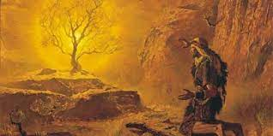
2. Recognize our Resources
A. YHWH; the Holy, Self existing one. Vs 2
“O my soul, thou has said unto the LORD,
(יהוה‎ yhwh) The sacred tetragrammaton.
1) Translated: LORD (6510x) GOD (4X); Jehovah (4x)!
“I AM THAT I AM:
say unto …Israel,
I AM hath sent me
unto you.”
Ex. 3:14

Slide 17
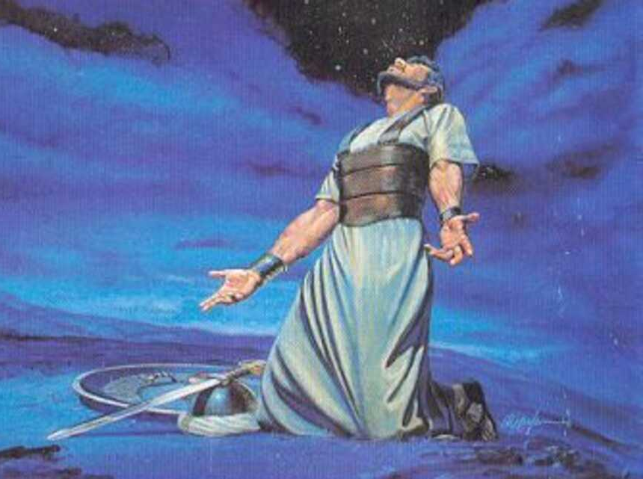
2. Recognize your Resources vs 2
B. Adonay: The Sovereign Lord of all. Vs 2
“I will say to the LORD, thou art my Lord…” (‏אֲדֹנָי‎ {adōnāy’}
1) Translated: Lord 431x;
lord 2x; God 1x
Fromʾādôn: lord 197x
master 105x; Lord 31x

Slide 18
3. Recognize our “Resister” Ps 16:4
A. Satan is the adversary (1 Pt 5:8) who
subtly seeks to get us to transfer our trust
away for our LORD
with devastating (and demonic) consequences!
Ps 16:4 “Their sorrows shall be multiplied that hasten after another god.”
and Lord! (Sovereign)

Slide 19
A. Satan is the adversary (1 Pt 5:8) who
subtly seeks to get us to transfer our trust
away for our LORD
1) 1 Chr 21:1 “Satan (śāṭān: adversary) stood up …,
and provoked (sût: pricked, seduced) David
to number Israel.”
Ex 30:12 “When thou takest the sum of the children of Israel …then shall they give every man a ransom for his soul unto the LORD,
…that there be no plague among them…”
and Lord! (Sovereign)

Slide 20
A. Satan is the Subtle/Seductive adversary
1) 1 Chr 21:1 “Satan (śāṭān: adversary) stood up …,
and provoked (sût: pricked, seduced) David.”
a) This act of prideful disobedience cost the
death of 70,000 Israelites. Vs 14
b) It was ended by repentance and sacrifice. 18 “Then the angel of the LORD commanded Gad to say to David, that David should go up,
and set up an altar unto the LORD in the threshingfloor of Ornan the Jebusite.”

Slide 21
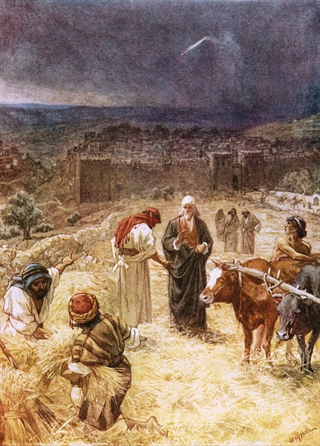
20 “Ornan saw the angel…
23 And Ornan said to David Take it to thee, …I give it all.
24 But David said to Ornan Nay; but I will verily buy it for the full price:
for I will not take that which is thine for the LORD,
nor offer burnt offerings
without cost.”
2 Ch. 21:15-30

Slide 22
Conclusion: Satan still seeks to get us to transfer our trust away for our LORD
Vs 4 “Their sorrows shall be multiplied
that hasten after another god.”*
(aḥēr’: strange {from ʾāḥar’ literally meaning: to loiter, procrastinate})
* “god” is italicized in KJV
and our Lord! (Sovereign)
(aṣṣeb’et: wounds; idols! )

Slide 23
The Old Testament is the record of Israel “hastening after another god”.
(See 1 Cor 10:11.12)
And History is a record of everyone else doing the same!

Slide 24
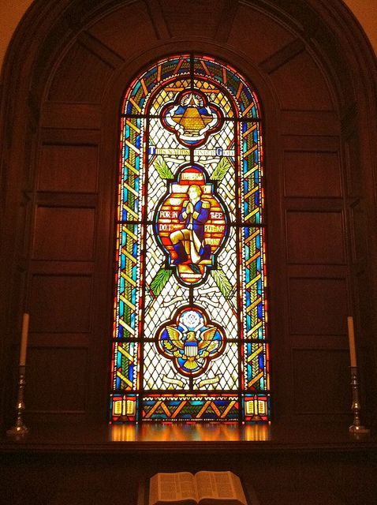
Example: America
US Congressional concurrent resolution #60 1954
“That the Architect of the Capitol is hereby authorized and directed to make available a room,
with facilities for prayer and meditation,
for the use of Members of the Senate and House of Representatives.”

Slide 25
The Great Seal of America
Initiated 7/5/1776
Approved by Congress 1782
Eye of Providence (Pr 15:3; Heb 4:13)
Watching over unfinished pyramid!
An’nuit Coep’tus
(God has favored our undertakings)
Nov’us Or’do Seclo’rum
"A New Order of the Ages"

Slide 26
The Great Seal of America
Top and Bottom
E Pluribus Unum
"Out of Many, One."

Slide 27
“This Nation Under God”
(From Gettysburg address)
Central figure is George Washington Praying in Valley Forge Dec. 1777.
https://www.mountvernon.org/library/digitalhistory/digital-encyclopedia/article/valley-forge/
Ps 16:1 “Preserve me O God,
for in thee do I put my trust!”
Two lower panels show bibles with candles (Ps 119:105)

Slide 28
Capital Chapel
A Bible, usually opened to Psalm 23,
sits on the altar underneath the window.
Two prayer benches, six chairs, plants, two candles and an American flag complete the furnishings in the room.

Slide 29
Application: Ps 16:1 “Preserve me O God,
for in thee do I put my trust.
2 …thou hast said unto the LORD,
Thou art my Lord:
4 Their sorrows shall be multiplied that hasten after another god.”
Which god is America hastening after?
Which are you hastening after?

Slide 30
4 “Sorrows multiplied that hasten after another…
5 The LORD is the portion of mine inheritance and of my cup: thou maintainest my lot.
6 The lines are fallen unto me in pleasant places; yea, I have a goodly heritage.
7 I will bless the LORD, who’s given me counsel:
8 I have set the LORD always before me:
because he is at my right hand,
I shall not be moved.”

Slide 31
8 “I have set the LORD always before me…
9 Therefore my heart is glad, and my glory rejoiceth: my flesh also shall rest in hope.
10 For thou wilt not leave my soul in hell;
neither …suffer thine Holy One to see corruption.
11 Thou wilt shew me the path of life:
in thy presence is fulness of joy;
at thy right hand there are pleasures for ever.”

