Slide 1
Pictures of the People of God
Seeing ourselves through God’s Eyes.

Slide 2
Pictures of God’s People
God’s Word uses parables (analogies) to help us understand Him, His purposes and plans.
Ps 36:9 “in thy light
shall we see light.”
(ôr) Clearly

Slide 3
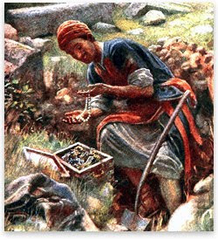
In Mt 13:44 God describes us as A Hidden Treasure!
“The kingdom of heaven is like unto treasure hid in a field;
the which when a man hath found, he hideth, and for joy thereof goeth and selleth all that he hath,
and buyeth that field.”
Agorazo: to redeem

Slide 4
Mt 13:45,46 compares us to “goodly Pearls”!
“The kingdom of heaven is like unto a merchant man, seeking goodly pearls:
(Kalos’: valuable, beautiful, virtuous)
“Who, when he had found one pearl of great price,
(Poly’timos: extraordinary value)
went and sold all that he had, and bought it.”
While Both parables describe the Price of our Redemption;
The Pearl focuses on the Process of our Perfection!

Slide 5
In Jer. 18:1-6 God compares us to Clay!
2 “Arise, and go down to the potter's house,
and there I will cause thee to hear my words…
6 “cannot I do with you as this potter?
Behold, as the clay is in the potter's hand,
so are ye in mine hand”

Slide 6
The Bible repeatedly compares us to Clay.
Gen 2:7 “the LORD God formed man of the dust (ʿāpār: grey dust/clay) of the ground,
and breathed into his nostrils the breath of life;
and man became a living soul.”
Job 10:8-9 “Thine hands have made me
and fashioned me …
thou hast made me as the clay”

Slide 7
The Bible repeatedly compares us to Clay.
“O LORD, thou art our father;
we are the clay,
and thou our potter;
and we all are the work of thy hand.”
Is. 64:8

Slide 8
1. The Purpose Of The Potter:
Perfection! (telios: complete)
A. He sees the finished product!
Jer. 29:11 “I know the thoughts
I think toward you, khaw-shab‘:
to fabricate, regard, purpose, value!
thoughts of peace, and not of evil,
to give you an expected end.”
(tiqwâ: the thing that I long for)

Slide 9
1. The Purpose Of The Potter:
A. He sees the finished product!
1) He begins “with an end in view”
Jer 1:5 “Before I formed thee in the belly I knew thee;
and before thou camest forth out of the womb I sanctified thee,
and I ordained thee a prophet unto the nations.”

Slide 10
1) Begins with an “end” in view. Eph. 2:10 “We are His workmanship, created in Christ unto good works,
which God before ordained that we should walk in them.”
Michelangelo, when asked how he could turn a
large hunk of marble into a beautiful horse replied:
“I Simply cut away everything
that doesn’t look like a horse.”
a) We’re Selected and shaped by design!
(Rev. 4:11) “For thy pleasure they were created…”

Slide 11
B. The “Plotter”: Satan Jn 10:10
1) Fuels Our Resistance/Rebellion To The Potter.
Sin (hamartanō: Missing the mark) is anything
that keeps us from God’s design. (Ro. 14:23)
“for whatsoever is not of faith is sin.”
(a) Sin get’s us “off center” of God’s will.
(b) This usually results in the vessel being
“marred in the hands of the potter.” (Jer. 18:4)
(shāḥat: decayed, ruined)

Slide 12
B. The “Plotter” (Devil)…
2) As long as we’re willing to stay on the wheel and submit to the Potter’s hands, there’s hope
because he can repair or remake us. Jer. 18:4
“so he made it again another vessel,
as seemed good to the potter to make it.”
Jer. 18:6 “cannot I do with you as this potter?”
Jer. 29:11 “I know the thoughts I think toward you … To give you an expected end.” (tiqwâ’: Hope)

Slide 13
2. The Process Of The Potter. (Sanctification: hagiasmos: Purify)
A. Selecting. Jn 15:16 “I have chosen you…”
He searches for the
right type of clay. Lk 19:10
“The son of man is come
to seek and to save,
that which was lost”

Slide 14
2) He pulls us from the “Pit”.
He Removes the “clay” from the mud. Ps 40:2 “He brought me up also out of an horrible pit, (Shāʾôn bôr: destructive dungeon)
out of the miry clay….” ( yâvên’: dregs; mud, mire.)
a) This represents “Salvation”. (Deliverance)
Col. 1:13 “Delivered us from the power of darkness
and translated us into the Kingdom of his son.”
Remember the Pit He found you in?

Slide 15
2. The Process of the Potter
He Cleanses Us. (Miry means muddy!)
Is. 64:8 comes after Is. 64:6!
“We are all as an unclean thing…”
1) He removes the mud from the clay.
a) He does this through His Word. Eph 5:26
“That he might sanctify and cleanse it
with the washing of water by the word”
His Word (Truth/Light) exposes our “mud”!
(deception and darkness) 1 Jn 1:5-9

Slide 16
2. The Process of the Potter
He Cleanses Us. (Miry means muddy!)
1) He Removes the mud from the clay.
b) The Bible calls this Sanctification.
1 Thes. 4:3 “this is the will of God,
even your sanctification”
Hagiasmos’: purification
from hagiazo: to consecrate/separate.

Slide 17
He Cleanses Us. (Miry means muddy!)
2) He removes the rocks/impurities.
a) While water cleanses the mud,
“Working” the clay reveals the impurities.
b) This is a painful process.
(The Pounding & kneading
is necessary
to bring impurities to the surface.)

Slide 18
2) He removes the rocks/impurities.
c) Our painful problems don’t cleanse us;
they reveal what’s inside that must be removed.
(Attitudes, bitterness, selfish motives, anger, pride, etc.)
d) Impurities” not found and removed here
will come out later cause more problems.
Where is selfishness best dealt with:
In children or adults?

Slide 19
2. The Process Of The Potter. A. Selecting. Jn 15:16 B. Cleansing. 1 Jn 1:5-9
C. Shaping. He places the clay
on the wheel and begins to shape it.
1) “Deeper” impurities that weren’t
discovered/ removed earlier
often surface at this stage.
Jer. 18:4 “The vessel that he made
…was marred in the hand of the potter.”
shāḥat: spoiled, ruined

Slide 20
2) We often react or reject the potter’s design and
become “Stiff-necked” in His hands.
Pr. 3:5,6 “Trust in the Lord…lean not unto thine own
understanding….in all thy ways acknowledge Him…”
Ps. 37:5,6 “Trust in the LORD…delight thyself also
in the lord.”
Ps. 37: 23 “The steps of a good man are ordered by
the LORD and he delighteth (ḥāpēṣ) in his way.”
to incline or bend; be pleased with and desire.
aw-nag' to be soft or pliable.

Slide 21
3) God uses many things to “Shape” us!
Ro. 8:28,29 “All things work together (synergeō : work / cooperate with) for good…” (agathos: to benefit)
to them that love God…
who are called according to His purpose.
For whom he did foreknow, he also did predestinate
To be conformed to the image of His son.”
Jms 1:2-5 “The trying of your faith worketh patience”

Slide 22
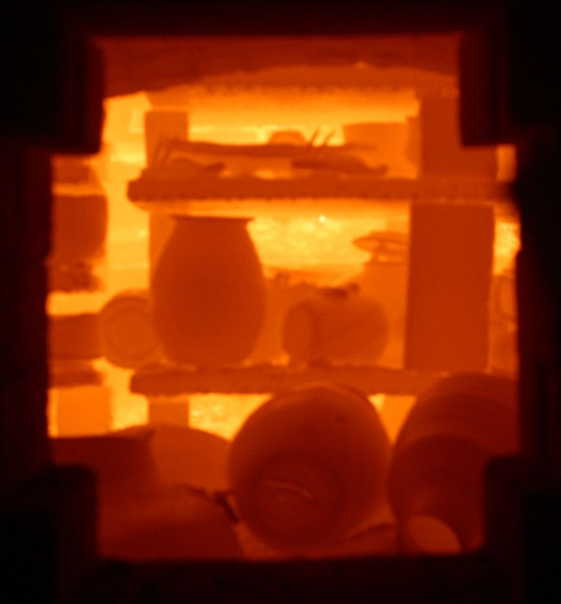
2. The Process Of The Potter.
After He Selects, Cleanses, and Shapes us,
we are still “useless” until we’ve going through
D. Firing.
1) Any impurities that remain will
cause “Cracks” at this point.
2) We’ll be “tempted” to cover our cracks with
“Wax” to hide them. (Sincere!!!)
a) This isolates us from the very sources of help
& grace God intends for us. James 4:6,7

Slide 23
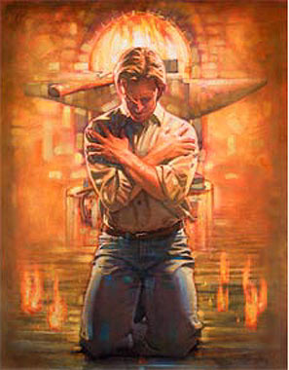
2. The Process Of The Potter.
D. Firing.
3) God uses the “Fire” of pressures, problems,
and “people” to accomplish this.
Is 48:10-11 “I have refined thee…
I have chosen thee in the furnace of affliction.
For mine own sake will I do it…For how shall my name be polluted?”

Slide 24
D. Firing. 1 Pt 1:7
“That the trial of your faith,
being much more precious than of gold that perishes,
though it be tried with fire,
might be found unto praise and honor and glory
at the appearing of Jesus Christ “

Slide 25
2. The Process Of The Potter.
Selecting B. Cleansing C. Shaping D. Firing
E. Painting.
1) God “decorates us” with Grace and Gifts to:
bless others and further His purposes.
2) This may make it (us) more “attractive”
but the value of the vessel is tied to its
Purity and Purpose!

Slide 26
Conclusion: Isaiah 64:8
“O LORD, thou art our father;
we are the clay, and thou our potter;
and we all are
the work of
thy hand.”

Slide 27
If God does the Selecting, Cleansing,
Shaping, Firing, And Painting...
What’s our “Part” in this “Partnership”?
Cooperating!
To stay Pliable. (Ps. 37:5,6)
And Centered in the Wheel. (His Will)
Ro. 12:1,2 “Present your bodies a living
sacrifice, holy, acceptable unto God…”

Slide 28
² And be not conformed to this world:
but be ye transformed
by the renewing of your mind,
that ye may prove what is that good, and acceptable, and perfect, will of God.”
Are you willing to resist the tendency to be
“conformed” to this world?

Slide 29
And Submit to the Transforming Touch of the Master’s Hand?

Slide 30
“Have thine own way, Lord! Have thine own way!
Thou art the potter, I am the clay.
Mold me and make me after thy will,
while I am waiting, yielded and still.
Have thine own way, Lord Have thine own way!
Hold o'er my being absolute sway.
Fill with thy Spirit till all shall see
Christ only, always, living in me!”
Adelaide A. Pollard
1902

