Slide 1
Pictures of the People of God
Seeing ourselves through God’s Eyes.

Slide 2
Pictures of God’s People
Our Perspective is shaped by our Perception.
Our Perception can be poisoned by deception!
Lies that are believed have great power over us.
2 Cor 4:4 “The God of this world blinds the minds…”

Slide 3
That’s why it’s important for us to see ourselves (and others) through God’s eyes!
The Bible reveals many different examples / pictures of how God sees us.
2 Cor. 4:6,7 “God…commanded the light to shine…in our hearts
…we have this treasure in earthen vessels”

Slide 4
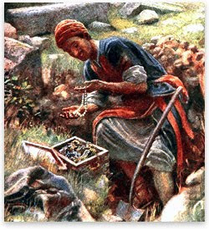
In Mt 13:44 God describes us as:
Pt 1: A Hidden Treasure!
“The kingdom of heaven is like unto treasure
hid in a field;
the which when a man hath found, he hideth,
and for joy thereof goeth
and selleth all that he hath,
and buyeth that field.”

Slide 5
Pt. 2 Goodly Pearls of Great Price!
Mt 13:45,46 “The kingdom of heaven is like unto a merchant man, seeking goodly pearls:
Who, when he had found one pearl of great price,
(Poly’timos: extraordinary value)
went and sold all that he had, and bought it.”

Slide 6
Pt. 3 We’re like clay in the hands of a Master Potter. Jer. 18:1-6
Behold, as the clay is in the potter's hand,
so are ye in mine hand”
Is 64:8 “Lord, thou art our father; we are the clay,
and thou our potter;
We are the work of thy hand.”

Slide 7
Part 4 God uses Marriage to describe our relation to Christ. Eph. 5:22-33
31 “For this cause shall a man leave his father and mother, and shall be joined unto his wife,
and they two shall be one flesh.
This is a great mystery: but I speak
concerning Christ and the church!
This symbolizes both the Intimacy and
Permanency of our relationship to Jesus.

Slide 8
Marriage symbolizes the Intimacy and Permanency of our relationship to Jesus.
Eph. 5: 31 “This is a great mystery: but I speak
concerning Christ and the church!
33 Nevertheless let every one of you in particular
so love his wife even as himself;
(vs 25 “Christ loved the church and gave himself for it”)
and the wife see that she reverence her husband.”
“For the husband is the head of the wife,
even as Christ is the head of the church”

Slide 9
Jesus sees us as His Bride!
This is a common theme of the Bible.
Is 62:4-5 “thou shalt be called Hephzibah, (my delight)
and thy land Beulah: (married)
for the LORD delighteth in thee…and shall be married.
For as a young man marrieth a virgin, …
and as the bridegroom rejoiceth over the bride,
so shall thy God rejoice over thee.”
2 Cor. 11:2 “I have espoused you to one husband,
that I may present you as a chaste virgin to Christ.”

Slide 10
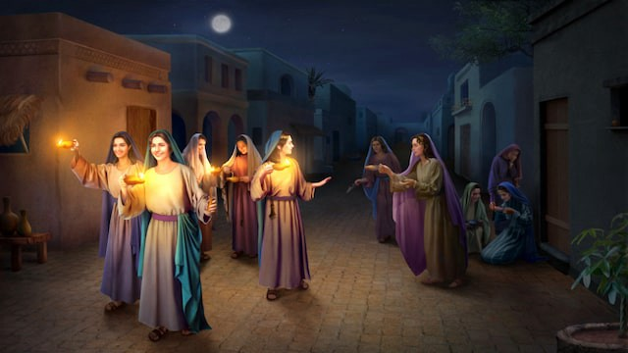
Mt. 25:1-13 “The Kingdom of heaven is like 10 virgins…that went forth to meet the bridegroom”
2 “five were wise”
“five were foolish”
All had an invitation,
but only some made adequate preparation!

Slide 11
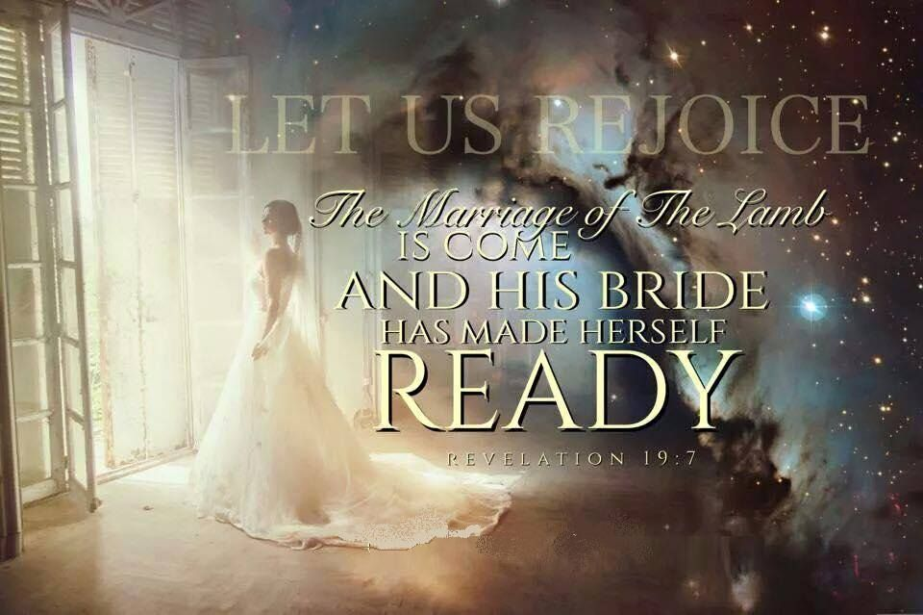

Slide 12
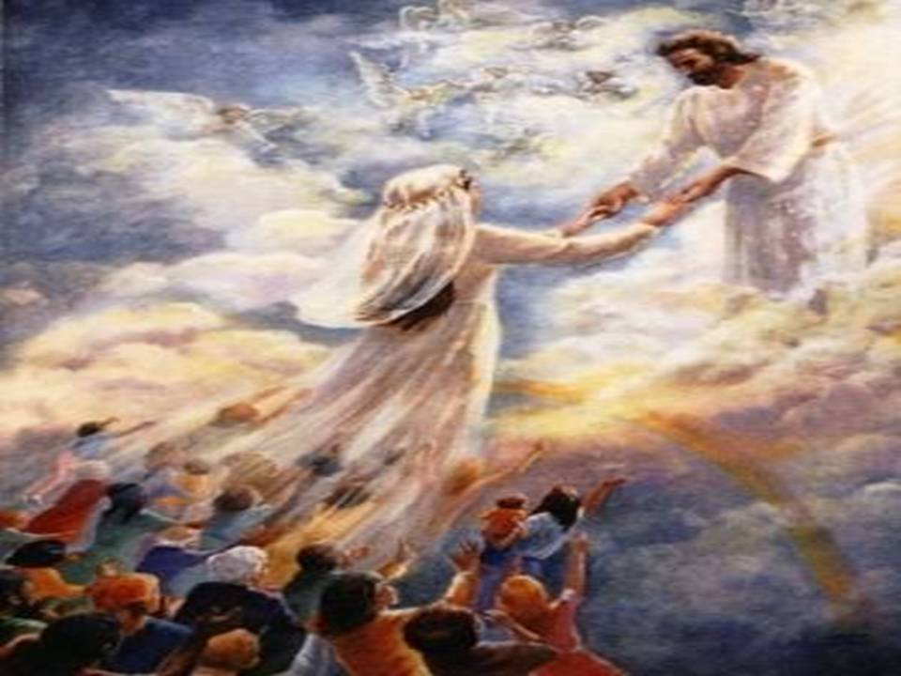
Jesus sees us as His Bride! Eph. 5:32
“This is a great mystery,
but I speak concerning
Christ and the church.”
Rev. 21:9
“Come I will show
thee the bride,
the Lamb’s wife“

Slide 13
How is the Church like a Bride?
Our relationship develops through stages.
1. Dating: Jesus initiates the relationship.
A. He Pursues us!
Jer 31:3 “I have loved thee with an everlasting love:
therefore with lovingkindness have I drawn thee.”
Hosea 11:4 “I drew them …with bands of love”
1 Jn 4:19 “We love him because he first loved us”

Slide 14
Our relationship develops through stages.
1. Dating: Jesus initiates the relationship.
B. The focus is gaining “information”
(about each other.)
Mt. 11:28,29 “Come unto me all ye that are weary
and heavy laden and I will give you rest.
Take my yoke upon you and learn of me.”
1) This “knowledge” becomes the basis of our faith.
2 Pt 1:2 “Grace and peace be multiplied unto you
through the knowledge of God and of Jesus our Lord”

Slide 15
Our relationship develops through stages.
1. Dating: Jesus initiates the relationship.
2. Engagement: Mutual commitment
A. Begins with a Proposal! Jn 3:16
“Whosoever believeth on him”
pisteuō: to credit, entrust, commit!
1) Our response is based on our Faith/Trust in Him!
Ro. 10:10 “With the heart man believeth
unto righteousness”

Slide 16
B. Involves a “Price”. Jn 3:16; Ro. 5:8
1) The Practice (Ex. 22:16,17; Deut. 22:28,29) “He shall surely endow her to be his wife…he shall pay the money
according to the dowry (mohar: bride price) of virgins.”
a) Paid by groom to the Bride’s family based
on the perceived value of the girl.
b) Why does Jesus have to “Buy us”?
Because we belong to another! Eph 2:1-4
Jn 8:44 “Ye are of your father the Devil…”

Slide 17
B. Involves a “Price”. Jn 3:16; Ro. 5:8
2) The Price: Jn 3:16 “God so loved the world,
that he gave his only begotten son”
1 Pt 1:19 “ye were redeemed …with the precious
blood of Christ“
Col 1:13-14 “Who delivered us from the power of darkness,
and translated us into the kingdom of his dear Son:
In whom we have redemption through his blood,
even the forgiveness of sins:”

Slide 18
2. Engagement: Proposal! Involves a “Price”.
C. This makes the relationship “Permanent”
(Legally Binding)
1) Mary became Joseph’s “espoused wife” Lk 1:27; 2:5
2) They were legally “married” (espoused) and could
only end the relationship through divorce. Mt 1:19
3) They were to remain mutually committed yet
sexually pure until the wedding night.
(Usually a year later)

Slide 19
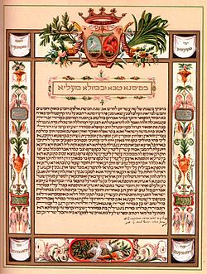
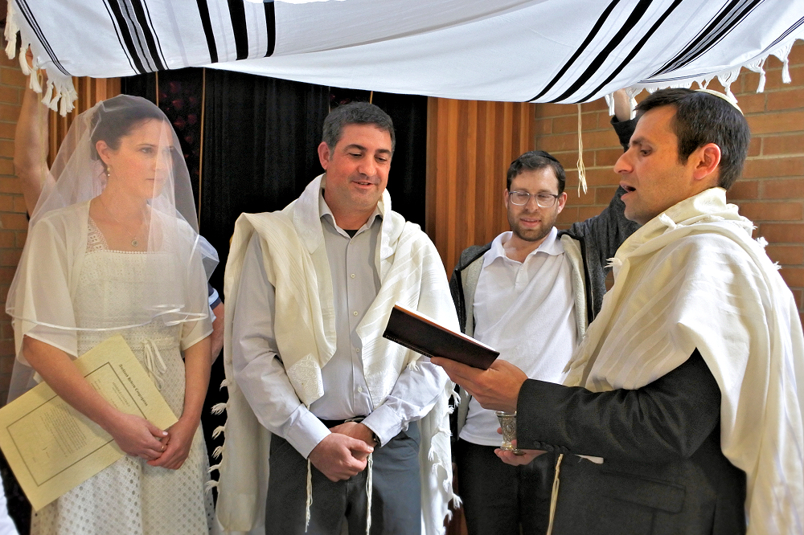
3) This makes the relationship “Permanent”
Jews use the Ketubah in their weddings which acts as a type of “prenuptial” agreement binding the groom to provide for the bride.
This is signed by witnesses and read under the chuppah in front of friends and relatives.

Slide 20
2. Engagement
A. Proposal! B. Involves a “Price”. C. Permanent
D. Preparation: A time for Building the relationship
in Preparation for a future together!
1) The Groom would prepare his home. Jn 14:2
“I go to prepare a place for you”
2) The Bride prepares herself! Rev. 19:7
“His wife hath Made herself ready”
Hetoi’mos: Adjusted, prepared

Slide 21
2) The Bride works to Prepare Herself
Rev. 19:7 “His wife hath Made herself ready”
How does she prepare?
By making some adjustments in:
a) Her attitudes:
1 Cor 13:11-13 “When I was a child,
I spake…understood…though as a child…”
She Thinks differently!

Slide 22
Prepares by making adjustments in:
a) Her attitude: Thinks differently 1Cor. 6:19-20
“know ye not that your body is the temple of the Holy Ghost which is in you, which ye have of God,
and ye are not your own?
For ye are bought with a price: therefore
glorify God in your body, and in your spirit,
which are God’s.”

Slide 23
She Prepares by making adjustments in
b) Her Actions:
(1) She removes or avoids temptations.
Jms 4:4-8 “friendship with the world is enmity with God..
…Draw nigh to God…resist the devil”
1 Pt 2:11 “abstain from fleshly lusts,
which war against the soul”
She Behaves differently!
See also 1 Jn 2:15-17; 28-3:3

Slide 24
She Prepares by making adjustments in
b) Her Actions.
(2) She adds some things to her life.
Mt. 6:20,21 “Lay up for yourselves treasures
(thesaurus: deposits) in (for) heaven.”
Remember “Hope Chests”?
She Behaves differently!

Slide 25
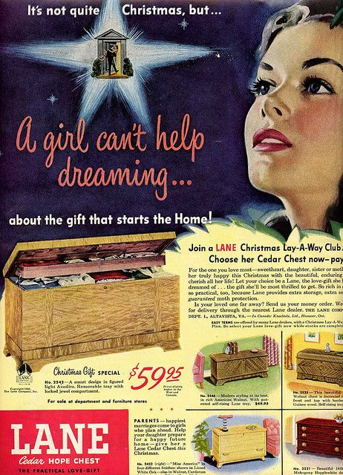
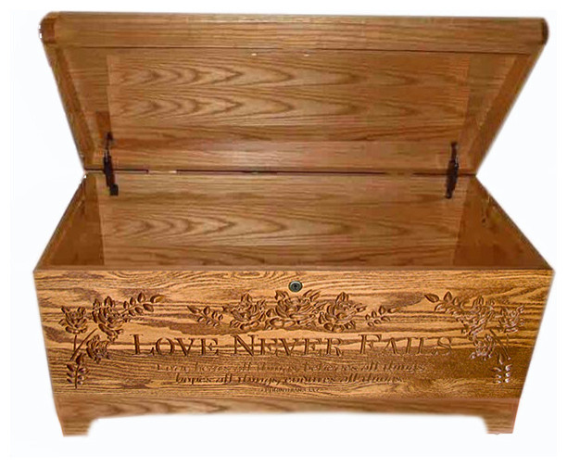
Jer 29:11 “I know the thoughts that I think toward you, saith the LORD, thoughts of peace, and not of evil,
to give you
an expected end.”
Tiqwâ: hope

Slide 26
(3) She prepares her wedding dress.
Rev 19:7 “The marriage of the lamb is come.
His wife hath made herself ready”

Slide 27
Rev. 18:8 “And to her was granted (did’omi: given)
that she should be arrayed
(peribal’lo: clothed, invested)
in fine linen, clean (katharos’: pure)
and white: (lampros’: radiant, magnificent)
for the fine linen is the righteousness
(Dikai’oma: Righteous deeds, decisions)
of saints.” (hagios: sacred, consecrated!)

Slide 28
Conclusion: Engagement involves a:
1) Proposal! 2) Price 3) Permanence 4) Preparation
This is the current stage of our relationship!
2 Cor 11:2 “I have espoused you to one husband, that I may present you as a chaste virgin to Christ.”
That’s why God describes our unfaithfulness to him as spiritual “Adultery!” James 4:4
“Ye adulterers and adulteresses, know ye not that the friendship of the world is enmity with God?”

Slide 29
While Dating is a time for gathering “information”
(about values, integrity, goals, compatibility)
The Engagement period is a time for Building and Binding our hearts together!
Mal. 2:13-16 “she is thy companion, (ḥaber’et)
from ḥābēr’: knit together
and the wife of thy covenant.”
berît: compact

Slide 30
This is our time to prepare for eternity by Building / Binding our relationship to Christ!
Like the fiancé we’re to prepare by
Remembering our Commitment to faithfulness.
Ro. 12:1 “Present your bodies a living sacrifice…”
2) Resisting the pressure to conform to this world.
Ro. 12:2 “Be not conformed to this world” Jms 4:4
Renovating our minds for Him and his purposes
vs 2 “be transformed by the renewing (renovating)
of you minds…”

Slide 31
This is mutually done. 2 Cor 5:20
“be reconciled to God” Katallassō: to change Mutually
Jesus’ part: Eph. 5:26-27 “sanctify and cleanse it (us) with the washing of water by the word,
That he might present it to himself a glorious church,
not having spot, or wrinkle, or any such thing;
but that it should be holy and without blemish.”
Our Part: Cooperating with him through
confession and cleansing. (1 Jn 1:6-9)

Slide 32
Example of this “mutual partnership””
Rev 19:7 “His wife hath made herself ready!
8 “to her was granted that she should be arrayed in fine linen, clean and white:
for the fine linen is the righteousness (Dikai’oma: Righteous deeds, decisions)
of saints.” (hagios:
sacred, consecrated!)

Slide 33
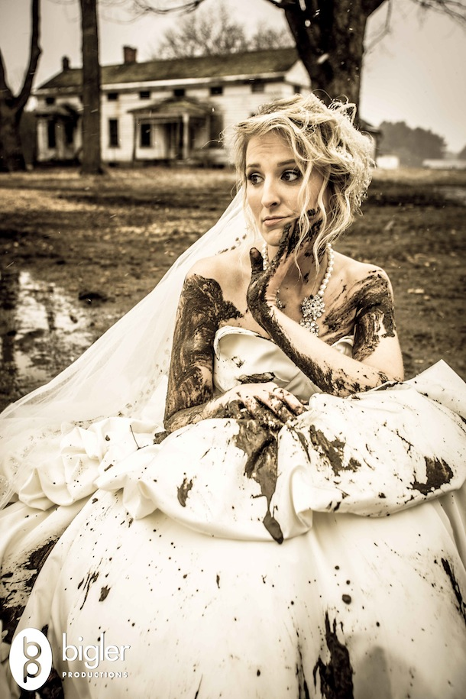
What if we’ve not made ourselves Ready?
1 Jn 2:28-29 “And now, abide in him; that, when he shall appear, we may have confidence,
and not be ashamed before him at his coming.
Aischyn’omai: disgraced!
28 If ye know that he is righteous,
ye know that every one that doeth righteousness is born of him.”
3:3 “Everyone that hath this hope…
Purifyeth himself, even as He is pure.”

Slide 34
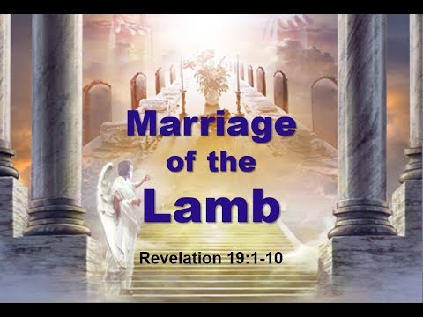
Rev. 22:17 “the Spirit and the Bride
say come.”
Have you responded to His invitation?

Slide 35
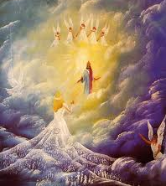
Rev 19:7 “the marriage of the Lamb is come,
and his wife hath made herself ready.”
Rev 22:12“I come quickly; and my reward is with me”
Are you making adequate Preparation for your “Wedding Day?”
Are you making adequate Preparation?

