Slide 1
Is. 58:12 “they that shall be of thee shall build the old waste places: thou shalt raise up the foundations of many generations; and thou shalt be called,
Re-
The repairer of the breach,
The restorer of paths to dwell in.”

Slide 2
Last week we examined God’s “If…Then” pattern that’s woven throughout scripture.
2 Chron. 7:14 “If my people…will humble themselves, pray…seek my face.
Then will I hear…forgive…heal”
Israel’s history (and ours) is full of examples of this pattern unfolding.
(Deut. 28-31; Judges; 2 Chron. 6,7)

Slide 3
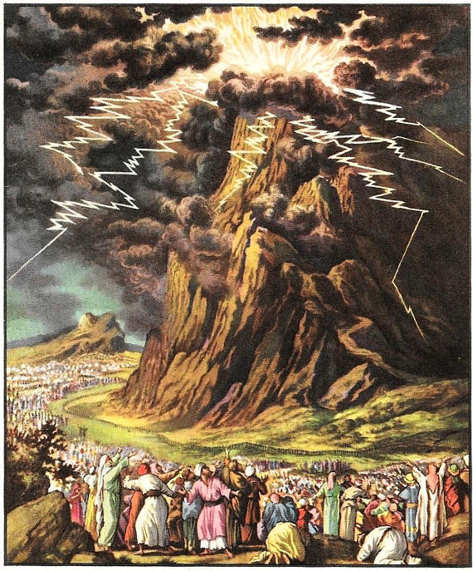
At Mt. Sinai God told Israel: (Ex 19:4-6)
“You’ve seen what I did …, and how I bare you on eagles' wings, and brought you unto myself.
Now therefore, if ye will obey my voice indeed,
and keep my covenant,
then ye shall be a peculiar treasure unto me…
And ye shall be unto me a kingdom of priests,
and an holy (qādôsh: sacred) nation. “

Slide 4
Over the next 1000 years this pattern continued:
When Israel Partnered (with God) ➔
➔Pride ➔ Presumption ➔ Pursue pleasure
This produces inevitable Problems (Ro. 1)
Their problems led to either further rebellion
or recognition and repentance!
Recognition and Repentance led them to:
Prayer ➔ Partnering with God!
And the cycle began again!
Prospered

Slide 5
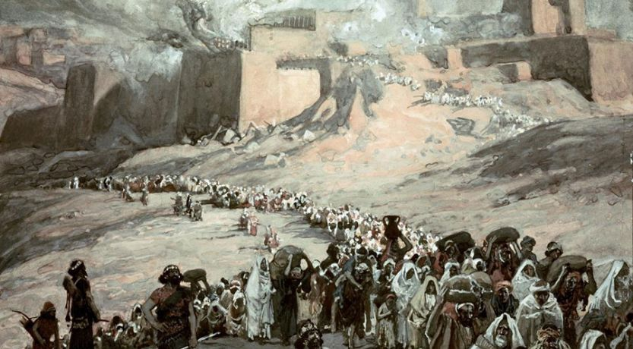

Slide 6
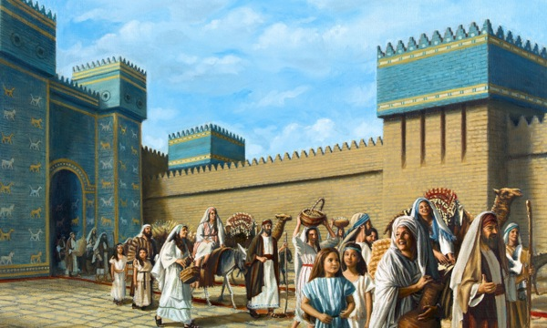
After 70 years, God miraculously moved to give Israel another chance and freedom and blessing.
King Cyrus permitted (and paid) for them to return and rebuild God’s Temple and their lives! Ezra 1
Isaiah 44:28 (200 years earlier) revealed God said:
”of Cyrus, He is my shepherd, and shall perform all my pleasure: even saying to Jerusalem, Thou shalt be built; and to the temple, Thy foundation shall be laid.”

Slide 7
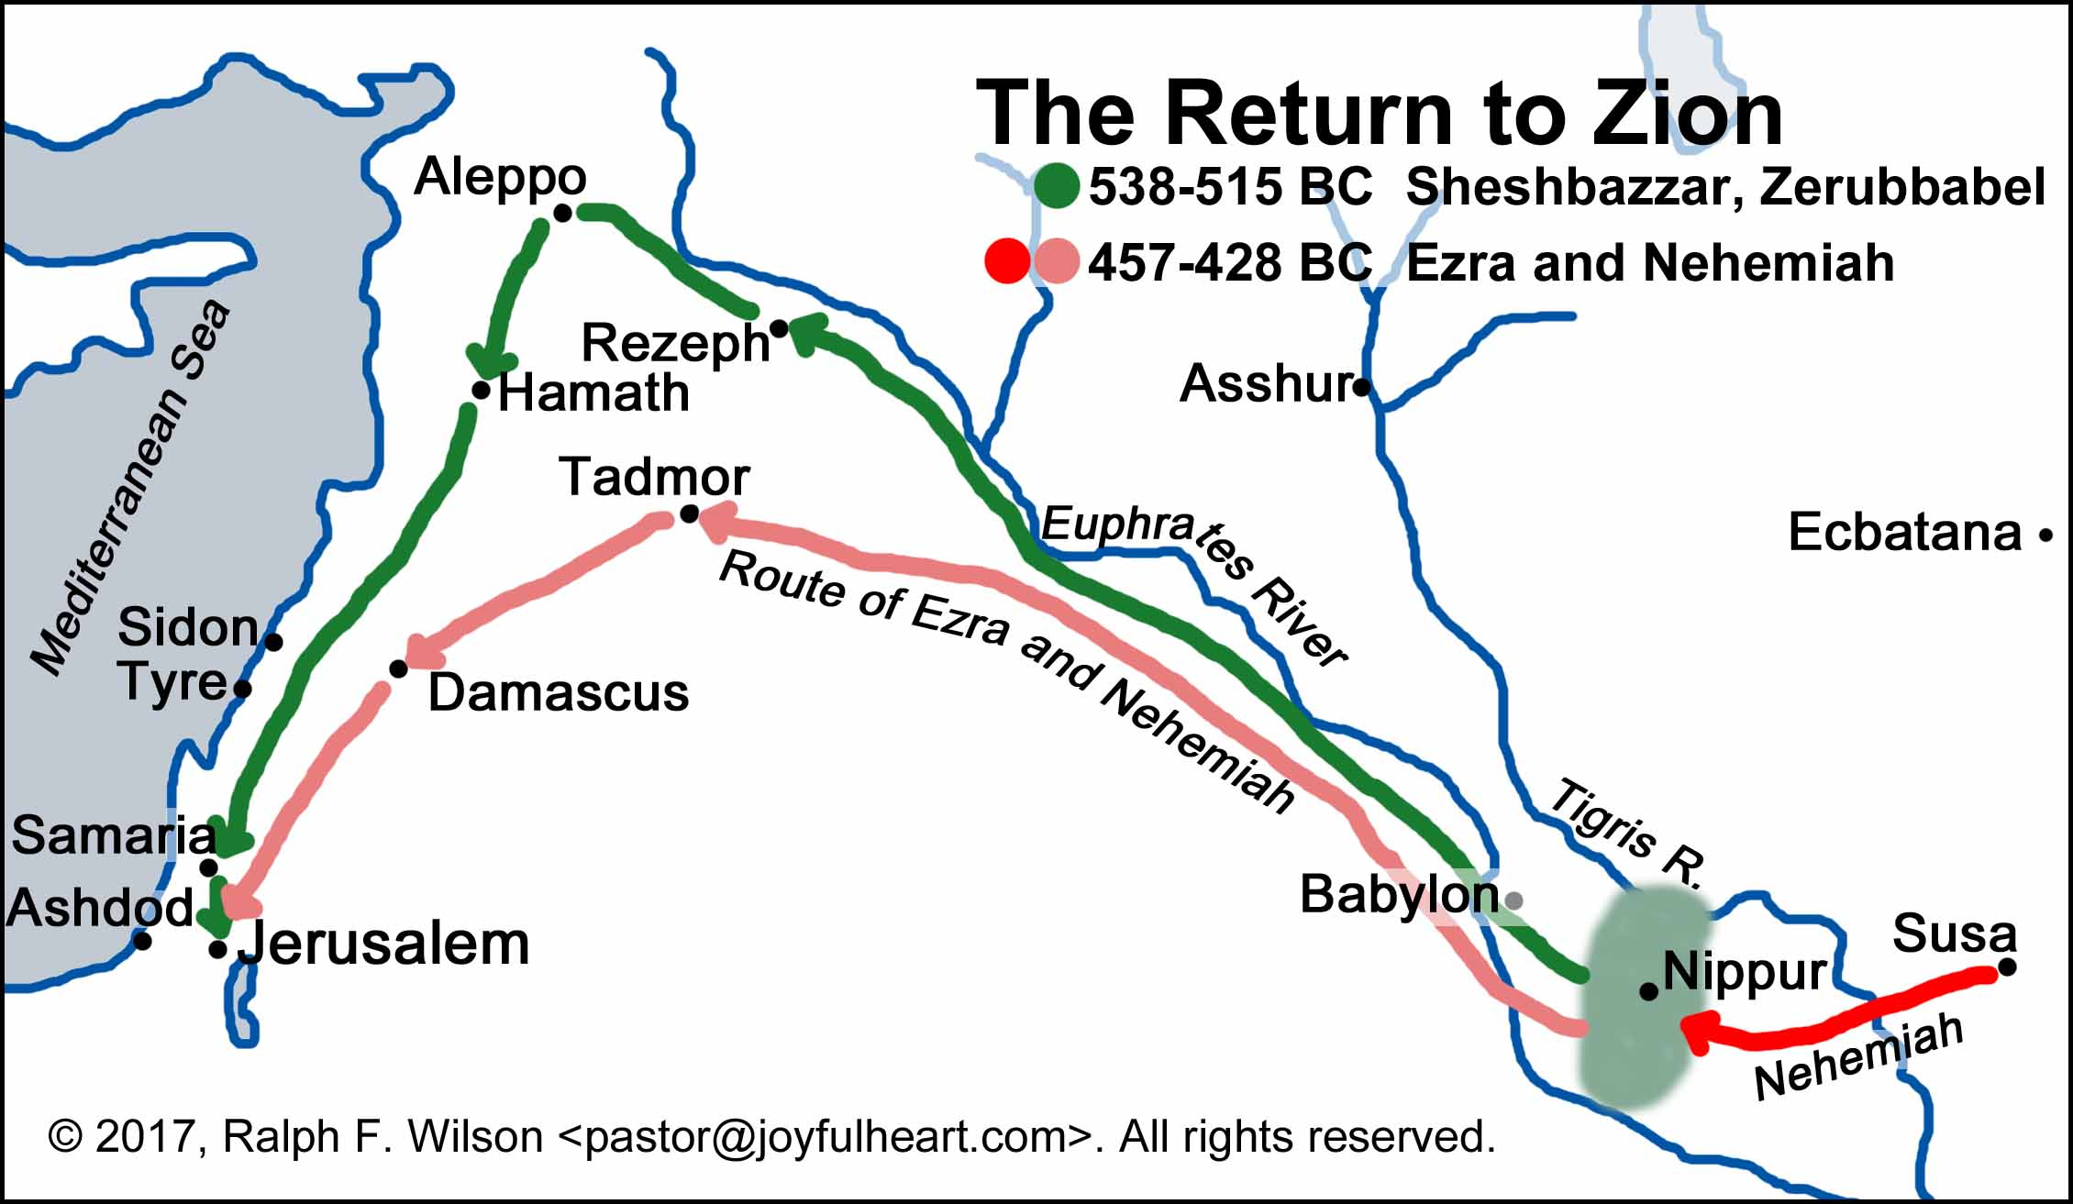
900 miles

Slide 8
1. Those willing to obey partnered with God,
but soon faced the problems of:
A. Discouragement: Ezra 3:12; Haggai 2:3
B. Deception/Infiltration: Ezra 4:1-2
Jude 4 “certain men crept in unwares”
C. Detours (Frustrations): Ezra 4:3-5
“Then the people of the land weakened the hands of the people of Judah, and troubled them in building,
And hired counsellors against them,
to frustrate their purpose”

Slide 9
C. Detours (Frustrations): Ezra 4:3-5
“hired counsellors …to frustrate their purpose”
1) This litigation lasted 15 years!
a) They began a deceptive letter writing
campaign against them. Vs 6-16
b) They saw an opportunity when Cyrus was
replaced by Artaxerxes (Vs 11)
who eventually ordered them to stop building!
(Vs 17-24)

Slide 10
2. They drifted away from God and
toward the pursuit of self interests.
The current is always away from God!
A. Most rationalize their selfish pursuits.
B. God raised up Haggai to challenge them.
Haggai 1:4-5 “Is it time for you, O ye, to dwell in your ceiled houses, and this house lie waste?
Now thus saith the LORD of Hosts;
Consider your ways.”

Slide 11
C. God raised up Zechariah to encourage. Zech. 4:6-9 “This is the word of the LORD unto Zerubbabel, saying, Not by might, nor by power,
but by my spirit, saith the LORD of hosts.
Who art thou, O great mountain?
before Zerubbabel thou shalt become a plain:
The word of the LORD came unto me, saying, The hands of Zerubbabel have laid the foundation of this house;
his hands shall also finish it; and thou shalt know that the LORD of hosts hath sent me unto you.”

Slide 12
3. They eventually stepped out in faith and began to rebuild. Ezra 5:1-2
“the prophets, Haggai and Zechariah, prophesied unto the Jews …in the name of the God of Israel…
Then rose up Zerubbabel, and Jeshua, and began to build the house of God which is at Jerusalem:
and with them were the prophets helping them.”

Slide 13
3. They stepped out in faith and began to rebuild. Ezra 5:1-2
A. This was immediately challenged. Vs 3,4
1) They took their names down. Vs 4
2) This became an opportunity to Witness. Vs 8-16
11 “We are the servants of the God of heaven and earth…”
3) Reported their actions to the King (Darius)
but this time they kept building! (5:5)

Slide 14
3. They stepped out in faith. Ezra 5:1-2
B. Darius (the new King) investigated and
re-authorized the Temple building. Ch. 6
1) He Ordered their enemies to help provide
the building materials and animals! Vs 6-9
2) Asked the Jews to pray for him. 10
3) He threatened any who opposed them. 11
What blessings might we be missing because of our hesitancy to trust and obey God?

Slide 15
4. After the Temple was built, the cycle
toward pleasure & self interest began again.
A. Solomon did this after the first Temple.
1) It took him 7 years to build God’s house,
But 13 to build his own! (1 Kings 6:38-7:1)
1 Kgs 11:1,4 “Solomon loved many strange women,
and his wives turned away his heart after other gods…
And his heart was not perfect with the LORD”

Slide 16
4. They drifted back toward self interest
B. Israel did the same thing! Ezra 9:1-2
“The people …priests, and the Levites, have not separated themselves from the people of the lands,
doing according to their abominations…
For they have taken of their daughters for themselves, and for their sons: so that the holy seed have mingled themselves with the people of those lands:
yea, the hand of the princes and rulers hath been chief in this trespass.”

Slide 17
In prosperity, God’s people had (once again) drifted back toward pride, presumption and the pursuit of pleasure.
C . This went unchecked until Ezra came in 458 BC.
(57 years after the Temple was re-built!)
Ezra 7:6 “Ezra …was a ready scribe in the law of Moses, which the LORD God of Israel had given…
10 For Ezra had prepared his heart
to seek the law of the LORD, and to do it,
and to teach in Israel statutes and judgments.”

Slide 18
Conclusion:
How do we correct this inevitable drift?
Recognize the real problem (sin) Rev. 3:15-18
Repent (of our Part in it). Rev. 3:19
Return to God’s Ways. Rev. 3:20
Realign our priorities (to God’s Plan) Rev. 4:11
Rebuild our lives on His Principles. Rev. 21:7 “blessed is he that keeps the sayings of this book”

Slide 19
Example of this process in Ezra.
Recognize the real problem. Ezra 9:3-4
“And when I heard this thing, I rent my garment and my mantle, and plucked off the hair of my head and of my beard, and sat down astonied.
Then were assembled unto me every one that trembled at the words of the God of Israel, because of the transgression of those that had been carried away”

Slide 20
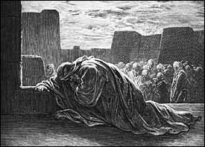
Example of this process in Ezra.
Recognize the real problem. Ezra 9:3-4
“because of the transgression of those that had been carried away; … I sat astonied.”
Shāmēm’: stunned, devastated, amazed!
Do we still “tremble at the words of God”?
Are we “astonished” at the sin around us?
What did Ezra see that most others didn’t?
Why did he see it (their sin) so clearly?
What did he do about it?

Slide 21
What did Ezra do about it?
2. Repent (compunction, reconsideration)
a) Ezra cared. 9:3-5 “rent my garment, plucked hair”
10:1 “weeping and casting himself down before God”
and prayed. 9:5-15 “spread out my hands to the Lord”
He couldn’t affect change,
James 5:16 “Confess your faults …and pray…
The effectual fervent prayer of a righteous man availeth much.”
but God could! (2 Tim. 2:24-26)

Slide 22
Remember God’s if-then promise of 2 Chr. 7:14?
b) God brought deep conviction!
10:1,2 “Now when Ezra had prayed, and when he had confessed, weeping and casting himself down … God;
there assembled unto him out of Israel a very great congregation of men and women and children:
for the people wept very sore. (conviction!)
We have trespassed against our God, and have taken strange wives of the people of the land:
“yet now there is hope in Israel concerning this thing.”

Slide 23
2 Ch. 7:14 “if my people…then will I…”
Remember…Repent
3. Return to Him and Receive His pardon. 10:3
“Now therefore let us make a covenant with our God
to put away all the wives, and such as are born of them, according to the counsel of my lord, and of those that tremble at the commandment of our God;
and let it be done according to the law.”

Slide 24
Remember…Repent… Return
4) Realign our priorities. 10:10-12
“Ezra …said unto them, Ye have transgressed, and have taken strange wives, to increase the trespass of Israel.
Now therefore make confession unto the LORD God,
and do his pleasure: and separate yourselves from the people of the land, and from the strange wives.
Then all the congregation answered and said with a loud voice, As thou hast said, so must we do.”

Slide 25
Remember…Repent… Return… Realign
5) Rebuild our lives on God’s principles.
The book of Ezra ends (10:44) with:
“All these had taken strange wives: and some of them had wives by whom they had children.”
They certainly felt bad about it, but there’s no record of what they actually did about it!
As a result, Nehemiah had to deal with this problem over a decade later. (Neh. 13)

Slide 26
Application: In order to rebuild a godly legacy we too must:
1. Recognize: Drift in our lives and its consequences. Re 2:5
2. Repent: Care and really Pray. (2 Chr 7:14)
3. Return to God and receive His pardon. 1 Jn 1:9
4. Realign our priorities. (Ro. 12:1,2)
5. Rebuild our lives on the foundation of God’s
Word and Will. (Mt. 7:24-27)

Slide 27
”I call heaven and earth to record this day against you, that I have set before you life and death, blessing and cursing:
therefore choose life, that both thou and thy seed may live:”

Slide 28
Vs 20 “That thou mayest love the LORD thy God…
obey His voice…cleave unto Him;
for He is thy life…”
Re-

