Slide 1
Setting the Stage
for the Last Days.

Slide 2
In the context of a Civil Crisis in Israel
1 Chron. 12:32 reveals:
“the children of Issachar…
had understanding of the times…
to know what Israel ought to do”
Do we have a good:
“understanding of (our) times?”

Slide 3
God’s word provides many clues about what the last generation will “look like”.
Spiritual “falling away”. 1 Tim. 4:1; 2 Tim. 4:3,4; 2 Thes. 2:3
2) A great “Moral” decay. 2 Tim. 3
3) Increase of Wars. Mt. 24:6; Rev. 5
4) Centralized Government. Rev. 13; Dan 2,7
5) Centralized Religion. Rev. 13:12
6) Centralized Currency. Rev. 13:16,17
7) Increased Deception. 2 Thes. 2:9-11

Slide 4
There are powerful forces at work
(Eph. 6:12; Rev. 12:12; 2 Thes. 2)
to move us toward this end.
Satan has been actively using “men, methods, and means” to help set the stage for the last days. 2 Tim. 3:12
“evil men and seducers shall wax worse and worse,
deceiving, and being deceived.”

Slide 5
Marxists base their strategies on Sun Tzu’s
"Art of War“:
when we are near, we must make the enemy believe
we are far away…”
The ultimate victory is to win without firing a shot.
Instead of attacking the U.S. at its strength,
(our Military)
They attack us through our vulnerabilities:
(our Liberties!)
“All war is deception…

Slide 6
Attacks on American/Biblical Values:
1848: Communist Manifesto:
"The first requisite for the happiness of the people is the abolition of religion.“ Karl Marx
1859: Origin of the Species. Charles Darwin
1869: Revolutionary Catechism. Sergey Nechayev
1889: “Gospel of Wealth” Andrew Carnegie:
“a cadre of millionaires should preside over the government, as a ‘beneficent necessity’ of human evolution.”
1903 “Pilgrim Society” (Here and Everywhere)

Slide 7
Attacks on American/Biblical Values:
1920: Formation of the ACLU. Roger Baldwin
1925: Scopes “Monkey Trial”
1933: Humanist Manifesto 1
1958: “The Naked Communist” W. Cleon Skousen
1962: Supreme Court removed God from school
1971: Rules for Radicals. Saul Alinsky
1973: Abortion legalized.

Slide 8
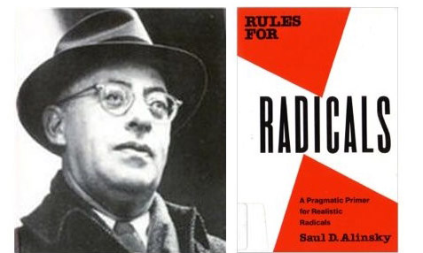
In his 1971 book dedication
“Lest we forget at least an …acknowledgment to the very first radical…known to man who rebelled against the establishment and did it so effectively that he at least won his own kingdom-
Lucifer”
Saul Alinsky

Slide 9
1. His Radical Philosophy
“The first step in community organization is community disorganization.
The disruption of the present organization is the first step toward community organization.
Present arrangements must be disorganized if they are to be displace by new patterns….
All change means disorganization of the old
and organization of the new.” S. Alisky
#23 of the Marxist Revolutionary Catechism.
https://usactionnews.com/2010/03/saul-alinsky-strategy-was-taught-by-obama/

Slide 10
“A Marxist begins with his prime truth that all evils are caused by the exploitation of the proletariat (workers) by the capitalists.
From this he logically proceeds to the revolution to end capitalism, then into the third stage
reorganization into a new social order of the dictatorship of the proletariat,
and finally the last stage —
the political paradise of communism.” S. Alinsky
#22 of the Marxist Revolutionary Catechism.
https://usactionnews.com/2010/03/saul-alinsky-strategy-was-taught-by-obama/

Slide 11
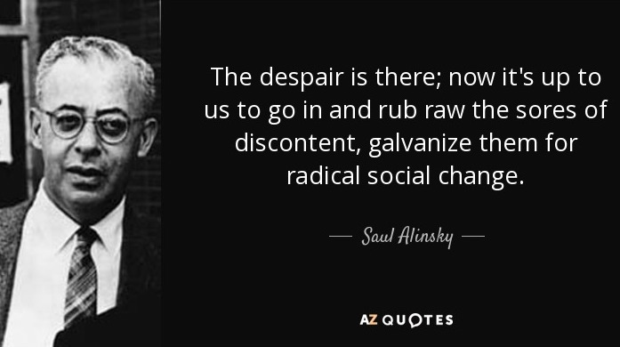
“the Society will use all its resources and energy toward increasing and intensifying the evils and miseries of the people until at last their patience is exhausted and they are driven to a general uprising.”
Revolutionary Catechism 22

Slide 12
“The organizers first job is to create the issues or problems…The organizer must first rub raw the resentments of the people of the community;
fan the latent hostilities of many of the people to the point of overt expression.
He must search out controversy and issues, rather than avoid them, for unless there is controversy people are not concerned enough to act. . . .
He must stir up dissatisfaction and discontent.”
Saul Alinsky
https://www.azquotes.com/quote/686733

Slide 13
“There’s another reason for working inside the system. Dostoevsky said that taking a new step is what people fear most. Any revolutionary change must be preceded by a passive, affirmative, non-challenging attitude toward change among the mass of our people.
They must feel so frustrated, so defeated, so lost, so futureless in the prevailing system that they are willing to let go of the past and change the future.
This acceptance is …essential to any revolution.”
https://www.brainyquote.com/quotes/saul_alinsky_745525

Slide 14
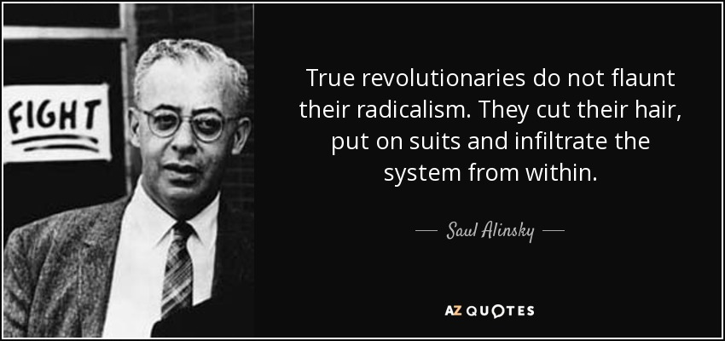
https://www.azquotes.com/quote/823473
This is right out of Sergey Nechayev 1869
The Revolutionary Catechism

Slide 15
1869 Revolutionary Catechism
13. “The revolutionary enters the world of the State,
of the privileged classes, …only for the purpose of bringing about its speedy & total destruction.
14. “Aiming at implacable revolution, the revolutionary may and frequently must live within society while pretending to be completely different from what he really is, for he must penetrate everywhere,
into all the higher and middle-classes, into the houses of commerce, the churches, … into the worlds of the bureaucracy and literature and the military”

Slide 16
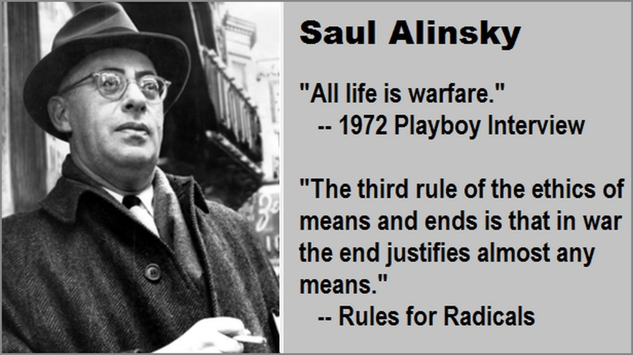

Slide 17
2. How effective was Alinsky’s approach?
A. Hillary (Clinton) wrote her college thesis on His methods.
https://www.economicpolicyjournal.com/2013/04/hillary-clintons-1969-thesis-on-saul.html

Slide 18
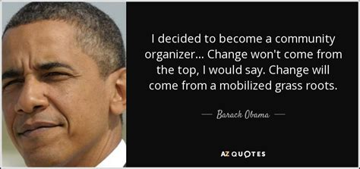
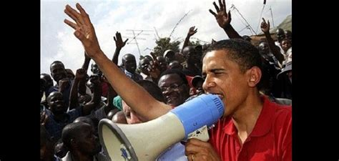
How effective was Alinsky’s approach?

Slide 19
“Barack Obama's training in Chicago by the great community organizers is showing its effectiveness.
It is an amazingly powerful format, and the method of my late father always works to get the message out and get the supporters on board.
When executed meticulously and thoughtfully,
it is a powerful strategy for initiating change and making it really happen.
Obama learned his lesson well.

Slide 20
I am proud to see that my father's model for organizing is being applied successfully beyond local community organizing to affect the Democratic campaign in 2008.
It is a fine tribute to Saul Alinsky …”
L. David Alinksy
In a letter to the editor of The Boston Globe published on August 31, 2008
about the Democratic National Convention

Slide 21
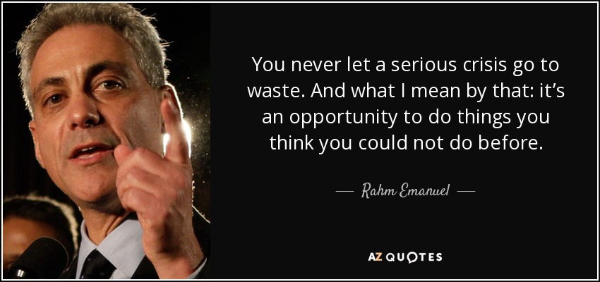
President Obama’s chief of staff.

Slide 22
Based on “Rules for Radicals” Columbia University Socialists Richard Cloward and Frances Piven devised the “Cloward-Piven Strategy” which effectively hastens the fall of Capitalism
by overloading the government bureaucracy with a flood of impossible demands,
pushing society into crisis and economic collapse.
Aka: “Fundamentally transform America!”
https://oathkeepers.org/2018/11/cloward-piven-strategy-explained/

Slide 23
C. The “Cloward-Piven Strategy” 1966
1) Control healthcare and you control the people.
2) Increase the Poverty level as high as possible,
poor people are easier to control and will not fight back if you are providing everything for them to live.
3) Increase the debt to an unsustainable level.
That way you are able to increase taxes,
and this will produce more poverty.

Slide 24
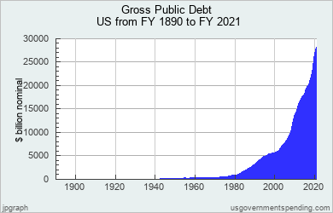

Slide 25
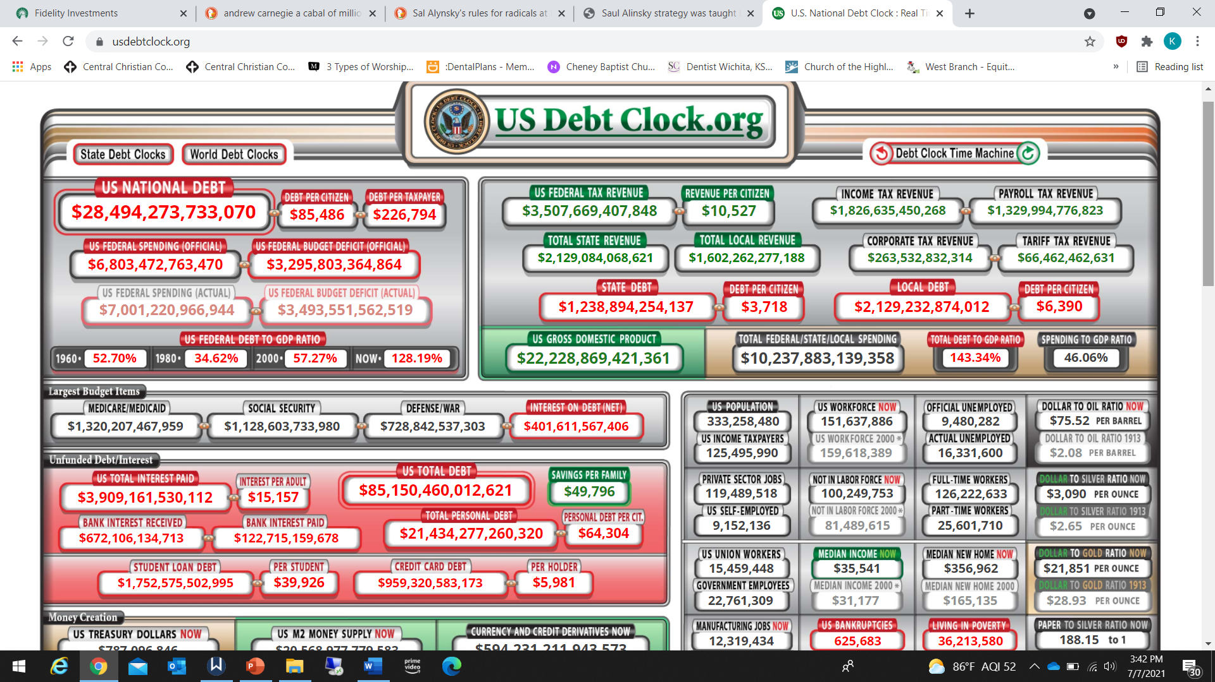

Slide 26
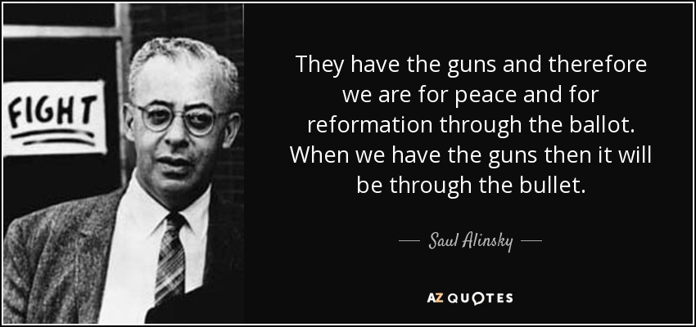
Remove the ability to defend themselves from the Government.
That way you are able to create a police state.
When we have the guns,
then it will be
through the bullet.
https://www.azquotes.com/quote/686713

Slide 27
The “Cloward-Piven Strategy” 1966
5) Take control of every aspect of their lives.
Welfare (Food, Housing, and Income)
6) Control what people read and listen to….
of what children learn in school.
7) Remove the belief in the God from schools.

Slide 28
“Of all the dispositions and habits which lead to
political prosperity,
religion and morality are indispensable supports.
In vain would that man claim the tribute of patriotism, who should labor to subvert these great pillars….
Whatever may be conceded to the influence of refined education on minds …reason and experience both forbid us to expect that national morality can prevail
in exclusion of religious principle.”
George Washington’s farewell address. 1796

Slide 29
The “Cloward-Piven Strategy” 1966
8) Divide the people into the wealthy and the poor.
This will cause more discontent and it will be easier to take (Tax) the wealthy with the support of the poor.
Despite making up the largest portion of the workforce, millennials (25-40) controlled just 4.6% of U.S. wealth.
Baby boomers control over 53%.
Which age group is rioting?
https://www.cnbc.com/2020/10/09/millennials-own-less-than-5percent-of-all-us-wealth.html

Slide 30
https://gsiexchange.com/fine-print-from-bidens-plan-reveals-a-bizarre-detail/?utm_source=feedbolt&utm_medium=email&utm_campaign=dailynews&utm_content=blogpost

Slide 31
2. Alinsky’s methods are active today!
D. “BLM co-founder Patrisse Cullors said …that she and her fellow organizers are “trained Marxists” –
making clear their movement’s ideological foundation.
Cullors, 36, was the protégé of Eric Mann,
former agitator of the Weather Underground domestic terror organization,
and spent years absorbing the Marxist-Leninist ideology that shaped her worldview.”
(Remember Bill Ayers?)
https://nypost.com/2020/06/25/blm-co-founder-describes-herself-as-trained-marxist/

Slide 32
“The Weather Underground stepped forward in 1969, inspired by communist ideologies and embracing violence and crime as a way to protest the Vietnam War, racism, and other left-wing aims.
“Our intention is to disrupt the empire ... to incapacitate it, to put pressure on the cracks,”
claimed the group’s 1974 manifesto, Prairie Fire.
By 1975 the group had claimed credit for 25 bombings—including the U.S. Capitol, the Pentagon, California Attorney General’s office, and New York City police station”
https://www.fbi.gov/history/famous-cases/weather-underground-bombings

Slide 33
E. FBI informant Larry Grathwohl penetrated Ayers’ Weather Underground Organization and later wrote:
“I asked, well, what's going to happen to those people that we can't re-educate; that are die-hard capitalists?
And the reply was that they'd have to be eliminated!
I want you to imagine sitting in a room with 25 people, most of which have graduate degrees from Columbia and other well-known educational centers, and hear them figuring out the logistics for the elimination of 25 million people.
And they were dead serious.”
“Bringing Down America: An FBI informer with the Weathermen” Arlington House, 1976

Slide 34
The New York Times of September 11, 2001, reporter Dinitia Smith noted that Ayers had allegedly summed up the Weatherman philosophy into the following:
“Kill all the rich people. Break up their cars and apartments. Bring the revolution home, kill your parents, that's where it's really at.”
In spite of his violent history, legal charges were dropped and he became an Author,College professor and vice president for Curriculum studies by the American Educational Research Association.
Dinitia Smith, No Regrets for a Love Of Explosives; In a Memoir of Sorts, a War Protester Talks of Life With the Weathermen, The New York Times, September 11, 2001

Slide 35
Conclusion: In the context of a Civil Crisis in Israel 1 Chron. 12:32 reveals:
“the children of Issachar…
had understanding of the times…
to know what Israel ought to do”
Do we have “Understanding of the times”
Do we know what to do?

Slide 36
Application: Eph 5:6-18
“Let no man deceive you with vain words: for because of these things cometh the wrath of God upon the children of disobedience.
Be not ye therefore partakers with them.
For ye were sometimes darkness,
but now are ye light in the Lord:
walk as children of light:”

Slide 37
Eph 5:9-11 “ (For the fruit of the Spirit is in all goodness and righteousness and truth;)
10 Proving what is acceptable unto the Lord.
11 And have no fellowship (partnership)
with the unfruitful works of darkness,
(By your vote, support, or silence!)
but rather reprove them.
Elen’cho: convince, convict, admonish.

Slide 38
Eph 5:13 “But all things that are reproved are made manifest by the light:”
¹⁴ Wherefore he saith,
Awake thou that sleepest,
and arise from the dead,
and Christ shall give thee light.”

Slide 39
Eph. 5: 15-16 “See then that
ye walk circumspectly,
not as fools, but as wise,
(Sophos: clear)
¹⁶ Redeeming the time,
(Exagoraz’ō: rescue from loss)
(Kairos: opportunity
because the days are evil.”
(akribōs’: straight, exact)
Poneros’: hurtful, diseased!

Slide 40
Eph. 5:17,18
“ Wherefore be ye not unwise,
but understanding what
the will of the Lord is.
And be not drunk with wine,..;
but be filled with the Spirit”
Pleroo: furnished, equipped, influenced

Slide 41
Will you allow God to furnish, equip and influence you for the challenges ahead,
so He can use you to help furnish, equip and influence others?
Mt 5:13-17

