Slide 1
“Thou shalt remember all the way which the LORD thy God led thee” Deuteronomy 8:2

Slide 2
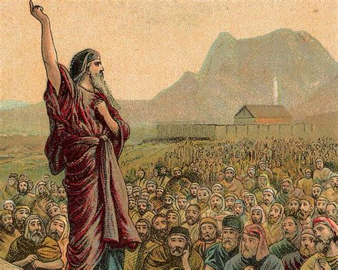
Deuteronomy (Hebrew) means:
“These are the Words.”
In Greek: “Second Law” (Remember)
It presents an interesting balance between
Reflection (of the Past)
and Direction
(for the future.)

Slide 3
After delivering them from slavery, God led Israel to Mt. Sinai:
Ex 19:4-6 “Ye have seen what I did …and how I bare you on eagles' wings, and brought you unto myself.
5 Now therefore, if ye will obey my voice indeed, and keep my covenant, (berît: compact)
then ye shall be a peculiar treasure unto me …:
6 And ye shall be unto me a kingdom of priests, and an holy nation…” (See Dt 30:15-20)

Slide 4
After a year of Demonstration
(of God’s Power and Provision)
and Instruction (in God’s Principles)
God led them to the brink of the promised land,
but they lacked the faith to enter. (Nu. 13,14)
Because they failed to learn & apply the many lessons of faith during that first year,
They rebelled against God’s direction
With tragic results!

Slide 5
The Psalmist reflected on this choice and applied it to all faith failures.
Ps. 95:5-8 “O come, let us worship and bow down:
let us kneel before the LORD our maker. For he is our God; and we’re the people of his pasture…
7 To day if ye will hear His voice,
8 Harden not your heart, as in the provocation,
and as in the day of temptation in the wilderness:”
See also Hebrews 3,4

Slide 6
9 “When your fathers tempted me, proved me, and saw my work.
10 Forty years long was I grieved (qûṭ: cut off)
with this generation, and said, It is a people
that do err (Tāʿâ: vacillate, drift) in their heart,
and they have not known my ways:
(yādaʿ: perceive, observe, consider)
11 Unto whom I sware in my wrath
that they should not enter into my rest.”
(Menûḥâ’: consolation, peace, matrimony)

Slide 7
Direction without honest reflection,
usually results it repetition!
(Of the same mistakes of ancient Israel)
1 Cor 10:11,12 “all these these things happened unto them for ensamples:
and they are written for our admonition…
Wherefore let him that thinketh he standeth
take heed lest he fall.”
We can easily end up in our own version of “wilderness wanderings”.

Slide 8
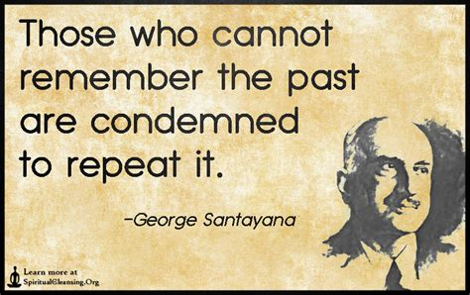
Direction without reflection,
Produces repetition!
The Life of Reason, 1905

Slide 9
We, like them, need to remember
God’s Precepts (Principles) Deut. 8:1
“All the commandments (miṣwâ: precepts {from ṣāwâ: appoint, order, charge}) which I command thee…shall ye observe to do,
(shamar’: Observe, to hedge about, guard.)
that ye may live and multiply…”
(Ḥāyâ’: be saved, quickened, preserved)
(John 10:10)

Slide 10
Why remember God’s Principles? Dt. 6:2
“keep (shamar) his commandments…observe to do them:
Faithful obedience blesses us with:
A. A Full life vs 2 “that thy days may be prolonged”
(See Ex. 20:12; Eph. 6:2,3; Rev. 4:11)
B. A Fulfilling life 3 “that it may be well with thee”
C. A Fruitful life 3“that ye may increase mightily”
Pr. 22:4 “By humility and the fear of the LORD are riches and honor and life.”

Slide 11
Faithful obedience blesses us!
Dt 10:12-13 “what doth the LORD require of thee?
13 …To keep the commandments of the LORD,
and his statutes, which I command thee …
for thy good?”
Ro. 12:1,2 “…that ye may prove what is that good, and acceptable, and perfect will of God”

Slide 12
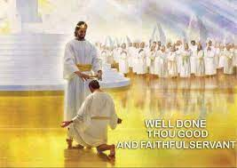
Faithful obedience blesses us! Mt 25:21,23 “Well done, thou good and faithful servant:
thou hast been faithful over a few things,
I will make thee ruler over many things:
enter thou into the joy of thy lord.”
Rev. 22:12 “behold, I come quickly; and my reward is with me,
(misthos: pay for service)
to give every man according as his work shall be.”
2 Tim. 4:7,8

Slide 13
2. How should we “keep” God’s Principles.
Dt 6:1 “These are the commandments which the LORD
your God commanded to teach you,
that ye might do them…”
A. With Dread (Fear) Dt. 6:2 “That thou mightest
fear (yare: dread, revere) the LORD thy God
to keep (Shamar) all his statutes
(ḥuqqâ: ordinance; {from ḥōq: prescribed})
and His commandments…”

Slide 14
1) A genuine fear of the Lord Provides:
a) Instruction: Ps 111:10 “The fear of the LORD is the
beginning of wisdom: a good understanding
have all they that do his commandments…”
b) Protection: Ps 34:7 “The angel of the LORD encampeth round about them that fear him, and delivereth them.”
Pr 14:26-27 “In the fear of the LORD is strong confidence: and his children shall have a place of refuge.
The fear of the LORD is a fountain of life,
to depart from the snares of death.”

Slide 15
c) Correction: Heb. 10:26.27 “If we sin willfully
after we’ve received the knowledge of the truth,
there remaineth no more sacrifice for sins, but a certain fearful looking for judgement and fiery indignation…”
30,31 “For we know Him that said,
‘vengeance belongeth unto me, I will recompence’ …and again, ‘The Lord shall judge His people.’
It is a fearful thing to fall into the hands
of the living God.”
See also Heb. 12:5-11 and Rev. 3:19

Slide 16
(a) Fear motivates honest confession!
(Is. 6:1-7)
“…I saw also the Lord sitting upon a throne, high and lifted up, and his train filled the temple. Above it stood the seraphims: each had six wings; and they cried unto another, …Holy, holy, holy, is the LORD of hosts:
the whole earth is full of his glory.
Then said I, Woe is me! for I am undone;
because I am a man of unclean lips, …for mine eyes have seen the King, the LORD of hosts….
7 …thine iniquity is taken away, thy sin is purged”
See also 1 Jn 1:5-10

Slide 17
2. How? Dt 6:1-2 “keep…His Commandments
B. With Determination (faithfulness)
Dt. 6:2 “all the days of thy life.”
1) This requires consistency/intentionality! 6-9
6 “And these words, …, shall be in thine heart:
7 and thou shalt teach them diligently
unto thy children, and shalt talk of them when
thou sittest in thine house… thou walkest by the way,
and when thou liest down, and when thou risest up.”

Slide 18
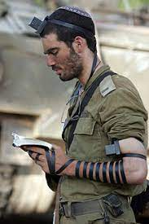
B. With Determination Dt. 6:2 “all the days of thy life.”
1) This requires consistency/intentionality! 7-9
8 “And thou shalt bind them for a sign upon thine hand, and they shall be as frontlets between thine eyes.”
a) Phylacteries contain 3 scripture passages
(Ex. 13:1-16; Dt 6:4-9; 11:13-21)
What was God’s purpose for this?
“Thou shalt remember!” (Dt 8:2)
https://www.jewishencyclopedia.com/articles/12125-phylacteries

Slide 19
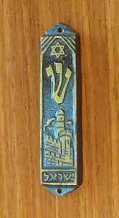
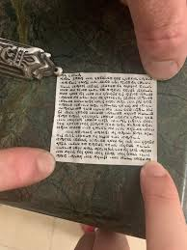
9 “And thou shalt write them upon the posts of thy house,
and on thy gates.”
b) Mezusahs are affixed at every doorway
(exterior and interior)
Mezusah
“Door post”
The Mezusahs contain 2 scripture passages. (Dt. 6:4-9 and Dt. 11:13-21)

Slide 20
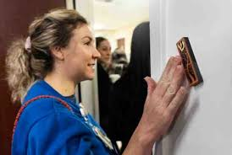
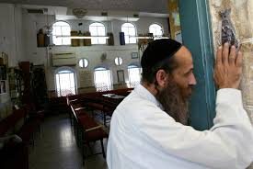
Devout Jews touch the mezuzah before entering the room,
often kissing the finger that did so!
What’s the point or
Intention of this?
What can it easily become? (Mt 15:6)

Slide 21
2. Remember God’s precepts (Principles) With:
A. Dread (Fear) Dt. 6:2 B. Determination (Faithfulness) 2-9
C. Devotion (Fidelity) 6:4,5
“Hear (šāmaʿ: listen/obey), O Israel:
The LORD our God is one LORD:
And thou shalt love the LORD thy God
with all thine heart, and with all thy soul,
and with all thy might.
And these words, which I command this day
shall be in thine heart:”

Slide 22
Remember God’s precepts (Principles) With:
C. Devotion (Fidelity) 6:4,5
1) Jesus summed up every Old Testament
Commandment with this in Mt 22:37:
“Thou shalt love the Lord thy God with all thy heart, and with all thy soul, and with all thy mind.
This is the first and great commandment.”
Ro. 13:10 “love is the fulfilling of the law”
1 Cor 13:13 “The greatest of these is charity”

Slide 23
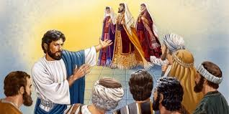
2) The pharisees had dread and determination,
but completely missed the Devotion.
Mt 23:5 “all their works they do for to be seen of men:
they make broad their phylacteries,
and enlarge the borders of their garments,
6 And love the uppermost rooms at feasts,
and the chief seats in the synagogues…”

Slide 24
Mt 23:23 “Woe unto you, scribes and Pharisees, hypocrites! for ye pay tithe of mint and anise and cummin, and have omitted the weightier matters of the law, judgment, mercy, and faith:
These ye ought to have done,
and not to leave the other undone.
24 Ye blind guides, which strain at a gnat
and swallow a camel.”
Duty without devotion is not only drudgery,
It’s dishonoring!

Slide 25
Why should we remember (keep)
God’s Commands?
They’re for our own Good!
Dt 10:12 “what doth the LORD thy God require of thee, but to fear the LORD thy God, to walk in all his ways, and to love him, and to serve the LORD thy God with all thy heart and with all thy soul,
13 To keep the commandments of the LORD…
for thy good?”

Slide 26
God’s commands help us produce a healthy:
Dread (Fear) Dt. 6:2
That helps Guard Guide us.
2) Determination (Faithfulness) 2-9
That helps Guide us (and our kids).
3) Devotion (Fidelity) 6:4,5
That helps Grow us.

Slide 27
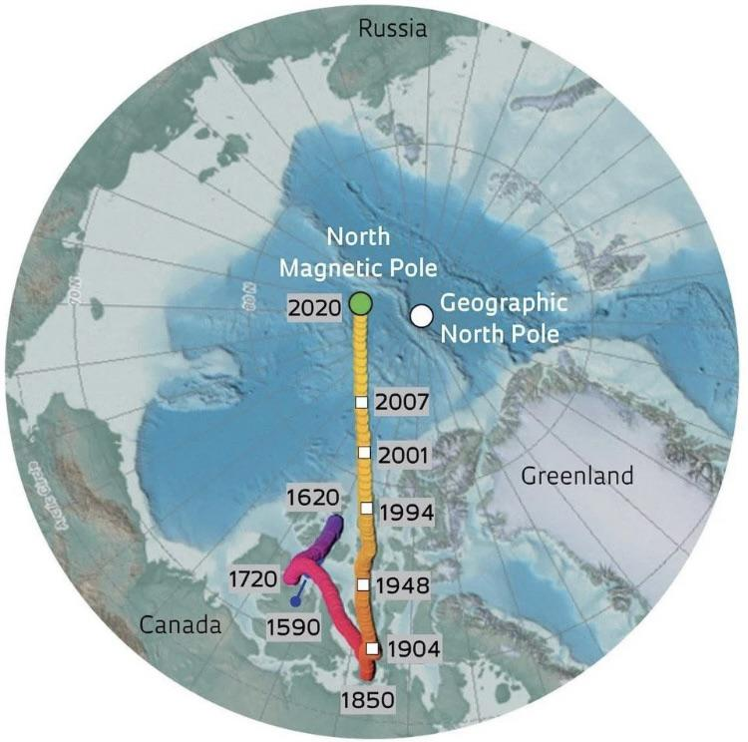
Everyone is guided by some “moral (?!?) compass”
What “calibrates” your compass?
(What’s your “Magnetic North Pole?”)
Just as the “magnetic north” has shifted (600 miles)
So most have shifted their “moral north pole” (convictions) away from God’s Principles,
(What’s right!)
toward Personality or Performance.
(What’s expedient or Convenient!)

Slide 28
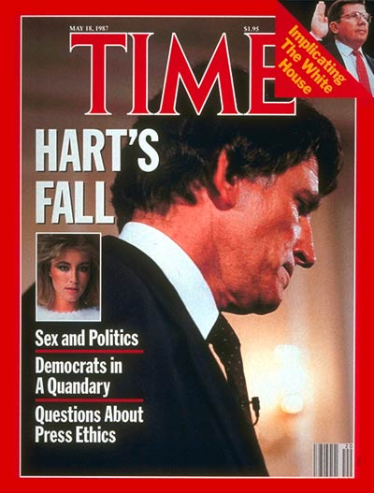
Our world (actually Satan’s {2 Cor 4:4; 1 Jn 5:19})
has shifted from a Principle centered compass
“we hold these truths to be self evident…”
to “Performance” or even “Personality” centered one.
1988 Democratic presidential frontrunner Gary Hart was caught in an affair;
And was immediately dropped from the race.

Slide 29
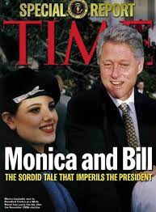
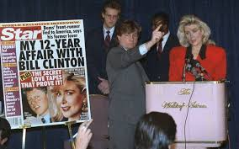
1992 Democratic Presidential frontrunner
(Bill Clinton) had multiple affairs
yet went on to with both the Democratic nomination
As well as the presidency.
(Gennifer Flowers)
His behavior continued
yet was ignored due to his performance
“it’s about the economy”
And personality.

Slide 30
Who/ What do you use/trust to “calibrate”
your moral compass?
“Wherewithal shall a young man cleanse his way?
by taking heed thereto according to thy word.
With my whole heart have I sought thee:
O let me not wander from thy commandments.
Thy word have I hid in mine heart,
that I might not sin against thee.”
Ps 119:9-11

Slide 31
“Another year is dawning; dear Father, let it be,
In working or in waiting, another year with thee.
Another year of progress, another year of praise,
Another year of proving thy presence all the days.
Another year of service, of witness for thy love;
Another year of training for holier work above.
Another year is dawning; dear Father, let it be,
on earth, or else in heaven, another year for thee.”
Frances Ridley Havergal (1836-1879)

