Slide 1
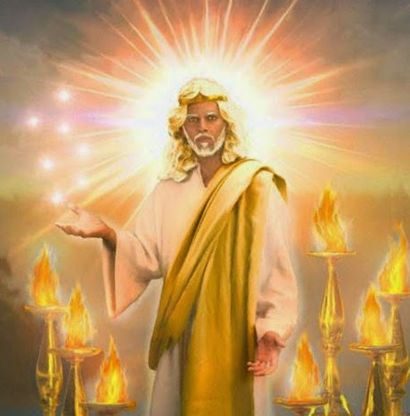
Revelation 1:1-2 ”The Revelation of Jesus Christ, which God gave …
to shew unto his servants things which must
shortly come to pass;
ἐν τάχος (en tachos)
En: Specific point (in time)
Tachos: quickly

Slide 2
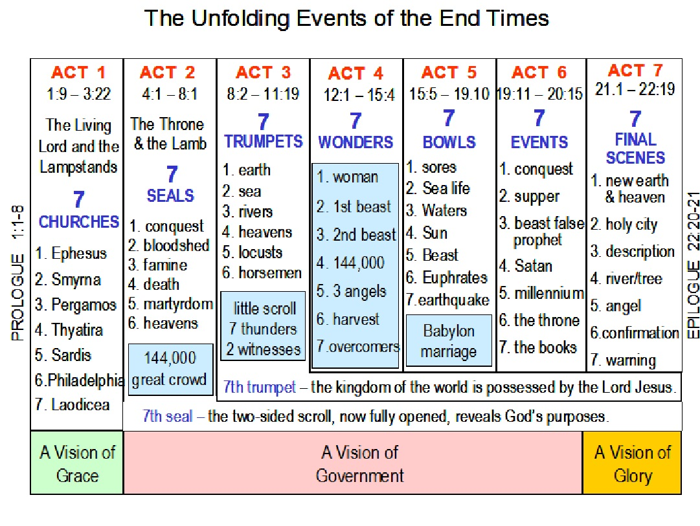
The Revelation of God’s Purposes and Processes
1. Plants
2. Ocean
3. Rivers
4. Heavens
5. Locusts
6. Army
1. Woman
2. Dragon
3. Beast
4. False
Prophet
5. Angels
6. Harvest
7. Over-
comers
1. Sores
2. Sea Life
3. Waters
4. Scorch
5. Darkness
6. Euphrates
7. Great
Earthquake
1. Marriage
2. Armageddon
3. Beasts
judged
4.Satan
bound
5. Kingdom
6. Rebellion
7. Final
Judgment
1. Antichrist
2. War
3. Famine
4. Death
5. Martyrs
6.Earthquake
1. Ephesus
2. Smyrna
3. Pergamos
4. Thyatira
5. Sardis
6.Philadelphia
7. Laodicea
7 Thunders,
2 Witnesses
Babylon
Judged
144,000 Evangelists
7th Trumpet: Kingdoms of the world become Christ’s
7th Seal Scroll, now opened, reveals God’s Purposes.
Grace
Government

Slide 3
Act 6 closes with Judgment Day!
Heb. 9:27 “it is appointed unto men once to die,
but after this the judgment”
Κρίσις (krisis): judgment, decision, damnation

Slide 4
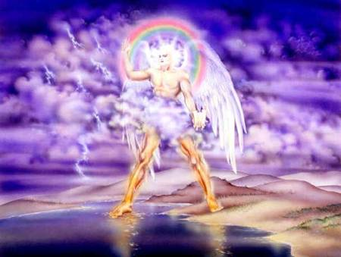
Rev. 10:6,7 reveals that:
“in the days of the voice of the seventh angel, when he shall begin to sound,
the mystery of God should be finished,
as he hath declared to his servants the prophets.”

Slide 5
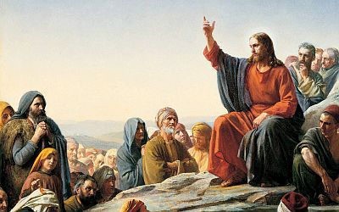
Act 7 Final Scenes. Rev. 21,22
21:1 “I saw a New Heaven and Earth, for the first heaven and earth were passed away”
Jesus told of this!
“Heaven and earth shall pass away,
but my words shall not pass away.”
Mt 24:35

Slide 6
Paul spoke about this. Ro. 8:18-22
Ro. 8:18-22 “I reckon that the sufferings of this present time are not worthy to be compared with the glory which shall be revealed in us.
For the earnest expectation of the creature (creation) waiteth for the manifestation of the sons of God…
Because the creature itself also shall be delivered from the bondage of corruption
into the glorious liberty of the children of God.
For we know that the whole creation groaneth and travaileth in pain together until now. “

Slide 7
1. “The Former Things are passed away”. Vs 4
A. Notice what “things” will be gone.
1) Separation: “There was no more sea”. V 1
What is it that makes hell so unbearable?
Utter isolation:
What makes heaven so incredibly sweet?
Intimate connection!
“outer darkness, there shall be wailing and gnashing of teeth.” Mt 22:13

Slide 8
1. “The Former Things are passed away”. Vs 4
A. Notice what “things” will be gone.
2) Tears: “God shall wipe away all tears…
there shall be no more…crying.” v 4
3) Death: “and there shall be No More Death” vs 4
4) Sorrow: “There shall be no more sorrow” Vs. 4
5) Pain: “No More Pain” Vs. 4

Slide 9
“For the Former Things are passed away”. Vs 4
6) Evil: vs 8 “the fearful, unbelieving, abominable,
murderers, whoremongers, sorcerers, Idolaters, liars
shall have there part in the lake which burneth with
fire and brimstone, which is the second death”
7) Curse 22:3 “there shall be no more curse:
but the throne of God and of the Lamb shall be in it;
and his servants shall serve him:”

Slide 10
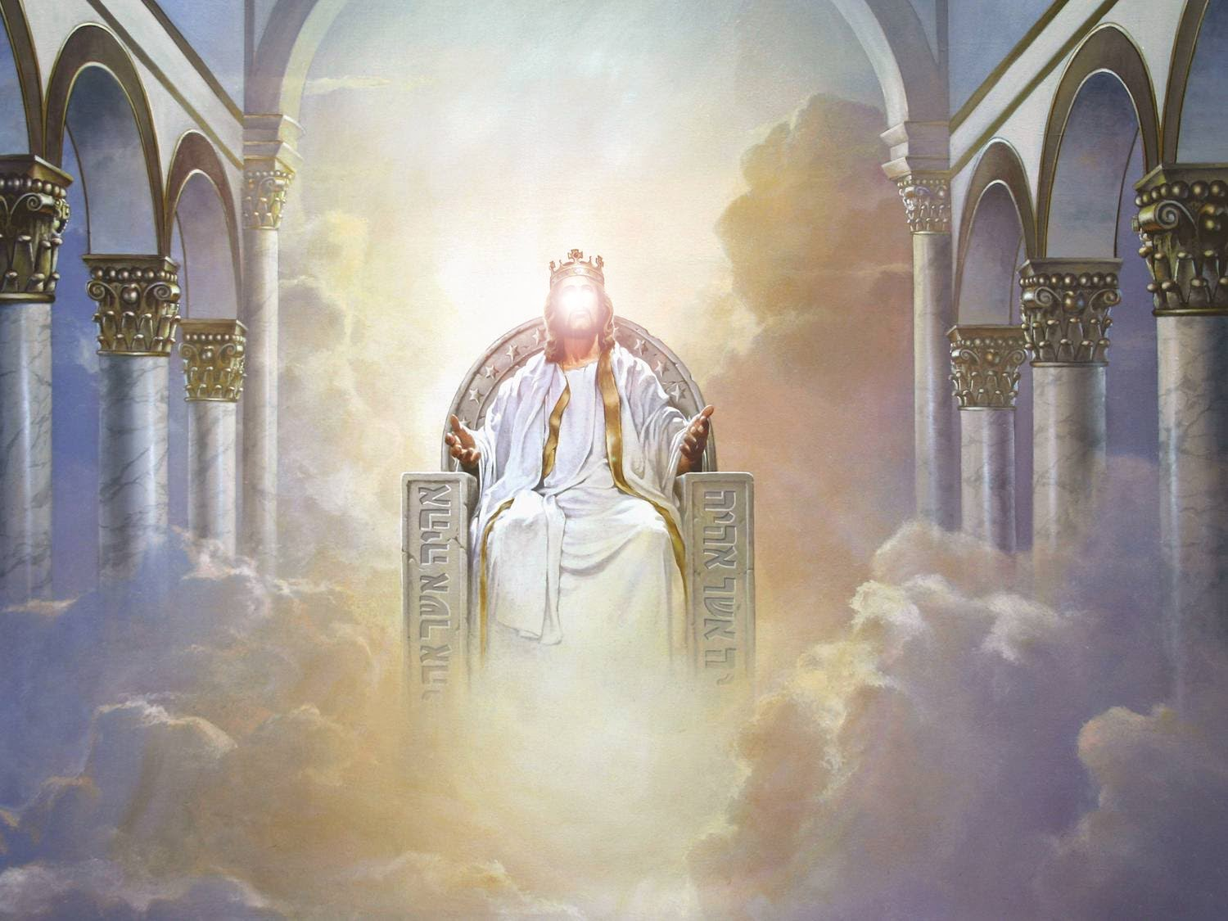
“He that sat upon the throne said,
Behold, I make all things new.” 21:5

Slide 11
2. “I make all things New”
God’s revealed some of the details. 1 Cor 2:9
“Eye hath not seen, nor ear heard,
neither have entered into the heart of man,
the things which God hath prepared
for them that love him.
10 But God hath revealed them unto us by his Spirit”

Slide 12
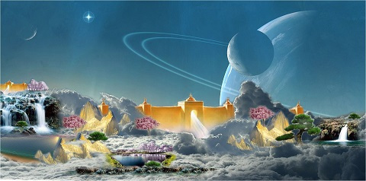
1) New Heavens (universe) Vs 1
2) New Earth.
“I saw a new heaven and a new earth”

Slide 13
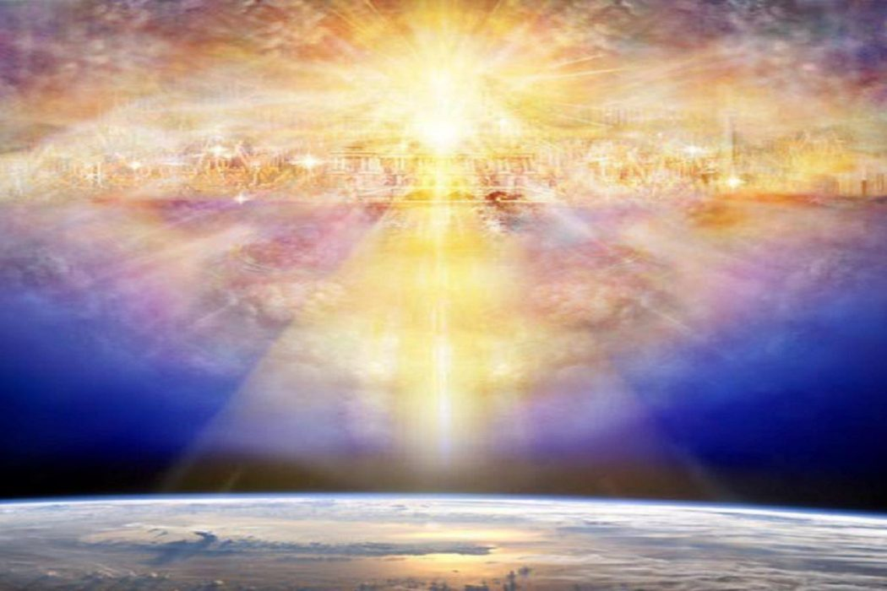
B. “I make all things New”
3) New Home. 21:2-3
“I … saw the holy city, new Jerusalem, coming down from God out of heaven,
prepared as a bride adorned for her husband…
I heard a great voice from heaven saying:
Behold, the tabernacle of God is with men,
and he will dwell with them”

Slide 14
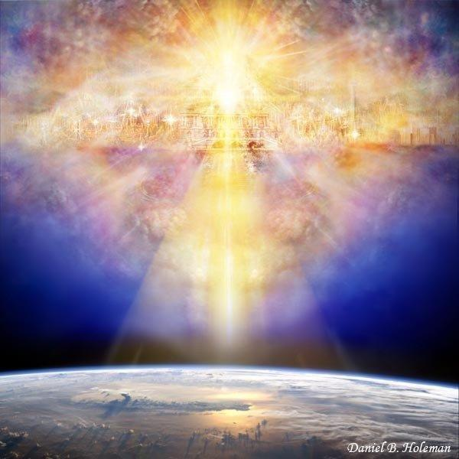
3) New Home 21:2,3 (Jn 14:2)“a place for you!”
21:9 “Come hither, I will shew thee the bride,
the Lamb's wife.
And he …shewed me that great city, the holy Jerusalem, descending out of heaven from God,
¹¹ Having the glory of God: and her light was like unto a stone most precious, even like a jasper stone, clear as crystal;

Slide 15
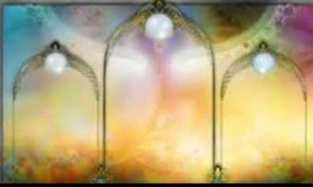
“Come, I will shew thee the bride, the Lamb's wife.” 21:9-27
a) “12 Gates were 12 Pearls.” vs 21
“And at the 12 gates, 12 angels.” 21:12

Slide 16
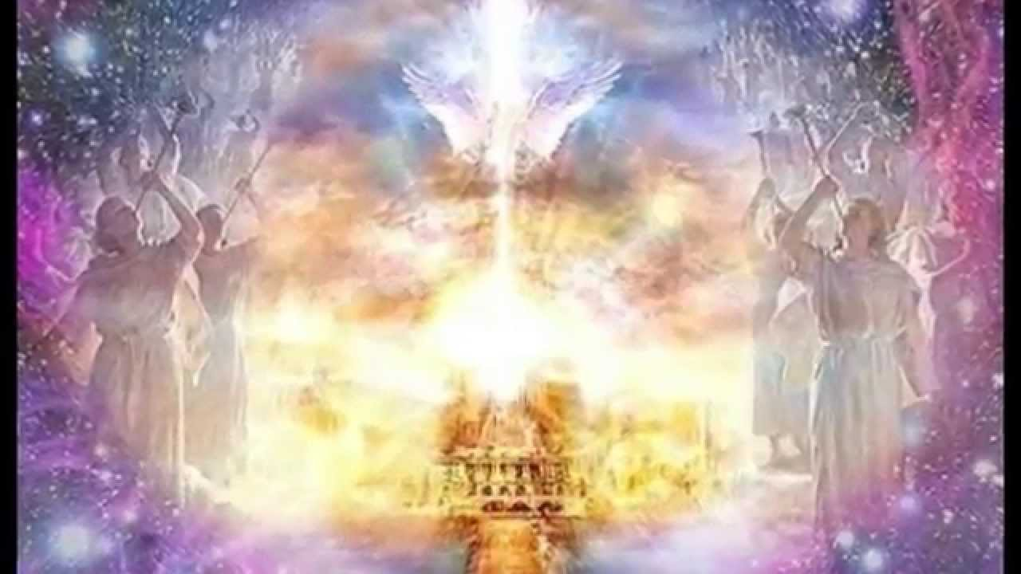
“Come, I will shew thee the bride, the Lamb's wife.
b) Symmetrical and huge. 21:16
“twelve thousand furlongs.
The length, breadth and height of it are equal.”
1 furlong = 660 feet.
12,000 = 1500 miles!
*Room for all!

Slide 17
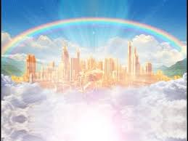
“I will shew thee the bride, the Lamb's wife.”
c) Made of purest Gold 21:18
“and the city was pure gold.”

Slide 18
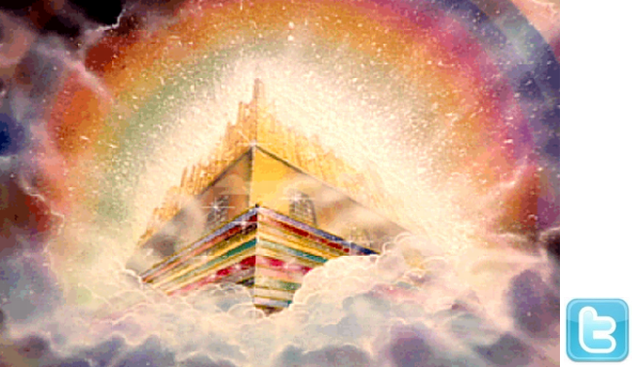
“I will shew thee the bride, the Lamb's wife.”
12 Foundations garnished with gems.
Vs 19 “the foundations of the wall of the city were garnished with all manner of precious stones.”

Slide 19
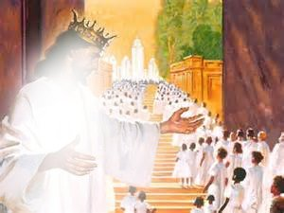
B. “I make all things New”
New Heaven, earth, home
4) New People. 21:3,24 “They shall be His People
…and the nations of them which are saved shall walk in the light of it.”

Slide 20
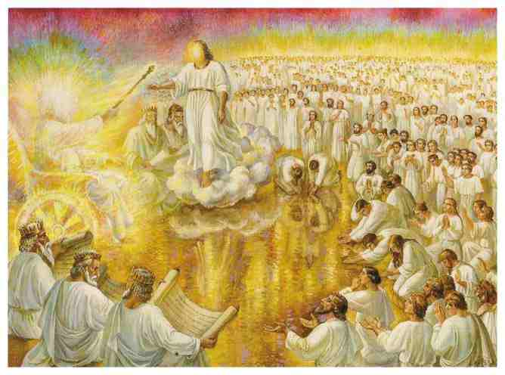
B. “I make all things New”
5) New Temple 21:22 “And I saw no temple:
for the Lord God Almighty and the Lamb are the temple of it.

Slide 21
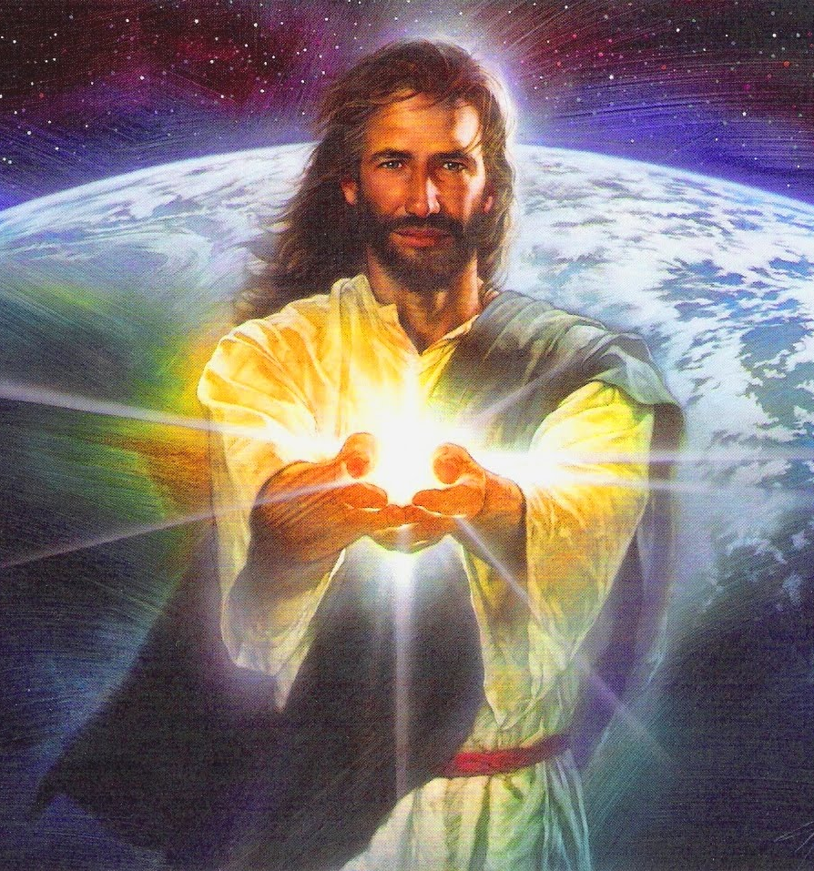
B. “I make all things New”
6) New Light. 21:23
“And the city had no need of the sun, or moon, to shine in it:
for the glory of God did lighten it, and the Lamb is the light thereof.”

Slide 22
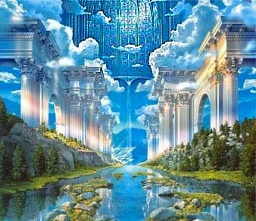
“I make all things New”
7) New Paradise. 22:1-2 “And he shewed me a pure river of water of life, clear as crystal, proceeding out of the throne of God and of the Lamb.
In the midst of the street of it, on either side of the river,
was there the tree of life,
which bare twelve manner of fruits, and yielded her fruit every month: and the leaves of the tree were for the healing of the nations.”

Slide 23
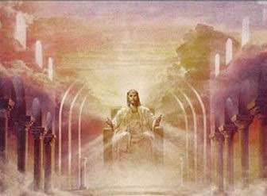
22:3-5 “And there shall be no more curse:
but the throne of God and the Lamb shall be in it;
and his servants shall serve him:
And they shall see his face; and his name shall be in their foreheads…
and they shall reign
for ever and ever.”

Slide 24
Revelation 22:6-7
“These sayings are faithful and true:
and the Lord God of the holy prophets sent his angel to shew unto his servants the things which must shortly (en tachos) be done.
Behold, I come quickly:
(tachu’: suddenly)
blessed is he that keepeth the sayings of the prophecy of this book.”

Slide 25
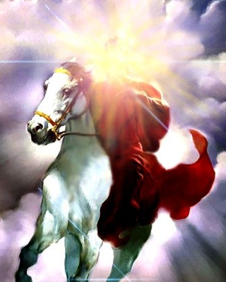
Rev. 22:12-14 “Behold, I come quickly;
and my reward is with me,
to give every man …as his work shall be…
Blessed are they that do his commandments, that they may have right to the tree of life,
and may enter in through the gates into the city.”

Slide 26
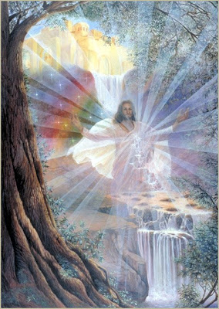
Rev 22:16-17 “I Jesus have sent mine angel to testify unto you these things in the churches.
the Spirit and the bride say, Come.
And let him that heareth say, Come.
And let him that is athirst come.
And whosoever will, let him take the water of life freely.”

Slide 27
Rev 22:20-21 “He which testifieth these things saith,
Surely I come quickly. Amen.
10 times in Rev. Jesus warns of His Coming!
3 times in the last Chapter!
Even so, come, Lord Jesus.”
Is that our attitude?

Slide 28
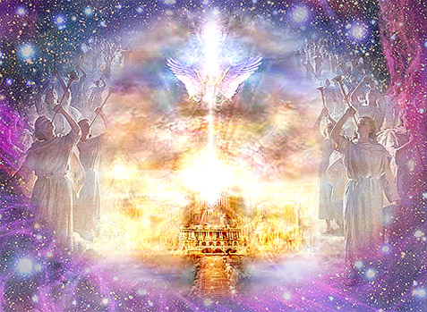
Heaven:
Don’t miss it for the world!

Slide 29
“The grace of our Lord Jesus Christ be with you all. Amen.” Rev. 22:21
Χάρις (char’is) the divine influence upon the heart, and its reflection in the life.
Have you Personally Responded
to God’s Grace?
2) Are you Practically Reflecting
His Grace to others?

