Slide 1
The Priorities of God’s People

Slide 2
The Passion of God is reflected in the Priorities He’s given His people.
These can be summed up in the:
The Great Commission (Mt. 28:18-20)
Sharing the gospel (Salvation)
Baptism (Identification/Association)
Discipleship (Transformation)

Slide 3
The Great Commandment Mt 22:37-39
“Thou shalt love the Lord thy God
with all thy heart, and with all thy soul, and with all thy mind.
This is the first and great commandment.
πρῶτος μέγας (protos megas)
And the second is like unto it,
Thou shalt love thy neighbor as thyself.”

Slide 4
If Sin (hamartano) literally means:
“to miss the mark”;
then wouldn’t the greatest “sin” be to miss (through neglect or intent)
The Greatest Command?

Slide 5
1. The “What” of Ministry. Jn 13
diakonia: service, aid, relief.
“loving our neighbor as ourself” should reveal itself through practical service.
Such Service (Ministry) is:
A. Love in Action (Jn. 13:1-17)
B. Labor in Jesus’ Name. (Mt. 25:40)
C. A Litmus test of our love. (1 Jn. 3:10-19)

Slide 6
The “Why” of Ministry Jn 13:
A. God’s love is Practical. (James 2:15,16)
B. God’s love is Personal (Mt. 25:35,36)
C. God’s Love is Powerful. (1 Cor 13:13)
“by this shall all men know that ye are my disciples;
If ye have love on to another.” Jn 13:35

Slide 7
The Who of Ministry Jn 13:13-17
A. God Decrees we should all be ministers.
Eph. 4:11 “gave…pastors and teachers;
for the perfecting
(katartismos’: complete repair, equipping)
of the saints, (hagios: sacred, consecrated)
for the work of the ministry.
ergon (labor) diakoni’a (service)

Slide 8
Eph. 4:11-13 “gave…pastors and teachers;
for the perfecting of the saints,
for the work of the ministry.
for the edifying
oikodomē’: building up
of the body of Christ…”
(See 1 Cor 12:27)

Slide 9
13 “Till we all come in the unity of the faith,
and of the knowledge of the Son of God,
unto a perfect (telios: mature) man,
unto the measure of the stature
of the fulness of Christ:…”
See Ro. 8:29

Slide 10
The Who of Ministry Jn 13:13-17
A. God Decrees we should all be ministers.
B. God Designs each of us for ministry.
1 Pt 4:10 “As every man hath received the gift,
even so minister the same one to another,
as good stewards of the manifold
grace of God."

Slide 11
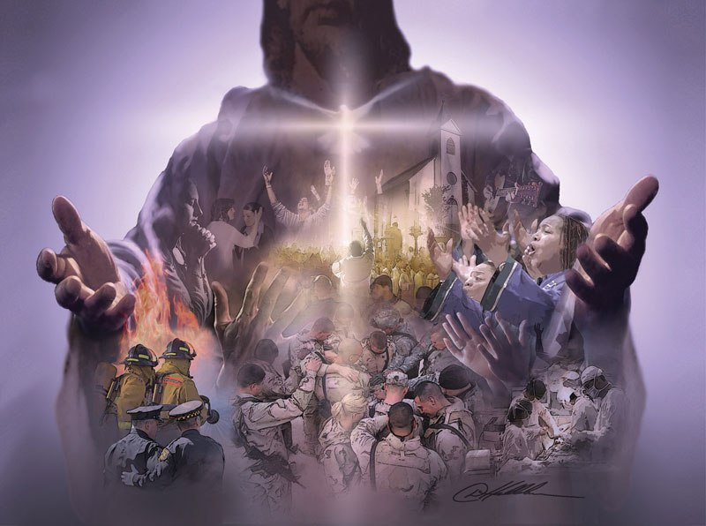
B. God Designs each of us for ministry.
This is what the term “Active Member”
is supposed to mean.
Gallop revealed that
< 10 % of evangelical Christians are involved in any ministry.

Slide 12
2) We don’t have the same gifts/opportunities.
Ro. 12:6 "Having then gifts differing according to the grace that is given to us…”
1 Cor 12:1-3 “There are diversities of gifts,
but the same Spirit.
And there are differences of administrations,
but the same Lord.
And there are diversities of operations,
but it is the same God which worketh all in all”

Slide 13
4. The How of Ministry
Understand Ministry Is Mandatory!
(We’re Saved to Serve!)
We’ll be evaluated in heaven
based on our service on earth. (Mt. 25:13-30)
“Well done, thou good and faithful servant: thou hast been faithful over a few things,
I will make thee ruler over many things” vs 21

Slide 14
2 Tim 4:7,8 “I’ve fought a good fight, I’ve finished my course, I’ve kept the faith,
henceforth there’s laid up for me a crown of righteousness which the Lord,
the righteous judge
shall give me in that day;
and not to me only, but unto all them also that love his appearing.”
”

Slide 15
B. Understand how God has
“SHAPED” you for His Service.
1) Spiritual Gifts. 1 Pt 4:10
"As every man hath received the gift,
char’isma: gratuity, endowment, qualification.
From char’is: Grace!
God’s influence in and through us! (Phil. 2:13)
so minister the same as good stewards…”

Slide 16
1) Spiritual Gifts. 1 Pt 4:10
Our Gifts come from God’s Grace!
“by the grace of God I am what I am:
and his grace which was bestowed upon me was not in vain; (kenos’: empty)
but I labored more abundantly…: yet not I,
but the grace of God which was with me.”
1 Cor 15:10

Slide 17
God has “SHAPED” us for Service.
2) Heart (Passion) Col 1:28-29
“we preach, warning …and teaching every man in all wisdom; that we may present every man perfect in Christ Jesus:
Whereunto I also labor,
striving according to his working,
which worketh in me mightily.”

Slide 18
God has “SHAPED” us for Service.
3) Abilities: Ex. 31:3
"I have filled him (Bezaleel)
with the spirit of God, in wisdom,
and in understanding, and in knowledge, and in all manner of workmanship…"
Long before the moment of need,
God had been preparing the man!

Slide 19
God has “SHAPED” us for Service.
Personality: (Temperament)
1 Cor 4:1-2 “Let a man account of us
as of the ministers of Christ,
Hypēret’ēs: under oarsman {1 Cor 3:9}
and stewards of the mysteries of God.
Moreover it is required in stewards,
that a man be found faithful.”

Slide 20
God has “SHAPED” us for Service.
Personality: (Temperament)
1 Cor 4:7,8 "For who maketh thee
to differ from another?
And what hast thou
that didst not receive?”

Slide 21
God has “SHAPED” us for Service.
5) Experiences Acts 18:3
"because he was of the same craft, he abode with them,(Aquila/Priscila) and wrought:
for by their occupation they were tentmakers.“
Paul’s education/experiences
enabled him to minister cross culturally!

Slide 22
God has “SHAPED” us for Service.
5) Experiences Phil 1:12,13
“But I would ye should understand,
that the things which happened unto me
have fallen out rather unto the furtherance of the gospel;
So that my bonds in Christ are manifest in all the palace, and in all other places…”

Slide 23
Don’t resist or resent your path / past;
It’s part of God’s Process
in writing your Story!
Use if For God’s Glory!!!!!
Moses, Joseph, Paul,
You and Me!

Slide 24
Conclusion:
Ministry may be “Mandatory”,
but that doesn’t mean it’s necessarily Natural or Comfortable!
The God who calls us will equip us;
but we must cooperate with His process! (Mt 11:28,29; 1 Cor 3:9)

Slide 25
Application:
1) Take time to consider how God has
uniquely “Shaped” you.
Spiritual Gifts, Heart, Abilities, Personality, Experiences
2) Consecrate (dedicate) your “Shape”
to His service! Ro 12:1-6…

Slide 26
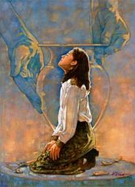
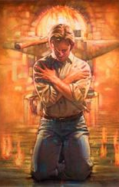
3) Cooperate with God’s processes to develop Your “Shape”.
(Mal. 3:17; Is.64:8)

Slide 27
4) Commit to investing in others.
2 Tim. 2:1,2
“be strong in the grace that is in Christ Jesus.
And the things that thou hast heard of me,
the same commit thou (paratith’ēmi: deposit)
to faithful men, (pistos: trustworthy)
who shall be able to teach others also.”

