Slide 1
The Strategy of Satan
2Cor 2:11 “Lest Satan should get an advantage of us: for we are not ignorant of his devices.” (noema: mind)
This Strategy involves:
Removing the “Strong man” as the loving leader / protector of the family. Mark 3:27
Removing Marriage as the foundation of Society. Heb. 13:4; Mal 2:14-16

Slide 2
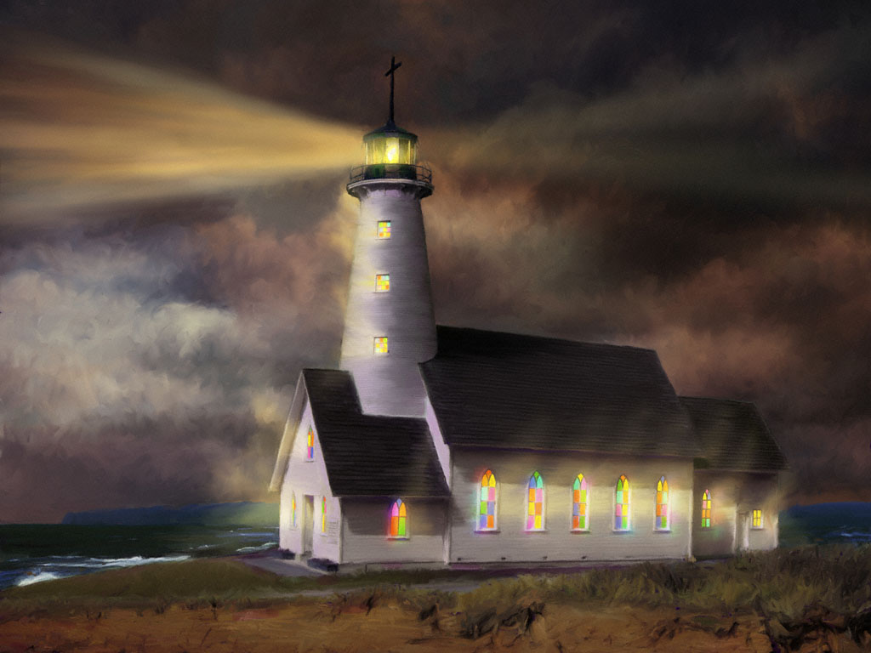
Removing the Scriptures (God’s Word)
as the Standard of Society. Ro. 1:28
Removing the church (God’s People)
as the Salt
(Preservation)
and Light
(Clarification)
of society.
Mt 5:13-16

Slide 3
“Woe to the inhabiters
of the earth!
For the devil is come down unto you,
having great wrath,
because he knows that he hath but a short time.”
Revelation 12:12
What’s His End Game?

Slide 4
He’s Setting the Stage
for the Last Days

Slide 5
God’s word provides many clues about what the last days will look like.

Slide 6
Setting the Stage for the Last Days
1. A Great Spiritual Apostacy.
1 Tim. 4:1 “in the latter times…depart from the faith…”
2 Tim. 4:3,4 “they’ll not endure sound doctrine, but after their own lust shall they heap to themselves teachers
…And turn away their ears from the truth.”
2 Thes. 2:3 “that day shall not come, except there come a falling away first, (apostasia: forsaking truth)
and that man of sin be revealed...”

Slide 7
1. A Great Spiritual Apostacy.
A. Only 37% of “Christian” Pastors and 6%
of “Christians” Have a biblical world view!
1) The rest have a syncretistic world view!
“The amalgamation of different religions, cultures, or schools of thought”
1Tim.4:1 “depart from the faith, giving heed to seducing spirits and doctrines of devils”

Slide 8
2 Cor 11:13-15 “For such are false apostles, deceitful workers,
transforming themselves into the apostles of Christ.
And no marvel; for Satan himself is transformed into an angel of light.
Therefore it is no great thing if his ministers also be transformed as the ministers of righteousness;
whose end shall be according to their works.”
(See also Jude and 2 Peter 2)

Slide 9
B. 1 Tim. 6 warns us to beware of and avoid:
1) Those who use money to promulgate: “Perverse disputings of men of corrupt minds
and destitute of the truth.” vs 5
2) Those who embrace / promulgate
a) False reasoning: “profane and vain babblings,
b) False “Science” “and oppositions of
science falsely so called:” Vs 20

Slide 10
3) When Greed (1 Tim 6:10) teams up with
false reasoning & false science (1 Tim 6:20);
They produce an inevitable drift from God.
“Which some professing have erred
(Astoche’ō: drift, deviate from truth)
concerning the faith.” 1 Tim 6:21
Powerful forces have been at work to pair these together to promote this “drift”
leading to:

Slide 11
2. A Great “Moral” decay. 2 Tim. 3:1-4
“In the last days, perilous times will come…
(Chalepos’: difficult, dangerous, furious)
2 For men shall be lovers of their own selves, covetous, boasters, proud, blasphemers, disobedient to parents, unthankful, unholy, 3 Without natural affection, trucebreakers, false accusers, incontinent, fierce,
despisers of those that are good,
4 Traitors, heady, highminded,
lovers of pleasures more than lovers of God…”

Slide 12
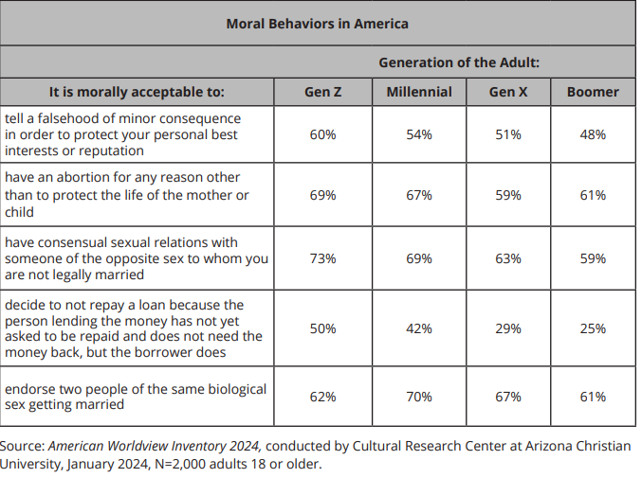
Right and Wrong have been turned upside down!
Isaiah 5: 20
LIE Ex. 20:16
Kill Ex 20:13
Fornicate Ex 20:14
Steal Ex 20:15
Gay marriage

Slide 13
Isaiah 5:20-24
“Woe unto them that call evil good, and good evil;
that put darkness for light, and light for darkness; that put bitter for sweet, and sweet for bitter!
Woe unto them that are wise in their own eyes…!
Which justify the wicked for reward…!
because they have cast away the law of the LORD.. and despised the word of the Holy One of Israel.”

Slide 14
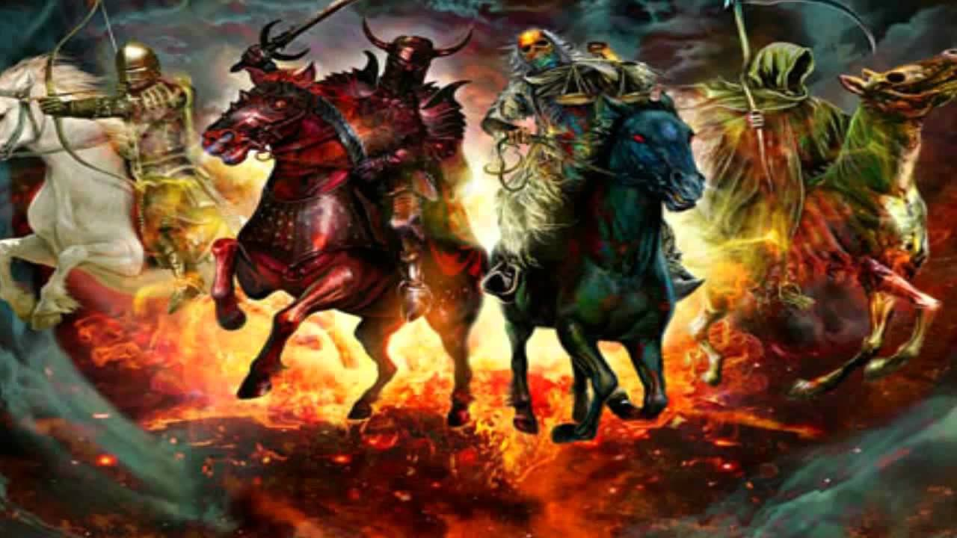
Selfishness produces:
3. Increase of Wars. James 4:1-3
Mt. 24:6;7 “wars and rumours of wars…,
Nation shall rise up against Nation…
These are the beginning of sorrows.”
Revelation 6

Slide 15
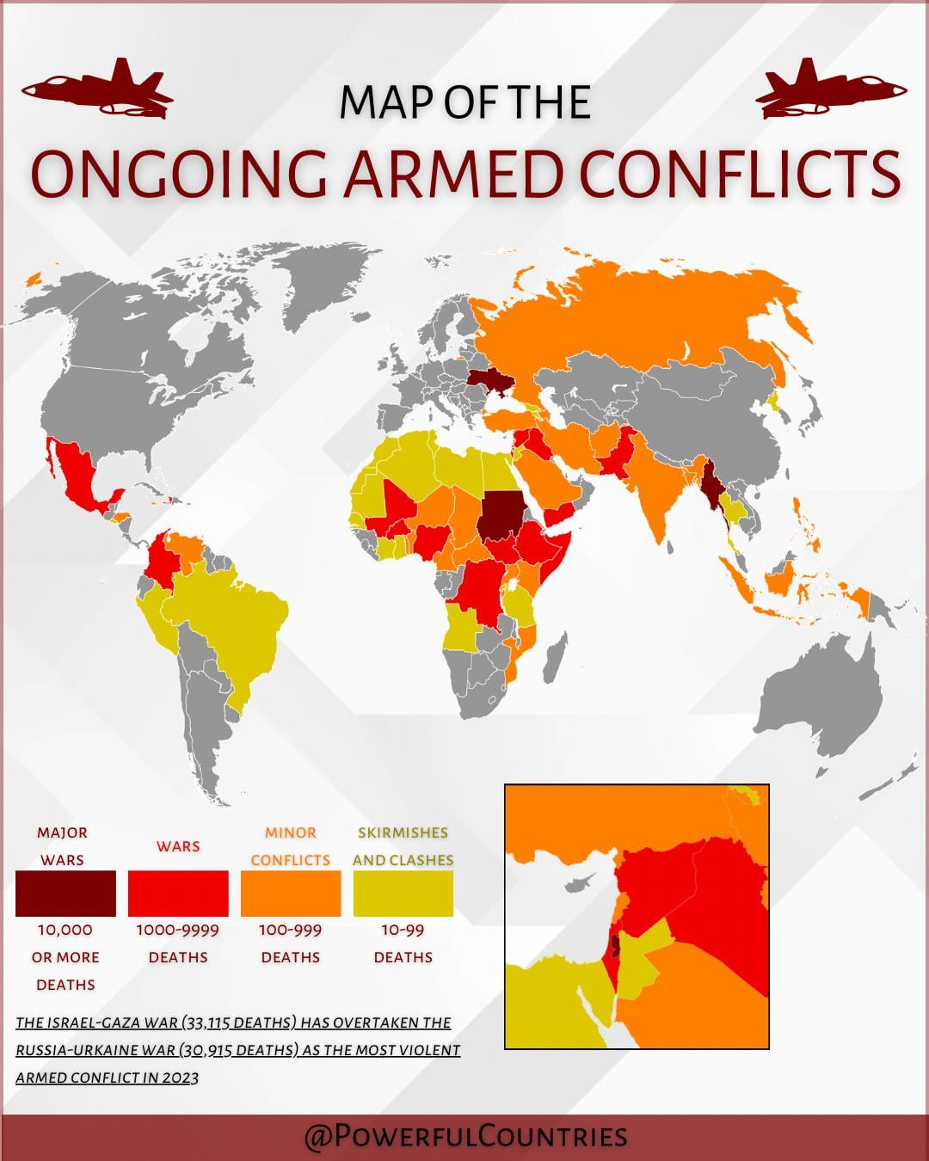
92 countries are currently involved in 56 conflicts,
more than at any time since WW2 visionofhumanity.orgJun 1

Slide 16
4. Resettling Israel in her own land
Mt. 24:32 “Now learn a parable of the fig tree;
When his branch is yet tender, and puts forth leaves,
ye know that summer is nigh:
33 So likewise ye, when ye shall see all these things, know that it is near, even at the doors.
34 Verily I say unto you, This generation shall not pass, till all these things be fulfilled. “
A. The fruitless fig tree (Mt. 21 & Lk 13:6-9) Blossomed.

Slide 17
5. Increased Demonic Influence 1 Tim. 4:2
“in the latter times…giving heed to seducing spirits
and doctrines of devils, speaking lies…”
Daniel 12:1 “at that time shall Michael stand up,
the great prince which standeth for …thy people:
and there shall be a time of trouble…”
Rev 18:2 “Babylon…is become the habitation of devils, and the hold of every foul spirit…“

Slide 18
5. Increased Demonic Influence
Much of what’s happening in our world is directly rooted in the demonic!
Our National Rejection of God’s word (60’s) has led to an escalation of demonic influence
with devastating and demonstrative consequences.

Slide 19
Eph. 6:12 “We wrestle against…principalities…powers,
against the rulers of the darkness of this world,
against spiritual wickedness in high places.”

Slide 20
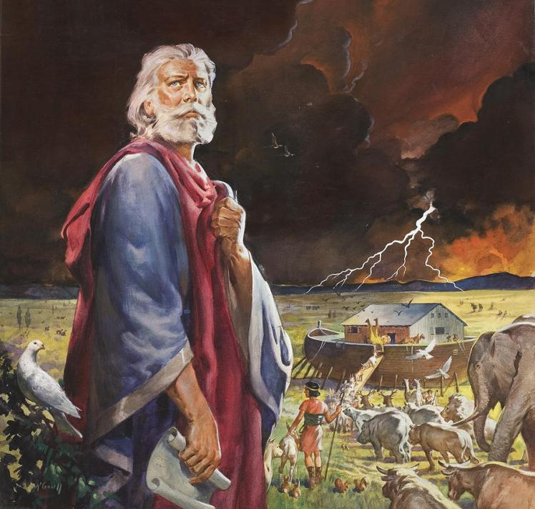
Luke 17:26
“as it was in the days of Noah,
(See Gen. 6)
so shall it be also
in the days of
the Son of man.”
Lk 17:26 “as

Slide 21
28 “Likewise as it was in the days of Lot; (Gen. 19)
30 Even thus shall it be in the day
when the Son of man is revealed.”
New York City
Boston
100,000 in Columbia

Slide 22
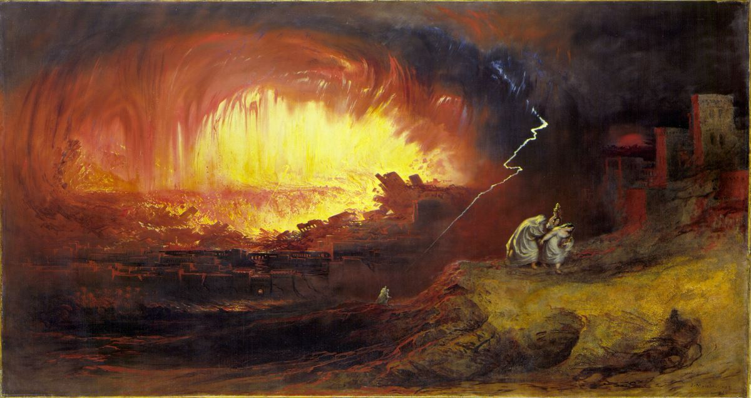
29 “it rained fire and brimstone from heaven,
and destroyed them all.

Slide 23
6. Increased Tribulation. Dan 12:1 (See Mt. 24)
Mt 24:7 “Famines, Pestilences, earthquakes…
9 Then shall they deliver you up …, and shall kill you: and ye shall be hated of all nations for my name's sake..
21 For then shall be great tribulation,
(Thlipsis: pressure, anguish, affliction)
such as was not since the beginning of the world …
22 And except those days should be shortened,
there should no flesh be saved:
but for the elect's sake those days shall be shortened.”

Slide 24
7. Increased (Instant) mis-Information
Dan 12:4 “knowledge shall be increased.”
Daʿat: cunning, ignorantly, unawares
Mis-information, Deception! (Gen. 2:17)
2 Tim. 3:13 “Evil men and seducers (goes: wizards)
shall wax worse and worse,
Deceiving and being deceived”
(planaō: cause to drift)

Slide 25
7. Increased (Instant) mis-Information
Mt 24:4 “Take heed that no man deceive you.
(Planaō: cause to drift from truth and safety)
5 For many shall come …saying, I am Christ;
and shall deceive many.
11 for many false prophets shall rise,
and shall deceive many.
24 there shall arise false Christs, and false prophets, and shall shew great signs and wonders; insomuch that, if it were possible, they shall deceive the very elect.”

Slide 26
In all this there is also increased opportunity
Dan. 12:3 “And they that be wise shall shine as the brightness of the firmament; and they that turn many to righteousness as the stars for ever ….
10 Many shall be purified, and made white, and tried; but the wicked shall do wickedly:
and none of the wicked shall understand;
but the wise shall understand.”

Slide 27
Esther 4:14 “who knoweth whether thou art
come to the kingdom
for such a time as this?”

Slide 28
Eph. 5:14 “Wherefore …Awake thou that sleepest, …and Christ shall give thee light.
15 See then that ye walk circumspectly,
not as fools, but as wise,
16 Redeeming the time, because the days are evil.
17 Wherefore be ye not unwise,
but understanding what the will of the Lord is.”
What is “God’s Will” for us in the face of our changing and challenging culture?

Slide 29
2 Tim. 3:13 “Evil men…shall wax worse and worse…
14 But continue thou in the things which thou hast learned and been assured of, …
16 All scripture is given by inspiration of God,
and is profitable for doctrine,
for reproof, (conviction)
for correction, for instruction in righteousness:
17 That the man of God may be perfect, (ar’tios: complete)
thoroughly furnished unto all good works.”

Slide 30
Ph 2:15-16 “That ye may be blameless and harmless, the sons of God, without rebuke,
in the midst of a crooked and perverse nation,
among whom ye shine as lights in the world;
Holding forth the word of life”
Make much of God’s Word,
and He will make much of you! Is. 6:8
“Whom shall we send, and who will go for us?
then said I, Here am I; send me!”

Slide 31
Josh 1:8 “This book of the law shall not depart out of thy mouth; but thou shalt meditate therein day and night,
that thou mayest observe to do according to all that is written therein:
for then thou shalt make thy way prosperous,
and then thou shalt have good success.
9 Have not I commanded thee? Be strong and of a good courage; be not afraid, neither be thou dismayed:
for the LORD thy God is with thee
whithersoever thou goest.”

