Slide 1
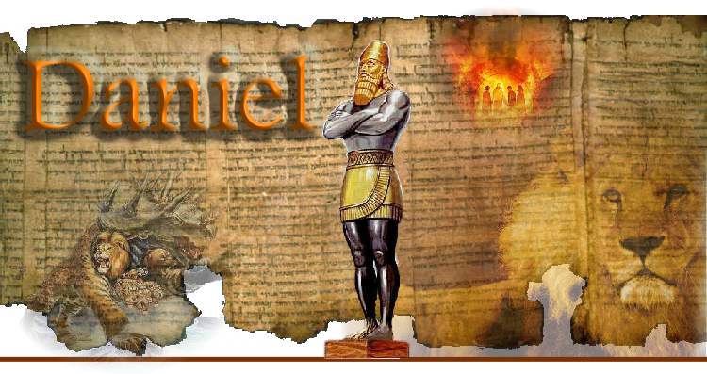
Prophecy and Prayer
And the last days!

Slide 2
God has a pattern of revealing his plans to his “partners”! Amos 3:7-8
“Surely the Lord GOD will do nothing,
but he reveals his secret unto his servants”
He revealed much of His Plan to Daniel!
And through him, to US!

Slide 3
The Course of Kingdoms: Daniel 2 (604 BC)
Gold Head: Babylon
vs 37-38 605 - 539 BC
“Thy dream, and the visions of thy head upon thy bed, are these” vs 28
Arms / chest of Silver: Medo : Persia vs 39
539 – 331 BC
Belly/Thigh of Brass:
Greece vs 39
331-168 BC
Legs of Iron: Rome vs 40
168 BC-476 AD

Slide 4
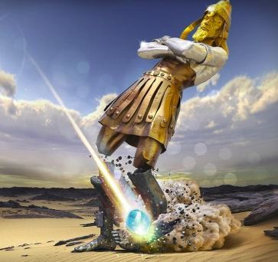
Feet with 10 toes:
Final kingdom with a confederacy of 10 Nations.
Vs 41-43
44 “in the days of these kings
shall God set up a kingdom, which shall never be destroyed…
And it shall stand forever”
Jesus Christ’s return!
(Ezek 21:27 Rev. 19:10-16)

Slide 5
The Four beasts (empires) of Daniel 7
Final world empire!
Rev 13
Roman
Medo-Perisan
Greek
Babylon

Slide 6
Daniel 7:21-22
“I beheld, and the same horn made war with the saints, and prevailed against them;
Until the Ancient of days came, and judgment was given to the saints of the most High; and the time came that the saints possessed the kingdom...
whose kingdom is an everlasting kingdom,
and all dominions shall serve and obey him.” (Christ)

Slide 7
Daniel 9 opens with him studying scripture.
Vs 2 “I Daniel understood by books the number of the years, whereof the word of the LORD came to Jeremiah the prophet, that he would accomplish seventy years in the desolations of Jerusalem.”
This was in 539 BC!
(67 years after he was captured)
2 Tim. 2:15 “Study to show thyself approved unto God, a workmen that needeth not to be ashamed,
rightly dividing the word of Truth”

Slide 8
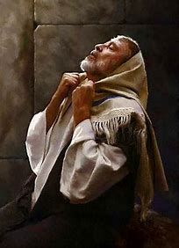
This revelation led to repentance and prayer.
Vs 3 “I set my face unto the Lord God, to seek by prayer and supplications, with fasting, sackcloth, and ashes”
His confession and prayer closed with this plea:
Vs 19 “O Lord, hear; O Lord, forgive; O Lord, hearken and do; defer not, for thine own sake,
O my God: for thy city
and thy people
are called by thy name.”

Slide 9
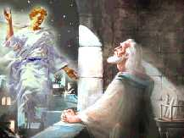
God answers his prayer by sending Gabriel
“while I was in prayer…Gabriel, … said, O Daniel, I am now come forth to give thee skill and understanding.
At the beginning of thy supplications the commandment came, and I am come to shew thee;
for thou art greatly beloved!
Therefore understand the matter
and consider the vision.”
Dan 9:21-23

Slide 10
Daniel 9:24 “Seventy weeks are determined upon
thy people and upon thy holy city,
to finish the transgression,
and to make an end of sins,
and to make reconciliation for iniquity,
and to bring in everlasting righteousness,
and to seal up the vision and prophecy,
and to anoint the most Holy.”
“Christ” (Christos) means
“the anointed one”!

Slide 11
1. 70 WEEKS DEFINED
A. 70 "weeks" (‏shābûaʿ) literally “sevens.”
1) Israel had a week consisting of 7 days (Ex. 23:12)
2) As well as a "week" of 7 years. (Lev. 25:3,4)
“Six years thou shalt sow thy field, and … prune thy vineyard, and gather in the fruit thereof;
But in the seventh year shall be a sabbath of rest unto the land, a sabbath for the LORD: thou shalt neither sow thy field, nor prune thy vineyard.”

Slide 12
B. Understanding Cause and Effect Dt 30:19,20
“I call heaven and earth to record this day against you, I’ve set before you life and death, blessing and cursing: therefore choose life,
that both thou and thy seed may live:
That thou mayest love the LORD thy God, and that thou mayest obey his voice, and …mayest cleave unto him:
for he is thy life, and the length of thy days:
that thou mayest dwell in the land which the LORD sware unto thy fathers…to give them.”

Slide 13
B. Understanding Cause and Effect
1) Israel was commanded to allow its land to
remain idle every seventh year (Lev. 25:1-4).
2) They repeatedly disobeyed/rebelled.
(Lev. 26:33-35; Jer. 34:12-22; 2 Chr. 36:21).
3) Over a total period of 490 years, the nation had
built up a land rest “debt” of seventy years.
God specifically warned them about the consequences of this 1000 years earlier! (Lev. 26)

Slide 14
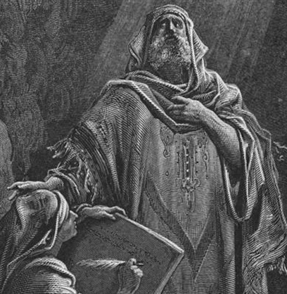
4) God revealed that they would remain in Babylon
for 70 years so the land could “enjoy her sabbaths.” Lev. 26:34; Jer 25:11-12 “this land shall be a desolation,… and these nations shall serve the king of Babylon seventy years.”
5) Daniel recognized that the 70
years of captivity represented
seventy “sevens of years” in
which those violations had
transpired.

Slide 15
6) Gabriel now tells him that another period, similar in length (490 years) was coming to them.
Daniel 9:24 “Seventy weeks are determined
upon thy people and upon thy holy city…”
Gabriel revealed that just as God would accomplish seventy years in the Babylonian captivity;
the future history of the Israel will be consummated in a period of seventy sevens (or 490 years.)

Slide 16
2. SEVENTY WEEKS DESCRIBED. Daniel 9:25 (539 BC)
“Know therefore and understand, that from the going forth of the commandment to restore and to build Jerusalem unto the Messiah the Prince shall be seven weeks, and threescore and two weeks: the street shall be built again, and the wall, even in troublous times.”
A. Begins with the command to rebuild Jerusalem.
1) This would come almost a century later.
It was given on March 14, 445BC by Artaxerxes 1 (Neh. 1)
Nehemiah shared Daniel’s concern regarding the state of Jerusalem, 94 years after Daniel’s prayer.

Slide 17
Dan 9:24 “Seventy weeks (490 years) are determined…”
B. It would consist of three distinct periods.
1) 7 “weeks” (49 Years) to Rebuild Jerusalem. 445-396 BC
“The street shall be built again and the wall,
even in troublesome times” Vs 25
2) 62 “weeks” (434 years) “Until the Messiah the Prince”
vs 26 “after threescore and two weeks shall Messiah
be cut off, but not for himself”
a) This brings the time table up to April 6 AD 32!
Sir Robert Anderson “The Coming Prince” 1909 Pg 121,122

Slide 18
Palm Sunday!
Zech. 9:9 “Rejoice greatly, O daughter of Zion… behold, thy King cometh unto thee: he is just, and having salvation; lowly, and riding upon an ass”

Slide 19
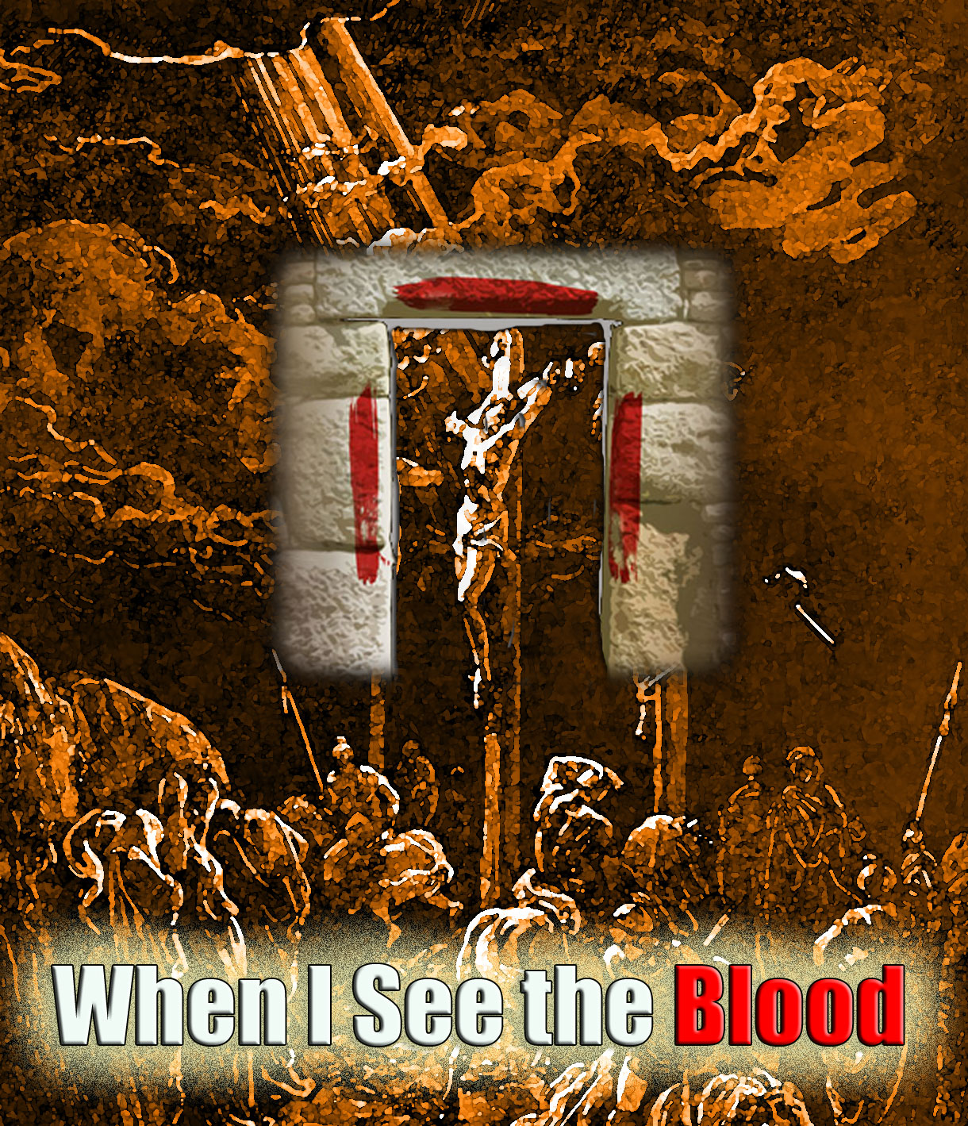
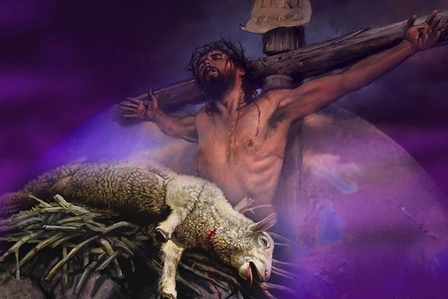
(1) The Passover lamb was chosen on 10th of Nisan
and sacrificed on the 14th of Nisan. (Ex. 12:1-6)
1 Cor 5:7 “Christ our passover is sacrificed for us:”

Slide 20
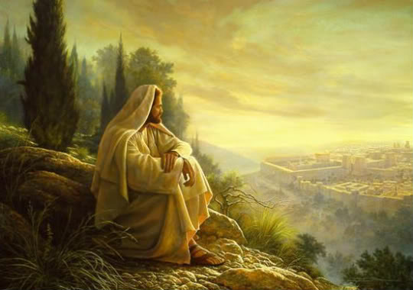
(2) “And when he …beheld the city, and wept over it, Saying, If thou hadst known, even thou,
at least in this thy day,
Luke 19:41-42
the things which belong unto thy peace!
but now they are hid from thine eyes”

Slide 21
“after threescore and two weeks shall Messiah be cut off,
but not for himself:” vs. 26
b) Who was the messiah “cut off” for? Is. 53
5 “he was wounded for our transgressions,
he was bruised for our iniquities:
the chastisement of our peace was upon him;
and with his stripes we are healed.
6 All we like sheep have gone astray;
we have turned every one to his own way;
and the LORD hath laid on him the iniquity of us all.”

Slide 22
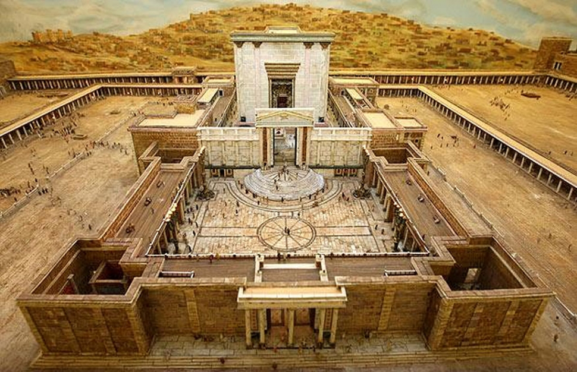
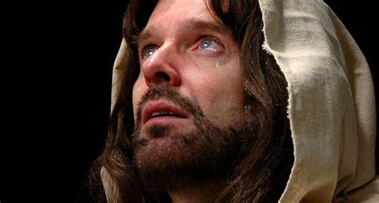
c) After the Messiah’s death: Dan 9:26
(1) “and the people of the prince that shall come
shall destroy the city and the sanctuary;
“There shall not be left one stone upon another.”
Mt. 24:2

Slide 23
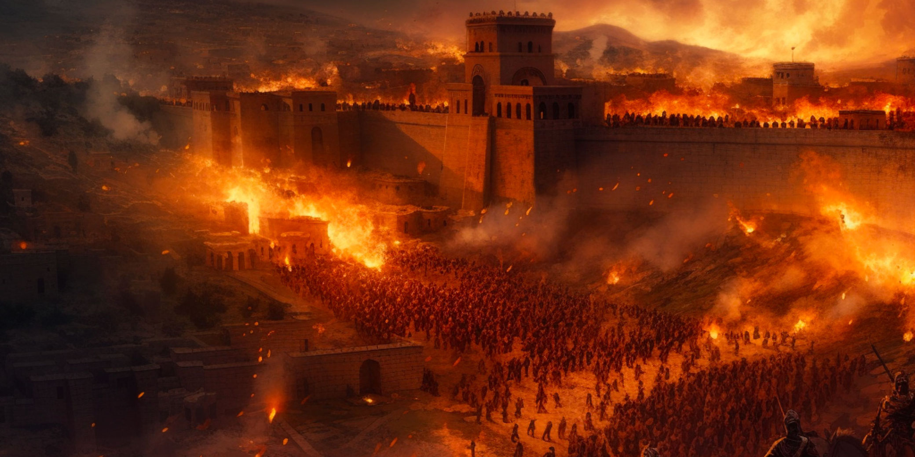
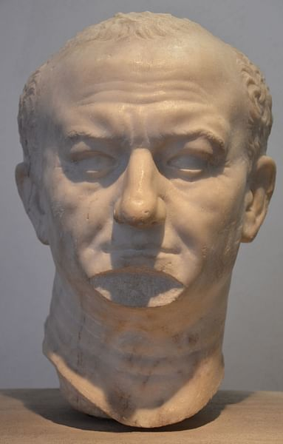
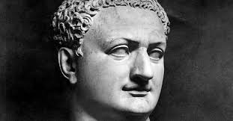
Luke 19:43-44 “For the days shall come upon thee,
that thine enemies shall cast a trench about thee…,
they shall not leave in thee one stone upon another
Titus
Vespasian
because thou knewest not
the time of thy visitation.”
8/30/70 AD

Slide 24
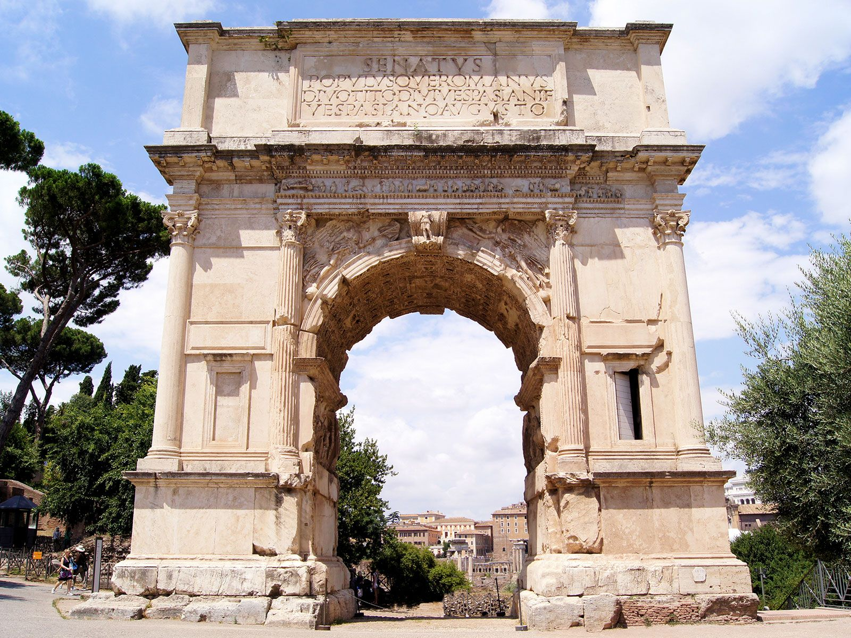
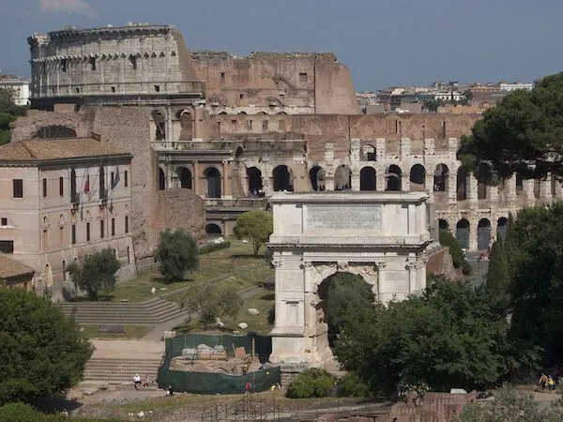
72-80 AD
The Colosseum was built to commemorate the destruction of Jerusalem, and was funded by the plunder from the Temple.
https://aish.com/the-colosseums-jewish-connection

Slide 25
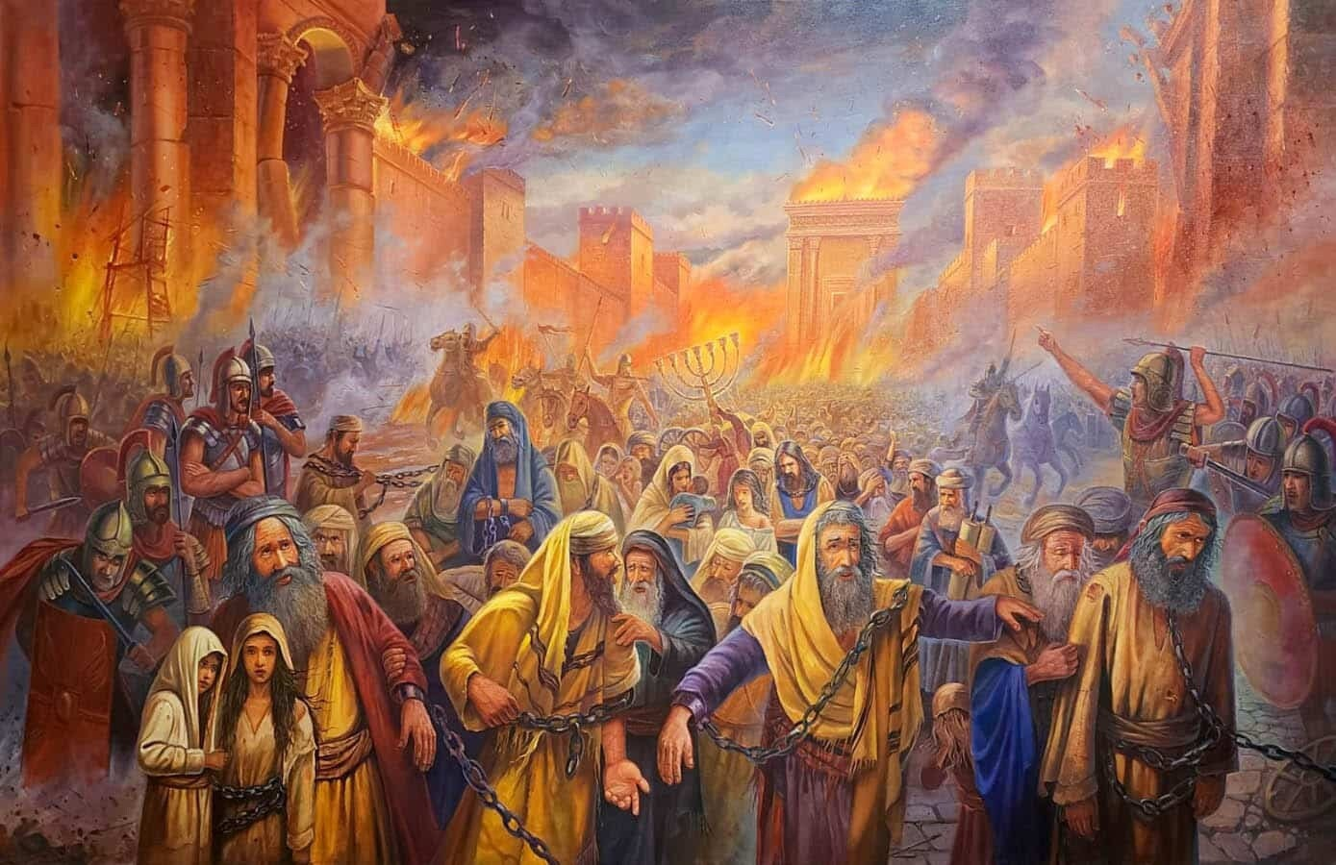
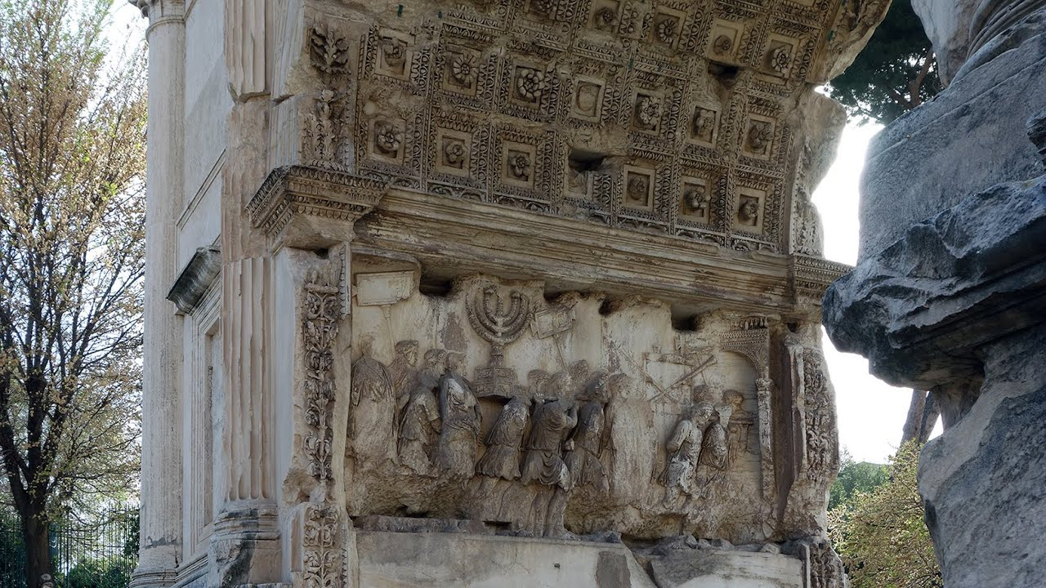
Titus captured 50,000 Jewish slaves,
many of whom he used to build the Colosseum.
Built by Domitian
81 AD
(Titus’ brother)

Slide 26
b) After the “Messiah is cut off”
Jerusalem and the Temple would be destroyed.
The Jews would suffer greatly after this. Daniel 9:26
“and the end thereof shall be with a flood,
and unto the end of the war desolations are determined. “
Flood: from ‏שָׁטַף‎ (shāṭap’) to inundate, overwhelm, cleanse!
War: ‏מִלְחָמָה‎ (milḥāmâ’) fighting.
Desolations: ‏שָׁמֵם‎ (shāmēm’) devastation, astonishment.

Slide 27
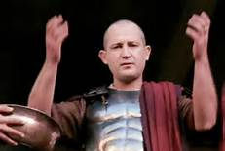
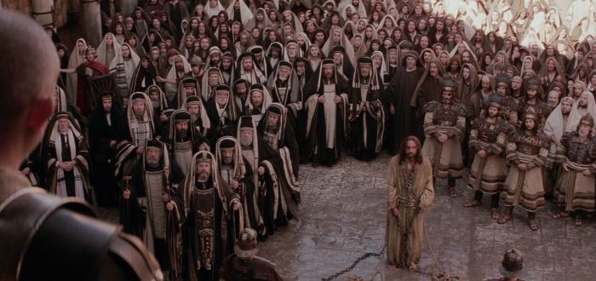
Remember Pilate’s proclamation: “I am innocent of the blood of this just person: see ye to it.
Mt 27:24-25
Then answered all the people, and said,
His blood be on us, and on our children.”

Slide 28
Dan 9:24 “Seventy weeks are determined upon thy people
B. Consisting of three distinct periods.
1) 7 “weeks” (49 Years) to Rebuild Jerusalem. V 25
2) 62 “weeks” (434 years) “Until the Messiah the Prince” 26
“and unto the end of the war desolations are determined.”
3) 1 “week” “He (the “prince that shall come” vs 26)
shall confirm the covenant for one week” 27
This is the final 7 year period
described in Rev. 6-19.

Slide 29
Dan 9:24 “Seventy weeks are determined upon thy people
Since this prophecy was specific to Israel,
There’s a parenthetical period between Messiah’s death and this final “week” that God calls
“The time (fulness or mystery) of the Gentiles”
(Ro. 11:25; Eph. 3:9)
Mt 24:14 “And this gospel of the kingdom shall be preached in all the world for a witness unto all nations;
and then shall the end come.”

Slide 30
Daniel’s study of scripture led to an awareness of God’s plan which led Daniel to:
Persistent Prayer (21 days in Daniel 10:2)
Personal Repentance (Dan. 9:2-19)
Powerful Revelation. (Understanding) (9:20-27)
Practical Partnership. (He got involved!)
What effect will our awareness of God’s plan Have on us?

Slide 31
2 Tim. 3 opens with
“in the last days perilous times shall come” and closes with:
“All scripture is given by inspiration of God, and is profitable …
That the man of God may be perfect,
(ar’tios: complete, ready)
thoroughly furnished (exartiz’o: prepared/equipped)
unto all good works.”

Slide 32
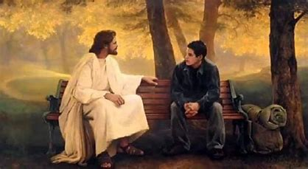
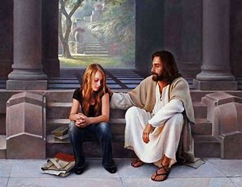
What are you doing to get ready
to partner with God?
2 Cor 5:20 “Now then we are ambassadors for Christ,
we pray you in Christ's stead,
be ye reconciled to God.”

