Slide 1
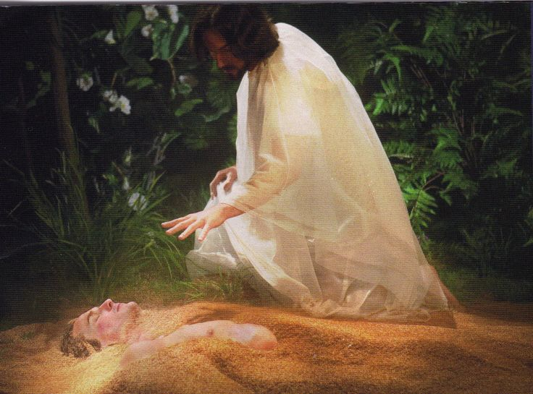
Gen. 1 reveals God’s original design (plan) for us.
“Let us make man in our image,
after our likeness:
And let them have dominion …”
Vs 26

Slide 2
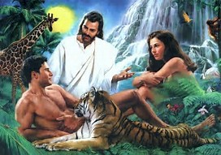
Vs 27 “So God created man in his own image
Male and Female created He them.
Vs 28 “And God blessed them, and said unto them,
Be fruitful, and multiply, and replenish the earth, and subdue (conquer) it:
and have dominion …over every living thing.”

Slide 3
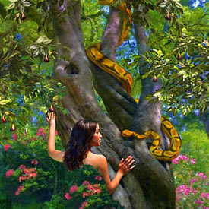
By Gen. 3 we learn that Satan used his subtlety to seduce them into sin, thereby
placing them under his dominion.

Slide 4
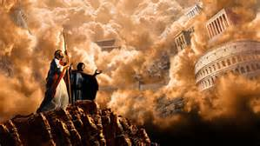
“All this power will I give thee, and the glory of them: for that is delivered unto me;
Paradi’dōmi: yielded, surrendered
and to whomsoever I will
I give it.”
Luke 4:6

Slide 5
Over the past several weeks we’ve been examining how God seeks to grow His people in such a way as to restore His “image” or pattern in their lives so that He can Partner with them to accomplish His purposes.
We’ve examined this process in the life of a man named Gideon from Judges 6-8 and saw how God was able shape him from a “Wimp” into a Warrior or “a mighty man of valor.”

Slide 6
While God was seeking to “shape” Gideon, Satan was busy seeking to “snare” him so as to turn him back to a “spiritual wimp”!
He usually does this by setting “snares” which eventually “trap us” in his “territory” where he influences us for his purposes!
Let’s examine the methods he chose to accomplish this in the life of Gideon.

Slide 7
The events recorded in Judges 6-8 actually occur over a very short period (weeks),
but have lasting impact. (40 years) 8:28
At the conclusion of this military campaign:
Israel tries to crown Gideon. 8:22
Gideon rightly refuses.
“The LORD shall rule over you” Judges 8:23
Gideon makes an “innocent” request. Vs 24

Slide 8
Gideon makes an “innocent” request. 24-26
“I would desire a request of you, that ye would give me every man the earrings of his prey.
And they answered, We will willingly give them.
And they spread a garment, and did cast therein every man the earrings of his prey….the weight of the golden earrings that he requested was a thousand and seven hundred shekels of gold;”
(about 60 lbs of Gold)

Slide 9
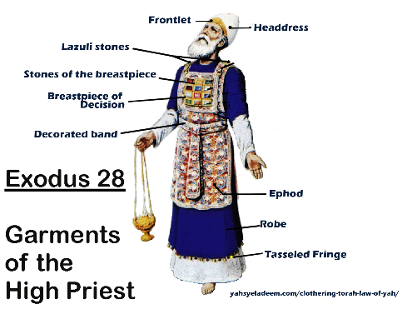
Gideon fashions an “ephod” from the gold.
8:27 “Gideon made an ephod thereof”
and put it in his city,
even in Ophrah:”
God’s “ephod” was with the Tabernacle in “Shiloh”.
(Josh. 18:1; Jdg 18:31)

Slide 10
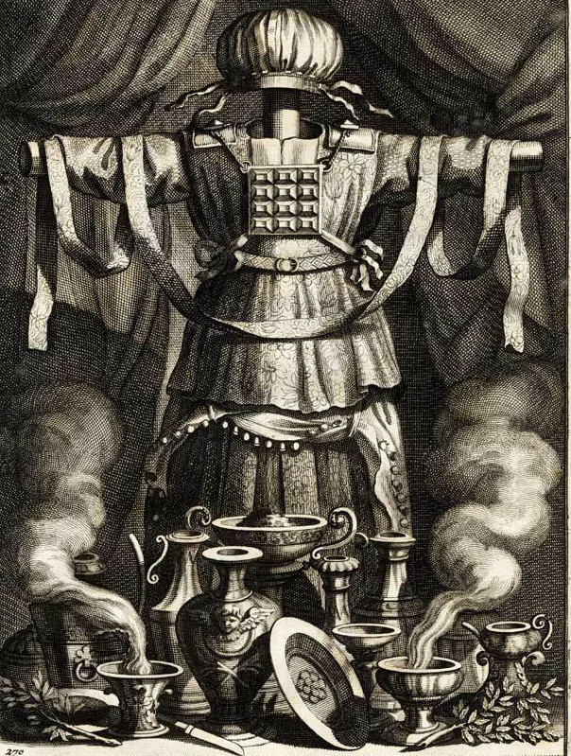
“all Israel went thither a whoring after it: which thing became a snare unto Gideon, and to his house.”
Whoring: zānâ’: commit adultery/fornication.
Snare: môqēsh’: a snare, hook, noose
Even after a great “victory”, Satan was able to lay a “snare” that Gideon walked right into.

Slide 11
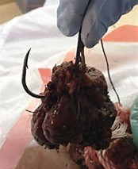
Understanding the “Snares” of the Devil.
1. Snares are effective because they’re usually:
A. Seductive. (Baited with something we want)
James 1:12-16 “Every man is tempted when he’s drawn away of his own Lust.
When lust hath conceived it bringeth forth sin,
sin, when it is finished, bringeth forth death!”
1) All of Satan’s “apples” have hooks! Pro. 7

Slide 12
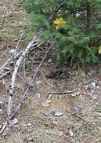
Understanding the “Snares” of the Devil.
1. Snares are effective because they’re usually:
A. Seductive. (Desired)
B. Subtle. (Disguised) Ps 19:12,13
“Who can understand his errors?
cleanse thou me from secret faults.
Keep back thy servant also from presumptuous sins;
let them not have dominion (power or rule) over me:”

Slide 13
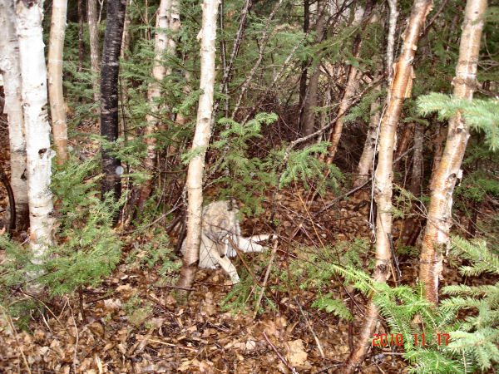
1. Snares are effective because they’re usually:
A. Seductive. (Desired)
B. Subtle (Disguised) Ps 19:12,13
C. Strong. (Dangerous “traps”)
1) They don’t always “kill” us, but they
always “keep” us from freedom!
2 Tim. 2:26 “that they may recover themselves out of the snare of the devil,
who are taken captive by him at his will.”

Slide 14
2. Satan’s “snare” for Gideon was:
A. Seductive. What did Gideon really “desire”?
1) Authority? He turned down the crown.
2) Gold/wealth? The 60 lbs of gold was probably
less than Gideon’s other “spoils”.
3) Honor/Respect? People have short memories!
It appears that Gideon just wanted some “token” to remember their great victory!
This seemed both “reasonable” and “innocent”.

Slide 15
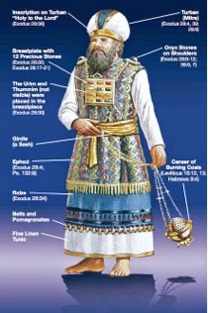
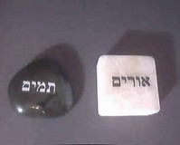
2. Satan’s “snare” for Gideon was:
B. Subtle: (Disguised)
1) Why did he really build an Ephod?
a) Ephod was a religious garment that
identified the High Priest. Ex 28
b) It supported the breastplate of
judgment containing the Urim and
Thummim. (Lights and Perfections)
c) God used them to direct Israel.
(Numbers 27:21; 1 Sam. 30:7)

Slide 16
2) Let’s examine these in Gideon’s life
B. Subtle: (Disguised)
2) Why did he build it in Ophrah? (His town)
a) God (Israel) already had an “Ephod” in Shiloh!
b) But Shiloh was in the territory of Ephraim!
His critical cousins! (Judges 8:1)
Bitterness may have been at the heart of it!
Remember Jeroboam’s golden calves?

Slide 17
2. Satan’s “snare” for Gideon was:
B. Subtle (Secret): Rationalized the Ephod as
a “religious” (respectable) item.
c) Gideon (as a “judge) may have “justified” the
use of an Ephod to discover God’s Guidance.
d) Even the “location” was designed to draw people away from “Ephraim”;
Where God’s “house” was!

Slide 18
2. Satan’s “snare” for Gideon was:
A. Seductive: (Desired honor… Pride)
B. Subtle: (Disguised Motive…Bitterness)
C. Strong: (Dangerous Consequences!)
1) He set in motion long term consequences!
“all Israel went thither a whoring after it:
which became a snare unto Gideon,
and to his house.”
Judges 8:27

Slide 19
Conclusion: Satan’s always seeking to regain “dominion” (influence/control) over us.
He can’t directly “influence” unless we “let him”!
Ro 6:16 “Know ye not, that to whom ye yield yourselves servants to obey, his servants ye are to whom ye obey; whether of sin unto death…”
In order to do this he sets Seductive, Subtle, and Secure “snares” to lure and “trap” us so
that he can exert influence in & over our lives.

Slide 20
Gideon rationalized his “innocent” choice, but unknowingly stepped into Satan’s snare.
It “became a Snare unto Gideon”
(His “ephod” replaced the idol of Baal!)
“and to his house”
His “bitterness” set in motion events that would destroy his entire family!

Slide 21
“Snare unto Gideon and his house”
He had a son with an Ephraimite concubine.
Abimelech felt insecure and bitter around his brothers. (Since they were from Manasseh)
With the help of his relatives in Shechem, (Ephraim territory) he murdered Gideon’s 70 sons! (Jdgs 9) (Only 1 escaped)
Abimelech declared himself King!

Slide 22
Application: Satan is still setting Snares
that (like Gideon’s) are usually:
Seductive: Involve something we “want”.
Subtle: We “rationalize” our “compromises”.
Strong: They will “trap” us and lead us away
from God, His House, and His Protection;
Leaving us under Satan’s Control.
“taken captive by him at his will”
2 Tim. 2:19-26

Slide 23
When we fail to recognize Satan’s snares, we end up getting “trapped” and set in motion events that will affect not only ourselves, but those around us.
“It became a snare unto Gideon,
and to his house”. Judges 8:27
Over the next few weeks, we’ll examine some Satan’s favorite “Snares”.

Slide 24
Like Gideon’s story, most of Satan’s snares are designed to isolate us from the house of God!
One of the important questions on the recent “Church Health Survey” was:
“Do we consider what our church will be like in another Generation?”

Slide 25
Have you considered what your children’s / grandchildren’s /great grandchildren’s view of and commitment to God
(His Word and Ways) will be?
How might Satan be using your current choices (aka: snares) to affect it?

Slide 26
(And God)
(God’s Will and Ways)

