Slide 1
Recognizing and Responding to God!
"My sheep hear my voice,
and I know them,
and they follow me:“ John 10:27

Slide 2
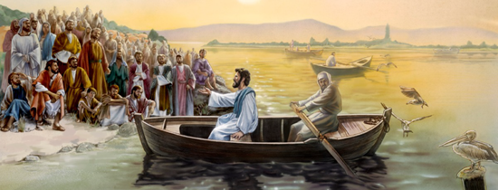
Mt 13:3 “He spake many things unto them in parables…”
Parable comes from parabole' which literally means:
“to cast near” (where someone can “grasp” it.)

Slide 3
Mt 13:3
“He spake many things unto them in parables…”
This first parable is significant because:
Jesus interpreted each point for us.
It reveals the importance of cultivating a
heart that’s Receptive (Open)
and Responsive (Obedient) to God.

Slide 4
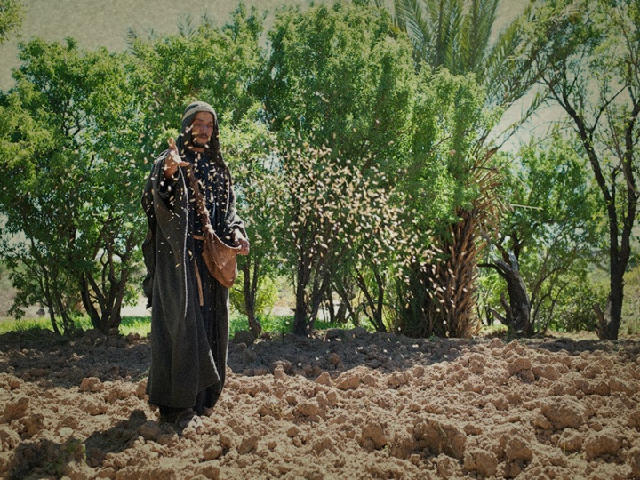
THE SOWER (messenger) Mt. 13:3
“Behold, a sower went forth to sow…”
Speirō: to scatter
We are called to share/spread God’s truths!
Mt. 28:18-20

Slide 5
Failure to obey will bring consequences!
Ezek. 3:18; 33:8 “When I say unto the wicked,
Thou shalt surely die; and thou givest him not warning, nor speakest to warn the wicked from his wicked way,
the same wicked man
shall die in his iniquity;
but his blood will I require at thine hand.”
to save his life;

Slide 6
Failure to obey will bring consequences!
Pr. 24:11-12 “If thou forbear to deliver them that are drawn unto death, and those that are ready to be slain;
If thou sayest, Behold, we knew it not;
doth not he that pondereth the heart consider it?
and he that keepeth thy soul,
doth not he know it?
and shall not he render to every man
according to his works?”

Slide 7
THE SEED (or message) Mt. 3:3, 19
“The Seed is the word of God.” Lk 8:11
Ps 126:5-6 “They that sow in tears
shall reap in joy.
He that goeth forth and weepeth,
bearing precious seed,
shall doubtless come again with rejoicing,
bringing his sheaves with him.”

Slide 8
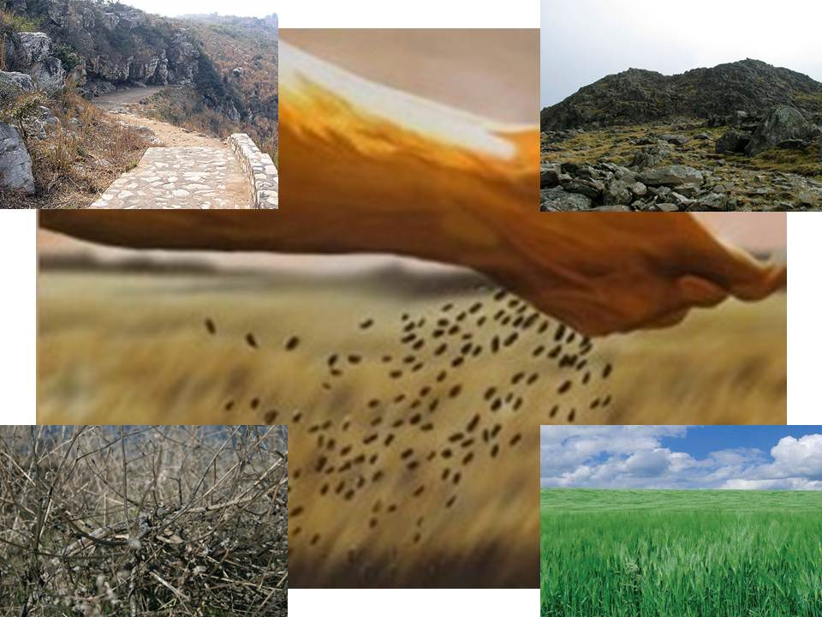
THE SOIL Vs. 4-9, 18-23
The soil represents the condition of the hearts
(basic attitudes) of the hearers.

Slide 9
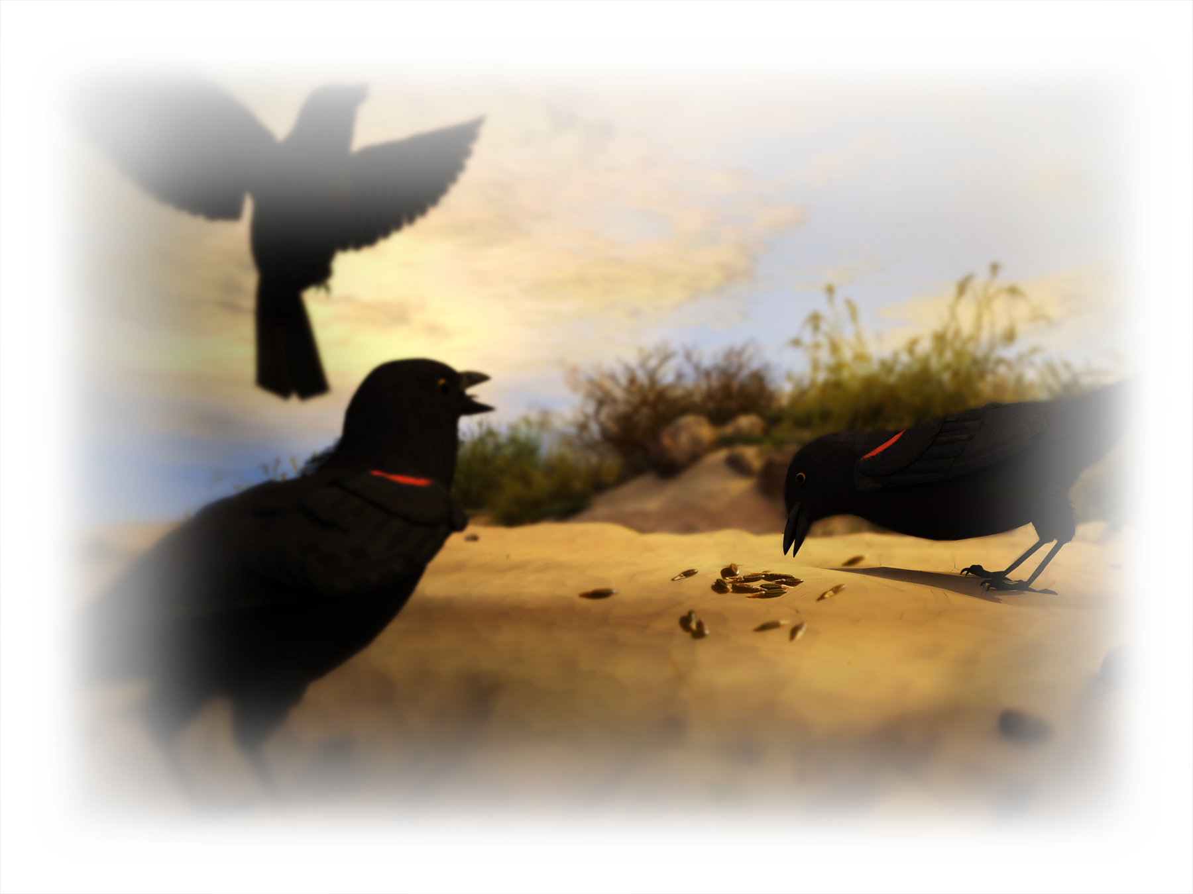
1. The Deceived Hearer. (a closed mind/heart)
Vs 19 When any one hears the word of the kingdom,
and understandeth it not, (Syni’ēmi)
From syn: union (put together) and hiemi (to send)
then comes the wicked one,
and catches away that which was sown in his heart.
This is he which received seed by the way side.”

Slide 10
2. The Disappointed Hearer (A superficial heart)
20,21 “he that received the seed into stony places,
the same is he that heareth the word,
and anon with joy receiveth it;
Yet hath he not root in himself, but dureth for a while:
when tribulation or persecution ariseth
because of the word,
by and by he is offended.”
Skandalizo: Trapped

Slide 11
3. The Distracted Hearer vs 7,22
The cluttered mind/heart
Vs 22 “He that received seed among the thorns
is he that heareth the word;
and the care of this world, and the deceitfulness of riches, choke the word,
and he becometh unfruitful.”

Slide 12
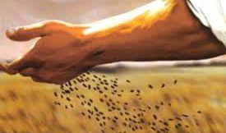
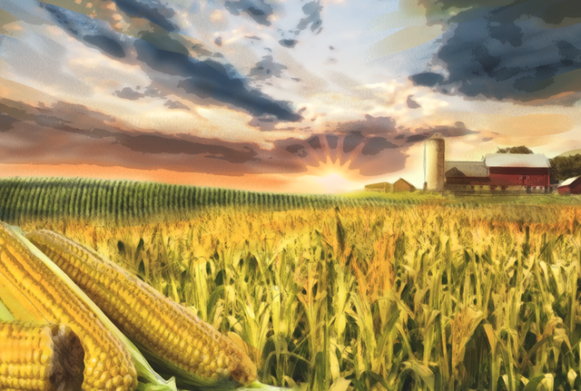
What’s the real problem with the hard,
shallow or cluttered soil (soul)?
They deny/defy the whole purpose of planting
To harvest the “fruit”.
This is God’s Goal as well!

Slide 13
This is God’s Goal as well!
Jn 15:16
“Ye have not chosen me,
but I have chosen you, and ordained you,
(tith’ēmi: purposed, placed, committed)
that ye should go and bring forth fruit,
and that your fruit should remain:”

Slide 14
This truth is woven throughout the scriptures.
Lk 13:6-9 “A certain man had a fig tree planted in his vineyard; and he came and sought fruit thereon, and found none.
Then said he unto the dresser …, Behold, these three years I come seeking fruit on this fig tree, and find none:
cut it down!
8 And he answering said unto him, Lord, let it alone this year also, till I shall dig about it, and dung it:
And if it bear fruit, well: and if not, then after that
thou shalt cut it down.”
Why cumbereth it the ground?

Slide 15
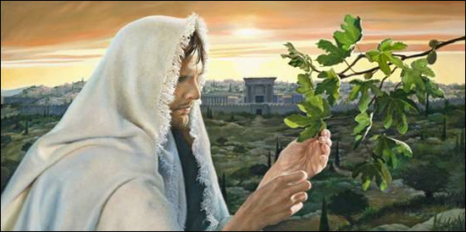
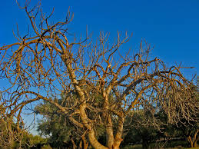
Mt 21:19 “when he saw a fig tree in the way, he came to it, and found nothing thereon, but leaves only,
and said unto it,
Let no fruit grow on thee henceforward for ever.
And presently the fig tree withered away”
See also Isaiah 5:1-7

Slide 16
The “Dedicated” Hearer vs 8,23
“he that received seed into the good ground…”
What makes the ground (soul) “good”?
1. It’s willing to be Cultivated
Cultivate is a verb (requires action) meaning:
1) To prepare something for use!
2) Try to acquire, develop or pursue
a quality, skill, or sentiment/attitude.

Slide 17
In this parable, 75% of the seed produced no fruit!
Same seed, same field…
The only variable was the condition of the soil!
Who’s responsible for the condition of our heart/soul?
(Heart)

Slide 18
1. Has a Cultivated mind/heart vs 23
B. How to cultivate (Prepare) a soul.
1) Plow up the “wayside” so the seed of
truth can penetrate. (Jer. 4:3; Hosea 10:12)
“Break up your fallow Ground …”
Joshua 1:8 “Thou shalt meditate (muse) there in…
That thou mayest observe to do all that is written therein…”

Slide 19
B. How to cultivate (Prepare) a soul.
2) Dig up the stony soil to identify/remove the
obstacles. (2 Cor.10:3-5) “Casting down imaginations,
(logismos’: human reasoning) see Jer. 17:9
and every thing that exalteth itself against the knowledge of God,
and bringing into captivity every thought
(No’ema: perception and purpose)
to the obedience of Christ”

Slide 20
B. How to cultivate (Prepare) a soul.
3) Pull up the weeds/thorns that compete with
the truth. (Heb. 12:1,2; 1Jn 2:15,16)
Col 2:7-8 “Rooted and built up in him,
and stablished in the faith, as ye have been taught, …
Beware lest any man spoil you through philosophy
(Love of worldy wisdom) see James 3:13-16
and vain deceit, after the tradition of men,
after the rudiments (principles) of the world, (1Jn 2:16)
and not after Christ.”

Slide 21
C. This involves a partnership!
1 Cor. 3:9
“We are laborers together with God;
(synergos’: working with/beside)
ye are God’s husbandry!”
(Geōr’gion: farm, garden!)
Farming is hard work!

Slide 22
“We are laborers together with God”
Our Part: Hosea 10:12
a) Preparation “break up your fallow ground:
Break up hard soil, (soul)
Dig up rocks, (obstacles/weights)
Pull up weeds. (worldliness)

Slide 23
Our Part: Hosea 10:12
b) Dedication “sow…in righteousness”
2 Tim 2:15 “Study (Spoudaz’ō: make diligent effort)
to shew thyself approved unto God,
(Dok’imos: current after assayal {testing})
a workman that needeth not to be ashamed,
(Erga’tēs: to toil and work {expend effort})
rightly dividing the word of truth.”
Orthotome’ō: to make (plow) straight, dissect.

Slide 24
Our Part: Hosea 10:12
a) Preparation: b) Dedication:
c) Application: Jn 13:17
“If ye know these things, happy (Makarios: blessed)
are ye if ye do them.”
James 1:22-25 “Be doers of the word
and not hearers only;
Deceiving your own selves”

Slide 25
Our Part: Hosea 10:12
a) Preparation: b) Dedication: c) Application:
Lk 6:44 “For every tree is known
by his own fruit...
46 And why call ye me, Lord, Lord,
and do not the things which I say?”

Slide 26
Our Part: Hosea 10:12
a) Preparation: b) Dedication: c) Application:
d) Supplication: “For it is time to seek the Lord”
We cannot be fruitful without God!
Ps. 127:1 “Except the LORD build the house,
they labor in vain that build it:
except the LORD keep the city,
the watchman waketh but in vain.”
Remember Ps. 126:5,6?

Slide 27
d) Supplication: “For it is time to seek the Lord”
We cannot be fruitful without God!
Jn 15:4,5 “Abide in me, and I in you. As the branch cannot bear fruit of itself, except it abide in the vine;
no more can ye, except ye abide in me.
I am the vine, ye are the branches:
He that abideth in me, and I in him,
the same bringeth forth much fruit:
for without me ye can do nothing.”

Slide 28
“we are laborers together with God”
Our Part: Hosea 10:12 “seek the Lord…
2) God’s Part:
a) Instruction Josh 1:8
Ps 32:8 “I will instruct thee and teach thee
in the way which thou shalt go:
I will guide thee with mine eye.”

Slide 29
“we are laborers together with God”
2) God’s Part:
b) Direction.
Pr. 3:5,6 “…In all thy ways acknowledge Him,
(Yada: recognize/know)
and He shall direct thy steps.”
Ps 119:105 “Thy word is a lamp unto my feet,
and a light unto my path.”

Slide 30
“we are laborers together with God”
2) God’s Part:
c) Inspiration. Hos. 10:12 “it is time to seek
the Lord, till He come and rain
righteousness upon you.”
Jn 15:5 “I am the vine… for without me
ye can do nothing!”
Is. 30:21 “This is the way, walk ye in it…”

Slide 31
“we are laborers together with God”
2) God’s Part:
c) Inspiration. 2 Tim 3:16-17
“All scripture is given by inspiration of God,
and is profitable for doctrine, for reproof,
for correction, for instruction in righteousness: That the man of God may be perfect,
(Artios: complete)
thoroughly furnished unto all good works.”

Slide 32
“We’re laborers together with God”
We can’t do God’s Part.
¾ of the seed produced no fruit!
Same seed, same field…
The only variable was the condition of the soil!
That’s why Jesus said in Mt. 13:9
“Who hath ears to hear, let him hear.”
Akou’ō: to hear (understand)
and harken! (OBEY/ apply!)
God won’t do our Part!

Slide 33
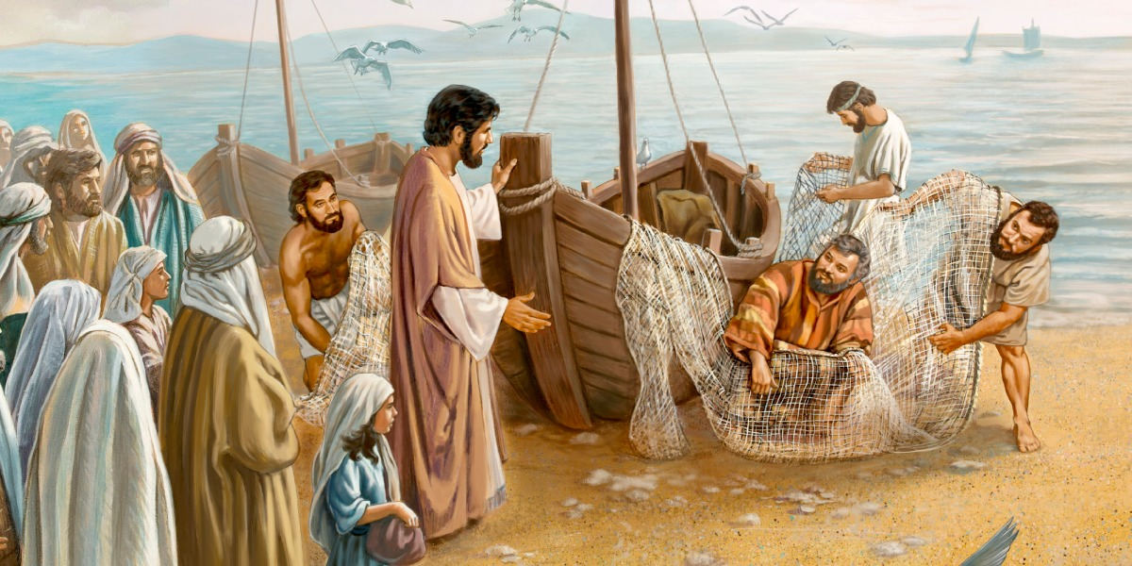
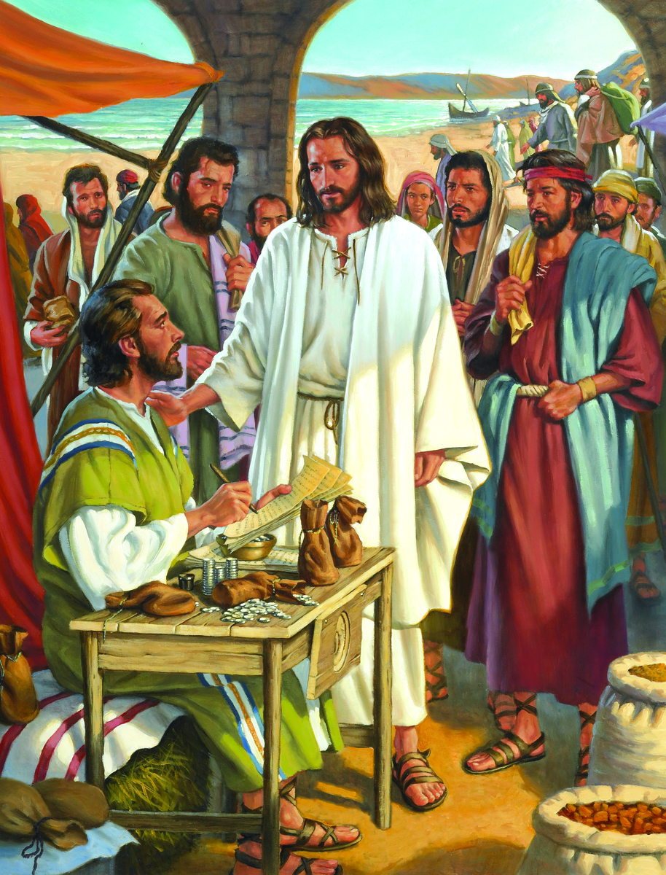
“Who hath ears to hear, let him hear.” Vs 9
Some will hear, hearken, and bear fruit.
Mt. 4:18-20
Mt. 9:9

Slide 34
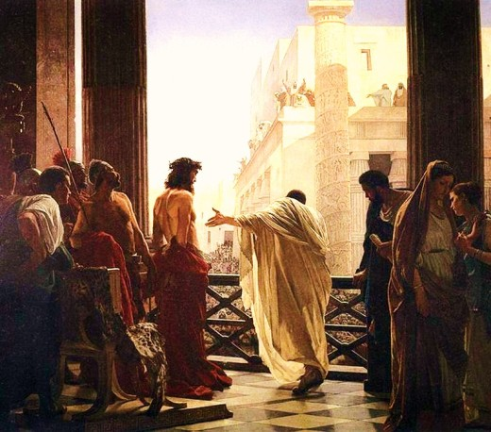
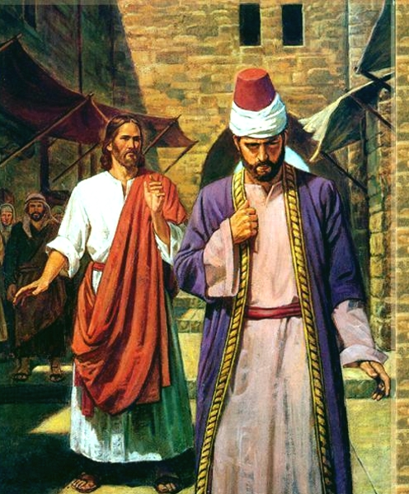
“Who hath ears to hear, let him hear.” Vs 9
Most will not!
Mt 7:13,14
“Few there be…”
“Crucify Him!”
Jn. 19:15
Mt. 19:16-22

Slide 35
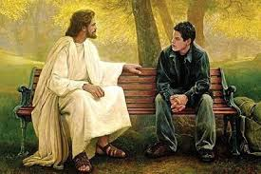
“Who hath ears to hear, let him hear.” Vs 9
What will you choose?
Will you purpose to partner with God to cultivate your soul to become more
receptive and
responsive to
God’s Truth?
Ro. 12:1,2
Lost and Found Greg Olsen
https://sethadamsmith.com/2015/07/29/lost-and-found/

Slide 36
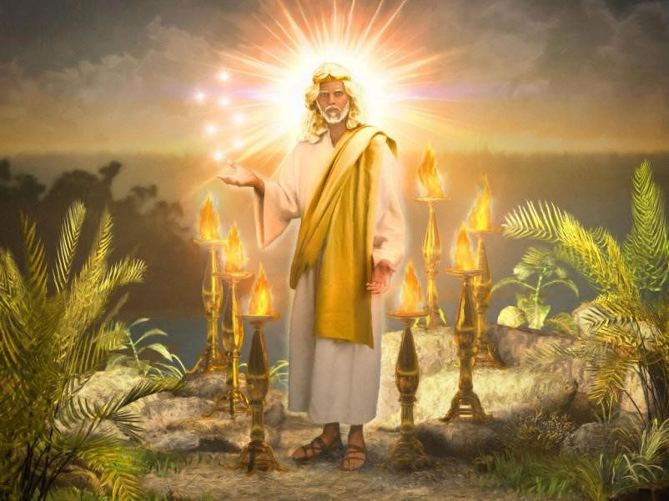
“He that hath an ear, let him hear what the Spirit saith”
Revelation 2:7, 11, 17, 29; 3:6, 13, 22

