Slide 2
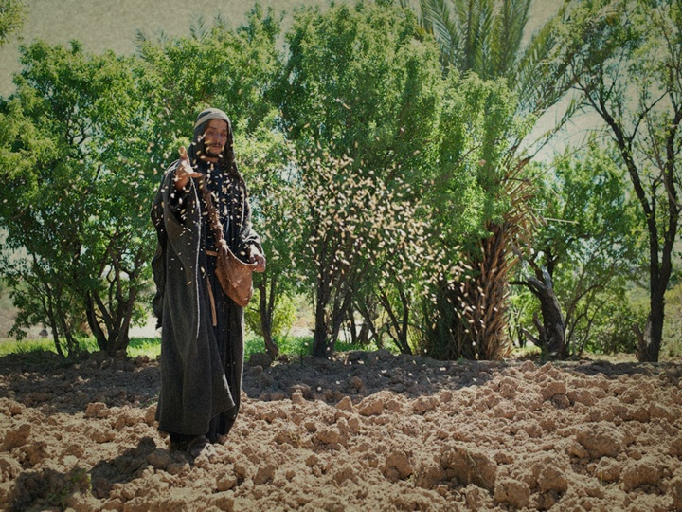
THE SOWER (messenger) Mt. 13:3
“Behold, a sower went forth to sow…”
Speirō: to scatter
Mt. 28:18-20
THE SEED (or message) Mt. 3:3, 19
“The Seed is the word of God.” Lk 8:11;
Ph. 2:13-16

Slide 3
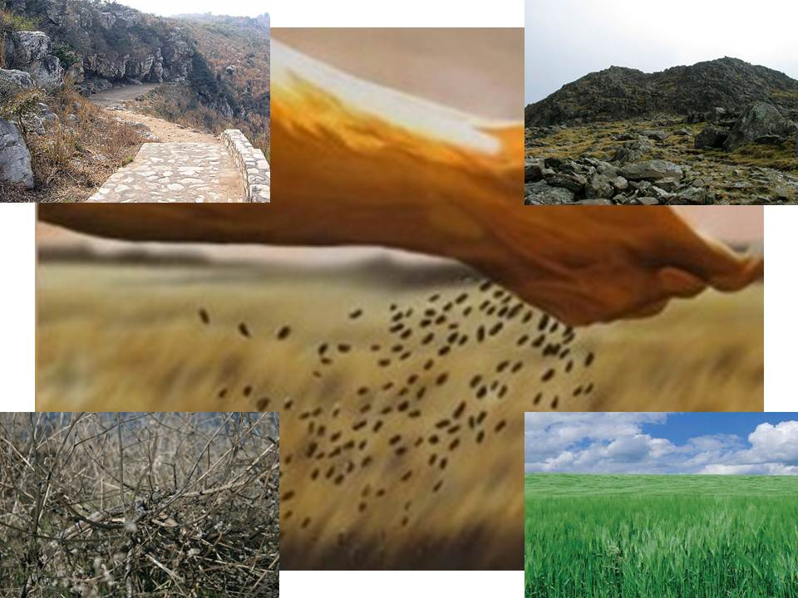
THE SOIL Vs. 4-9, 18-23
The soil represents the condition of the hearts
(basic attitudes) of the hearers.

Slide 4
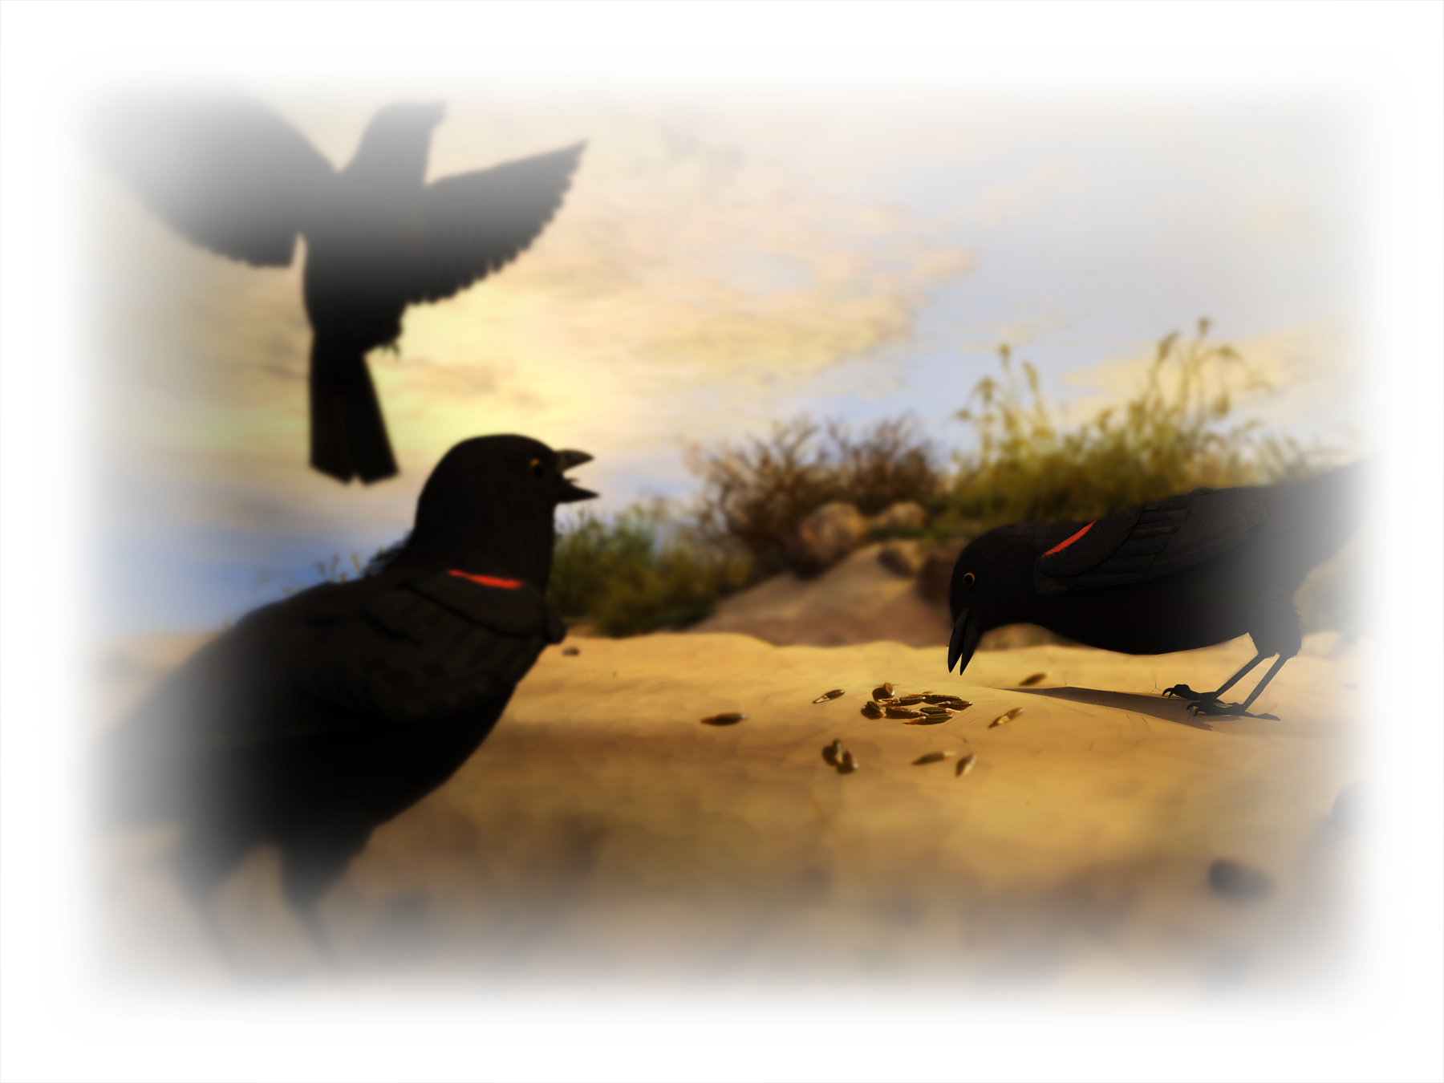
1. The Deceived Hearer. (a closed mind/heart)
Vs 19 When any one hears the word of the kingdom,
and understandeth it not, (Syni’ēmi)
From syn: union (put together) and hiemi (to send)
then comes the wicked one,
and catches away that which was sown in his heart.
This is he which received seed by the way side.”

Slide 5
2. The Disappointed Hearer (A superficial heart)
20,21 “he that received the seed into stony places,
the same is he that heareth the word,
and anon with joy receiveth it;
Yet hath he not root in himself, but dureth for a while:
when tribulation or persecution ariseth
because of the word,
by and by he is offended.”

Slide 6
3. The Distracted Hearer vs 7,22
The cluttered mind/heart
Vs 22 “He that received seed among the thorns
is he that heareth the word;
and the care of this world, and the deceitfulness of riches, choke the word,
and he becometh unfruitful.”

Slide 7
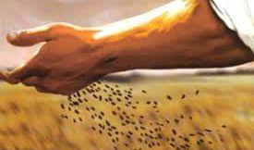
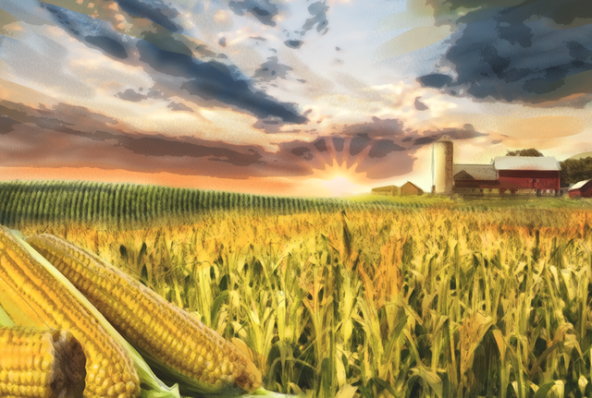
What’s the real problem with the hard,
shallow or cluttered soil (soul)?
They fail to produce a harvest!

Slide 8
The “Dedicated” Hearer vs 8,23
“the good ground…” Kalos: valuable
What makes the soil (soul) “good”?
1. It’s Cultivated (prepared)!
Plow up the “wayside” so the seed of truth can penetrate.
(Jer. 4:3; Hosea 10:12)
Dig up the stony soil to identify/remove obstacles. (2 Cor.10:3-5)
Pull up the “worldly weeds” that compete with the truth.
(Heb. 12:1,2; 1Jn 2:15,16)

Slide 9
“he that received seed into the good ground”
The Dedicated Hearer:
2. Has a Cooperative Soul.
1 Cor 3:9 “We’re laborers together with God
…ye are God’s husbandry”
Mt. 11:29 “take my yoke upon you…”
(I’ll be working with you!) Phil. 2:13; 4:13

Slide 10
The Dedicated Hearer vs 8,23
2. Has a Cooperative Soul.
Vs 23 “he that received seed into the good (kalos) ground is he that:
A. “hears the word.”
1) This implies that they recognize:
a) Who is speaking to them. Jn 10:10;11;27a
b) What he’s saying! Jn 10:27 b
(akouō: hear/hearken)

Slide 11
Learning to Listen to God!
“I am the good shepherd
…My sheep
hear my voice,
and I know them,
and they follow me:“
John 10:10,11; 27

Slide 12
2. Has a Cooperative Soul.
Vs 23 “he that received seed into good ground:
A. “hears the word.”
B. “and Understands it”
Syni’ēmi: “to put together”, apply
1) This implies that they Respond!
(To God’s word and Will!)
Jms 2:26 “For as the body without the spirit is dead,
so faith without works is dead also.”

Slide 13
2. They have a Cooperative mind/heart
Vs 23 “he that received seed into the good ground …:
B. “and understands it”
Syni’ēmi: “to put together”, apply
Heb 4:2 “unto us was the gospel preached, as well as them:
but the word preached did not profit them,
not being mixed with faith
in them that heard it.”

Slide 14
2. They have a Cooperative mind/heart
C. “which also bears fruit”
1) This is the whole point of planting!
2) Fruit requires a deeper connection (Commitment)
than just leaves.
a) There are many fruitless “believers”,
(found only 2x in NT. {Acts 5:14; 1 Tim. 4:12})
b) But There are no fruitless “disciples.”
Mentioned 243 x in NT
Which is God Expecting/Inspecting?
Karpophore’ō: fertile, fruitful

Slide 15
2. Has a Cooperative mind/heart
Vs 23 “he that received seed into the good ground:
D. “and bringes forth, (fruit) Poie’ō: to do/make,
commits (to maturity!) Jn 15:4-5
“Abide in me... As the branch cannot bear fruit of itself, except it abide in the vine; no more can ye, except ye abide in me. I am the vine, ye are the branches:
He that abideth in me, and I in him,
the same bringeth forth much fruit:
for without me ye can do nothing.”

Slide 16
The “Dedicated” Hearer vs 8,23
1. Has a cultivated Soul
2. Has a Cooperative Soul
Vs 23 “he that received seed into the good ground is he that hears …understands…bears fruit…
D. “and bringes forth, (poie’o: fruit to maturity)
some an hundredfold,
some sixty, some thirty.”
Why the differing amounts of fruitfulness?

Slide 17
Our Fruitfulness will Differ according to
Our ability (Persuasion: Faith in) His Purposes, Power and the degree of our Partnership!
Mt 9:29 “According to your faith be it unto you.”
25:14,15 “For the kingdom of heaven is as a man travelling into a far country, who called his own servants, and delivered unto them his goods.
To one he gave 5 talents, to another 2, & to another 1;
to every man according to his several ability; (dynamis)
and straightway took his journey.”

Slide 18
Vs 23 “some an hundredfold, some sixty, some thirty.”
Our Fruitfulness will Differ according to
Our ability (Persuasion: Faith in) His Purposes, Power and the degree of our Partnership!
Eph 3:20 “Now unto him that’s able to do exceeding abundantly above all that we ask or think,
according to the power that worketh in us”
Phil. 4:13 “I can do all things through Christ, which strengtheneth me.”

Slide 19
Our Fruitfulness will Differ according to
Our ability (persuasion/faith) in His Power, Purposes and the degree of our Partnership.
2 Cor 8:3-4 “For to their power, I bear record,
yea, and beyond their power
they were willing of themselves;
Praying us with much intreaty
that we would receive the gift,
and take upon us the fellowship (koinonia)
of the ministering to the saints.”

Slide 20
Our Fruitfulness will Differ according to
Our ability (Faith in Purpose/ Power/Partnership)
2) Our intensity, (Passion) Phil 3:7-15
“what things were gain to me, I count loss for Christ…
13 I count not myself to have apprehended: but this one thing I do, forgetting those things which are behind, and reaching forth unto those things which are before,
14 “I press toward the mark for the prize of the high calling of God in Christ Jesus
15 “let as many as be perfect (teleios) be thus minded”

Slide 21
Our Fruitfulness will Differ according to
2) Our intensity, (Passion) 1 Cor 9:24-27
“Know ye not that they which run in a race run all, but one receiveth the prize?
And every man that striveth for the mastery is temperate in all things. They do it to obtain a corruptible crown;
but we an incorruptible.
I therefore so run, not as uncertainly; so fight I,
not as one that beateth the air:
But I keep under my body, and bring it into subjection:”
So run, that ye may obtain.

Slide 22
Vs 23 “some an hundredfold, some sixty, some thirty.”
Our Fruitfulness will Differ according to
3) Our Opportunity. (Priority) Mt. 6:33
“Seek ye first the Kingdom of God,
And His righteousness,
and all these things shall be added unto you.”
Col 1:17-18 “he’s before all things, by him all things consist. And he is the head of the body, the church:
that in all things he might have the preeminence.”
Proteuo: first in rank and influence!

Slide 23
Our Fruitfulness will Differ according to
3) Our Opportunity. (Priority) Gal. 6:9,10
“let us not be weary in well doing:
for in due season we shall reap,
As we have therefore opportunity, (Kairos: season)
let us do good unto all men, especially unto them who are of the household of faith.”
The season of sowing and growing
will soon pass!
if we faint not.

Slide 24
The season of sowing & growing will pass!
Acts 24:24,25 “Felix came with …Drusilla, sent for Paul,
and heard him concerning the faith in Christ.
And as he reasoned of righteousness,
temperance, and judgment to come,
Felix trembled, answered
Go thy way for this time;
when I have a convenient season, (Kairos!)
I will call for thee.”

Slide 25
Conclusion:
Some day our season (opportunity)
for Cultivating and Cooperating will end!
Jeremiah 8:20
“The harvest is past,
the summer is ended,
and we are not saved.”

Slide 26
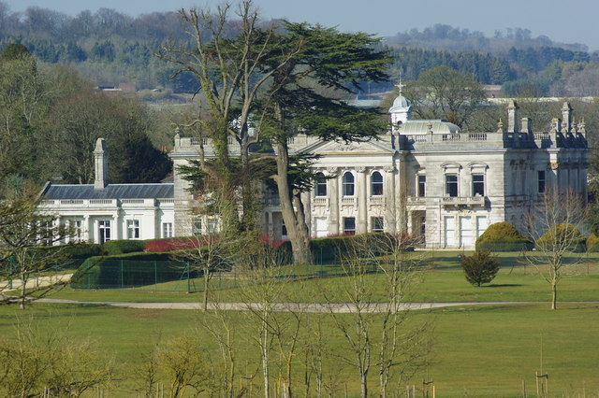
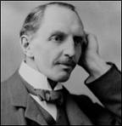
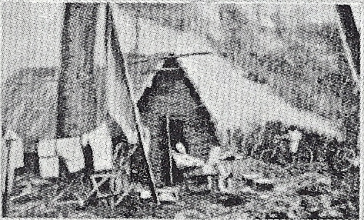
CT Studd
“Some want to live within the sound of church or chapel bell;
I want to run a rescue shop, within a yard of Hell!”
The Home he grew up in.
His home in Africa.

Slide 27
“Two little lines I heard one day,
Traveling along life’s busy way;
Bringing conviction to my heart,
And from my mind would not depart;
Only one life, ’twill soon be past,
Only what’s done for Christ will last.

Slide 28
Only one life, yes only one,
Soon will its fleeting hours be done;
Then, in ‘that day’ my Lord to meet,
And stand before His Judgement seat;
Only one life, ’twill soon be past,
Only what’s done for Christ will last.

Slide 29
Only one life, the still small voice,
Gently pleads for a better choice.
Bidding me selfish aims to leave,
And to God’s holy will to cleave;
Only one life, ’twill soon be past,
Only what’s done for Christ will last.

Slide 30
Only one life, a few brief years,
Each with its burdens, hopes, and fears;
Each with its claims I must fulfill,
living for self or in His will;
Only one life, ’twill soon be past,
Only what’s done for Christ will last.”
C.T. Studd

Slide 31
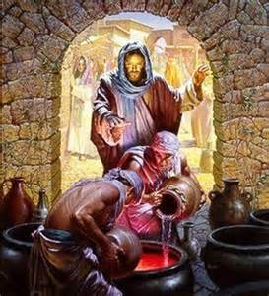
Is the “soil” of your soul (heart)
“Good” in God’s eyes?
Are you willing to partner with God in cultivating a cooperative heart?
Jesus’ first miracle illustrates the importance of this.
“Whatsoever he saith unto you, do it.”
John 2:5
Notes:
John 2:5

Slide 32
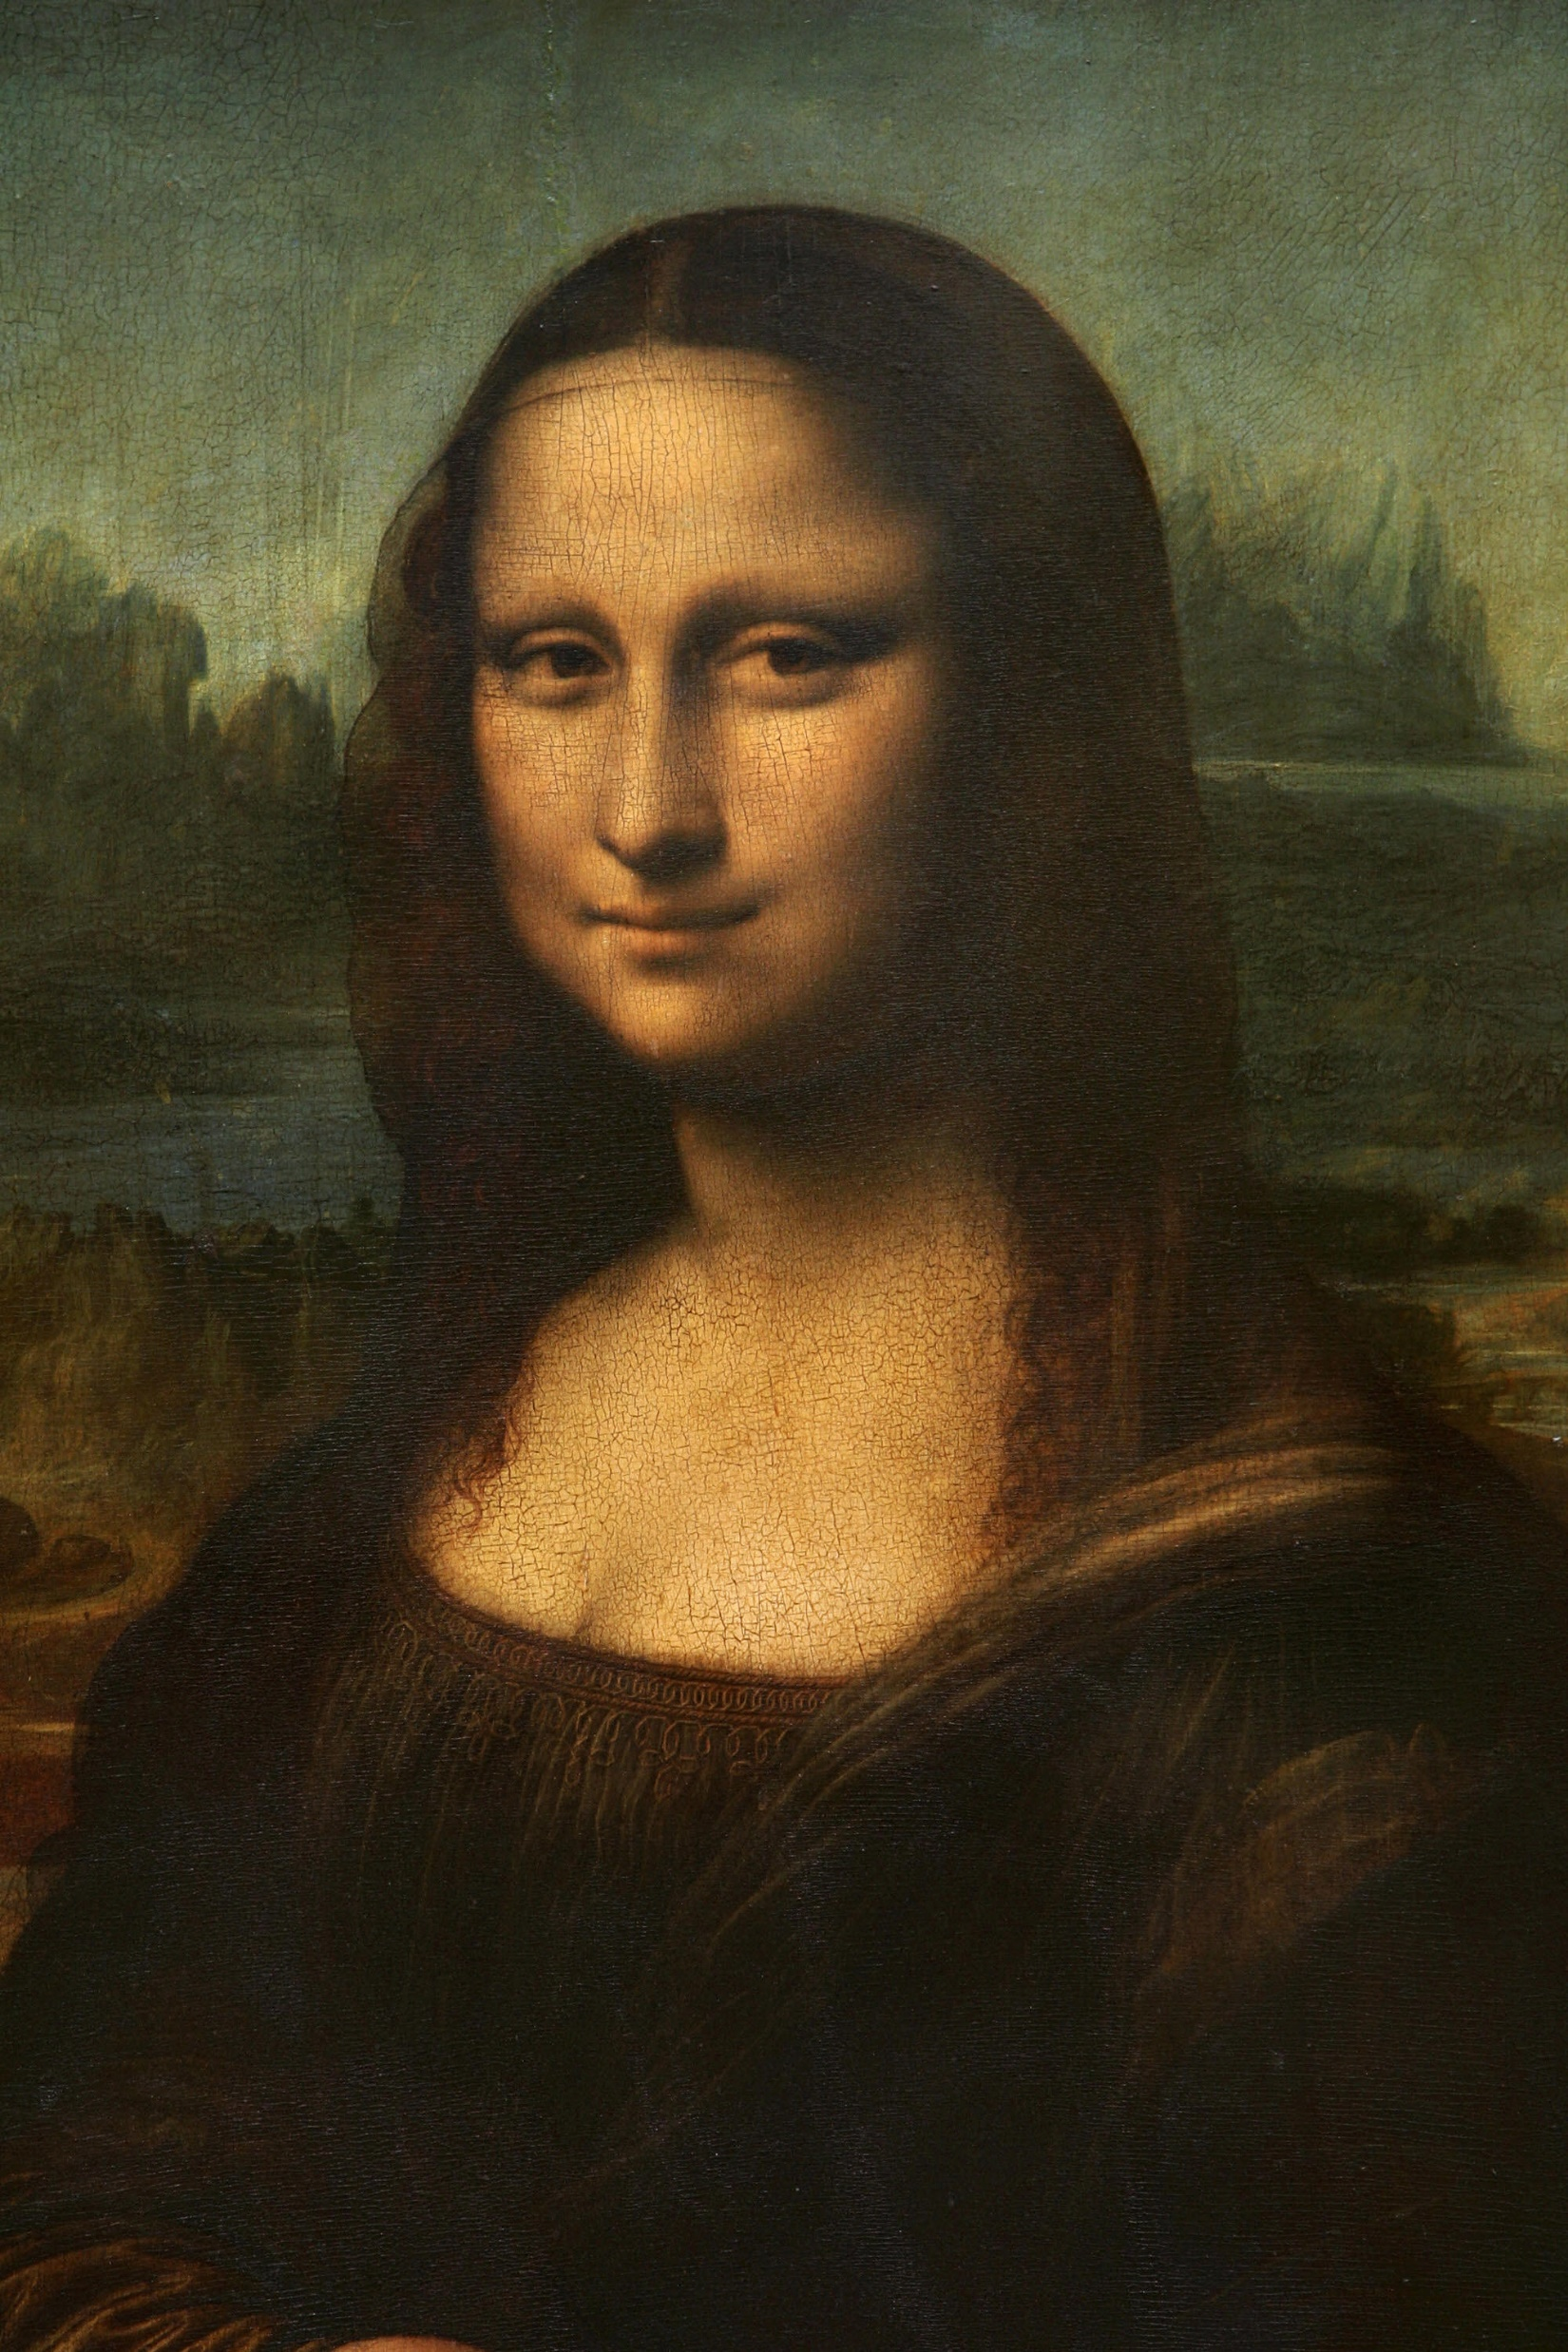
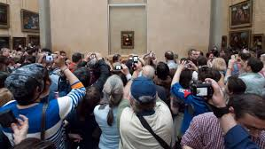
DaVinci’s “Mona Lisa”
painted in 1503
measures only 20” x 30”
yet captures one whole wall
Of the Louvre.

Slide 33
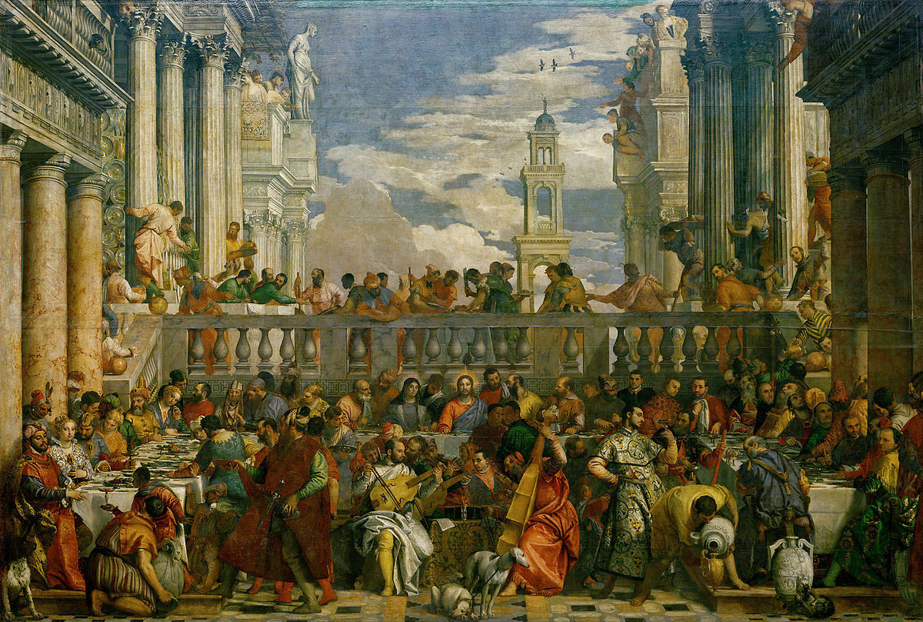
Paolo Veronese (1563) Wedding at Cana takes up the entire opposite wall at 22 ft x 32 ft. (704 St2)
Yet people are enamored by a picture 160 times smaller!

Slide 34
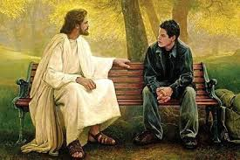
“Who hath ears to hear, let him hear.” Vs 9
Will you cultivate (Prepare) your
soul to receive God’s Truth?
2. Will you cooperate with God’s purposes
and plan to develop
Fruit in your life?
Jer. 29:11-13

Slide 35
Isaiah 6:8 “I heard the voice of the Lord, saying,
Whom shall I send, and who will go for us?
send me!”
Then said I, Here am I;

Slide 36
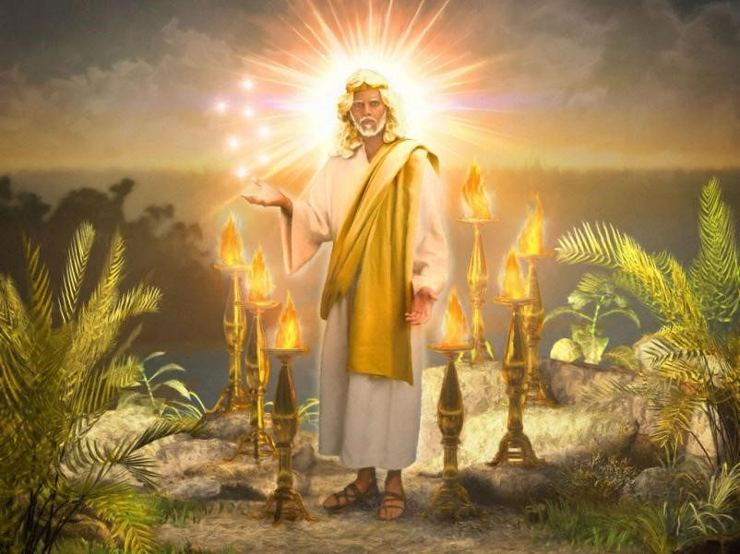
“He that hath an ear, let him hear what the Spirit saith”
Revelation 2:7, 11, 17, 29; 3:6, 13, 22

